Slide 1
CX1107: Binary Tree
Notes:
When the malloc() function is called with the required size, it returns a pointer to a newly allocated block size bytes long.
If the requested size of the memory is not available on the heap, the function returns a null pointer.
As you can see, the return type for malloc() is void*.
A void pointer is a pointer that has no associated data type with it. A void pointer can hold address of any type and can be typcasted to any type.
For instance, malloc() returns void* which can be typecasted to any type like int*, char*, etc.
Dr Hui Siu Cheung, SCE, NTU

Slide 2
BTNode
Start with a simple BTNode that stores an integer
  The type of item can be character, string, or structure, etc.
typedef struct _btnode{
int item;
struct _btnode *left;
struct _btnode *right;
} BTNode;
    typedef struct _listnode{
    int item;
    struct _listnode *next;
    }ListNode;
BTNode
5
Pointer to left child BTNode
Pointer to right child BTNode
Notes:
The C structure for binary tree node
The structure for binary tree can be defined as;
Typedef struct_btnode {…}
We have to define one integer variable to store values for the node.
int item;
Then we have to declare two pointers which pointers to the left and right child nodes.
struct_btnode *left;
struct_btnode *right;
Dr Hui Siu Cheung, SCE, NTU

Slide 3
PRE-ORDER, IN-ORDER AND POST-ORDER
E
Pre-Order Traversal
E
E
B
A
C
D
G
F
I
H
B
G
A
C
F
I
In-Order Traversal
A
B
C
D
E
F
G
H
I
D
H
Post-Order Traversal
A
D
C
B
F
H
I
G
E
Notes:
In post-order traversal, we can print the value of the current node after checking it’s left and right child subtree.
The output would be A, D, C, B, F, H, I, G and E.
Root node is the last node to be printed in post-order traversal.
Different traversal types outputs different results.

Slide 4
TREE TRAVERSAL PRE-ORDER: PRINT
void TreeTraversal_pre(BTNode *cur){
if (cur == NULL)
return;
printf(“%c ”,cur->item);
TreeTraversal_pre(cur->left); //Visit the left child node
TreeTraversal_pre(cur->right);//Visit the right child node
}
E
Output:
E
E
B
A
C
D
G
F
I
H
B
G
A
C
F
I
D
H
Notes:
The output of the code would be E, B, A, C, D, G, F, I and H.

Slide 5
TREE TRAVERSAL IN-ORDER: PRINT
void TreeTraversal_in(BTNode *cur){
if (cur == NULL)
return;
TreeTraversal_in(cur->left); //Visit the left child node
printf(“%c ”,cur->item);
TreeTraversal_in(cur->right);//Visit the right child node
}
E
Output:
E
A
B
C
D
E
F
G
H
I
B
G
A
C
F
I
D
H
Notes:
In in-order traversal, after checking whether the current node is NULL or NOT NULL, we check the left child subtree.
TreeTraversal_in(cur->left);
Then we print the current node value and check the right child subtree.
printf(“%c”, cur->item);
TreeTraversal_in(cur->right);
The output of the code would be A, B, C, D, F, G, H and I

Slide 6
TREE TRAVERSAL POST-ORDER: PRINT
void TreeTraversal_post(BTNode *cur){
if (cur == NULL)
return;
TreeTraversal_post(cur->left); //Visit the left child node
TreeTraversal_post(cur->right);//Visit the right child node
printf(“%c ”,cur->item);
}
E
Output:
E
A
D
C
B
F
H
I
G
E
B
G
A
C
F
I
D
H
Notes:
In post-order traversal, we can print the value of the current node after checking it’s left and right child subtree.
The output would be A, D, C, B, F, H, I, G and E.
Root node is the last node to be printed in post-order traversal.
Different traversal types outputs different results.

Slide 7
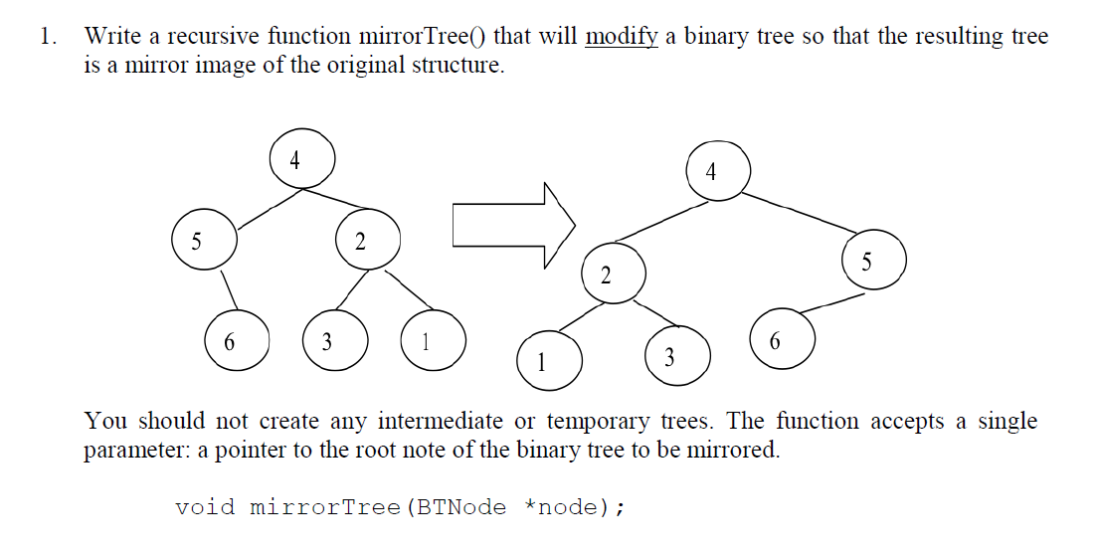
MIRRORTREE()

Slide 8
void mirrorTree(BTNode *node) using pre-order
1
2
3
4
5
6
7
8
9
10
11
12
13
14
15
void mirrorTree(BTNode *node)
{
BTNode *temp;
if (node == NULL)
return;
// Swap left and right BTNode pointers
// Using pre-order traversal
temp = node->left;
node->left = node->right;
node->right = temp;
mirrorTree(node->left);
mirrorTree(node->right);
}
Notes:
We can put all we learned from insertNode like this to form the complete function.
Dr. Newton Fernando, SCE, NTU

Slide 9
void mirrorTree(BTNode *node) using post-order
1
2
3
4
5
6
7
8
9
10
11
12
13
14
15
16
void mirrorTree(BTNode *node)
{
BTNode *temp;
if (node == NULL)
return;
// Swap left and right BTNode pointers
// Using post-order traversal
mirrorTree(node->left);
mirrorTree(node->right);
temp = node->left;
node->left = node->right;
node->right = temp;
}
Notes:
We can put all we learned from insertNode like this to form the complete function.
Dr. Newton Fernando, SCE, NTU

Slide 10
void mirrorTree(BTNode *node) using inorder
1
2
3
4
5
6
7
8
9
10
11
12
13
14
15
16
void mirrorTree(BTNode *node)
{
BTNode *temp;
if (node == NULL)
return;
// Swap left and right BTNode pointers
// Using in-order traversal
mirrorTree(node->left);
temp = node->left;
node->left = node->right;
node->right = temp;
mirrorTree(node->left);
}
Notes:
We can put all we learned from insertNode like this to form the complete function.
Dr. Newton Fernando, SCE, NTU

Slide 11
printSmallerValues()
(printSmallerValues) Write a C function printSmallerValues() that accepts a pointer to the root node of a binary tree and prints all integers stored in the tree that is smaller than a given value m.
The function prototype is given as follows:
void printSmallerValues(BTNode *node, int m);
For example, for the given binary tree (25, 30, 65, 50, 10, 60, 75) in Figure 6, by calling printSmallerValues() with value = 55 will print the values (50, 30, 25, 10) that are smaller than the 55. Those four nodes are colored in Red.
50
30
60
25
65
10
75
Notes:
We can put all we learned from insertNode like this to form the complete function.
Dr. Newton Fernando, SCE, NTU

Slide 12
printSmallerValues()
1
2
3
4
5
6
7
8
9
10
11
12
13
void printSmallerValues(BTNode *node, int m)
{
if (node==NULL)
return;
if (node->item<m)
printf("%d,", node->item);
printSmallerValues(node->left, m);
printSmallerValues(node->right, m);
return;
}
Notes:
We can put all we learned from insertNode like this to form the complete function.
Dr. Newton Fernando, SCE, NTU

Slide 13
smallestValue()
(smallestValue) Write a C function smallestValue() that returns the smallest value stored in a given tree. The function accepts a pointer to the root of the given tree.
The function prototype is given as follows:
int smallestValue(BTNode *node);
For example, for the given binary tree (25, 30, 65, 50, 10, 60, 75) in Figure 7, the smallest value is 10. The smallest value is colored in Red.
50
30
60
25
65
10
75
Notes:
We can put all we learned from insertNode like this to form the complete function.
Dr. Newton Fernando, SCE, NTU

Slide 14
smallestValue()
1
2
3
4
5
6
7
8
9
10
11
12
13
14
15
int smallestValue(BTNode *node)
{
int l,r;
if (node==NULL)
return 100000;
l=smallestValue(node->left);
r=smallestValue(node->right);
if (l<node->item && l<r)
return l;
else if (r<node->item && r<l)
return r;
else return node->item;
}
Notes:
We can put all we learned from insertNode like this to form the complete function.
Dr. Newton Fernando, SCE, NTU

Slide 15
hasGreatGrandchild()
(hasGreatGrandchild) Write a recursive C function hasGreatGrandchild() that prints the values stored in all nodes of a binary tree that have at least one great-grandchild. The function accepts a single parameter: a pointer to the root node of the binary tree. Note that you should use post-order traversal to print the values of the binary tree that have at least one great-grandchild.
The function prototype is given as follows:
int hasGreatGrandchild(BTNode *node);
For example, for the given binary tree (25, 30, 20, 37, 65, 50, 10, 60, 75, 15, 85) in Figure 8, the nodes that have at least one great-grandchild are colored in Red (30 60 50).
50
30
60
25
65
10
75
20
15
37
85
Notes:
We can put all we learned from insertNode like this to form the complete function.
Dr. Newton Fernando, SCE, NTU

Slide 16
hasGreatGrandchild()
50
if (r > l)
l = r;
if (l > 1)
printf("%d ", node->item);
return (l + 1);
L+1=2+1=3
30
60
L+1=1+1=2
25
65
10
75
20
15
L+1=0+1=1
37
85
L+1=-1 +1=0
-1
-1
Notes:
We can put all we learned from insertNode like this to form the complete function.
Dr. Newton Fernando, SCE, NTU

Slide 17
hasGreatGrandchild()
1
2
3
4
5
6
7
8
9
10
11
12
13
14
15
16
17
18
19
int hasGreatGrandchild(BTNode *node)
{
int l, r;
// Calculate the height of each node in the tree
// Print out (data stored in) node that has height > n
if (node == NULL)
return -1;
l = hasGreatGrandchild(node->left);
r = hasGreatGrandchild(node->right);
if (r > l)
l = r;
if (l > 1)
printf("%d ", node->item);
return (l + 1);
}
Notes:
We can put all we learned from insertNode like this to form the complete function.
Dr. Newton Fernando, SCE, NTU

