Slide 1
CX1107: TUTORIAL (WEEK 3)
Notes:
Dr Hui Siu Cheung, SCE, NTU

Slide 2
void moveEvenItemsToBackLL(LinkedList *ll);
(moveEvenItemsToBackLL) Write a C function moveEvenItemsToBackLL() that moves all the even integers to the back of the linked list.
The function prototype is given as follows:
void moveEvenItemsToBackLL(LinkedList *ll);
head index 0 index 1 index 2 index 3 index 4 index 5
ListNode *head
1101
2
3
4
7
15
18
NULL
6
int size
cur
Notes:
Dr Hui Siu Cheung, SCE, NTU

Slide 3
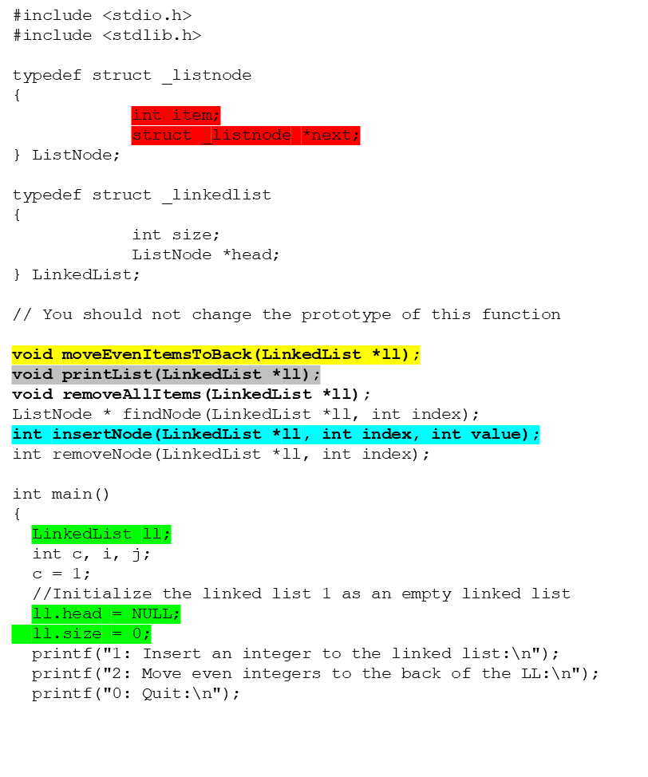
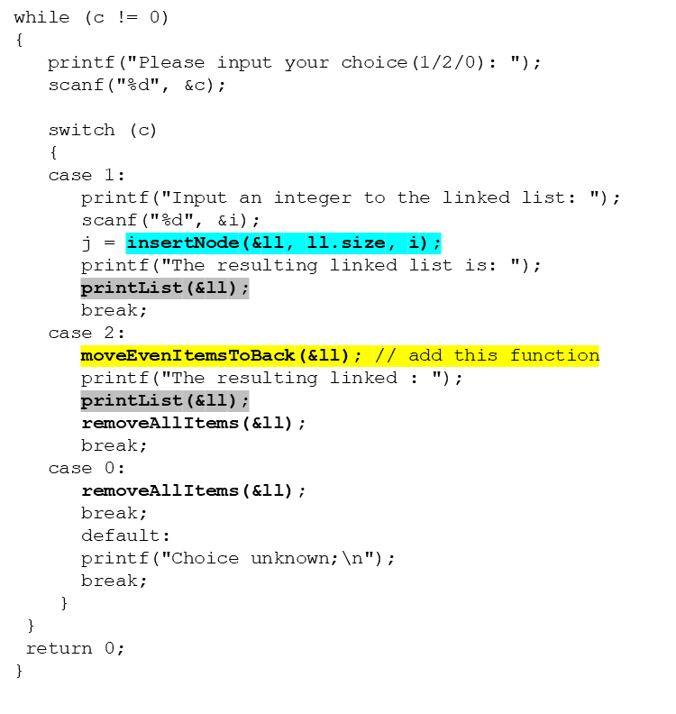
1
2
3
4
5
6
7
8
9
10
11
12
13
14
15
16
17
18
19
20
21
22
23
24
25
26
27
28
29
30
31
32
33
34
35
38
39
40
41
42
43
44
45
46
47
48
49
50
51
52
53
54
55
56
57
58
59
60
61
62
63
64
65
66
67
LinkedList ll
ListNode *head
ll
NULL
NULL
0
0
int size
stack

Slide 4
void moveEvenItemsToBackLL(LinkedList *ll);
ListNode *head
head index 0 index 1 index 2 index 3 index 4 index 5
LinkedList *ll
2
3
4
7
15
18
NULL
int size
index 0 index 1 index 2 index 3 index 4 index 5
ListNode *head
LinkedList *ll
3
4
7
15
18
2
NULL
int size
ListNode *head
index 0 index 1 index 2 index 3 index 4 index 5
LinkedList *ll
3
7
15
18
2
4
NULL
int size
index 0 index 1 index 2 index 3 index 4 index 5
ListNode *head
LinkedList *ll
3
7
15
2
4
18
NULL
int size
Notes:
Dr Hui Siu Cheung, SCE, NTU

Slide 5
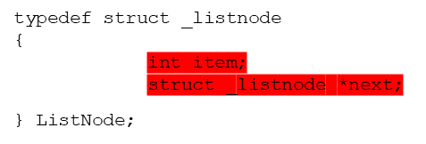
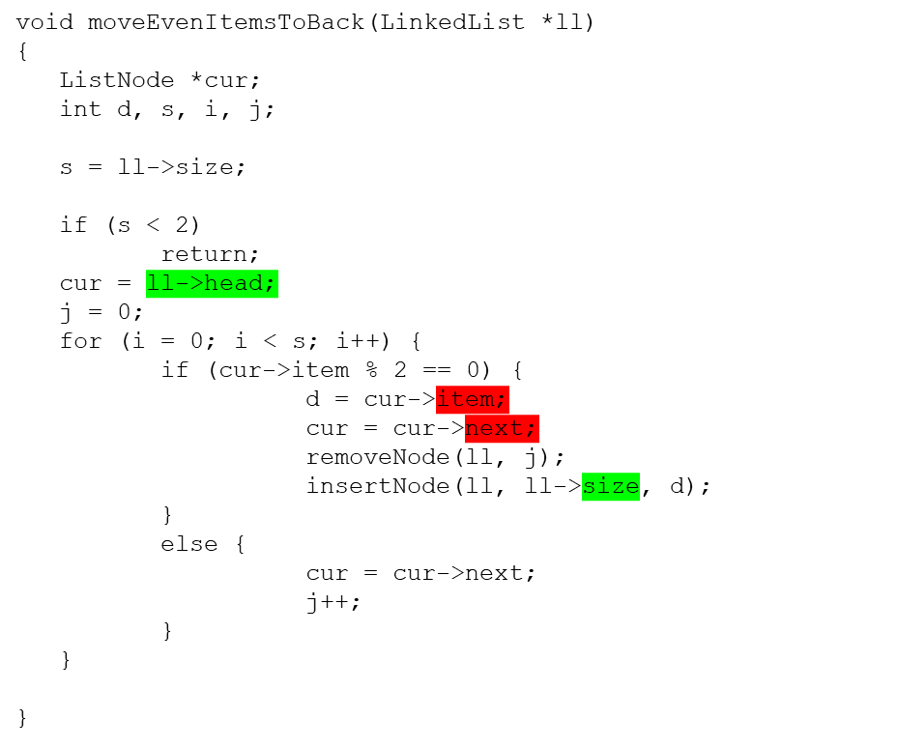
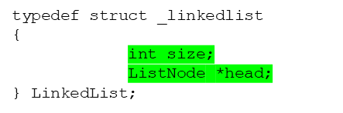

void moveEvenItemsToBackLL(LinkedList *ll);
1
2
3
4
5
6
7
8
9
10
11
12
13
14
15
16
17
18
19
20
21
22
23
24
25
item
next
LinkedList *ll
ListNode *head
0X100
0X100
1
index 0
int size
cur
0X100
Notes:
Dr. Newton Fernando, SCE, NTU

Slide 6
Int moveMaxToFront(ListNode **ptrHead);
30
20
70
40
ptrHead head
cur = (*ptrHead);
cur
maxItem = 30
30
20
70
40
ptrHead head pre = cur;
cur = cur->next;
pre
cur
30
20
70
40
ptrHead head pre = cur;
cur = cur->next;
pre
cur
30
20
70
40
ptrHead head preMax = pre;
preMax
pre
cur
maxItem = 70
30
20
70
40
ptrHead head
pre = cur; cur = cur->next;
cur = NULL
preMax
pre
Notes:
Dr Hui Siu Cheung, SCE, NTU

Slide 7

Int moveMaxToFront(ListNode **ptrHead);
30
20
70
40
ptrHead head
preMax
cur
pre
cur = preMax->next;
preMax->next = preMax->next->next;
cur->next = *ptrHead;
ptrHead head
30
20
40
70
preMax
pre
*ptrHead = cur;
cur
70
30
20
40
ptrHead head
Notes:
Dr Hui Siu Cheung, SCE, NTU

Slide 8
Int moveMaxToFront(ListNode **ptrHead);
int moveMaxToFront(ListNode **ptrHead)
{
ListNode *pre, *cur;
ListNode *preMax = NULL;
int maxItem;
// Empty list
if (*ptrHead == NULL) return -1;
// Only one node in the list
if ( (*ptrHead)->next == NULL )
return 0;
cur = (*ptrHead);
maxItem = (*ptrHead)->item;
// preMax gets set to the address of the ListNode with the max value
// If preMax is still NULL at the end, first node had the max value
while (cur != NULL){
if (cur->item > maxItem){
maxItem = cur->item;
preMax = pre;
}
pre = cur;
cur = cur->next;
}
// Never saw a value higher than the first node, nothing to move
if (preMax == NULL)
return 0;
// Move node with max value to first position
cur = preMax->next;
preMax->next = preMax->next->next;
// Update head pointer
cur->next = *ptrHead;
*ptrHead = cur;
return 0;
}
1
2
3
4
5
6
7
8
9
10
11
12
13
14
15
16
17
18
19
20
21
22
23
24
25
26
27
28
29
30
31
32
33
Notes:
Dr. Newton Fernando, SCE, NTU

Slide 9
void removeDuplicatesSortedLL(LinkedList *ll);
(removeDuplicatesSortedLL) Write a C function removeDuplicatesSortedLL() that removes all duplicate values from a sorted linked list. You may assume that the list is already in ascending sorted order.
The function prototype is given below:
void removeDuplicatesSortedLL(LinkedList *ll);
ListNode *head
LinkedList *ll
1101
10
20
20
40
50
index 0 index 1 index 2 index 3 index 4
5
int size
cur
temp
current->item == current->next->item
temp = current->next->next
free(current->next);
current->next = temp;
ll->size--;
ListNode *head
LinkedList *ll
1101
10
20
40
50
index 0 index 1 index 2 index 3
4
int size
cur
Notes:
Dr Hui Siu Cheung, SCE, NTU

Slide 10
void removeDuplicatesSortedLL(LinkedList *ll);
void removeDuplicatesSortedLL(LinkedList *ll)
{
ListNode *current, *temp;
current = ll->head;
if (current == NULL)
return;
while (current->next != NULL)
{
if (current->item == current->next->item)
{
temp = current->next->next;
free(current->next);
current->next = temp;
ll->size--;
}
else
{
current = current->next;
}
}
}
1
2
3
4
5
6
7
8
9
10
11
12
13
14
15
16
17
18
19
20
Notes:
Dr. Newton Fernando, SCE, NTU

Slide 11
VOID APPENDLL(LINKEDLIST *LL_A , LINKEDLIST *LL_B);
(appendLL) Write a C function appendLL() that takes two lists, ‘a’ and ‘b’, appends ‘b’ onto the end of ‘a’, and then sets ‘b’ to NULL (since it is now trailing off the end of ‘a’).
The function prototype is given below:
void appendLL(LinkedList *ll_a , LinkedList *ll_b);
ListNode *head
LinkedList *ll_a
1101
10
20
30
index 0 index 1 index 2
3
int size
ListNode *head
LinkedList *ll_b
1102
40
50
2
index 0 index 1
int size
LinkedList *ll_a
ListNode *head
1101
10
20
30
40
50
index 0 index 1 index 2 index 3 index 4
3
int size
Notes:
Dr Hui Siu Cheung, SCE, NTU

Slide 12
void removeDuplicatesSortedLL(LinkedList *ll);
1
2
3
4
5
6
7
8
9
10
11
12
13
14
15
16
17
void appendLL(LinkedList *ll_a , LinkedList *ll_b)
{
ListNode *cur;
if(ll_a->head == NULL){
ll_a->head = ll_b->head;
}
else{
cur = ll_a->head;
while(cur->next != NULL){
cur = cur->next;
}
cur->next = ll_b->head;
ll_a->size = ll_a->size + ll_b->size;
}
ll_b->head = NULL;
ll_b->size = 0;
}
ll_a
10
20
30
cur
ll_b
40
50
ll_a
10
20
30
40
50
ll_b
ll_b
NULL
Notes:
Dr. Newton Fernando, SCE, NTU

