Slide 1
Tutorial: STACKS AND QUEUES
Notes:
When the malloc() function is called with the required size, it returns a pointer to a newly allocated block size bytes long.
If the requested size of the memory is not available on the heap, the function returns a null pointer.
As you can see, the return type for malloc() is void*.
A void pointer is a pointer that has no associated data type with it. A void pointer can hold address of any type and can be typcasted to any type.
For instance, malloc() returns void* which can be typecasted to any type like int*, char*, etc.
Dr Hui Siu Cheung, SCE, NTU

Slide 2



STACK IMPLEMENTATION USING LINKED LISTS
Stack structure
  typedef struct _stack{
  LinkedList ll;
  } Stack;
Basically wrap up a linked list and use it for the actual data storage
Just need to ensure we control where elements are added/removed
Notice that the LinkedList already takes care of little things like keeping track of number of nodes, etc.
Notice this is a LinkedList, not a LinkedList *
Stack s
LinkedList ll
ListNode *head
int size
Notes:
Now the previous diagram has changed. We have an outer box for stack that covers the linked list struct. We are trying to build the concept that is visualized in the left diagram.
A stack has the values that are come in and go out only at the top position of the stack. But if we look at the memory layout, at the end we will get a stack structure. Inside the stack struct we have the linked list struct and inside the linked list struct we have two items as the head pointer and the size variable.
This is the simplest form of linked list we can have which does not include doubly linked nodes, or tail pointers. We have the nodes outside the struct and connected to the struct via the head pointer. The nodes are defined as external blocks of memory. Therefore, now we have a stack struct which wraps up the linked list structure which warps up a head pointer and a size variable.
In this way we do not need to worry about rewriting the code. For an example, if we want to add an item to the stack we have to call the insert node function in the linked list.
Dr Newton Fernando, SCE, NTU

Slide 3

QUEUE IMPLEMENTATION USING LINKED LISTS
Queue structure
  typedef struct _queue{
  LinkedList ll;
  } Queue;
Again, wrap up a linked list and use it for the actual data storage
Notice that the LinkedList already takes care of little things like keeping track of # of nodes, etc.
Notice this is a LinkedList, not a LinkedList *
LinkedList ll
Queue q
ListNode *head
int size
Notes:
Dr Hui Siu Cheung, SCE, NTU

Slide 4
STACK AND QUEUE FUNCTIONS
Stack Functions
void push(Stack *s, int item);
int pop(Stack *s);
int peek(Stack *s);
int isEmptyStack(Stack *s);
Queue Functions
void enqueue(Queue *q, int item);
int dequeue(Queue *q);
int peek(Queue *q)
int isEmptyQueue(Queue *s);

Slide 5
YOU SHOULD FIGURE OUT WHICH ONE IS POINTER, WHICH ONE IS NOT
When should I use “->” or ”.” ?
pointer->
Non-pointer.
Queue structure
typedef struct _queue {
LinkedList ll;
}Queue;
Queue q;
q.ll LinkedList
q.ll.head
(q.ll.head)->num integer
Queue *q;
q->ll LinkedList
q->ll.head
(q->ll.head)->num integer
Is a pointer
ListNode pointer
ListNode pointer
LinkedList ll
Queue q
*head
20
30
40
Queue* q
size
Notes:
Dr Hui Siu Cheung, SCE, NTU

Slide 6
QUEUE AND STACK IMPLEMENTATION USING LINKED LISTS
typedef struct _listnode{
int num;
struct _listnode *next;
}ListNode;
typedef struct _linkedlist{
ListNode *head;
ListNode *tail;
int size;
}LinkedList;
typedef struct _queue {
LinkedList ll;
}Queue;
typedef struct _listnode{
int num;
struct _listnode *next;
}ListNode;
typedef struct _linkedlist{
ListNode *head;
int size;
}LinkedList;
typedef struct _stack {
LinkedList ll;
}Stack;

Slide 7
LINKED LIST, STACK AND QUEUE FUNCTIONS
void printList(LinkedList *ll);
ListNode * findNode(LinkedList *ll, int index);
int insertNode(LinkedList *ll, int index, int value);
int removeNode(LinkedList *ll, int index);
void push(Stack *s, int item);
int pop(Stack *s);
int peek(Stack *s);
int isEmptyStack(Stack *s);
void enqueue(Queue *q, int item);
int dequeue(Queue *q);
int peek(Queue *q);
int isEmptyQueue(Queue *s);

Slide 8
VOID REVERSESTACK(STACK *S);
(reverseStack) Write a c function reverseStack() that reverses a stack using a queue. Note that the reverseStack() function only uses push()and pop()when adding or removing integers from the stack, and only uses enqueue() and dequeue() when adding or removing integers from the queue.
The function prototypes are given as follows:
void reverseStack(Stack *s);
For example: if the stack is <5, 4, 3, 2, 1>, the resulting stack will be <1, 2, 3, 4, 5>

Slide 9
VOID REVERSESTACK(STACK *S);
LinkedList ll
LinkedList ll
ListNode *head
Stack *s
ListNode *head
Stack *s
10
10
int size
int size
10
100
20
90
Queue q
30
80
LinkedList ll
40
ListNode *head
70
50
60
60
10
50
70
40
int size
30
80
90
20
100
10
10
20
30
40
50
60
70
80
90
100

Slide 10
void removeUntil(Stack *s, int value)
1
2
3
4
5
6
7
8
9
10
11
12
13
14
15
16
void reverseStack(Stack *s) {
int item;
Queue q;
q.ll.head = NULL;
q.ll.size = 0;
while (!isEmptyStack(s))
{
enqueue(&q, pop(s));
}
while (!isEmptyQueue(&q))
{
push(s, dequeue(&q));
}
}
void enqueue(Queue *q, int item);
int dequeue(Queue *q);
void push(Stack *s, int item);
int pop(Stack *s);
Notes:
We can put all we learned from insertNode like this to form the complete function.
Dr. Newton Fernando, SCE, NTU

Slide 11
VOID REVERSEFIRSTKITEMS(QUEUE *Q, INT K);
(reverseFirstKItems) Write a c function reverseFirstKItems()that reverses the order of the first k elements of the queue using a stack, leaving the other elements in the same relative order for given an integer k and a queue of integers. Note that the reverseFirstKItems()function only uses push() and pop() when adding or removing integers from the stack and only uses enqueue() and dequeue() when adding or removing integers from the queue.
The function prototypes are given as follows:
void reverseFirstKItems(Queue *q, int k);
For example: if the queue is <1, 2, 3, 4, 5, 6> and k =3, the resulting queue will be <3, 2, 1, 4, 5, 6>

Slide 12
VOID REVERSEFIRSTKITEMS(QUEUE *Q, INT K);
LinkedList ll
Stack s
queue *q
ListNode *head
LinkedList ll
ListNode *head
8
3
int size
int size
K=3
10
20
30
40
50
60
70
80
40
50
60
70
80
40
50
60
70
80
30
20
10
for(i=0; i< j-k;i++){
enqueue(q, dequeue(q));
}
J=8, k=3
30
20
30
20
10
40
50
60
70
80
10

Slide 13
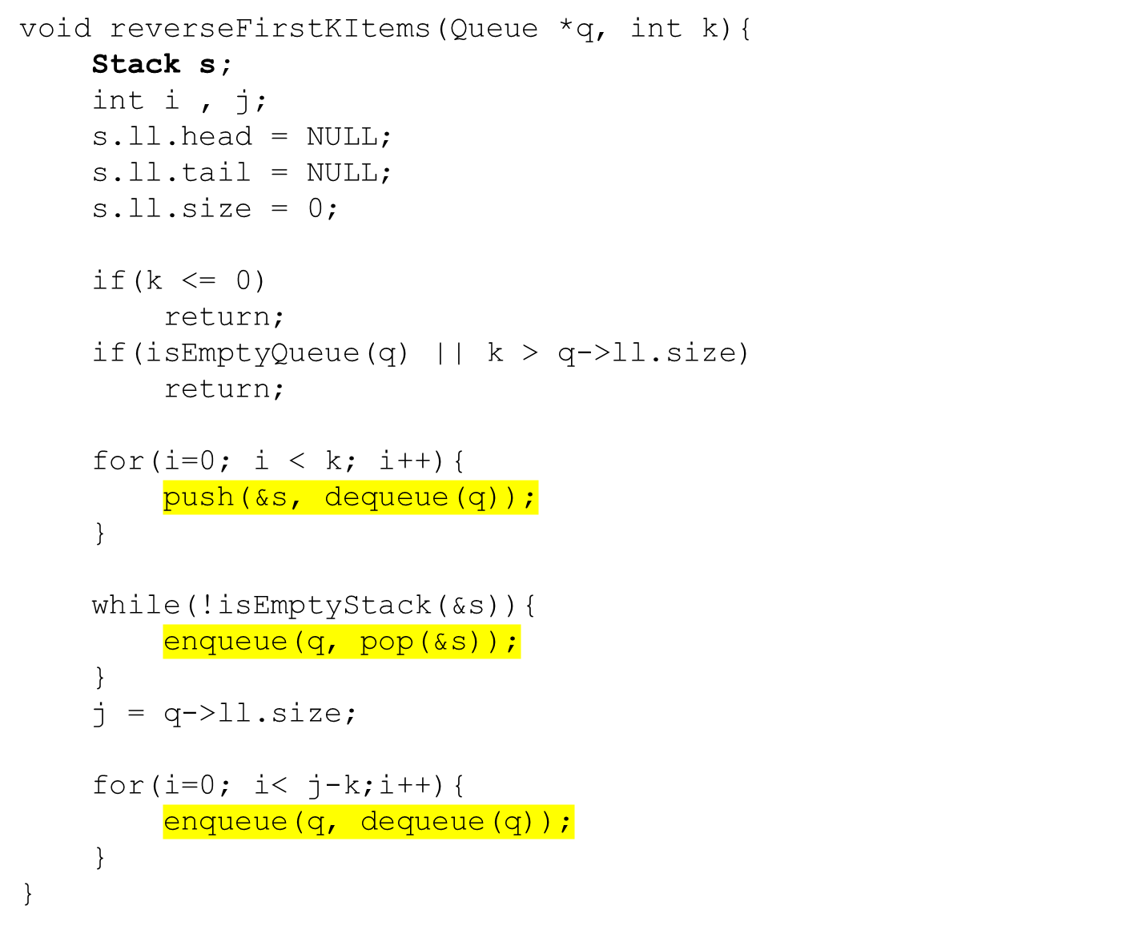
1
2
3
4
5
6
7
8
9
10
11
12
13
14
15
16
17
18
19
20
21
22
23
24
25
void enqueue(Queue *q, int item);
int dequeue(Queue *q);
void push(Stack *s, int item);
int pop(Stack *s);

Slide 14
VOID SORTSTACK(STACK *S);
(sortStack) Write a c function sortStack() that sorts a given stack in ascending order using another temporary stack. Note that the sortStack () function only uses push() and pop() when adding or removing integers from the stack.
The function prototype is given as follows:
void sortStack(Stack *s);

Slide 15
VOID SORTSTACK(STACK *S)
LinkedList ll
void sortstack(stack *s)
Stack *s
ListNode *head
10
int size
Stack ts;
ts.ll.head = NULL;
ts.ll.size = 0;
50
20
Stack ts
30
LinkedList ll
40
ListNode *head
10
NULL
0
70
60
int size
80
90
100
Stack s

Slide 16
VOID SORTSTACK(STACK *S)
Stack ts
LinkedList ll
LinkedList ll
Stack *s
ListNode *head
ListNode *head
NULL
0
10
int size
int size
100
while(!isEmptyStack(s)){
push(&ts, pop(s));
}
90
80
60
70
10
40
30
20
50

Slide 17

VOID SORTSTACK(STACK *S)
Stack ts
LinkedList ll
LinkedList ll
Stack *s
ListNode *head
ListNode *head
4
6
int size
int size
while(!isEmptyStack(s) && peek(s) < temp){
push(&ts, pop(s)); (60<70)
}
70
10
60
40
80
30
90
20
100
50

Slide 18
VOID SORTSTACK(STACK *S)
while(!isEmptyStack(s) && peek(s) < temp){
push(&ts, pop(s)); (60<70)
}
70
temp
60
60
10
10
40
70
40
80
30
80
30
90
20
90
20
100
50
100
50
Stack s
Stack ts
Stack s
Stack ts

Slide 19
VOID SORTSTACK(STACK *S)
Stack ts
LinkedList ll
LinkedList ll
Stack *s
ListNode *head
ListNode *head
NULL
10
0
int size
int size
10
1
2
3
4
5
6
7
8
9
10
11
12
13
14
15
16
17
18
19
20
21
void sortStack(Stack *s)
{
int temp;
Stack ts;
ts.ll.head = NULL;
ts.ll.size = 0;
while(!isEmptyStack(s)){
push(&ts,pop(s));
}
while(!isEmptyStack(&ts)){
temp = pop(&ts);
while(!isEmptyStack(s) && peek(s) < temp){
push(&ts, pop(s));
}
push(s, temp);
}
}
20
30
40
50
60
70
80
90
100
Stack s

Slide 20
1
2
3
4
5
6
7
8
9
10
11
12
13
14
15
16
17
18
19
20
21
void sortStack(Stack *s)
{
int temp;
Stack ts;
ts.ll.head = NULL;
ts.ll.size = 0;
while(!isEmptyStack(s)){
push(&ts,pop(s));
}
while(!isEmptyStack(&ts)){
temp = pop(&ts);
while(!isEmptyStack(s) && peek(s) < temp){
push(&ts, pop(s));
}
push(s, temp);
}
}
void enqueue(Queue *q, int item);
int dequeue(Queue *q);
void push(Stack *s, int item);
int pop(Stack *s);

