Slide 1
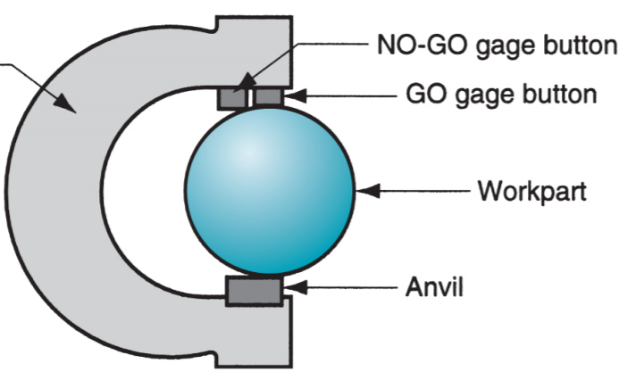
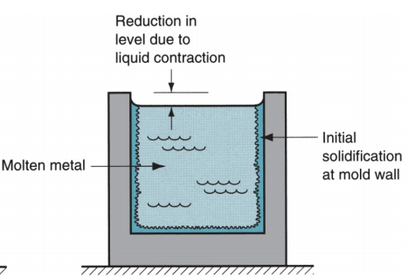
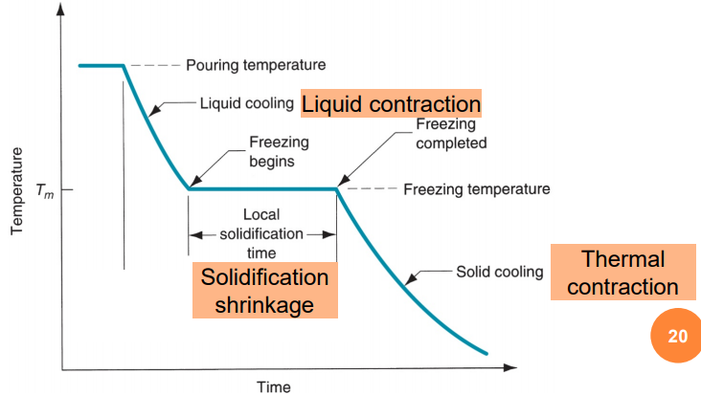
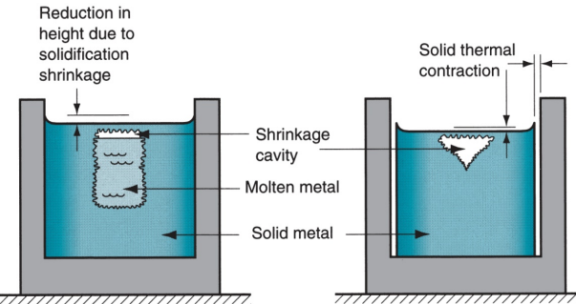
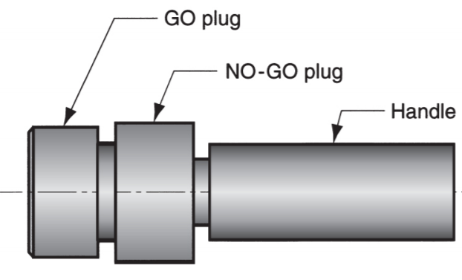
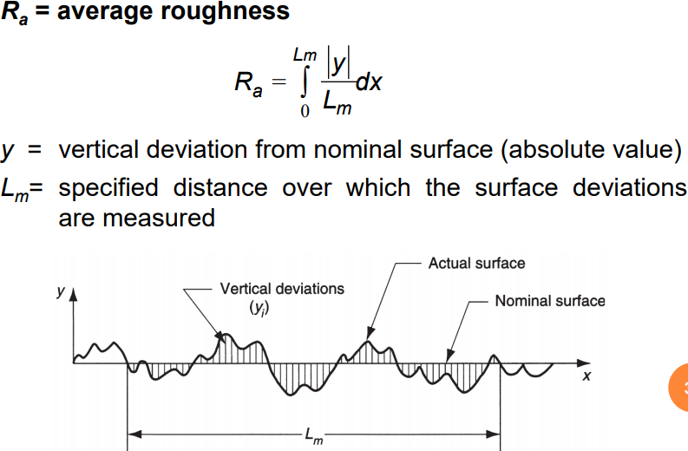
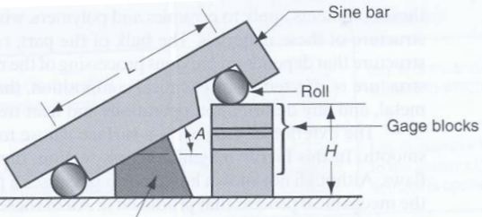


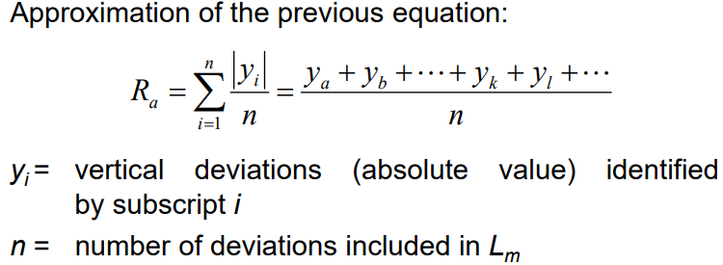

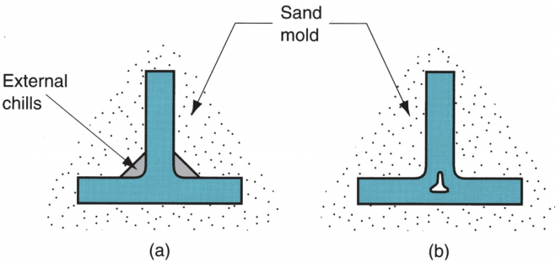

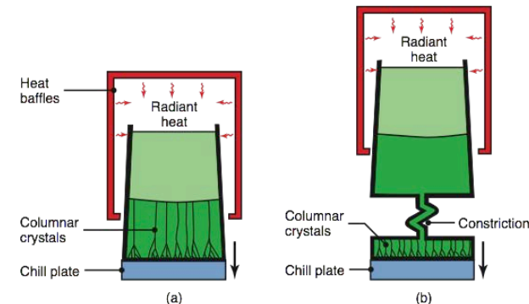

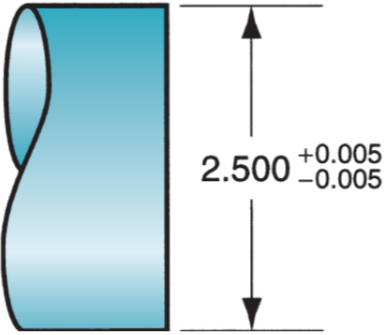
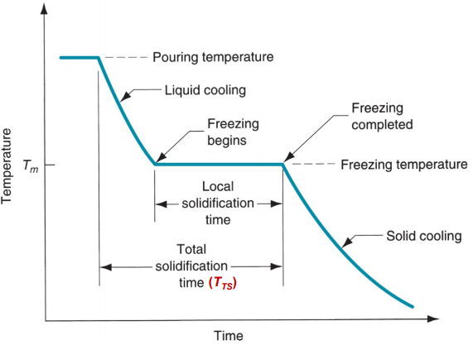
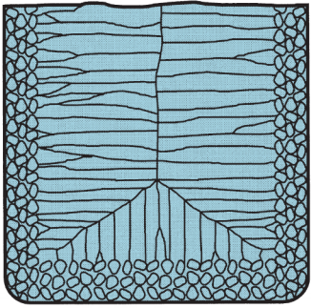
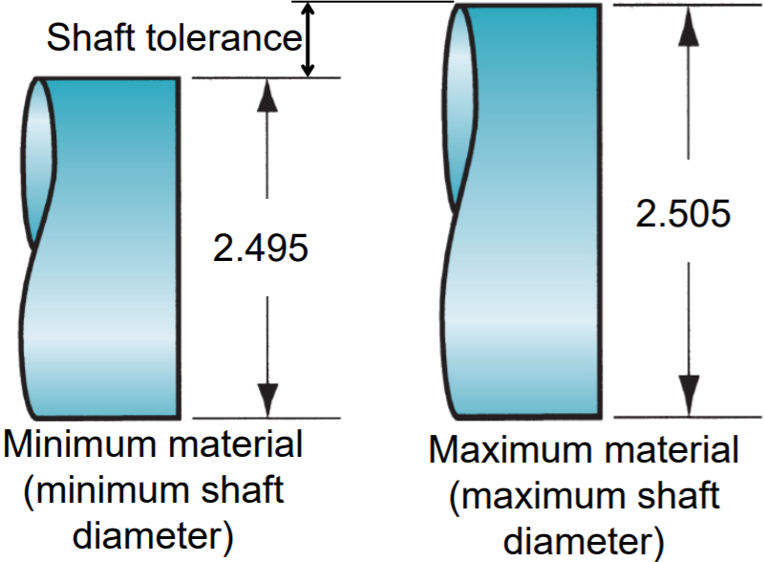
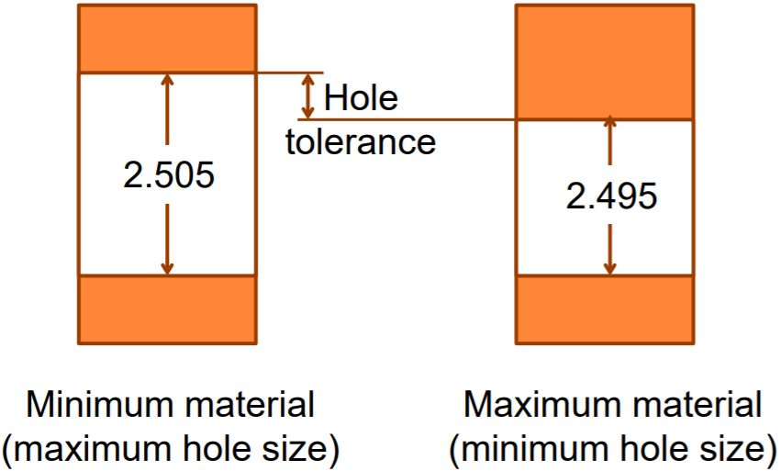
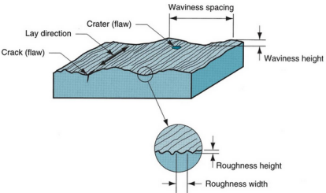
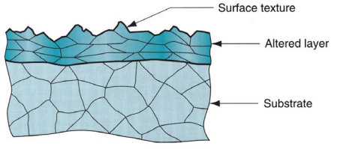
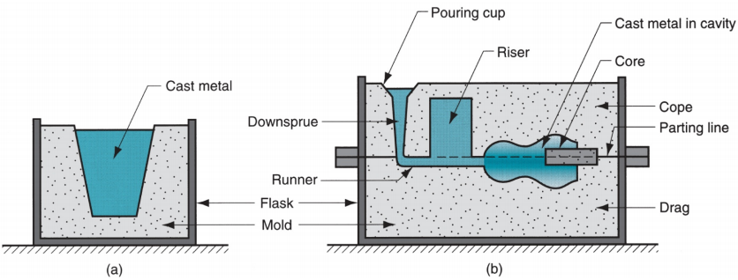
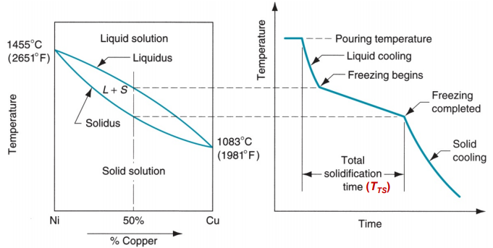
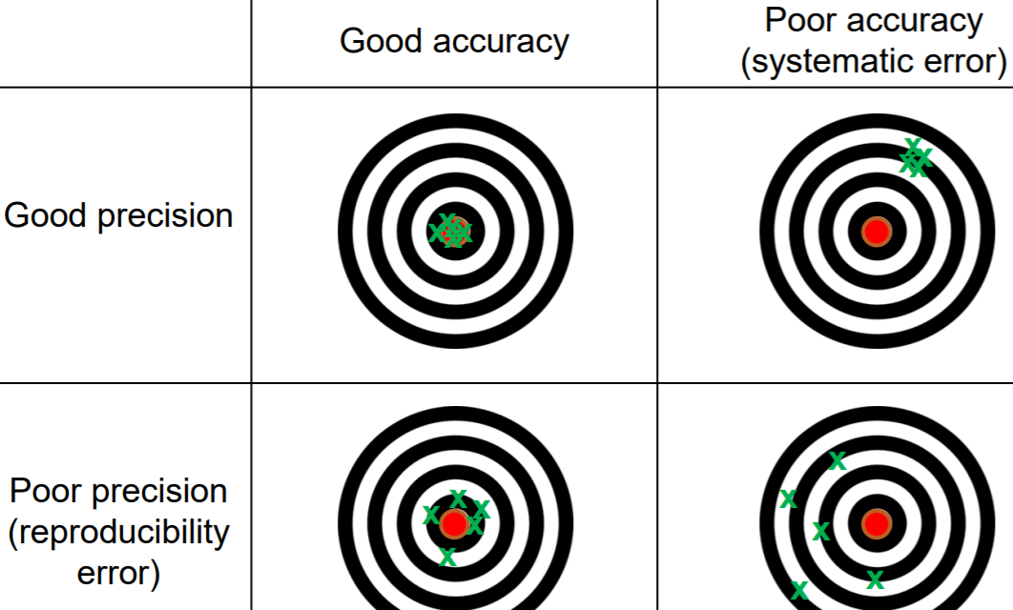
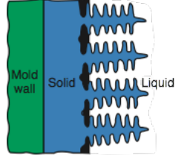
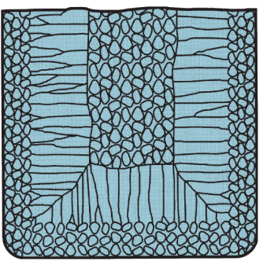
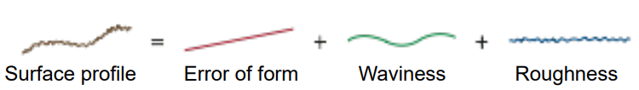
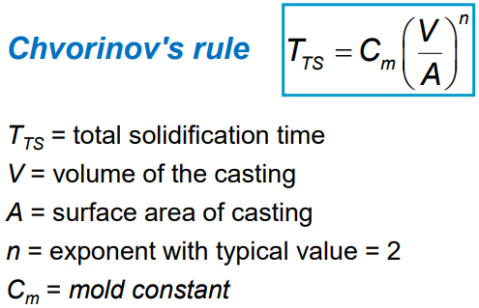
Techincal & Economic process - provides shape, dimensions, properties & value. Metals – alloys (>=2, >=1 metallic); ferrous: cast iron,steel(75% of world metal tonnage); nonferrous: all other metallic elements and their alloys: aluminium, copper, nickel, silver, tin Polymers – repeating structural units of mers; atoms share electrons; form large molecules; carbon + >=1 other element (e.g. hydrogen, nitrogen, oxygen, chlorine) Thermoplastic: multiple heating/cooling w/o altering molecular structure; usually soften; no cross-linking. Thermosetting: molecules chemically transform to rigid stuct during curing; usually hardens Elastomers: elastic; e.g. rubber, silicon Ceramics: contains (semi)metallic and nonmetallic(oxygen, nitrogen, carbon) Crystalline ceramics: traditional (clay) & modern (alumina); Glasses: like silica Composites: mixture of all 3 Materials Differences are: chemical, mechanical & physical properties -> affects manu. processes that can be used Shaping - change geometry of material; Solidification: use heated liquid/semifluid; moulding & casting. Particulate: use metal/ ceramic powders; pressed or sintered; Deformation: use ductile solid (e.g. metal); apply force > yield strength (forging & extrusion) Material Removal: start material ductile/brittle solid; turning, drilling, milling Minimize waste in shaping; e.g. molding waste less than material removal Net shape process – little/no waste & no machining. Near net shape process – min. machining Assembly – joining: permanent joint; welding, brazing, soldering, adhesive bonding. Mechanical: fastening; threaded fasteners (screws, bolts); press fitting; expansion fits. Trends – environment; microfabrication; nanotechnology; additive: freeform & toolless | Snap gage – for checking outside dimension If does not go in GO gage : > max dimensions If does go in NO-GO gage : < min dimensions dimension Example: Length of sine bar = 15cm; Rolls diameter = 2.5cm; gage blocks = 4cm, 0.5cm,0.065cm; find angle. Answer: Angle (A) = sin⁻¹(total height of gage blocks / Length of sine bar) = sin⁻¹((4+0.5+0.065)/15) = 17.72° Other angular measurements: Bevel protractor with vernier scale Electronic gages: based on transducers capable of converting a linear displacement into electrical signal Other considerations: Flat stable surface; Non-contact metrology (optical systems like lasers) | Lay(predominant direction or pattern of surface texture) Methods of measurement for surface roughness: Fingernail test, Stylus, Optical Stylus head traverses horizontally across surface; stylus moves vertically to follow surface profile; vertical movement converted to electronic signal – profile of actual surface or average roughness value; stylus path smoother than actual as cannot go into small peaks Surface Roughness Equations Problems with R_{a} – waviness included; Lay not accounted for Cutoff length – filter to separate waviness from roughness deviations; sampling distance along the surface; sampling distance shorter than waviness eliminates waviness deviations and only has roughness deviations; typically 0.8mm and L_{m} is normally x5 of cutoff length Lay direction – stylus should traverse perpendicular to lay direction * Do not confuse hardness with roughness | Expendable mold advantages: more intricate geometires; don’t need to worry about getting material out of mold Expendable mold disadvantages: one-time use Permanent mold advantages: more economic in mass production Permanent mold disadvantages: limited by the need to open the mold (refer to mold diagram on the bottom right) Cope – upper half; Drag – lower half; separated by parting line; Flask – box containing cope and drag; Mold Cavity – external surfaces of cast; Core – internal surfaces of cast; Downsprue – entrance to runner leading to cavity; Pouring Cup – minimizes splash/turbulence as metal flows down; Riser – reservoir in mold, source of liquid metal to compensate shrinkage during solidification (designed to freeze after main casting); Gate – entrance of mold cavity Factors for successful mold – pouring temp; pouring rate; turbulence Bernoulli’s Theorem: h = head(cm),p=liquid pressure(n/cm²), ρ=density(g/cm³), v=flow velocity(cm/s), g = gravitational acceleration constant = 981cm/s², F=head losses due to friction(cm) Can ignore friction losses and assume system remains at atmospheric pressure; velocity at base of sprue assuming that point 1:top of sprue→ v1=0; point 2:base of sprue→ h2=0 Continuity law: Flow velocity increases towards the base of the sprue. To maintain the continuity law, the cross sectional area decreases → tapered sprue (prevent aspiration). Mold cavity filling time – assume runner to cavity horizontal (h = sprue base) Fluidity is the capability of molten metal to fill the mold cavity; high viscosity = low fluidity Spiral mold test - Greater the length of the solidified metal, greater its fluidity. | Further reduction in volume due to thermal contraction during cooling of solid metal Solidification shrinkage happens in almost all metals cause density in solid > liquid Hence, causes reduction in volume. Exception: cast iron with high C content (expands instead) Pattern shrinkage allowance – amount by which mold larger than final casting size Directional Solidification – minimize effect of shrinkage; want regions of casting furthest away from liquid metal to freeze first & solidify towards riser → molten metal continually available from risers to prevent shrinkage voids; makes use of Chvorinov’s rule (a)External chills to encourage rapid freezing in thin section Of casting (b) Result if chills were NOT used Turbine Blade Casting (a)Directional solidification (b)Produce single-crystal blade Riser Design – is a waste Metal separated from Casting and remelted to make more castings; minimize waste by using min. vol of metal in riser; shape of riser designed to maximize V/A ratio → allows riser volume to be reduced
 |  | Casting of Metal: molten metal flows by gravity/other force into mold where it solidifies in shape of mold cavity; Steps: melt the metal, pour into mold, let it freeze Pros of Casting: create complex part geometries; create external & internal shapes; some processes are net/near net shape; produce large parts(sand casting) & small parts; mass production (permanent mold casting) Cons of Casting: limitations on mechanical processes; poor dimensional accuracy/surface finish (e.g. sand casting); safety hazard to workers; environment Mold in Casting – cavity: determines shape (actual size & shape of cavity must be enlarged to allow shrinkage); made from diff materials, e.g. metal(used for low melting point metals(aluminium)) Types of Molds: open mold(a) & closed mold(b) Expendable mold processes – destroyed to remove casting (materials: sand (moist),plaster, binders(maintains shape)) Permanent mold processes – mass production (use metal)
 | Tolerances (variation from dimension) vary depending on process parameters; increases with part size Processes that give good surface finishing: honing, lapping, polishing, superfinishing Nominal surface: designer’s intended surface contour Importance of surfaces: Aesthetic, Safety, Friction/Wear, Mechanical/Physical Properties, Assembly of parts, smooth surface better for electrical contacts Elements of surface texture – roughness(small deviations from nominal surface; determined by material characteristics and processes), waviness(deviations of much larger spacing; due to work deflection, vibration, tooling) Elements of surface texture – roughness(small deviations from nominal surface; determined by material characteristics and processes), waviness(deviations of much larger spacing; due to work deflection, vibration, tooling); Flaws(irregularies that occur occasionally on surface; cracks, scratches,etc; affect surface integrity); Lay |  | Pure metal solidifies at a constant temp. = to its Freezing/melting point Solidification (pure metal) - thin skin of solid metal formed immediately; thickness increases to form shell ard molten metal; rate of freezing depends on heat transfer into mood/thermal properties of metal Alloys freeze over a temp. range Exceptions: Eutectic alloys (single temp.) Solidification (alloy) – form dendrites in mushy zone; Grain structure segregation of alloy components in center of casting | General Defects –Misrun: casting solidified before completely filling the mold cavity; Cold Shut: two portions of metal flow tgt but lack of fusion due to premature freezing; Cold Shot: Metal splatters during pouring leading to formation of solid globules; Shrinkage cavity:depression on surface/internal void (solidification shrinkage) that restricts amount of molten metal available in last region to freeze; Microporosity: Small voids (holes) distributed throughout the casting (localized solidification shrinkage) of the final molten metal within the dendritic structure; Hot Tears: casting restrained from contraction due to the mold during final stages of solidification/early stages of cooling after solidification; Sand Blow: Balloon-shaped gas cavity caused by release of mold gases during pouring; Pin Holes: Formation of many small gas cavities at or slightly below the surface of the casting; Penetration: fluidity of the liquid metal is high, it may penetrate into the sand mold or core, causing the casting surface to consist of a mixture of sand grains and metal; Mold Crack: crack develops in the mold, into which liquid metal can seep to form a “fin” on the final casting; Mold Shift: step in the cast product at the parting line caused by sidewise relative displacement of cope and drag; Product Design Considerations – Geometric Simplicity & avoid unnecessary complexities(Simplifies mold-making; Reduces the need for cores; Improves the strength of the casting); Suggestions - Corners on casting: sources of stress concentrations → cause hot tearing & cracks; Section Thickness: Should be uniform to avoid shrinkage cavities; Design change to eliminate the need for a core; Draft angle (taper): expendable/permanent mold casting → facilitates removal of pattern/part from mold (refer to image behind)
GO gage – part can be inserted; max material; smallest hole diameter; HAS wear allowance
frame
NO-GO gage – part cannot be inserted; min material; biggest hole diameter: NO wear allowance
Plug gage – internal dimensions
If does not go in GO gage : hole too small
If does go in NO-GO gage : hole too big
H: dependent on no. of gage blocks
L: standard dimension of sine bar
Workpart to be measured
Q = volumetric flow rate(cm³/s)
A = area (cm²)
V = flow velocity(com/s)
V=volume of
cavity (cm³)
Q=see above equation
Dimension – indicates basic/ nominal size
Tolerance – define limits of allowed variation
Measurement errors: systematic(+/- deviations; accurate if don’t have); random(e.g. misalignment; precise if minimise) Precision: Repeatability Accuracy: Close to True value Resolution: Smallest discrimination Precision gage blocks: calibration of instruments; not really measurements Linear dimensions: graduated(has scale; ruler, vernier calliper, micrometer(measure part length)); nongraduated (no scale; compare/ transfer dimension for measurement by graduated device; outside callipers, etc) Comparative instruments: mech gages(mechanically magnify deviation of permit observation) Dial indicator(linear movement of contact pointer into rotation; measure straightness, flatness, runout by comparison with ref surface or circle, etc.)
Types of tolerances: Bilateral(+&-; can be unbalanced); Unilateral(+/-); Limit(shows max and min dimensions)
Surface texture
– geometry; aka roughness; repetitive/random deviations from nominal surface
Surface integrity – material characteristics immediately beneath the surface; changes to this subsurface that resulted from the processes that created it
Mushy zone
Dendrites
Mold Constant C_{m} depends on:
Mold material; thermal properties of casting material; pouring temperature relative to melting point
T_{TS} depends on size and shape of cast
Required: T_{TS} (riser) > T_{TS} (cast)
But since C_{m} is equal, riser need to have larger V-to-A ratio → main casting solidify first

Slide 2
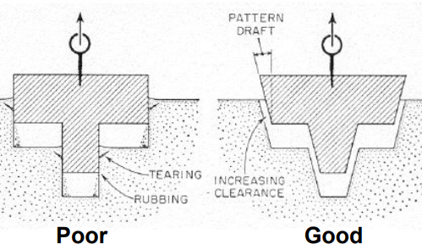
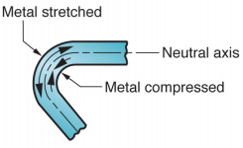
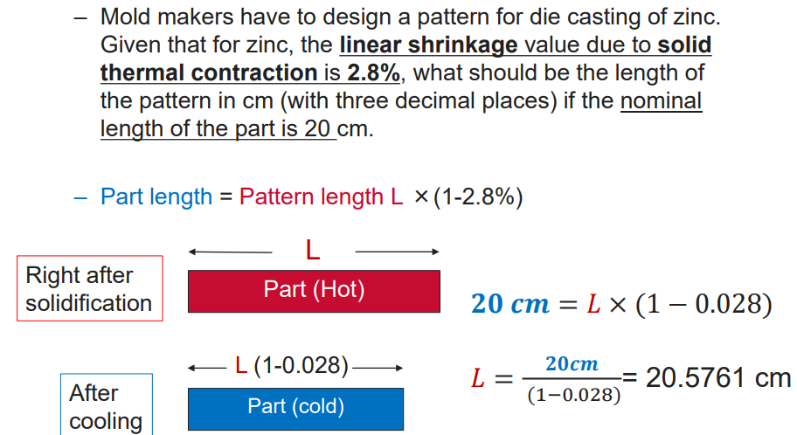
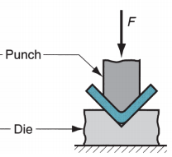
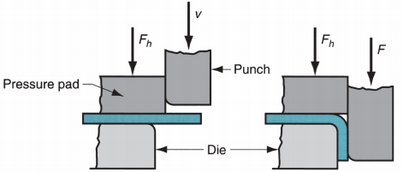
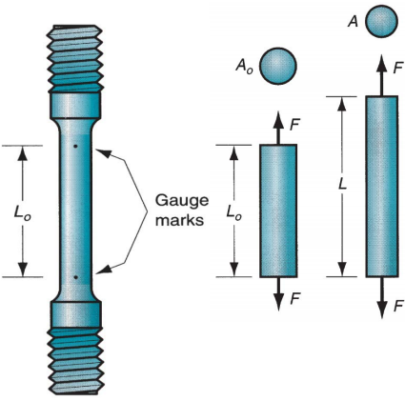
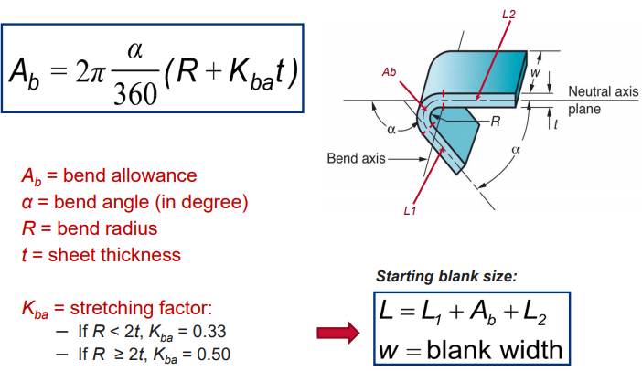
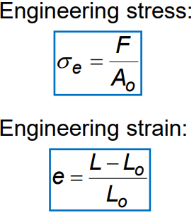
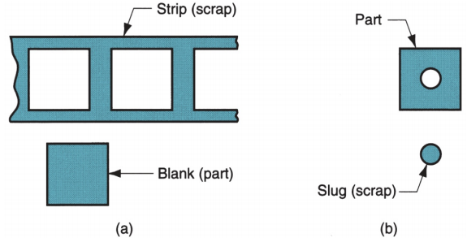
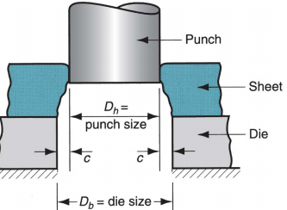
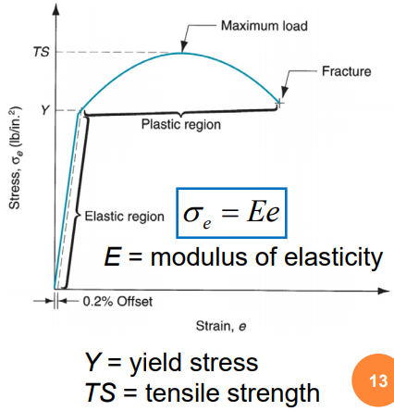
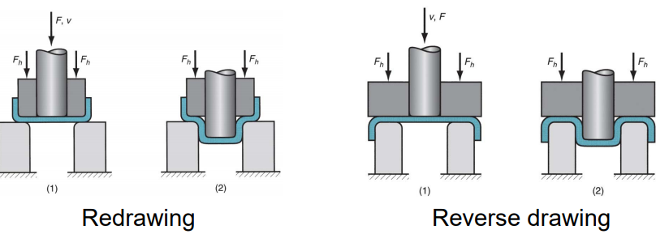
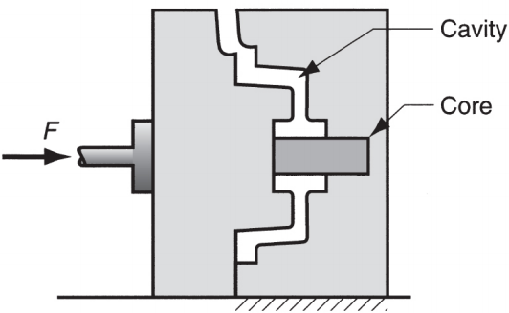
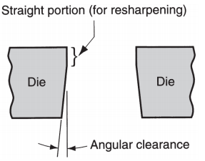

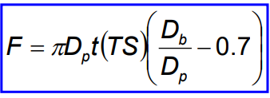
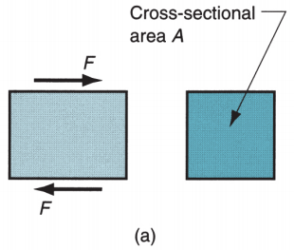
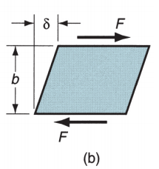
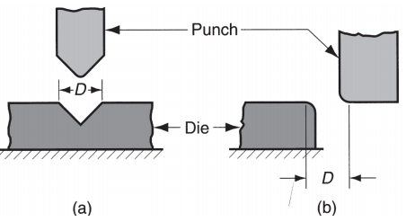


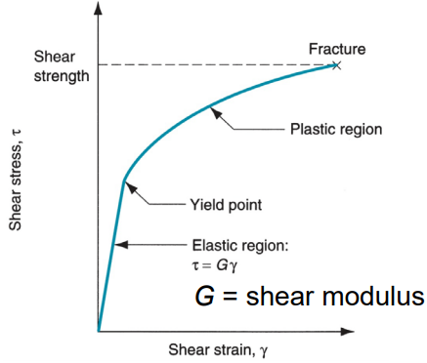

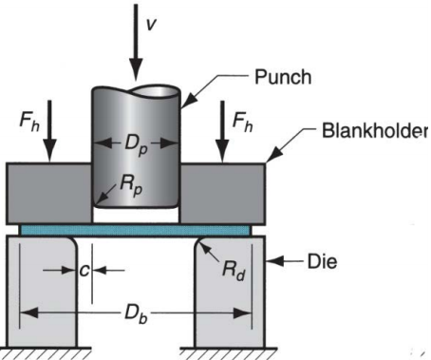
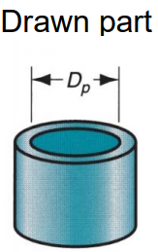
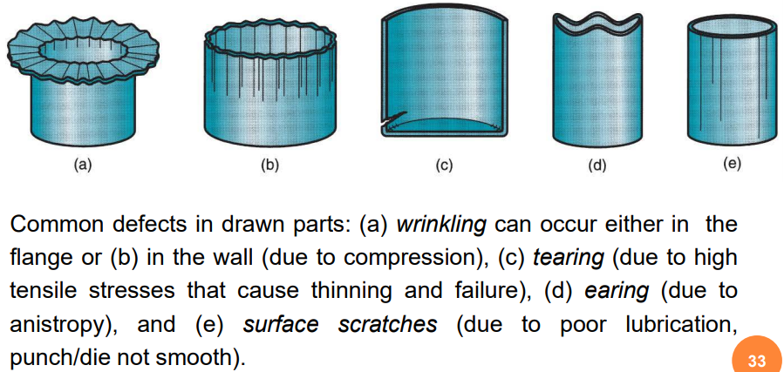
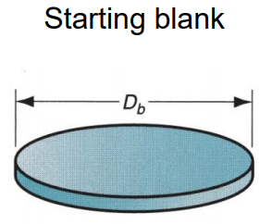
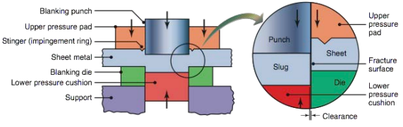
Die/Investment Casting: GOOD dimensional accuracy/finish Machining Allowances – sand casting likely to be machined to achieve required dimensions/features; Machining Allowance: add. Material left on casting in those surfaces when machining is necessary; Typical machining allowances for sand castings → ard 1.5 and 3 mm (part after shrinkage will be 1.5/3 mm bigger than required, machining to achieve final dimensions) | Advantages - Economical for large production; Good accuracy & surface finish; Thin sections possible; Rapid cooling → small grain size & good strength of cast product Disadvantages - limited to metals with low melting points; part geometry must allow removal from the die | Advantages of sheet metal parts - High strength; Good dimensional accuracy; Good surface finish; Relatively low cost; Economical mass production for large quantities. Sheet metalworking Terminology - Punch-and-die = tooling to perform cutting, bending, and drawing; Stamping press = machine tool that performs most sheet metal operations; Stampings = sheet metal products. Shearing - cutting material without producing chips. Steps - (1) Just before the punch contacts the workpiece; (2) the punch pushes into the workpiece, causing plastic deformation; (3) the punch penetrates the workpiece causing a smooth cut surface; and (4) fracture is initiated at opposing cutting edges to separate the sheet. Characteristics of Shear Edges – Rollover: Depression made by punch prior to cutting. Burnish: Smooth region resulting from penetration of the punch prior to fracture. Fracture zone: Relatively rough surface caused by fracture of the metal as punch goes down. Burr: Sharp corner edge due to elongation of metal during final stage of separation. Shearing Processes - Shearing: separate large sheets; Blanking: cut part perimeters out of sheet metal; Punching: make holes in sheet metal Blanking (a) - sheet metal cutting to separate a piece of metal (blank) from the surrounding sheet. Punching (b) - similar to blanking except that cut piece is scrap, called a slug. Punch & Die Sizes – c is clearance: too small → fracture lines pass each other, double burnishing & larger force; too big →metal pinched between cutting edges & excessive burr results. a = allowance (depends on type of metal) t = sheet thickness Angular clearance – Purpose: allows slug/blank to drop through die; commonly 0.25° to 1.5° on each side Questions - ultimate tensile strength = max load divide original area of specimen; stress-strain curve: elastic region = proportional relationship between stress & strain, plastic region = power function → flow curve; “shear strength of metal < tensile strength”→ shear = (0.7)tensile | Bending - forming of solid parts, where angled/ring-shaped workpieces are produced from sheet or strip metal Sheet Metal Bending – Metal on the inside of the neutral plane is compressed, while the metal on the outside of the neutral plane is stretched V-bending – performed with a V-shaped die. * Low production quantity * V-dies are simple & inexpensive Bend Allowance Formula A_{b}: length of neutral axis within bended portion Neutral axis length the same before & after bending Springback(bending) - decrease in bend angle and an increase in bend radius; elastic recovery of metal Reason - bending pressure removed → elastic energy remains in bent part → recovers partially toward its original shape. Springback Compensation – Overbending: bend more to allow springback; Bottoming: high compressive pressure causes plastic deformation at bend area Maximum bending force – TS = sheet strength of sheet metal; w = part width in direction of bend axis; D = die opening; t = sheet thickness * v-bending, K_{bf} = 1.33; edge bending, K_{bf} = 0.33 (cause pushing 1 side only) Die opening dimension D - (a)V-die, (b)wiping die Questions – Sheet metal Bending involves tension & compression; bending force depends on Ultimate Tensile strength | Drawing Sequence * As metal bends along die, tensile stress on cup wall as it is straightened; Friction & compression; compressive stress on the flange; Final cup shape showing effects of thinning in the cup walls Major Stresses in Flange and Wall Flange: Compressive hoop stress (may cause wrinkling) Wall: Longitudinal tensile stress (blank being pulled into the cavity, may cause tearing) Compression: Perimeter reduces but volume is constant → thickness must increase * Wrinkling: As initial sheet thickness t decreases, wrinkles increases Blankholder – prevent/reduce wrinkles on flange (flange thickens); F_{h} = blankholder force F_{h} too low: cause wrinkles; F_{h} too high: prevents metal from flowing into die cavity; tearing due to stretching Tests for drawing feasibility (3 criteria) – [D_{b} = blank diameter, D_{p} = punch diameter] 1. Drawing ratio DR (DR = D_{b}/D_{p}) * Indicates severity if given drawing operation → Upper limit: DR ≤ 2.0; i.e. if DR > 2.0, the operation is not feasible 2. Reduction r (r = (D_{b}-D_{p})/D_{b}) → * should be ≤ 0.50 3. Thickness-to-diameter ratio (T/D_{b}) T = thickness of starting blank * Desirable for t/D_{b} ratio to be greater than 1%; As t/D_{b} decreases, tendency for wrinkling increases. Overall: if 1,2,3 not respected → operation not feasible → redrawing required; blank can be drawn in >=2 steps with annealing between the steps Redrawing & Reverse Drawing – If shape change is too severe to be produced in one single drawing step, redrawing or reverse drawing can be used. After fulfilling the 3 conditions for drawing, do blank size determination → Starting sheet metal blank volume >= final product volume Drawing Force (needed to determine tonnage of press) F = maximum drawing force (N) D_{p} = punch diameter (mm) D_{b} = starting blank diameter (mm) t = original sheet thickness (mm) TS = tensile strength (MPa) 0.7 = correction factor to account for friction Blankholder Force or Holding Force Holding pressure ≈ 0.015 x yield strength Holding force ≈ holding pressure x starting area of blank held by blankholder (refer to image beside) F_{h} = blankholder force (N) ;Y = yield strength of sheet metal (MPa); Rd = die corner radius (mm) Defects in Drawing Operations
Investment Casting (aka lost wax process) - pattern made of wax coated with refractory material to make mold → wax is melted away prior to pouring molten metal; precision casting process → high accuracy/intricate details Steps – (1)Wax patterns produced; (2) Several patterns are attached to a sprue → pattern tree; (3) coat tree with thin layer of refractory material (slurry; e.g. silicon compotes); (4) full mold formed by covering the coated tree with sufficient refractory material (make it rigid); (5) mold is held in an inverted position, heated to melt the wax & permit it to drip out of the cavity; (6) mold is preheated to a high temp., molten metal poured → solidifies; (7) The mold is broken away from finished casting and parts are separated from the sprue Advantages – casting parts of great complexity; Close dimensional control & good surface finish; Wax can usually be recovered for reuse; net shape process (no machining) Disadvantages – many steps; expensive Basic Permanent Mold Process - Molds used for casting lower melting point alloys are commonly made of steel or cast iron; for casting steel must be made of refractory material (due to high pouring temp.) Steps – (1) mold is preheated & coated for lubrication & heat dissipation; (2) Cores (if any) are inserted and mold is closed; (3) Molten metal is poured into the mold, where it solidifies Advantages – Good dimensional control & surface finish; Rapid solidification caused by the metal mold results in a finer grain structure, so castings are stronger Disadvantages – limited to metals of lower melting point; Simpler part geometries compared to sand casting because of the need to open the mold; High mold cost Applications – high mold cost → best suited to high volume production; automated; Metals commonly cast: aluminum, magnesium, copper-base alloys, and cast iron (NO steel → pouring temp too high) Die Casting - permanent mold casting process in which molten metal is injected into mold cavity under high pressure; Pressure is maintained during solidification, then the mold is opened and the part is removed Hot-Chamber Die Casting – Metal is melted in a container, piston injects liquid metal under high pressure into the die; high production rates; low melting-point metals that do not chemically attack the plunger and other mechanical components; Casting metals: zinc, tin, lead, & magnesium Cold-Chamber Die Casting – Molten metal poured into unheated chamber from external melting container, and a piston injects metal under high pressure into die cavity; High production rate(not as fast as hot-chamber due to pouring step; Casting metals: aluminum, brass, and magnesium alloys; Can be used on low melting-point alloys (zinc, tin, lead) → hot-chamber process would be more advantageous for those alloys. Molds for Die casting – made of tool/mold/maraging steel; tungsten/molybdenum used to die cast iron/steel; ejector pins required to remove part from die when opened; use lubricants to prevent sticking & better heat transfer | Stress-strain relationships – types of static stress: tensile(stretching);compressive(squeezing);shear(adjacent portions slide against each other) Stress-strain curve - basic relationship that describes mechanical properties for all three types Tensile Test – most common test Tensile test sequence: (1) No load; (2) uniform elongation; (3) maximum load; (4) necking(dent inwards); (5) fracture (breakage); (6) putting pieces back together to measure final length Stress-strain plot – Elastic region: Material returns to its original length when the stress is removed. Plastic region: Permanent deformation, material does not return to its original length when the stress is removed. Strain/work hardening: metal is becoming stronger as strain increases. Shear Properties – application of stresses in opposite directions on either side of a thin element: (a) shear stress and (b) shear strain. F = applied force; A = area over which force is applied; δ = deflection of the element; and b = distance over which deflection occurs Typical shear stress-strain curve from a torsion test: * Shear stress at fracture = shear strength S * Shear strength can be estimated from tensile strength: S ≅ 0.7(TS) Bulk deformation – compression forces (rolling, forging, extrusion) & tension force (wire/bar drawing) Sheet Metalworking - Cutting & forming operations performed on relatively thin sheets of metal; Thickness of sheet metal = 0.4 mm to 6 mm (if thickness > 6 mm → plate); Operations usually performed as cold working, i.e. operating temperature below 30% of the melting point of the metal (Kelvin); Most commonly used metals: low carbon steel (0.06 to 0.15% carbon).
 |  | Cutting Force Calculations – determine press size(tonnage) t = sheet thickness, L = length of cut (perimeter of shape that is cut), S = shear strength of metal (MPa = N/mm²); Shear Angles Advantages – reduce cutting force/shock from press & cutting gradually over a longer stroke Other Cutting Operations - Cutoff & Parting Fine blanking - shearing process which produces very highly precise workpieces with completely smooth, tear-free sheared surfaces; more costly; triple action press (control cracks & clearance 1% of sheet thickness)
 |  |  | Drawing – forming of smooth (sheet) blanks into hollow parts; e.g. cup/box/complex-curved, hollow-shaped parts. Db = blank diameter, Rd = die radius Dp = punch diameter, Rp = punch radius F = drawing force(applied at v), Fh = blankholder force Sides of punch&die separated by a clearance c = 1.1t t = sheet thickness (c >10% of sheet thickness)
Dimensional accuracy & finish → vary depends on process
Sand Casting: POOR dimensional accuracy/finish
Sand Casting –
most widely
used;
volumetric
size of pattern
is bigger than
cast part
Edge bending - performed with a wiping die
* High production quantity
* more complicated & costly (especially if angle > 90°).
Position of neutral axis
Convert to radian
Fracture
surface
little stretch
penetration
Large stretch
c = at
Punching (hole size = Punch size D_{h});
Blanking (blank size = Die size D_{b})
* D_{b}=D_{h}+2(c)
F = S t L = 0.7(TS) t L
* Refer to blank/punch image above
sheet metal produced by rolling

