Slide 1
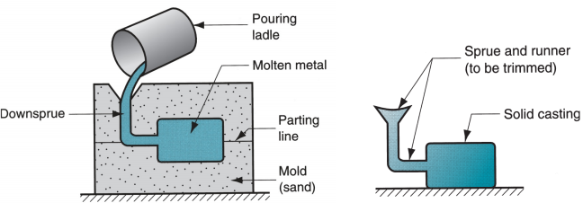
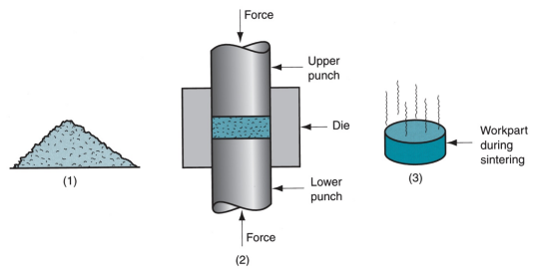
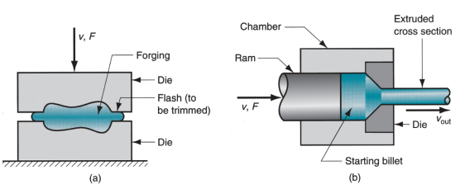
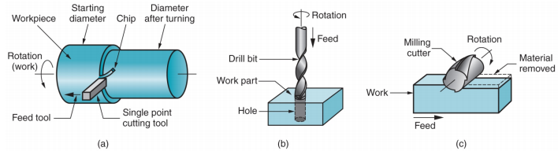
Chapter 1: Manufacturing (Lecture 1) Metals >> usually alloys → >=2 elements, at least 1 is metallic >> Ferrous Metal → based on iron; e.g. steel and cast iron >> Nonferrous Metal → all other metallic elements and their alloys; e.g. Aluminum, copper, nickel, silver, tin Polymers >> Compound formed of repeating structural units called mers, whose atoms share electrons to form very large molecules; consists of carbon plus >=1 other element e.g. hydrogen, nitrogen, oxygen & chlorine >> Thermoplastic polymers - can be subjected to multiple heating & cooling cycles without altering molecular structure (often softens) >> Thermosetting polymers - molecules chemically transform into a rigid structure during curing (will harden) >> Elastomers - show significant elastic behavior Ceramics >> Compounds containing metallic/semi-metallic & nonmetallic elements. >> Typical nonmetallic elements are oxygen, nitrogen, and carbon >> Crystalline ceramics – includes: Traditional ceramics, such as clay, and modern ceramics, such as alumina >> Glasses – mostly based on silica Composites Nonhomogeneous mixtures of the other 3 basic types rather than a unique category Manufacturing Processes >> Shaping operations - operations that change the geometry of the starting material >> Assembly operations - join >= 2 components to create a new entity | Shaping Processes >> Solidification processes - starting material is a heated liquid or semifluid >> Particulate processing - starting material consists of powders >> Deformation processes - starting material is a ductile solid (commonly metal) >> Material removal processes - starting material is a ductile or brittle solid Solidification Processes >> Starting material is heated sufficiently to transform it into a liquid/highly plastic state >> Casting process at left and casting product at right Particulate Processing (1) Starting materials are metal or ceramic powders, which are (2) pressed and (3) sintered Deformation Processes >> Starting workpart is shaped by application of forces that exceed the yield strength of the material >> e.g. (a) forging and (b) extrusion Material Removal Processes >> Excess material removed from the starting piece so what remains is the desired geometry >> e.g. (a) turning, (b) drilling, and (c) milling | Waste in Shaping Processes >> desirable to minimize waste >> Material removal processes are wasteful in the unit operations, but molding and particulate processing operations waste little material >> Terminology for min. waste processes: → Net shape processes – little/no waste of starting material & no machining required → Near net shape processes - when minimum machining required Assembly Operations >> >=2 separate parts are joined to form a new entity >> Joining processes – create a permanent joint; e.g Welding, brazing, soldering, adhesive bonding >> Mechanical assembly – fastening by mechanical methods; e.g. Threaded fasteners (screws, bolts & nuts); press fitting, expansion fits. Trends in Manufacturing - Environmentally conscious manufacturing >> Determining the most efficient use of materials & natural resources in production, minimizing the negative consequences on the environment e.g. Green manufacturing, cleaner production, sustainable manufacturing >> basic approaches: Design products that minimize environmental impact & Design processes that are environmentally friendly Trends in Manufacturing – Microfabrication >> Processes that make parts and products whose feature sizes are in the micron range (10-6 m); e.g. Ink-jet printing heads, compact disks, microsensors used in automobiles Trends in Manufacturing – Nanotechnology >> Materials and products whose feature sizes are in the nanometer range (10-9 m) e.g. Coatings for catalytic converters, flat screen TV monitors | Trends in Manufacturing – Additive manufacturing >> processes where the part is built layer-by-layer using the information provided by a CAD model e.g. Rapid prototyping, rapid tooling, direct-digital manufacturing, stereolithography, 3D printing >> Advantages → Free-form fabrication processes: capable of producing any required geometry, provided that the dimensions fit within the envelope of the equipment → Tool-less methods: do not require mould, dies and fixtures | Important Points >> Why does Dimension matter in manufacturing? Ans: dimensional tolerances are to ensure your parts fit together to form a successful final product; account for errors to save cost on no. of procedures to be done >> Precision vs. Accuracy >> Tolerance >> Dimension measuring instruments >> Use of Go/No-Go gages for dimensional inspections >> Use of Sine Bar for angle inspections >> Surface roughness/waviness

Slide 2

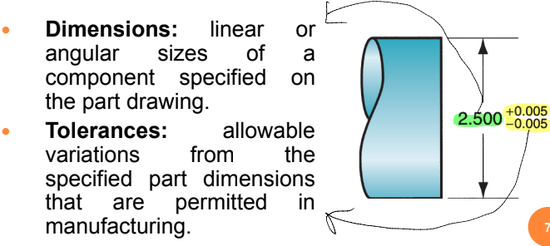
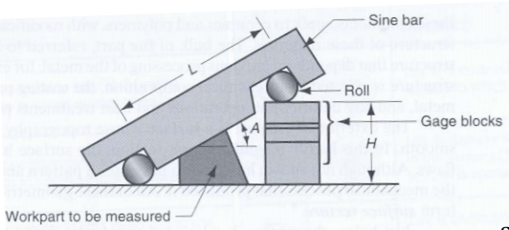
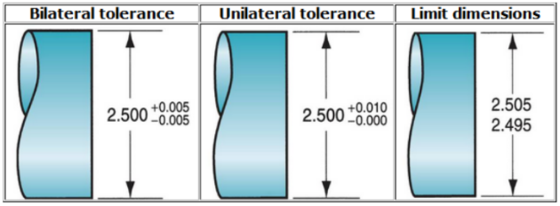
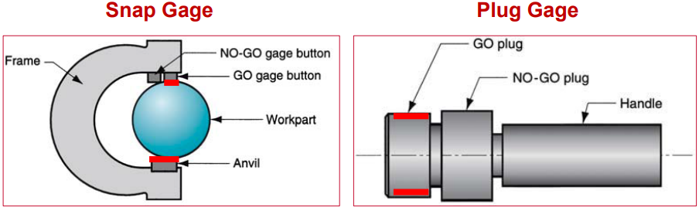
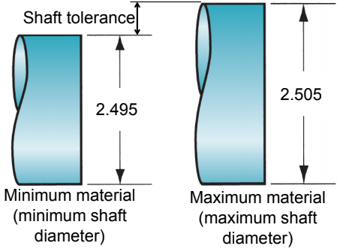
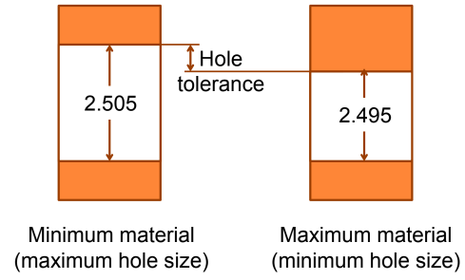
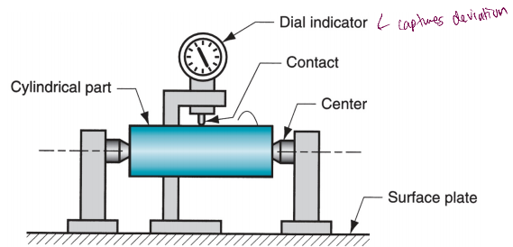
Chapter 1: Dimensional Measurements (Lecture 2) Dimensions and Tolerances >> dimension aka basic/nominal size Bilateral tolerance >> Variation is permitted in both positive & negative directions from nominal dimension >> Possible for a bilateral tolerance to be Unbalanced; e.g. 2.500 +0.010, -0.005 Unilateral tolerance >> Variation from the specified dimension is permitted in only one direction. >> Either positive or negative, but not both; e.g. 2.500 +0.010, -0.000 Limit Dimensions >> Permissible variation in a part feature size consists of the maximum and minimum dimensions allowed Systematic Errors >> positive or negative deviations from the true value that are consistent from one measurement to the other >> no systematic error → “Accurate” e.g. error in methodology of doing experiment, external conditions, improper calculations Random Errors >> due to imprecise reading, set up variations, temperature change, wear, misalignment >> min random errors → “Precise” | Precision VS Accuracy VS Resolution >> Precision = Repeatability (no random errors) >> Accuracy = Close to True Value (no systematic errors) >> Resolution = smallest discrimination that the instrument can show Measurement Instruments and Gages – Precision Gage Blocks >> used for calibration of instruments; not really for measurements Measurement Instruments and Gages – Linear Dimensions >> E.g. ruler, micrometer, vernier caliper Measurement Instruments and Gages – Nongraduated measuring devices >> no scale and are used to compare dimensions or to transfer a dimension for measurement by a graduated device; e.g. outside calipers Measurement Instruments and Gages – Comparative instruments >> Mechanical gages are designed to mechanically magnify the deviation to permit observation >> Dial Indicator: converts and amplifies the linear movement of a contact pointer into rotation of a dial >> Applications: measuring straightness, flatness, parallelism, squareness, roundness, and runout by comparison With a reference surface or circle, etc | Fixed gages: GO/NO-GO gages >> GO limit - used to check dimension at its maximum material condition (inserted) >> NO-GO limit - used to inspect the minimum material condition of the dimension in question (not inserted) >> Snap gage – check outside dimension → if does not go in GO gauge, above maximum dimension → if does not go in NO-GO gauge, below minimum dimension >> Plug gage – for checking internal dimension → GO – check max material condition; if does not go in, too small of a hole → NO-GO - check min material condition; if go in, too big of a hole >> Either snap gage or plug gage, the wear allowance is only applied to the GO gage dimension Example: 32.00 ± 0.16mm diameter hole; wear allowance = 2% of tolerance band (affects only GO!); find nominal size of GO and NO GO gage. Answer: NO GO (biggest hole) = 32.00 + 0.16 = 32.16mm Wear allowance = 0.16 x 2 = 0.32; 0.32 x 2% = 0.0064mm GO (smallest hole): 32.00 – 0.16 – 0.0064 = 31.84.64mm | Angular Measurements >> Sine bar H = dependent on no. of gauge blocks L = standard dimension of sine bar >> Bevel protractor with vernier scale Electronic gages >> Family of measuring & gaging instruments based on transducers capable of converting a linear displacement into an electrical signal >> Electrical signal is amplified and transformed into suitable data format such as a digital readout >> Applications of electronic gages have grown rapidly in recent years, driven by advances in microprocessor technology, and are gradually replacing many of the conventional devices Other Considerations >> Flat stable surface required to improve measurement results → Metrology lab – granite table >> Non-contact metrology → laser, etc

Slide 3
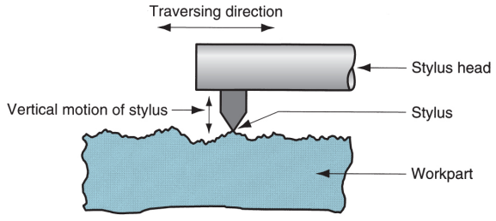
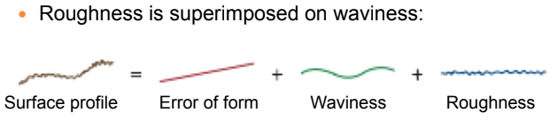
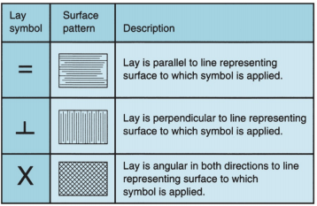
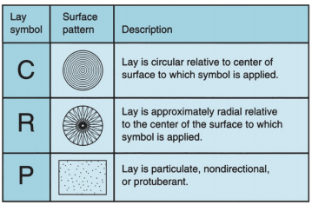
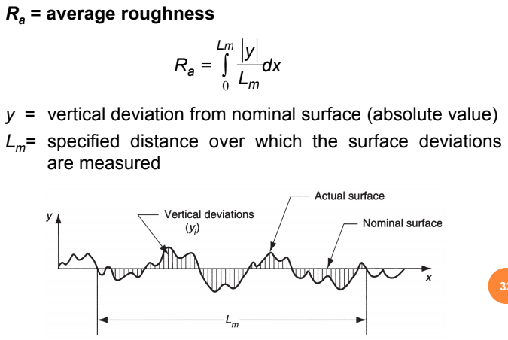
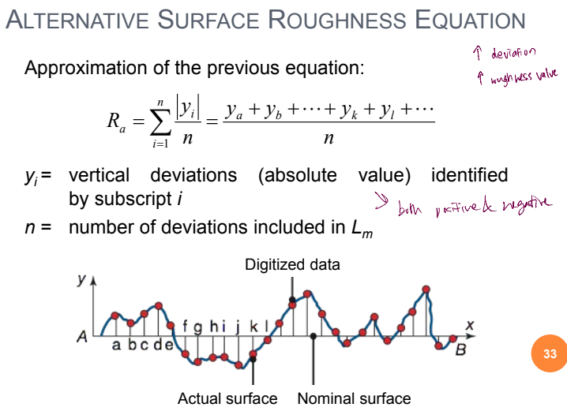
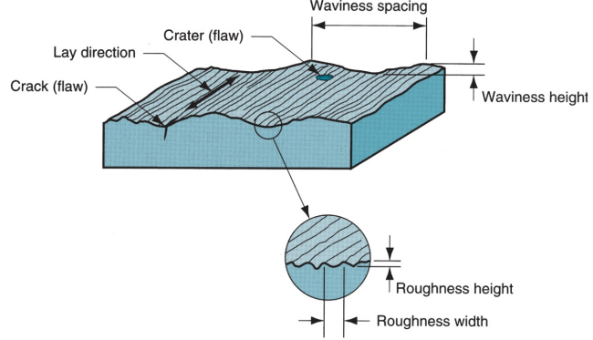
Chapter 1: Surface Measurements (Lecture 3) Surfaces & Manufacturing Processes >> processing cost increases with improvement in surface finish → additional operations & more time are usually required to obtain increasingly better surfaces Characteristics of Surfaces >> Nominal surface – designer’s intended surface contour of part, defined by lines in the engineering drawing >> Nominal surfaces appear as absolutely straight lines, ideal circles, round holes, and other edges & surfaces that are geometrically perfect. >> Actual surfaces of a part are determined by the manufacturing processes used to make them >> Variety of processes result in wide variations in surface characteristics Importance of Surfaces >> Aesthetic reasons >> Surfaces affect safety >> Friction and wear depend on surface characteristics >> Affect mechanical & physical properties >> Assembly of parts affected (proper seal) >> Smooth surfaces make better electrical contacts Measurement of Surfaces >> Surface texture - geometry of surface, commonly measured as surface roughness >> Surface integrity - deals with material characteristics immediately beneath the surface and the changes to this subsurface that resulted from processes that created it Surface Texture >> topography and geometric features of the surface >> when highly magnified, the surface not straight and smooth >> It has roughness, waviness, flaws, a pattern and/or direction resulting from the mechanical process that produced it (lay) | Four Elements of Surface Texture >> Roughness - small, finely-spaced deviations from nominal surface; Determined by material characteristics and processes that formed the surface >> Waviness - deviations of much larger spacing; occur due to work deflection, vibration, tooling, and similar factors >> Lay - predominant direction or pattern of the surface texture >> Flaws - irregularities that occur occasionally on surface; e.g. cracks, scratches, inclusions, and similar defects in the surface; although some flaws relate to surface texture, they also affect surface integrity Surface Roughness >> measurable characteristic based on roughness deviations >> 3 methods to measure surface roughness: Subjective comparison with standard test surfaces (e.g. Fingernail test); Stylus electronic instruments (most common); Optical techniques Surface Finish >> more subjective term denoting smoothness & general quality of a surface; In popular usage, surface finish is often used as a synonym for surface roughness | Stylus Traversing Surface >> Stylus head traverses horizontally across surface, while stylus moves vertically to follow surface profile Stylus Instrument >> Similar to fingernail test, but more scientific >> In these electronic devices, a cone-shaped diamond stylus is traversed across test surface at slow speed. >> As the stylus head is traversed horizontally, it also moves vertically to follow the surface deviations. >> vertical movement is converted into an electronic signal that can be displayed as → Profile of the actual surface; Average roughness value >> Note that the profile of stylus path is smoother than the actual surface profile (can’t go into the small peaks, lose a little bit of data) Problems with R_{A} Calculation >> Waviness may get included >> Lay of surface pattern not accounted for. | Cutoff Length >> used as a filter to separate waviness from roughness deviations >> Cutoff length is a sampling distance along surface → A sampling distance shorter than the waviness eliminates waviness deviations and only includes roughness deviations; Typical cutoff length is 0.8 mm and L_{m} is normally set at 5 times the cutoff length Lay Direction >> Surface roughness may vary significantly depending on direction measured >> Stylus should traverse perpendicular to the lay direction (capture all necessary information) Surface Integrity >> Surface texture alone does not completely describe a surface. >> may be metallurgical changes in altered layer beneath surface that can have a significant effect on a material mechanical properties >> Surface integrity is the study and control of this subsurface layer and the changes in it that occur during processing which may influence the performance of the finished part or product Surface Changes caused by Processing >> Surface changes are caused by the application of various forms of energy during processing: → e.g. Mechanical energy is most common form in manufacturing (e.g. in processes such as forging, extrusion, and machining) → Although its primary function is to change geometry of workpart, mechanical energy can also cause residual stresses, work hardening, & cracks in surface layers

