Slide 1


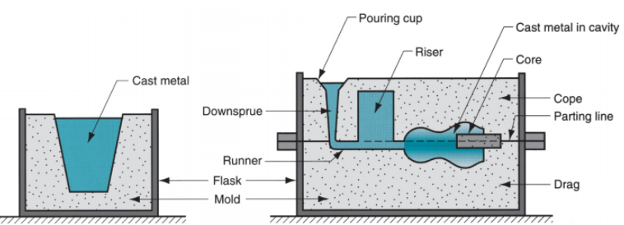



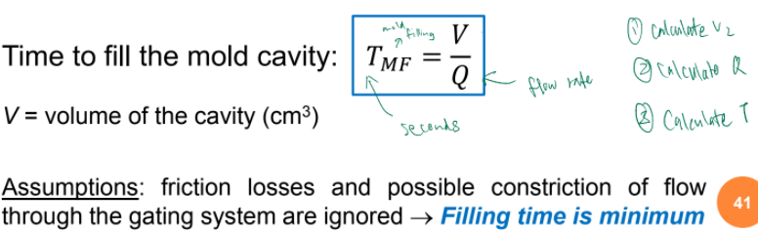
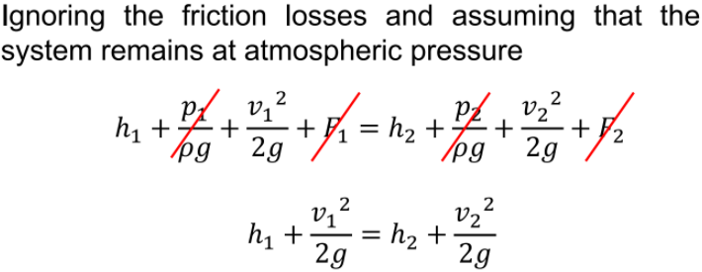
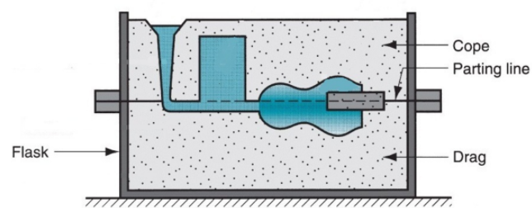
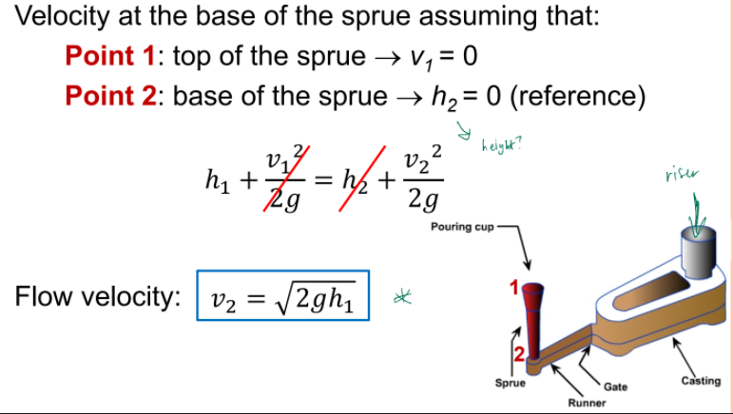
Chapter 2: Fundamentals of Casting [Heating & Pouring] (Lecture 4) Solidification Process >> Starting work material is either a liquid or is in a highly plastic condition, and a part is created through solidification of material Casting of Metals >> Process in which molten metal flows by gravity or other force into a mold where it solidifies in the shape of the mold cavity >> Steps in casting seem simple: melt the metal → Pour it into a mold → Let it freeze Net Shape >> Parts with complex features can be produce without the need for additional operations (e.g. machining) to achieve the required shape and dimensions Near Net Shape >> Parts with complex features can be produce with limited need for additional operations (e.g. machining) to achieve the required shape and dimensions Pros of Casting >> create complex part geometries >> create both external and internal shapes >> Some casting processes are net shape; others are near net shape >> produce very large parts. >> Some casting methods are suited to mass production Cons of Casting >> Limitations on mechanical properties >> Poor dimensional accuracy and surface finish for some processes; e.g. sand casting >> Safety hazards to workers due to hot molten metals >> Environmental problems Parts made by Casting >> big parts – e.g. church bells, big statues → sand casting – only small amt of parts being made so can afford to have a mold that is only used once >> small parts – e.g. jewelry, frying pan → usually NOT sand casting | Mold in Casting >> Contains cavity whose geometry determines part shape: Actual size & shape of cavity must be slightly enlarged to allow for shrinkage of metal during solidification and cooling >> Molds are made of a variety of materials, including sand, plaster, ceramic, and metal → metallic material you are casting should have a melting point that is lower than the die/mold itself or mold will melt Open and Closed Molds Expendable Mold Processes >> use an expendable mold which must be destroyed to remove casting → Mold materials: sand, plaster, and similar materials, plus binders >> Pros: More intricate geometries possible >> Cons: Can only use once Permanent Mold Processes >> use a permanent mold which can be used to produce many castings → Made of metal (or, less commonly, a ceramic refractory material) >> Pros: suitable for mass production Sand Casting Mold >> Mold consists of two halves: Cope = upper half of mold; Drag = bottom half >> Mold halves are contained in a box, called a flask. >> The two halves separate at parting line Forming the Mold Cavity in Sand Casting >> Mold cavity formed by packing sand around a pattern; has shape of part. >> When the pattern is removed, the remaining cavity of the packed sand has the desired shape of the cast part >> The pattern is usually oversized to allow for shrinkage of metal during solidification and cooling. >> Sand for the mold is moist and contains a binder to maintain its shape. | Use of a Core in the Mold Cavity >> The mold cavity provides the external surfaces of the cast part >> In addition, a casting may have internal surfaces, determined by a core, placed inside the mold cavity to define the interior geometry of part, e.g. a hole >> In sand casting, cores are generally made of sand Gating System >> Channel through which molten metal flows into cavity from outside of mold: → Consists of a downsprue, through which metal enters runner leading to main cavity → At the top of downsprue, a pouring cup is often used to minimize splash and turbulence as the metal flows into downsprue Riser >> a reservoir in the mold which is a source of liquid metal to compensate for shrinkage of the part during solidification → The riser must be designed to freeze after the main casting Gate >> denotes the entrance of the mold cavity Pattern VS Core in Sand Casting Pattern: determines shape of cast part >> Core: determines the internal geometry if the casting includes a cavity; create holes Steps in Casting (1) Melt the metal (2) Pour it into a mold by gravity or force. The mold cavity dictates the shape of the cast part. (3) Let it freeze (solidify) into the mold; The cast part takes the shape of the mold cavity Heating the Metal >> Heating furnaces are used >> The heat required is the sum of: Heat to raise temperature to melting point; Heat of fusion to convert from solid to liquid; Heat to raise molten metal to desired tempe. for pouring (melting pt =/= temp for pouring) | Pouring the Molten Metal >> metal must flow into all regions of the mold, most importantly the main cavity, before solidifying >> Factors that determine success: (1) Pouring temperature. (2) Pouring rate: volumetric rate at which molten metal is poured into mold (cm3/s) → Too slow: metal will freeze before filling the cavity. → Too fast: causes turbulence, the metal flow is irregular rather than smooth and streamlined as in laminar flow. (3) Turbulence: metal oxides may be entrapped during solidification & degrade the casting quality; also aggravates mold erosion Bernoulli’s’ Theorem “Sum of energies (head, pressure, kinetic and friction) at any two points in a flowing liquid are equal.” h = head (cm) p = pressure on the liquid (N/cm2) ρ = density (g/cm3) v = flow velocity (cm/s) g = gravitational acceleration constant = 981 cm/s2 F = head losses due to friction (cm) | Continuity Law “The volume rate of flow is constant throughout the liquid.” Q = volumetric flow rate (cm3/s) A = cross-sectional area (cm2) v = flow velocity (cm/s) >> Flow velocity increases towards the base of the sprue. To maintain the continuity law, the cross sectional area decreases → tapered sprue (prevents aspiration) Mold Cavity Filling Time >> Assuming that the runner from the sprue base to the mold cavity is horizontal (and therefore the head h is the same as at the sprue base) >> The volume rate of flow through the gate and into the mold cavity is the same as at the sprue base: Fluidity of Molten Metal >> capability of molten metal to fill the mold cavity (High viscosity = Low fluidity) >> e.g. Spiral mold test: Greater the length of the solidified metal, greater its fluidity Important Points >> Pros & Cons of Casting as compared to other processes >> What kind of product is suitable to for casting? >> Terminologies for parts in a sand casting mold, and their functions >> Factors that determines a successful casting >> Chvorinov’s rule: solidification Time vs. casting Volume and Area >> Shrinkage during: • Liquid Cooling • Solidification • Solid Cooling >> Pattern Shrinkage Allowance >> Common defects in casting • How to avoid the defects >> Common types of casting & their features

Slide 2
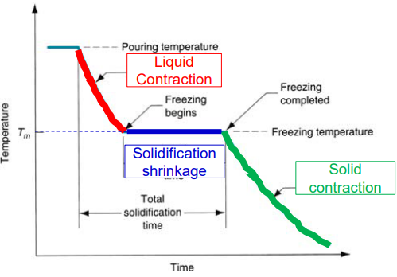
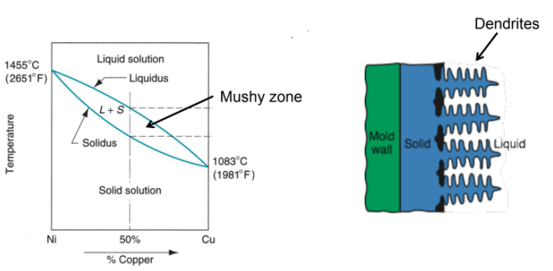
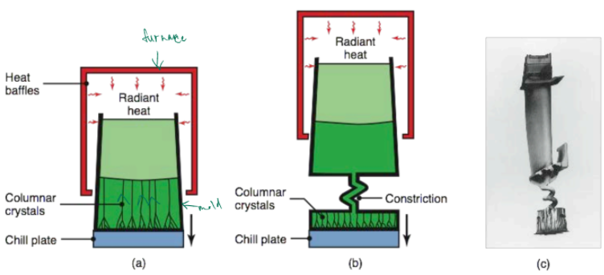
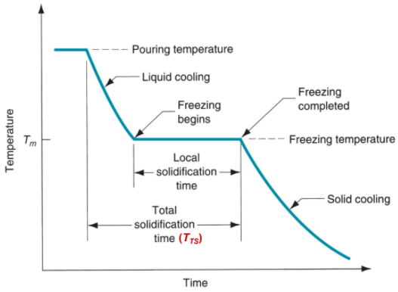
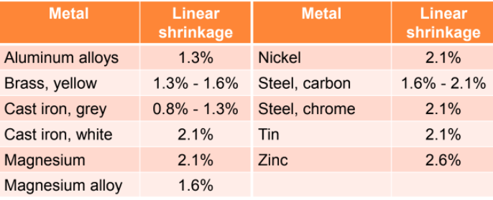
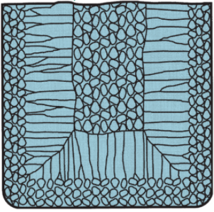
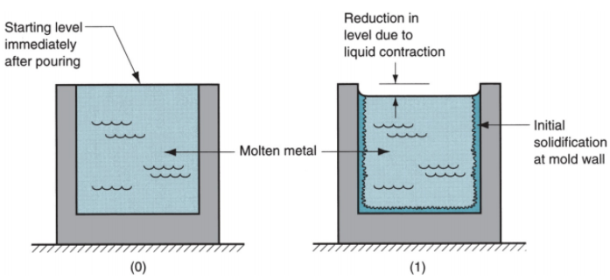
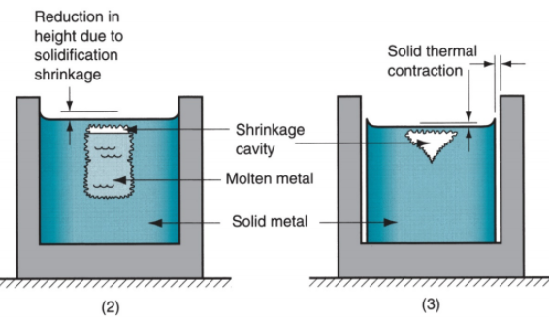

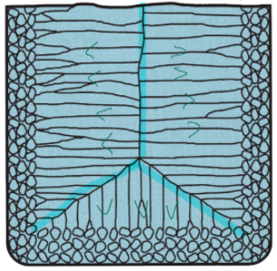
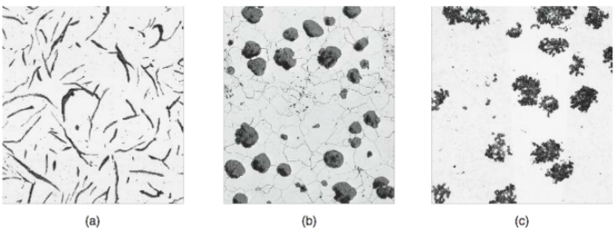
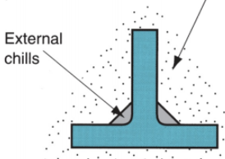
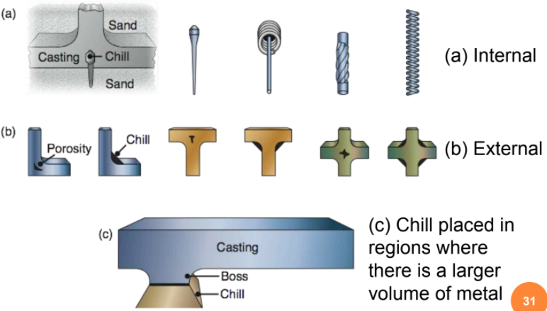
Chapter 2: Fundamentals of Casting [Solidification & Cooling] (Lecture 5) Solidification of Metals >> Transformation of molten metal back into solid state >> Solidification differs depending on whether metal is: a pure element or alloy >> A pure metal solidifies at a constant temperature equal to its freezing point (same as melting point) Solidification of Pure Metals >> Due to the chilling action of the mold wall, a thin skin of solid metal is formed at the interface immediately after pouring >> Skin thickness increases to form a shell around the molten metal as solidification progresses >> Rate of freezing depends on heat transfer into the mold, as well as thermal properties of the metal >> Characteristic grain structure in a casting of a pure metal, showing randomly oriented grains of small size near the mold wall, and large columnar grains oriented toward the center of the casting Solidification of alloys VS pure metals >> pure metals solidify at a single temperature equal to the melting point >> most alloys start to solidify at the liquidus and complete solidification occurs at the solidus, where the liquidus is a higher temperature than the solidus >> Exceptions are eutectic alloys, which solidify at a single temperature equal to the eutectic temperature | Solidification of Alloys >> Most alloys freeze over temperature range >> Formation of dendrites (tree like structure) in the mushy zone (L + S) >> Characteristic grain structure in an alloy casting, showing segregation of alloying components in the center of the casting Solidification Time: Chvorinov’s Rule T_{TS} = total solidification time V = volume of casting A = Surface area of casting n = exponent (usually ‘2’) C_{m} = mold constant >> ↑ volume, ↑ time of solidification >> ↑ area, ↓ time of solidification (low volume to surface ratio) Mold Constant in Chvorinov’s Rule >> Depends on: → Mold material; Thermal properties of casting metal; Pouring temperature relative to melting point >> The value of Cm for a given casting operation can be based on experimental data from previous operations carried out using the same mold material, metal, and pouring temperature, even though the shape of the part may be quite different What Chvorinov’s Rule Tells Us >> Casting with a higher volume-to-surface area ratio cools and solidifies more slowly than one with a lower ratio: To feed molten metal to the main cavity, T_{TS} for the riser > T_{TS} for the main casting >> Since the mold constants of the riser and casting will be equal, we need to design the riser to have a larger volume-to-area ratio so that the main casting solidifies First – minimizes effects of shrinkage as riser can play its role and supply molten metal to the cavity | Shrinkage during Solidification and Cooling >> Volume contraction will occur during the Different phases of cooling and solidification (0) Starting level of molten metal immediately after pouring (1) Reduction in level caused by liquid contraction during cooling (2) Reduction in height and formation of shrinkage cavity caused by solidification (3) Further reduction in volume due to thermal contraction during cooling of solid metal Solidification Shrinkage >> Occurs in nearly all metals because solid phase has higher density than liquid phase >> Thus, solidification causes a reduction in volume per unit weight of metal >> Exception: cast iron with high C content: Graphitization (creation of graphite) during final stages of freezing causes expansion that counteracts volumetric decrease associated with phase change Microstructure for Cast Iron a) Ferritic gray iron with graphite flakes; (b) ferritic nodular iron, (ductile iron) with graphite in nodular form; and (c) Ferritic malleable iron. This cast iron solidified as white cast iron, with the carbon present as cementite (Fe3C), and was heat treated to graphitize the carbon | Shrinkage Allowance >> Pattern makers correct for solidification shrinkage & thermal contraction by making the mold cavity oversized >> The amount by which the mold is made larger relative to final casting size is called pattern shrinkage allowance >> Casting dimensions are expressed linearly, so allowances are applied accordingly Directional Solidification >> To minimize the effects of shrinkage, it is desirable for regions of the casting most distant from the liquid metal supply to freeze first and for solidification to progress from these regions toward the riser(s) >> Thus, molten metal is continually available from the risers to prevent shrinkage voids. >> The term directional solidification describes this aspect of freezing and methods by which it is controlled Achieving Directional Solidification >> using Chvorinov's rule to design the casting, its orientation in the mold, and the riser system that feeds it >> Locate sections of casting with lower V/A ratios away from riser, so freezing occurs first in these regions, and liquid metal supply for the rest of casting remains open (no blockage of passage way) >> Chills - internal or external heat sinks that cause rapid freezing in certain regions of the casting External Chills >> External chills to encourage rapid freezing of the molten metal in a thin section of the casting | Example: Turbine Blade Casting Methods of casting turbine blades: (a) directional solidification; (b) method to produce a single-crystal blade; and (c) a single-crystal blade with the constriction portion still attached Riser Design >> A riser is waste metal that is separated from the casting and remelted to make more castings >> To minimize waste in the unit operation, it is desirable for the volume of metal in the riser to be as minimum as possible >> The shape of the riser is normally designed to maximize the V/A ratio, this allows the riser volume to be reduced to the minimum possible value Questions Qns: How can we make use of Chrinov’s law to design a suitable riser for a casting process? Ans: riser should have a high volume to surface ratio to allow larger total solidification time for molten metal in the riser

Slide 3
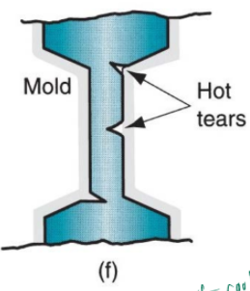
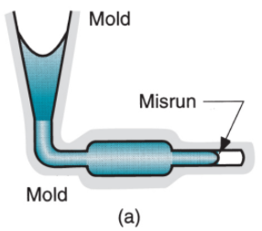
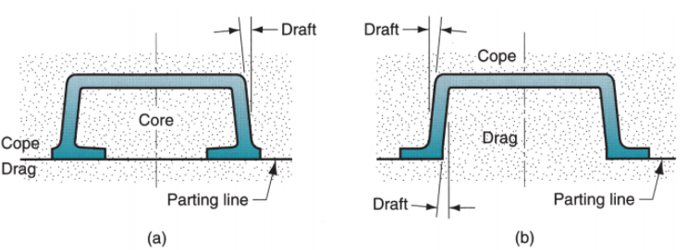
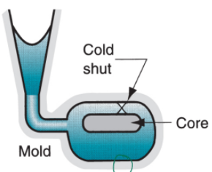
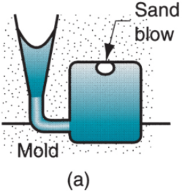
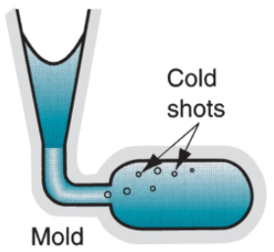
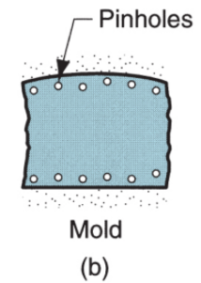
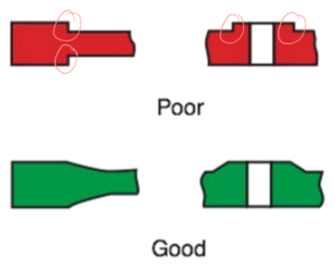
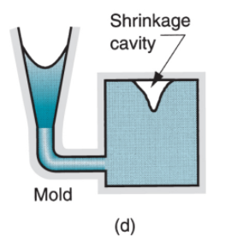
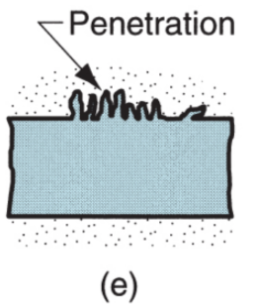
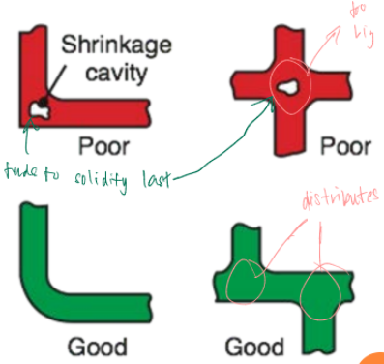
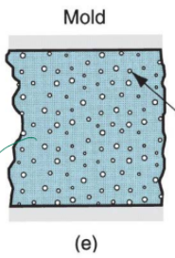
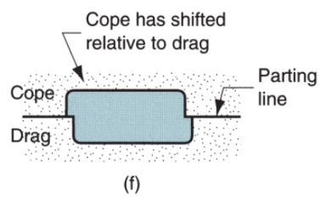
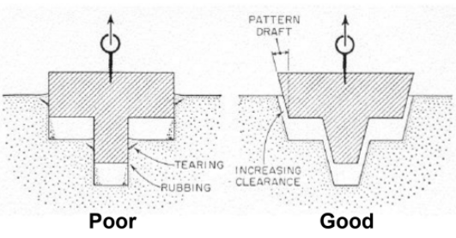
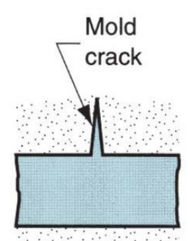
Chapter 2: Metal Casting Processes [Defects and Product Design] (Lecture 6) General Defects: Misrun >>A casting that has solidified before completely filling the mold cavity → e.g. problem with pouring temp; velocity of pour; improper design of mold General Defects: Cold Shut >> Two portions of metal flow together but there is a lack of fusion due to premature freezing → e.g. position of gate not good; temp too low; pouring too slow General Defects: Cold Shot >> Metal splatters during pouring lading to the formation of solid globules which become entrapped in the casting → e.g. Turbulence General Defects: Shrinkage Cavity >> Depression in the surface or internal void caused by solidification shrinkage that restricts the amount of molten metal available in last region to freeze → how to avoid: design a good riser & die General Defects: Shrinkage Cavity >> Small voids distributed throughout the casting caused by localized solidification shrinkage of the final molten metal within the dendritic structure → how to avoid: use squeeze casting to compress material; die casting which distribute metal inside die | General Defects: Hot Tears >> The casting is restrained from contraction because of the mold during final stages of solidification or early stages of cooling after Solidification → high stress concentration; how to avoid: have a collapsible mold; remove part early (just after solidification) – last portion of cooling done outside of mold Sand Casting Defects: Sand Blow >> Balloon-shaped gas cavity caused by release of mold gases during pouring → caused by gases released by surrounding sand Sand Casting Defects: Pin Holes >> Formation of many small gas cavities at or slightly below the surface of the casting → caused by gases released by surrounding sand Sand Casting Defects: Penetration >> When the fluidity of the liquid metal is high, it may penetrate into the sand mold or core, causing the casting surface to consist of a mixture of sand grains and metal → almost can be due to nature of sand mold Sand Casting Defects: Mold Shift >> A step in the cast product at the parting line caused by sidewise relative displacement of cope and drag Sand Casting Defects: Mold Crack >> Occurs when a crack develops in the mold, into which liquid metal can seep to form a “fin” on the final casting | Foundry’s Inspection Methods >> Visual inspection to detect obvious defects such as misruns, cold shuts, and severe surface flaws >> Dimensional measurements to insure that tolerances have been met >> Metallurgical, chemical, physical, and other tests concerned with the quality of the cast metal Product Design Considerations >> Geometric Simplicity - although casting can be used to produce complex part geometries, simplifying the part design usually improves castability >> Avoiding unnecessary complexities - Simplifies mold-making; Reduces the need for cores; Improves the strength of the casting; decrease defects Corners on the Casting >> Sharp corners and angles should be avoided, since they are sources of stress concentrations and may cause hot Tearing and cracks >> Generous fillets should be designed on inside corners & sharp edges should be Blended Section Thickness >> Should be uniform to avoid shrinkage cavities. Thicker section creates hot spots in the casting which take longer to solidify and are likely locations for shrinkage cavities. → ‘use chill’ Draft angle (taper) >> In expendable mold casting: draft facilitates removal of the pattern from mold >> In permanent mold casting: purpose is to aid in removal of the part from the mold | No Core Design change to eliminate need for using a core: (a) original design, and (b) redesign Dimensional tolerances and surface finish >> Dimensional accuracy and finish vary significantly, depending on the process >> Sand casting: poor dimensional accuracies and finish >> Die casting and investment casting: good dimensional accuracies and finish Machining Allowances >> Almost all sand castings must be machined to achieve the required dimensions and part features (has bad surface finish) >> Additional material, called the machining allowance, is left on the casting in those surfaces where machining is necessary (mainly for sand casting, cause can’t achieve very good dimensional accuracy) >> Typical machining allowances for sand castings are around 1.5 and 3 mm (part after shrinkage, will be 1.5 or 3.omm bigger than required, then machining to achieve final dimensions)

Slide 4
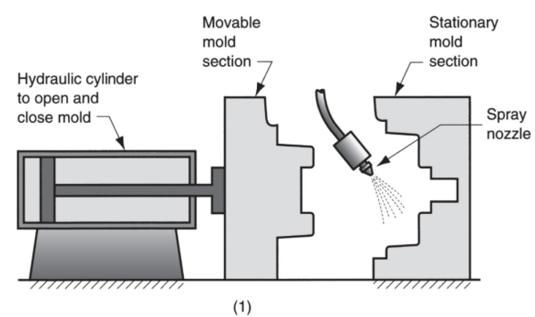
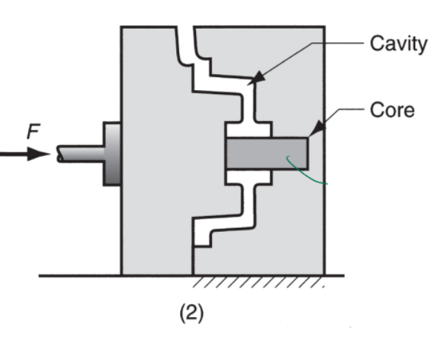
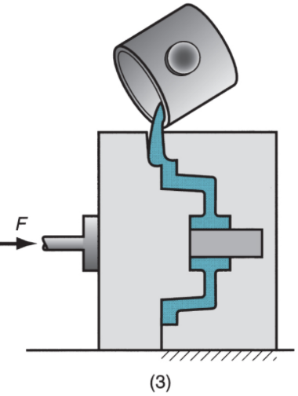
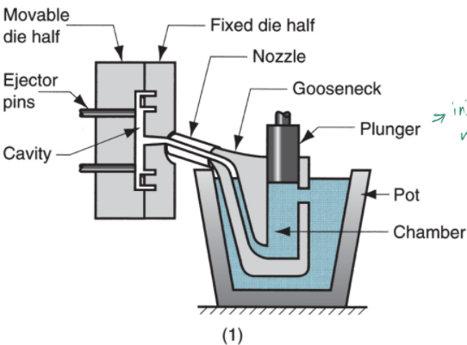
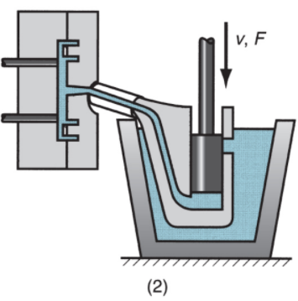
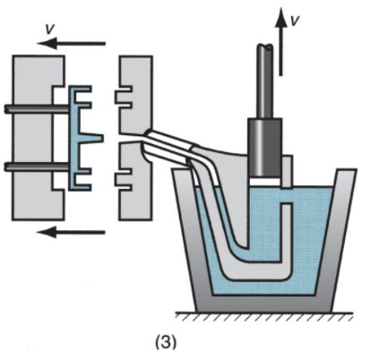
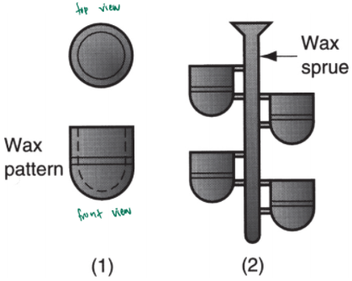
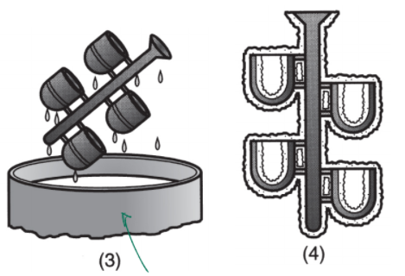
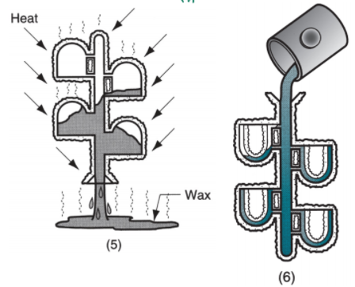
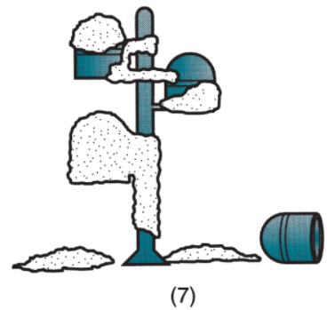
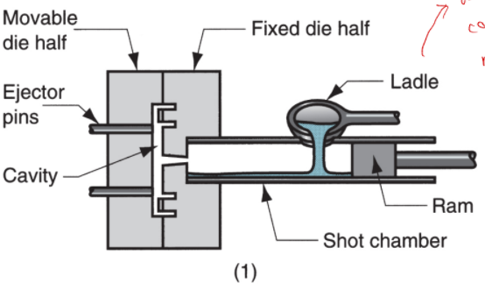
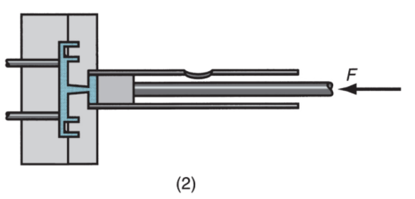
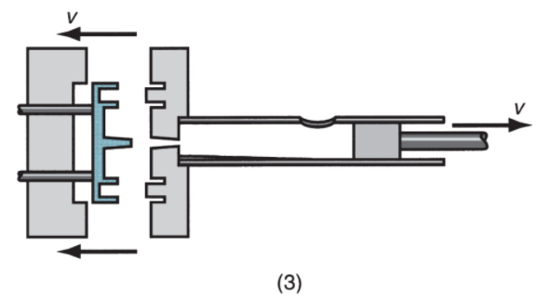
Chapter 2: Metal Casting Processes [Processes description] (Lecture 7) Categories of Casting Processes >> Expendable mold processes – use an expendable mold which must be destroyed to remove casting → Mold materials: sand, plaster, and similar materials, plus binders >> Permanent mold processes – use a permanent mold which can be used to produce many castings → Made of metal (or, less commonly, a ceramic refractory material) Expandable Mold Casting Processes >> Sand Casting → Most widely used casting process → Nearly all alloys can be sand cast (including high melting temperature alloys such as steel, nickel and titanium) → Size range from small to very large → Production quantities: one to millions >> Investment Casting >> Others: shell molding, vacuum molding, plaster mold and ceramic mold, expanded polystyrene process >> Cons: new mold required for every casting Investment Casting (Lost Wax Process) >> A pattern made of wax is coated with a refractory material to make the mold, after which wax is melted away prior to pouring molten metal >> "Investment" comes from a less familiar definition of "invest" - "to cover completely," which refers to coating of refractory material around wax pattern >> a precision casting process - Capable of producing castings of high accuracy and intricate details Steps In Investment Casting | (1) Wax patterns are produced → Create a master mold → wax pattern should include shrinkage allowance (2) Several patterns are attached to a sprue to form a pattern tree (3) The pattern tree is coated with a thin layer of refractory material (Slurry, compotes of silicon, etc) (4) the full mold is formed by covering the coated tree with sufficient refractory material to make it rigid (5) The mold is held in an inverted position and heated to melt the wax and permit it to drip out of the cavity (6) The mold is preheated to a high temperature, the molten metal is poured, and it solidifies (7) The mold is broken away from the finished casting and the parts are separated from the sprue Investment Casting: Pros and Cons >> Pros: Parts of great complexity and intricacy can be cast; Close dimensional control and good surface finish; Wax can usually be recovered for reuse; a net shape process - Additional machining is not normally required >> Cons: Many processing steps; Expensive Permanent Molding Casting Processes >> Pros: mold is reused many times >> e.g. Basic permanent mold casting, Die casting, Squeeze casting, Centrifugal Casting The Basic Permanent Mold Process >> Uses a metal mold constructed of two sections designed for easy, precise opening and closing >> Molds used for casting lower melting point alloys are commonly made of steel or cast iron >> Molds used for casting steel must be made of refractory material, due to the very high pouring temperatures | Steps in Permanent Mold Casting (1) The mold is preheated and coated for lubrication and heat dissipation (2) Cores (if any are used) are inserted and mold is closed (3) Molten metal is poured into the mold, where it solidifies Permanent Molding Casting: Pros & Cons >> Pros: Good dimensional control and surface finish; Rapid solidification caused by the metal mold results in a finer grain structure, so castings are stronger >> Cons: Generally limited to metals of lower melting point; Simpler part geometries compared to sand casting because of the need to open the mold; High cost of the mold Applications and Metals for Permanent Molding Casting >> best suited for high volume production and can be automated accordingly >> Typical parts: automotive pistons, pump bodies, and certain castings for aircraft and missiles >> Metals commonly cast: aluminum, magnesium, copper-base alloys, and cast iron; Unsuited to steels because of the very high pouring temperatures required Die Casting >> permanent mold casting process in which molten metal is injected into mold cavity under high pressure >> pressure maintained during solidification, then mold is opened & part is removed >> Molds in this casting operation – ‘dies’ >> Use of high pressure to force molten metal into the die cavity is what distinguishes this process from other permanent mold processes Die Casting Machines >> Designed to hold and accurately close two mold halves and keep them closed while liquid metal is forced into cavity >> Two main types: 1. Hot-chamber machine 2. Cold-chamber machine * Difference: How material poured into die | Hot Chamber Die Casting >> Metal is melted in a container, and a piston injects liquid metal under high pressure into the die >> High production rates - 500 parts per hour not uncommon >> Applications limited to low melting-point metals that do not chemically attack the plunger and other mechanical components >> Casting metals: zinc, tin, lead, and magnesium (1) With die closed and plunger withdrawn, molten metal flows into chamber (2) The plunger forces the metal in the chamber to flow into the die, maintaining pressure during cooling and solidification (3) The plunger is withdrawn, the die is opened, and the casting is ejected Cold Chamber Die Casting >> Molten metal is poured into a unheated chamber from an external melting container, and a piston injects metal under high pressure into the die cavity >> High production rate but not usually as fast as hot-chamber machines because of the pouring step. >> Casting metals: aluminum, brass, and magnesium alloys (more effective due to high temp requirement) >> Can also be used on low melting-point alloys (zinc, tin, lead) although the hot-chamber process would be more advantageous for those alloys (higher speed, more parts) (1) With the die closed and ram withdrawn, molten metal is poured into the chamber (2) The ram forces metal to flow into die, maintaining pressure during cooling & solidification (3) The ram is withdrawn, the die is opened, and the part is ejected | Molds for Die Casting >> Usually made of steel >> Tungsten and molybdenum (good refractory qualities) used to die cast steel and cast iron >> Ejector pins required to remove the part from the die when it opens >> Lubricants must be sprayed onto the cavity surfaces to prevent sticking (better heat transfer between metal and die) Die Casting: Pros & Cons >> Pros: Economical for large production quantities; Good accuracy and surface finish; Thin sections possible; Rapid cooling means small grain size and good strength of the cast product >> Cons: Generally limited to metals with low melting points; The part geometry must allow removal from the die Question Qns: The slurry for the first dip in investment casting should have fine ceramic particles. Why? Ans: Ensure a smooth surface finish on the part; subsequent dips can be made in a courser slurry to bulk up on the investment Qns: Why risers aren’t used in dies for die casting? Ans: Because of the high injection pressures in die casting, there is no need for risers to provide back pressure on the cavity to compensate for shrinkage Qns: Mold Cores for holes or internal features in the part can be fixed or retractable. When must it be retractabkle? Ans: When the axis of the hole is not parallel to the motion of the opening and closing of the die

