Slide 1
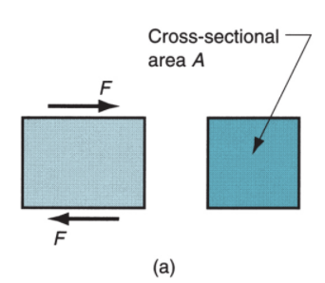

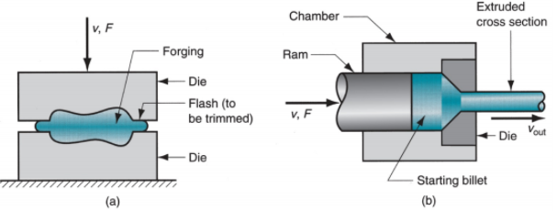
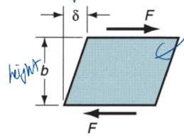

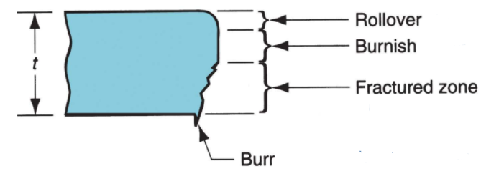

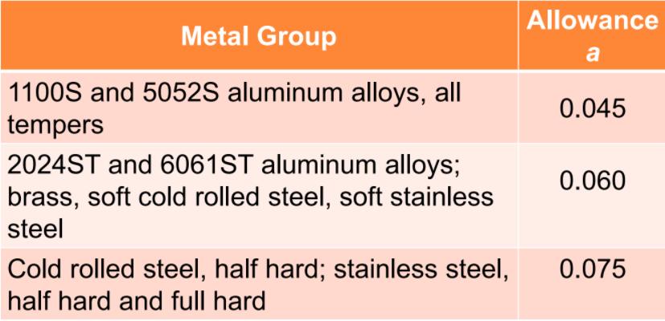
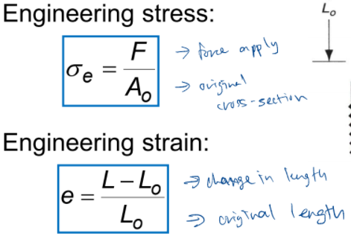
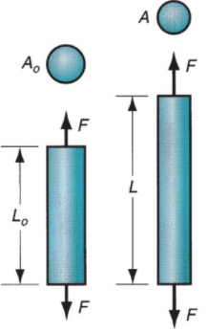
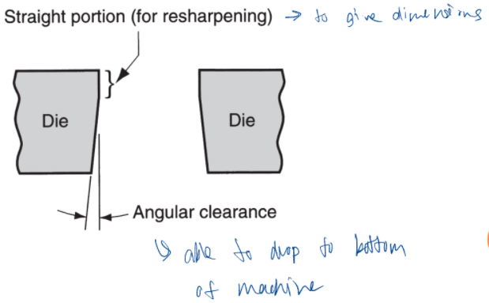
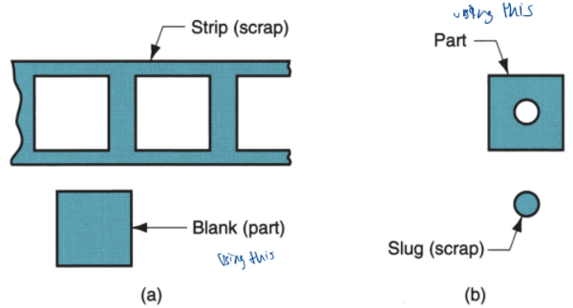
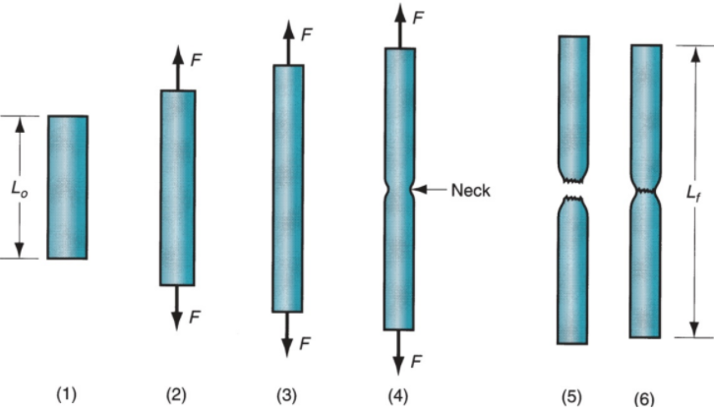
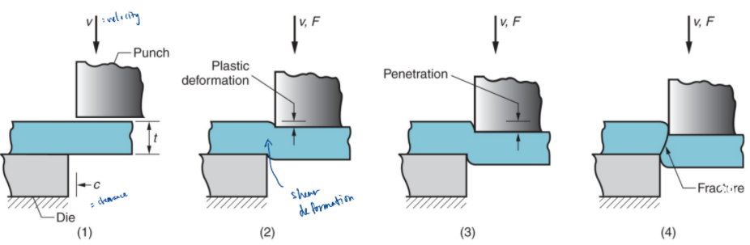
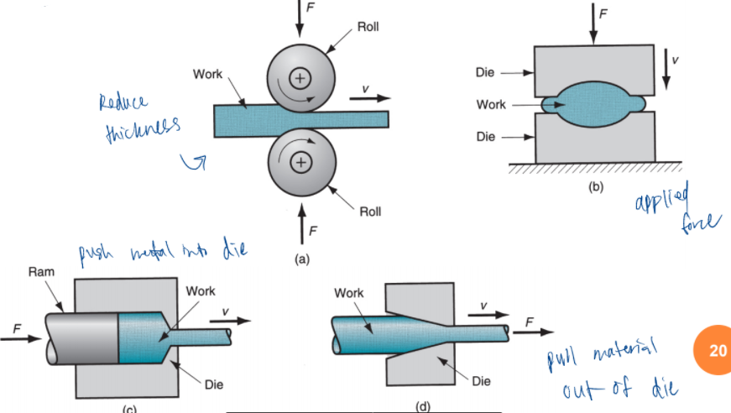
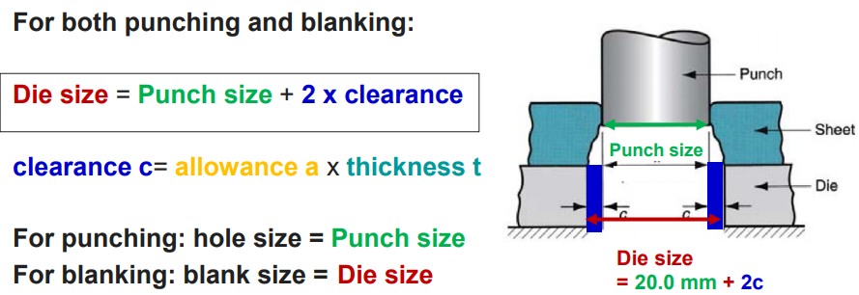
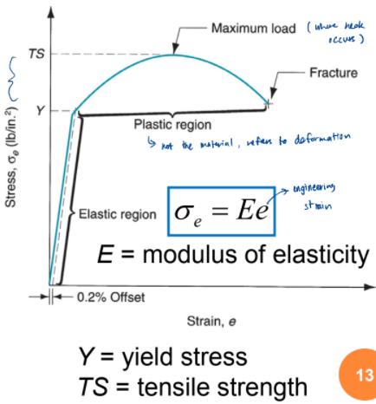
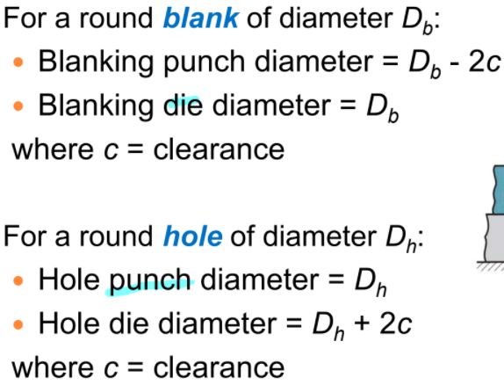
Chapter 3: Sheet Metalworking [Shearing, Blanking & Punching] (Lecture 8) Deformation Processes >> Starting workpart is shaped by application of forces that exceed the yield stress of the material >> Examples: (a) forging and (b) extrusion Stress-Strain Relationships >> Types of Static Stresses: 1. Tensile – stretching (pull) the material 2. Shear - causing adjacent portions of the material to slide against each other (apply forces in opposite direction) 3. Compressive – squeezing the material Tensile Test Tensile Test Sequence >> (1) No load; (2) uniform elongation; (3) Maximum load; (4) necking; (5) fracture; (6) putting pieces back together to measure final length Typical Engineering Stress-Strain Plot >> Two regions: → Elastic region: Material returns to its original length when the stress is removed. → Plastic region: Permanent deformation, material does not return to its original length when the stress is removed. | Strain/Work Hardening >> What is happening between Y and TS on the curve >> defined as metal becoming stronger as strain increases Shear Stress >> F = applied force; A = area where force is applied Shear Strain >> δ = deflection of the element; b = distance over which deflection occurs Shear Stress >> Shear stress at fracture = shear strength S >> Shear strength can be estimated from tensile strength: S ≅ 0.7(TS) (use when only tensile strength is given) Basic Types of Metal Forming Processes >> Bulk deformation – start with a block of material and apply compression force or some tension force → Compression forces: Rolling, Forging, Extrusion → Tension force: Wire and bar drawing >> Sheet metalworking → Bending operations, deep or cup drawing, shearing processes Bulk Deformation Processes >> (a) Rolling, (b) forging, (c) extrusion and (d) wire and bar drawing | Sheet Metalworking >> Cutting and forming operations performed on relatively thin sheets of metal >> Thickness of sheet metal = 0.4 mm to 6 mm (if thickness > 6 mm → plate) >> Operations usually performed as cold working i.e. operating temperature below 30% of melting point of the metal (Kelvin) >> Most commonly used metals: low carbon steel (0.06 to 0.15% carbon), aluminum and titanium Advantages of Sheet Metal Parts >> High strength; Good dimensional accuracy; Good surface finish; Relatively low cost; Economical mass production for large quantities Sheet Metalworking Terminology >> Punch-and-die = tooling to perform cutting, bending, and drawing >> Stamping press = machine tool that performs most sheet metal operations >> Stampings = sheet metal products Shearing >> Cutting material without producing chips (unlike machining) Sheet Metal Cutting (1) Just before the punch contacts the workpiece; (2) the punch pushes into the workpiece, causing plastic deformation; (3) the punch penetrates into the workpiece causing a smooth cut surface; and (4) fracture is initiated at opposing cutting edges to separate the sheet | Characteristics of Shear Edges Rollover - Depression made by the punch prior to cutting Burnish - Smooth region resulting from penetration of the punch prior to fracture Fracture zone - Relatively rough surface caused by the fracture of the metal as the punch goes down Burr - Sharp corner edge caused by the elongation of the metal during the final stage of separation Shearing, Blanking and Punching >> Shearing to separate large sheets >> Blanking to cut part perimeters out of sheet metal >> Punching to make holes in sheet metal * ALL are shearing processes, all cutting metal by shear stress if material Blanking and Punching >> Blanking (a) - sheet metal cutting to separate a piece of metal (called a blank) from the surrounding sheet >> Punching (b) - similar to blanking except that the cut piece is scrap, called a slug Punch and Die Sizes | Clearance >> Distance between punch cutting edge and die cutting edge >> Typical values range between 4% and 8% of sheet thickness: → Clearance too small: cause non-optimal fracture and too large forces → Clearance too big: causes oversized burr Clearance in Sheet Metal Cutting >> c = clearance; a = allowance; and t = sheet thickness >> Allowance a is determined according to the type of metal (softer metal, deforms more, smaller allowance) Angular Clearance >> Purpose: allows slug or blank to drop through the die >> Typical values: 0.25° to 1.5° on each side Important Points >> SHEARING, BLANKING, & PUNCHING → Determine the die and punch sizes; Clearance; Force of operation required >> BENDING → Determine the starting blank length; Meaning of Bend allowance, k factor, neutral axis; Bending force required for certain operation >> DEEP DRAWING → Determine starting blank size; Whether the operating is feasible; Reasons for defects

Slide 2
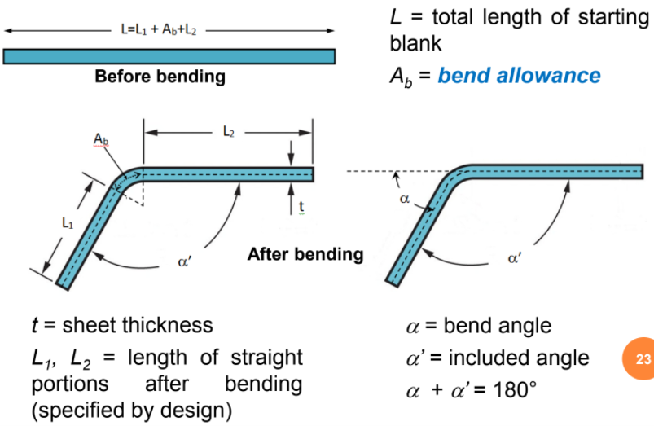
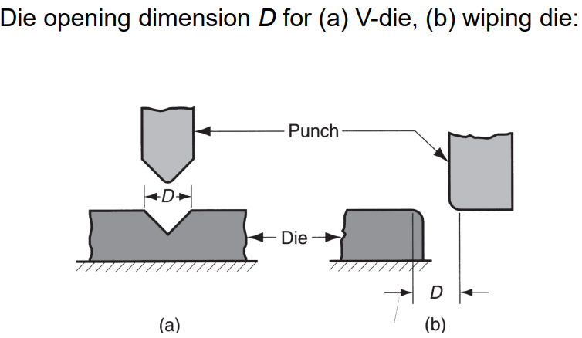
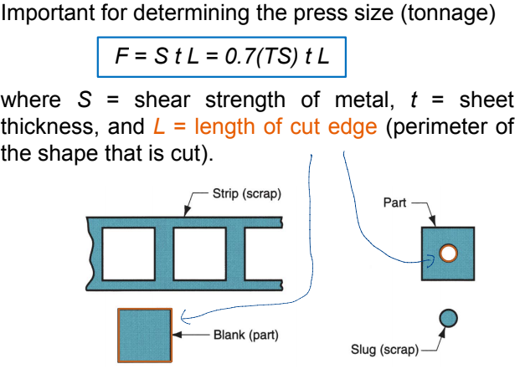
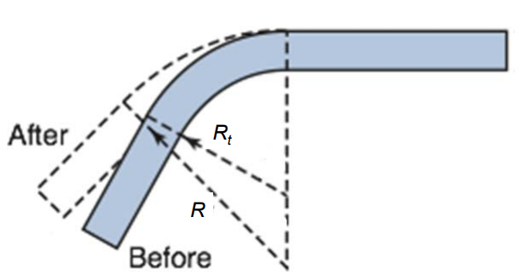
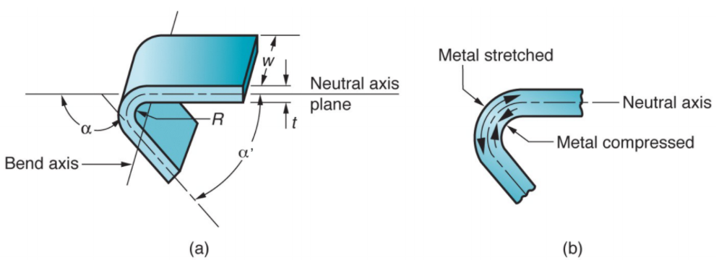
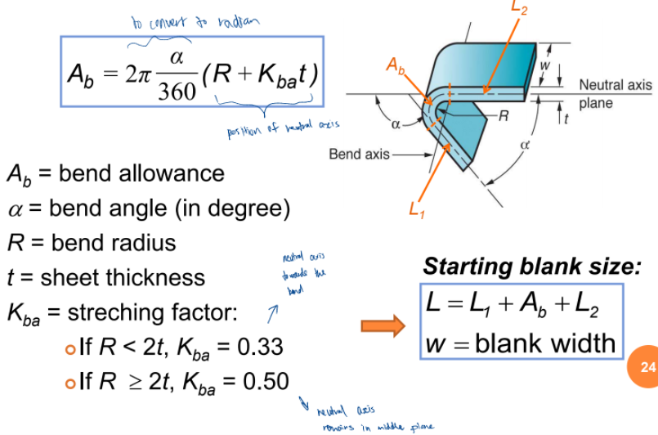
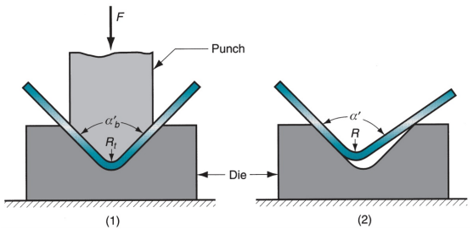
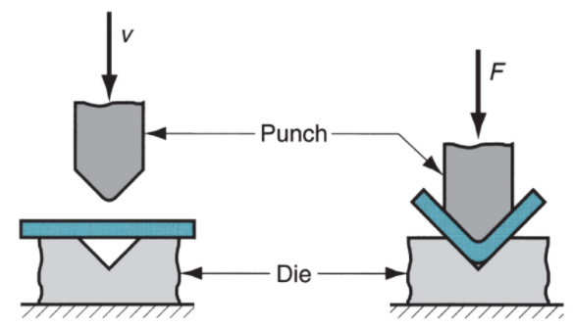
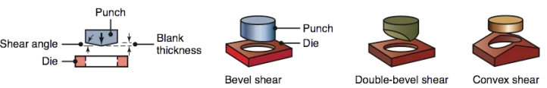
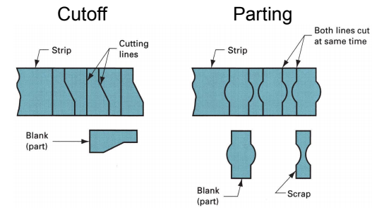
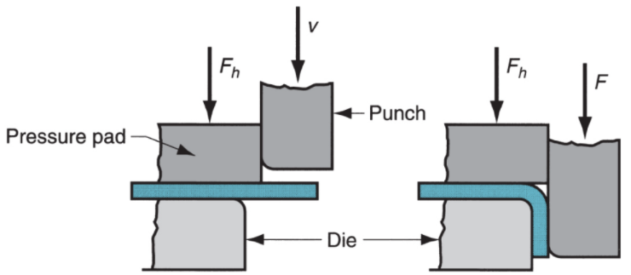
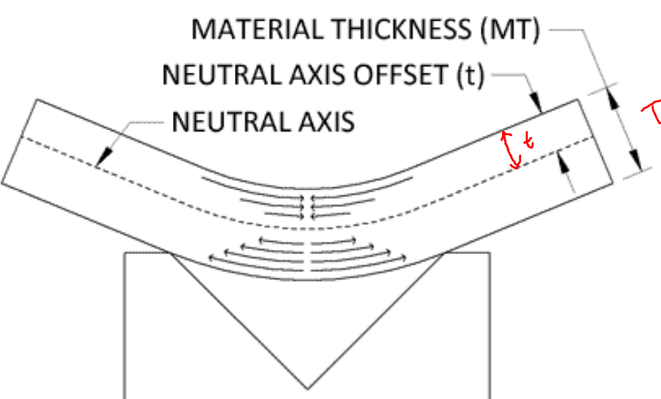
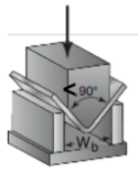
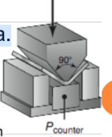
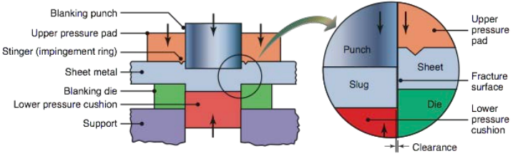
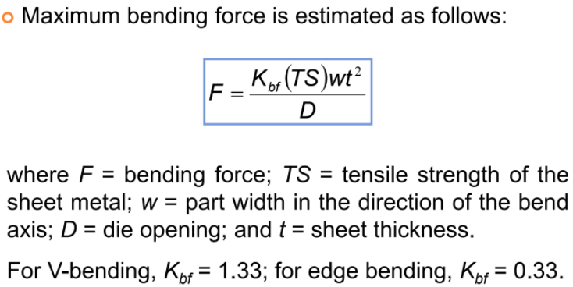
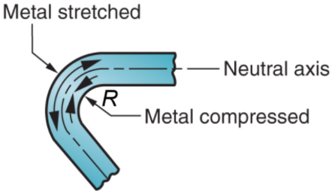
Chapter 3: Sheet Metalworking [Bending Operations] (Lecture 9) Cutting Forces Calculation >> Assumptions: Neglect minor effect of clearance in calculating L (perimeter) Entire length is made at the same time (maximum cutting force calculated) Shear Angles >> Advantages: reduces the cutting force; reduces shock on the press; cutting gradually over a longer stroke Other Cutting Operations Fine Blanking >> shearing process which produces very highly precise workpieces with completely smooth, tear-free sheared surfaces >> more precise, costly and complex >> triple action press – control cracks & clearance 1% of sheet thickness | Bending >> forming of solid parts, where angled or ring-shaped workpieces are produced from sheet or strip metal Sheet Metal Bending >> (a) Straining of sheet metal around a straight axis to take a permanent bend (b) Metal on the inside of the neutral plane is compressed, while the metal on the outside of the neutral plane is stretched Types of Sheet Metal Bending – V-bending >> performed with V-shaped die >> Low production quantity >> V-dies are simple & inexpensive Types of Sheet Metal Bending – Edge bending >> performed with a wiping die >> High production quantity >> Dies are more complicated and costly (especially if angle > 90°) Stretching during Bending >> If the bend radius R is small relative to the sheet thickness, the metal tends to stretch during bending. >> Important to estimate amt of stretching, so final part length = specified dimension >> Problem: to determine length of neutral axis of part before bending → blank size | Required Blank Length Bend Allowance Formula >> A_{b} is the length of the neutral axis within the bended portion >> Neutral axis is at plane where the length before & after bending remains the same; has 0 net stress; no deformation there >> For bending with little stretch: (bend on big material) R ≥ 2t, K_{ba} = 0.50 >> For bending with large stretch: (bend on small material) If R < 2t, K_{ba} = 0.33 | Springback >> Increase in the included angle of the bent part relative to the included angle of the forming tool after the tool is removed >> Reason: When the bending pressure is removed, the elastic energy remains in the bent part, causing it to recover partially toward its original shape >> seen as a decrease in bend angle and an increase in bend radius: (1) during bending, the workpiece is forced to take the radius R_{t} and angle αb’ of the bending tool; (2) after the punch is removed, the workpiece springs back to R and α’ Springback Compensation >> Methods of reducing or eliminating springback in bending operations: → Overbending: bend more than required to allow for springback; e.g. included angle after bending <90°, after springback, angle = 90° → high compressive pressure causes plastic deformation at the bend area Bending Forces | Die Opening Dimensions

Slide 3
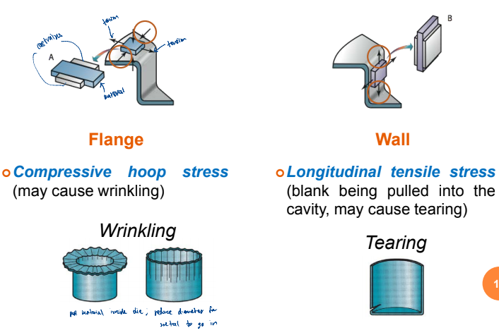
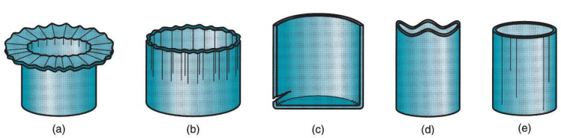
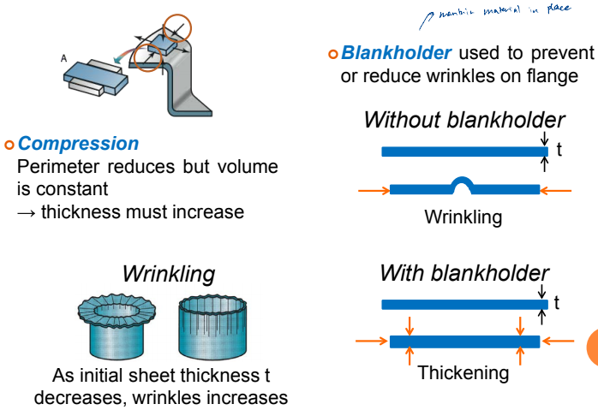
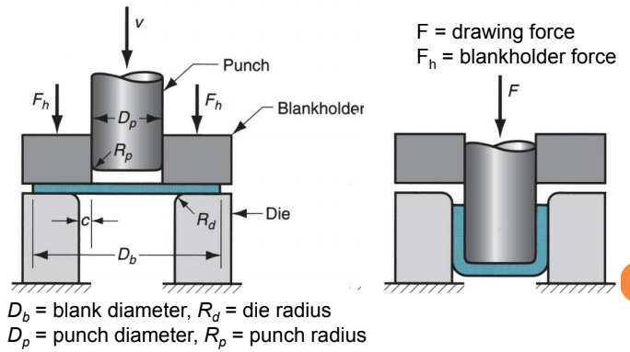
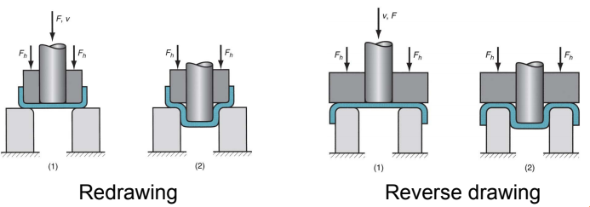
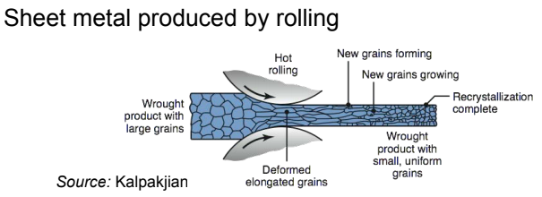


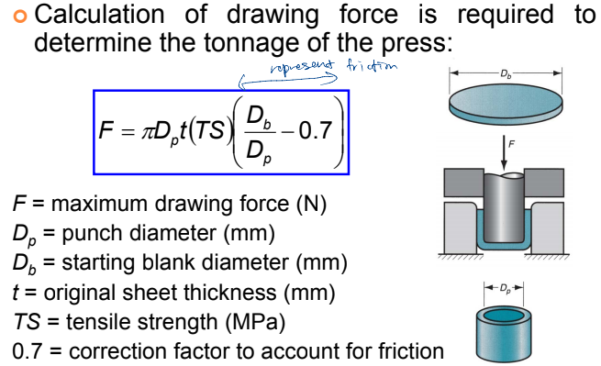
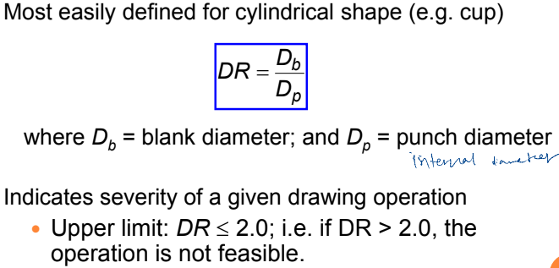
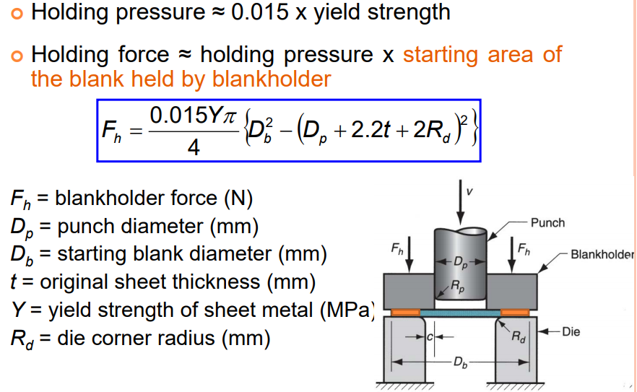
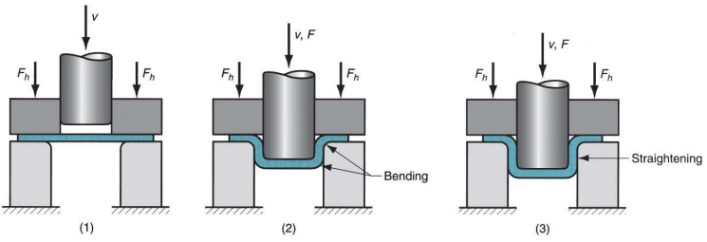
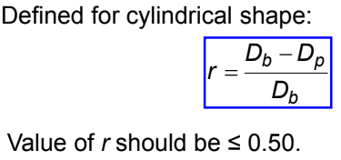
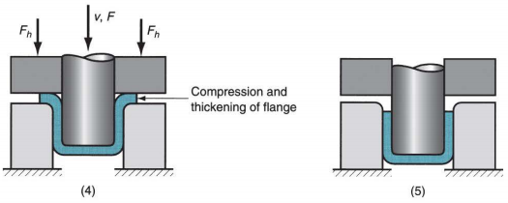
Chapter 3: Sheet Metalworking [Drawing Operations] (Lecture 10) Drawing >> Sheet metal forming to make cup-shaped, box-shaped, or other complex-curved, hollow-shaped parts >> Sheet metal blank is positioned over the die cavity & then the punch pushes metal into the opening >> Products: beverage cans, ammunition shells, automobile body panels >> aka deep drawing (to distinguish it from wire and bar drawing) Deep Drawing of a Cup >> (left) before the punch contacts the workpiece; (right) near end of the stroke Clearance in Drawing >> Sides of punch and die separated by a clearance c given by: where t = sheet thickness → clearance ~10% greater than sheet thickness Drawing Sequence (1) Punch makes initial contact with the workpiece (blank) (2) Downwards movement of the punch, metal bends along the die (3) Straightening to form the cup wall, tensile stress on the cup wall (4) Friction and compression; compressive stress on the flange (5) Final cup shape showing effects of thinning in the cup walls | Major Stresses in Flange and Wall Compression in Flange and Wrinkles Effect of Blankholder Force >> F_{h} too low: Causes wrinkles >> F_{h} too high: prevents metal from flowing into die cavity; may cause tearing due to stretching of metal (more tension) Tests of Drawing Feasibility >> Three criteria are used to test for drawability: Drawing ratio, Reduction, Thickness-to-diameter ratio Drawing Ratio DR Reduction R Thickness-to-Diameter Ratio T/D_{B} >> Thickness t of starting blank divided by blank diameter: Desirable for t/Db ratio to be greater than 1%.; As t/Db decreases, tendency for wrinkling increases | Tests of Drawing Feasibility >> Conditions for drawability → DR ≤ 2.0 → r ≤ 0.50 → t/D_{b} > 1% >> If the limits on DR, r and t/Db are not respected, then the operation is not feasible in one step, redrawing is required A blank can be drawn in 2 steps or more with annealing between the steps (reduce stress in material; recover ductility) Redrawing & Reverse Drawing >> If shape change is too severe to be produced in one single drawing step, redrawing or reverse drawing can be used Blank Size Determination >> After checking tests of drawing feasibility >> Starting sheet metal blank >= final product volume; Assume negligible thinning of part wall; Neglect die and punch radii Drawing Force Blankholder Force or Holding Force | Defects in Drawing Operations (a) wrinkling can occur either in the flange or (b) in the wall (due to compression), (c) tearing (due to high tensile stresses that cause thinning and failure), (d) earing (due to anistropy), and (e) surface scratches (due to poor lubrication, punch/die not smooth) Reason for Earing >> Anisotropy of starting sheet causes earing

