Slide 1
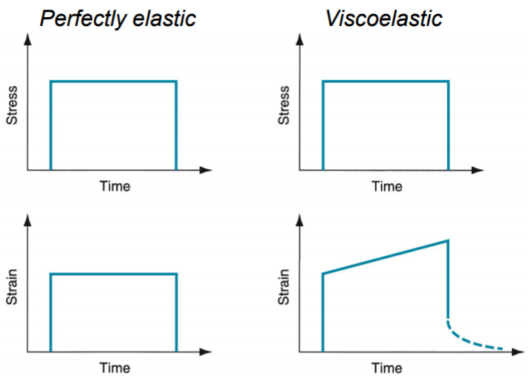
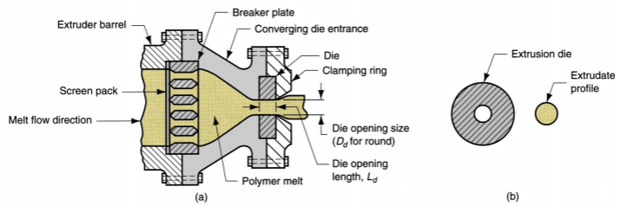
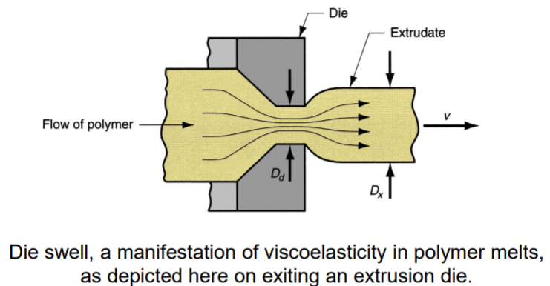
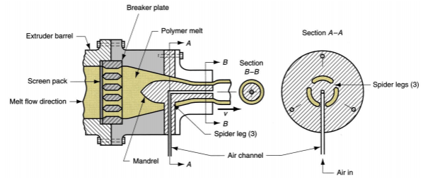
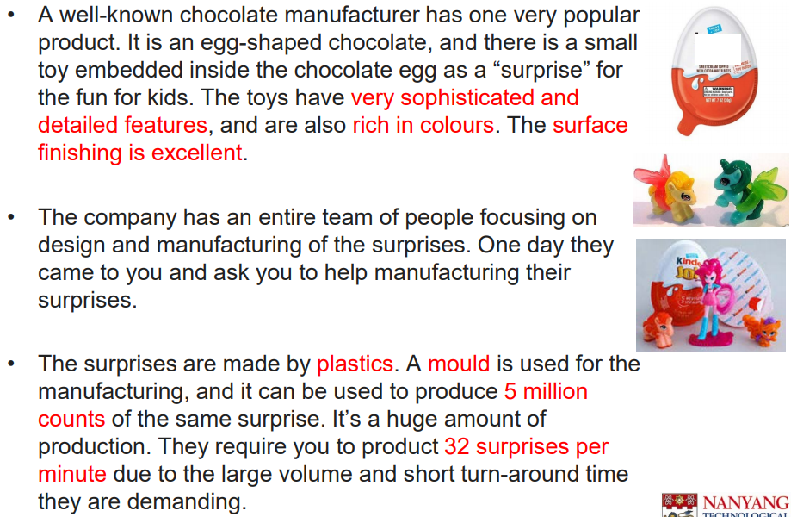
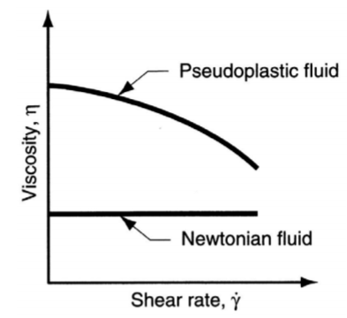
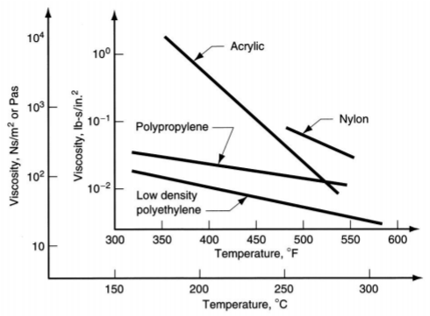
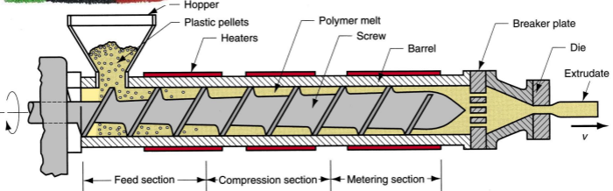
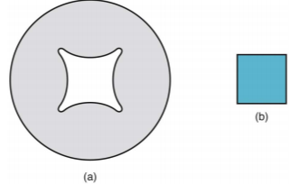
Chapter 4: Polymers (Lecture 11) Plastic Shaping >> almost unlimited variety of part geometries >> Net shape process → no need further shaping >> less energy requirement than metals → lower temperature during production >> painting or plating is usually not required Thermoplastics >> Chemical structure remains unchanged during heating & shaping; recyclable >> Used more commercially; >70% of total plastics tonnage Thermosets >> Undergo a curing process during heating & shaping; permanent change in molecular structure >> Once cured, cannot be remelted/recycled Polymer Melts >> heated → softens to the consistency of a liquid >> Properties: Viscosity & Viscoelasticity Viscosity of Polymer Melts >> Fluid property that relates shear stress to shear rate during flow >> high molecular weight → polymer melt is a thick fluid with high viscosity >> Most polymer shaping processes involve flow through small channels or die openings → large flow rates → high shear rates & stresses; need a lot of pressures to accomplish process Viscosity and Shear Rate/Temperature >> Viscosity decreases with shear rate / temperature; fluid thinner at higher shear rates/temperatures >> molecular weight of polymer also affects viscosity | Viscoelasticity Die Swell >> Extruded polymer "remembers" previous shape when in the larger cross section of the extruder, tries to return to it after leaving the die orifice. Plastic Shaping Process – Casting >> Pour liquid resin into mould → gravity to fill cavity → polymer hardens >> Thermoplastics : acrylics, polystyrene, polyamides (nylons) & PVC >> Thermosetting polymers: polyurethane, unsaturated polyesters, phenolic & epoxies >> Simpler mold >> Suited to quantities >> Can be used for encapsulation (electronics) Plastic Shaping Process – Extrusion >> compression process → material forced to flow through a die orifice to provide long continuous product whose cross-sectional shape is determined by the shape of the orifice >> Widely used for thermoplastics of elastomers to mass produce items ( e.g. pipes, coated electrical wires ) >> continuous process → extrudate is then cut into desired lengths Extruder (Single-screw) >> channel depth decreases along the screw | Extruder Barrel >> feedstock ( plastic pellets; melted by electric heater) fed by gravity onto screw whose rotation moves material through barrel; mixing/mechanical working adds heat which maintains melt Extruder Screw (sections) >> Feed section → feedstock moved from hopper & preheated >> Compression section → polymer becomes fluid, air mixed with pellets extracted from melt, & material is compressed >> Metering section → melt is homogenized and sufficient pressure developed to pump it through die opening Extruder Die >> Before reaching die, the melt passes through a screen pack - series of wire meshes supported by a stiff plate containing small axial holes >> Functions of screen pack: Filter out contaminants/hard lumps; Build pressure in metering section; Straighten flow of polymer melt and remove its "memory" of circular motion from screw Die configurations & Extruded Products >> shape of the die orifice determines the cross-sectional shape of the extrudate >> E.g. Solid profiles, Hollow profiles, such as tubes, Wire and cable coating, Sheet and film, Filaments Extrusion of solid profiles >> regular shapes: rounds, squares >> Irregular cross sections: Structural shapes, Door and window moldings, Automobile trim, House siding Extrusion of solid profiles >> Die cross section (a) showing required orifice to obtain (b) a square extruded profile >> Change in shape due to die swell. | Extrusion Die for Solid Cross Section >> (a) Side view cross-section of extrusion die for solid regular shapes( e.g. round stock) >> (b) front view of die, with profile of extrudate Hollow Profiles >> e.g. tubes, pipes, hoses >> require mandrel to form the shape >> Mandrel held in place using a spider → Polymer melt flows around legs supporting the mandrel to reunite into a monolithic tube wall >> Mandrel often includes air channel → air blown to maintain hollow form of extrudate during hardening Extrusion Die for Hollow Shapes >> Section A-A is a front view cross-section showing how the mandrel is held in place; >> Section B-B shows the tubular cross-section just prior to exiting the die; die swell causes an enlargement of the diameter Extra: Die Swell is the tendency of the extrudate to expand in the cross-sectional dimensions immediately on exiting the die orifice; it results from the viscoelastic properties of the polymer melt More Questions >> You found that the dimensions of the surprises you manufactured were all smaller than what your client asked for. You double checked, and the moulds were all designed to be the same dimensions as the design of the surprises by the client. What would be the reason for such mistake? Ans: Forgot to consider shrinkage | Important Points >> Thermoplastics & Thermosets >> Major plastic shaping processes, common categories, features of each category, process/equipment description: 1. Casting 2. Extrusion → Know how to draw 3. Injection Molding * 4. Compression molding 5. Transfer molding 6. Blow molding 7. Thermoforming >> Die Swell → what kind of fluid will have die swell? Ans: viscoelastic fluids (polymer melts) >> Shrinkage & factors affecting shrinkage Questions >> What are the limitations in terms of materials selection in the blow molding process? Give your reasons. Ans: Only thermoplastic materials can be used for blow molding as process involves two forming steps. A parison (hollow tube) needs to be pre-formed by injection molding or other method (e.g. extrusion) before being inflated to conform to the mold. Therefore, if a thermoset material was used, it would already have been cross-linked during the pre-forming step and could not be soften for the blow molding operation >> Which process will you use to make the surprises? Ans: Injection Moulding >> The mould needs to be used for 5 million times. Which process will you use to make the mould? Ans: CNC Machining (could be 3D printing but it will have not so good surface finish and dimensions)

Slide 2
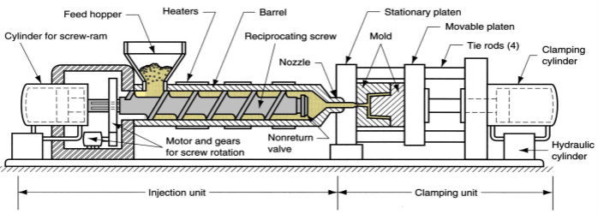
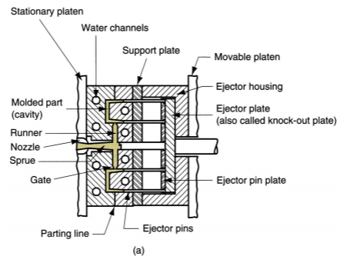
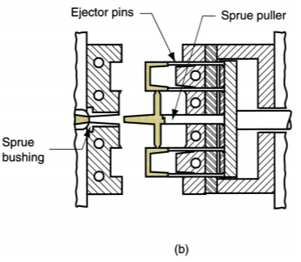
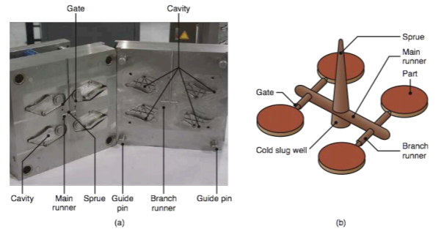
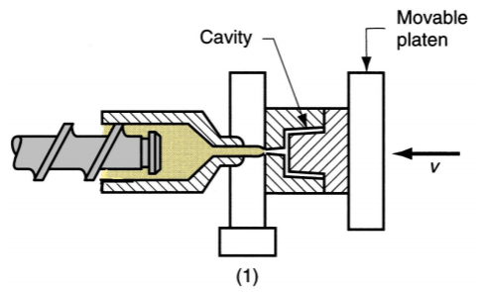
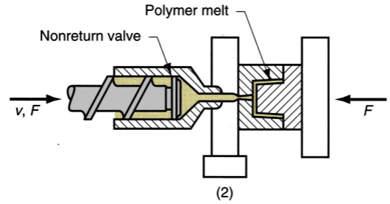
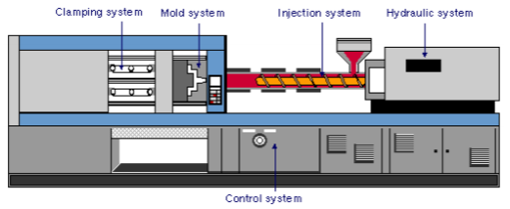
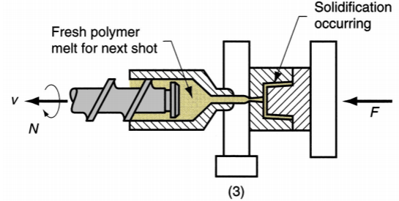
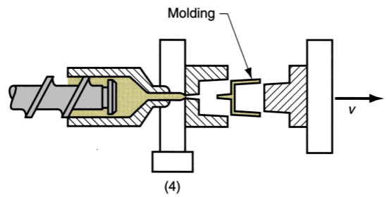
Chapter 4: Polymers (Lecture 12) Injection Molding >> Polymer is heated to a highly plastic state → forced to flow under high pressure into a mold cavity for solidification → molding removed from cavity >> Produces discrete components almost always to net shape >> Typical cycle time ∼10 to 30 sec; but cycles of > =1 minute not uncommon >> Mold may contain multiple cavities, so multiple moldings are produced each cycle Injection Molded Parts >> Complex and intricate shapes are possible >> Shape Limitations: Capability to fabricate a mold whose cavity is the same geometry as part & Shape must allow for part removal from mold >> Part size: ∼ 50 g to ∼ 25 kg >> economical only for large production quantities due to high cost of mold Polymers for Injection Molding >> Popularly used for thermoplastics >> Also used for thermosets & elastomers → Modifications in equipment and operating parameters must be made to avoid premature cross-linking of these materials before injection Injection Molding Machine >> Injection system: Melts and delivers polymer melt; like extruder >> Clamping system: Opens and closes mold each injection cycle | Injection Molding Machine Injection Unit of Molding Machine >> Consists of barrel fed from one end by a hopper containing supply of plastic pellets >> Inside the barrel is a screw which: 1. Rotates for mixing and heating polymer 2. Acts as a ram (i.e., plunger) to inject molten plastic into mold → Non-return valve near tip of screw prevents melt flowing backward along screw threads → Later in molding cycle ram retracts to its former position Clamping Unit of Molding Machine >> Functions: 1. Holds two halves of mold in proper alignment with each other. 2. Keeps mold closed during injection by applying a clamping force sufficient to resist injection force. 3. Opens and closes mold at the appropriate times in molding cycle. Injection Molding Cycle 1. Mold is closed 2. Melt is injected into cavity. 3. Screw is retracted. 4. Mold opens and part is ejected. The Mold >> special tool in injection molding >> Custom-designed and fabricated for the part to be produced >> When production run is finished, the mold is replaced with a new mold for the next part >> Various types of mold for injection molding: Two-plate/Three-plate/Hot-runner mold | Two-Plate Mold (a) closed; Mold has two cavities to produce two cup-shaped parts with each injection shot (b) Open Mould Features (a) Two-plate mold (b) injection molding of four parts Two-Plate Mold Features >> Cavity – geometry of part but slightly oversized to allow for shrinkage → Created by machining of mating surfaces of two mold halves >> Distribution channel through which polymer melt flows from nozzle into mold cavity → Sprue - leads from nozzle into mold → Runners - lead from sprue to cavity → Gates - constrict flow of plastic into cavity >> Ejection system – to eject molded part from cavity at end of molding cycle → Ejector pins built into moving half of mold usually accomplish this function >> Cooling system - external pump connected to passageways in mold → water circulated; removes heat from hot plastic >> Air vents – to permit evacuation of air from cavity as polymer melt rushes in Three-Plate Mold >> Uses three plates to separate parts from sprue and runner when the mold opens >> Advantages over two -plate mold: → mold opens, runner & parts disconnect & drop into two containers under mold → Allows automatic operation of molding machine. | Hot-Runner Mold >> Eliminates solidification of sprue and runner by locating heaters around the corresponding runner channels >> plastic in mold cavity solidifies, material in sprue & runner channels remains molten, ready to be injected into cavity in next cycle >> Advantage: Saves material that otherwise would be scrap in the unit operation Shrinkage >> Reduction in linear size during cooling from molding to room temperature >> Polymers have high thermal expansion coefficients, so significant shrinkage occurs during solidification and cooling in mold Compensation for Shrinkage >> Dimensions of the mold cavity must be larger than the specified part dimensions: D_{c} = D_{p} + D_{p}S + D_{p}S² D_{c} = dimension of cavity; D_{p} = molded part dimension (nominal size); S = shrinkage value Example: Shrinkage value S = 0.025 Nominal length D_{p} = 50.0 mm D_{c} = 50.0 + 50.0 x 0.025 + 50.0 x (0.025)2 = 51.28 mm Factors affecting Shrinkage >> Injection pressure – higher pressures force more material into mold cavity to reduce shrinkage >> Compaction time (aka packing time) - similar effect – longer time forces more material into the cavity before solidification to reduce shrinkage >> Molding temperature - higher temperatures lower polymer melt viscosity, allowing more material to be packed into mold to reduce shrinkage >> Thicker parts have higher shrinkage | Defects in Injection Molding >> Short shot: Molding has solidified before completion >> Flash: Polymer melt squeezes into the parting surface or around ejection pins >> Sink marks and voids: Usually due to too thick molded sections where there is insufficient material to compensate for shrinkage >> Weld line: Polymer flows around a core or other convex section and meets from opposite directions
Polymer | Shrinkage(mm/mm)
Nylon 6,6 | 0.020
Polyethylene | 0.025
Polystyrene | 0.004
PVC | 0.005

Slide 3
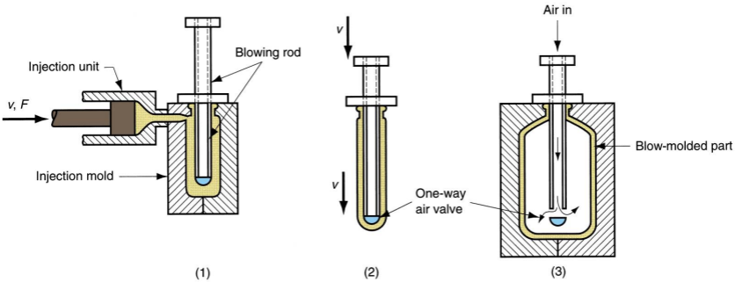
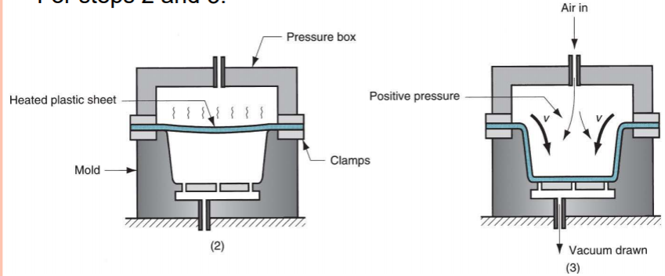
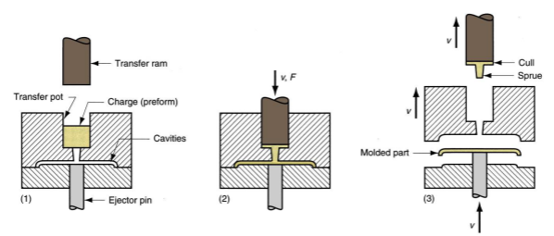
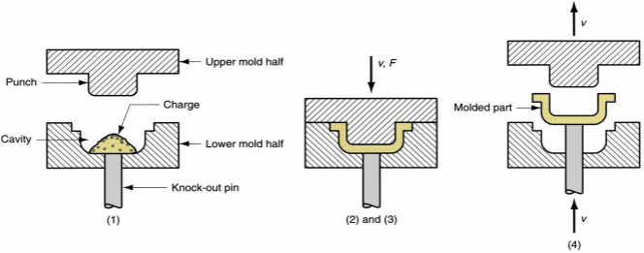
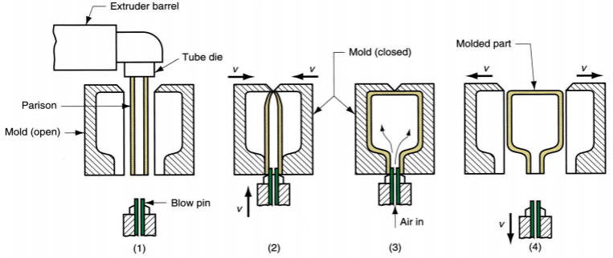
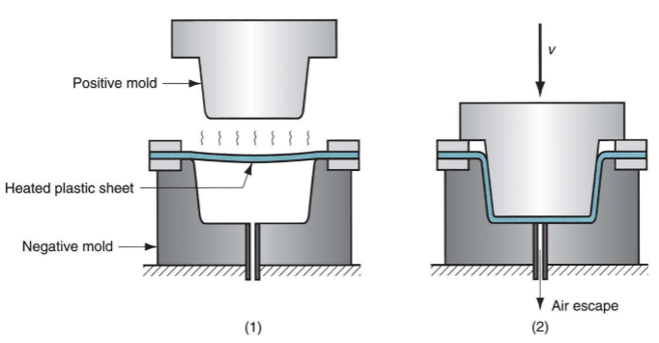
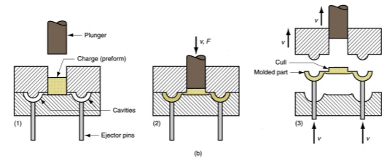
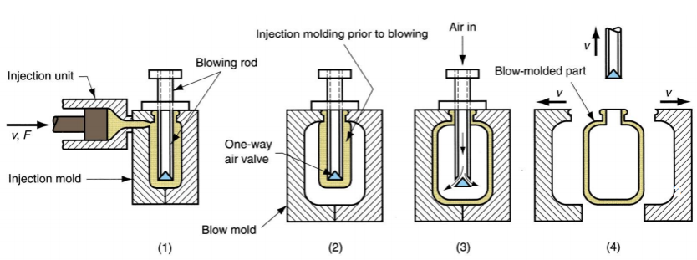
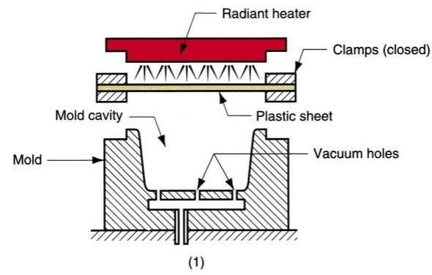
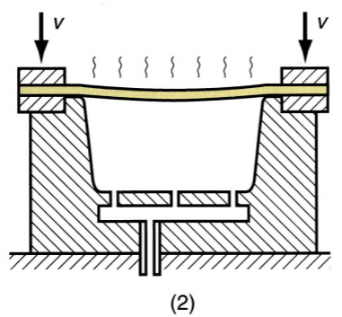
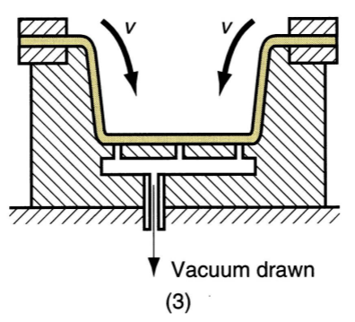
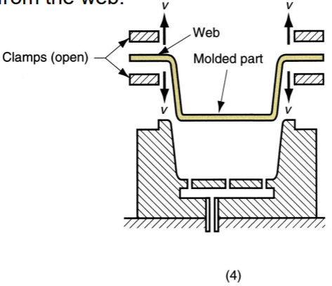
Chapter 4: Polymers (Lecture 13) Compression Molding >> widely used for thermosetting plastics >> Also used for rubber tires and polymer matrix composite parts >> Molding compound available in several forms: powders/pellets, liquid, or preform >> Amount of charge must be precisely controlled to obtain repeatable consistency in the molded product (1) charge is loaded, (2) & (3) charge is compressed and cured, and (4) part is ejected and removed >> Molding materials: Phenolics, melamine, epoxies, elastomers, etc. >> Typical compression-molded products: Electric plugs, sockets, and housings; pot handles, and dinnerware plates >> compression molding == close die forging for metals Molds for Compression Molding >> Simpler than injection molds >> no sprue and runner system >> Process itself generally limited to simpler part geometries due to lower flow capabilities of thermosetting materials >> Mold must be heated, usually by electric resistance, steam, or hot oil circulation Transfer Molding >> Modified from compression molding, polymer enters the mold cavity as a fluid >> Thermoset charge is loaded into a chamber immediately ahead of the mold cavity, where it is heated; pressure is then applied to force soft polymer to flow into heated mold where it cures >> Two variants: Pot transfer molding – charge is injected from a "pot" through a vertical sprue channel into cavity Plunger transfer molding – plunger injects charge from a heated well through channels into cavity | Pot Transfer Mold (1) The charge is loaded into the pot. (2) Softened polymer is pressed into the mold cavity and cured (3) The part is ejected. Plunger Transfer Molding (1) The charge is loaded into the pot (2) Softened polymer pressed from heated well laterally into mold cavity & cured (3) The part is ejected Compression VS Transfer Molding >> Both: scrap is produced each cycle as leftover material, called the cull >> thermoset scrap cannot be recovered >> Transfer molding capable of molding more intricate part shapes than compression molding, but not as intricate as injection molding Remark: Transfer molding very good for molding with inserts, in which a metal or ceramic insert is placed into cavity prior to injection, and the plastic bonds to the insert during molding (e.g. IC package) Similarities in Processes >> Transfer and compression molding both use thermosets and elastomers >> Transfer and injection molding – the charge is preheated in a separate chamber before being injected into the mold Blow Molding >> Air pressure is used to inflate soft plastic into a mold cavity >> Important for making one-piece hollow plastic parts with thin walls, such as bottles >> Because these items are used for consumer beverages in mass markets, production is typically organized for very high quantities | Blow Molding Process >> Accomplished in two steps: 1. Fabrication of a starting tube (parison) 2. Inflation of the tube to desired final shape >> Forming the parison is accomplished by either extrusion or injection molding Extrusion Blow Molding (1) Extrusion of the parison; (2) Parison is pinched at the top & sealed at the bottom around a metal blow pin as the two halves of the mold come together; (3) the tube is inflated so that it takes the shape of the mold cavity; and (4) the mold is opened to remove the solidified part Injection Blow Molding (1) The parison is injection molded around a blowing rod; (2) the injection mold is opened and the parison is transferred to a blow mold; (3) the soft polymer is inflated to conform to the blow mold; and (4) the blow mold is opened and blown product is removed Stretch Blow Molding >> Variation of injection blow molding; blowing rod stretches the soft parison for a more favorable stressing of polymer than conventional blow molding >> Resulting structure is more rigid, more transparent, and more impact resistant >> Most widely used material is polyethylene terephthalate (PET) which has very low permeability and is strengthened by stretch blow molding → Combination of properties makes it ideal as container for carbonated beverages >> Produce hollow, seamless containers such as bottles | Stretch Blow Molding (cont.) (1) Injection molding of the parison (2) Stretching (3) Blowing Materials & Products in Blow Molding >> only thermoplastics >> Materials: high density polyethylene, polypropylene (PP), polyvinylchloride (PVC), and polyethylene terephthalate >> e.g. disposable containers, large shipping drums for liquids & powders, large storage tanks, gasoline tanks, toys, & hulls for sail boards & small boats Thermoforming >> Flat thermoplastic sheet/film is heated & deformed into desired shape using mold >> Heating usually accomplished by radiant electric heaters located on one or both sides of starting plastic sheet or film >> Widely used in packaging of products and to fabricate large items such as bathtubs, contoured skylights, and internal door liners for refrigerators Vacuum Thermoforming (1) flat plastic sheet is softened by heating (2) The softened sheet is placed over a concave mold cavity (3) vacuum draws the sheet into the cavity (4) Plastic hardens on contact with the cold mold surface, and the part is removed and subsequently trimmed from the web | Pressure Thermoforming >> Higher pressure (3 – 4 atm) can be used (vacuum limited to pressure of 1 atm) Mechanical Thermoforming >> Better dimensional control, surface details on both sides. >> Two mold halves: more costly Materials for Thermoforming >> Only thermoplastics → Extruded sheets of thermosetting/ elastomeric polymers have been cross-linked & cannot be softened by reheating >> Common TP polymers: polystyrene, ABS, PVC, acrylic, polyethylene, and polypropylene Applications of Thermoforming >> Thin films: blister packs and skin packs for packaging commodity products such as cosmetics, toiletries, small tools, and fasteners (nails, screws, etc.) → For best efficiency, filling process to containerize item(s) is immediately downstream from thermoforming >> Thicker sheet stock: boat hulls, shower stalls, advertising displays and signs, bathtubs, certain toys, contoured skylights, internal door liners for refrigerators.

