Slide 1
Solar Forecasting Using Previous Data with LSTM
Alt Başlık

Slide 2
MOTIVATION

Slide 5
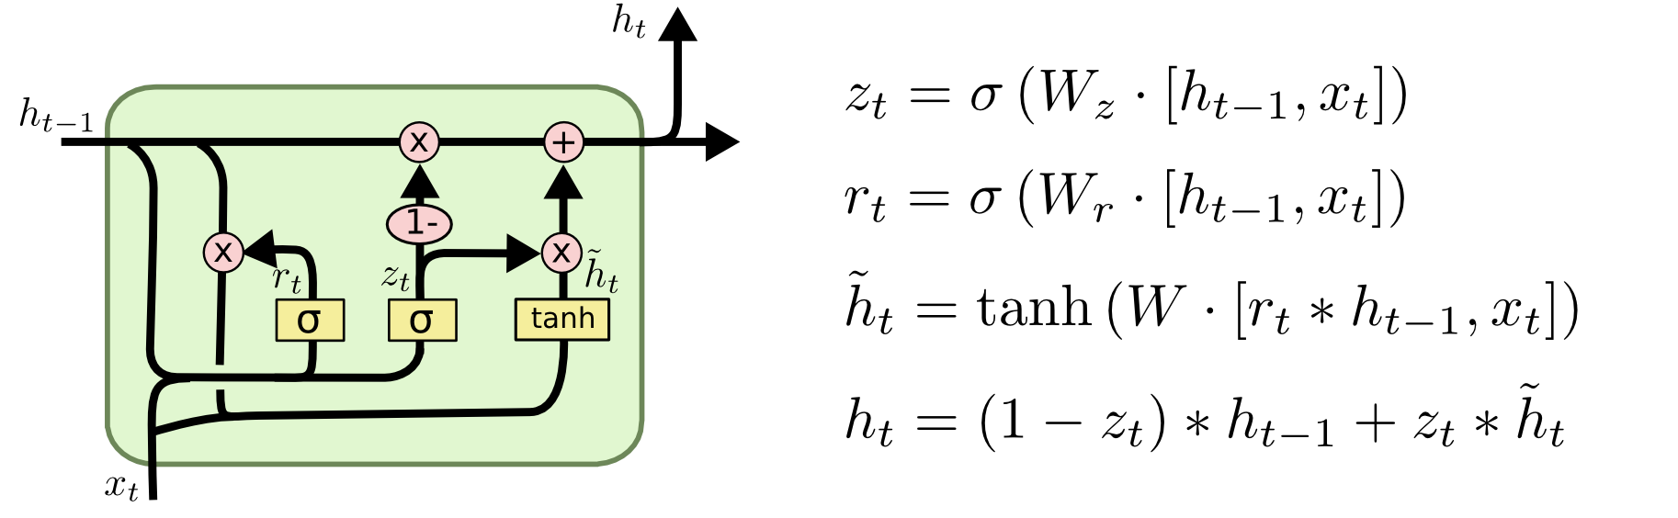
LSTM

Slide 6
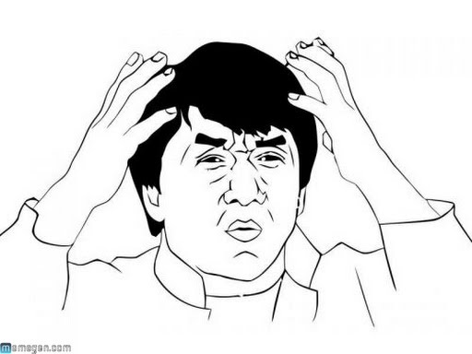

Slide 7
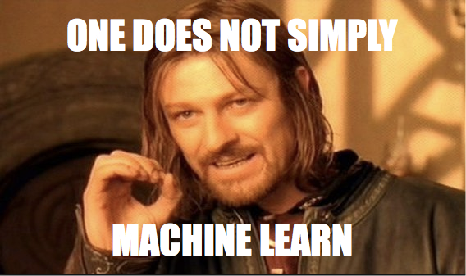
Slayt Başlığı Ekle - 3

Slide 8
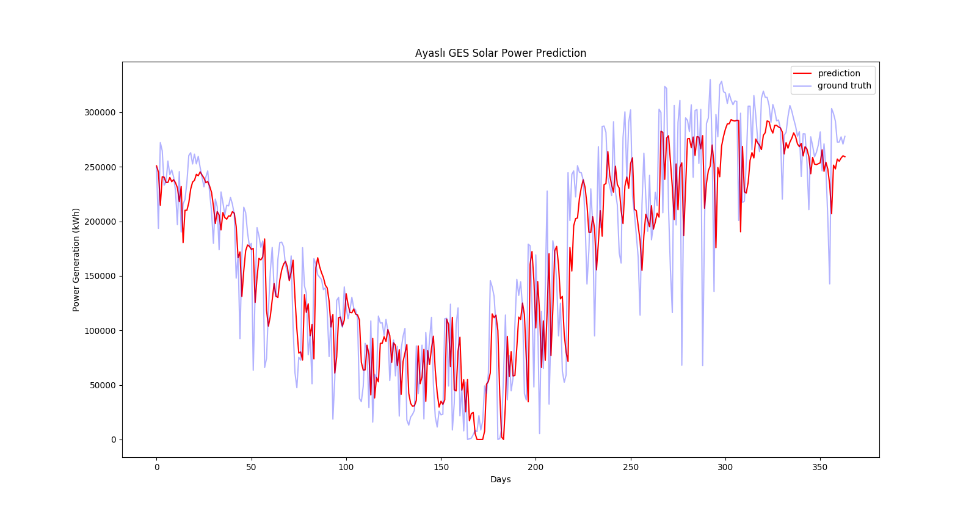

Slide 9
What’s next?
Future Prediction??
Causal Networks
More data

