Slide 1
Solar Forecasting Using Previous Data with LSTM
Alt Başlık

Slide 2
MOTIVATION

Slide 5
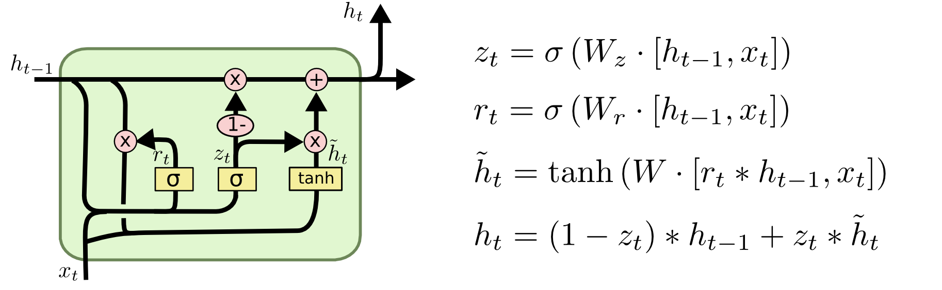
LSTM

Slide 6


Slide 7
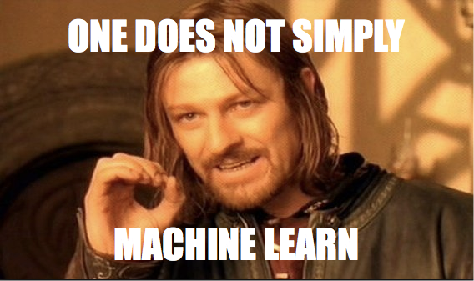
Slayt Başlığı Ekle - 3

Slide 8
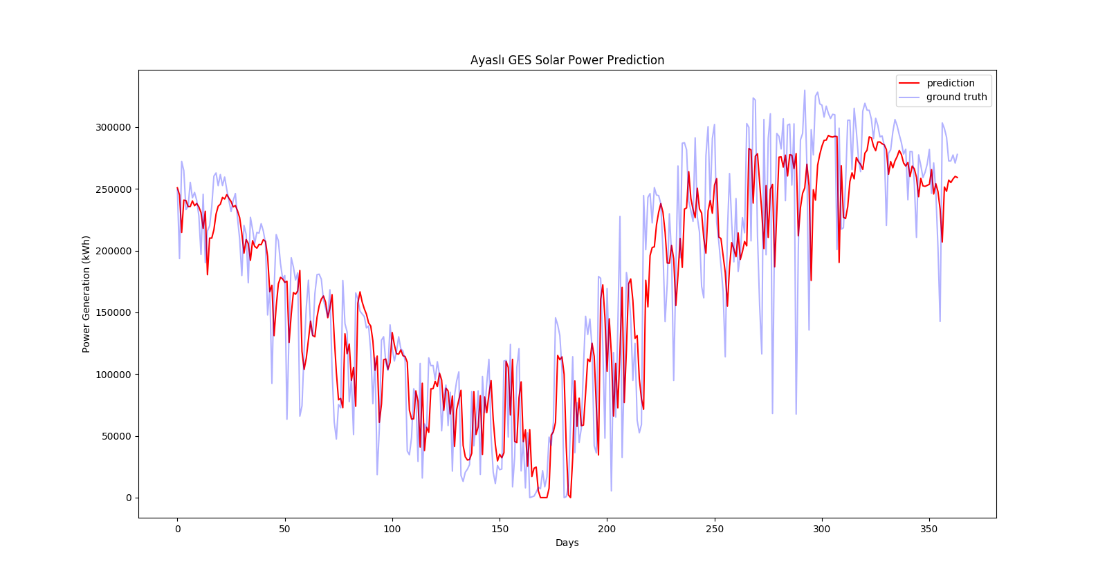

Slide 9
LSTM-RCNN vs Function fitting?
LSTM-RCNN
Work very well on long-term predictions (trends, 1 month predictions)
High accuracy - Less engineering time cost (versus fitting)
Real-time problems (poor response)

Slide 10
Function fitting
Real-time data input
Better response
Good for short term forecasting (1-6 hours)
Fixed weights, accuracy problems?

Slide 11
What’s next?
Combining both?
Real-time problems? (IoT, Radiation, Cloud Monitoring)
Updating weights and biases with neural net (supervised learning) and forecast with current weight and biases
Blockchain?

Slide 12

Blockchain

