Slide 1
IMMD

Slide 3
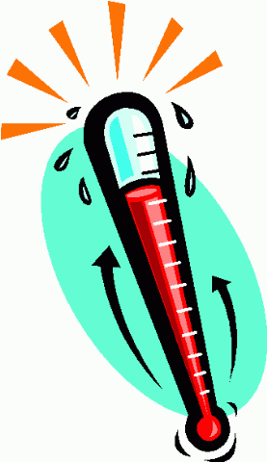
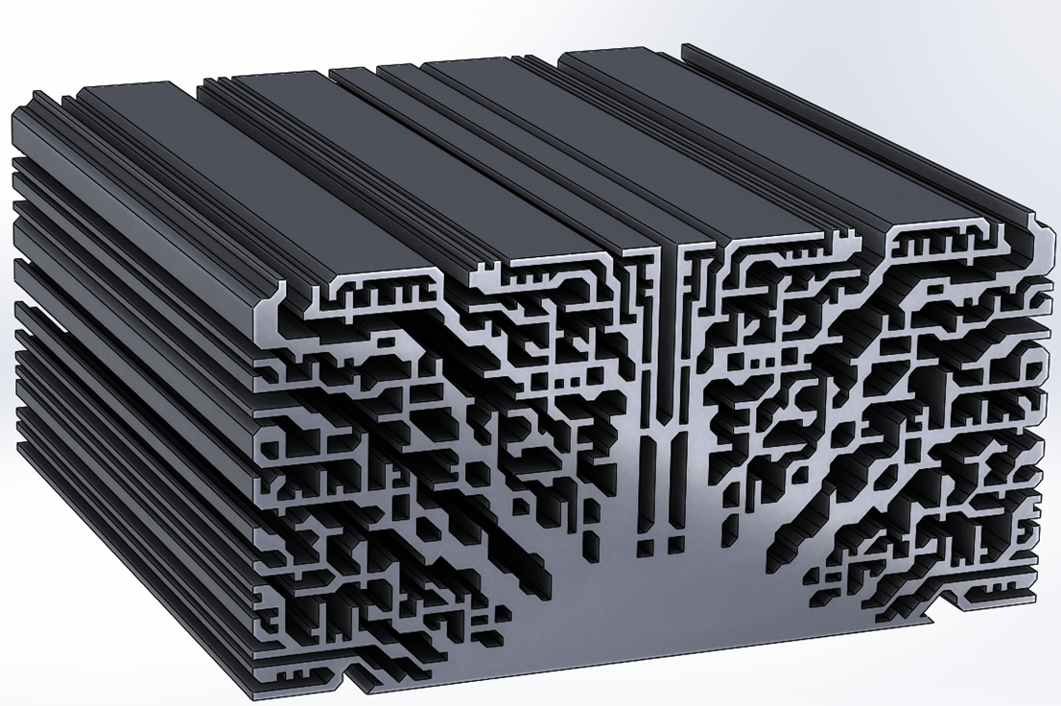
Motivations for IMD
Overcoming maximum temperature limitations of power electronics
HOW?
Higher-temperature power electronics
Higher efficency
(kill the source of thermal heat!)
Better thermal management(more effective heat transfer techniques)

Slide 4
Higher efficiency, how?
Most important principle for higher efficiency..
Higher efficiency = Lower losses
Back to EE212
Leakage current
Wide-Bandgap?

Slide 5
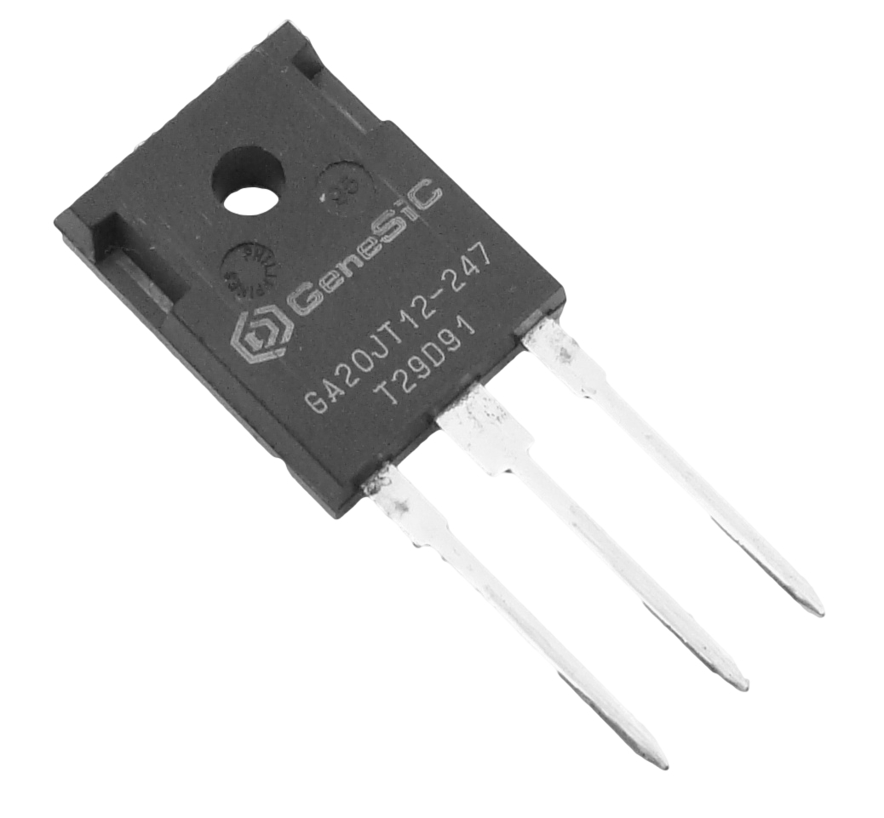
SiC

Slide 6
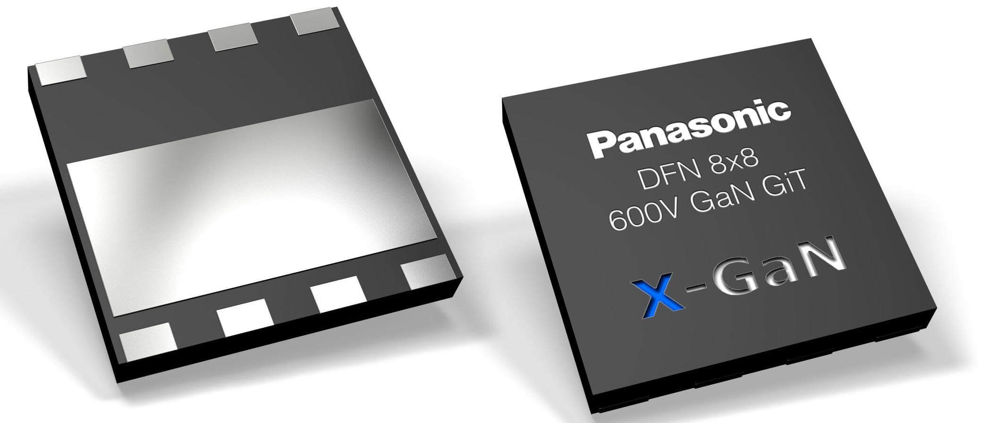
GaN

Slide 7
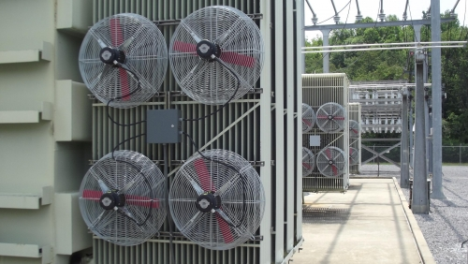
Less Heat
Have lower leakage current
Less the on-resistance same voltage rating
Faster rise and fall times
3x thermal conductivity (SiC)
Less Switching Loss
Thermal Management

Slide 8
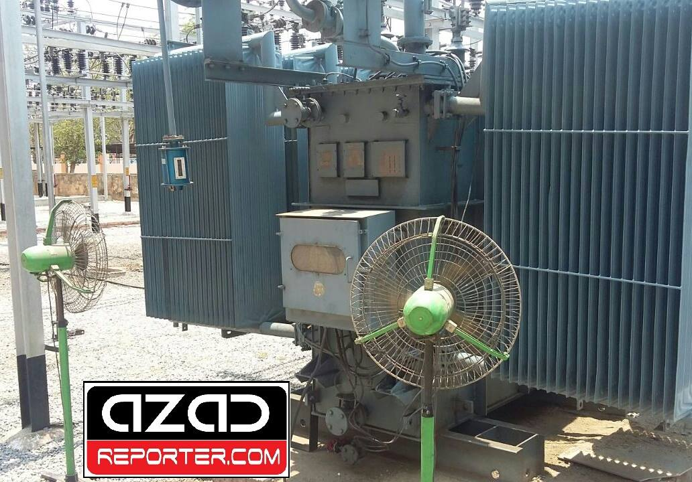
What is wrong with fans?

Slide 9
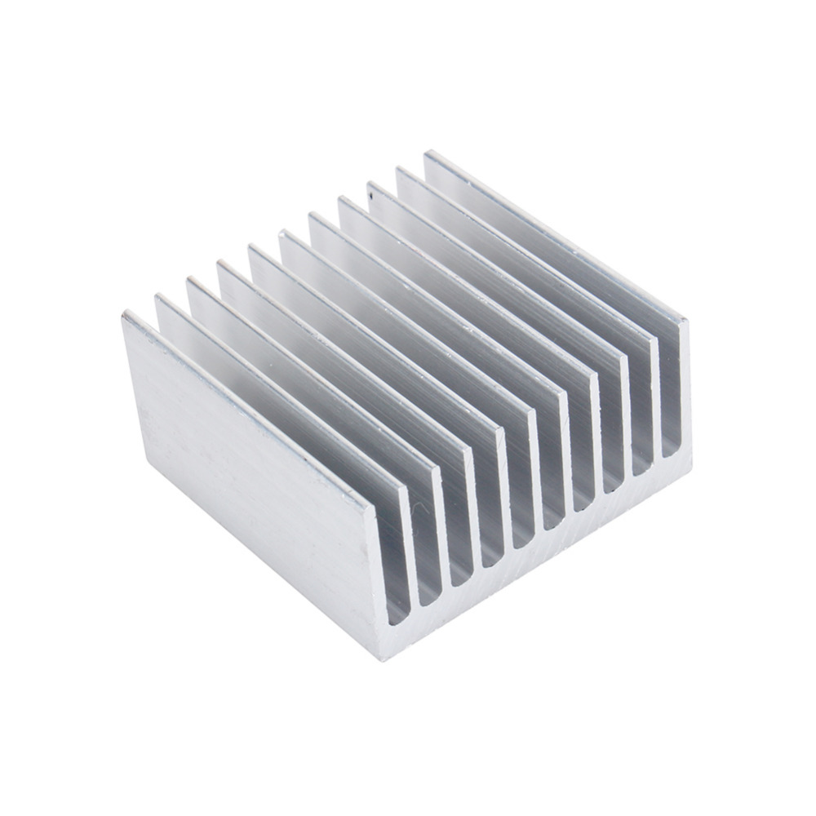
Efficency
Lower power density (power/volume)
Cost
SiC based power converter thermal resistance = 0.11 K/W
Si-based power converter thermal impedance = 0.0035 K/W
x30
SiC
Si

