Slide 1
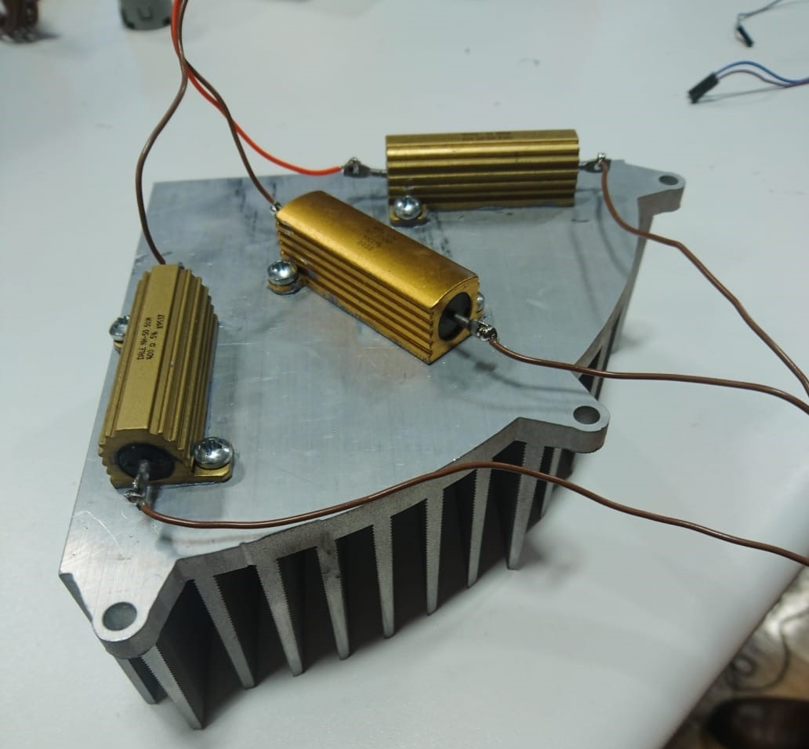
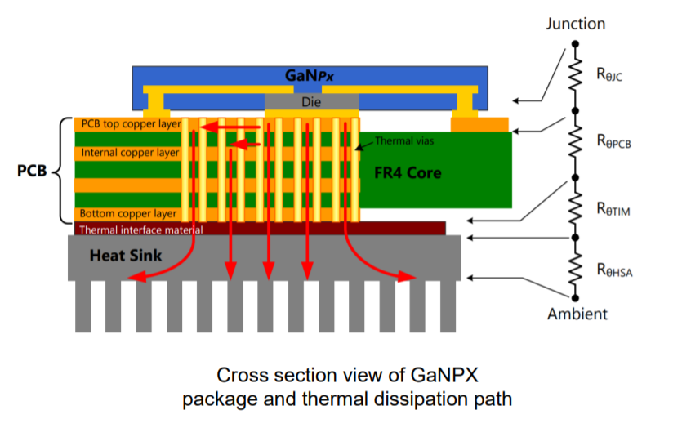
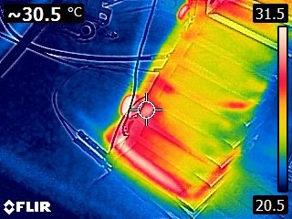
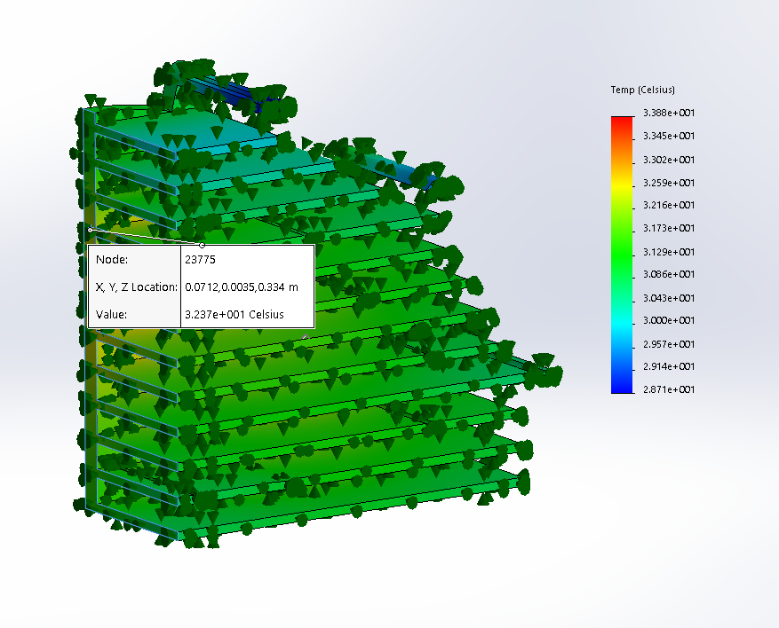
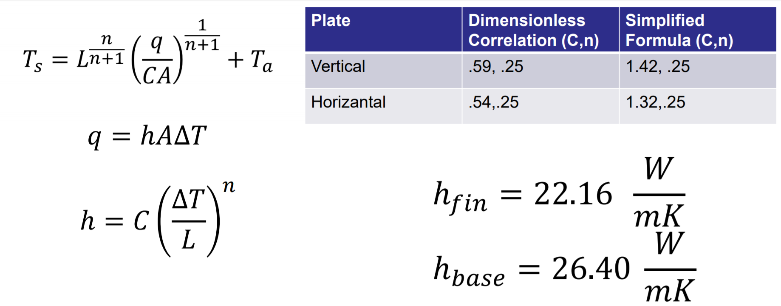
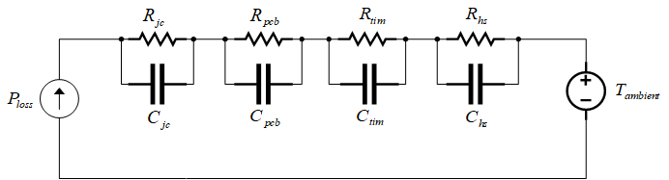
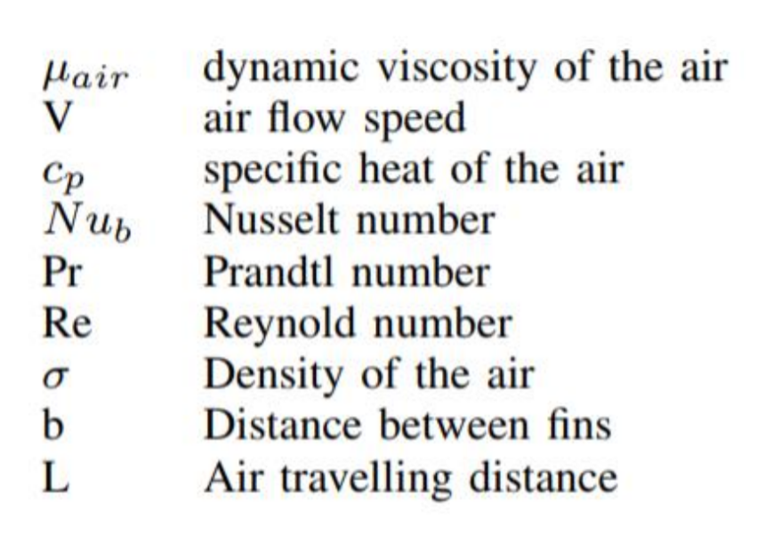
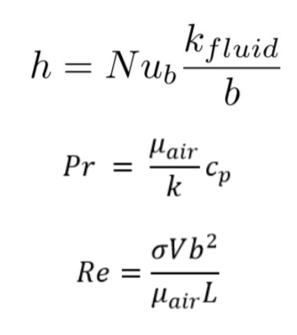
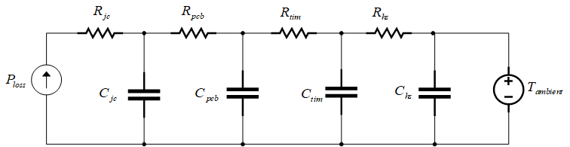
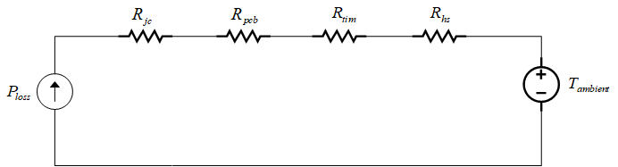
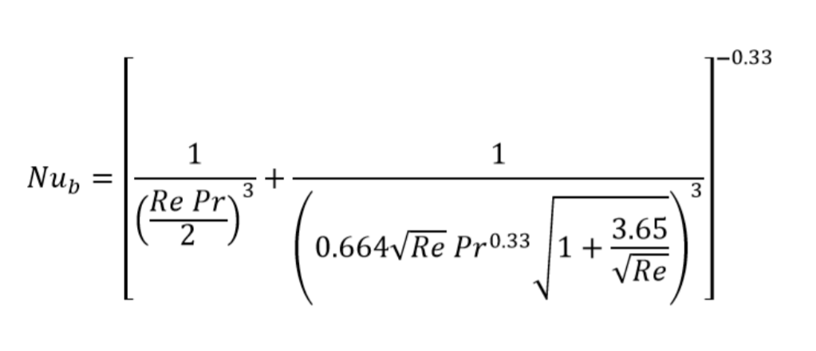
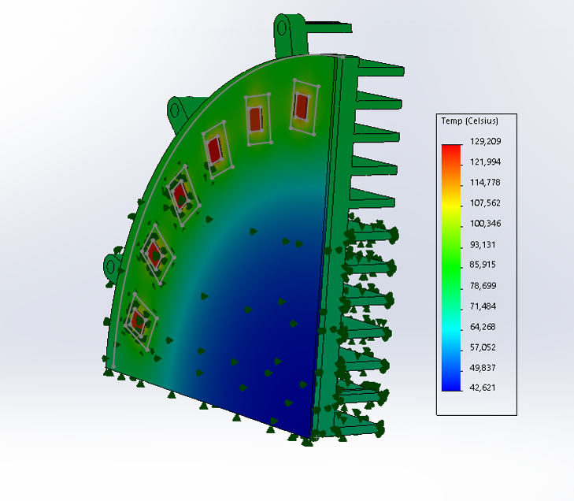
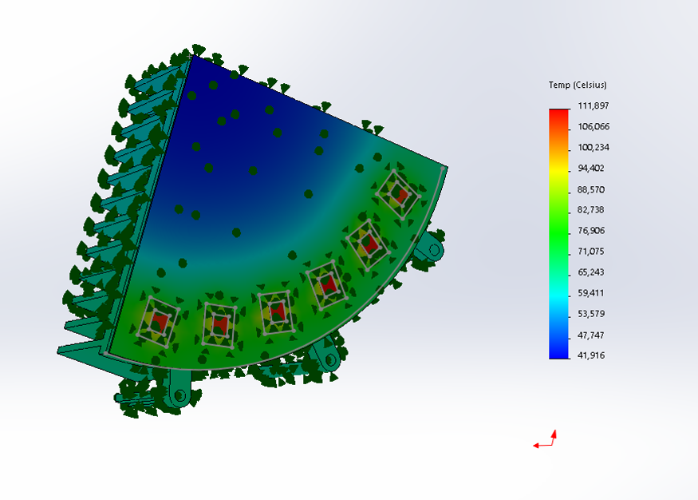
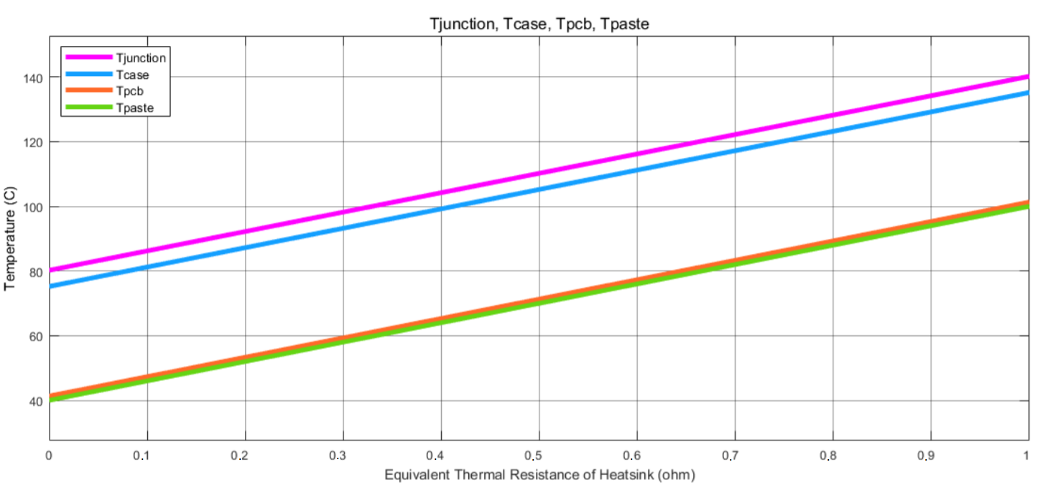
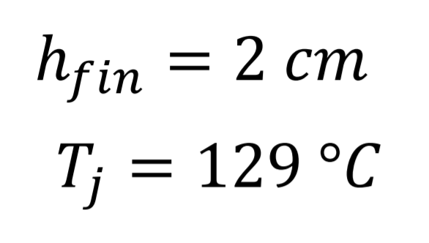
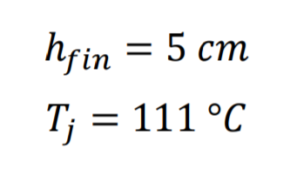


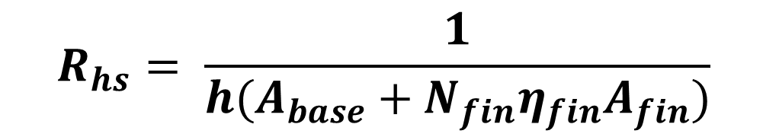
Thermal Modelling of IMMD Structure and Heat-Sink Design
Nail Tosun
(nail.tosun@metu.edu.tr)
Mesut Uğur
(ugurm@metu.edu.tr)
Ozan Keysan
(keysan@metu.edu.tr)
PowerLab Research Group, METU, ANKARA
Abstract
FEA and Test Results
The power losses on the motor drive circuit occur as thermal pressure on the motor drive. As a result, the temperature of the motor-driver board may increase and the drive may disturb the operation may cause permanent damage to the circuit elements (particularly transistors). A cooler must be used in order to effectively remove the heat energy generating from power losses. The aim of this project is to construct a thermal model and design a heatsink to 7.5kW Integrated Modular Motor Driver system. The physical properties of the cooler are important here. If the heat sink is produced longer than necessary, increased motor size causes a reduction in the power density. On the other hand, a heat sink designed shorter than necessary puts the operation at risk. In the heat sink design, lumped parameter thermal circuit modeling was performed at first, then the required thermal resistance of the heat sink is calculated as a result of the analysis on this model.
Testing was carried out by using metal resistors on the heat sink and at the same time, model verification is tried to be done by using FEA. Metal resistors have a total power rating of 44.1 W. Measurements were recorded with a thermal camera at an ambient temperature of 18.3°C
Thermal Path on Drive Side
Test setup
In this model, $P_{loss}$ is the power loss of each GaN transistor, $T_{j}$ , $T_{c}$ , $T_{pcb}$ , $T_{hs}$ and $T_{a}$ are junction, package, printed circuit board, cooler base and ambient temperature respectively. Resistances refer to the thermal resistance between the two points.
Test results
FEA results
Lumped Parameters and
Heat Sink Design
Heat Convection Coefficient Calculations
$$R_{hs}= \frac{1}{h(A_{base}+N_{fin}η_{fin}A_{fin})}$$
Cauer Model
Constant C,n values
Foster Model
Optimization of the fin height
Only Resistive Network
Since the heat sinks are quarter slice shaped instead of rectangular and the fan size is smaller than heat sink size
L, air traveling distance
V, air flow speeds
are different at each wing. Both variables are calculated by taking the average of all values. h was calculated as 18.36 W / m-K. According to this calculated value, the heat sink fin length was determined, appropriate aluminum profiles are taken accordingly and they were cut as desired by using water jet.
Conclusion
Steady state analysis is carried out in only resistive network model for the thermal equivalent circuit modelling and calculating convection coefficient. Convection coefficient is computed first using lumped parameter method. According to this calculated value, the heat sink fin height was determined, appropriate aluminum profiles are taken accordingly and heat sinks are produced. Obtained results are tested and verified using FEA method. Further analysis and design is made again using FEA in order to obtain a smaller fin height value and increase the power density. Finally, comparing to the first result, an optimized and better result in terms of power density is obtained which is 2 cm.
PCB with heat sink
References
[1] GaN Systems, “PCB Thermal Design Guide for GaN Enhancement Mode Power Transistors” Application Notes, 2018.
[2] ncropera, F.P., and DeWitt, D.P., Fundamentals of Heat and Mass Transfer, John Wiley and Sons, New York, NY, 1985.

