Slide 1
Thermal Analysis

Slide 2
Convection Coefficient
12 Volt
Sections | Air Flow
1 | 1.84
2 | 2.06
3 | 2.06
4 | 1.86
5 | 1.43
6 | 1.36
7 | 1.3
h = 18.36 W/m-K
Assumptions;
Taking averages of fin air flow speeds.
Not rectangle shape,normalization.
Average speed = 1.7 m/s

Slide 3

Setup
Voltage (Volts) | Air Flow (m/s)
12 | 3.54
11 | 3.28
10 | 2.94
9 | 2.73
8 | 2.32
7 | 1.96
6 | 1.65
5 | 1.24
3 heat source (2x 400ohm and 1 500 ohm metal resistor)
Total 44.1 W input power (from power supply)
Better contact (thermal paste, screwing)
12 V DC fan with given voltage air-flow characteristic
${18}^{o}C$ ambient temperature

Slide 4
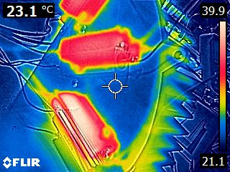
Base temperature

Slide 5
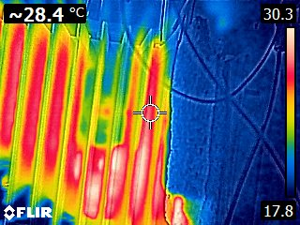
Other side

Slide 6
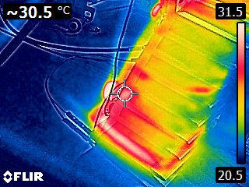
Sides

Slide 7
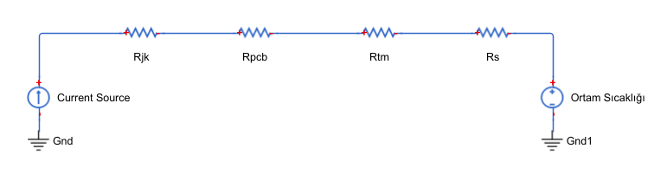
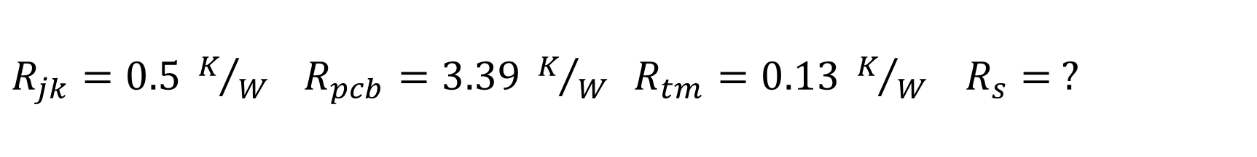
$R_{jk}=0.5 K/W R_{pcb}=3.39 K/W R_{tm}=0.13 K/W$ $R_{s}= ?$

Slide 8
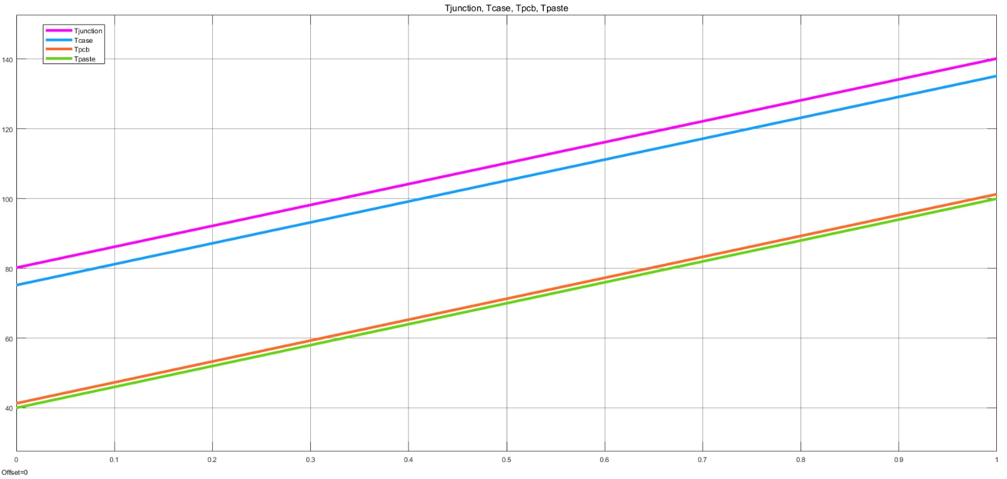

Slide 9
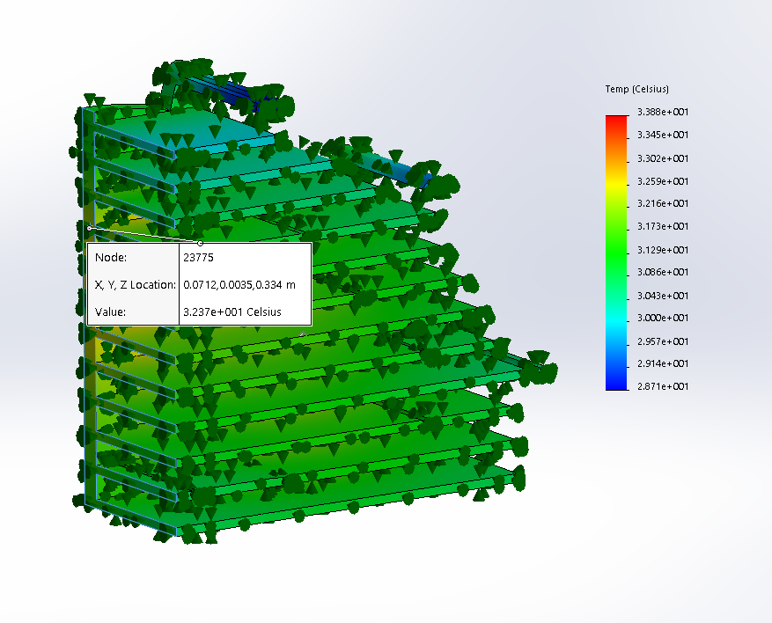

Comparison Side $T_{fea}={32.37}^{0}C$, $T_{exp}={30.5}^{0}C$

Slide 10
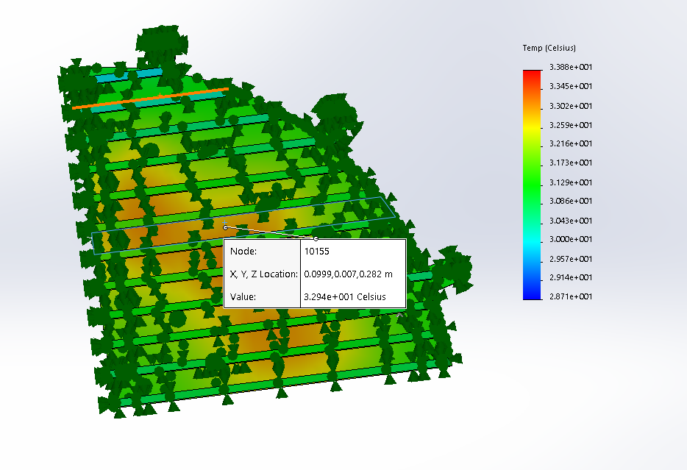

Comparison Top $T_{fea}={32.94}^{0}C$, $T_{exp}={30.3}^{0}C$

Slide 11
Comparison Bottom:

