Slide 1
IMMD Termal Simülasyonu

Slide 2
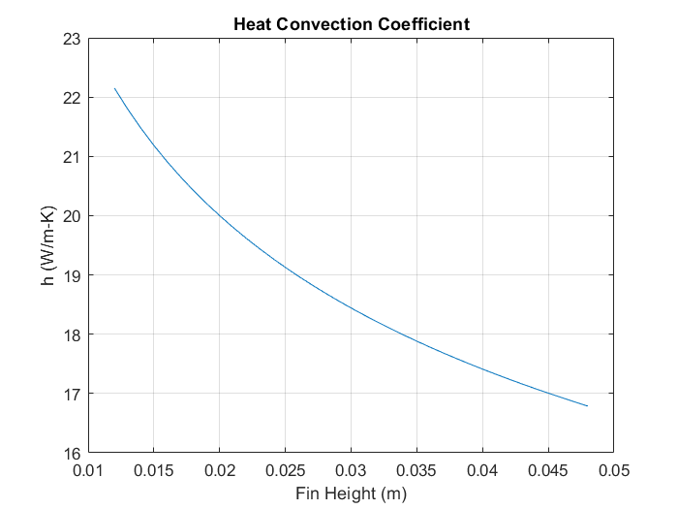
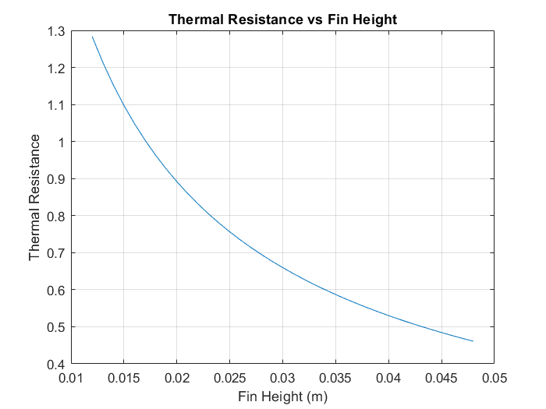
Fin height vs Heat Convection Coefficent

Slide 3
Study 1 (4.8 cm fin)
hfin = 17 W/m-K
Ambient temperature 20 Celcius
Loss, 6,5 Watt per GaN

Slide 4
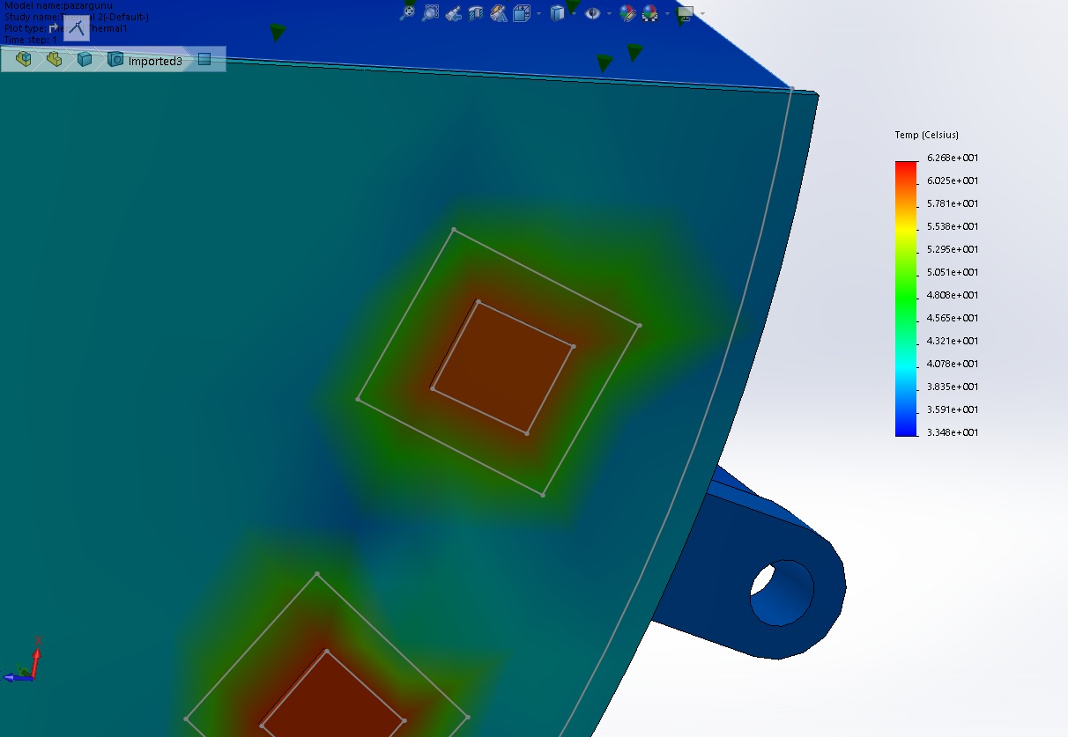
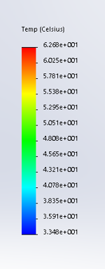

Slide 5

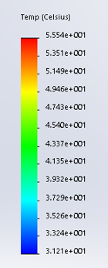

Slide 6
Study 2 (4.8 cm fin)
hfin = 17 W/m-K
Ambient temperature 40 Celcius
Loss, 5,4 Watt per GaN

Slide 7
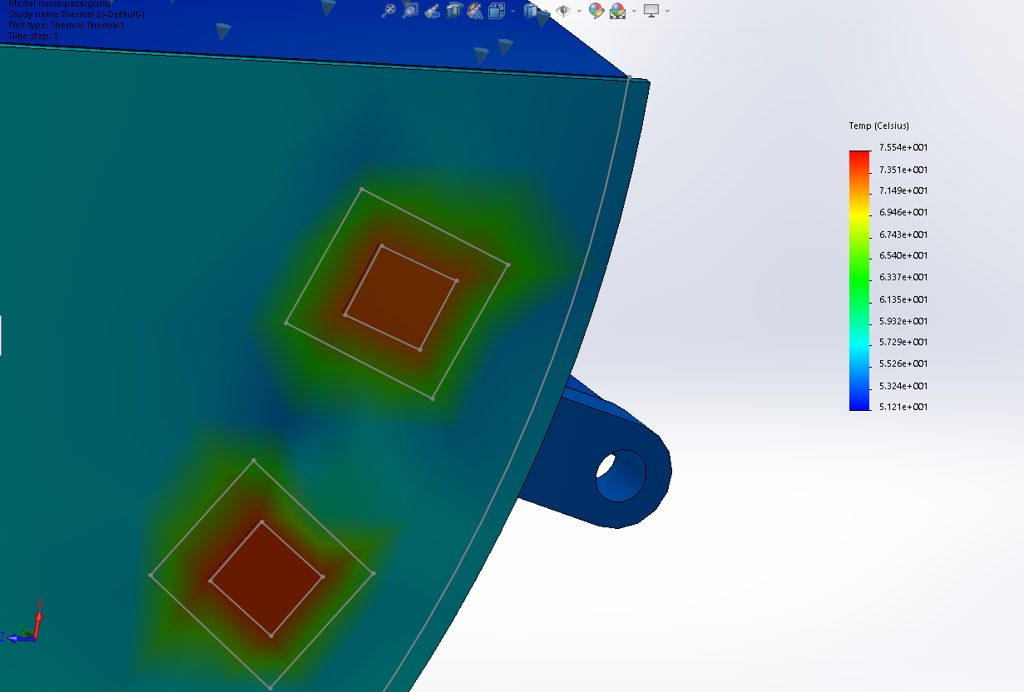
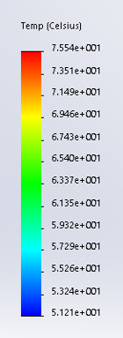

Slide 8

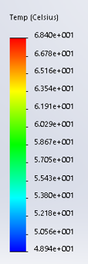

Slide 9
Study 3 (2.4 cm fin)
hfin = 19.2 W/m-K
Ambient temperature 40 Celcius
Loss, 6,5 Watt per GaN

Slide 10
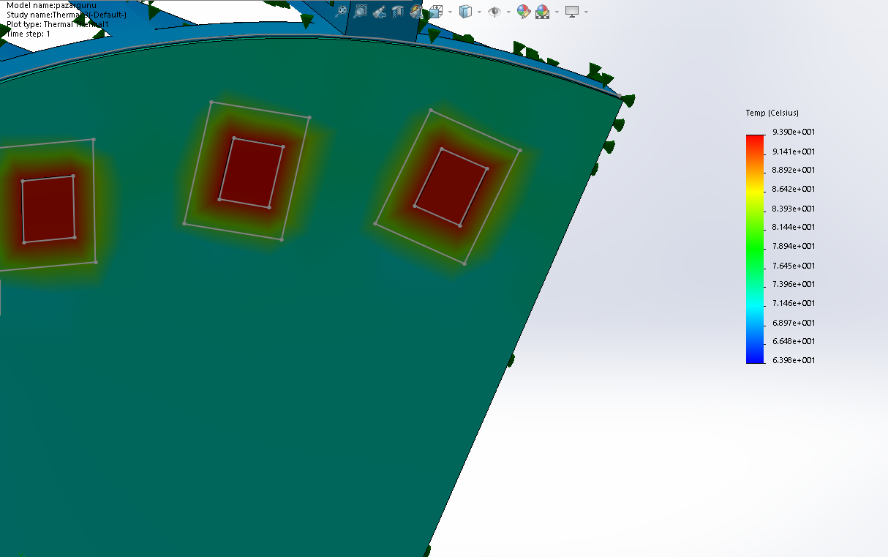
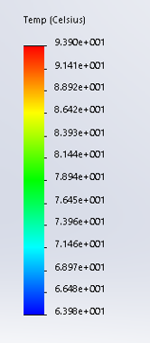

Slide 11
