Slide 1
Thermal FEA

Slide 2
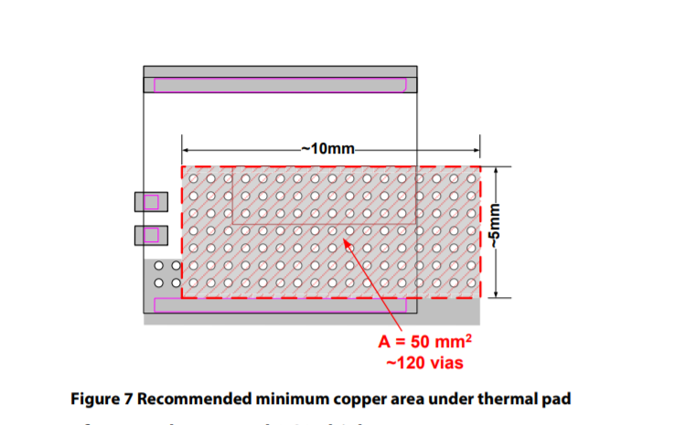
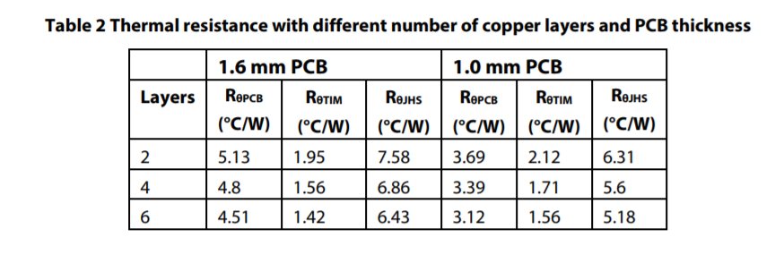



$$R_{pcb}=\frac{l}{ρA}$$
$$ρ=\frac{l}{R_{pcb}A}$$
$ρ=$5.8997 W/m-K

Slide 3
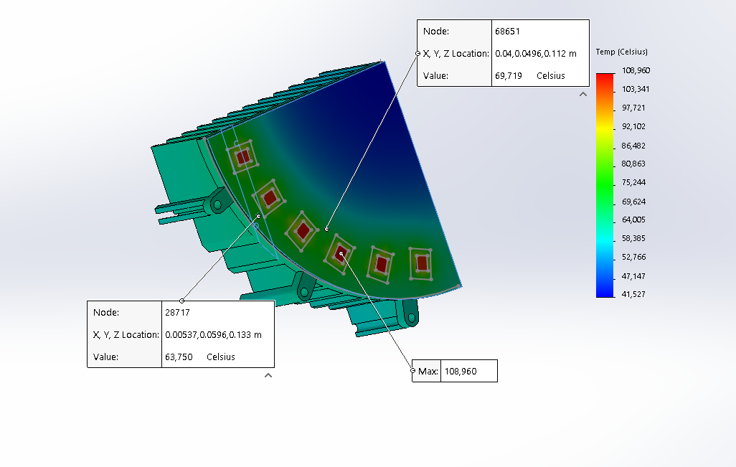




$$P_{GaN}=10 W$$
$$T_{amb}= {40 C}^{o}$$
$$h_{fe}=18W/(m−K )$$
$$h_{be}=5W/(m−K )$$

Slide 4
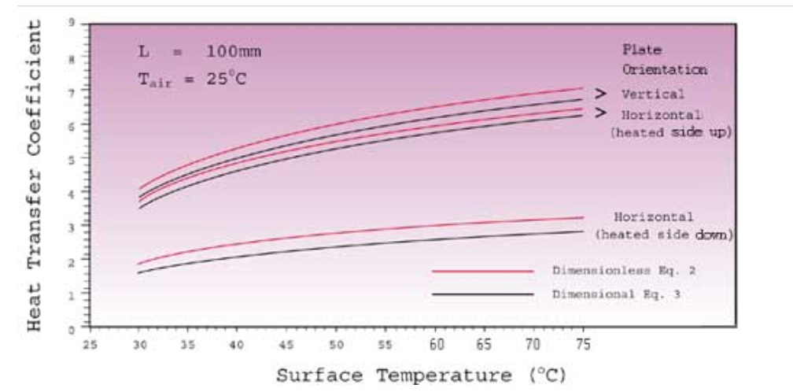

Slide 5
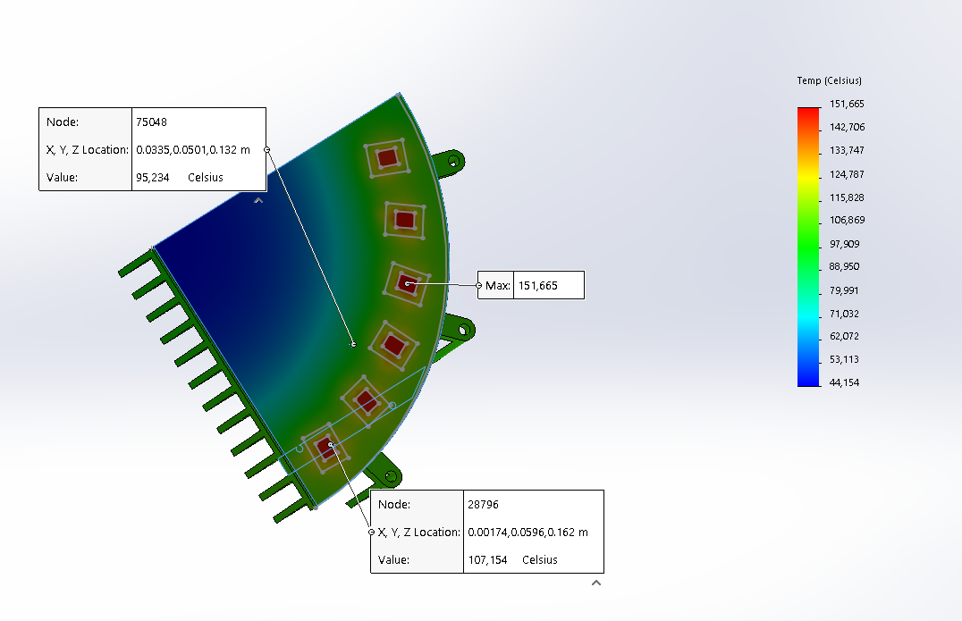



$$h_{c}=5W/(m−K )$$
$$P_{GaN}=10 W$$
$$T_{amb}= {40 C}^{o}$$

Slide 6



$$h_{c}=5W/(m−K )$$
$$P_{GaN}=10 W$$
$$T_{amb}= {40 C}^{o}$$

Slide 7
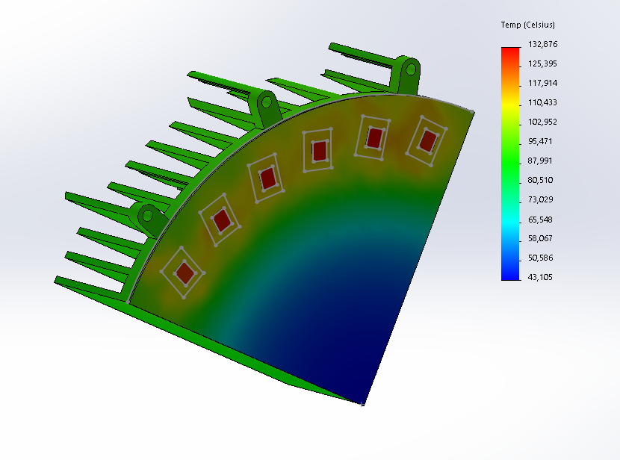



$$h_{c}=6W/(m−K )$$
$$P_{GaN}=10 W$$
$$T_{amb}= {40 C}^{o}$$

Slide 8
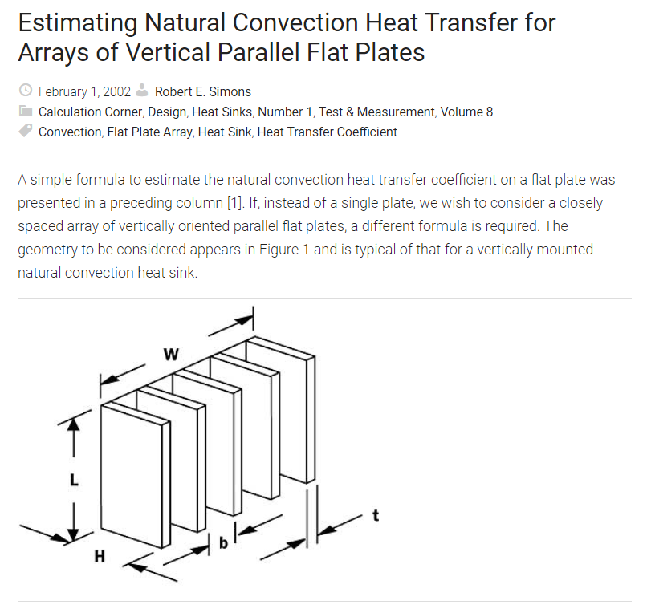
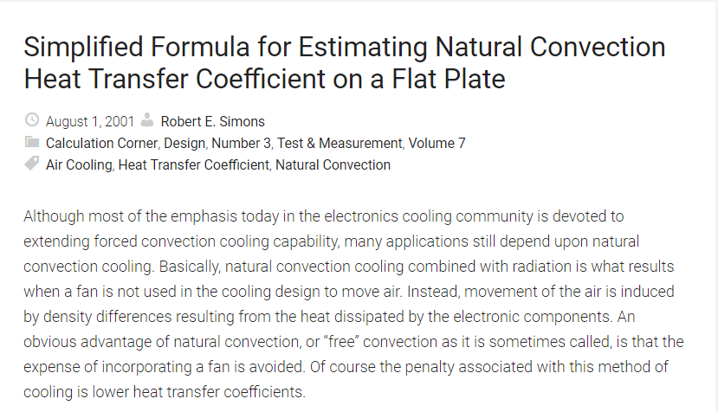

Estimating natural convection for heat-sink
$h_{fin}$
$h_{base}$

Slide 9
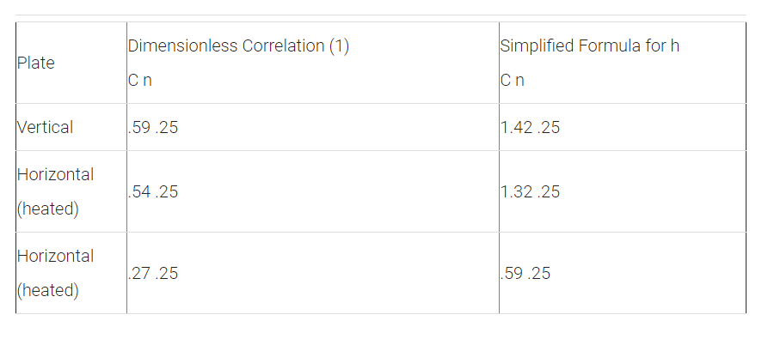
Estimating natural convection for heat-sink
Simplified Formula for h
Dimensionless Correlation

Slide 10
