Slide 1

The effect of Fin Height on Natural Convection Coefficient

Slide 2
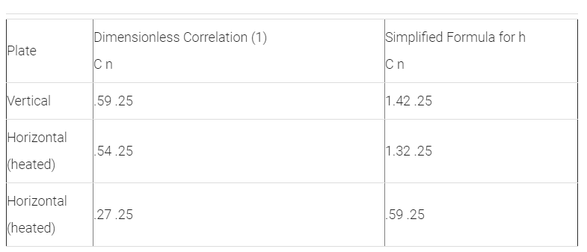
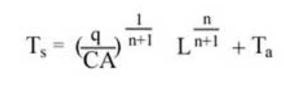
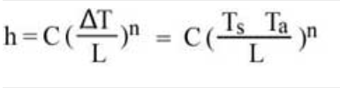

Estimation of Natural Convection Flat surfaces (Base of the heat sink)
Two method proposed
Dimensionless Number Correlations
Boundary condition (Surface temperature needed.)
Simplified formula (Comes from DNC &Newton rate equation)
Boundary condition estimated
$T_{s}$ = surface temperature
q = Heat power entering the surface
L = Vertical length of the solid
C and n are constants

Slide 3
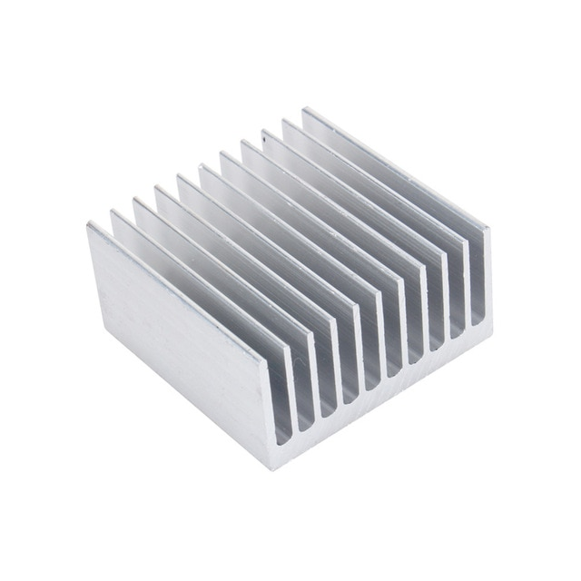
Estimation of Natural Convection Flat surfaces (Base of the heat sink)
Last time I used DNC
Boundary conditions are guessed last time
Now, surface temperature founded by simplified formula
Assumptions
Fins are normalized
All heat splitted equally

Slide 4
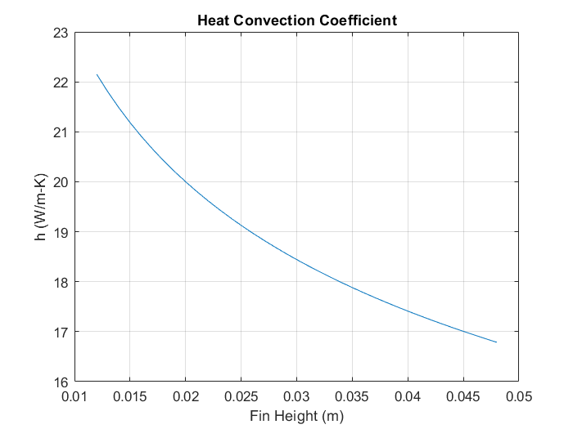
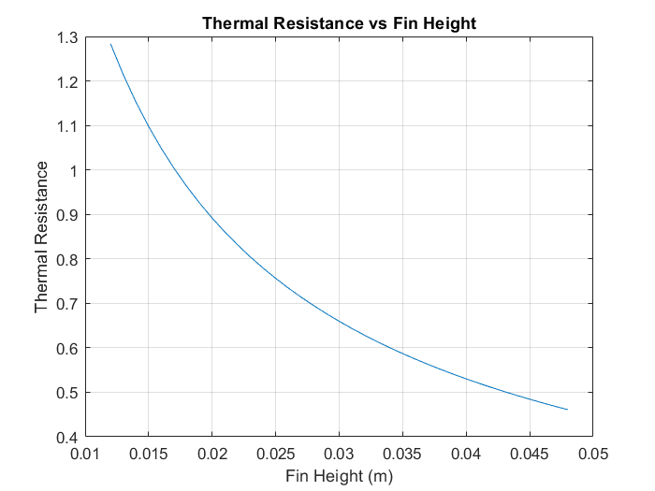
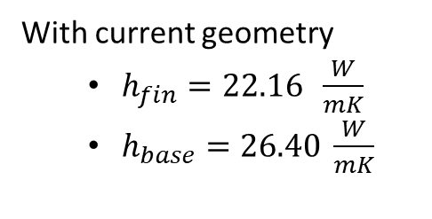
With current geometry
$h_{fin}=22.16 \frac{W}{mK}$
$h_{base}=26.40 \frac{W}{mK}$
The reason for fin efficieny?

Slide 5
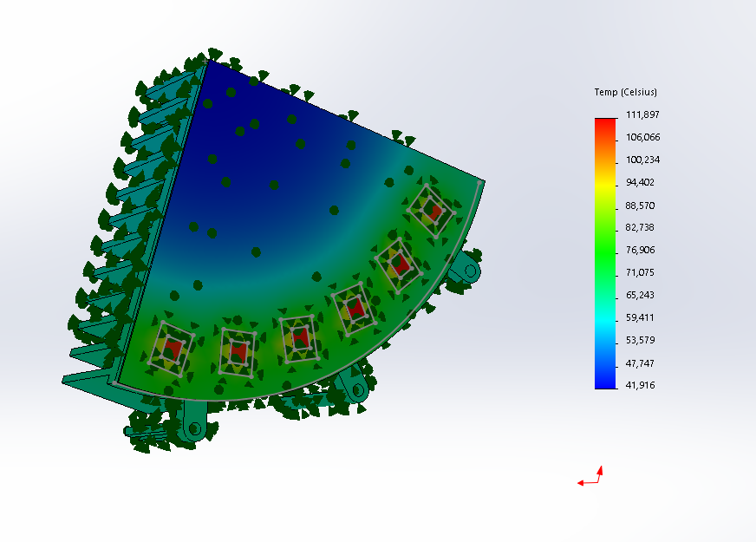
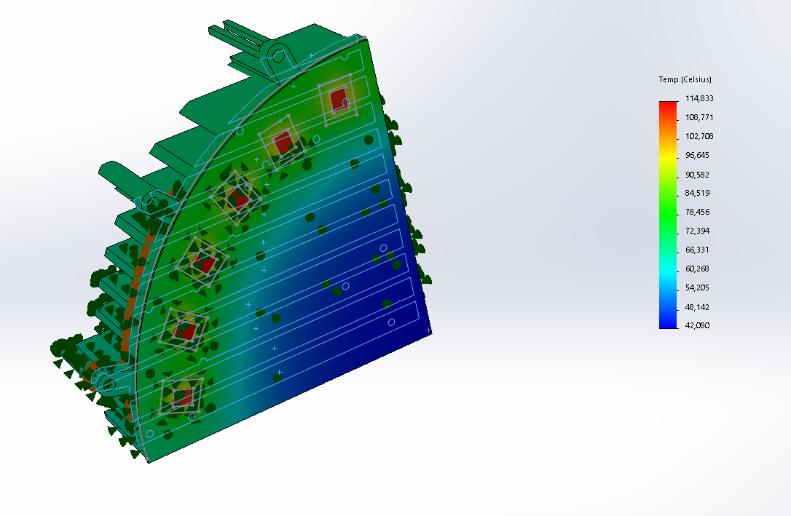
Fin height = 4.8 cm
Fin height = 3.8 cm

Slide 6
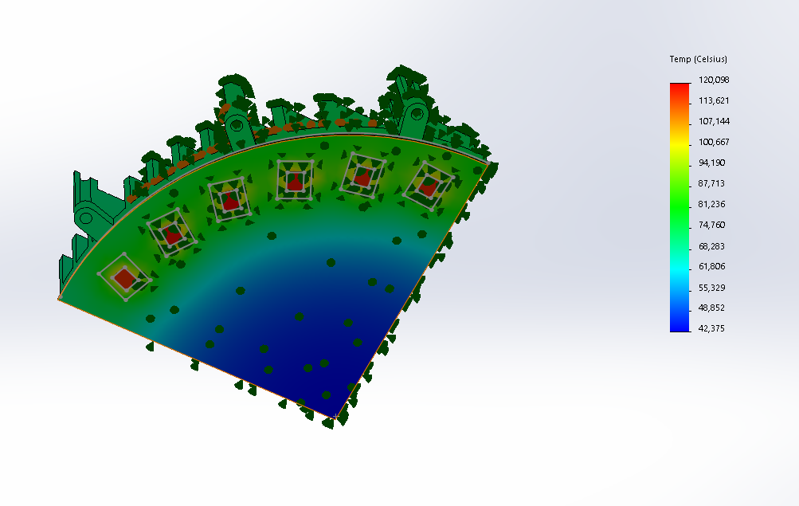
Fin height = 2.8cm

Slide 7
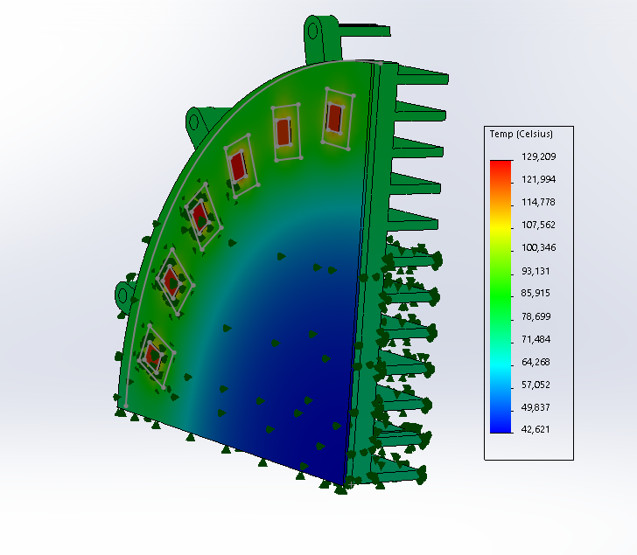
Fin height = 2 cm

