Slide 1
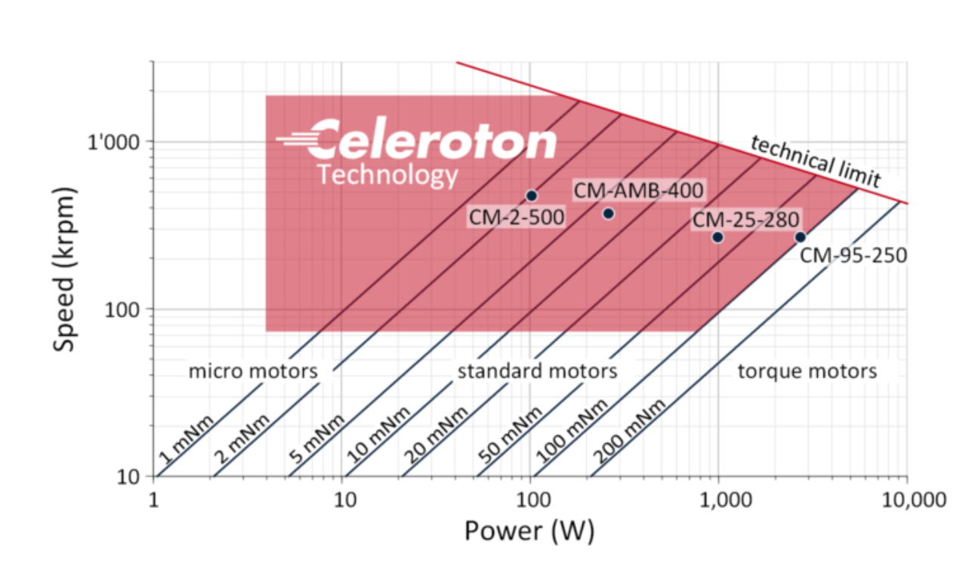
Ultra-high speed electrical machines
General look:
1) Loss distribution, calculation methods (mostly analytical)
2) a few 2D FEM computations (i.e. stray fields)
3) Material choices (litz wire, core materials, sleeves, magnets)
4) Drive (i.e. modulation)
5) Design equations (mechanical, thermal constraints etc.)
Articles:
L. Schwager, A. Tüysüz, C. Zwyssig and J. W. Kolar, "Modeling and Comparison of Machine and Converter Losses for PWM and PAM in High-Speed Drives," in IEEE Transactions on Industry Applications, vol. 50, no. 2, pp. 995-1006, March-April 2014, doi: 10.1109/TIA.2013.2272711.
J. Luomi, C. Zwyssig, A. Looser and J. W. Kolar, "Efficiency Optimization of a 100-W 500 000-r/min Permanent-Magnet Machine Including Air-Friction Losses," in IEEE Transactions on Industry Applications, vol. 45, no. 4, pp. 1368-1377, July-aug. 2009, doi: 10.1109/TIA.2009.2023492.
D. Krähenbühl, C. Zwyssig, H. Weser and J. W. Kolar, "A Miniature 500 000-r/min Electrically Driven Turbocompressor," in IEEE Transactions on Industry Applications, vol. 46, no. 6, pp. 2459-2466, Nov.-Dec. 2010, doi: 10.1109/TIA.2010.2073673.
C. Zwyssig, S. D. Round and J. W. Kolar, "An Ultrahigh-Speed, Low Power Electrical Drive System," in IEEE Transactions on Industrial Electronics, vol. 55, no. 2, pp. 577-585, Feb. 2008, doi: 10.1109/TIE.2007.911950.
** Zwyssig’s Thesis (Kolar’s student) C. Zwyssig, S. D. Round and J. W. Kolar, "An Ultrahigh-Speed, Low Power Electrical Drive System," in IEEE Transactions on Industrial Electronics, vol. 55, no. 2, pp. 577-585, Feb. 2008, doi: 10.1109/TIE.2007.911950.
List continues
2007-2014
There is also a PhD thesis.

Slide 2
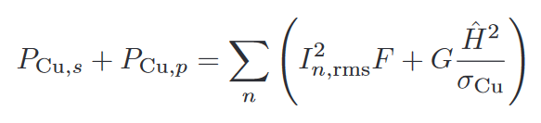
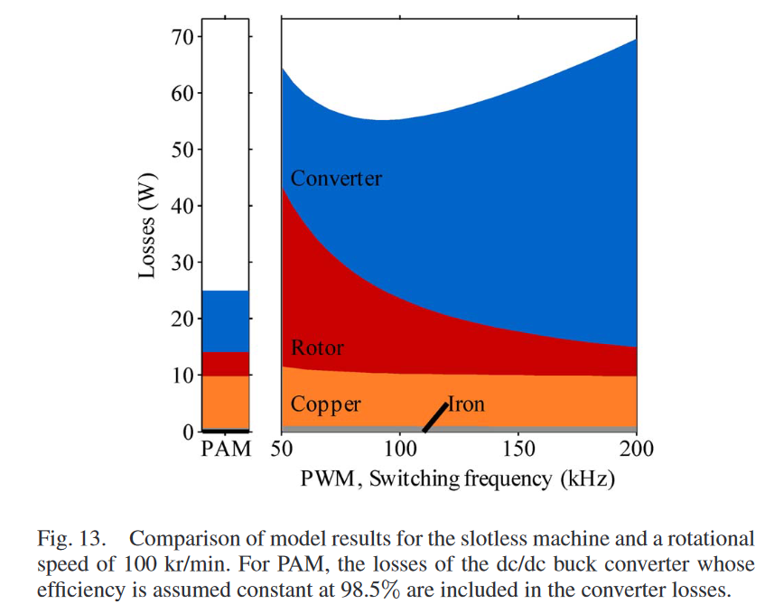

Zwyssig’s Article (Kolar’s student, the founder of the Celeroton)
Copper Loss – seems constant
Eddy loss
Proximity loss
Max. $η$
Ref: J. A. Ferreira, Electromagnetic Modeling of Power Electronic Converters. Norwell, MA, USA: Kluwer, 1989.
F, and G are almost constant in some predefined frequency range (which is heavily dependent on conductor diameter).
F, and G can be calculated analytically with Bessel functions.
Ref: J. Muhlethaler (Kolar’s student), “Modeling and multi-objective optimization of inductive ¨ power components,” Ph.D. dissertation, Dept. Elect. Eng, Swiss Federal Inst. Technol. Zurich (ETHZ), Zurich, Switzerland, 2012
Lower rotor loss
Constant copper loss? (Litz wire dimensions are missing, probably they are using really thin litz. )

Slide 3
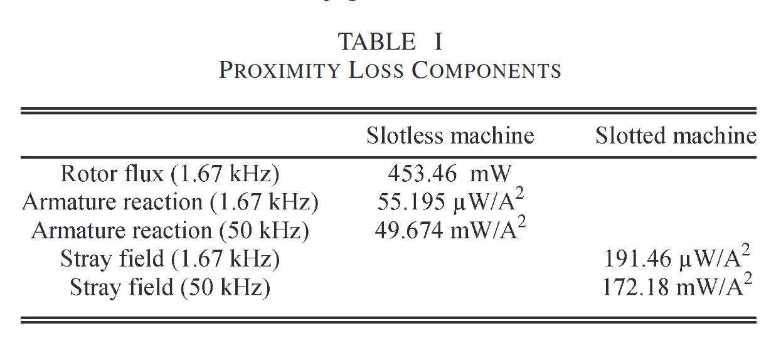
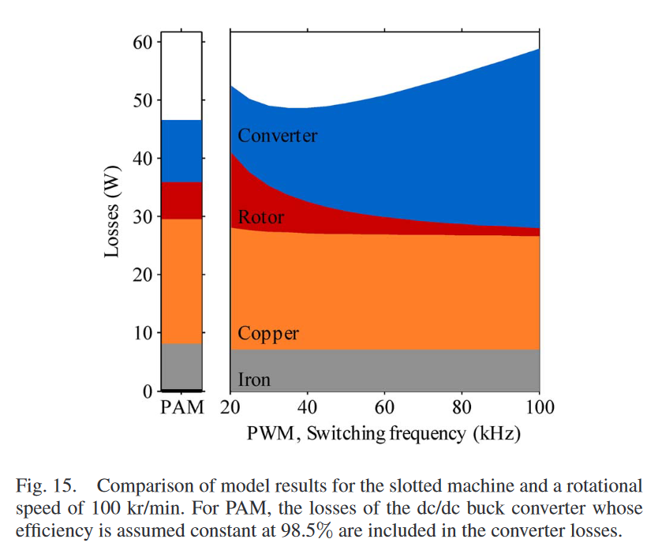
Slotless vs Slotted machine
Proximity loss mechanisms
Slotless: Two main flux sources (armature, and rotor fields)
Armature field is not that strong due to large effective airgap. (low inductance) (But it may has serious amount high time frequency components)
Proximity loss
Slotted: Most of the flux goes through teeth, so only stray flux creates proximity.
Slotless
Slotted
Stray field is more dominant
That is why slotted machine has more copper loss
more proximity loss
more core loss

Slide 4
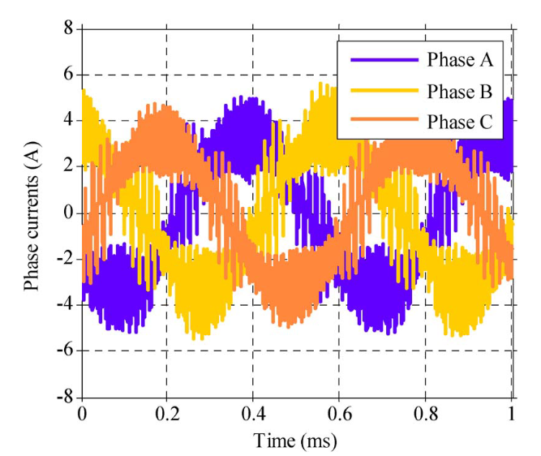
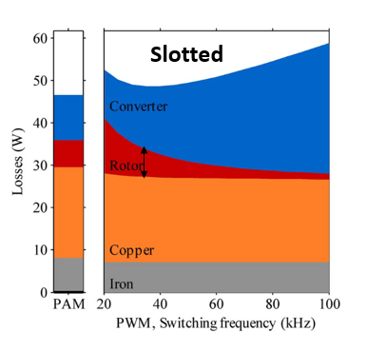
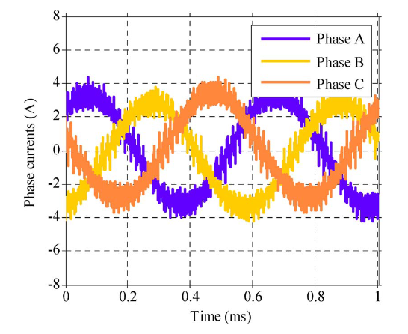


Slotless vs Slotted machine
Rotor loss (eddy current reaction)
It is mostly related to the armature field time harmonics.
Slotless machine has less inductance (as effective airgap is larger) than slotted machine.
Higher amplitude switching current
More rotor loss
Rotor loss decreases with frequency
Why?
f
$${\hat{I}}_{high}$$
Ideally we can say that eddy loss should be constant.
But, high frequency make diffusion difficult
$$P_{rotor}$$
Slotless
Slotted
Slotless
more rotor loss (PWM)
Slotted

Slide 5
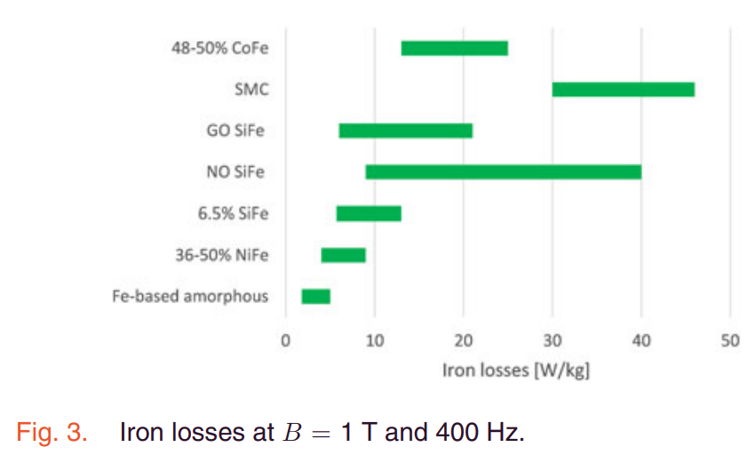
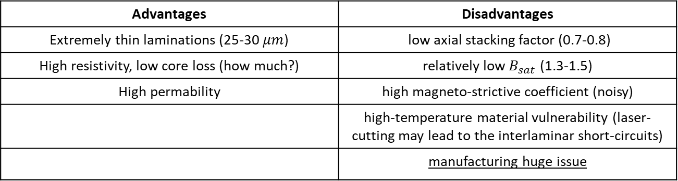
Slotless vs Slotted machine
Core loss
Material: Amorphous Iron
Typical choices: SiFe, NiFe, Amorphous Iron, SMC
SMC: poor mechanical performance, non-uniform density for specific geometries
SiFe (high Si): general choise, thin laminations are required (0.1 mm)
NiFe: suggested for high speed applications*, lower core losses??? (not significant)
Amorphous Iron: high permability, low core loss, Celeroton choise?? **
Core loss typically 20-30 % of the overall losses.
However, in the article it is extremely low.
** Zwyssig’s Thesis (Kolar’s student) C. Zwyssig, S. D. Round and J. W. Kolar, "An Ultrahigh-Speed, Low Power Electrical Drive System," in IEEE Transactions on Industrial Electronics, vol. 55, no. 2, pp. 577-585, Feb. 2008, doi: 10.1109/TIE.2007.911950.
Advantages | Disadvantages
Extremely thin laminations (25-30 $μm$) | low axial stacking factor (0.7-0.8)
High resistivity, low core loss (how much?) | relatively low $B_{sat}$ (1.3-1.5)
High permability | high magneto-strictive coefficient (noisy)
 | high-temperature material vulnerability (laser-cutting may lead to the interlaminar short-circuits)
 | manufacturing huge issue
* A. Krings, M. Cossale, A. Tenconi, J. Soulard, A. Cavagnino and A. Boglietti, "Magnetic Materials Used in Electrical Machines: A Comparison and Selection Guide for Early Machine Design," in IEEE Industry Applications Magazine, vol. 23, no. 6, pp. 21-28, Nov.-Dec. 2017, doi: 10.1109/MIAS.2016.2600721.
F. R. Ismagilov, L. Papini, V. E. Vavilov and D. V. Gusakov, "Design and Performance of a High-Speed Permanent Magnet Generator with Amorphous Alloy Magnetic Core for Aerospace Applications," in IEEE Transactions on Industrial Electronics, vol. 67, no. 3, pp. 1750-1758, March 2020, doi: 10.1109/TIE.2019.2905806.

Slide 6
Main Idea
Assuming contant loss budget
f
Decreases rotor loss (which may be an advantageous as rotor cooling can be challenging.)
Increases converter loss (obviously)
Don’t change core loss significantly (questionable, it can be related with material)
Slotted
Slotless
Increases rotor loss (as the inductance is lowered, maybe solved additional inductor or with an increase in converter’s inductance)
Decreases copper loss (stray field can be larger than armature’s field -> more proximity loss)
Decreases core loss (larger effective air-gap, lower air-gap flux densities, less iron part no tooth)
Increases converter loss (reasons) But converter can be cooled more easily
PWM
PAM
PAM is more convenient in high frequency machines (Why? harmonic spectrum)
Material: Amorphous Iron, alternatives High-Si SiFe (common choice), nanocrystalline metals???
Manufacturing challenges vs low core loss
Bearings: Celeroton use ball bearings, alternatives are air bearing, magnetic bearings

Slide 7
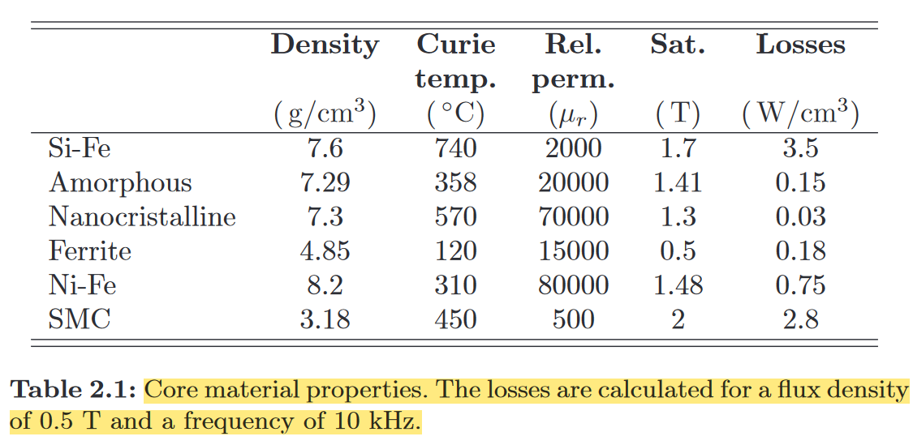
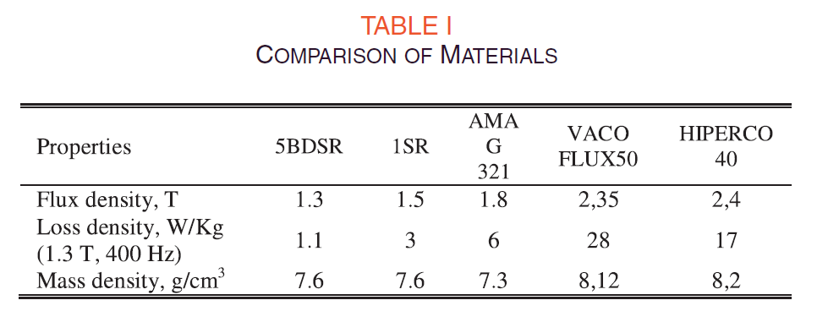

Slide 8
Slotless vs Slotted machine
Modulation

