Slide 1

A Dissertation Submitted for Fulfillment for the Requirement of the Degree of Bachelor of Science in Statistics.
1
Presented By
Naimur Rahman Naim ID: 18STA014 Session: 2018-2019 Department of Statistics
Md. Shohel Rana ID: 18STA041 Session: 2018-2019 Department of Statistics
Tushar Ahmmad ID: 18STA055 Session: 2018-2019 Department of Statistics
Bangabandhu Sheikh Mujibur Rahman Science and Technology University ; Gopalganj-8100

Slide 2
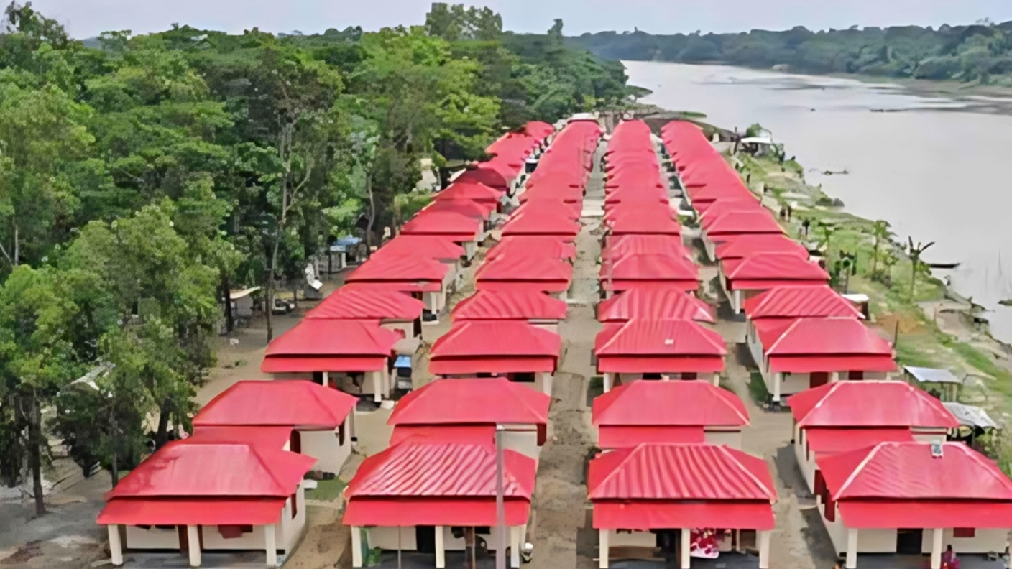
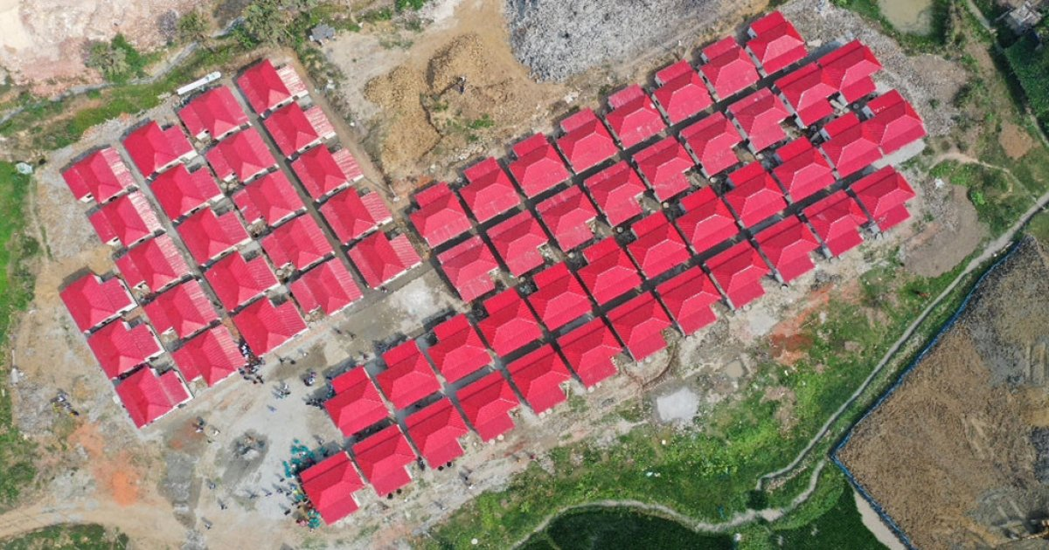
2

Slide 3
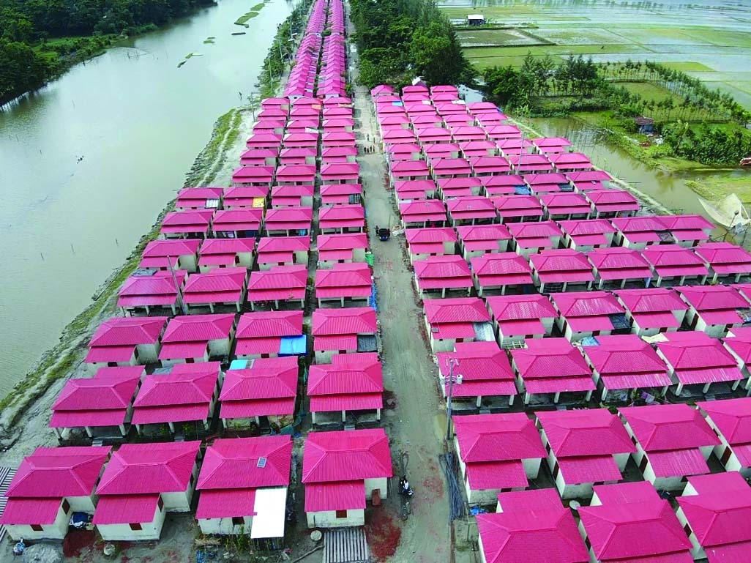
3
B
D
C
A
Outline of The Presentation
Methodology
Conclusion
Result Discussion
Introduction

Slide 4
C
R
I
O
M
Results Discussions
Methodology
Introduction
Objectives
Conclusion

Slide 5
4
I
O
M
R
C
Introduction
Objectives
Methodology
Results & Discussions
Conclusion

Slide 6
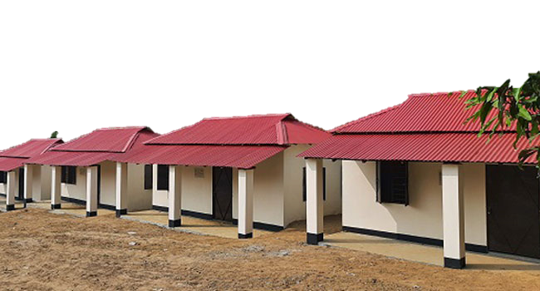
5
C
R
I
O
M
Housing is one of the basic liberties like food, clothing, etc., and it is important for a human being to live with dignity. Since its inception in 1997, the Bangladesh government funded a multi-phased project named “Ashrayan” that helped thousands of homeless and landless families nationwide by offering them housing, and socioeconomic support.
Results Discussions
Methodology
Introduction
Objectives
Conclusion

Slide 7
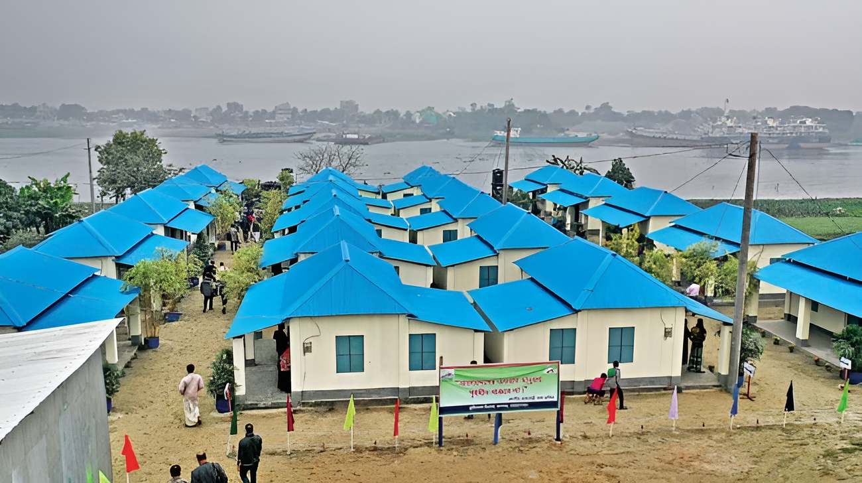
6
O
1. To evaluate the Socioeconomic impact of the people of the Ashrayan project in Gopalganj District.
Objectives
2. To assess the project's effectiveness in improving the quality of life for homeless individuals.

Slide 8
7
M
Data Source
Sampling Technique
Methodology
Data Collection
Data Analysis

Slide 9
We take our data only from primary sources.
8
Data Source
Sampling Technique
Data Collection
Data analysis
Univariate
Bivariate
Pearson Chi-Square
Logistic Regression
Binary Logistic Regression
We used stratified sampling to select a representative sample from the diverse population of Gopalganj District which was divided into five strata based on their upazila.
This approach aimed to provide a more accurate representation of the population and enhance the validity of the research findings.
We take our data only from the people of Ashrayan project of Gopalganj through face-to-face or interviewing process.

Slide 10
Results Analysis and Discussions
9
Univariate
Figure: Graphical representation of the age of the respondents
Figure: Graphical representation of the respondents by gender.

Slide 11
Results Analysis and Discussions
10
Univariate
Figure: Graphical representation of the respondents by Education Level
Figure: Graphical representation of the residents by Family Types

Slide 12
Results Analysis and Discussions
11
Univariate
Figure: Graphical representation of the residents by Family Member
Figure: Graphical representation of the respondents by Earning member

Slide 13
Results Analysis and Discussions
12
Univariate
Figure: Graphical Representation of the Respondents by overall condition has improved or not
Figure: Graphical Representation of the Respondents by Monthly Income

Slide 14
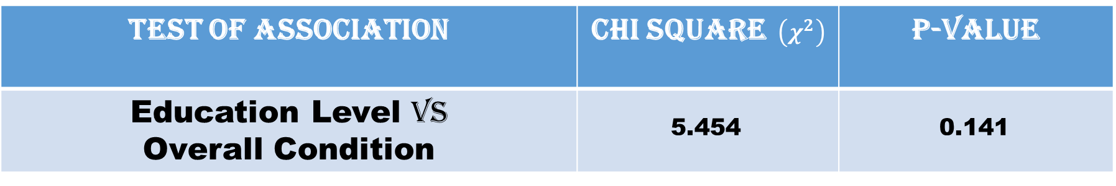
Results Analysis and Discussions
13
bivariate
H₀ : There is no significant association. H₁ : There is a significant association.
Test of Association | Chi square $\left(χ^{2}\right)$ | P-value
Education Level vs Overall Condition | 5.454 | 0.141
Health vs Overall Condition | 17.803 | < 0.001
Child Education Facility vs Overall Condition | 5.674 | 0.017
Living Condition vs Overall Condition | 9.951 | 0.041
Security vs Overall Condition | 1.004 | 0.80

Slide 15
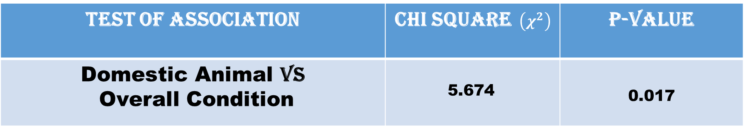
bivariate
14
H₀ : There is no significant association. H₁ : There is a significant association.
Test of Association | Chi square $\left(χ^{2}\right)$ | P-value
Domestic Animal vs Overall Condition | 5.674 | 0.017
Housing Condition vs Overall Condition | 17.803 | < 0.001
Economical Condition vs Overall Condition | 14.441 | 0.006
Employment vs Overall Condition | 4.750 | 0.029
Average Monthly Income vs Overall Condition | 15.189 | 0.010

Slide 16
Results Analysis and Discussions
15
Logistic Regression
Table: Logistic Regression Analysis
Variables in the Equation | B | S.E. | Sig. | Odds Ratio | 95% C.I.for EXP(B)
 |  |  |  |  | Lower | Upper
Education Facilities | 0.331 | 0.458 | 0.469 | 0.718 | 0.293 | 1.761
Electricity | 0.478 | 0.422 | 0.257 | 1.613 | 0.705 | 3.692
Have domestic animal | 0.863 | 0.591 | 0.144 | 2.371 | 0.744 | 7.557
Improvements of Housing Condition | 3.833 | 0.525 | <0.001 | 46.221 | 16.510 | 129.398
Monthly Income
0-5k | -1.378 | 0.785 | 0.079 | 0.252 | 0.054 | 1.175
5k-10k (ref) | 0.176 | 0.850 | 0.010 | 0.113 | 0.021 | 0.600
10k-15k | -0.276 | 0.875 | 0.752 | 0.759 | 0.137 | 4.212
15k-20k | -0.765 | 1.116 | 0.493 | 0.465 | 0.052 | 4.147
20k-25k | 1.319 | 1.260 | 0.295 | 3.740 | 0.316 | 44.230
Employment | -1.444 | 0.569 | 0.011 | 0.236 | 0.077 | 0.720
Health | 0.835 | 0.197 | 0.089 | 0.715 | 0.486 | 1.053
Living Condition
Strongly Improved | -1.432 | 0.898 | 0.111 | 0.239 | 0.041 | 1.388
Improved (ref) | 1.047 | 0.826 | 0.205 | 0.351 | 0.069 | 1.772
Not Improved | 0.016 | 0.863 | 0.985 | 1.016 | 0.187 | 5.513
Strongly Not Improved | -0.439 | 1.119 | 0.695 | 0.644 | 0.072 | 5.780
Satisfaction
Strongly Improved | 0.479 | 0.613 | 0.434 | 1.615 | 0.486 | 5.369
Improved (ref) | 1.002 | 0.731 | 0.170 | 2.724 | 0.650 | 11.408
Not Improved | 2.231 | 0.959 | 0.020 | 9.314 | 1.422 | 61.000
Strongly Not Improved | 18.779 | 19.969 | 1.000 | 43.168 | 0.000 | .
Economical Condition | -0.870 | 0.431 | 0.044 | 0.419 | 0.180 | 0.975
Constant | -0.561 | 1.954 | 0.774 | 0.570

Slide 17
16
D
Discussion
Housing Conditions OR: 46.221 P<.001
Children's’ Education P=0.017
Health P<.001
Income Challenges P=.010 (5k-10k)
Employment P=.029
Education level 48.9% (illiterate)
Discussions

Slide 18
17
C
“In conclusion, while the Ashrayan Project has successfully improved living conditions for homeless individuals, shelter alone is not enough. Comprehensive support, particularly in education, income generation, and healthcare, is needed to ensure long-term socio-economic stability.”
Conclusion

Slide 19
18
R
Need for job creation programs
[ Can plan a micro-loan scheme specially for the Ashrayan Project’s people ]
Focus on healthcare services
[ Family Planning or Health complex programs can be held on a monthly basis ]
Enhance education and skill development
Recommendation

Slide 20
Assessing the Social and Economic Conditions of Beneficiaries under the Ashrayan Project in Bangladesh: A Critical Study. From https://www.researchgate.net/publication/383901033_Assessing_the_Social_and_Economic_Conditions_of_Beneficiaries_under_the_Ashrayan_Project_in_Bangladesh_A_Critical_Study
19
R
2. AN EVALUATION OF ASRAYON PROJECT AT DEBIDWAR, COMILLA IN BANGLDESH. From 339_Sayeed's_Thesis_Final.pdf (northsouth.edu)
3. Parvin, A., Hakim, S. S., & Islam, M. (2022, May 29). Policy, design, and way of life in settlement projects: The case of Ashrayan, Bangladesh. International Journal of Disaster Risk Reduction, 77, 1-15. From, https://doi.org/10.1016/j.ijdrr.2022.103073
4. Mallick, P., & Mostafa, A. (2022, November 17). Housing Transformation Process in Government Provided Rehabilitation Project: A Study of Bhandarpara Ashrayan Prokolpo. Khulna University Studies(Special Issue (ICSTEM4IR)), 484–494. From, https://doi.org/10.53808/KUS.2022.ICSTEM4IR.0185-se
5. Ahmed, F., Rahman, A., & Khatun, A. (2019). The Role of Health Services in Socioeconomic Development: Evidence from Bangladesh. Journal of Health Economics, 28(4), 542-559. From, Full article: The role of information and communication technologies in socio-economic development: towards a multi-dimensional framework* (tandfonline.com)
Reference

Slide 21
20
Acknowledgment
We thank our supervisor Dr. Rehena Parveen for guiding us to build such a constructive thesis paper.

Slide 22
21
THANK YOU ALL

