Slide 1


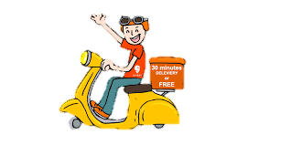
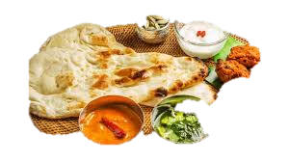
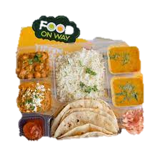
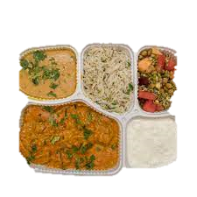
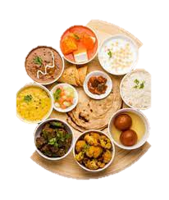
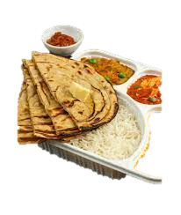
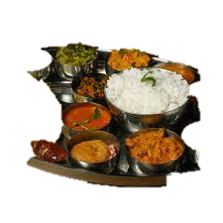
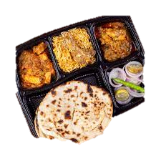
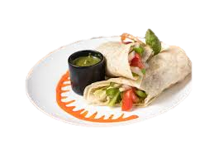
Banglore Swiggy Data Analysis
Prashant Naima
iNeuron.ai

Slide 2
OBJECTIVES -
To get the insights of the Restaurants comparison of different areas in Bangalore (India). The insight includes the top Restaurants by rating and price of the cuisines, it also provides us the leverage to select the top Restaurants by area-wise.
To get the insights about the top Restaurants according, the ratings must be between 3.60 to 4.80 and there is slicer for price range, the data would be change when we increase of decrease the price range. These insights will help the stakeholders to decide which Restaurant is the best in a particular area with top rating.

Slide 3
DATA SHARING AGREEMENT -
Sample File Name (ex. Swiggy Bangalore Outlet Details.csv)
Length of Data Stamp (8 digits)
Length of Time Stamp (6 digits)
Number of columns
Column Name
Column Data Type

Slide 4
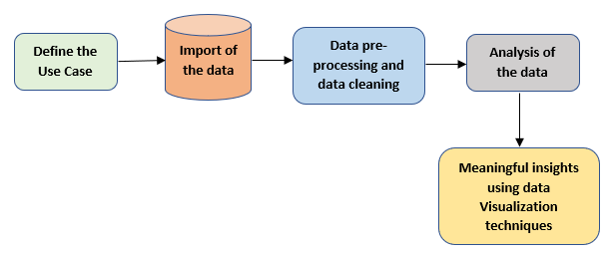
ARCHITECTURE -

Slide 5
DATA OVERVIEW -
The Data includes single .csv file with all examples.
The Number of Instance - 119 for Swiggy Bangalore Outlet Details.csv
Number of attributes – 5 attributes

Slide 6
KEY PERFORMANCE INDICATORS-
Key indicators displaying a summary of the shop name with cuisine, information based on various parameters –
Name of Shops in Bangalore.
Name of cuisine corresponding to the given shop.
Location of the Shop in Bangalore.
Rating of the shop (Between 1 to 5).
Cost_for_Two (food price for two people).

Slide 7
INSIGHT SUMMARY -
There are 115 Restaurants in Bangalore with 79 different cuisines in 4 different location (according to the given dataset).
The top 5 Restaurants in Koramangala by rating is Khichdi Experiment, Corner House, Natural Ice Cream, Bowl 99 and China Pearl. Also, the top 5 Restaurants by Cost_for_Two is Nagarjuna, Pizza Hut, Taco Bell, Meghana Foods and China Pearl.
There are 4 location in total of out which 3 location are dominating with highest number of Restaurants these are Koramangala. BTM and HSR.
Koramangala has 64 Restaurants, in BTM, there are 35 Restaurants and HSR has 18 Restaurants. and Jayanagar has only one restaurant.

Slide 8
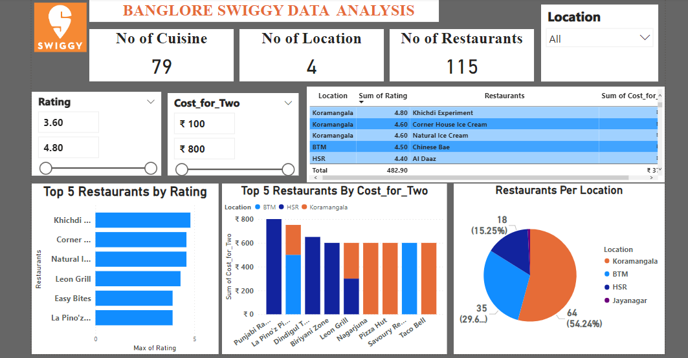
DASHBOARD OVERVIEW

Slide 9
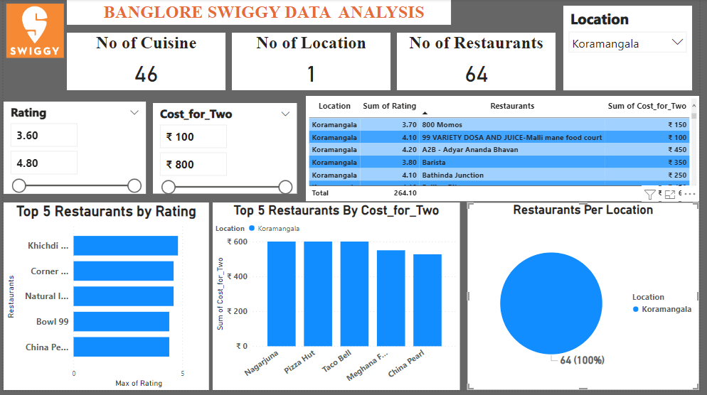
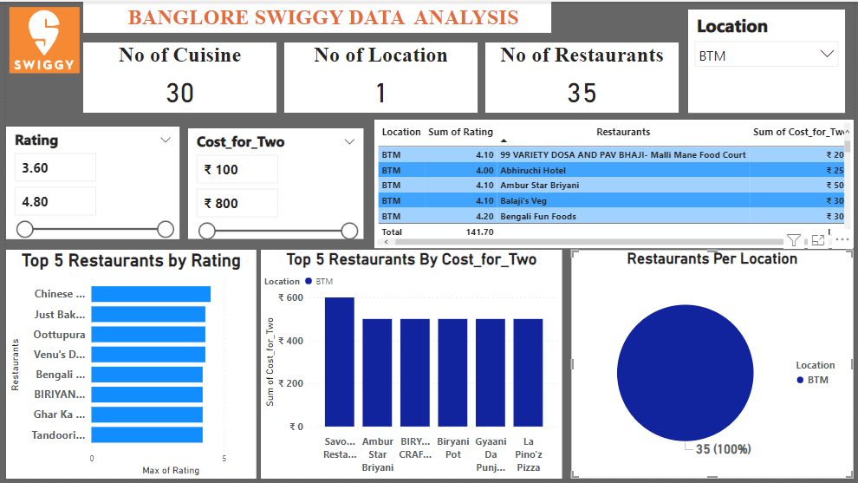
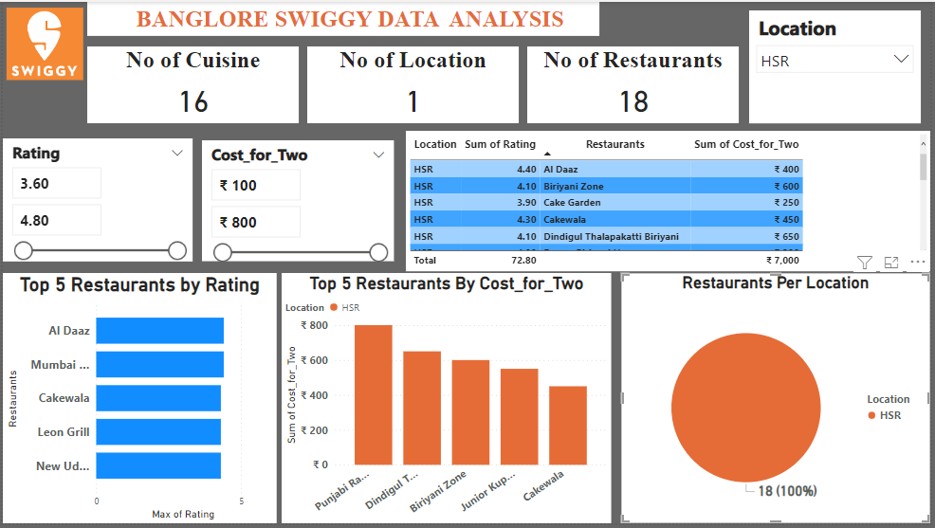
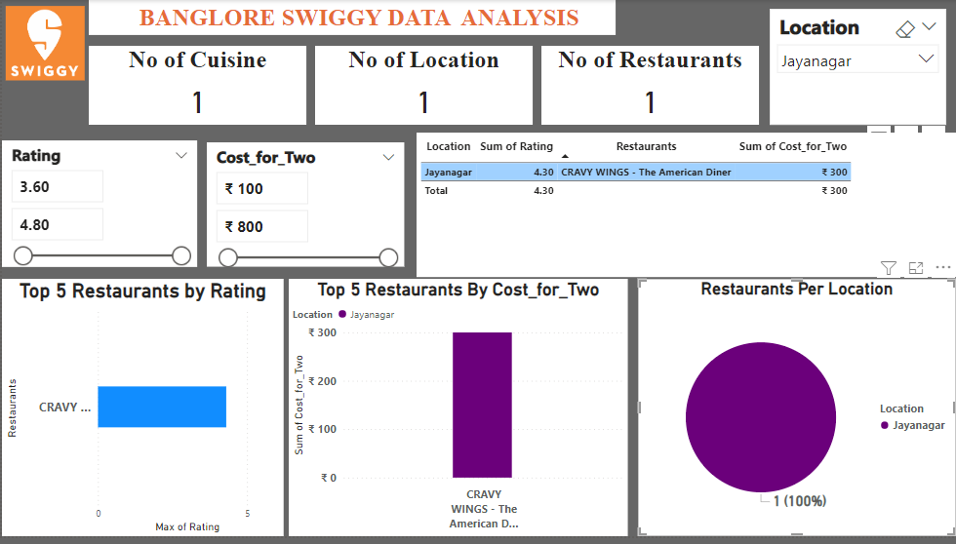
DASHBOARD OVERVIEW

Slide 10
Q & A-
Q.1). What’s the Source of Dataset ?
ANS – This Dataset is publicly available for research, Available at https://drive.google.com/drive/folders/1FkmFVL8wlJmQWP1z52TD8PlhOJhitTyI?usp=s named as Swiggy Bangalore Outlet Details.csv.
Q.2). What was the Type of Dataset ?
ANS – The Data was available in csv format.
Q.3). What’s the complete flow you followed in this Project?
ANS – Refer all slides in sequence for better Understanding.
Q. 4). What steps should I follow to get insights from the data?
Step1 – Download the data and store it in a location in your PC.
Step2 – Open Swiggy_Bangalore_Data_Analysis.pbix file in your pc and then you can see all the insights.

