Slide 1
IQIC PROJECT
TEAM No. 6

Slide 2
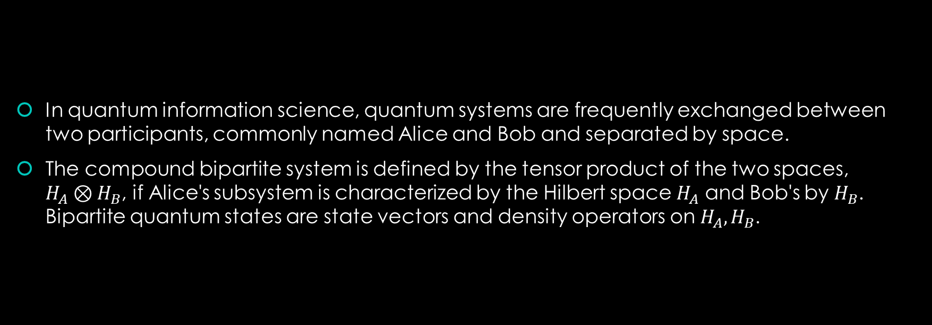
Bipartite Systems
In quantum information science, quantum systems are frequently exchanged between two participants, commonly named Alice and Bob and separated by space.
The compound bipartite system is defined by the tensor product of the two spaces, $H_{A}⊗H_{B}$, if Alice's subsystem is characterized by the Hilbert space $H_{A}$ and Bob's by $H_{B}$. Bipartite quantum states are state vectors and density operators on $H_{A}, H_{B}$.

Slide 3
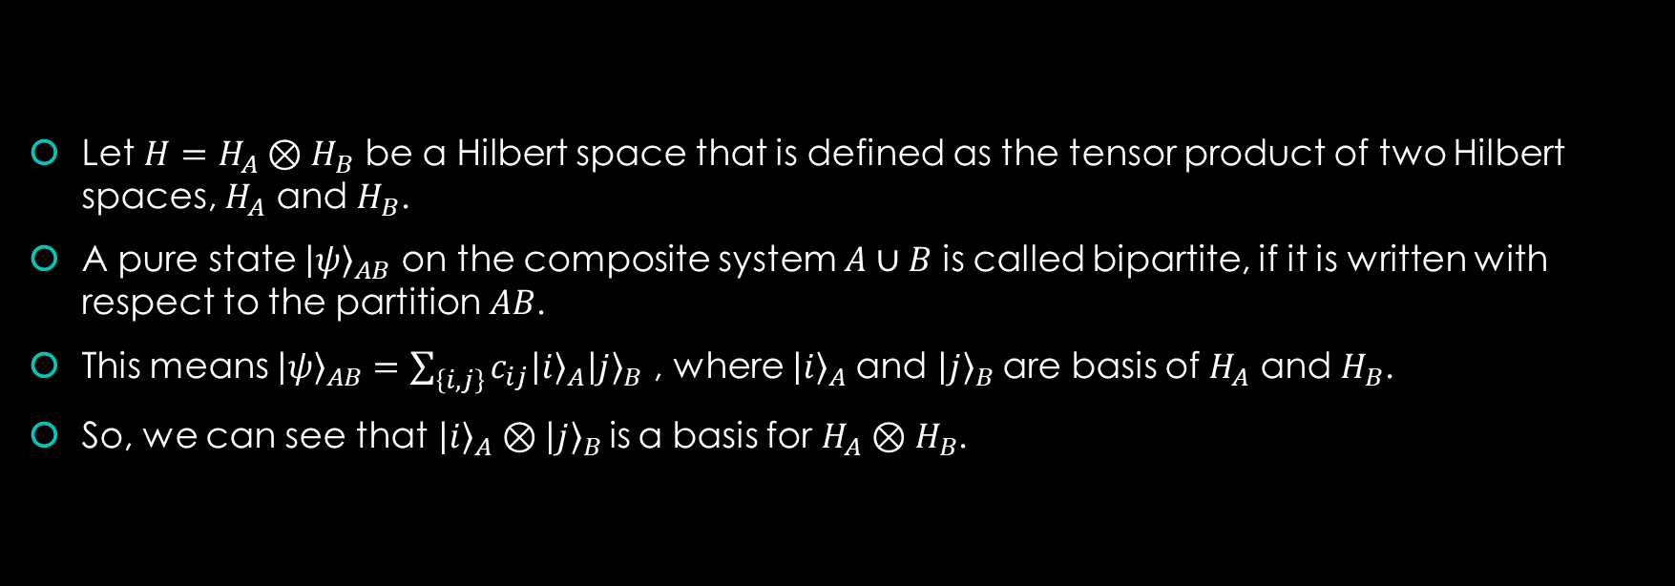
Pure Bipartite State
Let $H=H_{A}⊗H_{B}$ be a Hilbert space that is defined as the tensor product of two Hilbert spaces, $H_{A}$ and $H_{B}$.
A pure state ${\left|ψ\right\rangle }_{AB}$ on the composite system $A∪B$ is called bipartite, if it is written with respect to the partition $AB$.
This means ${\left|ψ\right\rangle }_{AB}=\sum_{\left\{i,j\right\}}{c_{ij}{\left|i\right\rangle }_{A}{\left|j\right\rangle }_{B}}$ , where ${\left|i\right\rangle }_{A}$and ${\left|j\right\rangle }_{B}$are basis of $H_{A}$ and $H_{B}$.
So, we can see that${\left|i\right\rangle }_{A}⊗{\left|j\right\rangle }_{B}$is a basis for $H_{A}⊗H_{B}$.

Slide 4

Mixed Bipartite State
Let $ρ_{AB}$be a mixed state on a composite system $A∪B$.
We then say that it is a mixed bipartite state on $H_{A}⊗H_{B}$if it is written with respect to partition $AB.$
This means that $\sum_{\left\{i,j\right\}}{p_{ij}ρ_{A}^{i}⊗ρ_{B}^{j}}$. Here, $ρ_{A}^{i}$and $ρ_{B}^{i}$are basis in $H_{A}$and $H_{B}$respectively.
So, we can see that$ρ_{A}^{i}⊗ρ_{B}^{j}$ is a basis for $H_{A}⊗H_{B}$.

Slide 5
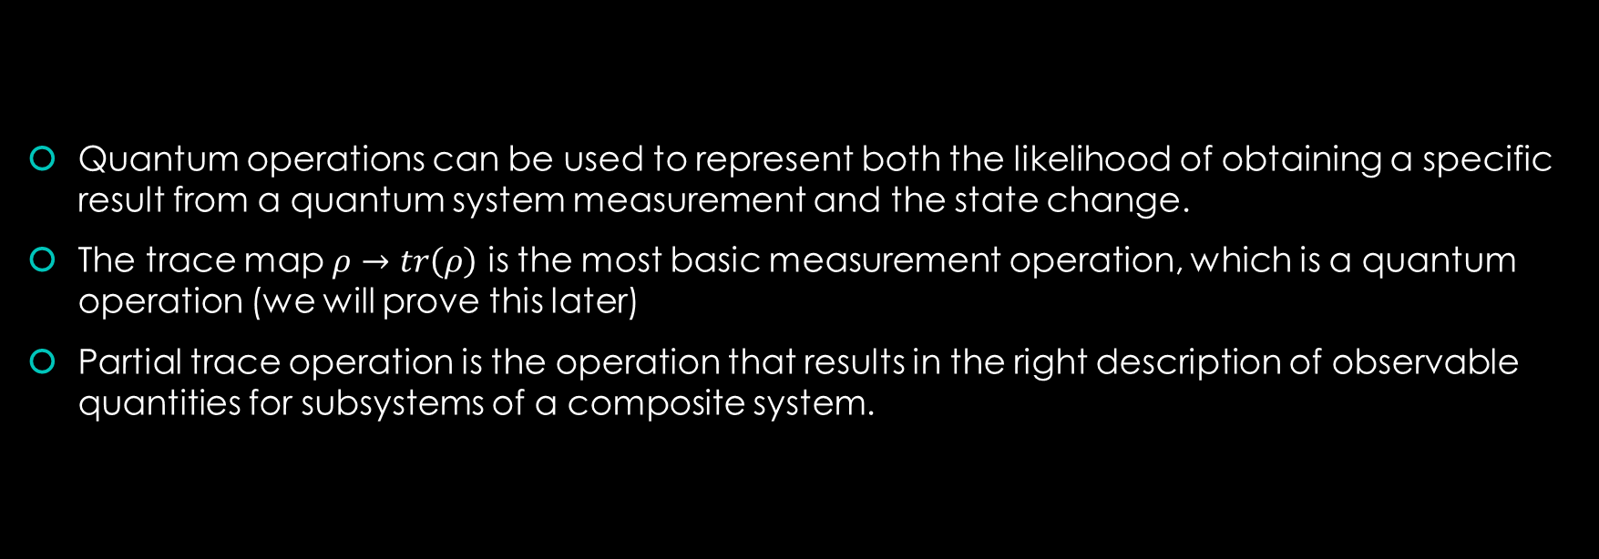
Trace and Partial Trace
Quantum operations can be used to represent both the likelihood of obtaining a specific result from a quantum system measurement and the state change.
The trace map $ρ→tr\left(ρ\right)$ is the most basic measurement operation, which is a quantum operation (we will prove this later)
Partial trace operation is the operation that results in the right description of observable quantities for subsystems of a composite system.

Slide 6
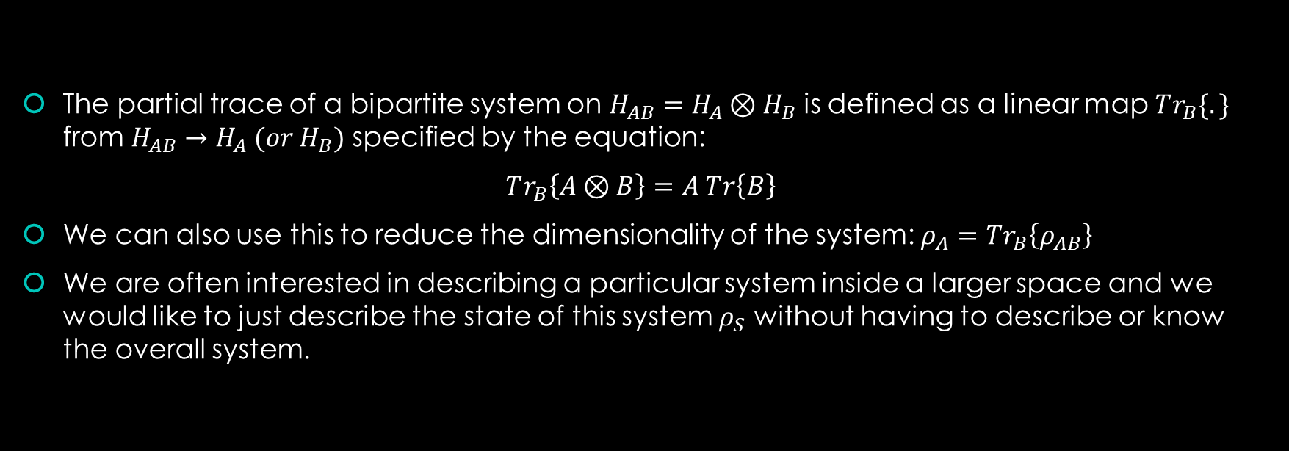
Trace and Partial Trace
The partial trace of a bipartite system on $H_{AB}=H_{A}⊗H_{B}$ is defined as a linear map $Tr_{B}\{.\}$ from $H_{AB}→H_{A} (or H_{B})$ specified by the equation:
$Tr_{B}\left\{A⊗B\right\}=A Tr\left\{B\right\}$
We can also use this to reduce the dimensionality of the system: $ρ_{A}=Tr_{B}\left\{ρ_{AB}\right\}$
We are often interested in describing a particular system inside a larger space and we would like to just describe the state of this system $ρ_{S}$ without having to describe or know the overall system.

Slide 7

Trace and Partial Trace
This is done using Partial Trace which reveals the entanglement of a state.
To calculate the partial trace, write $ρ$ as a sum of tensor products,
$ρ=\sum_{\left\{i,j,k,h\right\}}{m_{ijkh}|a_{i}⟩⟨a_{j}|⊗|b_{k}⟩⟨b_{h}|}$
For each term we have
$Tr_{B}\{|a_{i}⟩⟨a_{j}|⊗|b_{k}⟩⟨b_{h}|\}$ = $\left|a_{i}\right\rangle \left\langle a_{j}\right| Tr \{|b_{k}⟩⟨b_{h}|\}$.

Slide 8
Open Quantum Channel:
in the real world there are no perfectly closed systems, except perhaps the universe as a whole
Real systems suffer from unwanted interactions with the outside world called noise
in order to build useful quantum information processing systems, we need to understand and control such noise processes
An open system is nothing more than one which has interactions with some other environment system, whose dynamics we wish to neglect, or average over

Slide 9
Noise in Classical Systems

Slide 10
Quantum Channels

