Slide 1
Markup Languages
SGML - Standard Generalized Markup Language.
HTML - Hypertext Markup Language.
XHTML - Extensible Hypertext Markup Language.
XML - Extensible Markup Language.

Slide 2
SGML - Standard Generalized Markup Language.
An ISO standard for the definition of markup languages
SGML is a language for defining markup languages.
HTML is one such "application" of SGML.

Slide 3
An SGML application consists of several parts:
1. The SGML declaration: specifies which characters and delimiters may appear in the application.
2. The document type definition (DTD): defines the syntax of markup constructs.
3. A specification that describes the semantics to be ascribed to the markup.
4. Document instances containing data (contents) and markup.

Slide 4
HTML - Hypertext Markup Language.
HTML is the standard markup language for Web pages.
With HTML you can create your own Website.
HTML describes the structure of a Web page
HTML consists of a series of elements
HTML elements tell the browser how to display the content
HTML pages are saved with .html extension

Slide 5
A Simple HTML Document
<!DOCTYPE html> <html> <head> <title>Page Title</title> </head> <body> <h1>My First Heading</h1> <p>My first paragraph.</p> </body> </html>

Slide 6
The <!DOCTYPE html> declaration defines that this document is an HTML5 document
The <html> element is the root element of an HTML page
The <head> element contains meta information about the HTML page
The <title> element specifies a title for the HTML page
The <body> element defines the document's body

Slide 7
What is an HTML Element?
An HTML element is defined by a start tag, some content, and an end tag:
<tagname> Content goeshere... </tagname>
<h1>My First Heading</h1>
<p>My first paragraph.</p>

Slide 8
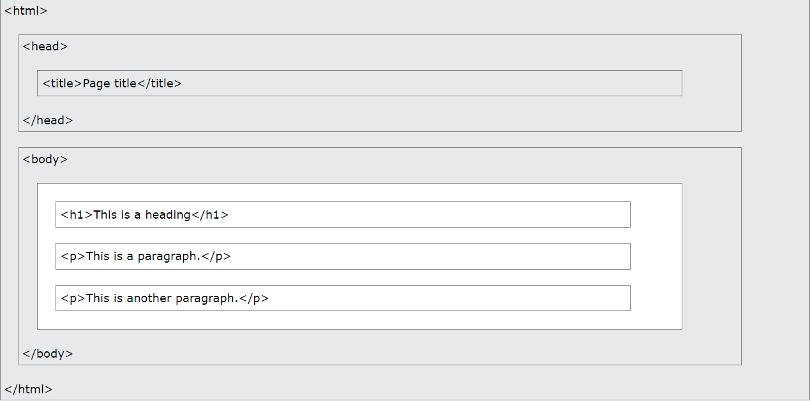
HTML Page Structure

Slide 9
HTML Editors
A simple text editor is all you need to learn HTML.
Notepad or TextEdit
Notepad++
Sublime
Visual Studio
etc…..

Slide 10
XHTML EXtensible HyperText Markup Language
XHTML is a stricter, more XML-based version of HTML
XHTML is HTML defined as an XML application
XHTML is supported by all major browsers

Slide 11
Why XHTML?
XML is a markup language where all documents must be marked up correctly (be "well-formed").
XHTML was developed to make HTML more extensible and flexible to work with other data formats (such as XML).
XHTML comes with a much stricter error handling.

Slide 12
Most Important Differences from HTML
<!DOCTYPE> is mandatory
The xmlns attribute in <html> is mandatory
<html>, <head>, <title>, and <body> are mandatory
Elements must always be properly nested
Elements must always be closed
Elements must always be in lowercase
Attribute names must always be in lowercase
Attribute values must always be quoted
Attribute minimization is forbidden

