Slide 1
ECS 412: Project Work
Automatic Word Embeddings-Based Glossary Term Extraction from Large-Sized Software Requirements
Naimish Sharma
18151
Electrical Engineering and Computer Science
BS Project
Under Supervision of Dr Arpit Sharma

Slide 2
Introduction
Requirements are the basis for every project defining what the stakeholders in a potential new system need from it, and also what the system must do in order to satisfy that need.
Better quality requirements means better software product.
Poor Quality requirements because of different interpretations of technical terms in requirements by different stakeholders.
Technical terms should be defined in glossary to have similar interpretations by different stakeholders.
Manual extraction of glossary terms is time consuming.

Slide 3
Motivation
Approach is inspired by technique used in paper “Siba Mishra and Arpit Sharma. Automatic word embeddings-based glossary term extraction from large-sized software requirements. In International Working Conference on Requirements Engineering: Foundation for Software Quality, pages 203–218. Springer, 2020” to extract glossary terms.
Candidate glossary terms are extracted using Text chunking.
Word embedding based semantic filter is used to reduce the number of glossary terms such that only domain specific glossary terms remain in our final list of glossary terms.

Slide 4
Approach
1. Data Gathering
C_CRE - Corpus obtained by joining feature and benefit attribute i.e. “feature” + “,” + “benefit” + “.” for each user story in CrowdRE dataset.
C_HA - Corpus obtained after crawling the web pages from “Wikipedia home automation” (HA) category, maximum depth used for subcategory traversal is 2. Using PetScan all the page titles upto maximum subcategory 2 are downloaded in csv file and then using Beautiful Soup web scrapping is performed using the page titles.

Slide 5
Approach
2. Data Preprocessing(NLP Pipeline)
3. Candidate Glossary Term Extraction
Using NLTK (pos − tag) Tagger part of speech of each token is obtained. Grammer is defined as {< DT >? < JJ >∗< NN >}.
“[1]”, digits, extra white spaces,alpha numeric characters
Word Tokenization
Lowering of Tokens
Lemmatization and Stopword Removal
C’_CRE
C_CRE
C_HA
C’_HA

Slide 6
Approach
Text chunking is performed on both corpus based on this grammer to obtain Noun Phrases(NP).
GT(NPs from C’_CRE) and TW(NPs from C’_HA)
CGT = GT ∩ TW
4. Semantic Filtering of Candidate Glossary Terms
C’_CRE transformed to C’’_CRE by replacing space(‘ ’) with underscore(‘ ’) and adding dollar(‘$’) before and after the NP for each NP present in CGT.
C’_HA transformed to C’’_HA by replacing space(‘ ’) with underscore(‘ ’) for each NP present in CGT.

Slide 7
Results and Discussion
Skip-gram and Continuous Bag of Words (CBOW) Word2Vec models are used to to produce word embeddings and for computing semantic similarity scores of NPs present in CGT.
Corpus used to learn word embeddings is C’’_CRE union C’’_HA.
Vector size used is 100, window size used is 10, and the minimum count (c = 1) for all the experiments.
Using cosine similarity, sematic relationship of two words is computed in the vector space i.e. how close or far are they in vector space.
Glossary terms with similarity more than 0.85 are only included in final list of glossary terms.

Slide 8
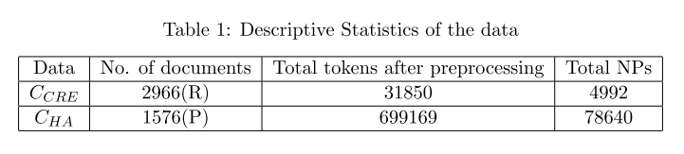
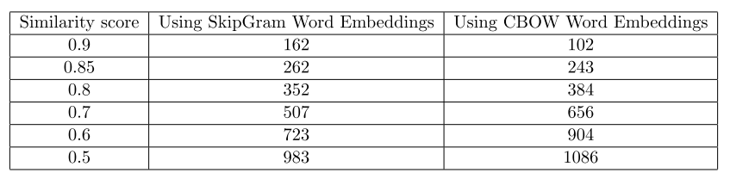
Results and Discussion

Slide 9
Results and Discussion
Number of NPs in CGT is 1800
using only text chunking there are 1800 glossary terms overall whereas using word embedding based semantic filter (with similarity value greater than 0.85) glossary terms in our final list reduces to 262 and 243 using SkipGram and CBOW word embeddings respectively
Ground Truth is generated manually over first 100 requirements and then Precision and Recall are calculated by extracting candidate glossary terms by text chunking(NPs). Recall and precision are around 78% and 22% respectively
Precision is low because we used only text chunking to extract candidate glossary terms from subset of requirements.

Slide 10
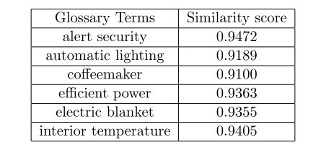
Conclusion
Word Embedding based semantic filter helped in reducing number of candidate glossary terms from 4992 to around 262 from 2966 requirements
We even counted terms as candidate glossary terms which are rare and appeared maybe once in our corpus(Ex - smart tv, smart fridge)
Limitations is that it requires large amount of domain specific corpus to design semantic filters. Many new emerging domains have sortage of domain specific corpus on web therefore this approach will not work.

Slide 11
Future Work
Use of BERT, LSTM, fastext to obtain word embeddings and ensure that only domain specific terms are there in final list of glossary
More domain specific corpus can be generated using other websites, magazines and articles.
Many pages we extracted from wikipedia were not domain specific but we still included in Home Automation corpus. So, to get rid of this problem we can design some filter to include a wikipedia page in our corpus only if it is domain specific.
This approach can be applied to various other domains having domain specific rich corpus available on internet.

