Slide 1


Purchase Pattern
Analysis
Dashboard-based Business Insights
Prepared by: Zinzuvadia Naimish

Slide 2
Project Overview
The purpose of the dataset is to leverage Market Basket Analysis (MBA) on a Transaction dataset to unveil relationships between products. The objective is to extract valuable insights which includes understanding customer purchasing behavior, identifying frequently co-occurring products, and deriving actionable recommendations to enhance sales strategies, growth opportunities and customer satisfaction.

Slide 3
Data Cleaning Process
Below is the clear document Data Cleaning Steps of the project report:-
01. Import and Load Raw data :-
The raw data was loaded using Excel.
Column names and data were checked for inconsistency.

Slide 4
.
02. Handling Missing Values :-
Rows with missing CustomerId was handled by generating CustomerId.
Itemname column had Null-Values, Special characters in around 6000 rows which were removed from the Actual Table ‘Sales’ and copied to a new table ‘Stock_Adjustments’.
The Itemname with the highest number of transactions was identified as the MODE, indicating the most commonly purchased product.

Slide 5
.
03. Removing Duplicate Records :-
Exact duplicate records were removed to prevent inflated sales and quantity calculations.
04. Filtering Invalid Transactions :-
Removed transactions with Negative quantities (product returns or errors)

Slide 6
.
5. Outlier Treatment :-
Extreme values in quantity and revenue were reviewed.
Outliers caused by data entry errors were removed
6. Data Type Corrections :-
Data types were standardized for accurate analysis.
Converted Invoice-Date to Date/Time format.
Ensured Quantity and Price were numeric.
Standardized text fields such as Itemname descriptions and country names.

Slide 7
.
07. Final Data Validation :-
After cleaning, the dataset was revalidated to ensure consistency and readiness for analysis.

Slide 8
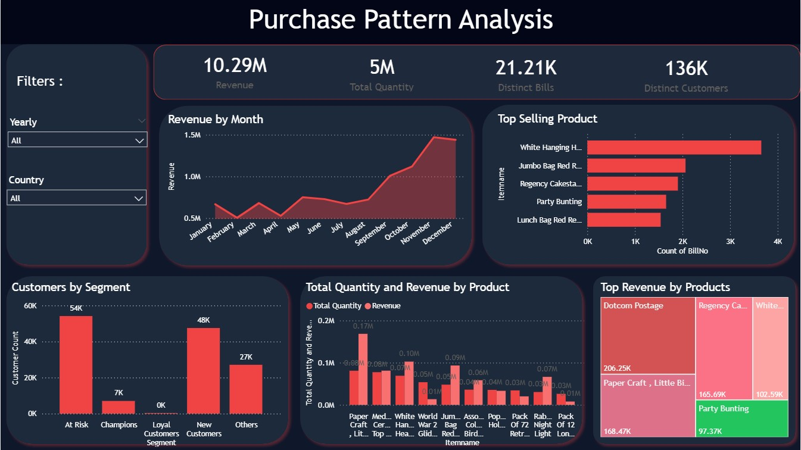

Slide 9
Key KPIs Overview
  Revenue: 9.48M
  Total Quantity: 5M
  Distinct Bills: 19.54K
  Distinct Customers: 122K

Slide 10
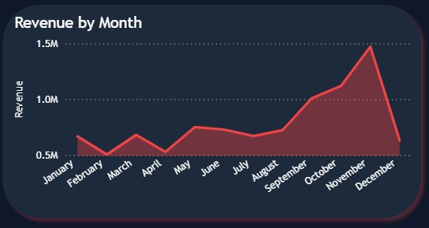
Monthly Revenue Trend
  Revenue peaks in November
  Seasonal demand observed
  Low performance in early months

Slide 11
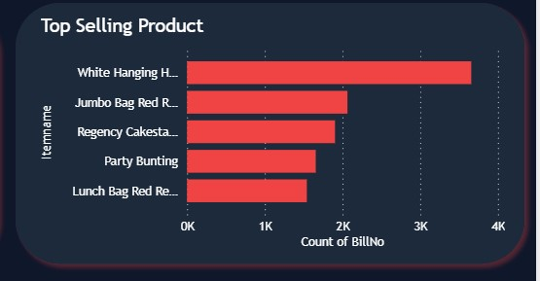
Top Selling Items
  White Hanging Heart
  Regency Cake stand 3 Tier
  Hand Warmer

Slide 12
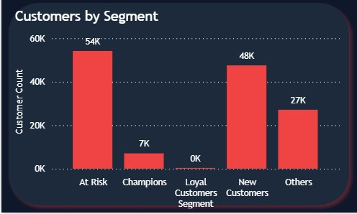
Customer Segmentation
  At Risk: 54K
  New Customers: 48K
  Champions: 7K

Slide 13
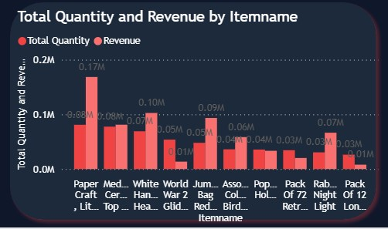
Quantity vs Revenue
Some items have high quantity but low revenue Need pricing optimization
Few items drive majority revenue Pareto Principle observed

Slide 14
Business Recommendations
  Inventory planning for peak months
  Focus on best sellers
  Customer retention strategies

Slide 15
Thank You

