Slide 1
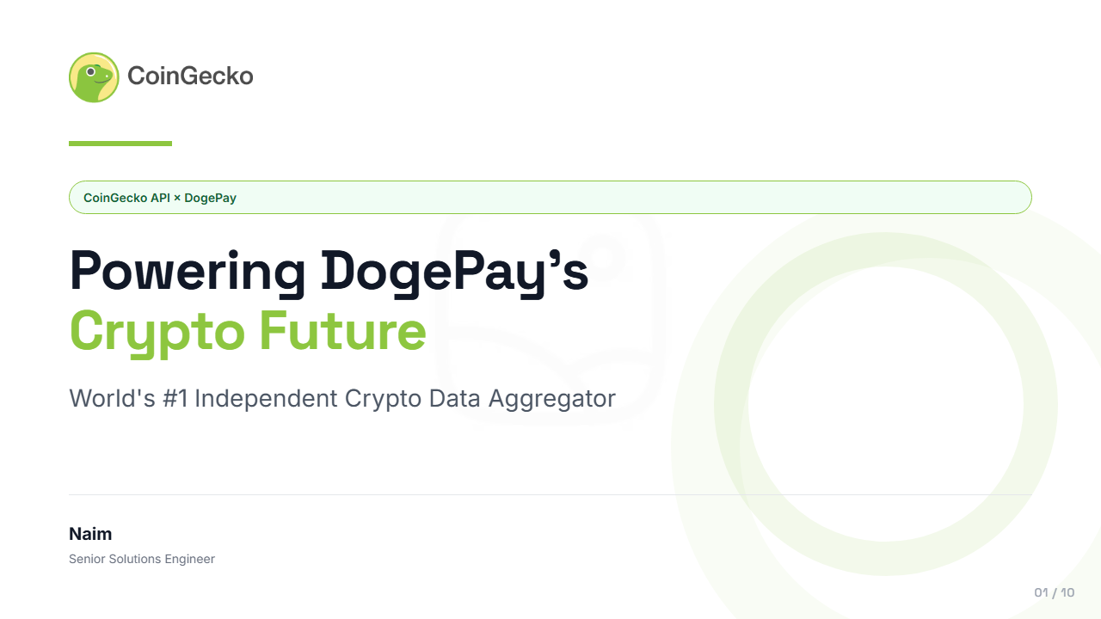
Notes:
“Hi everyone, I’m Naim.
This presentation shows how CoinGecko can help DogePay launch crypto price tracking for 2M users today, while preparing the platform for trading in the future.”
“Since this scenario simulates a first discovery call, I focused on three things:
1) Building trust in the data provider,
2) Showing a realistic rollout path,
3) Making sure the architecture scales for millions of users.”

Slide 2
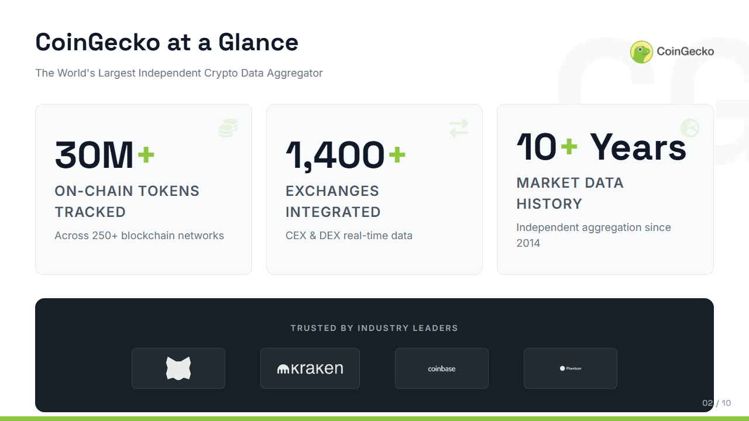
Notes:
For a regulated fintech like DogePay, independence matters.
CoinGecko aggregates data across 1,400 exchanges rather than operating an exchange itself, which removes conflicts of interest.”

Slide 3
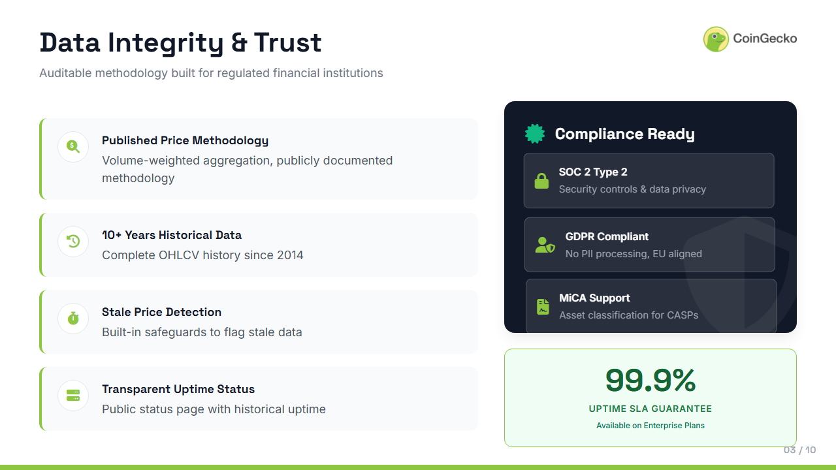
Notes:
“This slide is really about risk reduction.”
These aren't checkboxes for us. They're how we built the product from day one.

Slide 4
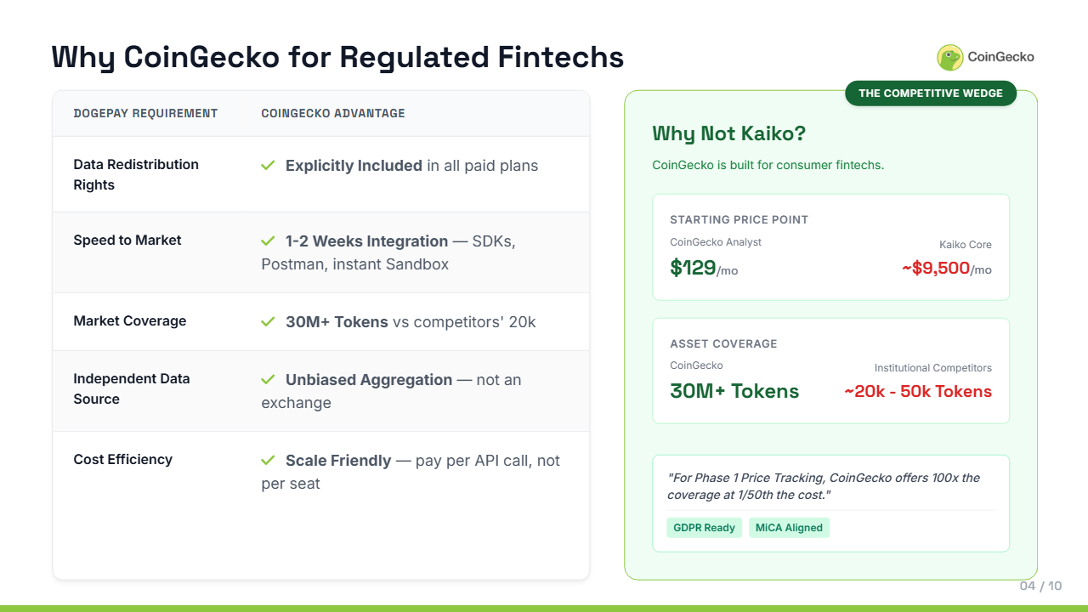
Notes:
This is the commercial fit slide.

Slide 5
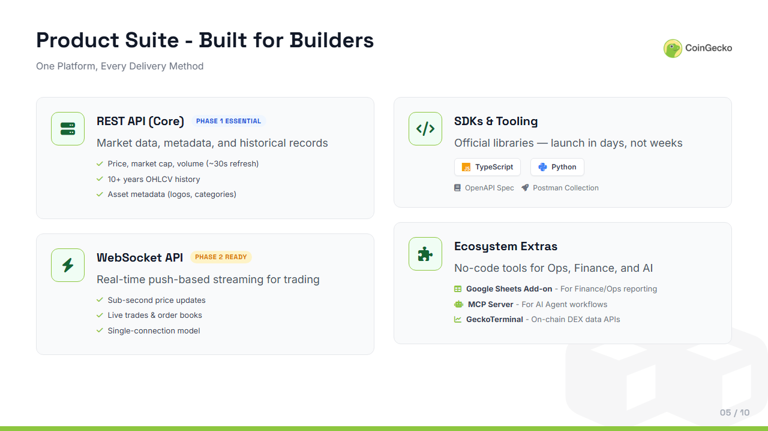
Notes:
How “I kept the product story modular. start small scale later
”
3 cue points:
REST API is the Phase 1 core for market data, metadata, and historical records
WebSocket is Phase 2 ready for real-time trading interfaces
SDKs and tooling reduce implementation time; extras are there but not central to this conversation
Transition:
“The most important part is how that product stack maps directly to DogePay’s roadmap.”

Slide 6
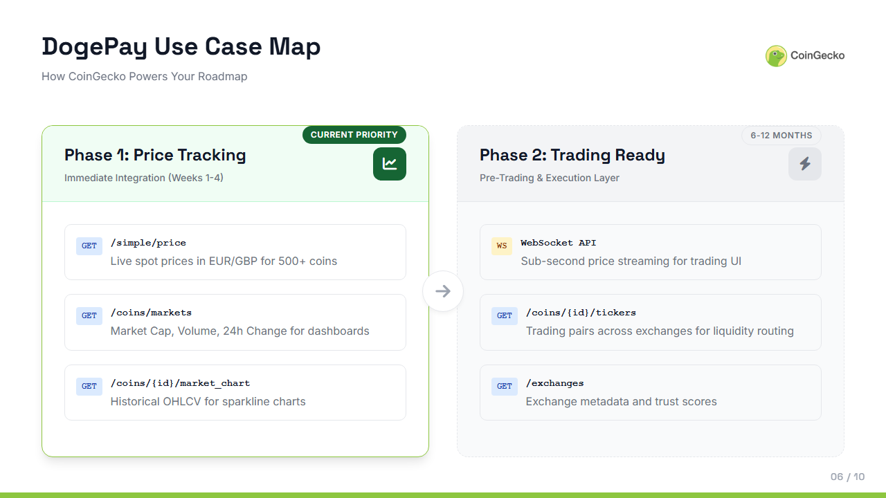
Notes:
“This is the most tailored slide in the deck.”
3 cue points:
Phase 1: /simple/price, /coins/markets, and /market_chart cover price tracking, dashboards, and charts
Phase 2: WebSocket, tickers, and exchange data support pre-trading and execution needs
this shows a clean roadmap from immediate launch needs to trading readiness later
Does this match what your team was thinking architecturally, or are there constraints I should know about?

Slide 7
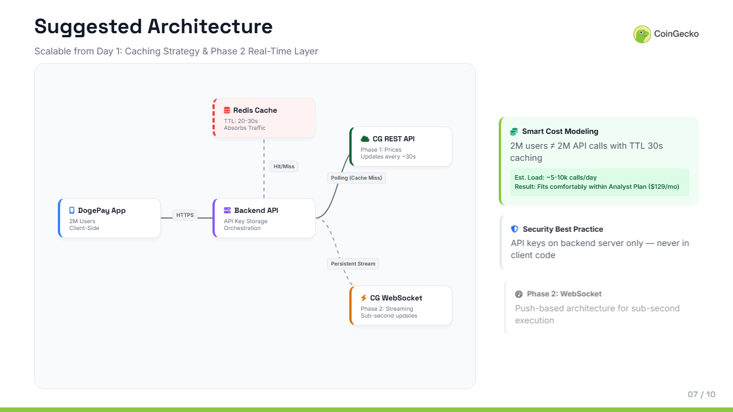
Notes:
This is the more technical depth slide.
3 cue points:
How does this scale to 2 million users without blowing up our API budget? The answer is in Redis caching
estimated load stays around 5k to 10k calls a day, which keeps Phase 1 commercially efficient
API keys stay on the backend, and
WebSocket becomes the natural upgrade path for Phase 2

Slide 8
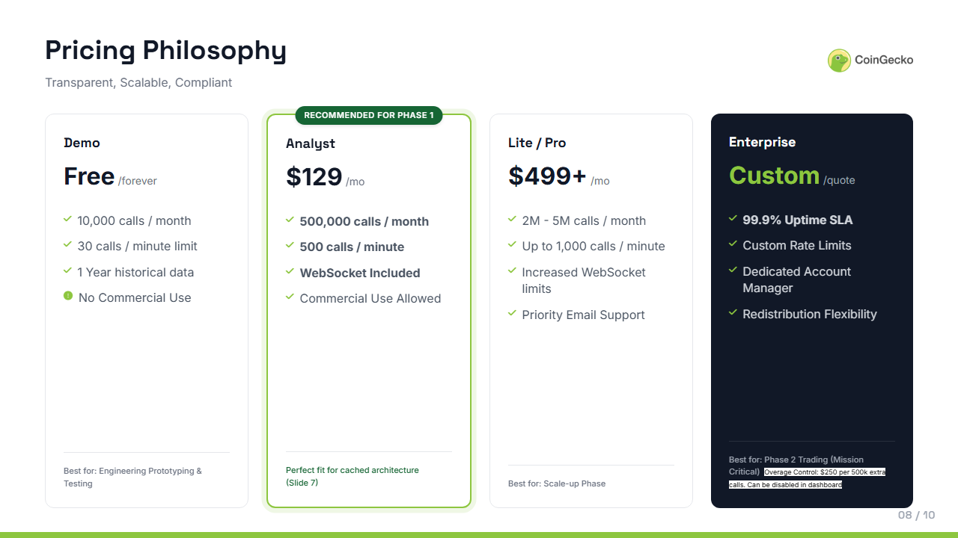
Notes:
his slide is confirmation, not persuasion..”
3 cue points:
Demo is for prototyping, Analyst is the right Phase 1 recommendation, Enterprise is for mission-critical trading later
Analyst fits the cached architecture and allows commercial use at a manageable cost
the message here is transparent pricing, scalable growth, and no overbuying too early
Then I shift from presenting to discovering

Slide 9
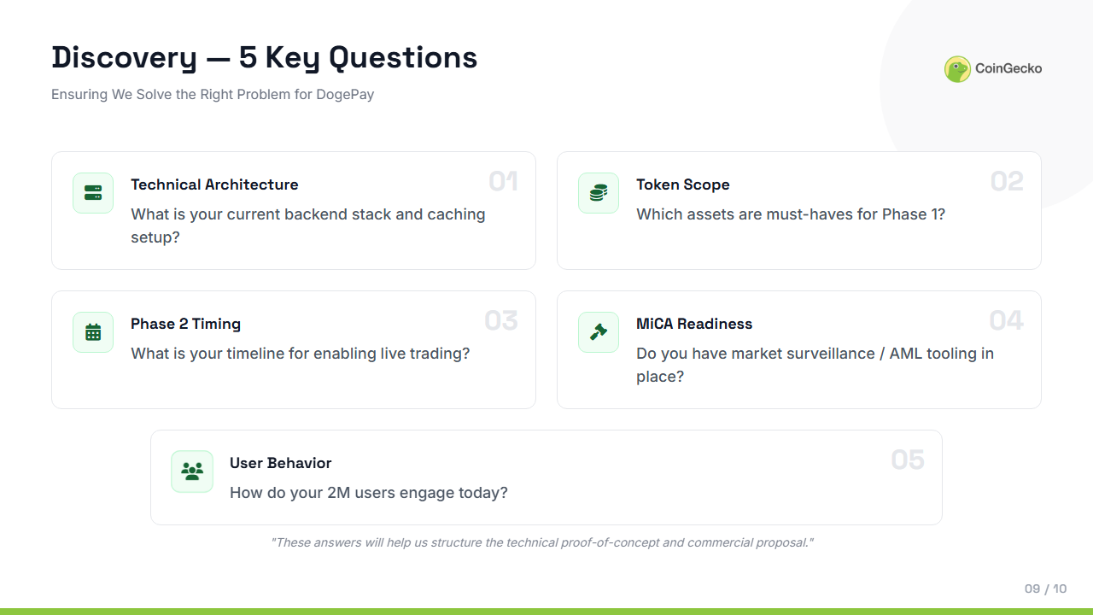
Notes:
Without knowing all these, cost modeling is just an estimate.

Slide 10
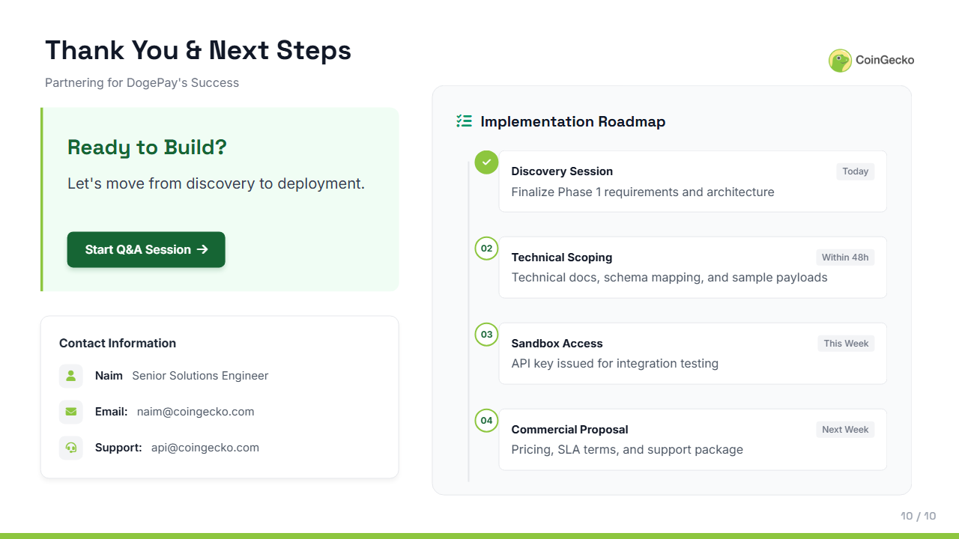
Notes:
From discussion to action message: ready to help DogePay move from discovery to deployment
roadmap: discovery today, technical scoping in 48 hours, sandbox this week, proposal next week
Close:
“Thanks for reviewing — I’m looking forward for questions.”

