Slide 1

Summer Internship
Naimur Rahman

Slide 2
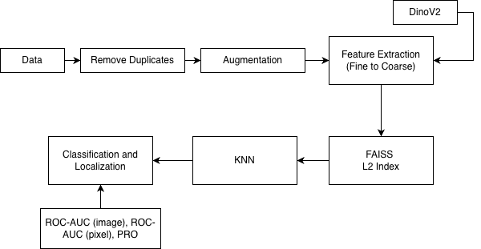
Cosine, Euclidian
Alignment
ResNet, Qwen
Fine to Coarse
Feature Extraction
Stable Diffusion
Flux Schnell
Lora
TTA

Slide 3
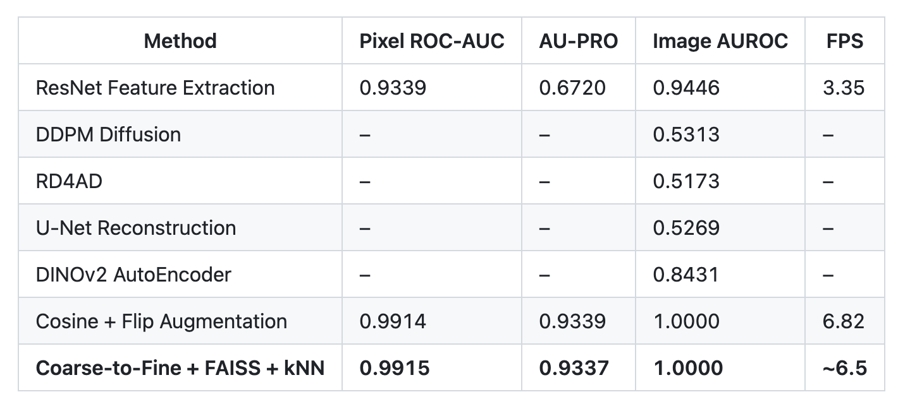
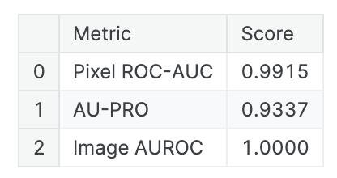

Slide 4
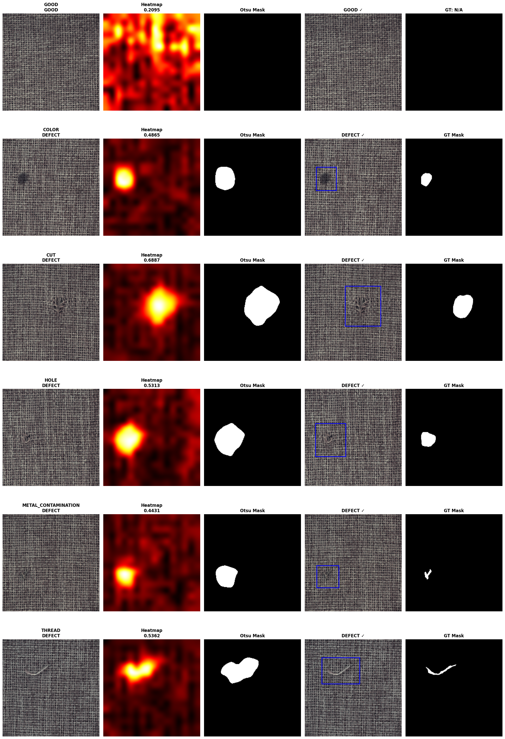

Slide 5
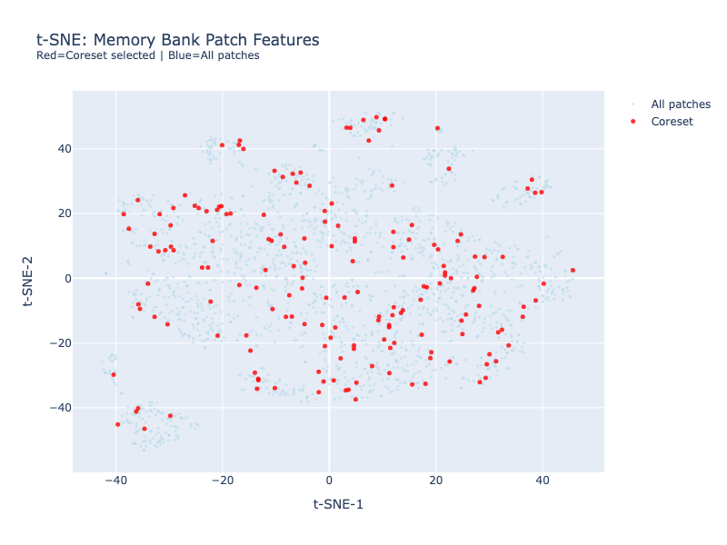
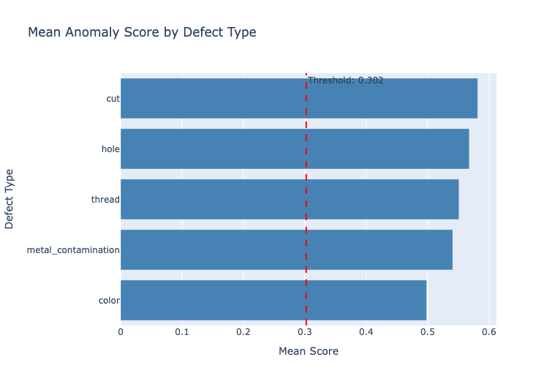

Slide 6
