Slide 1
Format specifiers in printf

Slide 2
Flag | Format | Value | Output | Explanation
- | %-6d | 12 | 12 | Left-justified within width
0 | %06d | 12 | 000012 | Zero-padded on the left
+ | %+d | 12 | +12 | Forces sign for positive number
space | % d | 12 | 12 | Leading space for positive number
- + width | %-8.2f | 12.3 | 12.30 | Left-aligned float
0 + width | %08.2f | 12.3 | 00012.30 | Zero-padded float
+ + width | %+8.2f | 12.3 | +12.30 | Sign with alignment
- + 0 | %-08d | 12 | 12 | - overrides 0
+ + space | %+ d | 12 | +12 | + overrides space
precision vs 0 | %08.4d | 25 | 00000025 | Precision ignores 0 flag

Slide 3
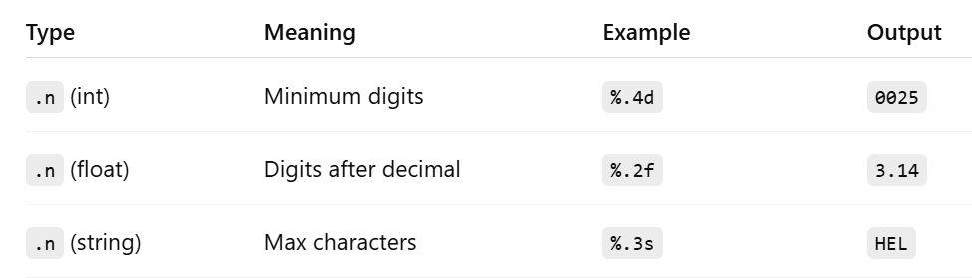
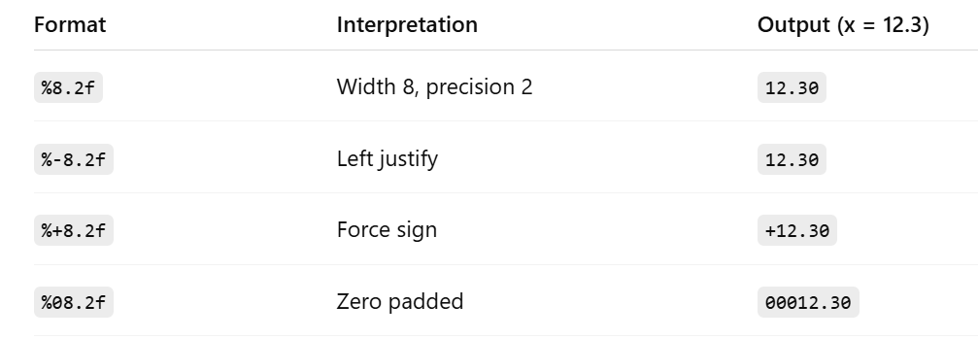

Slide 4
Single dimensional Arrays

Slide 5
Accident Problem
Each year the Department of Traffic Accidents receives accident count reports from a number of cities and towns across the country. Given details of ‘n’ days, develop an algorithm and write a program to determine the average number of accidents and for each day, print the difference between the number of accidents on that day and average. For example, if the number of days is 5 and the values are 10, 12, 15, 13, 5 then average is 11 and the difference of values are 1, 1, 4, 2, 6

Slide 6
Accident problem
Input | Output | Logic Involved
Value of ‘n’, ‘n’ numbers | Average and ‘n’ values that is the difference between average and value | Find average and difference

Slide 7
Algorithm
Read the value of ‘n’
Read the number of accidents happened in ‘n’ days
Find average
For each value print the difference between average and the value

Slide 8
New Stuff...
We can find the difference between average and the number of accidents on a particular day only after reading all numbers from the user
So data has to be stored
Same type of data is to be stored
Number of items not known prior
Best choice would be using arrays in C
Array - Can store a fixed-size sequential collection of elements of the same type

Slide 9
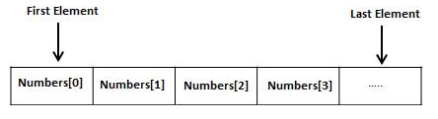
Arrays in C
Consist of contiguous memory locations
lowest address corresponds to the first element
highest address to the last element
Array indices start with zero
The elements have indices from 0 to ‘n-1’
Similar to list in Python but homogenous

Slide 10
Compare List and Arrays
List | Arrays
Can have mixed type of elements | Can have only one type of element
Size is not given in the beginning L = [] | Size has to be specified during declaration int a[10];
Elements are accessed by subscript operator L[0], L[1]... | Same way a[0], a[1], a[2],...
Size is dynamic, increases when elements are added and decreases when removed | Size is static and memory

Slide 11
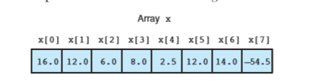
Declaration of Arrays in C
type arrayName [ arraySize ];
double balance[10];
Initializing Arrays
double balance[] = {1000.0, 2.0, 3.4, 7.0, 50.0};
(or)
double balance[5] = {1000.0, 2.0, 3.4, 7.0, 50.0};

Slide 12
Cannot assign one array to other
int ia[] = {0, 1, 2}; // ok: array of ints
int ia2[] = ia; // error: cannot initialize one array with another
int main()
{
const unsigned array_size = 3;
int ia3[array_size];
// ok: but elements are uninitialized!
ia3 = ia; // error: cannot assign one array to another
return 0;
}

Slide 13
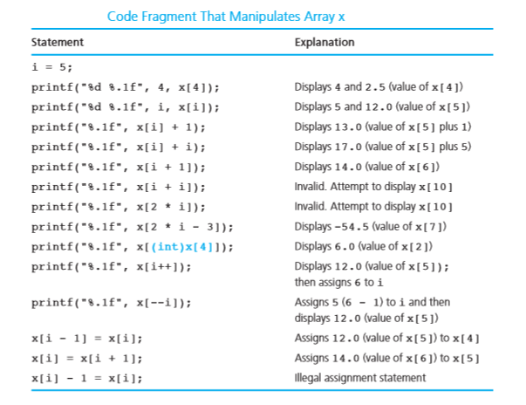

Slide 14
Strings in C
No data type string
Represented as array of characters

Slide 15
Character Arrays Are Special
Can be initialized with either a list of comma-separated character literals enclosed in braces or a string literal
Two forms are not equivalent
String literal contains an additional terminating null character

Slide 16

Strcpy
used to copy a string and can be as strcpy(destination, source)
Will not perform any boundary checking, and thus there is a risk of overrunning the strings

Slide 17
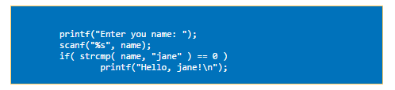
Strcmp
used to compare two strings and can be used as strcmp(str1, str2)
If the first string is greater than the second string a number greater than null is returned.
If the first string is less than the second string a number less than null is returned.
If the first and the second string are equal a null is returned.

Slide 18
#include <stdio.h>
#include <string.h>
int main()
{
char str1[] = "abcd", str2[] = "abCd", str3[] = "abcd";
int result;
// comparing strings str1 and str2
result = strcmp(str1, str2);
printf("strcmp(str1, str2) = %d\n", result);
// comparing strings str1 and str3
result = strcmp(str1, str3);
printf("strcmp(str1, str3) = %d\n", result);
return 0;

Slide 19
Output
strcmp(str1, str2) = 32
strcmp(str1, str3) = 0
The first unmatched character between string str1 and str2 is third character. The ASCII value of 'c' is 99 and the ASCII value of 'C' is 67. Hence, when strings str1 and str2 are compared, the return value is 32.
When strings str1 and str3 are compared, the result is 0 because both strings are identical.

Slide 20

strcat
concatenates a string onto the end of the other string and the resultant string is returned
strcat() will not perform any _{boundary} checking, and thus there is a risk of overrunning the strings.

Slide 21

strlen
returns the length of a string
All characters before the null termination

Slide 22
Palindrome
#include <stdio.h>
#include <string.h>
int main(){
char string1[20];
int i, length;
int flag = 0;
printf("Enter a string:");
scanf("%s", string1);
length = strlen(string1);
for(i=0;i < length ;i++){
if(string1[i] != string1[length-i-1]){
flag = 1;
break; }}
if (flag) {
printf("%s is not a palindrome", string1);
}
else {
printf("%s is a palindrome", string1);
}
return 0;
}

Slide 23
Strrev
strrev(b);
strrev( ) function reverses a given string in C language.
#include<stdio.h>
#include<string.h>
int main()
{
char name[30] = "Hello";
printf("String before strrev( ) : %s\n",name);
printf("String after strrev( ) : %s",strrev(name));
return 0;
}

Slide 24
Huffman Coding Problem
Huffman code is a particular type of optimal prefix code for characters. It is commonly used for lossless data compression. It is a variable-length code derived from frequency of occurrence. Given a string develop an algorithm and write a C program to determine frequency of occurrence of each character in the string.

Slide 25
Huffman Coding problem
Input | Output | Logic Involved
A string S | Frequency count of each letter in S | Convert all letters to uniform case and check if it is a particular letter and increment corresponding count

Slide 26
Algorithm
Read a string
Make all letters in the string to be in lowercase
Process character by character
If the character is an alphabet then increment count of it
Print count of all alphabets

Slide 27
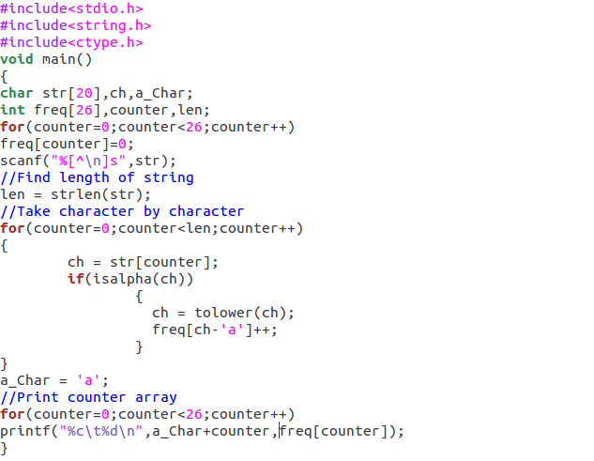

Slide 28
