Slide 1
BACSE104 (2 4 0 4) Structured and Object Oriented Programming

Slide 2
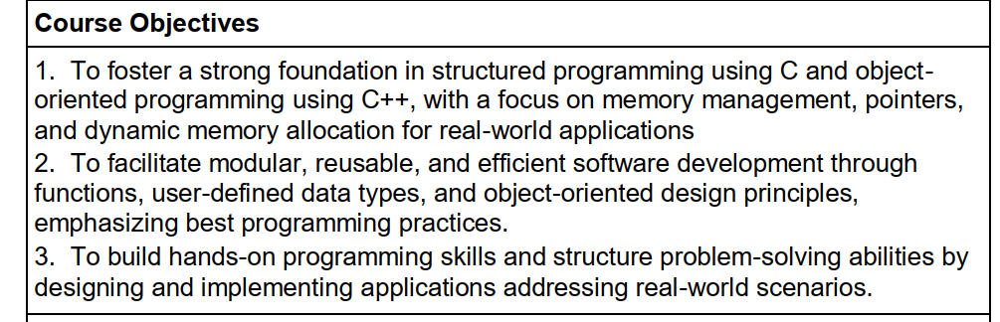

Slide 3
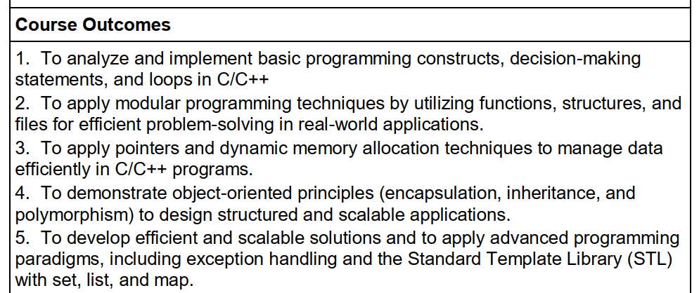

Slide 4
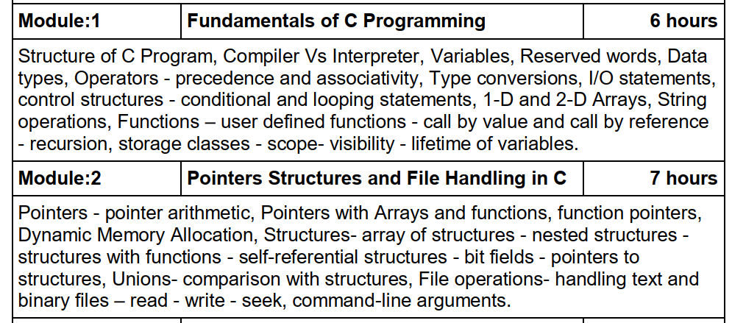
SYLLABUS

Slide 5
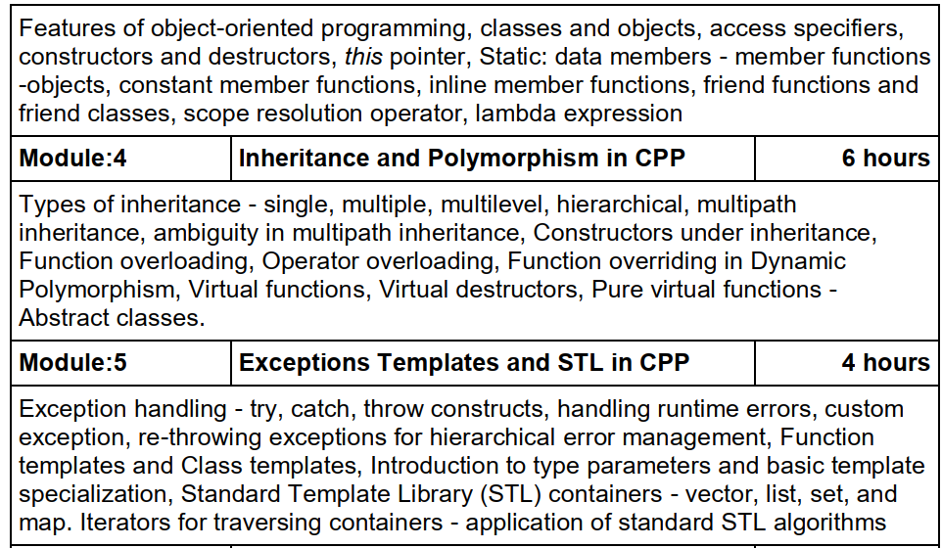
SYLLABUS

Slide 6
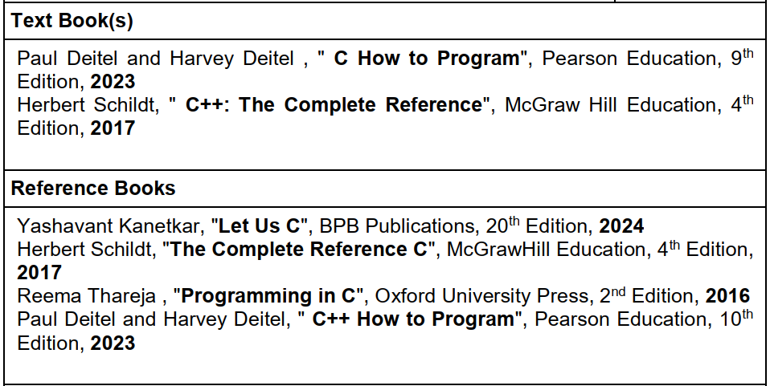

Slide 7
Evaluation- Theory BACSE104
Assignment-1 : 10%
Assignment-2 : 10%
Quiz : 10%
CAT-1: 15%
CAT-2 : 15%
FAT : 40%

Slide 8
Evaluation- LAB BACSE104
PAT-1 : 10%
PAT-2 : 15%
PAT-3 : 15%
PAT-4: 10%
Practice in Iam Neo – 10%
FAT : 40%

Slide 9
What is a Program?
A program is a set of instructions written to perform a specific task. Examples: WhatsApp chat, YouTube app, ATM operations, bill payment.
A computer understands only binary (0s & 1s). Programming languages help humans communicate with machines.

Slide 10
What is a Programming Language?
A programming language is a communication bridge between:
Human → Computer
Human writes code
Compiler converts it
CPU executes it

Slide 11
Evolution of Programming Languages (1940 → 2025 → Future)
1940s – Machine Language (1st Generation)
Programs written directly in binary (0s & 1s). Extremely difficult.
1950s – Assembly Language (2nd Generation)
Mnemonics like:
MOV A, B
ADD A, C
Easier, but still hardware-dependent.

Slide 12
Evolution of Programming Languages (1940 → 2025 → Future)
1960s–2025 – High-Level Languages (3rd Generation)
Human-friendly languages:
C, C++, Java, Python, JavaScript
Procedural Languages → C
Object-Oriented Languages → C++
Managed & Virtual Machine Languages → Java
Scripting → Python
2000+ – Domain-Specific Languages (4th Generation)
SQL, MATLAB, R, SAS.
2020+ – AI-Assisted Programming (5th Generation)
AI tools like ChatGPT, Copilot generate code automatically.

Slide 13
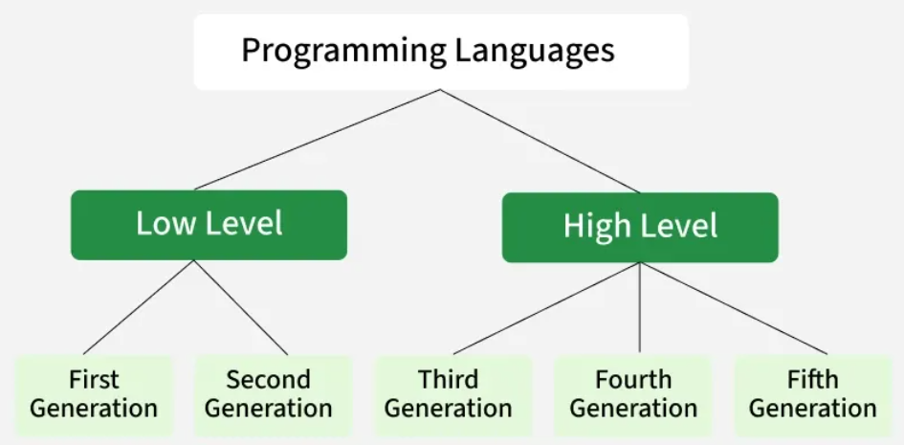

Slide 14
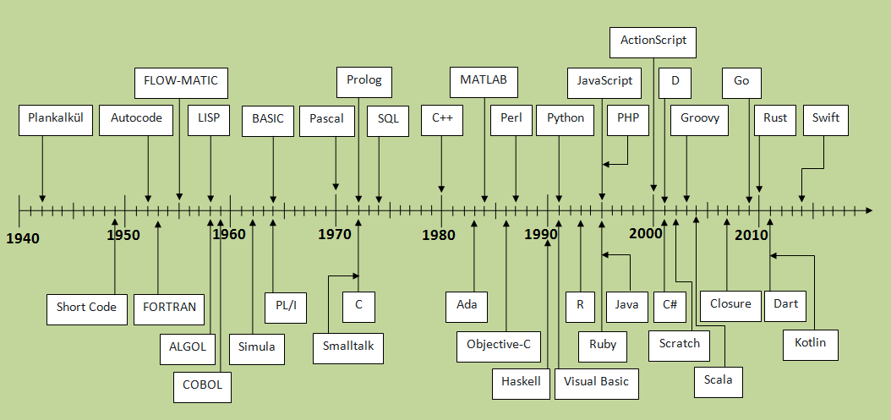

Slide 15
Future of Programming – Of course its started
90% of code written by AI
Natural language programming
Neural-linked programming
Quantum programming
Robotics & embedded coding (still dominated by C/C++)

Slide 16
WHY Learn C Programming in Even Now?
C teaches:
Memory
Pointers
Logic
Efficiency
System-level thinking
C is the foundation of all modern languages and used in:
Operating Systems
Embedded devices
Robotics
IoT
Automotive systems
Banking hardware
Medical instruments

Slide 17
C vs C++
C = Procedural Language
Focus on functions
Program = Set of instructions
No classes/objects
Direct hardware control
Fast & efficient
Used for OS, embedded & low-level systems
C++ = Object-Oriented Language
Built on top of C
Adds classes, objects, inheritance, polymorphism, abstraction, encapsulation
Supports both procedural + OOP (hybrid)
Used in: Gaming engines, Real-time simulations, Banking systems, Robotics, 3D Rendering (Unreal Engine), Automotive software (ADAS, ECUs)

Slide 18
Why C Came First, Then C++?
🔵 C → Focus: How to do the task?
Steps, procedures, functions.
🔴 C++ → Focus: Who performs the task?
Objects, responsibilities, real-world modelling.
BCPL → B → C → C++ → Java → C#
Python, JavaScript are influenced indirectly.

Slide 19
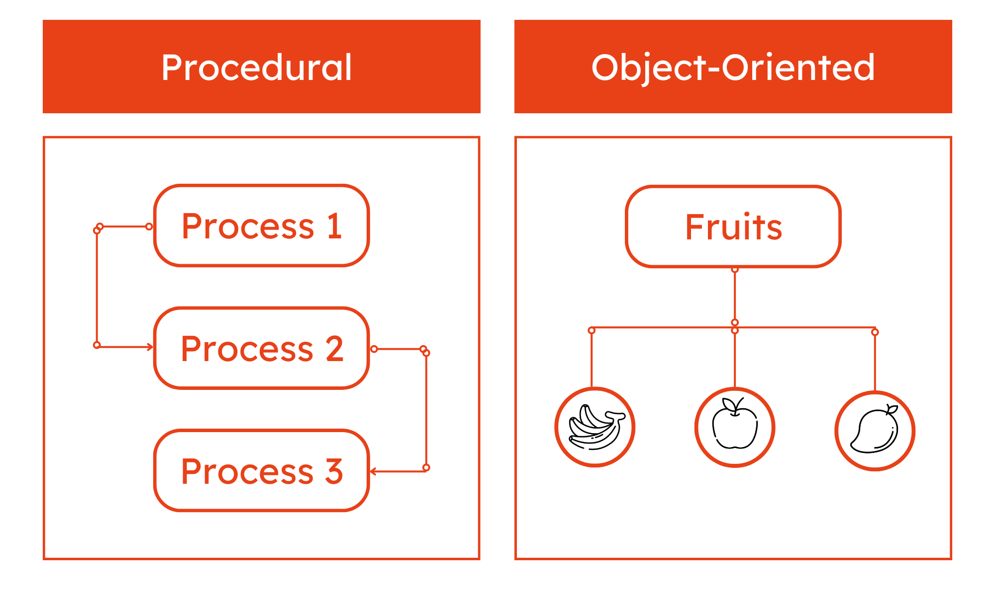

Slide 20
Why We Learn BOTH C and C++ Today?
⭐ Why Learn C?
Memory-level understanding
Pointers, arrays, recursion
Efficient system programming
Base for modern languages
⭐ Why Learn C++?
Real-world problem modelling
Object Oriented design
Industry demand (gaming, AI frameworks, robotics)
Strong base for learning Java

Slide 21
Future of Programming (C & C++)
C remains dominant in embedded & OS-level tasks
C++ 26/29 standards (modern C++) are booming
AI-powered compilers will still rely on C/C++ foundations
Robotics, ADAS, aerospace → C++
IoT, medical devices → C

Slide 22
What is C?
C is a general-purpose, procedural programming language developed by Dennis Ritchie at Bell Labs in 1972.
It was originally created for system programming, especially for writing operating systems.
Why C became popular?
Fast & efficient (close to hardware)
Portable (write once, run anywhere)
Structured language (clean design)
Rich set of operators
Flexibility for both low-level & high-level tasks

Slide 23
Where is C used today?
C is still unbeatable in:
Operating Systems Windows, Linux, iOS kernel components
Embedded Systems Washing machine boards, microcontrollers
Automotive Control Units
Robotics firmware
Telecom systems
Compilers & interpreters
Game engines core

Slide 24
#include <stdio.h>
int main() {
printf("Hello, World!");
return 0;
}

Slide 25
Structure of a C Program
Documentation Section → // comments
Link Section → #include <stdio.h>
Definition Section → #define PI 3.14
Global Declarations → int a;
main() Function → starting point of program
User-defined Functions → custom functions
#include <stdio.h>
#define PI 3.14
int main() {
printf("Area: %f", PI * 5 * 5);
return 0;
}

Slide 26
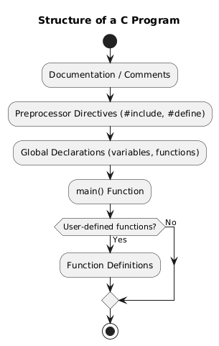

Slide 27
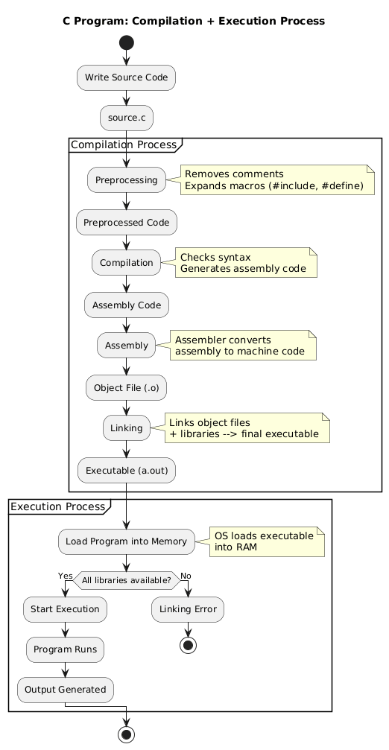

Slide 28
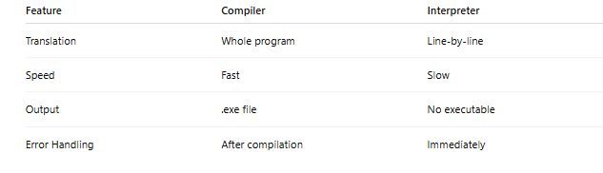
Compiler vs Interpreter
Compiler
Translates entire program at once
Generates .exe file
Faster execution
Error messages shown after full compilation Examples: C, C++, Java
Interpreter
Translates line-by-line
No executable generated
Slower execution Examples: Python, JavaScript

Slide 29
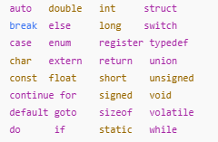
Tokens in C
Tokens are the smallest elements in a C program. Every program is built using these tokens.
Types of Tokens
Keywords are reserved words which cannot be used as variable names - Example: int, return, if, while - 32

Slide 30
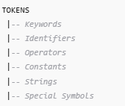
Tokens
Identifiers
User-defined names
Examples: age, sum, marks
Constants
Fixed values
Examples: 10, 3.14, 'A'
Strings
Sequence of characters
"Hello World"
Operators
Symbols performing operations
+, -, *, /, %, ==, &&
Special Symbols
(), {}, [], ;, #, " "

Slide 31
Variables in C
What is a Variable?
A variable is a named memory location that can store a value which may change during program execution.
“Variable = a name given to a box in memory where we keep a value.”

Slide 32
Variables in C
Declaration and Initialization
Declaration – Telling the compiler what type of data the variable will hold.
int age;
float salary;
char grade;
Initialization – Giving an initial value at the time of declaration.
int age = 20;
float salary = 35000.50;
char grade = 'A’;
int x; // declaration
x = 10; // assignment

Slide 33
Variables in C
Rules for Naming Variables (Identifiers)
Can contain letters, digits, and underscore (_).
Must not start with a digit.
✅ mark1, _total
❌ 1stmark
No spaces or special characters like @ , . #.
Case-sensitive. Total and total are different.
Keywords cannot be used as variable names.
❌ int while; is invalid.

Slide 34
Variables in C
Memory Concept
When you declare a variable, the compiler reserves some bytes in RAM.
int a = 5;
If int is 4 bytes:
Address | Value
1000 | 5
1001 | –
1002 | –
1003 | –

Slide 35
Variables in C
Types of Variables
Local variables – Declared inside a function/block.
Global variables – Declared outside all functions.
Formal parameters – Variables in function parameter list.
Common Beginner Errors
Using a variable without declaring it.
Mismatched type (storing 3.14 in int unintentionally).
Typo in variable name.

Slide 36
DATA TYPES IN C
C needs to know what kind of data you store so it can:
Reserve appropriate memory size.
Decide valid operations.
Interpret bits correctly (as int, float, char…).
Classification of Data Types
Basic (Primary) Types
Int, char, float, double, _Bool (in newer standards)
Derived Types
Arrays, Pointers, Structures, Unions, Function types
Void Type
void – “no value / no type”
Type Modifiers
short, long, signed, unsigned

Slide 37
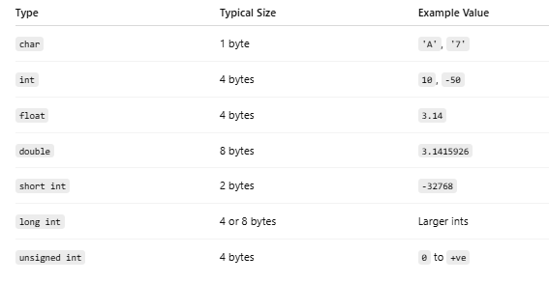
DATA TYPES IN C

Slide 38
DATA TYPES IN C
What are Type Modifiers?
Type modifiers are keywords in C that are used to change the size or range of a basic data type. They do not create new data types; they modify existing ones like int, double, or char.
C provides four type modifiers:
short, long, signed, unsigned
These modifiers are used with integer and character data types to:
Increase the storage size
Decrease the storage size
Remove negative number support
Add support for larger numbers
Increase precision (for long double)
Type modifiers help programmers control memory usage, especially important in embedded systems, IoT, system-level programming.

Slide 39
DATA TYPES IN C
Why Do We Need Type Modifiers?
Because not every situation needs a full 4-byte integer.
Example Situations:
If you only need to store values from 0 to 255, using a 4-byte int wastes memory → use unsigned char.
If you need to store very large integers, int is not enough → use long int.
If you want to prevent negative values, use unsigned.
Type modifiers give fine control over memory and value range

Slide 40
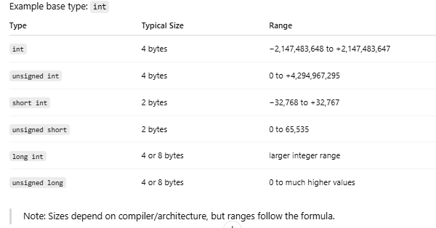
DATA TYPES IN C
How Type Modifiers Affect a Data Type

Slide 41
DATA TYPES IN C
short int s = 32767;
unsigned short u = 65535;
long int hugeNumber = 1234567890;
unsigned long bigPositive = 4000000000;
signed char c1 = -10;
unsigned char c2 = 250;

Slide 42
OPERATORS IN C

Slide 43
What is an Operator?
Definition: A symbol that performs a specific operation on operands.
Simple Logic:
• Operator = Action
• Operand = Data
Example:
int a = 10 + 20;
(+) is the Operator | (10, 20) are Operands

Slide 44
Why Are Operators Important?
Operators allow C programs to:
• Perform calculations
• Make decisions (if/else)
• Control program flow
• Manipulate data and Work with memory addresses
Bottom Line: Without operators, you cannot write logic.

Slide 45
Types of Operators in C
C provides these major categories:
1. Arithmetic (+, -, *, /, %)
2. Relational (<, >, ==)
3. Logical (&&, ||, !)
4. Assignment (=, +=)
5. Increment/Decrement (++, --)
6. Conditional/Ternary (?:)
7. Bitwise (&, |, ^)
8. Special (sizeof, comma, pointer)

Slide 46
Arithmetic Operators
Basic Math Operations:
• (+) Addition
• (-) Subtraction
• (*) Multiplication
• (/) Division
• (%) Modulus (Remainder)
Important Note:
Integer Division: 10 / 3 = 3 (Not 3.33)
Modulus (%): Works ONLY with integers.

Slide 47
Relational Operators
Used to compare two values (Returns True/False).
• < Less than
• <= Less than or equal
• > Greater than
• >= Greater than or equal
• == Equal to
• != Not equal to
Usage: Used primarily in Decision Making (if/while).

Slide 48
Logical Operators
Used to combine conditions.
1. && (AND): True only if BOTH are true.
2. || (OR): True if AT LEAST ONE is true.
3. ! (NOT): Reverses the truth value.
A | B | A && B | A||B
0 | 0 | 0 | 0
0 | 1 | 0 | 1
1 | 0 | 0 | 1
1 | 1 | 1 | 1

Slide 49


Assignment Operators
Assigns values from right side to left side.
• = (Simple Assign) -> a = 5
• += (Add & Assign) -> a += 10 (same as a = a + 10)
• -= (Sub & Assign)
• *= (Mul & Assign)
• /= (Div & Assign)
• %= (Mod & Assign)

Slide 50
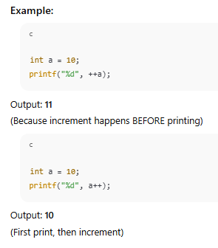
Increment / Decrement (++ / --)
Pre vs Post (Interview Concept)
1. Pre-Increment (++a):
First Increment -> Then Print/Use
2. Post-Increment (a++):
First Print/Use -> Then Increment

Slide 51
Conditional Operators
Conditional (Ternary):
Syntax: condition ? true_val : false_val;
Ex: int max = (a > b) ? a : b;
if(a > b)
max = a;
else
max = b;

Slide 52
Bitwise Operators
Bitwise Operators (Advanced):
Operate on individual bits (0s and 1s)
Used in Embedded Systems, OS Kernels, Cryptography, Image Processing,
Outputs numerical values, not booleans
Operator | Meaning
& | Bitwise AND
| | Bitwise OR
^ | Bitwise XOR
<< | Left Shift
>> | Right Shift
~ | Bitwise NOT

Slide 53
Bitwise AND (&)
Truth: only 1 & 1 = 1 any other case 0
Example: 12 & 10
12 = 1100,
10 = 1010
→ 1000 (8)
Used for masking, filtering bits

Slide 54
Bitwise OR (|)
Truth: any 1 → output 1
Example: 12 | 10
1100 |
1010
→ 1110 (14)
Used for setting bits, enabling flags

Slide 55
Bitwise XOR (^)
Truth: 1 if bits differ
Example: 12 ^ 10
1100 ^
1010
→ 0110 (6)
Used in encryption, parity checking

Slide 56
Bitwise NOT (~)
Flips all bits (1→0, 0→1)
Example: ~5 (00000101 → 11111010)
Result = -6 due to 2's complement

Slide 57
Left Shift (<<)
Shifts bits left, inserts 0s
5 << 1: 0101 → 1010 (10)
Equivalent to multiply by 2

Slide 58
Right Shift (>>)
Shifts bits right
20 >> 1: 10100 → 01010 (10)
Equivalent to divide by 2

Slide 59
Masking Example
x = 10101110 &
00001111
Result = 00001110
Used to extract lower bits

Slide 60
Summary Table
& : AND → masking
| : OR → setting bits
^ : XOR → toggling
~ : NOT → inversion
<< : left shift → x2
>> : right shift → /2

Slide 61
Special Operators
1. sizeof(): Returns size of datatype.
printf('%d', sizeof(int)); // 4 bytes
2. Address Of (&): Returns memory address.
&x → address of x
3. Dereference (*): Value at address.
*p → value at address p
4. Comma (,): Executes left to right, returns last value.
int a = (1, 2, 3); // a = 3

Slide 62
Operator Precedence
Think of an expression like:
int x = 10 + 20 * 3;
There are multiple operators: =, +, *.
We need rules to decide:
Which operator is done first? → This is precedence
If two operators have the same level, which side first? → This is associativity

Slide 63
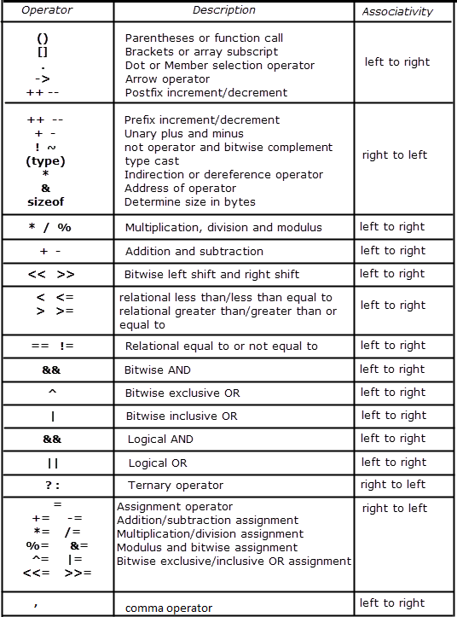
Operator Precedence (The Pyramid)
Highest Priority:
1. () [] -> . ++ --
2. ! ~ (unary) * &
3. * / %
4. + -
5. << >>
6. < <= > >=
7. == !=
8. && then ||
9. = += -=
Lowest Priority: ,

Slide 64
Operator Precedence
Rule 1 – Operator Precedence
Precedence = which operator is stronger.
Higher precedence → evaluated first.
Example:
10 + 20 * 3
* has higher precedence than +
So 20 * 3 is done first → 60
Then 10 + 60 → 70
So:
10 + 20 * 3 ≡ 10 + (20 * 3)

Slide 65
Operator Precedence
Rule 2 – Associativity
Associativity = direction (left/right) for operators at the same precedence level.
Example:
10 - 5 - 2
- and - have same precedence, so we use associativity.
- is left to right
So expression becomes: (10 - 5) - 2 → 5 - 2 → 3 Not 10 - (5 - 2) (which would be 7 – wrong).

Slide 66
Example
Rule: When precedence is equal, check Associativity.
Left to Right: Arithmetic, Relational, Logical
Right to Left: Assignment (=), Unary, Ternary
Example Evaluation Tree:
Expression: 10 + 20 * 3
Step 1: 20 * 3 = 60
Step 2: 10 + 60 = 70
Final Answer: 70

Slide 67
Associativity
Left-to-right: + - * / < > == && ||
Right-to-left: = += -= ! ++ -- ?:
Used when precedence is same.

Slide 68
Left-to-Right Example
Expression: 20 - 5 - 3
Left associative → (20 - 5) - 3 = 12
Not evaluated as → 20 - (5 - 3)

Slide 69
Right-to-Left Example
Expression: a = b = c = 5;
Evaluates as → a = (b = (c = 5));
All variables become 5.

Slide 70
Complex Expression Breakdown
Expression: 10 + 20 * 3 > 40 && 5 < 2 + 3
Step 1: 20 * 3 = 60
Step 2: 10 + 60 = 70
Step 3: 70 > 40 → 1
Step 4: 2 + 3 = 5 → 5 < 5 → 0
Final: 1 && 0 = 0

Slide 71
Expression Tree (Complex)
&&
/ \
> <
/ \ / \
+ 40 5 +
/ \ / \
10 * 2 3
/ \
20 3

Slide 72
Type Conversion in C
Changing a value from one data type to another
Happens during assignments & expressions
Follows type promotion hierarchy
Types: Implicit (automatic) & Explicit (manual type casting)

Slide 73
Why Type Conversion is Needed
To perform operations between different data types
To avoid wrong results (e.g., integer division)
To store one type into another safely
To control how data is processed

Slide 74
Example: Mixed Data Types
int salary = 50000;
float bonus = 3500.75;
float total = salary + bonus;
salary (int) → float automatically

Slide 75
Wrong Result Without Conversion
float x = 5 / 2; // integer division → 2.0
Correct: float x = (float)5 / 2; // 2.5

Slide 76
Implicit Conversion
Performed automatically by the compiler
Small → Big type:
char < int < float < double
Prevents data loss

Slide 77
Implicit Example 1
int a=10; float b=2.5; float c=a+b;
a promoted to float → 10.0 + 2.5 = 12.5

Slide 78
Implicit Example 2: ASCII Promotion
char ch='A'; int x=ch+5;
'A' → 65, 65+5=70

Slide 79
Explicit Conversion (Type Casting)
Manual conversion using (type)
Example: float c = (float)a / b;
a becomes 5.0 → result becomes 2.5

Slide 80
Explicit Example: Data Loss
int x=300; char c=(char)x;
char stores -128 to 127 →
stored value becomes 44

Slide 81
Type Modifier vs Type Conversion
Modifier: short, long, unsigned (changes size)
Conversion: int→float, float→int (changes type)

Slide 82
Promotion Rules
In expressions, small types are promoted to larger types
Final result takes the largest data type present

Slide 83
Implicit Conversion Flowchart
char → short → int → float → double → long double

Slide 84
Explicit Conversion Flowchart
VALUE → (type) → NEW VALUE
Examples: (float)5 → 5.0, (int)2.39 → 2

Slide 85
Summary
Implicit: automatic, safe, compiler-controlled
Explicit: manual, programmer-controlled
Needed for accuracy, safety, mixed expressions

Slide 86
What is I/O in C?
Input → Getting data from the user
Output → Displaying data to the user
C uses printf() and scanf() for I/O

Slide 87
Input / Output Statements in C
printf() → Output function
scanf() → Input function
Requires #include <stdio.h>

Slide 88
printf() – Output Function
Syntax: printf("format string", values);
Example: printf("Sum = %d", 50); → Sum = 50

Slide 89
Format Specifiers (printf)
int → %d
float → %f
double → %lf
char → %c
string → %s
long int → %ld
unsigned int → %u
hexadecimal → %x / %X
octal → %o

Slide 90
scanf() – Input Function
Syntax: scanf("format string", &variable);
Always use & except with strings
Example: scanf("%d", &age);

Slide 91
Format Specifiers (scanf)
int → %d
float → %f
double → %lf
char → %c
string → %s (NO & needed)

Slide 92
printf vs scanf
Feature | printf() | scanf()
Purpose | Display output | Take input
Works on | Format string + values | Format string + addresses
Uses & ? | NO | YES (except string)
Reads? | Nothing | Keyboard input

Slide 93
Escape Sequences
\n → New line
\t → Tab space
\\ → Backslash
\" → Double quote
\b → Backspace
\r → Carriage return
printf("Hello\nWorld");
Hello
World

Slide 94
Carriage Return (\r) in C – Examples
Carriage return moves cursor to the start of the same line.
printf("Hello World");
printf("\rHi");
Output: Hi llo World (Hi overwrites He)

Slide 95
Examples
printf("ABCDE");
printf("\r12");
Output: 12CDE (12 overwrites AB)
printf("Loading...");
printf("\rDone");
Output: Doneing... (Done overwrites Load)

Slide 96
Examples
printf("123456\rABC");
Output: ABC456 (ABC overwrites 123)
printf("Hello World\n");
printf("\rWel");
Output:
Hello World
Wel (\n moved to new line so no overwrite)

Slide 97
Multiple Inputs Using scanf()
Example:
int a, b;
scanf("%d %d", &a, &b);
User enters: 10 20

Slide 98
Common Mistakes
Missing &: scanf("%d", age); → WRONG
Correct: scanf("%d", &age);
Using %d for float → WRONG
Using %f instead of %lf for double → WRONG

Slide 99
How printf() Works – Diagram
VALUE → printf() → SCREEN
Example: printf("%d", 10) → 10

Slide 100
How scanf() Works – Diagram
User Input → scanf() → Stored in variable
Example: User types 45 → age = 45 (stored)

Slide 101
Example Program
#include <stdio.h>
void main() {
int age; float marks;
printf("Enter age: "); scanf("%d", &age);
printf("Enter marks: "); scanf("%f", &marks);
printf("Age = %d, Marks = %.2f", age, marks);
}

Slide 102
Formatting Output (printf)
Decimal control: printf("%.2f", 5.6789); → 5.68
Width formatting: printf("%5d", 10); → ' 10'

Slide 103
Control Structures in C
Control how, when, and how many times a statements execute.
Types:
Conditional (Selection),
Looping (Iteration).

Slide 104
Why Control Structures Are Needed
To make decisions based on conditions.
To repeat actions without rewriting code many times.
To skip or exit sections of code logically.
To improve readability, structure, and reduce redundancy.

Slide 105
Conditional Control Structures
Used for decision-making.
Types:
if
if-else
else-if ladder
nested if
switch
?: (ternary)

Slide 106
if Statement – Example
Syntax:
if (condition) {
// statements;
}
Example:
int age = 20;
if (age >= 18) {
printf("Eligible to vote\n");
}

Slide 107
if–else Statement – Example
Syntax:
if (condition) {
// true block
} else {
// false block
}
Example:
int marks = 45;
if (marks >= 50)
printf("Pass\n");
else
printf("Fail\n");

Slide 108
else-if Ladder – Example
Used for multiple conditions.
Example:
int marks = 78;
if (marks >= 90)
printf("Grade A\n");
else if (marks >= 80)
printf("Grade B\n");
else if (marks >= 70)
printf("Grade C\n");
else
printf("Fail\n");

Slide 109
Nested if – Example
if inside another if: dependent conditions.
Example:
int age = 20;
int citizen = 1; // 1 = yes
if (age >= 18) {
if (citizen == 1) {
printf("Eligible to vote\n");
}
}

Slide 110
switch-case – Example
Used for constant values.
Syntax & Example:
int day = 2;
switch(day) {
case 1: printf("Monday\n"); break;
case 2: printf("Tuesday\n"); break;
case 3: printf("Wednesday\n"); break;
default: printf("Invalid day\n");
}
Note: break is mandatory

Slide 111
Ternary Operator ?: – Example
Shorthand for simple if–else.
Syntax:
condition ? expression1 : expression2;
Example:
int marks = 60;
char *result;
result = (marks >= 50) ? "Pass" : "Fail";
printf("%s\n", result);

Slide 112
Looping Structures in C
Used to repeat statements.
Types: for, while, do-while.

Slide 113
for Loop – Example
Best when number of iterations is known.
Syntax:
for (initialization; condition; increment) {
// body
}
Example:
for (int i = 1; i <= 5; i++) {
printf("%d ", i);
}

Slide 114
while Loop – Example
Condition is checked before each iteration.
Example:
int n = 1;
while (n <= 5) {
printf("%d ", n);
n++;
}

Slide 115
do-while Loop – Example
Executes at least once (condition checked at end).
Example:
int i = 1;
do {
printf("%d ", i);
i++;
} while (i <= 5);

Slide 116
Loop Control – break and continue
break: exits loop immediately.
continue: skips current iteration and moves to next.
Example (break):
for (int i = 1; i <= 10; i++) {
if (i == 5) break;
printf("%d ", i);
}
Example (continue):
for (int i = 1; i <= 5; i++) {
if (i == 3) continue;
printf("%d ", i);
}

Slide 117
Infinite Loop – Example
Runs forever until forcefully stopped.
Example:
while (1) {
printf("Running...\n");
}
Or:
for(;;) {
// infinite loop
}

Slide 118
Nested Loops – Example
Loop inside another loop, useful for patterns & matrices.
Example:
for (int i = 1; i <= 3; i++) {
for (int j = 1; j <= 3; j++) {
printf("%d %d\n", i, j);
}
}

Slide 119
Summary of Control Structures
Sequential: straight execution.
Conditional: if, if-else, else-if, nested if, switch, ?:
Looping: for, while, do-while, with break/continue.
Control structures form the backbone of program logic.

Slide 120
Arrays in C
Array = collection of similar data types stored in contiguous memory.
Helps store multiple values using a single variable name.

Slide 121
Why Arrays Are Needed
To store a list of values (marks, prices, scores).
Enables easy processing using loops.
Used in algorithms, searching, sorting, matrices.

Slide 122
1D Array Declaration
Syntax: int a[5];
Creates 5 integer storage locations.

Slide 123
Initialization Methods
Full init: int a[5] = {10,20,30,40,50};
Partial init: int a[5] = {10,20}; // remaining = 0
Compiler counts: int a[] = {1,2,3,4};

Slide 124
Accessing 1D Array
Example:
printf("%d", a[2]); // prints 3rd element

Slide 125
Input/Output of 1D Array
Input: for(i=0;i<5;i++) scanf("%d", &a[i]);
Output: for(i=0;i<5;i++) printf("%d ", a[i]);

Slide 126
1D Array Memory Layout
Example: int a[5]={10,20,30,40,50};
Index: 0 1 2 3 4
Value:10 20 30 40 50
Address (if int=4 bytes):
1000 1004 1008 1012 1016

Slide 127
Common Errors in Arrays
Out of range access: a[5] = 10; // invalid
Using uninitialized array gives garbage values.
Negative or extremely large index invalid.

Slide 128
2D Array Declaration
Syntax: int a[3][4];
Creates a 3x4 matrix (12 elements).

Slide 129
2D Array Initialization
Matrix form: int a[2][3]={{1,2,3},{4,5,6}};
Single line: int a[2][3]={1,2,3,4,5,6};

Slide 130
Accessing 2D Array
Example: printf("%d", a[1][2]); // row 1, col 2

Slide 131
2D Array Input/Output
Input: nested loop with scanf(&a[i][j])
Output: nested loop with printf(a[i][j])

Slide 132
2D Array Memory Layout (Row-Major)
For a[2][3]={{1,2,3},{4,5,6}}:
Stored row-by-row: 1 2 3 4 5 6
Addresses: 1000 1004 1008 1012 1016 1020

Slide 133
Difference: 1D vs 2D
1D: linear list, accessed via a[i]
2D: table form, accessed via a[i][j]

Slide 134
Strings in C
A string is a 1D array of characters ending with null character '\0'.
char name[10] = "John";
Memory Layout
J o h n \0 _ _ _ _
C does NOT have a built-in string type.
Strings are managed using character arrays + string library functions.

Slide 135
Why Strings?
✔ To store names, words, sentences ✔ To process text (count letters, compare text) ✔ For input/output involving characters ✔ For file processing ✔ For real applications (login forms, messages, commands

Slide 136
String Declaration Methods
Method 1: Character array with size
char s[10] = "Hello";
Method 2: Compiler decides size
char s[] = "Hello";
Method 3: Character-by-character initialization
char s[6] = {H,e,l,l,o,\0};
Method 4: Without initialization
char s[20];
(This contains garbage until you assign.)

Slide 137
String Input Methods
Using scanf()
scanf("%s", s);
Limit: Stops reading at space
Input: `Hello World` → stores only `Hello`
Using gets() — NOT recommended
gets(s);
Unsafe, removed from latest compilers.
Using fgets() — BEST
fgets(s, 20, stdin);
Reads full line including spaces.

Slide 138
String Output Methods
printf("%s", s);
puts(s); // prints with newline

Slide 139
String Operations strlen()
Counts characters excluding '\0'.
int len = strlen("Hello"); // 5

Slide 140
strcpy()
Copies source string to destination.
strcpy(a, "Hello");
strcpy(b, a);

Slide 141
strcat()
Concatenates two strings.
char s1[20] = "Hello ";
char s2[] = "World";
strcat(s1, s2); // Hello World

Slide 142
strcmp()
Compares two strings lexicographically.
Returns 0 if equal,
<0 if s1<s2,
>0 if s1>s2.
strcmp("Apple", "Banana"); // <0
strcmp("Cat", "Cat"); // 0

Slide 143
Case Conversion Functions
strupr(s); // HELLO
strlwr(s); // hello
Note: Not available in all compilers.

Slide 144
Character Search – strchr()
Finds first occurrence of a character.
char *p = strchr("Hello", 'l’); //llo
Function Call | First Occurrence | Output
strchr("Hello", 'l') | index 2 | llo
strchr("Banana", 'n') | index 2 | nana
strchr("Apple", 'z') | not found | (null)
strchr("Hello World", ' ') | index 5 | World
strchr("Character", 'a') | index 2 | aracter

Slide 145
strrev()
Reverses string.
strrev(s); // compiler dependent

Slide 146
Manual String Length Logic
int len=0;
while(s[len] != '\0') len++;

Slide 147
Manual String Copy Logic
int i=0;
while((d[i] = s[i]) != '\0') i++;

Slide 148
Manual String Compare Logic
int i=0;
while(s1[i] == s2[i]) {
if(s1[i]=='\0') return 0;
i++;
}
return s1[i] - s2[i];

Slide 149
Memory Layout Example
char s[] = "Cat";
C a t \0
Addresses: 1000 1001 1002 1003

Slide 150
Functions in C – Introduction
• Functions break large programs into smaller modules.
• Improve Readability, Reusability, Debugging, Avoid repetition and Modular programming
• Two main types:
Library Functions &
User-defined Functions.

Slide 151
Functions in C – Introduction
General syntax:
return_type function_name(parameter_list) {
// body
}

Slide 152
User-Defined Functions
• Created by the programmer.
• Example:
int add(int a, int b) {
return a + b;
}

Slide 153
User-Defined Functions
• Created by the programmer.
• Example:
int add(int a, int b) {
return a + b;
}

Slide 154
Structure of a User-Defined Function
A function has 3 major parts
A. Function Declaration (Prototype)
Tells the compiler about return type, name, and parameters.
B. Function Definition
Actual code.
C. Function Call
Calling the function from main.

Slide 155
Function Declaration & Definition
Declaration: tells compiler about name, return type, and parameters.
Definition: actual body of the function.
Example:
int sum(int, int); // declaration
int sum(int a, int b) { return a + b; } // definition

Slide 156
Function Call
• Call by writing function_name(arguments);
Example:
int result = sum(10, 20);
printf("%d", result);

Slide 157
Function Categories Based on Arguments & Return Type
Type | Example
No argument, no return | void display()
With argument, no return | void print(int x)
No argument, with return | int input()
With argument, with return | int add(int a, int b)

Slide 158
Call by Value
• A COPY of actual value is passed.
• Changes inside function DO NOT affect original variable.
Example:
void modify(int x) { x = 100; }

Slide 159
Call by Value – Example Output
void modify(int x) { x = 100; }
int main() {
int a = 10;
modify(a);
printf("%d", a); // Output: 10
}

Slide 160
Call by Reference
• Function receives address of variables.
• Changes affect original variable.
Example:
void change(int *p) { *p = 50; }

Slide 161
Call by Reference – Example Output
void modify(int *p) {
*p = 100;
}
int main() {
int a = 10;
modify(&a);
printf("%d", a); // Output: 100
}

Slide 162
CV vs CR
Feature | Call by Value | Call by Reference
What is passed? | Copy of value | Address
Can modify original variable? | ❌ No | ✔ Yes
Memory use | More | Less
Required concept | Simple | Needs pointers
Risk | Very safe | Unsafe if misused

Slide 163
Recursion – Introduction
• Recursion = A function calling itself until a stopping condition.
✔ Requires 2 things:
1️⃣ Base case – stopping condition 2️⃣ Recursive call – function calls itself
• Used for factorial, Fibonacci, towers of Hanoi.
Example:
int fact(int n){
if(n==0) return 1;
return n * fact(n-1);
}

Slide 164
Recursion – Execution Flow
Example: fact(4)
• fact(4) → 4 * fact(3)
• fact(3) → 3 * fact(2)
• fact(2) → 2 * fact(1)
• fact(1) → 1 * fact(0)
• fact(0) → 1

Slide 165
Recursion – Output Example
printf("%d", fact(4));
Output: 24

Slide 166
Fibonacci Using Recursion
int fib(int n) {
if (n == 0) return 0;
if (n == 1) return 1;
return fib(n-1) + fib(n-2);
}

Slide 167
Advantages and Disadvantages
✔ Reduces code size ✔ Makes tree-based logic easy ✔ Simple for mathematical algorithms
❌ Slow for large inputs ❌ More memory usage (stack frames) ❌ Risk of stack overflow if base case missing

Slide 168
STORAGE CLASSES IN C
Storage classes define 4 things about a variable:
Where it is stored in memory
Lifetime (how long it exists)
Scope (where it can be accessed)
Default value

Slide 169
Storage Class
C has 4 storage classes:
auto
register
static
extern

Slide 170
Auto Storage Class
(Default for local variables)
✔ Definition
Variables declared inside a block without any keyword are auto variables.
✔ Example
#include <stdio.h>
void test() {
int x; \\auto int x;
printf("%d\n", x); // garbage value
}
int main() { test(); }

Slide 171
Auto Storage Class
Property | Value
Scope | Local to the block
Lifetime | Exists until the block ends
Storage | RAM
Default value | Garbage

Slide 172
Register Storage Class
Used for fast access variables (stored in CPU register).
register int counter;
⚠ Important Rule:
register int x;
printf("%p", &x); // Error!
Because register variables do not have a memory address accessible to programmers.
✔ When to use?
Loop counters (for (register int i=0; i<n; i++))
Frequently used variables

Slide 173
Register Storage Class
Scope | Local
Lifetime | Until function ends
Storage | CPU registers (if available)
Default value | Garbage
Address access | ❌ Cannot use & operator

Slide 174
Static Storage Class
Gives variables lifetime = entire program.
✔ Static Local Variable
void demo() {
static int x = 0;
x++;
printf("%d ", x);
}
int main() {
demo();
demo();
demo();
}
✔ Output:
1 2 3
✔ Why?
Static variables retain previous value
They are created only once
Memory Diagram:
First call: x = 1
Second call: x = 2
Third call: x = 3

Slide 175
Static Storage Class
Property | Value
Scope | Local to function
Lifetime | Entire program
Default value | 0
Storage | Data Segment (static memory)

Slide 176
Extern Storage Class
Used to access global variable from another file or outside the function.
✔ Example (same file)
int a = 10;
void display() {
extern int a;
printf("%d", a);
}
✔ Example (two files)
File 1: a.c
int x = 50;
File 2: b.c
#include <stdio.h>
extern int x;
// declare variable from another file
int main() {
printf("%d", x);
}
✔ Output:
50

Slide 177
Extern Storage Class
Property | Value
Scope | Global
Lifetime | Entire program
Storage | Data segment
Default value | 0

Slide 178
Comparison
Storage Class | Scope | Lifetime | Default Value | Storage | Keyword Used
auto | Local | Inside block | Garbage | RAM | auto
register | Local | Inside block | Garbage | CPU Register | register
static | Local/Global | Entire program | 0 | Data segment | static
extern | Global | Entire program | 0 | Data segment | extern

