Slide 1
BACSE104 (2 4 0 4) Structured and Object Oriented Programming
Dr.Radha R
Associate Professor
SCOPE

Slide 2
Course Outcome
To analyze and implement basic programming constructs, decision-making statements, and loops in C/C++
To apply modular programming techniques by utilizing functions, structures, and files for efficient problem-solving in real-world applications.
To apply pointers and dynamic memory allocation techniques to manage data efficiently in C/C++ programs.
To demonstrate object-oriented principles (encapsulation, inheritance, and polymorphism) to design structured and scalable applications.
To develop efficient and scalable solutions and to apply advanced programming paradigms, including exception handling and the Standard Template Library (STL) with set, list, and map.

Slide 3
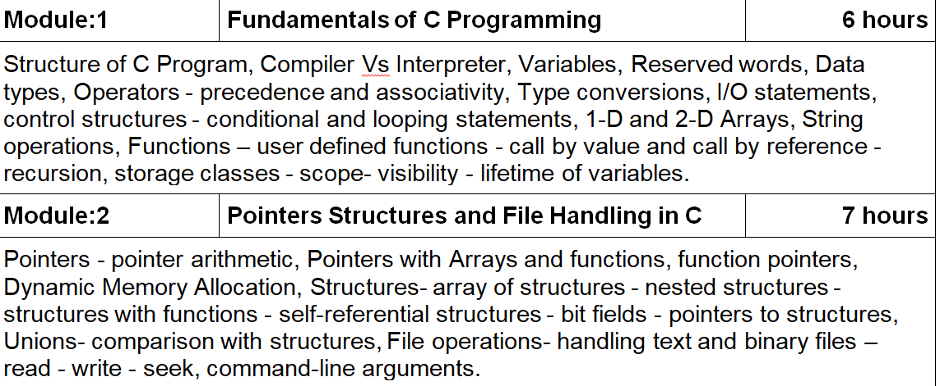
Syllabus

Slide 4
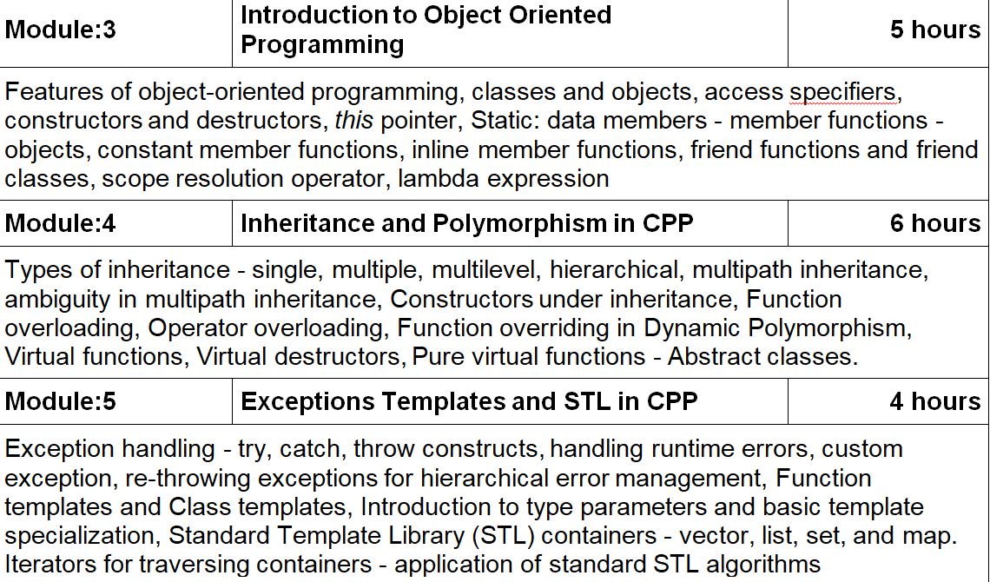
Syllabus

Slide 5
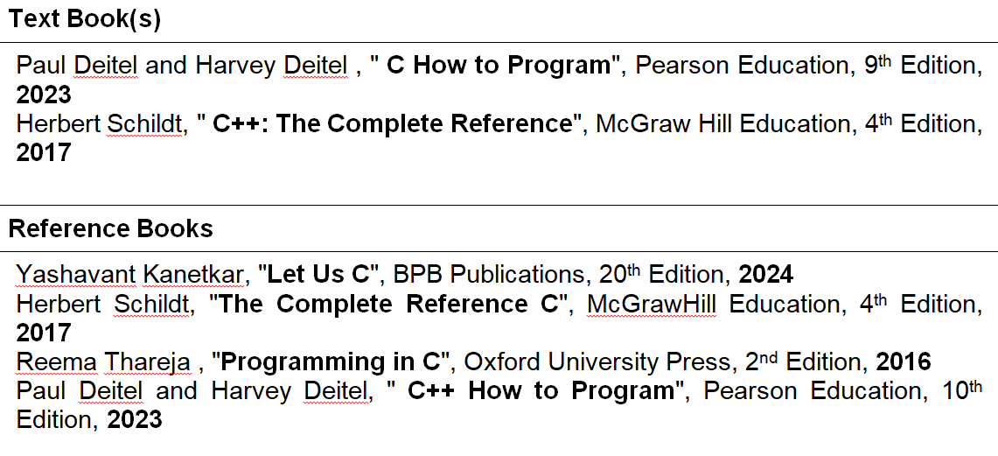

Slide 6
Theory
Evaluation- Theory BACSE104
component | Max Marks | Weightage | CO | BTL
DA1 – (Handwritten Assignment on C) | 25 | 10 | 2 | 3-Apply
DA2 – (Handwritten Assignment on C++) | 25 | 10 | 3 | 3-Apply
Quiz (IamNeo) | 25 | 10 | 5 | 3-Apply
CAT1 | 50 | 15 | 1,2,3 | 3-Apply
CAT2 | 50 | 15 | 3,4,5 | 3-Apply
FAT | 100 | 40 | 1,2,3,4,5 | 3-Apply

Slide 7
Evaluation- Lab BACSE104
COMPONENT | Max Marks | Weightage | PATTERN | TIME DURATION
PAT1 | 30 | 10 | 5 Debugging questions- 15 Marks 1 Hard Question-10 marks 1 Easy Question – 5 marks | 30 MINUTES (6 minutes each) 30 minutes 15 minutes Total – 75 minutes
PAT2 | 30 | 15
PAT3 | 30 | 15
PAT4 | 30 | 10
IAMNEO PROGRESS | 10 | 10
FAT | 50 | 40 | Aim &Algorithm- 10 marks 5 Debugging questions- 15 Marks 1 Hard Question-15 marks 1 Easy Question-10 marks | 15 minutes 30 MINUTES (6 minutes each) 30 minutes 15 minutes Total – 100 minutes

Slide 8
Schedule for PAT
Schedule of PATs
ASSESSMEN | DATE | SYLLABUS
PAT1 | JAN 19-23 | MODULE 1
PAT2 | FEB 23-27 | MODULE 2
PAT3 | MAR 23-27 | MODULE 3 AND MODULE 4 (Till Operator overloading)
PAT4 | APR 6-10 | Module 4 and Module 5 (till Templates)
FAT | APR 11-17 | MODULE 1-5

Slide 9
Schedule for PAT
Syllabus of CAT
ASSESSMENT | SYLLABUS
CAT 1 | MODULE 1 & Half of MODULE 2
CAT 2 | MODULE 2 (Remaining) MODULE 3 MODULE 4 (Half)

Slide 10
What is C?
Dennis Ritchie – AT&T Bell Laboratories – 1972
Widely used today
extends to newer system architectures
efficiency/performance
low-level access
1

Slide 11
Features of C
C features:
Few keywords
Structures, unions – compound data types
Pointers – memory, arrays
External standard library – I/O, other facilities
Compiles to native code
Macro preprocessor

Slide 12
What is C used for?
Systems programming:
OSes, like Linux
microcontrollers: automobiles and airplanes
embedded processors: phones, portable electronics, etc.
DSP processors: digital audio and TV systems
. . .

Slide 13
C vs. related languages
Derivatives: C++, Objective C, C#
Influenced: Java, Perl, Python (quite different)
C lacks:
exceptions
range-checking
garbage collection
object-oriented programming
polymorphism
. . .
Low-level language ⇒ faster code (usually)

Slide 14
Warning: low-level language!
Inherently unsafe:
No range checking
Limited type safety at compile time
No type checking at runtime

Slide 15
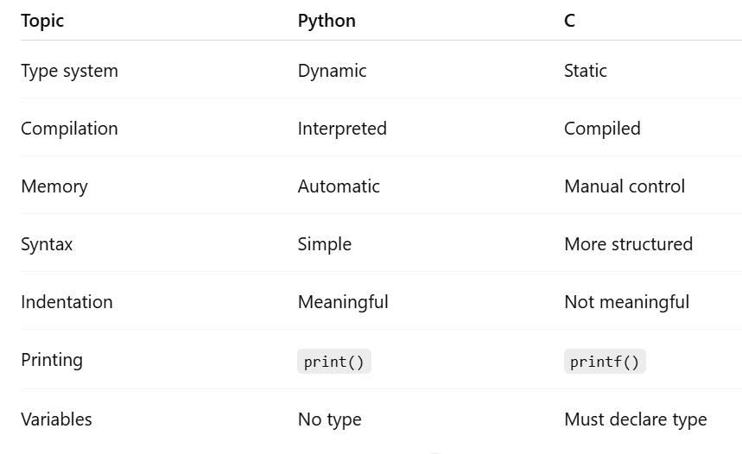

Slide 16
First Code
#include <stdio.h>
int main() {
printf("Hello, World!");
return 0;
}

Slide 17
C Programming language
C is a fast, small,general-purpose,platform dependent programming language.
C is used for systems programming (e.g., compilers and interpreters, operating systems, database systems, microcontrollers etc.)
C is static (compiled), typed, structured and imperative.
"C is quirky, ﬂawed, and an enormous success."–Ritchie
1

Slide 18
Deﬁnitions
Datatypes:
The datatype of an object in memory determines the set of values it can have and what operations that can be performed on it.
C is a weakly typed language. It allows implicit conversions as well as forced (potentially dangerous) casting.
Operators:
Operators specify how an object can be manipulated (e.g.,, numeric vs. string operations).
operators can be unary(e.g., -,++),binary (e.g.,
+,-,*,/),ternary (?:)
3

Slide 19
Deﬁnitions (contd.)
Expressions:
An expression in a programming language is a combination of values, variables, operators, and functions
Variables:
A variable is as named link/reference to a value stored in the system’s memory or an expression that can be evaluated.
Consider: int x=0,y=0; y=x+2;.
x, y are variables
y = x + 2 is an expression
• + is an operator.

Slide 20
Variable names
Naming rules:
Variable names can contain letters,digits and _
Variable names should start with letters.
Keywords (e.g., for,while etc.) cannot be used as variable names
Variable names are case sensitive. int x; int X declares two different variables.
Pop quiz (correct/incorrect):
int money$owed; (incorrect: cannot contain $)
int total_count (correct)
int score2 (correct)
int 2ndscore (incorrect: must start with a letter)
int long (incorrect: cannot use keyword)

Slide 21
Data types and sizes
C has a small family of datatypes.
Numeric (int,ﬂoat,double)
Character (char)
User deﬁned (struct,union)

Slide 22
Numeric data types
Depending on the precision and range required, you can use one of the following datatypes.
 | signed | unsigned
short | short int x;short y; | unsigned short x;unsigned short int y;
default | int x; | unsigned int x;
long | long x; | unsigned long x;
ﬂoat | ﬂoat x; | N/A
double | double x; | N/A
char | char x; signed char x; | unsigned char x;
The unsigned version has roughly double the range of its signed counterparts.
Signed and unsigned characters differ only when used in arithmetic expressions.
Titbit: Flickr changed from unsigned long (2³² − 1) to string two years ago.

Slide 23
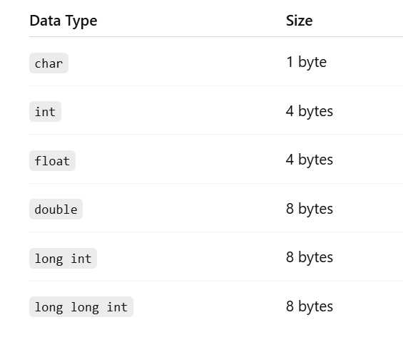
DATA TYPES

Slide 24
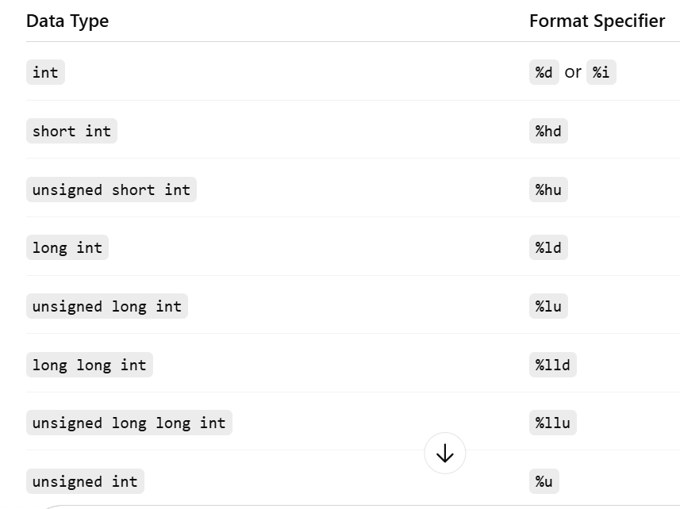
FORMAT SPECTFIERS

Slide 25
Constants
Constants are literal/ﬁxed values assigned to variables or used directly in expressions.
Datatype | example | meaning
 | int i=3; | integer
 | long l=3; | long integer
integer | unsigned long ul= 3UL; | unsigned long
 | int i=0xA; | hexadecimal
 | int i=012; | octal number
 | ﬂoat pi=3.14159 | ﬂoat
ﬂoating point | ﬂoat pi=3.141F | ﬂoat
 | double pi=3.1415926535897932384L | double

Slide 26
Constants (contd.)
Datatype | example | meaning
character | ’A’ ’\x41’ ’\0101’ | character speciﬁed in hex speciﬁed in octal
string | "hello world" "hello""world" | string literal same as "hello world"
enumeration | enum BOOL {NO,YES} enum COLOR {R=1,G,B,Y=10} | NO=0,YES=1 G=2,B=3

Slide 27
Declarations
The general format for a declaration is type variable-name [=value] Examples:
char x; /∗ uninitialized ∗/
char x=’A’; /∗ intialized to ’ A’∗/
char x=’A’,y=’B’; /∗multiple variables initialized ∗/
char x=y=’Z’;/∗multiple initializations ∗/
.

Slide 28
Arithmetic operators
operator | meaning | examples
+ | addition | x=3+2; /∗constants∗/ y+z; /∗variables∗/ x+y+2; /∗both∗/
- | subtraction | 3−2; /∗constants∗/ int x=y−z; /∗variables∗/ y−2−z; /∗both∗/
* | multiplication | int x=3∗2; /∗constants∗/ int x=y∗z; /∗variables∗/ x∗y∗2; /∗both∗/
14

Slide 29
Arithmetic operators (contd.)
operator | meaning | examples
/ | division | ﬂoat x=3/2; /∗produces x=1 (int /) ∗/ ﬂoat x=3.0/2 /∗produces x=1.5 (ﬂoat /) ∗/ int x=3.0/2; /∗produces x=1 (int conversion)∗/
% | modulus (remainder) | int x=3%2; /∗produces x=1∗/ int y=7;int x=y%4; /∗produces 3∗/ int y=7;int x=y%10; /∗produces7∗/

Slide 30
Relational Operators
Relational operators compare two operands to produce a ’boolean’ result. In C any non-zero value (1 by convention) is considered to be ’true’ and 0 is considered to be false.
operator | meaning | examples
> | greater than | 3>2; /∗evaluates to 1 ∗/ 2.99>3 /∗evaluates to 0 ∗/
>= | greater than or equal to | 3>=3; /∗evaluates to 1 ∗/ 2.99>=3 /∗evaluates to 0 ∗/
< | lesser than | 3<3; /∗evaluates to 0 ∗/ ’A’<’B’/∗evaluates to 1∗/
<= | lesser than or equal to | 3<=3; /∗evaluates to 1 ∗/ 3.99<3 /∗evaluates to 0 ∗/

Slide 31
Relational Operators
Testing equality is one of the most commonly used relational
operator. Gotchas:
Note that the "==" equality operator is different from the
"=", assignment operator.
Note that the "==" operator on ﬂoat variables is tricky because of ﬁnite precision.
operator == | meaning equal to | examples 3==3; /∗evaluates to 1 ∗/ ’A’==’a’/∗evaluates to 0 ∗/
!= | not equal to | 3!=3; /∗evaluates to 0 ∗/ 2.99!=3 /∗evaluates to 1 ∗/

Slide 32
Logical operators
operator | meaning | examples
&& | AND | ((9/3)==3) && (2∗3==6); /∗evaluates to 1 ∗/ (’A’==’a’) && (3==3) /∗evaluates to 0 ∗/
|| | OR | 2==3 || ’A’==’A’; /∗evaluates to 1 ∗/ 2.99>=3 || 0 /∗evaluates to 0 ∗/
! | NOT | !(3==3); /∗evaluates to 0 ∗/ !(2.99>=3) /∗evaluates to 1 ∗/
Short circuit: The evaluation of an expression is discontinued if the value of a conditional expression can be determined early. Be careful of any side effects in the code.
Examples:
(3==3) || (( c=getchar())==’y’). The second expression is not evaluated.
(0) && ((x=x+1)>0) . The second expression is not evaluated.

Slide 33
Increment and decrement operators
Increment and decrement are common arithmetic operation. C provides two short cuts for the same.
Postﬁx
x++ is a short cut for x=x+1
x−− is a short cut for x=x−1
y=x++ is a short cut for y=x;x=x+1. x is evaluated before it is incremented.
y=x−− is a short cut for y=x;x=x−1. x is evaluated before it is decremented.

Slide 34
Increment and decrement operators
Preﬁx:
• ++x is a short cut for x=x+1
−−x is a short cut for x=x−1
y=++x is a short cut for x=x+1;y=x;. x is evaluate after it is incremented.
y=−−x is a short cut for x=x−1;y=x;. x is evaluate after it is decremented.

Slide 35
Bitwise Operators
operator | meaning | examples
& | AND | 0x77 & 0x3; /∗evaluates to 0x3 ∗/ 0x77 & 0x0; /∗evaluates to 0 ∗/
| | OR | 0x700 | 0x33; /∗evaluates to 0x733 ∗/ 0x070 | 0 /∗evaluates to 0x070 ∗/
ˆ | XOR | 0x770 ^ 0x773; /∗evaluates to 0x3 ∗/ 0x33 ^ 0x33; /∗evaluates to 0 ∗/
« | left shift | 0x01<<4; /∗evaluates to 0x10 ∗/ 1<<2; /∗evaluates to 4 ∗/
» | right shift | 0x010>>4; /∗evaluates to 0x01 ∗/ 4>>1 /∗evaluates to 2 ∗/
Notes:
AND is true only if both operands are true.
OR is true if any operand is true.
XOR is true if only one of the operand is true.

Slide 36
Assignment Operators
Another common expression type found while programming in C is of the type var = var (op) expr
x=x+1
x=x∗10
x=x/2
C provides compact assignment operators that can be used instead.
x+=1 /∗is the same as x=x+1∗/
x−=1 /∗is the same as x=x−1∗/
x∗=10 /∗is the same as x=x∗10 ∗/
x/=2 /∗ is the same as x=x/2
x%=2 /∗is the same as x=x%2

Slide 37
Conditional Expression
A common pattern in C (and in most programming) languages is the following:
i f ( cond )
x=<expra >;
else
x=<exprb >;
C provides syntactic sugar to express the same using the ternary operator ’?:’
s ign=x >0?1: −1;
isodd=x%2==1?1:0;
i f ( x%2==1) isodd=1
else
isodd=0
i f ( x >0) s ign =1
else
s ign=−1
Notice how the ternary operator makes the code shorter and easier to understand (syntactic sugar).

Slide 38
Type Conversions
When variables are promoted to higher precision, data is preserved. This is automatically done by the compiler for mixed data type expressions.
i n t i ;
f l o a t f ;
f = i + 3 . 14159 ; / ∗ i i s promoted to f l o a t , f =( f l o a t ) i +3.14159 ∗ /
Another conversion done automatically by the compiler is ’char’
→ ’int’. This allows comparisons as well as manupilations of character variables.
i supper =( c>=’A’ && c<=’Z’ ) ? 1 : 0 ; / ∗ c and l i t e r a l constants
are converted to i n t ∗ /
i f ( ! i supper )
c=c−’a’+’A’ ; / ∗ s u b t r a c t i o n i s p o s s i b l e
because of i n t e g e r conversion ∗ /
As a rule (with exceptions), the compiler promotes each term in an binary expression to the highest precision operand.
24

Slide 39
Precedence and Order of Evaluation
++,–,(cast),sizeof have the highest priority
*,/,% have higher priority than +,­-
• ==,!= have higher priority than &&,||
assignment operators have very low priority
Use () generously to avoid ambiguities or side effects associated with precendence of operators.
y=x∗3+2 /∗same as y=(x∗3)+2∗/
x!=0 && y==0 /∗same as (x!=0) && (y==0)∗/
d= c>=’0’&& c<=’9’/∗same as d=(c>=’0’) && (c<=’9’)∗/
25

Slide 40
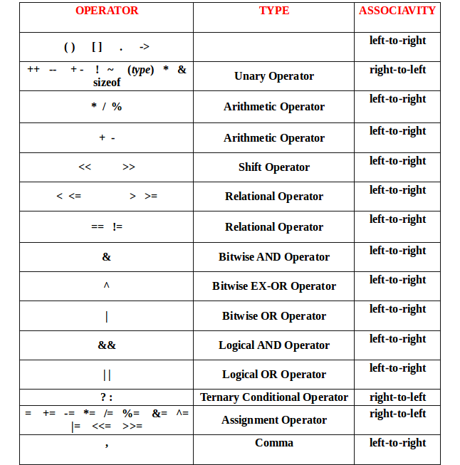

Slide 41
Blocks and compound statements
A simple statement ends in a semicolon:
z = foo(x+y);
Consider the multiple statements:
temp = x+y ;
z = foo ( temp ) ;
Curly braces – combine into compound statement/block
4

Slide 42
Blocks
Block can substitute for simple statement
Compiled as a single unit
Variables can be declared inside
{
i n t temp = x+y ; z = foo ( temp ) ;
}
Block can be empty {}
No semicolon at end

Slide 43
Nested blocks
Blocks nested inside each other
{
i n t temp = x+y ; z = foo ( temp ) ;
{
f l o a t temp2 = x∗y ; z += bar ( temp2 ) ;
}
}

Slide 44
Control conditions
Unlike C++ or Java, no boolean type (in C89/C90)
in C99, bool type available (use stdbool.h)
Condition is an expression (or series of expressions)
e.g. n < 3 or x < y || z < y
Expression is non-zero ⇒ condition true
Expression must be numeric (or a pointer)
const char s t r [ ] = "some text" ;
i f ( s t r ) / ∗ s t r i n g i s not n u l l ∗ /
return 0 ;
7

Slide 45
Conditional statements
The if statement
The switch statement

Slide 46
The if statement
i f ( x % 2 ) y += x / 2 ;
Evaluate condition
if (x % 2 == 0)
If true, evaluate inner statement
y += x/2;
Otherwise, do nothing

Slide 47
The else keyword
i f ( x % 2 == 0 ) y += x / 2 ;
else
y += ( x + 1 ) / 2 ;
Optional
Execute statement if condition is false
y += (x+1)/2;
Either inner statement may be block

Slide 48
The else if keyword
i f ( x % 2 == 0 ) y += x / 2 ;
else i f ( x % 4 == 1 ) y += 2 ∗ ( ( x + 3 ) / 4 ) ;
else
y += ( x + 1 ) / 2 ;
Additional alternative control paths
Conditions evaluated in order until one is met; inner statement then executed
If multiple conditions true, only first executed
Equivalent to nested if statements

Slide 49
Nesting if statements
i f ( x % 4 == 0 )
i f ( x % 2 == 0 ) y = 2 ;
else
y = 1 ;
To which if statement does the else keyword belong?

Slide 50
Nesting if statements
To associate else with outer if statement: use braces
i f ( x % 4 == 0 ) {
i f ( x % 2 == 0 ) y = 2 ;
} else
y = 1 ;

Slide 51
The switch statement
Alternative conditional statement
Integer (or character) variable as input
Considers cases for value of variable
switch ( ch ) {
case ’Y’ : / ∗ ch == ’ Y ’ ∗ /
/ ∗ do something ∗ /
break ;
case ’N’ : / ∗ ch == ’N ’ ∗ /
/ ∗ do something else ∗ /
break ;
default : / ∗ otherwise ∗ /
/ ∗ do a t h i r d t h i n g ∗ /
break ;
}

Slide 52
Multiple cases
Compares variable to each case in order
When match found, starts executing inner code until
break; reached
Execution “falls through” if break; not included
switch ( ch ) {
switch ( ch ) {
case ’Y’ :
case ’y’ :
/ ∗ do something i f ch == ’ Y ’ or
ch == ’ y ’ ∗ /
break ;
case ’Y’ :
/ ∗ do something i f ch == ’ Y ’ ∗ /
case ’N’ :
/ ∗ do something i f ch == ’ Y ’ or
ch == ’N ’ ∗ /
break ;
}
}

Slide 53
The switch statement
Contents of switch statement a block
Case labels: different entry points into block
Similar to labels used with goto keyword (next lecture. . . )

Slide 54
Loop statements
The while loop
The for loop
The do-while loop
The break and continue keywords

Slide 55
The while loop
while ( / ∗ c o n d i t i o n ∗ / )
/ ∗ loop body ∗ /
Simplest loop structure – evaluate body as long as condition is true
Condition evaluated first, so body may never be executed

Slide 56
The for loop
i n t f a c t o r i a l ( i n t n ) {
i n t i , j = 1 ;
for ( i = 1 ; i <= n ; i ++) j ∗= i ;
return j ;
}
The “counting” loop
Inside parentheses, three expressions, separated by semicolons:
Initialization: i = 1
Condition: i <= n
Increment: i++
Expressions can be empty (condition assumed to be “true”)

Slide 57
The for loop
Equivalent to while loop:
i n t f a c t o r i a l ( i n t n ) {
i n t j = 1 ;
i n t i = 1 ; / ∗ i n i t i a l i z a t i o n ∗ /
while ( i <= n / ∗ c o n d i t i o n ∗ / ) { j ∗= i ;
i ++; / ∗ increment ∗ /
}
return j ;
}

Slide 58
The for loop
Compound expressions separated by commas
i n t f a c t o r i a l ( i n t n ) {
i n t i , j ;
for ( i = 1 , j = 1 ; i <= n ; j ∗= i , i ++)
;
return j ;
}
Comma: operator with lowest precedence, evaluated left-to-right; not same as between function arguments

Slide 59
The do-while loop
char c ;
do {
/ ∗ loop body ∗ /
puts ( "Keep going? (y/n) " ) ; c = getchar ( ) ;
/ ∗ other processing ∗ /
} while ( c == ’y’ && / ∗ other
c o n d i t i o n s ∗ / ) ;
Differs from while loop – condition evaluated after each iteration
Body executed at least once
Note semicolon at end

Slide 60
The break keyword
Sometimes want to terminate a loop early
break; exits innermost loop or switch statement to exit early
Consider the modification of the do-while example:
char c ;
do {
/ ∗ loop body ∗ /
puts ( "Keep going? (y/n) " ) ; c = getchar ( ) ;
i f ( c ! = ’y’ )
break ;
/ ∗ other processing ∗ /
} while ( / ∗ other c o n d i t i o n s ∗ / ) ;

Slide 61
The continue keyword
Use to skip an iteration
continue; skips rest of innermost loop body, jumping to loop condition
Example:
# define min ( a , b ) ( ( a ) < ( b ) ? ( a ) : ( b ) )
i n t gcd ( i n t a , i n t b ) {
i n t i , r e t = 1 , minval = min ( a , b ) ;
for ( i = 2 ; i <= minval ; i ++) {
i f ( a % i ) / ∗ i not d i v i s o r of a ∗ /
continue ;
i f ( b % i == 0 ) / ∗ i i s d i v i s o r of both a and b ∗ / r e t = i ;
}
return r e t ;
}

