Slide 1
IBM University Engagement Project Submission
“Exploring the Power of Agentic AI with IBM Granite and IBM Bob”

Slide 2
Project Tile – [Social Media Agent]
Domain of Project – [ like Social Media Automation / Marketing Technology / AI / … ]
Student Name | Recent Passport Photo | Email ID | Mobile number [WhatsApp]
Rimjhim Gaud |  | nainabhargav55@gmail.com | 8503010066

Slide 3
Problem Statement -
Problem Statement : Social Media Agent
The Challenge
Brands, influencers, and organizations struggle to keep up with the fast-paced and fragmented world of social media. Content trends evolve hourly, audience sentiment shifts rapidly, and competitor strategies are difficult to track. Managing multiple platforms often leads to scattered insights, missed engagement opportunities, and ineffective campaigns. The challenge is not only to collect social media data but also to analyze, predict, and recommend actions in real time
The Objective
Build an agentic AI application that acts as an intelligent social media companion.
The solution should:
Fuse Multichannel Data :- Collect and synthesize content, comments, hashtags, and competitor posts from platforms like X, LinkedIn, Instagram, and Facebook into unified insights.
Enable Multimodal Interaction :- Accept user inputs (text, images, or voice prompts) and generate creative post drafts, captions, or campaign ideas aligned with brand tone.
Create a Predictive & Agentic Layer :- Forecast trending hashtags, audience sentiment shifts, and competitor engagement patterns while suggesting the best posting schedules.
Visualize Social Media Pulse :- Provide a dashboard with real-time analytics—engagement trends, influencer mapping, sentiment tracking, and campaign performance forecasts.

Slide 4
Proposed Solution -
Proposed Solution: AI-Powered Social Media Agent
A multi-agent AI solution built using IBM Bob, IBM watsonx.ai, and Granite Models to automate content creation, trend tracking, and audience engagement.
The system uses a Retrieval-Augmented Generation (RAG) pipeline to fetch live market trends and brand data to generate relevant posts.
The system consists of four key Agents:
* Trend Intelligence Agent: Analyzesviral trends and competitor strategies using RAG.
* Content Generation Agent: Creates captions, hashtags, and posts tailored to brand voice and platforms.
* Engagement Agent: Manages comments, DMs, and community interactions.
* Analytics Agent: Tracks post performance and suggests campaign strategies.
The solution includes a user-friendly dashboard (built with Streamlit or React) that visualizes campaign performance, tracks audience growth, and previews upcoming pots.
IBM Bob is used to orchestrate agent workflows, while watsonx.ai ensures scalable model deployment, embeddings, and AI governance. Granite models power reasoning, summarization, and personalization.
Overall, this solution delivers an end-to-end intelligent social media assistant that enhances brand presence, saves time and maximizes engagement through data-driven recommendations.

Slide 5
Technology Used
IBM Bob platform -For designing and orchestrating multi-agent workflows visually
IBM Grainte model - (for eg – ibm-granite-3-2-8b) – For content generation,social media copywriting,engagement strategy,and sentiment analysis
IBM Cloud – It provides the infrastructure to build, deploy, and scale the Social Media Agent efficiently. IBM Cloud enables a reliable, secure, and scalable environment for deploying the Social Media Agents.
RAG– RAG to fetch real-time trends and brand guidelines, and audience data first, then generate intelligent post idea and responses, making the Social Media Agent more trustworthy and effective
IBM Watsonx.ai - For model deployment, embeddings, and AI governance
Vector Database (FAISS/Chroma) – For RAG-based brand asset and historical campaign data retrieval

Slide 6
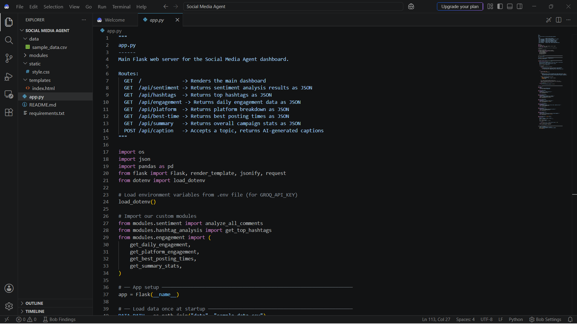
Required Files created using IBM bob -
App.py
Data
Modules
Requirements.txt
Index.html

Slide 7
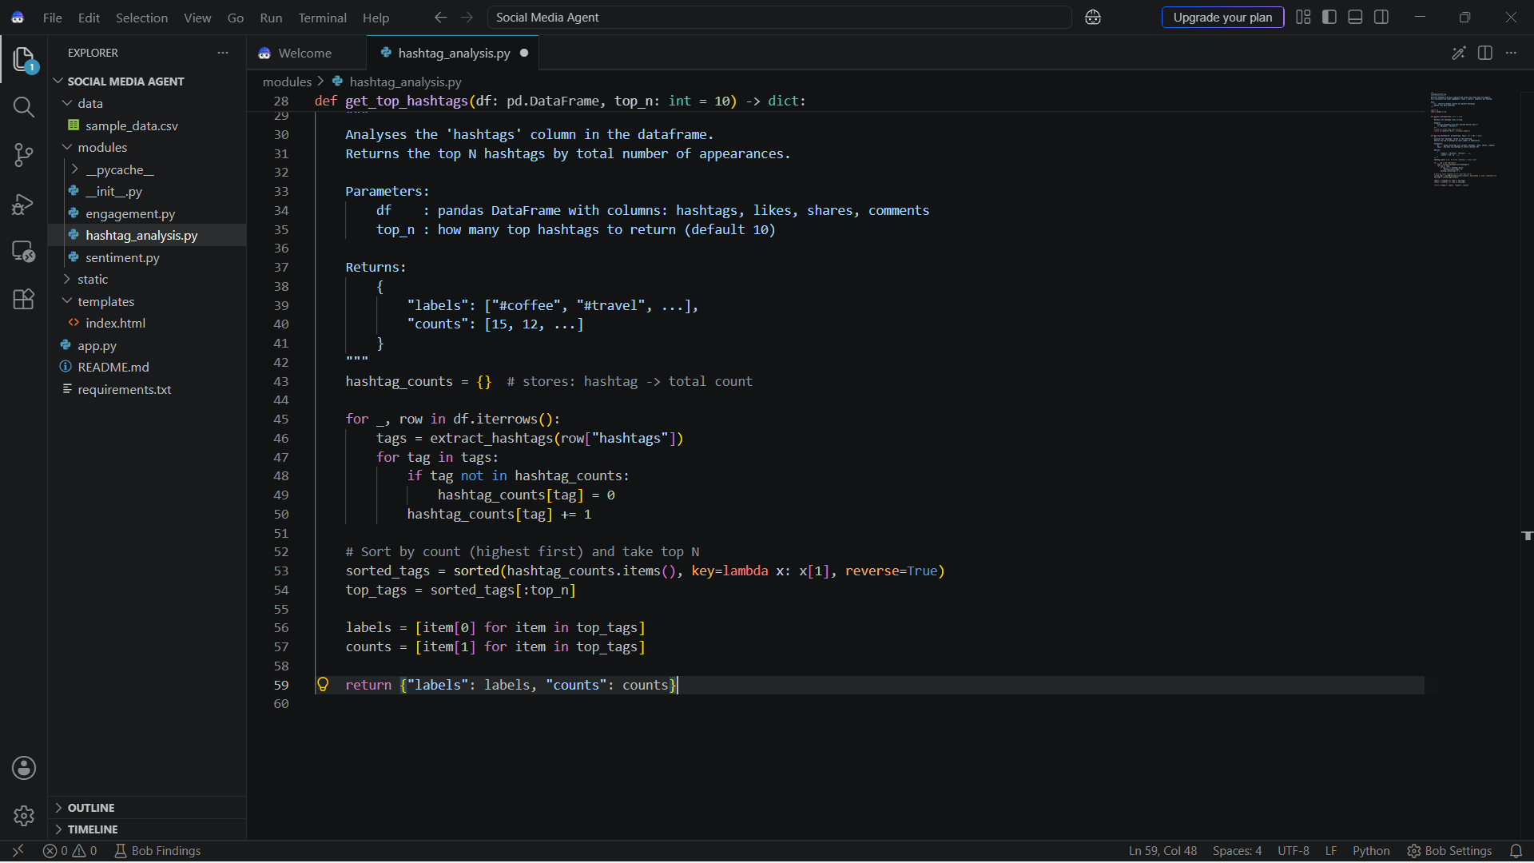
IBM Bob Screenshots:

Slide 8
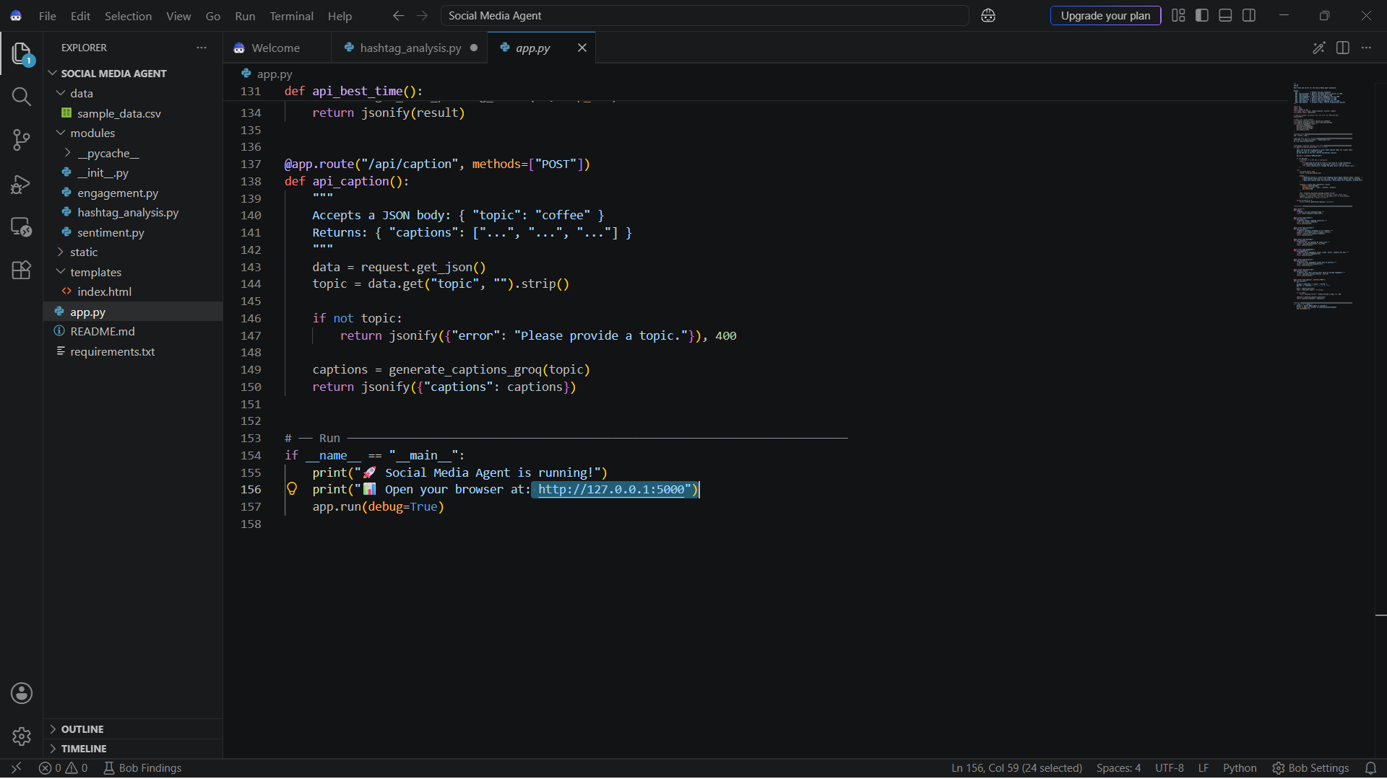

Slide 9
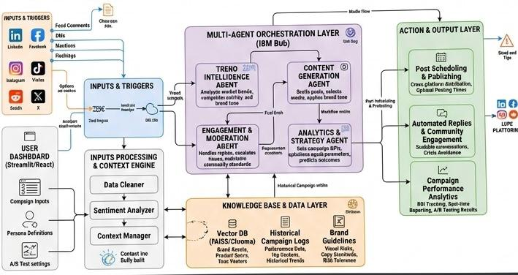
Architecture blueprint for IBM bob:

Slide 10

Role of Agentic AI in the solution
Role of Agentic AI in Social Media Agent
Agentic AI enables the Social Media Agent to function as an intelligent, autonomous system rather than a simple chatbot. Using IBM watsonx.ai and IBM Granite models, it coordinates multiple specialized agents to deliver personalized social media management.
Each agent performs a specific role—such as analyzing live trends, deafting tailored posts, engaging with comments, and evaluating performance metrics—while workingcollaboratively. This multi-agent approach ensures efficient task execution and accurate results.
Agentic AI also brings context awareness, understanding brand voice, target audience preferences, and campaign objectives to generate tailored content. It supports real-time adaptation, continuously refining post schedules and responses based on audience interactions.
Additionally, agents communicate with each other, enabling better decision-making and improved campaign performance.
Overall, Agentic AI makes the system proactive, personalized, and goal-driven, acting like a smart digital social media manager that helps brands maximize engagement and presence.

Slide 11
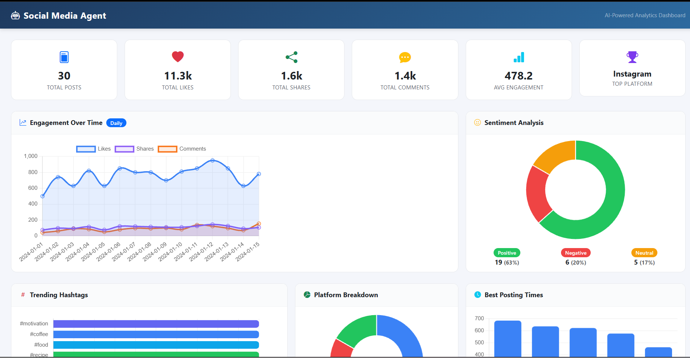
Project Output Screenshot
·
·
·

Slide 12
Novelty and Uniqueness
The proposed Social Media Agent stands out by combining Agentic AI, RAG, and personalization into a single intelligent system.
Multi-Agent Intelligence – Instead of a single chatbot, multiple specialized agents collaborate to deliver data-driven social media management.
RAG-Based Accuracy – Integrates real-time trend retrieval and brand guidelines with AI generation, eliminating generic responses.
Hyper-Personalization – Tailors post captions,tone and campaign schedules based on brand voice, target audience,and platfrom dynamics.
Real-Time Feedback Loop – Continuously adapts content strategy based on post performance, engagement metrics, and audience interaction.
Multi-Modal Input – Supports text, voice, and image-based meal tracking for better usability.
Scalable & Enterprise-Ready – Built on IBM watsonx.ai with IBM Granite models, ensuring reliability and governance.
This makes the solution a smart, adaptive, and proactive digital social, not just a static content generator.

Slide 13
Git Hub Link
· Please create public github repository (Enable Add README button while creating repository) with format –
Please test and Paste the working Github URL –
Make sure you have Uploaded following three files into your github repository
1) All Agent relevant files of IBM Cloud , 2) yourproblemstatement.pdf file 3) your projectpresntation.pptx file 4)any other files
·
·
·

Slide 14
Future Scope
1.Integration with Social Media APIs & Analytics Tools –
The system can be integrated directly with platforms like LinkedIn, X (Twitter), Instagram, and Meta Ads to auto-publish content and collect real-time engagement data such as impressions, clicks, shares, and audience demographics. This will enable the Social Media Agent to provide more accurate and dynamic campaign strategy adjustments based on actual performance metrics..
2.AI-Powered Voice Assistant & Multilingual Content Generation –
Enhancing the system with a voice-enabled assistant and support for multiple global and regional languages will improve accessibility. Brand managers and creators can interact naturally in their preferred language to generate localized social posts and campaigns, making the solution more inclusive and suitable for diverse global target audiences.
·
·
·

Slide 15
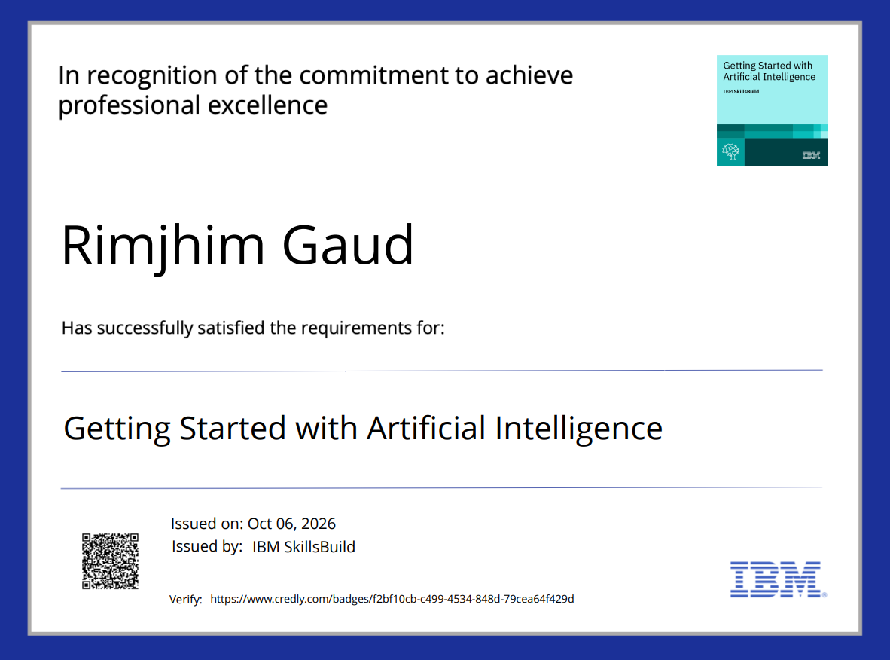
Certificates Earned:
Please add your credly certificate

Slide 16
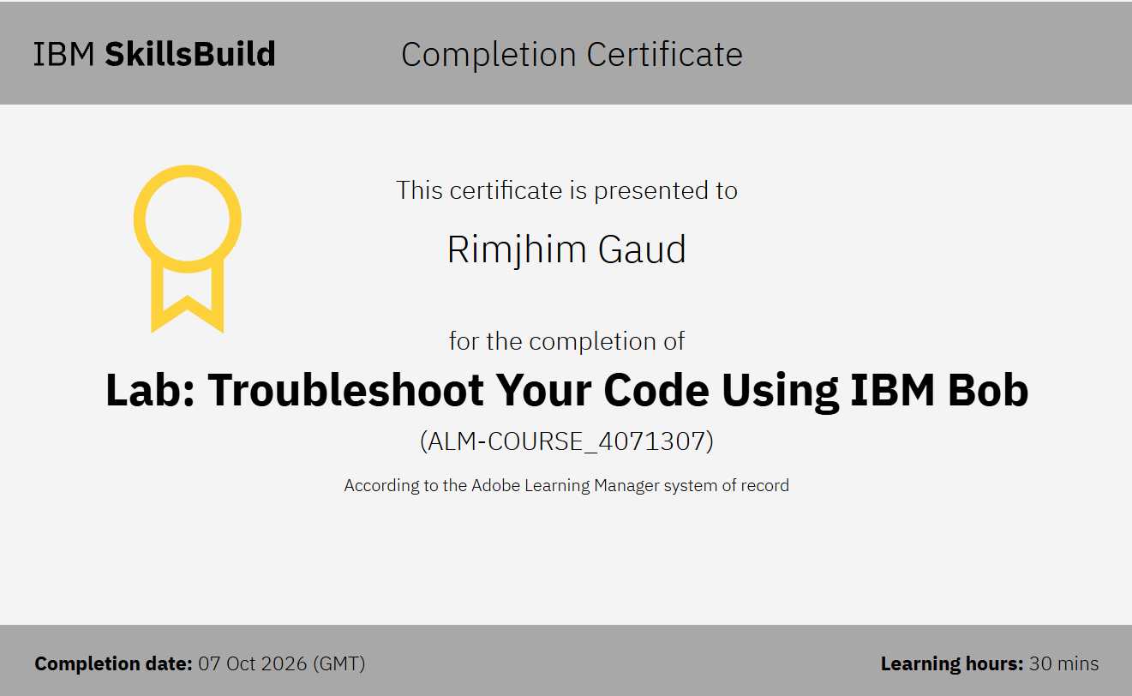
Certificates Earned:​
Add your IBM BOB Certificate

Slide 17


