Slide 1
Hadoop-Docker

Slide 2
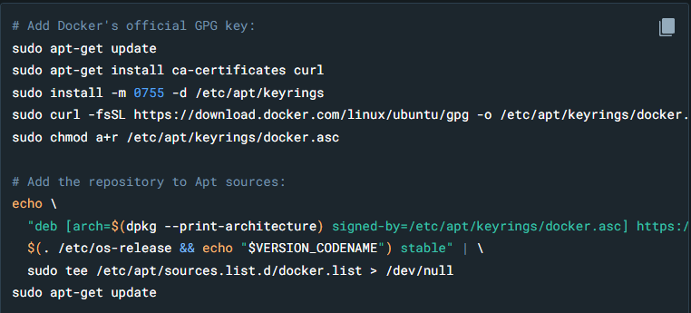
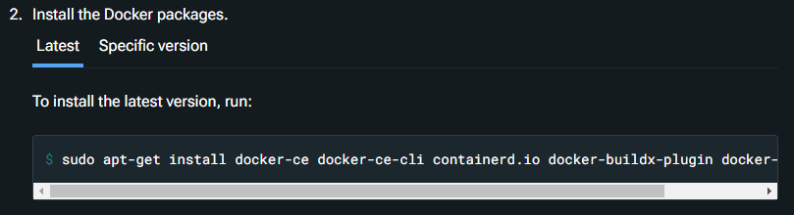
Installation
Set up Docker Engine
https://docs.docker.com/engine/install/ubuntu/
Run steps 1 and 2 from “install from apt repository”.

Slide 3
Installation
Run after the previous steps

Slide 4
Installation
Clone the repository
https://github.com/dhzdhd/hadoop-docker-compose.git
Cd into the directory
Run “sudo docker compose up –d ”
After the building of the container is complete ,

Slide 5
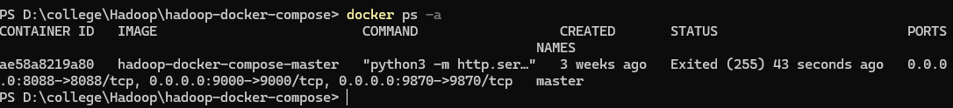
Installation
Run “sudo docker ps –a ”
This is the container id copy it (ctrl+shift+c)

Slide 6
Installation
Once that is done Run “docker exec –it <container_id> /bin/bash”
Run “init” [ THIS STEP IS TO BE DONE ONLY THE FIRST TIME ,DOING IT AGAIN FORMATS HDFS ]

Slide 7
Running docker(hadoop) after first time.
Go to the directory , that was cloned.
Open the directory in terminal
Run “docker ps –a ” like in the previous slide and copy the container id
Run “docker exec –it<container_name> bin/bash”
Run “Restart” [ DO NOT RUN INIT , IT FORMATS HDFS ]

Slide 8
Notes
Suppose there is a problem during the building of container, that is because , the hbase website might be blocked due to manipal proxy , please stop the process(ctrl c) and run “docker compose up” after connecting to hotspot.
For Windows do not use sudo while running the commands, install docker desktop , and clone the repository, follow the steps from slide 4-7
You can use the “workdir” directory to copy your files in and out of the container.
You can access the hdfs file view at “localhost:9870”.

Slide 9
How does it look?
It should look something like this
From this point it is usual Hadoop.

