Slide 1


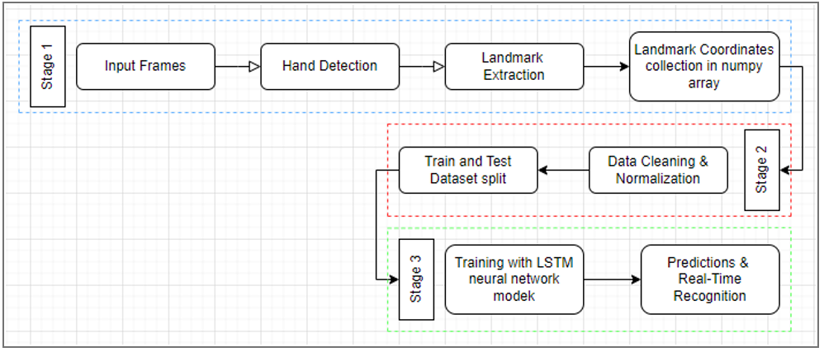
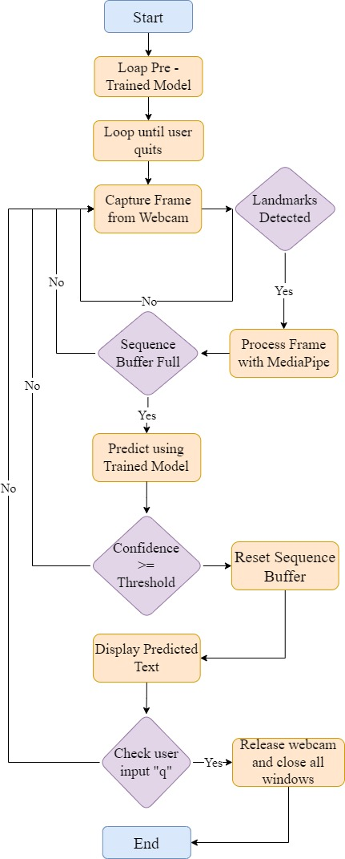
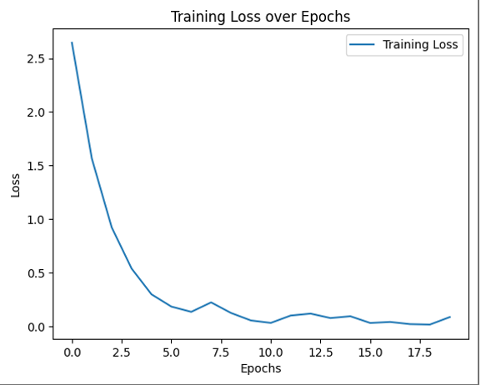
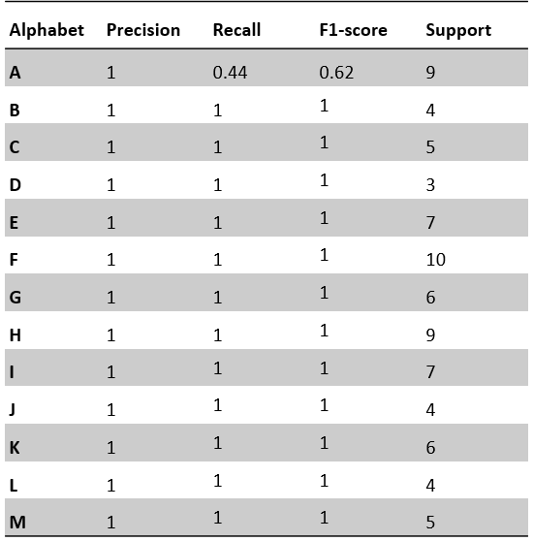
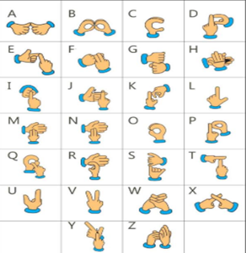
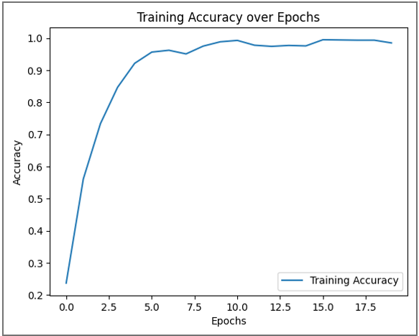
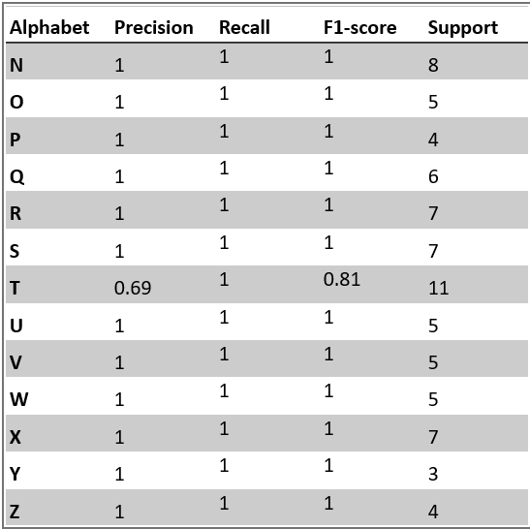


HAND SIGN RECOGNITION SYSTEM
INTRODUCTION
India has around 63 million people with hearing and speaking disabilities who rely on sign language for communication. Research in sign language recognition has seen progress, with both sensor-based and vision-based methods being explored. While sensor-based approaches like glove-based systems have been historically accurate, vision-based methods are gaining traction due to their cost-effectiveness. The project focuses on a vision-based approach for Indian Sign Language (ISL) alphabet recognition, leveraging MediaPipe for hand landmarks extraction and LSTM for gesture recognition. A custom dataset was created for experimentation. Pyttsx3 is used for low-latency text-to-speech functionality, facilitating efficient communication.
OBJECTIVE
METHODOLOGY
FLOW CHART
RESULTS
Create a diverse dataset of hand images and videos representing various ISL signs.
Pre-processes data to normalize,
extract relevant features and
segment individual signs from
continuous sequences to prepare
for recognition.
Train a deep learning model
network , to recognize individual
ISL signs based on the
pre-processed data.
Create a user-friendly interface to capture hand gestures in real-time, feeding the data into the trained model for sign recognition, and translate the recognized signs into spoken words.
STAGE -1 (DATA COLLECTION)
The first stage involves collecting input frames, likely video frames. Then, hand detection is performed on these frames. Hand landmarks are extracted from the detected hands. Finally, the coordinates of these landmarks are collected into a NumPy array.
STAGE -2 (DATA PREPROCESSING)
The collected data is then split into training and testing datasets. Data cleaning and normalization is likely performed on the training data to improve the performance of the model.
STAGE -3 (TRAINING AND EVALUATION)
An LSTM neural network model is trained on the preprocessed training data. The trained model is then used to make predictions on the testing dataset. The accuracy of the model is likely evaluated based on how well it can detect hands and recognize landmarks in the real-time frames.
CONCLUSION
AREAS OF APPLICATION
This project presents a vision-based system utilizing MediaPipe for real-time processing to translate Indian Sign Language (ISL) alphabets into text and speech. The system successfully trained a Long Short-Term Memory (LSTM) Neural Network on a self-generated 2D image dataset, achieving recognition of both static and real-time gestures. Looking ahead, future research can explore integrating Augmented Reality (AR) and Virtual Reality (VR) to create immersive learning experiences.
Real-time translation in classrooms, lectures, and workshops, ensuring equal access to education for students who use ISL.
Breaking down communication barriers in everyday life, allowing individuals who use ISL to engage in conversations with friends, family, and the broader community.
References
D. Bhavana, K. et al. Hand Sign Recognition using CNN [J]. Int J Performability Eng, 2021, 17(3): 314-321.
Mujahid, A et al. Real-Time Hand Gesture Recognition Based on Deep Learning YOLOv3 Model. Appl. Sci. 2021, 11, 4164.
Razieh Rastgoo et al. Hand sign language recognition using multi-view hand skeleton, Expert Systems with Applications,Vol. 150,2020,113336,ISSN 0957-4174
Mujahid, A. et al. Real-Time Hand Gesture Recognition Based on Deep Learning YOLOv3 Model. Appl. Sci. 2021, 11, 4164.
Team Details
PARTH AGARWAL B.tech CSE (BAO –NH) SEMESTER-VI MENTOR NAME-
NAINA GUPTA B.tech CSE (BAO –NH) SEMESTER-VI DR. HEMANT PETWAL
ARYAN KUMAR B.tech CSE (AIML –NH) SEMESTER-VI

