Slide 1
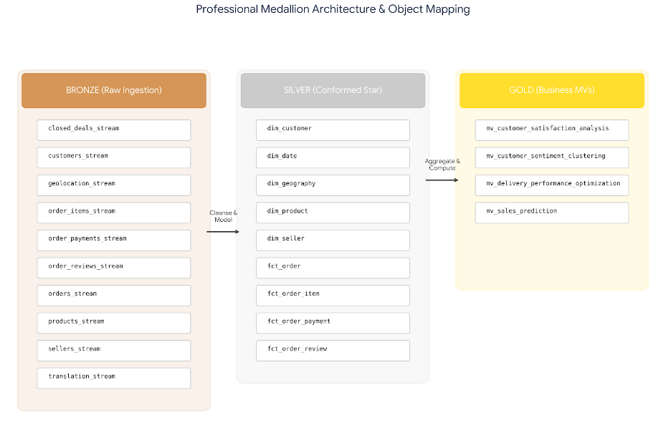
Data Architecture – Medallion
Granular Bronze Ingestion: The raw layer is expanded into independent, individual stream objects (such as orders_stream and products_stream), tracking exact data sources instead of generic, high-level groupings.
Conformed Silver Dimensions: Master reference tables like dim_seller and dim_customer standardize business entities, with specialized logic merging streams (e.g., combining products_stream and translation_stream to provide English category names in dim_product).
Atomic Silver Facts: Core transaction events land into four discrete fact tables (fct_order, fct_order_item, fct_order_payment, and fct_order_review) that are bound to dimensions via strict Primary Key and Foreign Key relational constraints.
Isolated Time-Intelligence Routing: To prevent visual overlap and crossing boundaries, a dedicated, orthogonal channel route connects calendar fields from dim_date directly to the purchase_at field inside fct_order.
Gold Semantic Aggregations: The transactional histories from the Silver tier are rolled up into specialized, business-ready Materialized Views (such as mv_sales_prediction and mv_delivery_perf_opt) to power end-user analytics and prediction models.

Slide 2
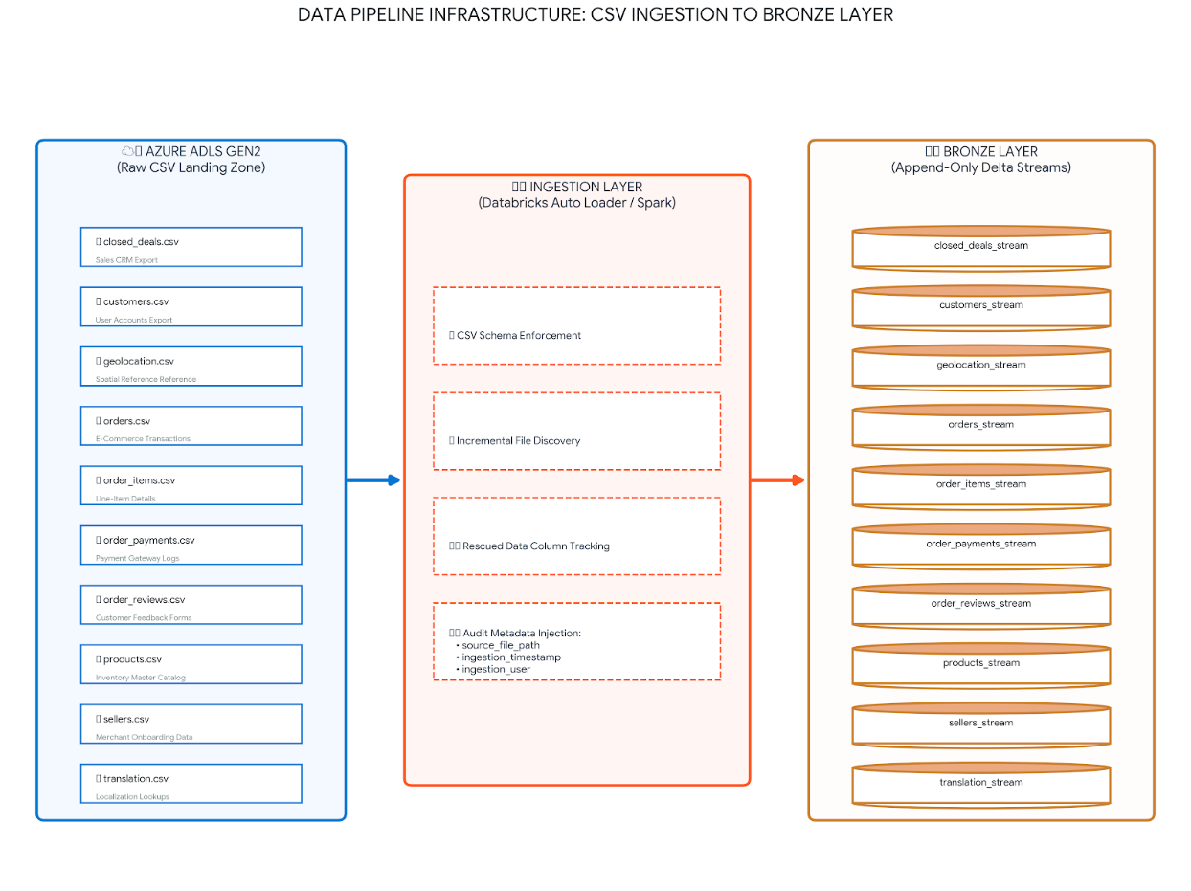
Data Architecture – Medallion (Ingestion to Bronze Layer)
Metadata
source_file_path | string
ingestion_timestamp | timestamp
ingestion_user | string

Slide 3
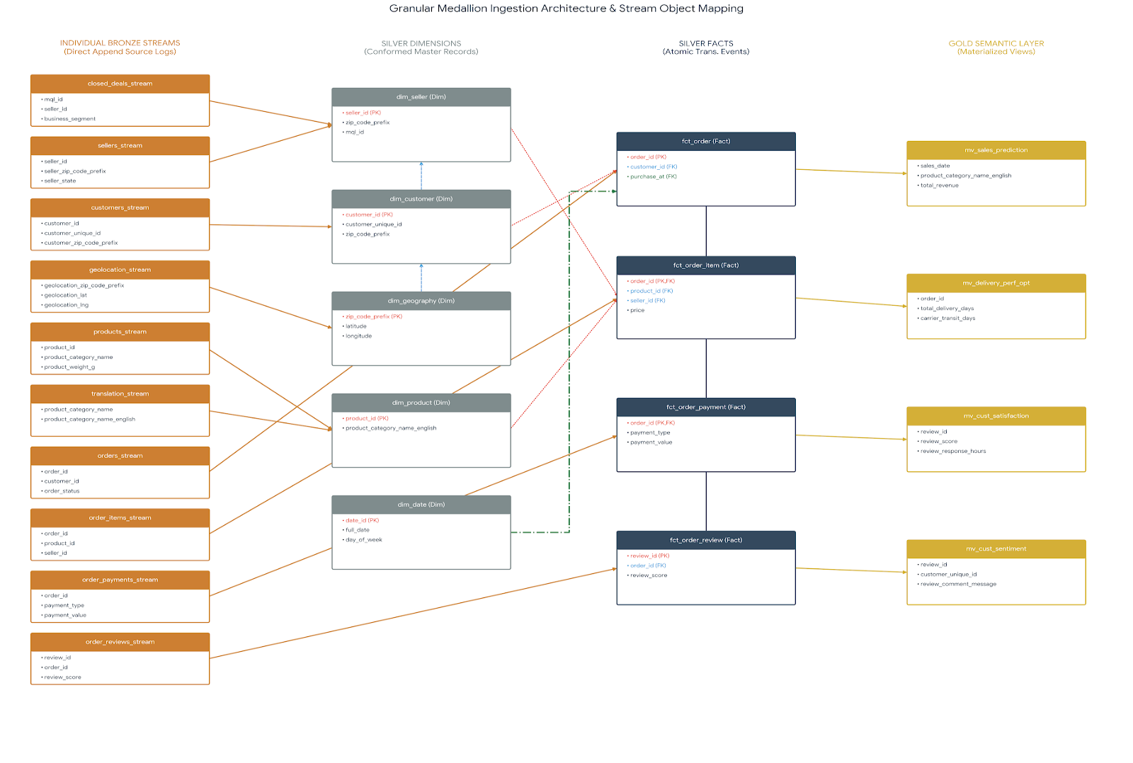
Data Architecture – Medallion (Continued)

Slide 4
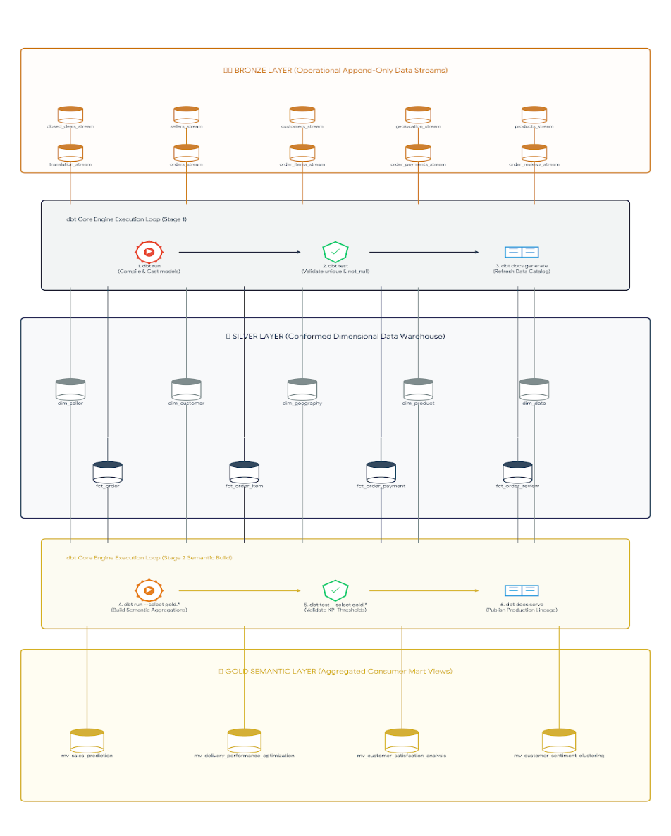
DBT Pipeline
Stage 1 Verification:
Validating unique and not null assertions before data lands in your Silver Dimensions.
Stage 2 Verification:
Executing complex operational constraints (e.g., verifying relational constraints and matching dates via dbt_utils.expression_is_true to ensure that facts map correctly to master records.

Slide 5
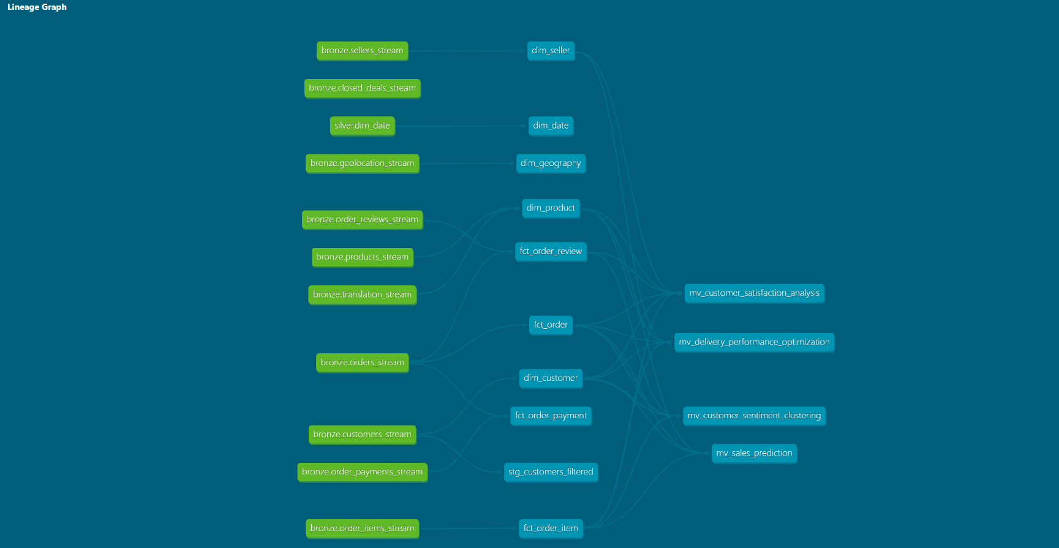
DBT Data Lineage

