Slide 1

Rating Prediction Project
Submitted by
Naincy Joshi

Slide 2
Dataset :-
We have collected dataset through scrapping the data through E-commerce website.
We have collected the Rating and the Reviews of the customer given to many products such as smartphone, monitor, printer, camera, router,and many more.
The rating are out of 5 and we have round up the rating.
The reviews are the text which has to be tozenized and lemmantize to extract the root of the sentences

Slide 3
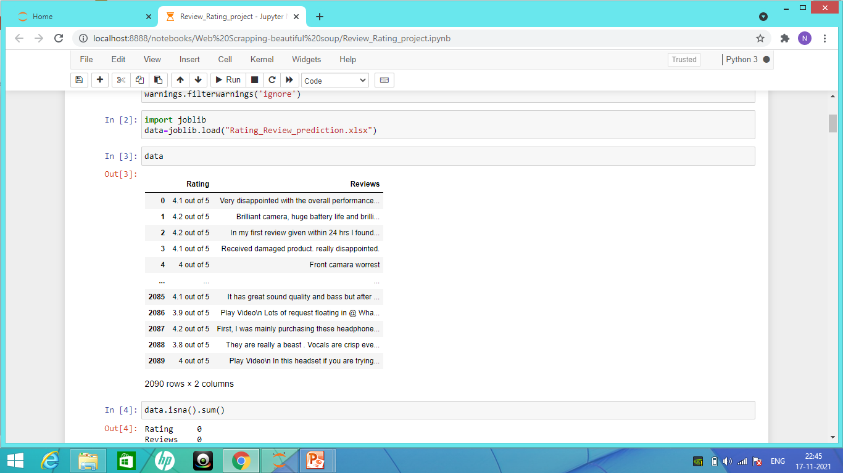
Dataset details :-

Slide 4
Preprocesing the data
We will check whether data contains any missing value through the code data.isna().sum()
If any we will fill the missing value either through mean, mode and median. We can also drop the null value through the use of dropna()
We have checked the datatype through data.info() .The Rating and the Review both are object type.
We have to convert the rating into integer.

Slide 5
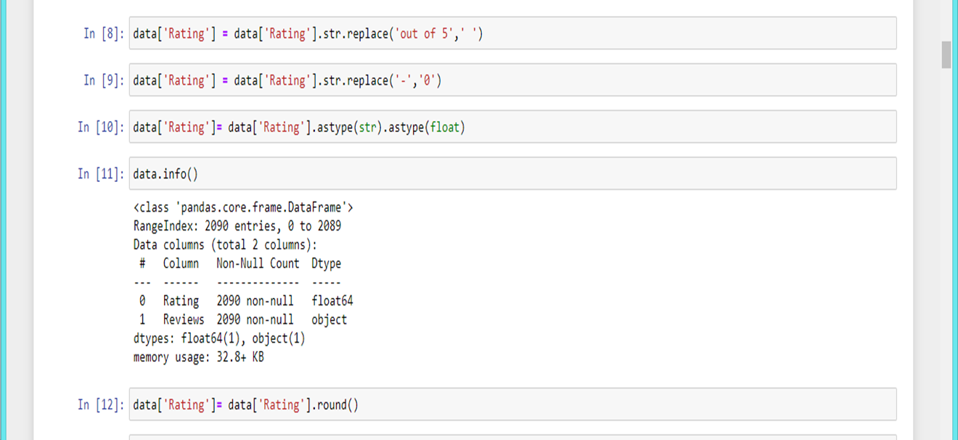

Slide 6
In the Rating column we have “4.2 out of 5” so we will be replacing the out of 5 with the blank space and then we will convert into the float value into the integer.
We will round up the value of the rating.
We will clean the “Review column”
We will convert all the text into lower case.
In the review column, we will remove the the numbers or any other symbolic expression which has no meaning to the computer language.
Commas and semicolons are to be removed

Slide 7
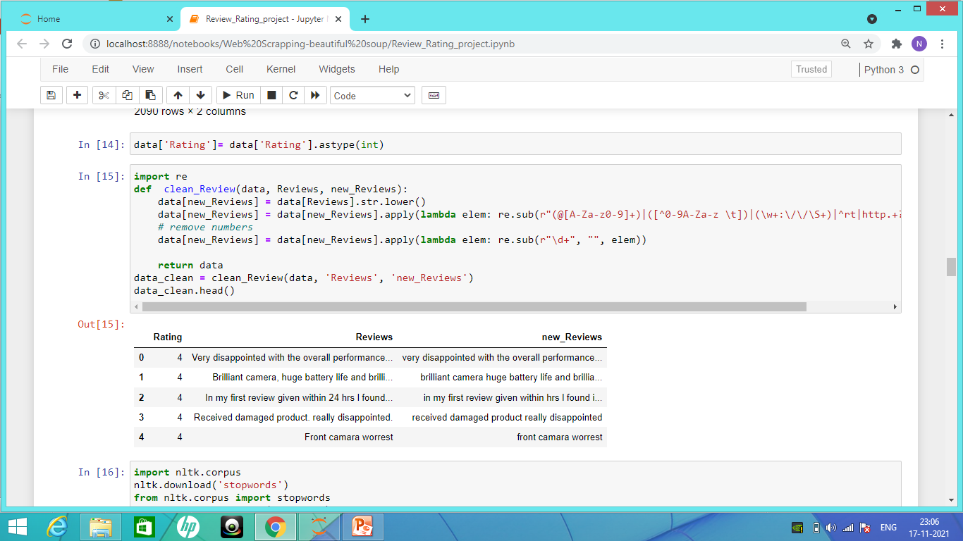
Cleaning the Review column :-

Slide 8
Cleaning the dataset
The NLTK library is one of the oldest and most commonly used Python libraries for Natural Language Processing. NLTK supports stop word removal, and you can find the list of stop words in the corpus module.
Text may contain stop words like ‘the’, ‘is’, ‘are’. Stop words can be filtered from the text to be processed. There is no universal list of stop words in nlp (Natural Language Process) research, however the nltk module contains a list of stop words.

Slide 9
Stop words are frequently used words that carry very little meaning. Stop words are words that are so common they are basically ignored by typical tokenizers.
By default, NLTK (Natural Language Toolkit) includes a list of 40 stop words, including: “a”, “an”, “the”, “of”, “in”, etc.
TF-IDF is an abbreviation for Term Frequency Inverse Document Frequency.
This is very common algorithm to transform text into a meaningful representation of numbers which is used to fit machine algorithm for prediction.

Slide 10
Let’s take sample example and explore two different spicy sparse matrix before go into deep explanation . It gives overall view what I am trying to explain below .Simple basic example of TF-IDF.
Train Document Set: d1: The sky is blue. d2: The sun is bright. Test Document Set: d3: The sun in the sky is bright. d4: We can see the shining sun, the bright sun.

Slide 11
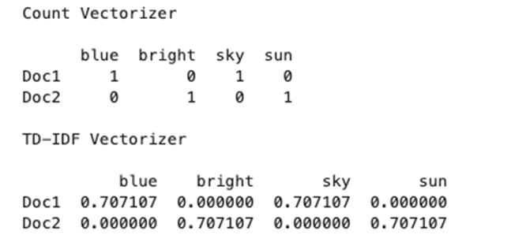

Slide 12
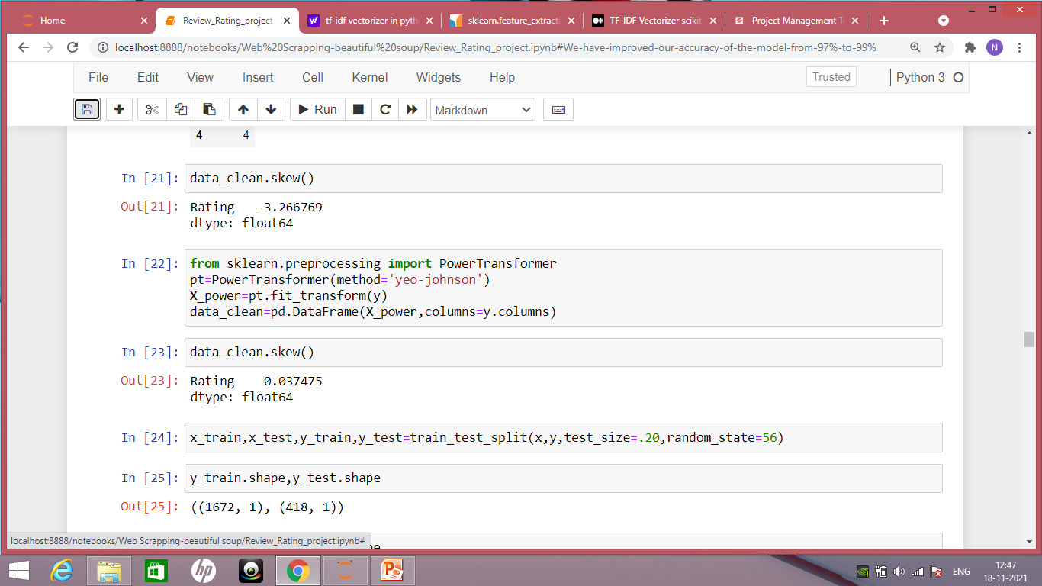
Removing the skewness

Slide 13
Power transforms are a family of parametric, monotonic transformations that are applied to make data more Gaussian-like.
Currently, Power Transformer supports the Box-Cox transform and the Yeo-Johnson transform. The optimal parameter for stabilizing variance and minimizing skewness is estimated through maximum likelihood.
Box-Cox requires input data to be strictly positive, while Yeo-Johnson supports both positive or negative data.
We have removed the skewness using power transformer

Slide 14
Splitting the dataset
In machine learning, Train Test split activity is done to measure the performance of the machine learning algorithm when they are used to predict the new data which is not used to train the model.
We have split the dataset using train test split
We took test size as 0.2 it means 20% of the data is test set and 80% data is of train set.
Train Sets – Used to fit the data into your machine learning model Test Sets – Used to evaluate the fit in your machine learning mode.

Slide 15
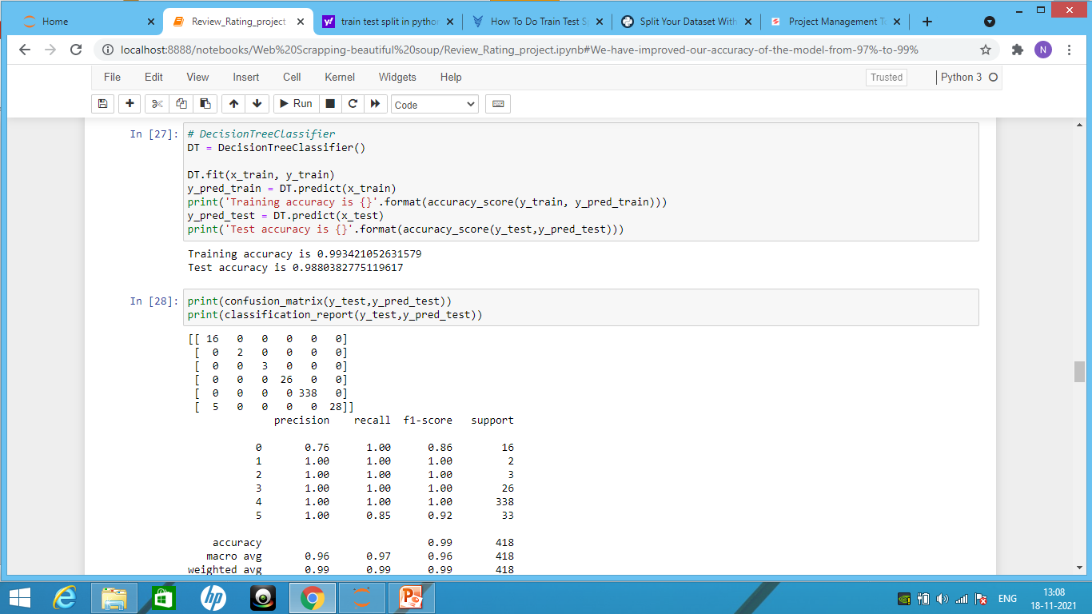
Building the model:-

Slide 16
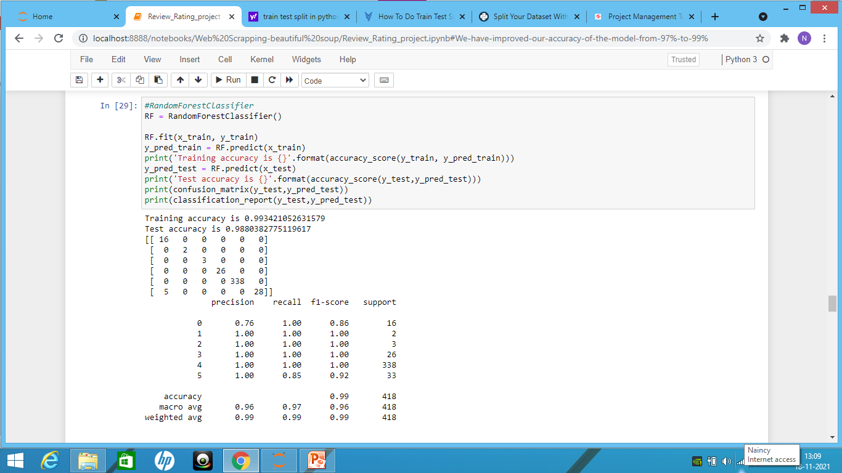
Random Forest Classifier:-

Slide 17
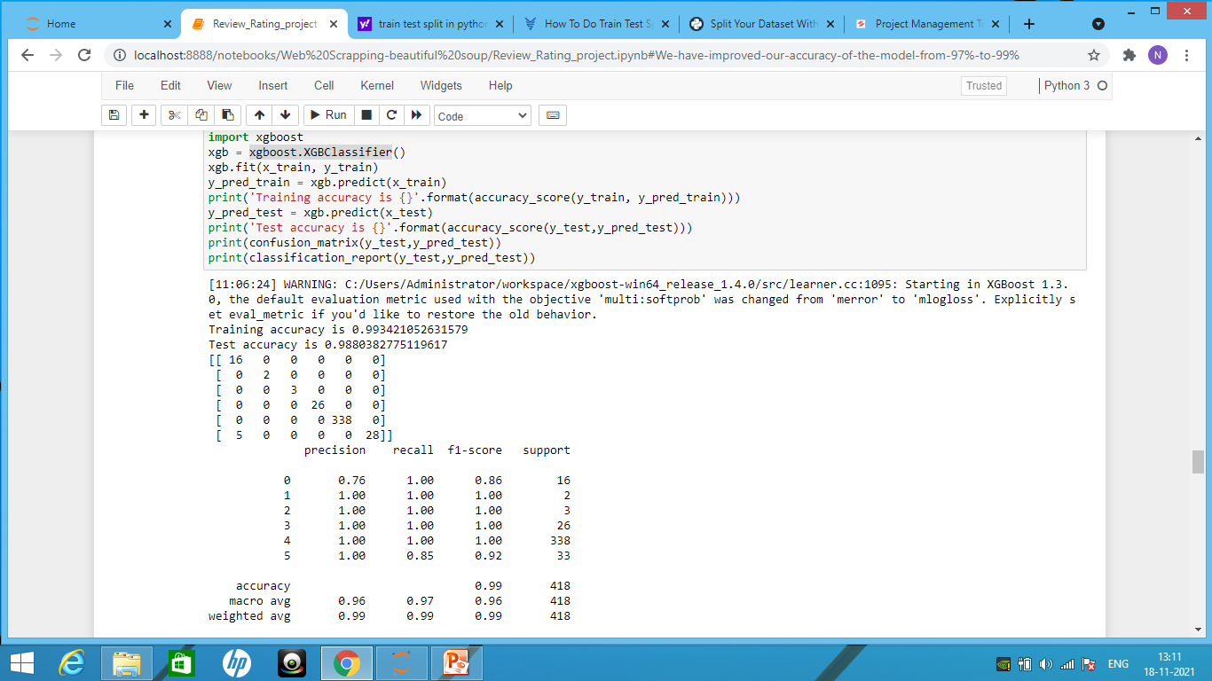
XGBClassifier

Slide 18
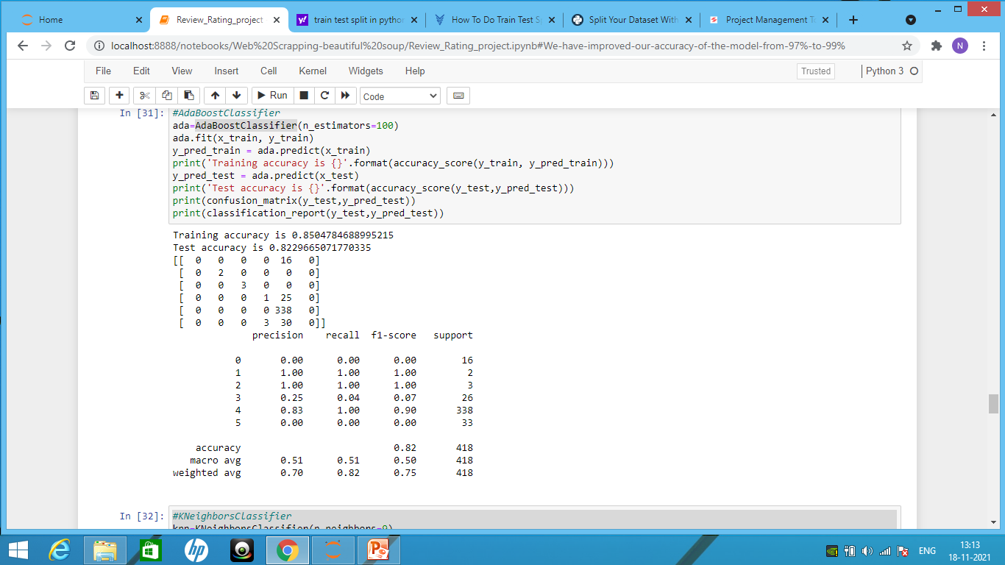
AdaBosstClassifier

Slide 19
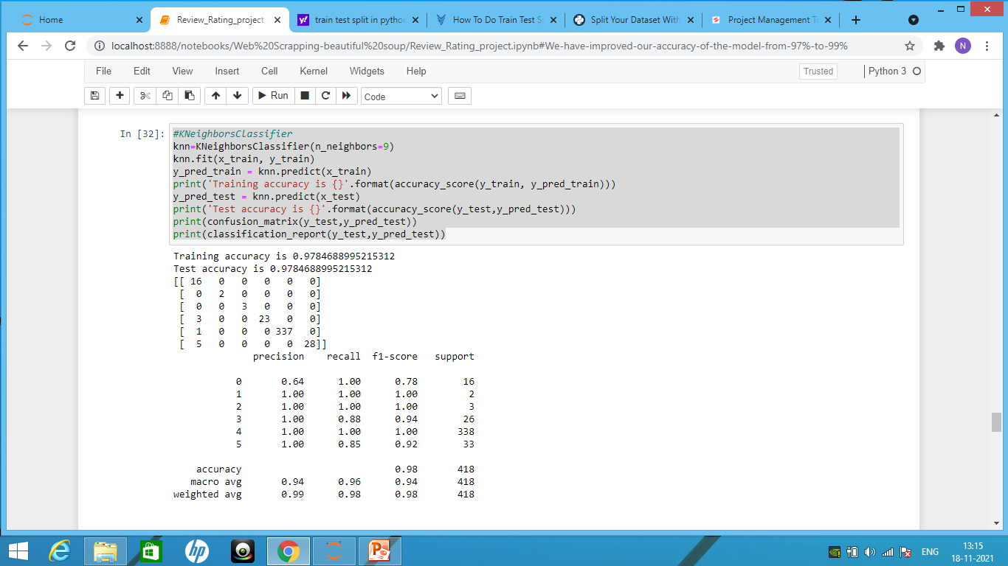
K-Nearest Neighbor

Slide 20
This step is actually quite simple. Once we decide which model to apply on the data, we can create an object of its corresponding class, and fit the object on our training set, considering X_train as the input and y_train as the output.
After this step we will improve the model accuracy or its performance using hyper-parameter function.
In this model we will take the K-nearest neighbor because the difference between the train accuracy and test accuracy is less.

Slide 21
Viewing Result
The performance of a classifier can be assessed by the parameters of accuracy, precision, recall, and f1-score. These values can be seen using a method known as classification_report (). It can also be viewed as a confusion matrix that helps us to know how many of which category of data have been classified correctly.

Slide 22
Hyper-parameter Tunning
The k-nearest neighbors algorithm (KNN) is a non-parametric method used for classification and regression. In both cases, the input consists of the k closest training examples in the feature space. The output depends on whether k-NN is used for classification or regression.
In the case of k-NN, we can tune k, the number of nearest neighbors.
We can also tune our distance i.e P metric/similarity function as well.

Slide 23
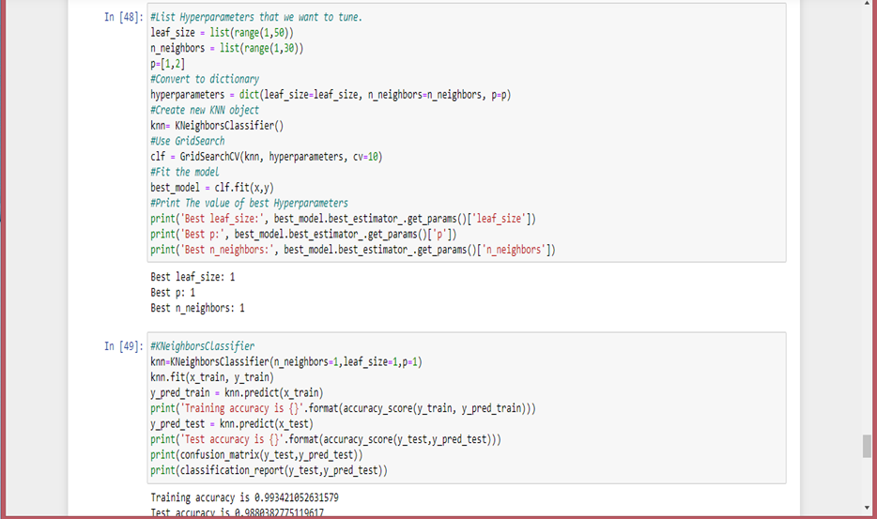

Slide 24
WE got the the K-nearest number as 1 and the distance P is also 1.
Hyperparameter tuning is done to increase the efficiency of a model by tuning the parameters of the neural network.
We have increased the model accuracy from 97% to 99%.

Slide 25
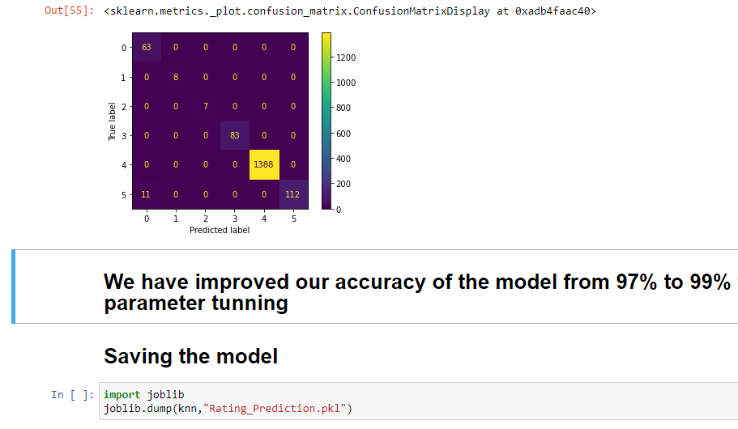
Saving the model
We will save the model using joblib.

