Slide 1

USED_CAR PROJECT
SUBMITTED BY
NAINCY JOSHI

Slide 2
Dataset Details
We have scrapped the used_car details from various car websites such as cars24,cardekho,olx etc.
Then we concatenated this whole data and make into a one DataFrame.
There are 9 columns such Model Name,Year,Variant,Function such as automatic or manual,Owner,Location,Driven,EMI and the target column “Price”.

Slide 3
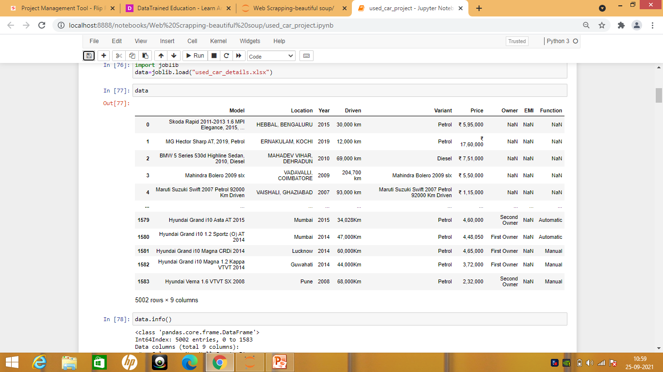
This is the data where we need to clean,Explore and build the model.

Slide 4
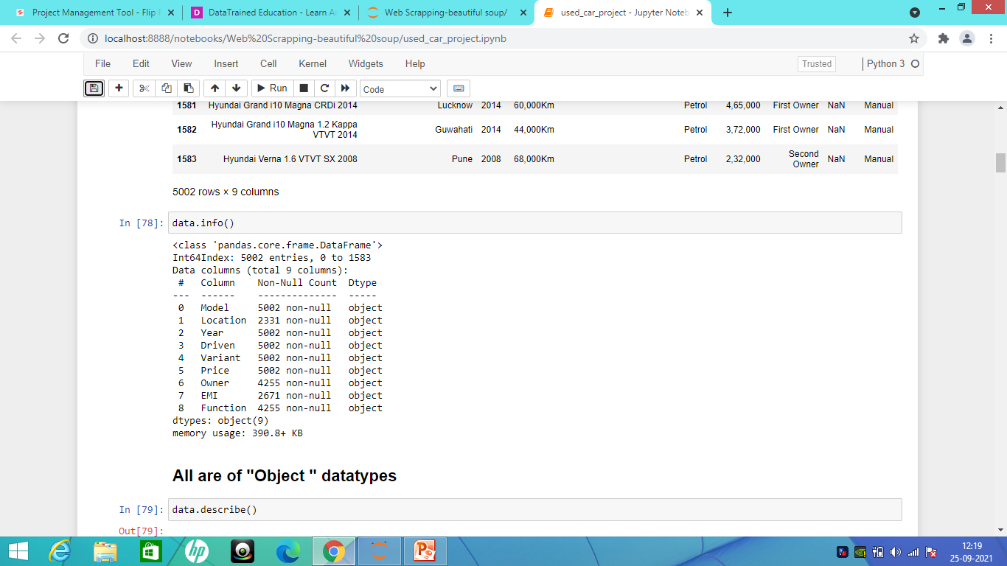
Data.info() will provide information about the datatypes.

Slide 5
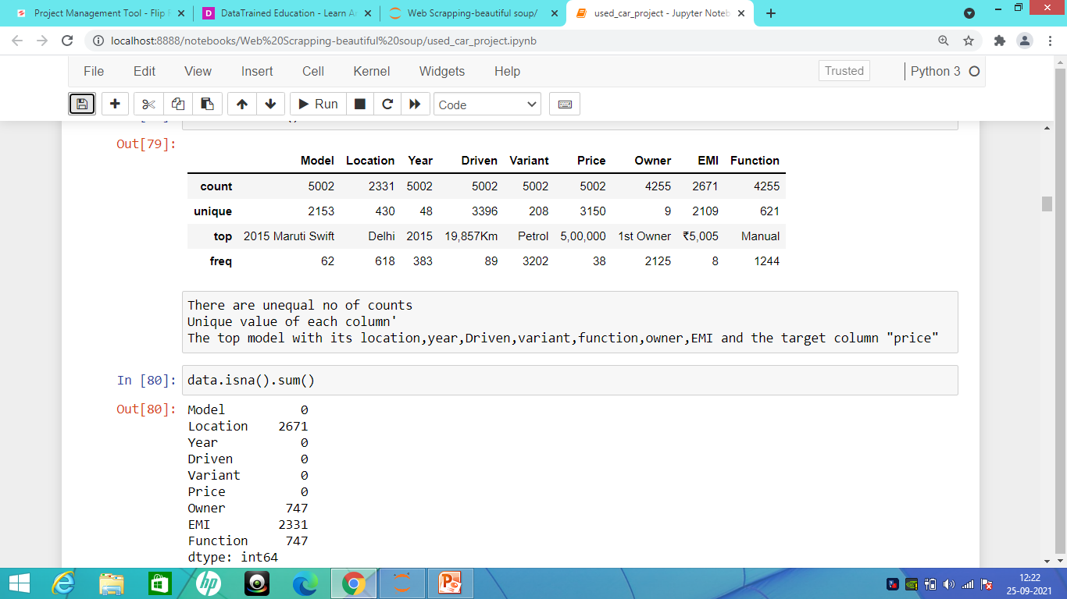
Data.isna().sum() will give us missing value in the dataset.

Slide 6
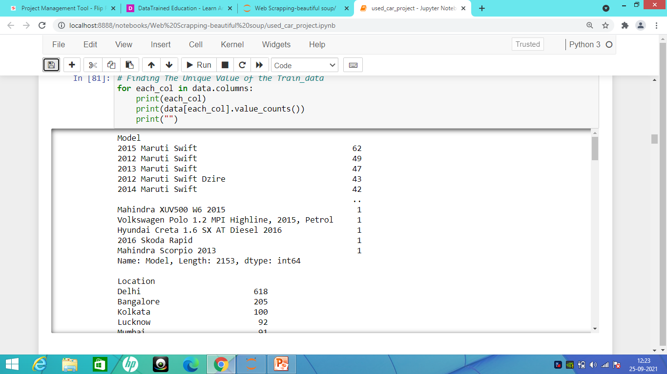
It will provide us the unique value in each column of the dataset.

Slide 7
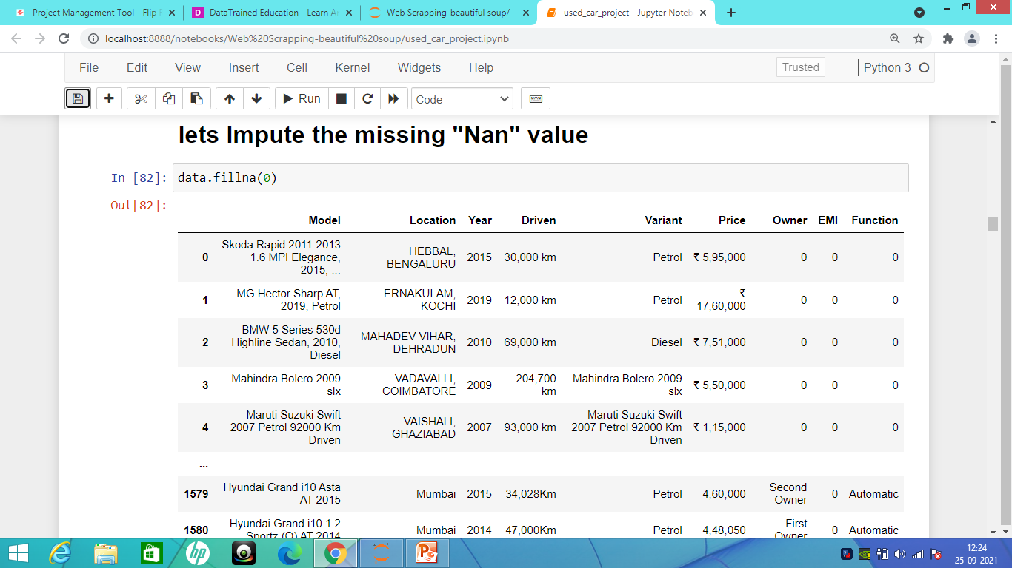
DATA CLEANING:

Slide 8
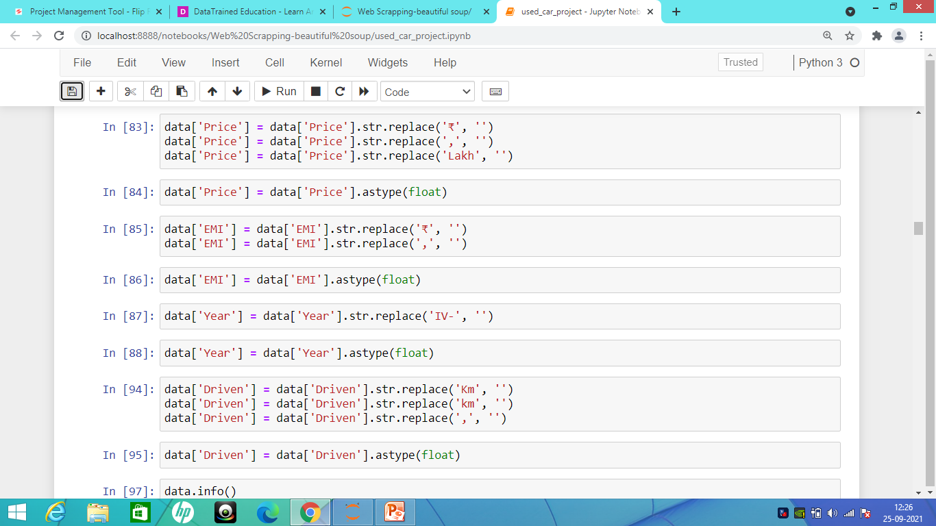
Replacing the value and converting Object datatype into Float datatype.

Slide 9
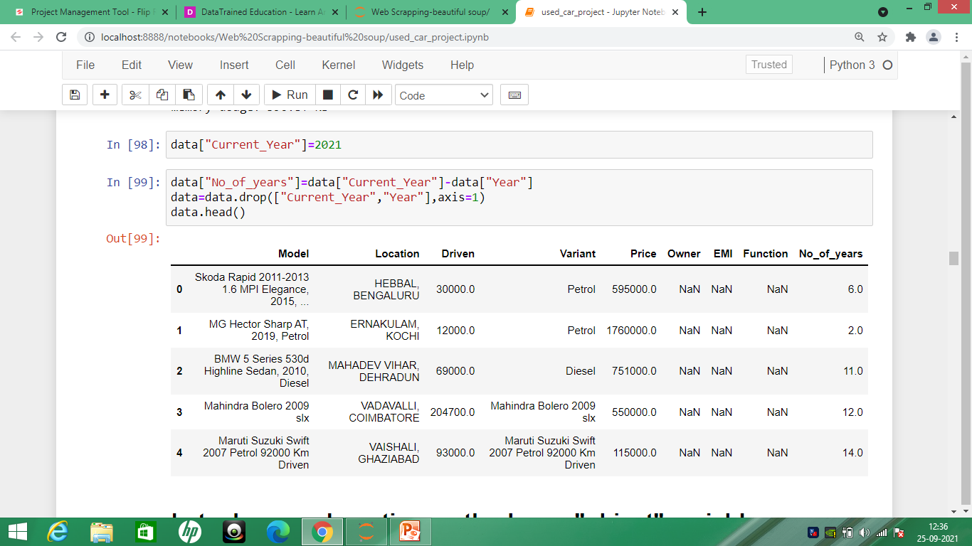
Adding new column No_of_years

Slide 10
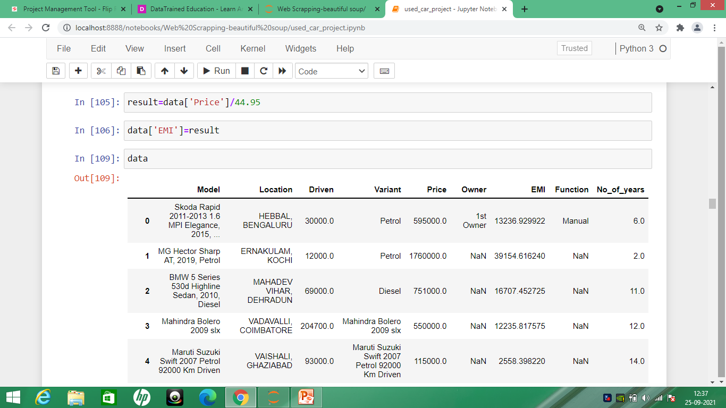
Imputing the EMI value to the dataset based on the calculation of the data.

Slide 11
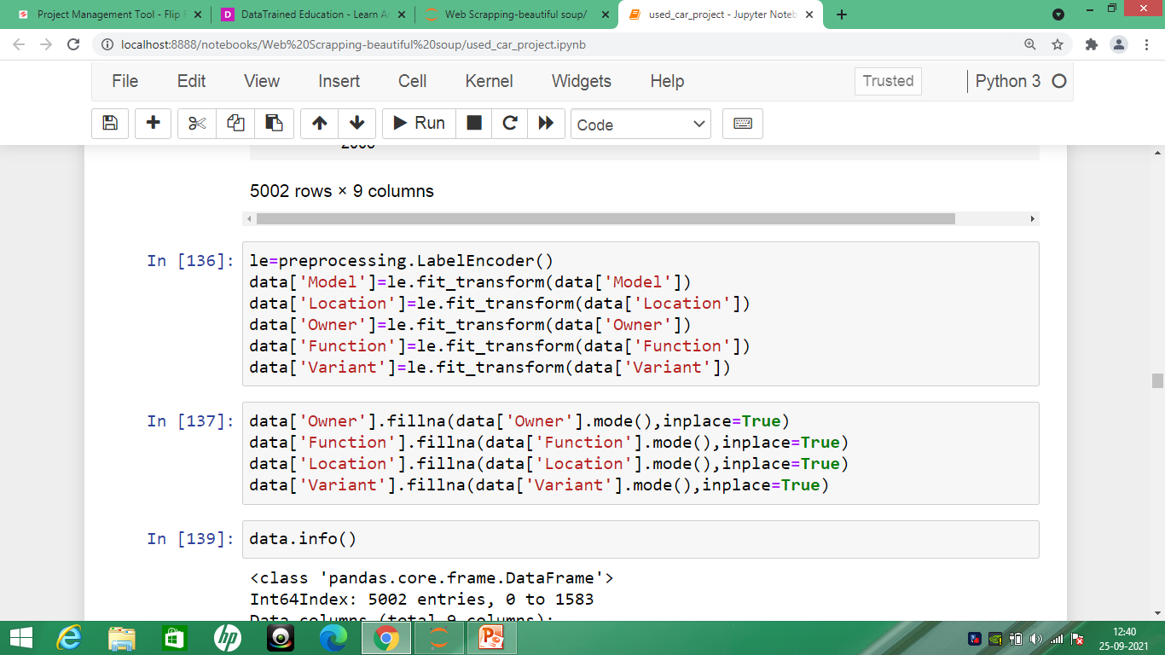
labelEncoder() used to encode the dataset and then we are going to use mode in object datatype to fill the missing value.

Slide 12
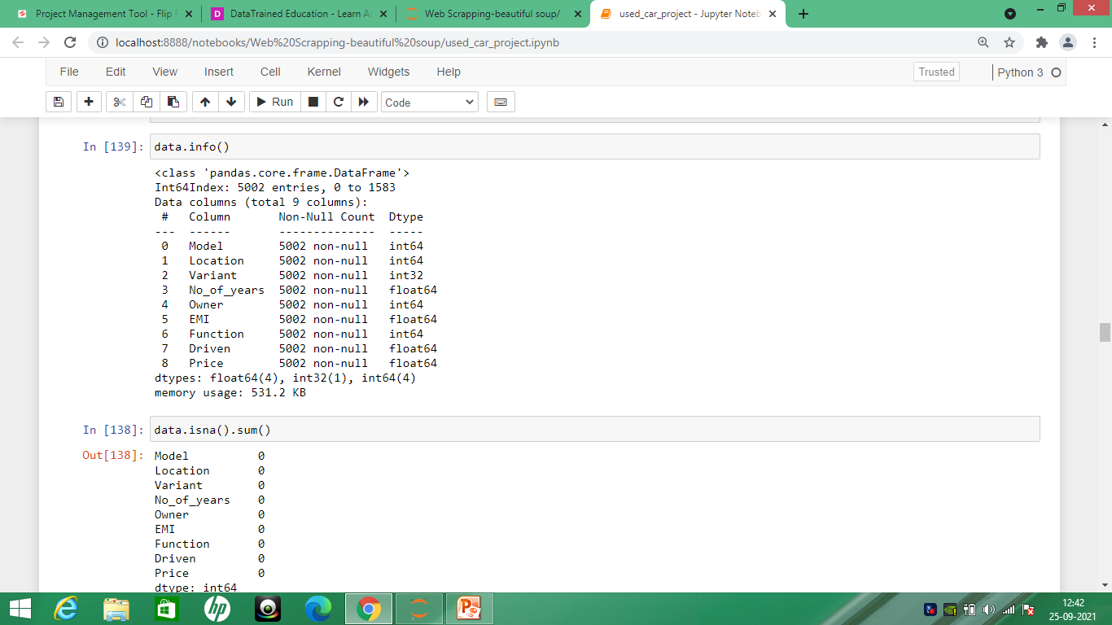
As there is no missing value and all the datatype in the fomat of Float and int.

Slide 13
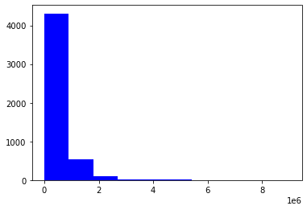
Visualization: Skew in the “price”: 5.225212587913762

Slide 14
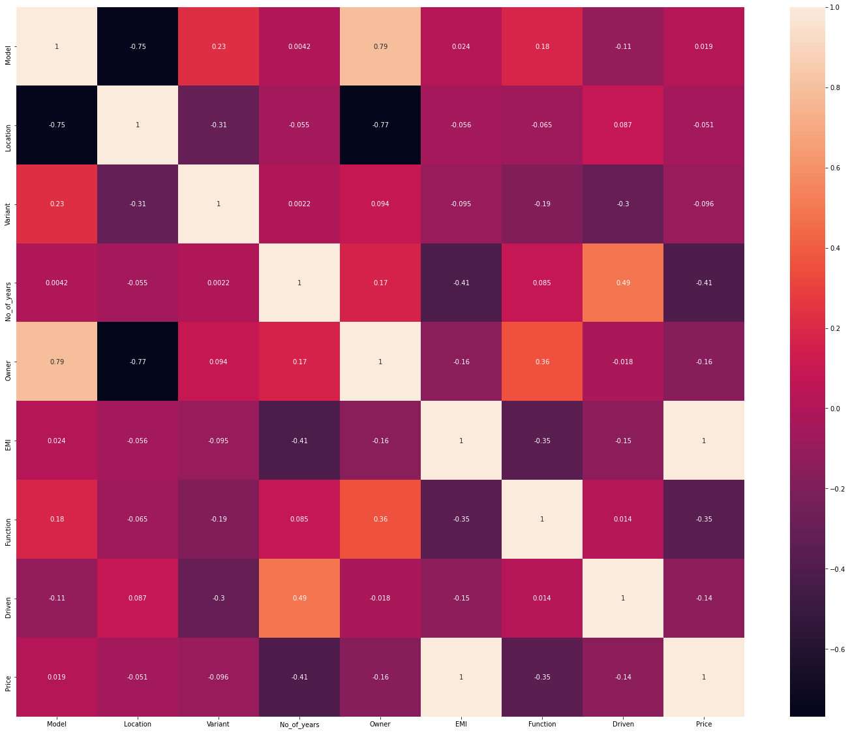
Data.corr() with the other feature of the column with the target column

Slide 15
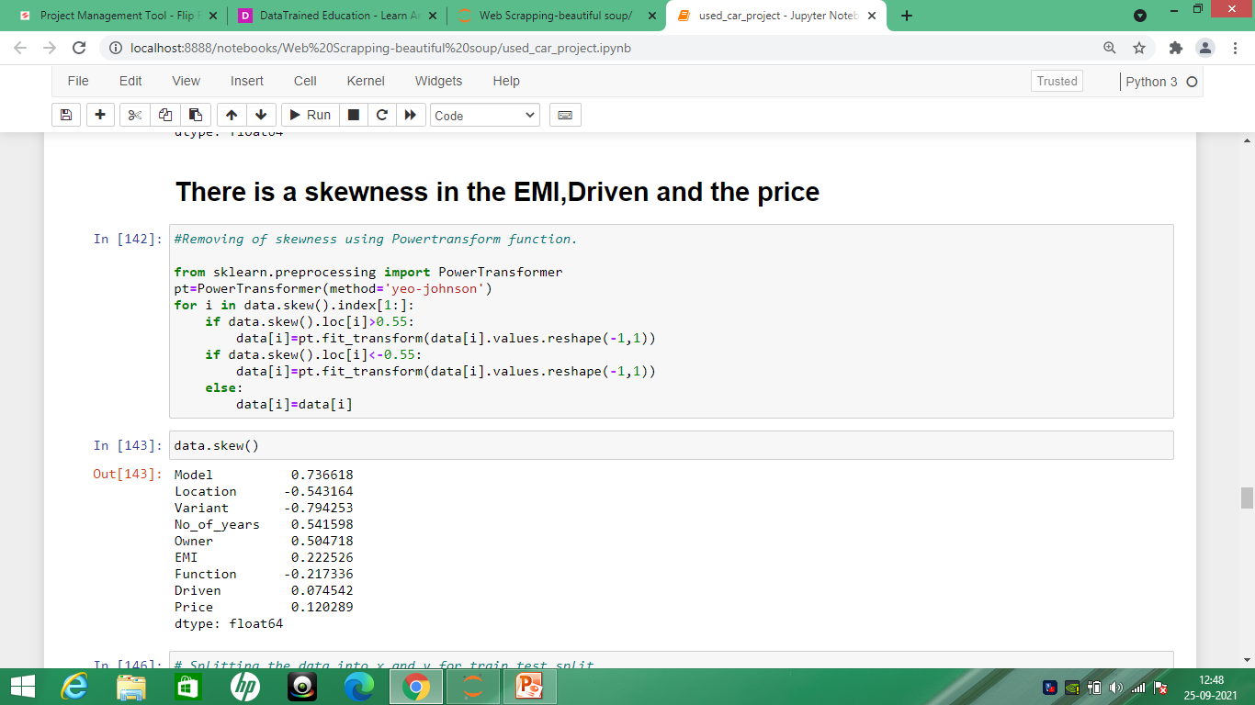
We will remove skewness by using PowerTransform Function.

Slide 16
Data Cleaning Explanation:
We have removed the rupee sign to convert the object datatype of “Price” into float value.
In the column “Driven” there is a km word mention in the column so we will remove it.
We will convert the object datatype into the float value.
Then we will impute the object datatype into float using mode option.

Slide 17
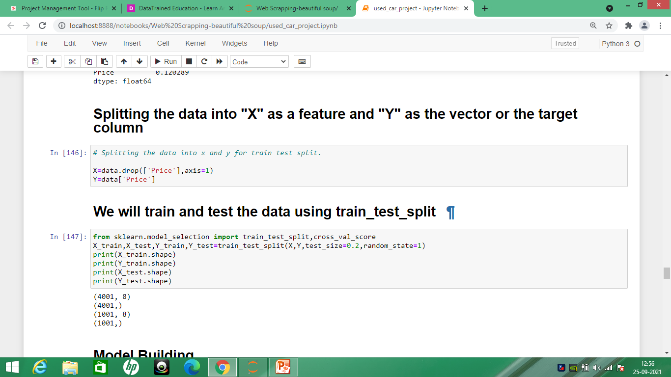
Splitting the data into “X” as a feature and “Y” as the target column or the vector.

Slide 18
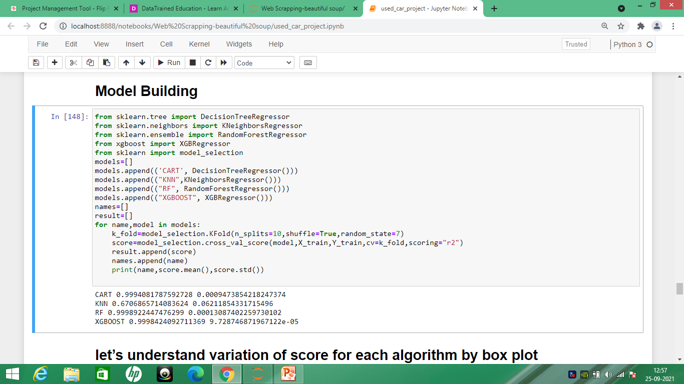
Building the model

Slide 19
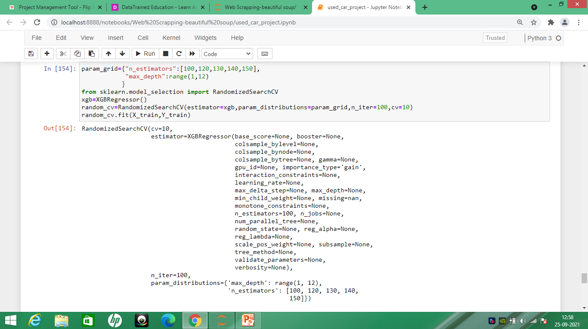
Hyper-parameter Tunning

Slide 20
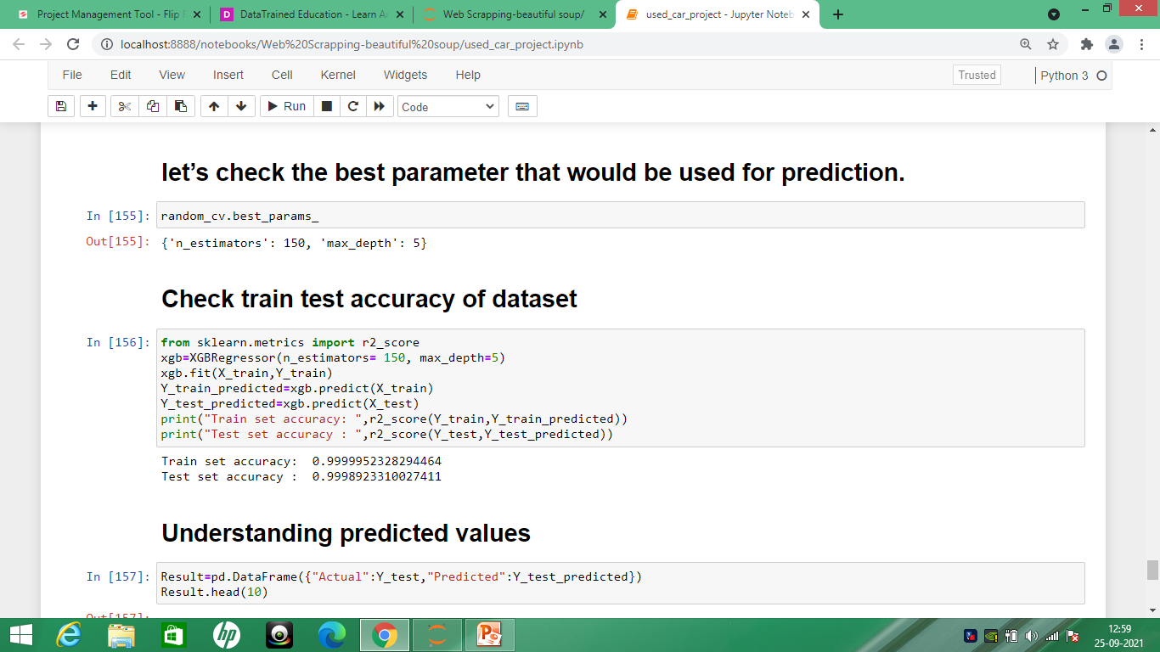
Checking the best parameter prediction

Slide 21
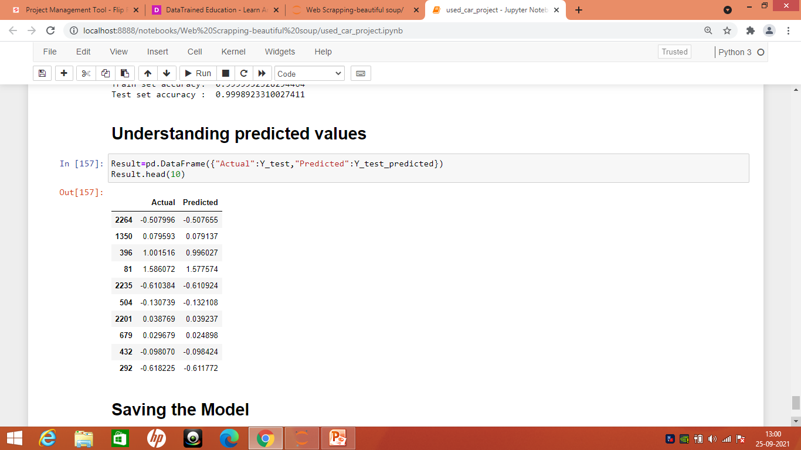
Understanding the predicted value

Slide 22
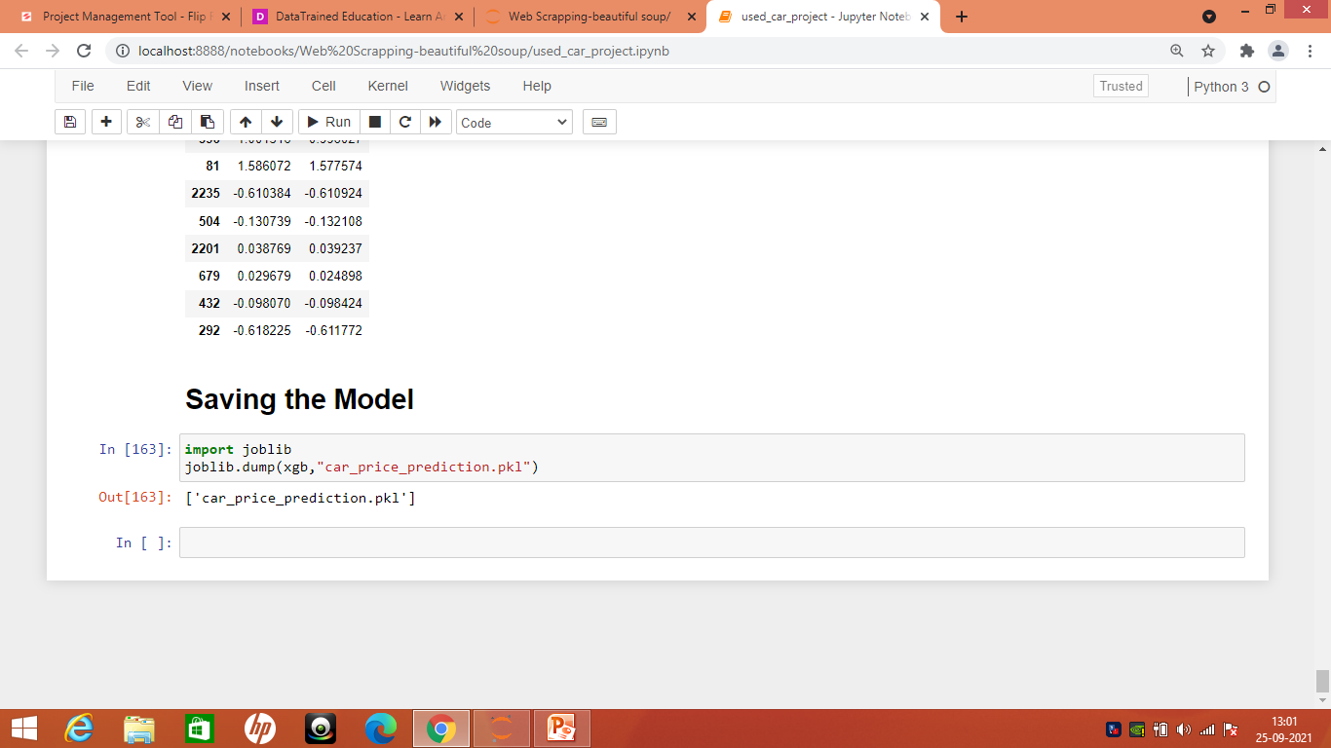
Saving the model

