Slide 1

Flight_Price_prediction
Submitted by:
Naincy Joshi

Slide 2
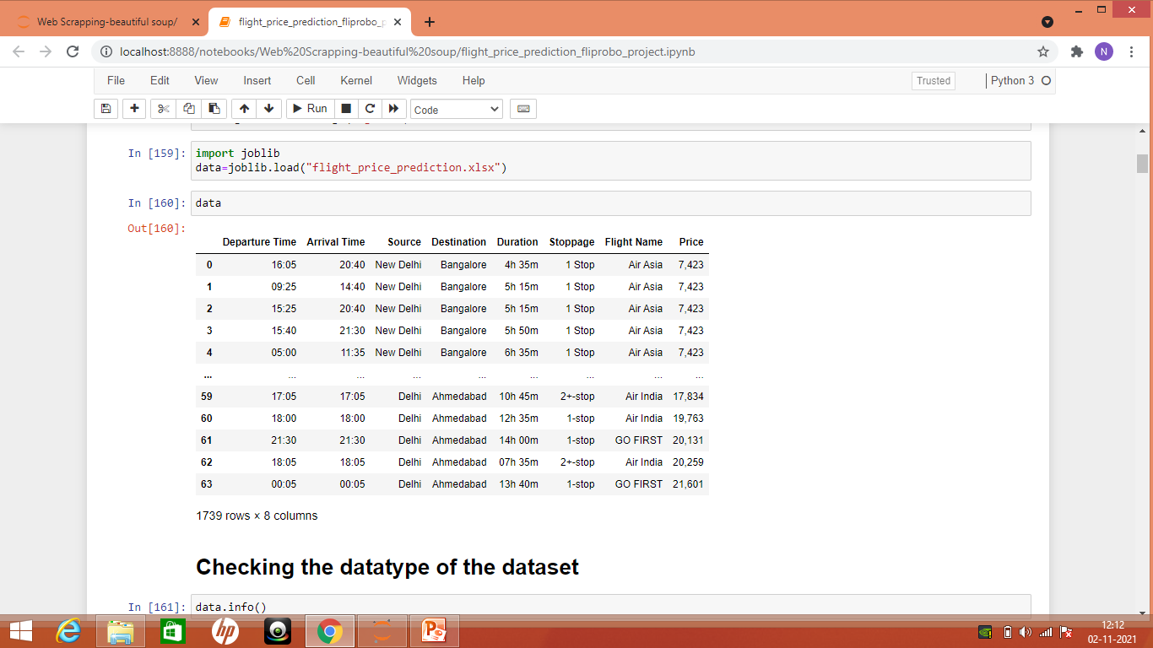
Importing dataset

Slide 3
Dataset Details:
We have 1739 Rows x 8 Columns.
Thee columns contains Departure time of the flight.
Arrival time of the flight.
Source and the destination of the flight.
Duration is the total time taken by the flight.
Stoppage means how much stops it take.
Airline name means which airline do the passenger take the services.
The target output i.e the Price

Slide 4
Pre-processing :
In the pre-processing we have found that all the datatype are of “object”,so we need to convert into the machine learning language.
Then we check whether data contains the missing value or not through the data. isna().sum() which give us missing value. In this dataset there is no missing value.

Slide 5
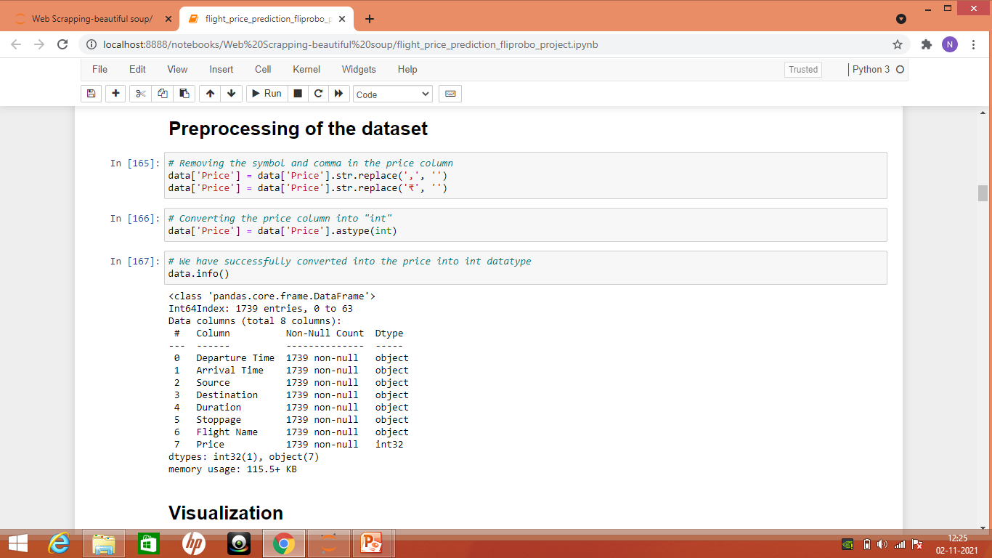
Replacing the comma and converting price into int

Slide 6
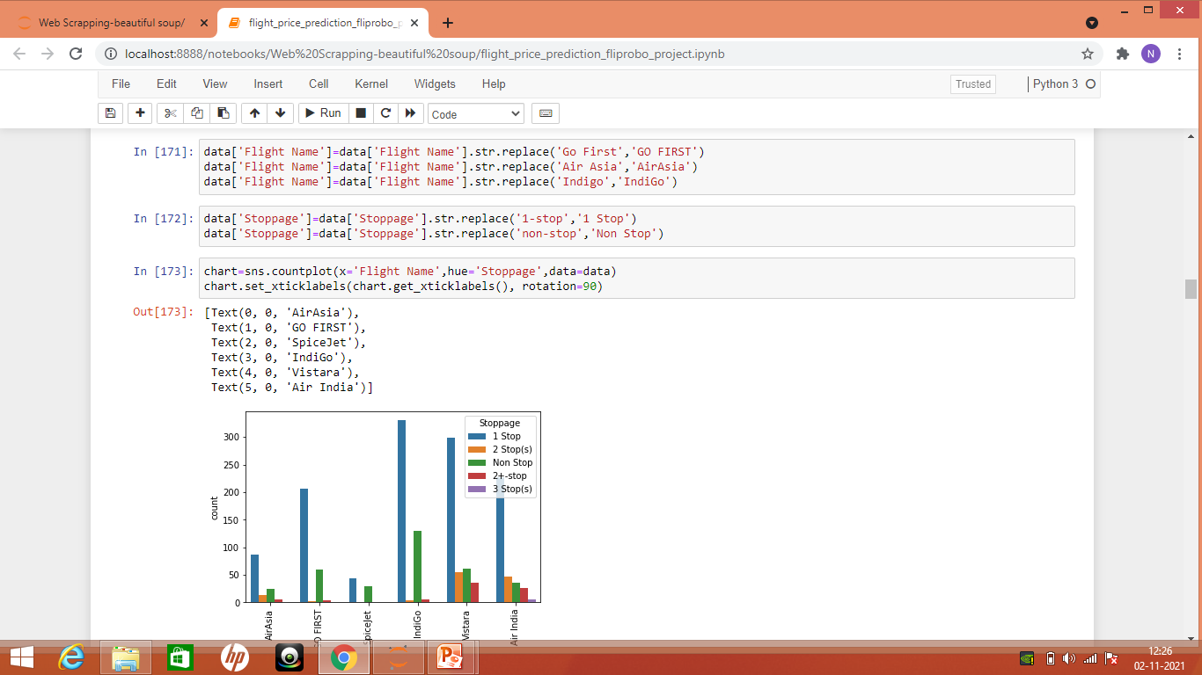
Replacing the repeated name with different style
We have replaced the name of the airline which are of same name but written with different format

Slide 7
There are lot of words with same meaning but written in different style.
In Source column we have two name such as “Delhi” and “New Delhi” which are of same category, so we have replaced with one.
Likewise in every column there is something or the other.
Now we will look some visualization of the dataset.

Slide 8
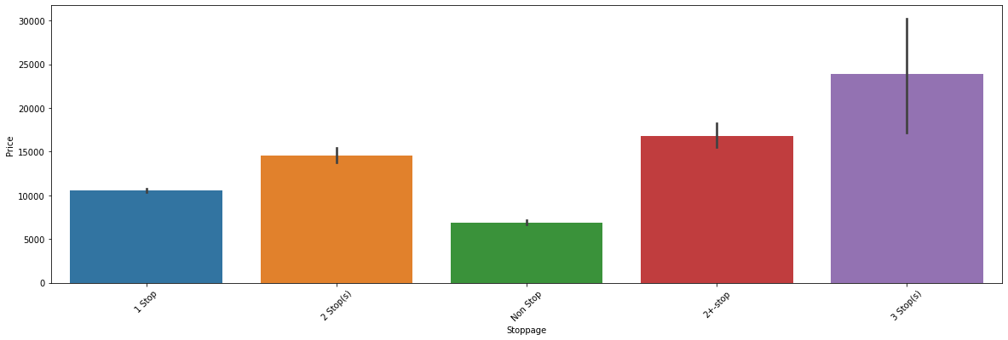
Visualization:

Slide 9
Above figure shows the stoppage distribution to the price.
As we can see from the figure that stoppage is directly proportional to the price.
As the stoppage increases, the price of the flight also goes increases.

Slide 10
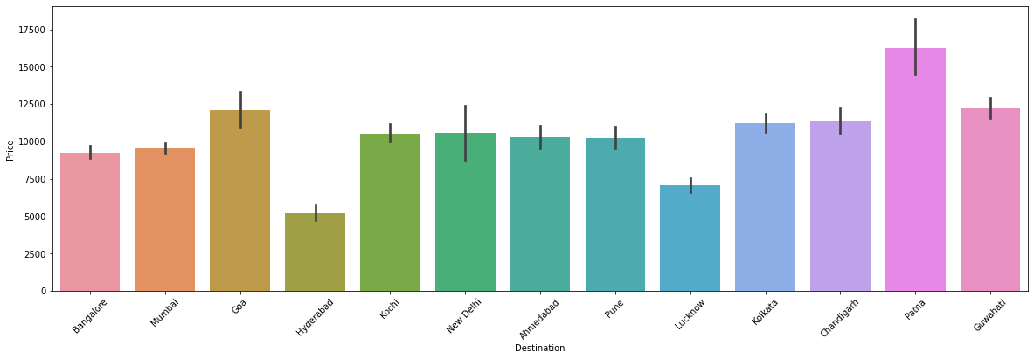

Slide 11
As we can see from the above graph that the price of the cities such as patna, Goa and guwahati air fare cost is most due to non frequent flight.
The cost of the cities such as Mumbai, new delhi, ahmedabad, pune are nominal due to more frequent flight to these cities.

Slide 12
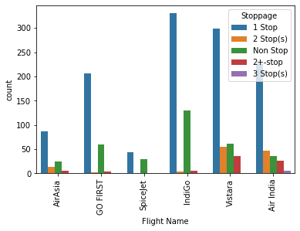

Slide 13
From the above figure, we can conclude that the airline “Indigo” flight has highest number of non-stop flight , 1-Stop flight and many more
Airline such as “ Airasia ” has less number of flight due to less frequent in the day-to day services.
“spicejet” has more of non-stop and 1 stop flight.

Slide 14
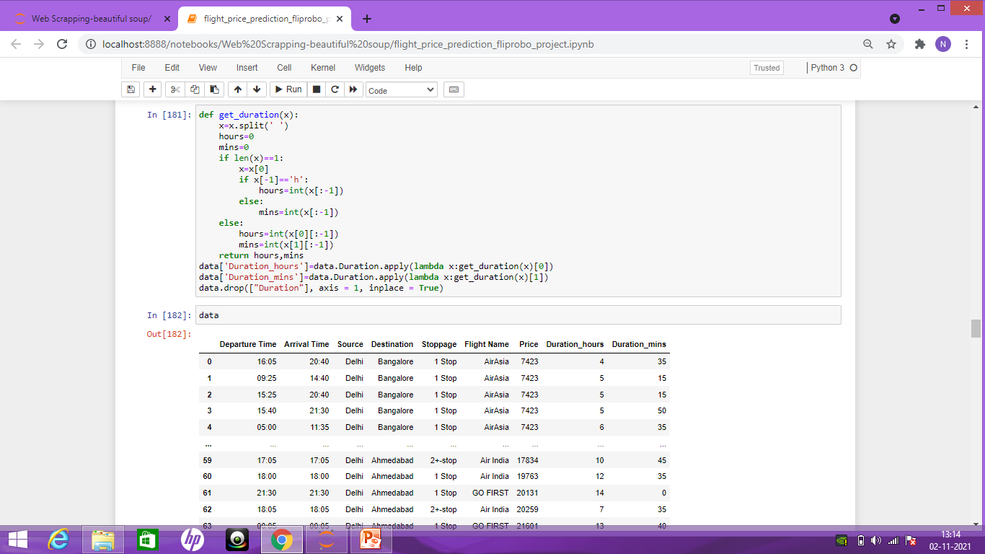

Slide 15
As we have added a two new columns such as the duration hours and duration minutes from the duartion column.
It means we have separated the hour and time from the duration column and appended into two new columns.

Slide 16
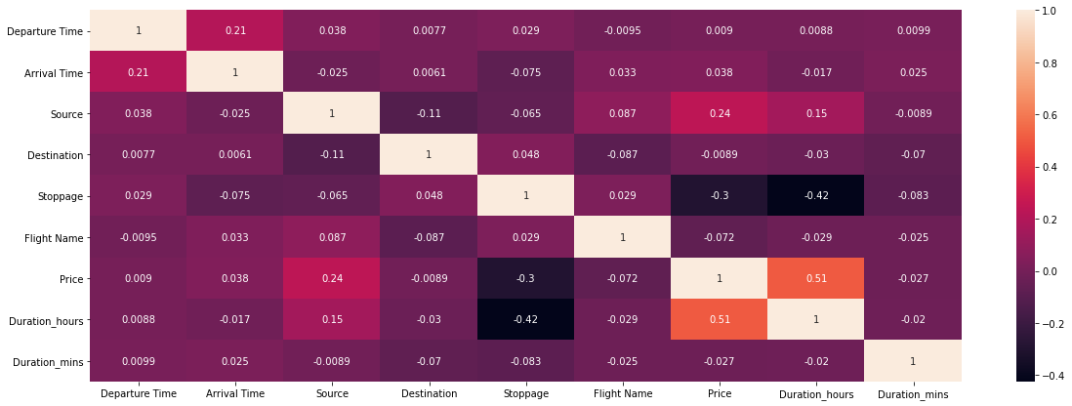

Slide 17
From the above heat map, we can conclude the relationship between the feature columns with the target column such as “Price”.
As we can see that the highest relationship with the “price” is the “duration of the hour” that takes to travel from one place to another.
The label “price” also had good relationship with the “source” from the journey start.

Slide 18
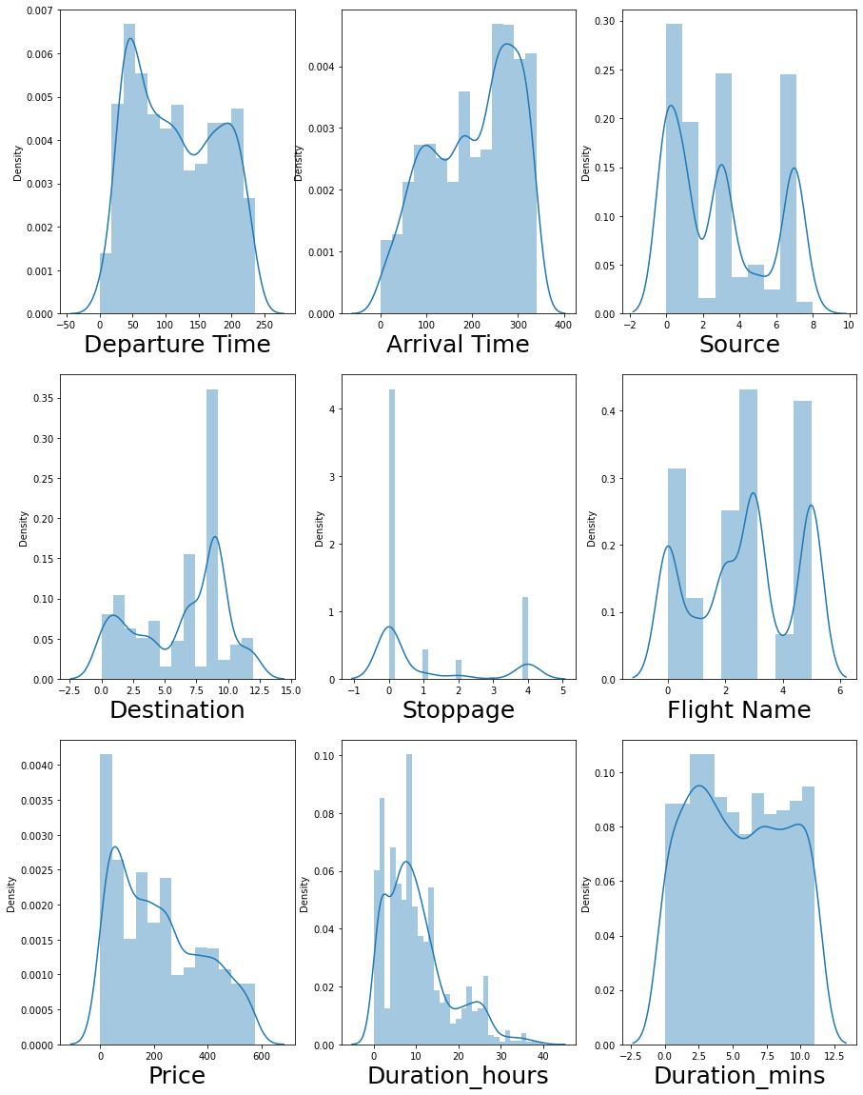

Slide 19
As we can see that there is no outlier in the dataset.
So will convert the object datatype into the machine learning language.
We will be using Label Encoder() to convert the datatype into machine learning code.

Slide 20
Splitting the data into “x” and “y” column
We will be using Z score to remove the skewness in the dataset.
Then we divide the column into “x” as the feature column and “y” as the label column or the vector column.
The label column or the vector in this dataset is the “Price” column.

Slide 21
Splitting the dataset into train and test model
We will split the data into training and for testing purpose.
We will divide the data into train as the 0.8
i.e 80% is the training dataset and testing
purpose as 0.2 means 20% for the testing
data.

Slide 22
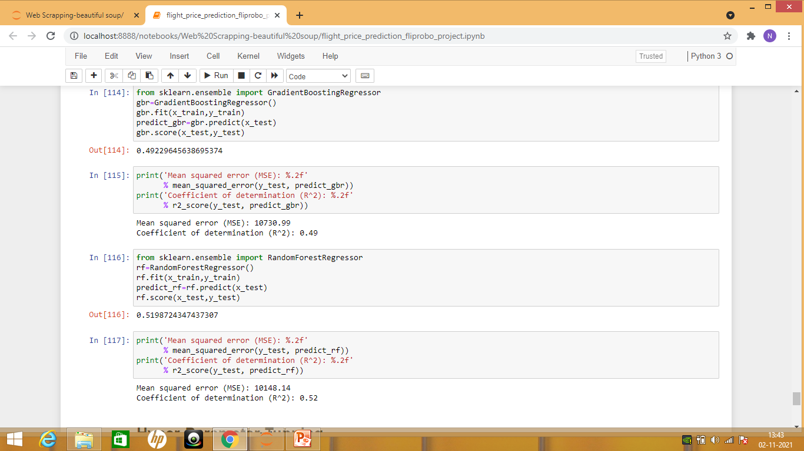
Building the model:

Slide 23
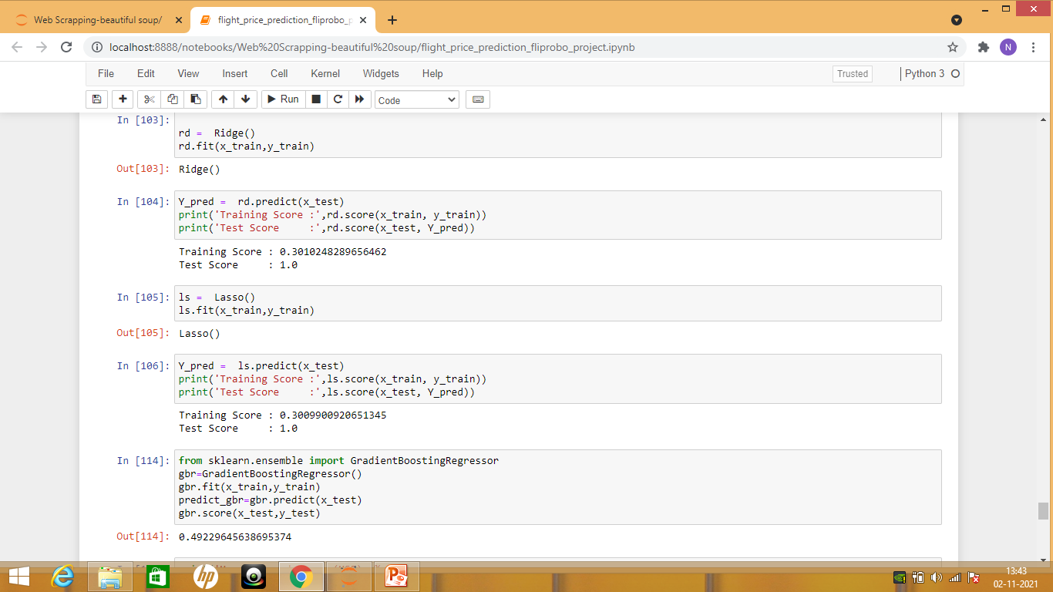

Slide 24
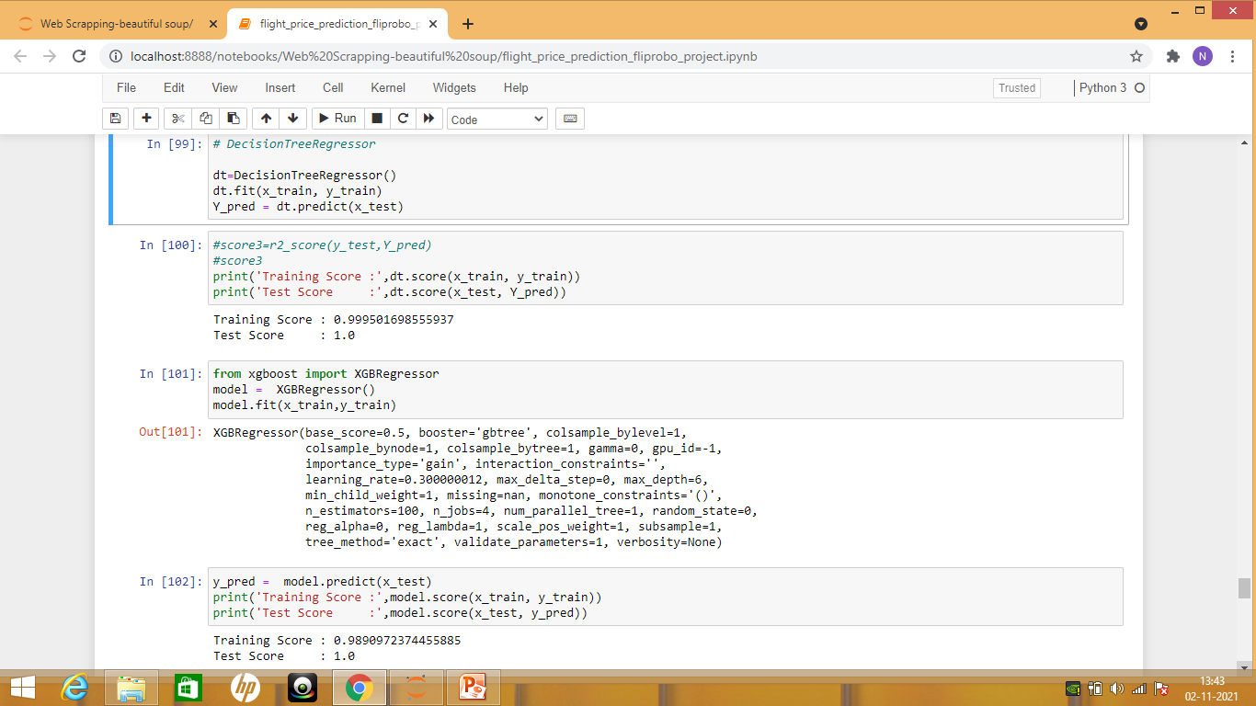

Slide 25
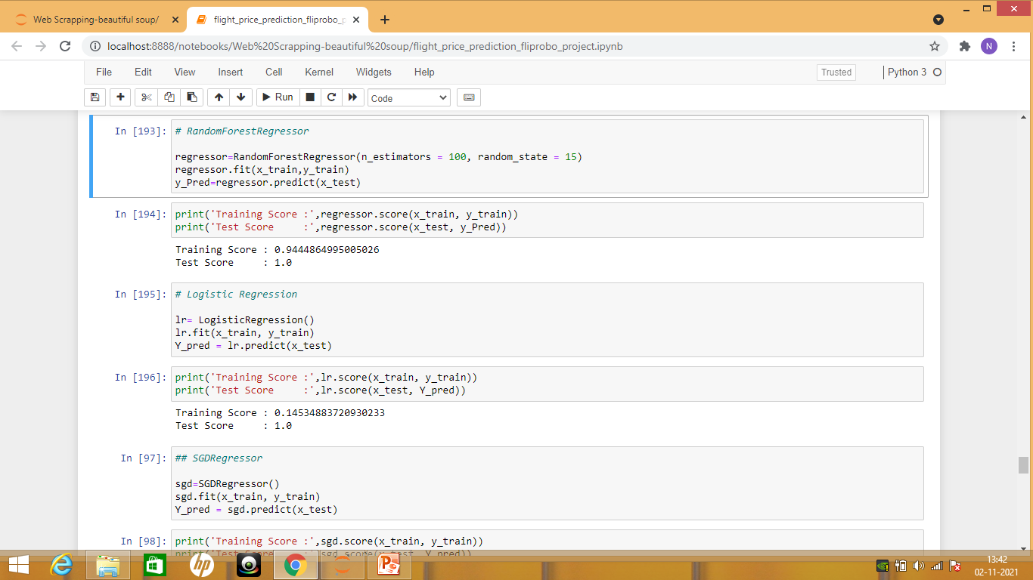

Slide 26
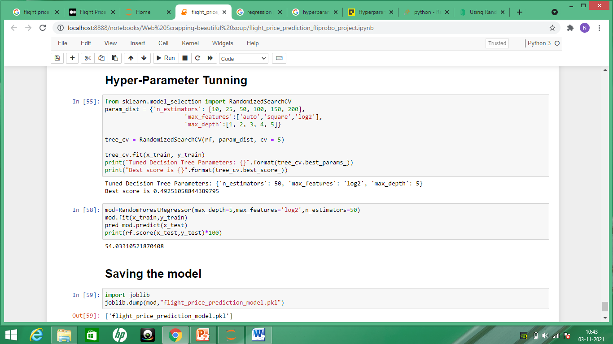
Hyper-Parameter Tuning

Slide 27
Conclusion:
We have applied various technique to build the technique like Ridge, Lasso, Random Forest Regressor, Xgb Regressor and Gradient Boosting Regressor.All are Ensemble technique.
When building models, comparing them and deciding which one is better is a crucial step. You should test lots of things and then analyze summaries. Drop some variables, sum or multiply them and again test. After completing the series of analysis, you will check the mean squared error.

Slide 28
We have used hyper-parameter tunning to tune the model
In the case of a random forest, hyperparameters include the number of decision trees in the forest and the number of features considered by each tree when splitting a node. (The parameters of a random forest are the variables and thresholds used to split each node learned during training)

Slide 29
As we have achieved the model accuracy as 49% but when we tunned the model, we got the accuracy as 54%.
As we know this is very less accuracy due to many other features that are missing such as date of journey or any other additional feature such as meal is included or not
We have saved the model using joblib and there is always a scope to improve the accuracy.

