Slide 1

Malignant-Comment-Classifier
Submitted by
Naincy Joshi

Slide 2
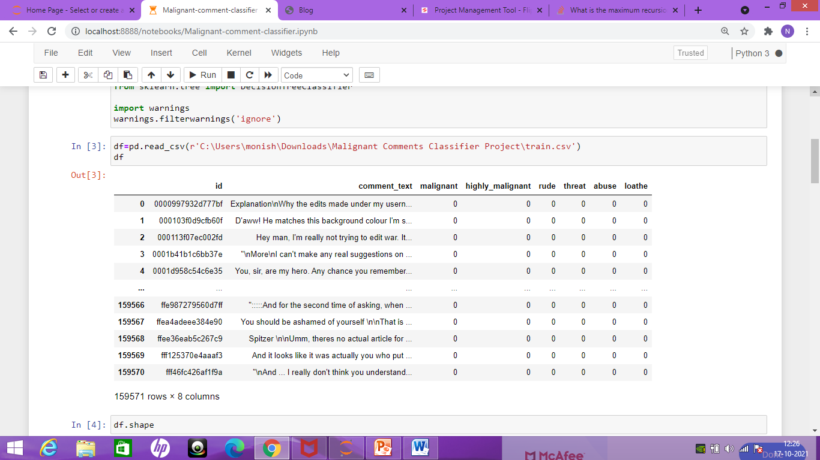
We have two data set one is the train data and the other is the test data.

Slide 3
Attribute Explaination
1. ID refers to the unique identification of the text.
2. Comment_text column contains entire text of the comment.
3. Malignant, highly_malignant, rude, threat, abuse, loathe are those features wherein 0 denotes that the comment is not categorized as that particular feature

Slide 4
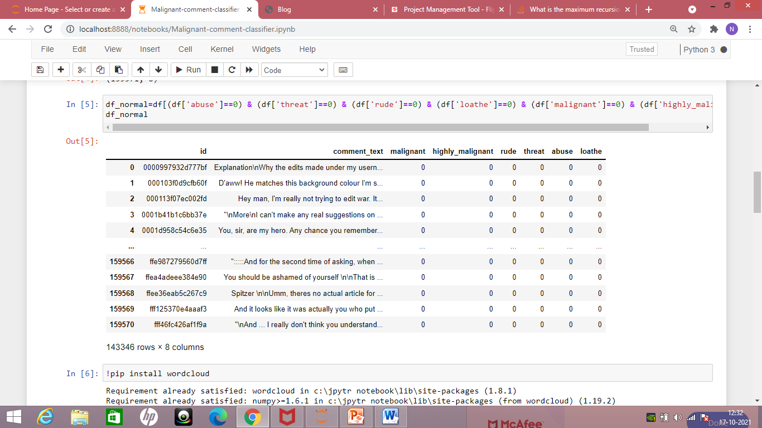
Intial Observation
We can observe that many comments are categorized as ‘normal’; just like a real time scenario, we will find a greater number of normal comments than negative comments.
Out of 159571 no. of records, 143346 records are normal as shown below

Slide 5
Visualization in NLP
When we are analyzing huge data, visualization plays a vital role in giving summary of the text.
We have a library in python called WordCloud which helps in highlighting the frequently appearing words. We will use the same to visualize the various comments. Before that we need to preprocess the data by cleaning it and segregating it by comment category.
I have imported necessary libraries and cleaned dataset as below:-

Slide 6
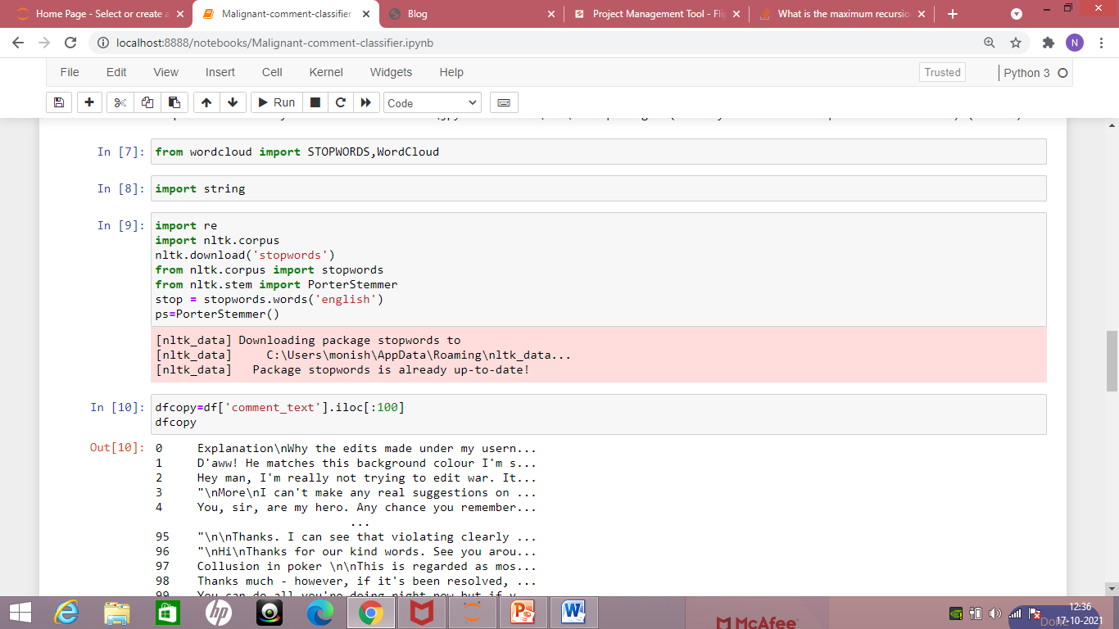
Cleaning the Comment_text

Slide 7
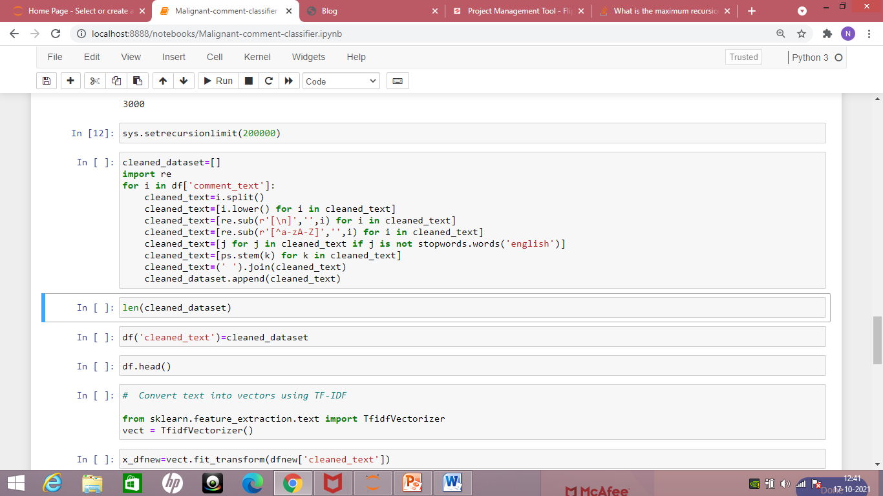
Cleaning the dataset and creating a new column which contains cleaned_text: -

Slide 8
Model Building in NLP
The next step would be to build Model for Multi Label classification. Before executing that process, we need to convert the text into numbers by using some Techniques like BOW (Bag of Words), Tf-idf-vectorizer and Word2Vec. This is required as Algorithms can only accept numbers and not text for model building.
Here, Tf-idf-vectorizer is used to convert the text into vectors.

Slide 9
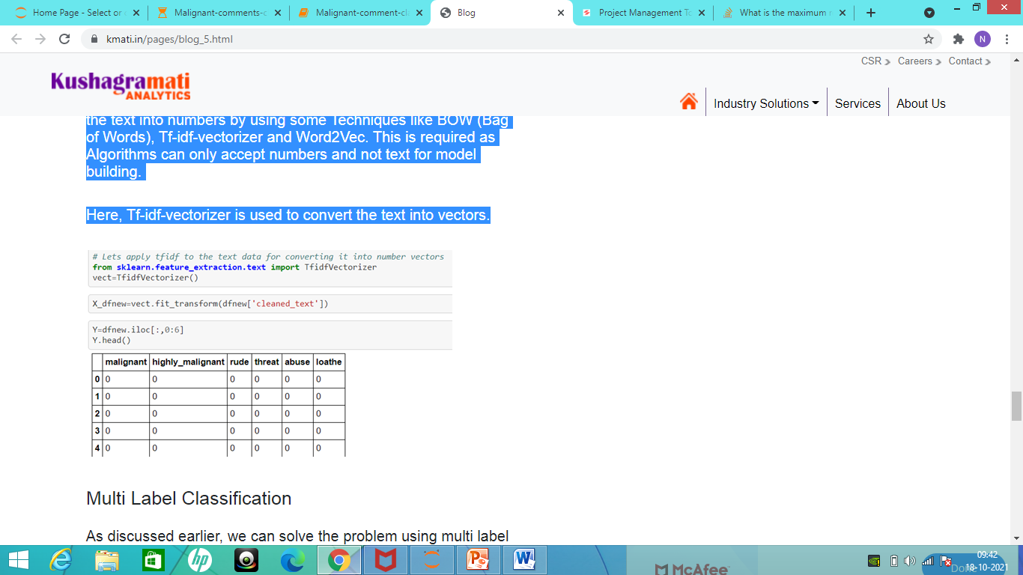

Slide 10
MultiLabel Classification
As discussed earlier, we can solve the problem using multi label classification. We have used algorithms like OneVsRest and Multi-Output Classifier on above the classifiers.
Classifiers used :-
1) MultiOutput Classifier on the RandomForest Classifier

Slide 11
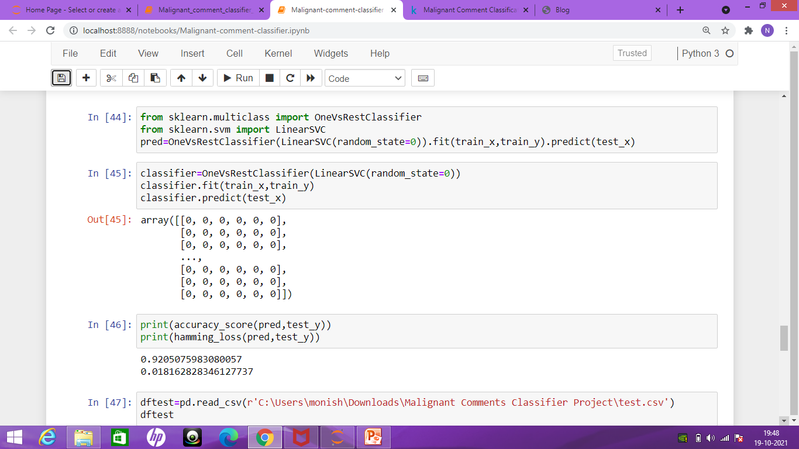
OneVsRest Classifier on above the LinearSVC

Slide 12
OneVsRest over LinearSVC is giving us better results. Hence, it makes good sense to use OneVsRest Classifier.
Checking the Model on New Dataset.
The finalized model for giving predictions on a new dataset after cleaning it is shown below:

Slide 13
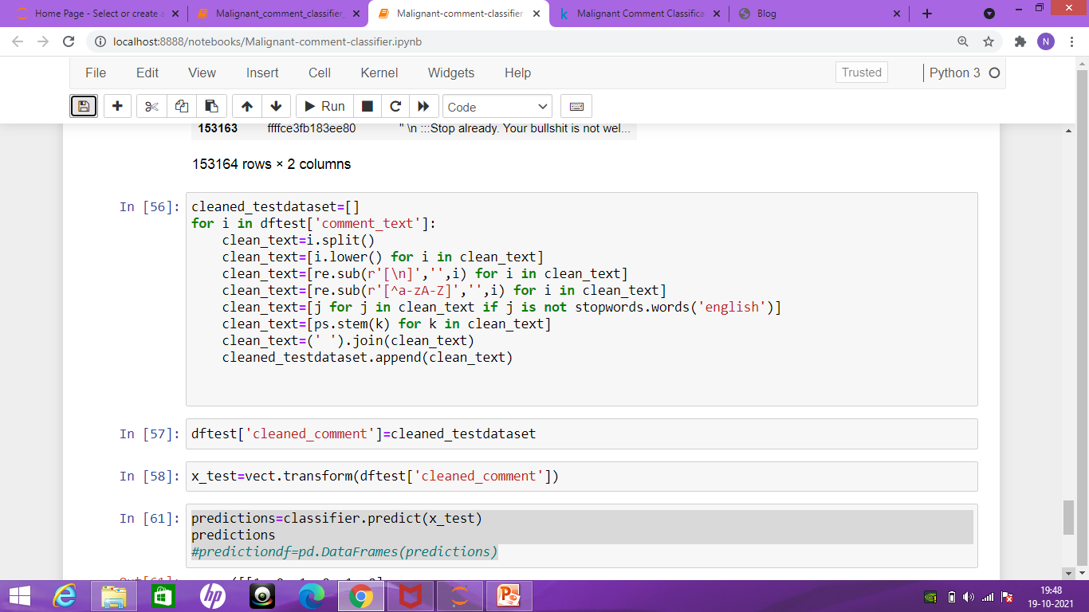
Cleaning the test data:

Slide 14
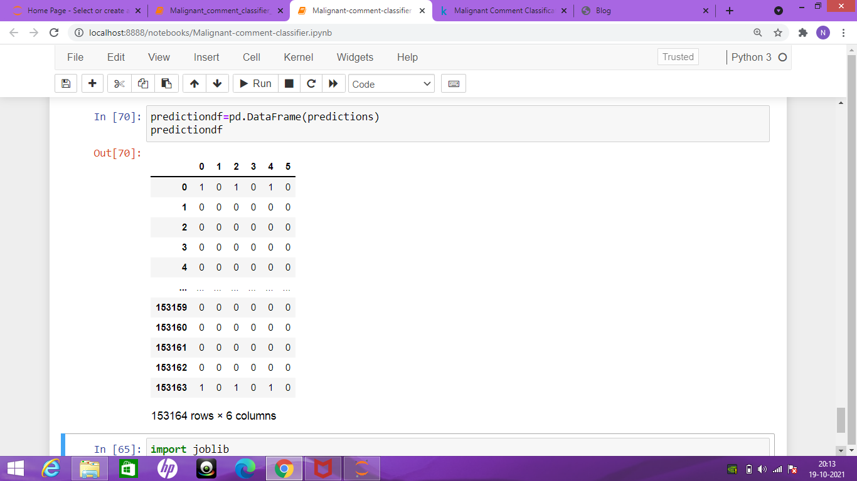
Predicting the test data

Slide 15
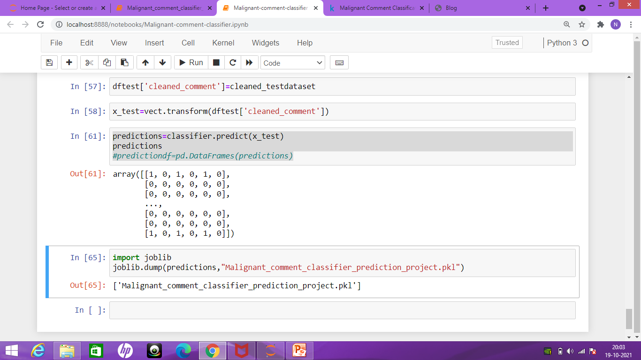
Saving the Model:
In this Project, we have analysed the texts using NLP techniques and successfully made predictions using multi-label classifier.

