Slide 1




Analysis of the relationship between New York City Accidents and Weather
C-DAC Bangalore
Course: PG-DBDA SEPT 2022
PG –DAC/DITISS
NAME: Jemima Joaquina Dias PRN: 220950125041
NAME: Kajal Patel PRN: 22095015442
NAME: Kamal Prakash Yadav PRN: 220950125043
NAME: Nainesh Anil Khanjire PRN: 220950125053
NAME: Nalin Pushp PRN: 220950125054
Center for Development of Advanced Computing

Slide 2
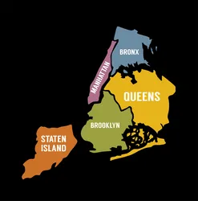

C-DAC Bangalore
INTRODUCTION
New York
often called New York City or NYC, is the most populous city in the United States, referred to collectively as the Five Borough
This project is developed to understand feature correlations, patterns and analyze trends with the current weather conditions in the area of the accident
Data related to weather taken for the year 2016 to 2023 , data related to traffic accidents in the New York City from NYC-Open Data website for the year 2012 to 2023 is used
Technologies used in this project are:
Python3
PySpark
MongoDB
Machine Learning
Power BI, AMcharts5

Slide 3

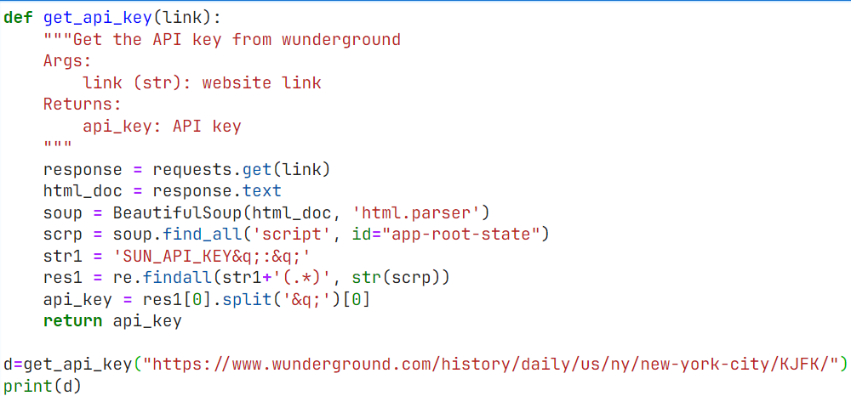

C-DAC Bangalore
DATA EXTRACTION
Beautiful Soup is a Python package for parsing HTML and XML documents
Data related to weather taken for the year 2016 to 2023
Total no of rows in the extracted dataset is 68030 and total no of columns are 17
Data related to traffic accidents in the New York City NYC Open Data website from the year 2012 to 2023
Total no of rows in the extracted dataset is 1972605 and total no of columns are 29
References:
https://www.wunderground.com/history/daily/us/ny/new-york-city/KJFK
https://data.cityofnewyork.us/Public-Safety/Motor-Vehicle-Collisions-Crashes/h9gi-nx95

Slide 4
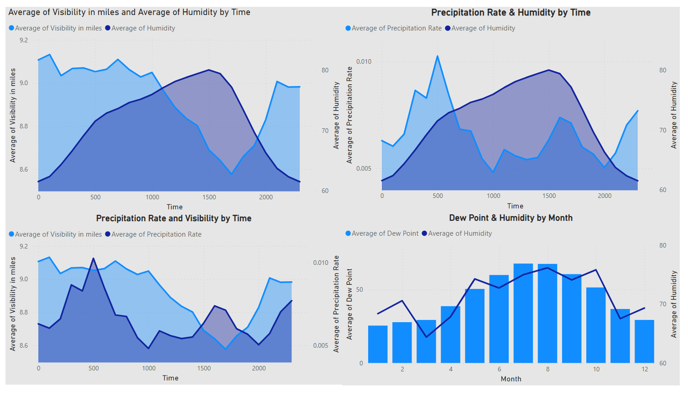
C-DAC Bangalore
WEATHER EDA
Reference: https://learn.microsoft.com/

Slide 5
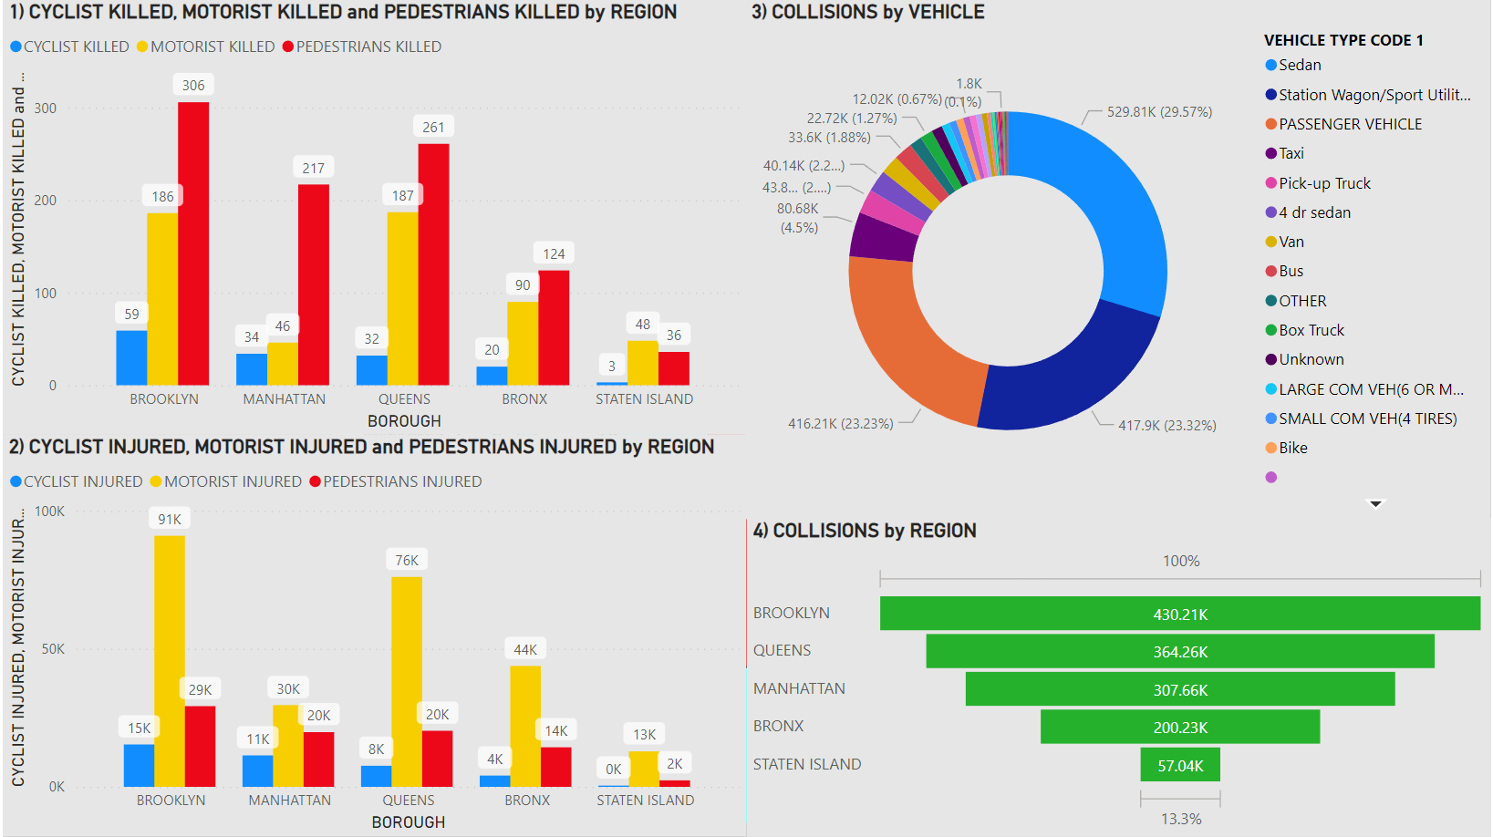
C-DAC Bangalore
VEHICLE CRASH EDA
Reference: https://learn.microsoft.com/

Slide 6

C-DAC Bangalore
MERGE DATA
Creating a single column by combining date and timestamp to create a unique key in both the dataset
Joined both datasets on unique key by using PySpark
Reference: https://spark.apache.org/docs/latest/api/python/getting_started/quickstart_ps.html

Slide 7

C-DAC Bangalore
DATABASE
Pushed merged dataset to MongoDB Atlas Cluster by creating a database and collection
connect to instance :
client = pymongo.MongoClient(“<link_to_cluster>”)
db = client[‘db_name’]
collection = db[‘collection_name’]
to push data:
collection.insert_many(data)
Reference:
https://www.mongodb.com/docs/atlas/getting-started/
https://www.mongodb.com/docs/drivers/python/

Slide 8
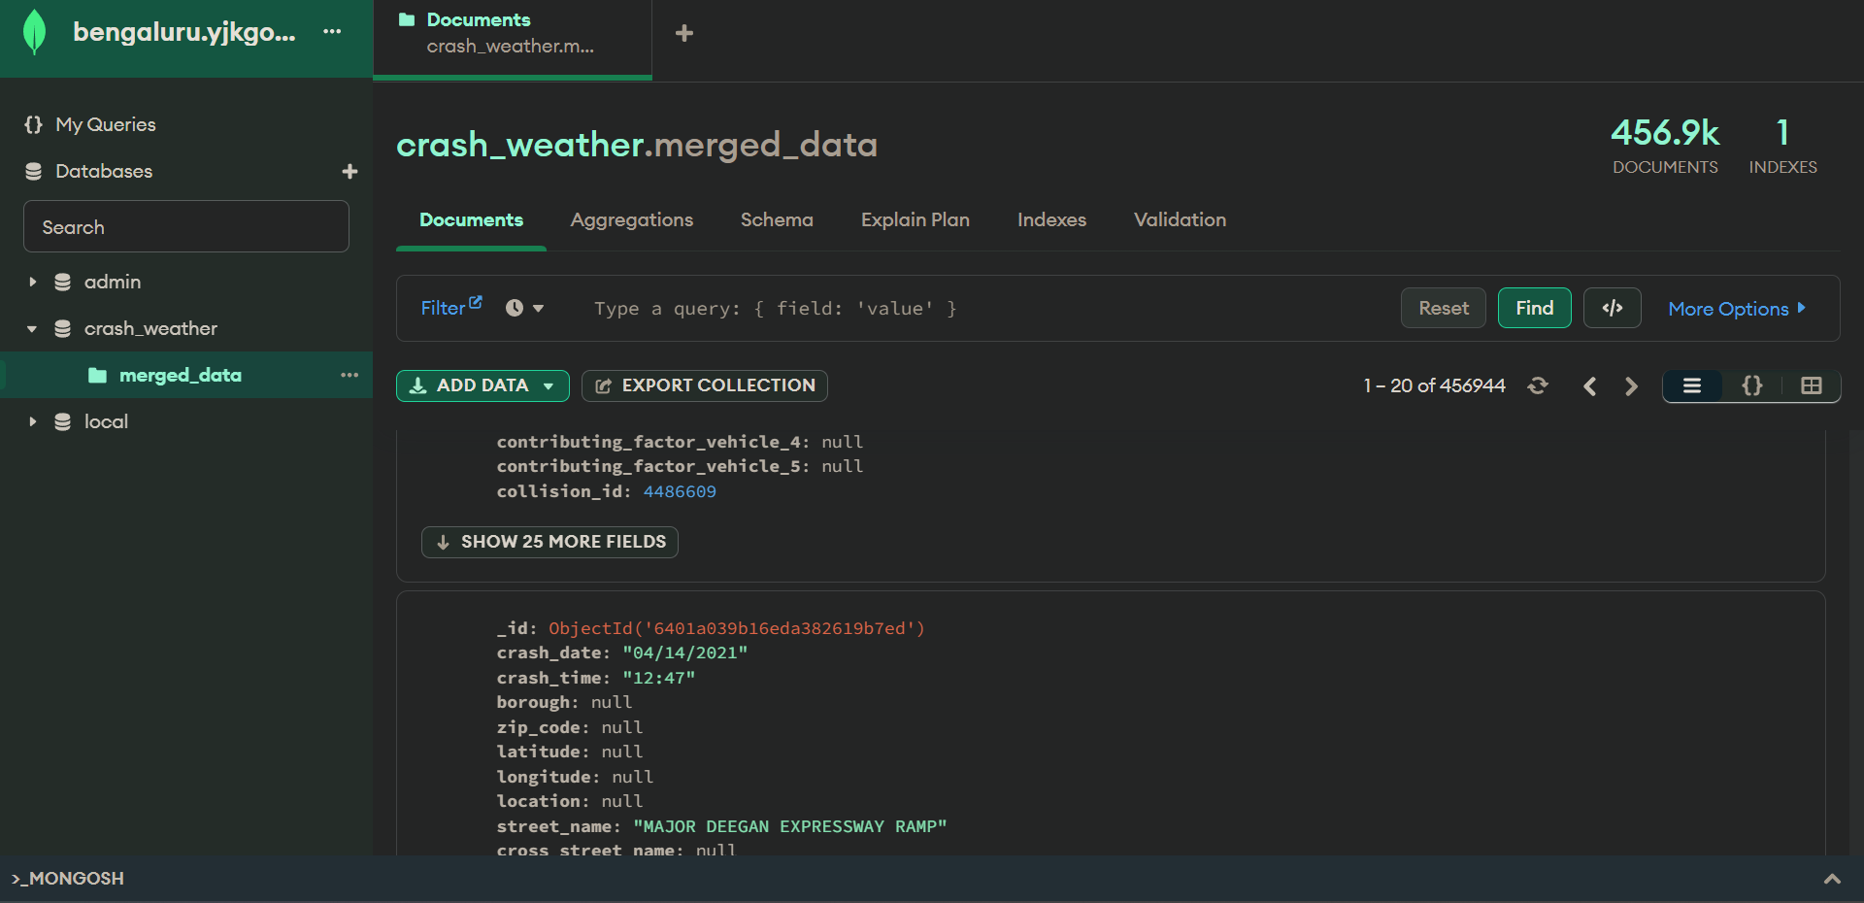
C-DAC Bangalore
MONGODB ATLAS
CLICK TO SEE CLUSTER

Slide 9

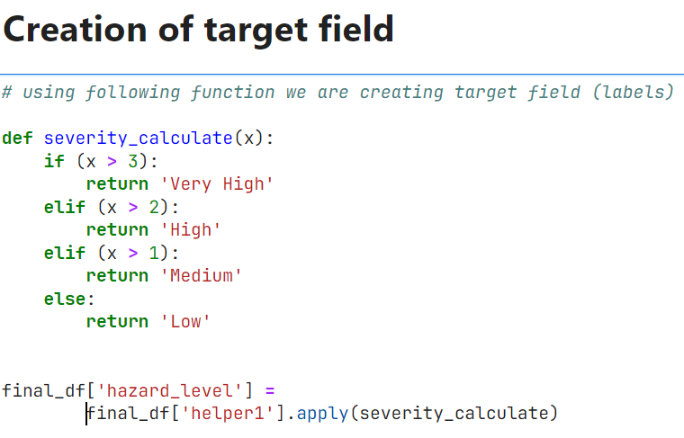
C-DAC Bangalore
MACHINE LEARNING
Severity level is calculated on the basis of
['NUMBER OF MOTORIST KILLED']*3 + ['NUMBER OF MOTORIST INJURED’]*1
resulting in severity levels of low, medium, high, very high
Severity | Killed | Injured | Severity condition
Low | 0 | 1 | At least one injured
Medium | 0 | 2 | At least two injured
High | 1 | 3 | Either one killed or more than two injured
Very high | >1 | >3 | Either more than one killed or more than 3 injured

Slide 10
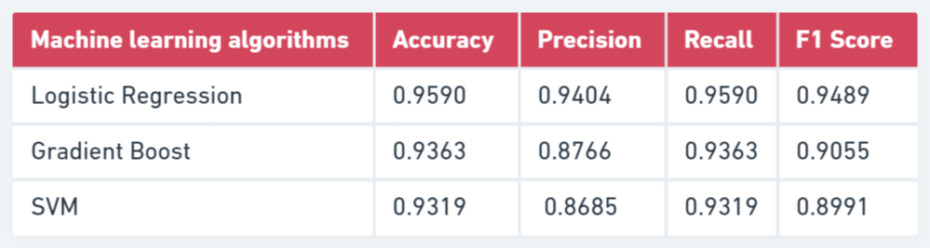
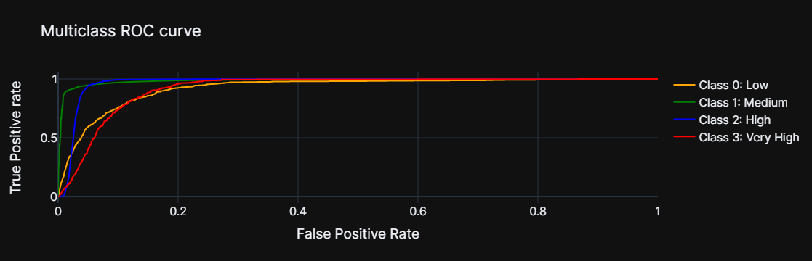
C-DAC Bangalore
MACHINE LEARNING METRICS

Slide 11

C-DAC Bangalore
VISUALISATION
We have developed a frontend using HTML, AMCharts, and Power BI.
HTML and CSS are used to create the main page, while AMCharts is used to create a race chart displaying 10 years of data and a heat map showing the distribution of crashes during the week.
We have embedded Power BI into HTML using an inline frame to display the weather and crash data dashboard.
Our frontend provides an interactive and visually appealing way to analyze crash and weather data for New York City.
LINK TO FRONTEND

Slide 12
C-DAC Bangalore
CONCLUSION
NYC has 5 boroughs and a population of 8.8 million.
Crashes decreased after 2019, with Brooklyn being the most dangerous region and Staten Island the safest.
More pedestrians are injured, and more motorists are killed, with sedans and SUVs being the most involved vehicles.
Weekdays, especially from 8 am to 6 pm, have more crashes than weekends, with Friday at 5 pm being the peak time.
High humidity leads to reduced visibility and more crashes, with July and August being more prone to accidents, and "Mostly Cloudy" and "Cloudy" conditions being the most common.

Slide 13
C-DAC Bangalore
THANK YOU !

