Slide 1
R-Programming
Dr. Ch. Janaki
C-DAC Bangalore

Slide 2
DAY 1
Session 15: o The R project for Statistical Computing o Why R o Introduction & Installation of R o R Basics, Finding Help, o Code Editors for R, o Exploring RGui o Exploring RStudio o Basic Mathematical & Arithmetic operations in R
Session 16: o Data Objects- Data Types & Data Structures (e.g. lists. Arrays, matrices, data frames) o Packages in R o Working with Packages o Handling Data in R Workspace o Reading & Importing data from Text files, Excel files, Multiple o Exporting Data from R
Session 18: o Functions o Built in functions in R (numeric, character, statistical) o Interactive reporting with R markdown
Notes:
‹#›

Slide 3
DAY 2
Session 17: o Introduction to tidy verse (group of packages) o Manipulating and Processing Data in R o Creating, Accessing and Sorting data frames o Extracting, Combining, Merging, reshaping data frames
o Introduction to R Shiny

Slide 4


What is R?
The R statistical programming language is a free open-source package based on the S language
( developed by Bell Labs).
R was created by Ross Ihaka and Robert Gentleman at the university of Auckland, New Zealand
The language is very powerful for writing programs.
Many statistical functions are already built in.
Contributed packages expand the functionality to cutting edge research.
Ross Ihaka
Robert Gentleman
Notes:
‹#›

Slide 5
R VS PYTHON
R & Python – Both are powerful languages.
R – Good for Data Analytics, Statistical analysis, Visualization, pre and post-processing. Easy to learn.
Python - For Machine learning and Deep learning, data analytics, non-statistical tasks, handling large datasets.

Slide 6
BASIC FEATURES OF R
R is for data analysis and data visualization tool.
Visualization in the form of charts, plots and graphs
It is supported with number of graphical, statistical techniques.
There are several GUI editors of R language, out of which RGUI and Rstudio are commonly used.
Common characteristics of R
Effective and powerful data handling
Arrays and Matrices related operations
Graphical representations of the analysis
Notes:
‹#›

Slide 7
Basic Features of R – Statistical Features
R provides various statistical and graphical techniques, such as
Linear and non-linear modeling
Classical statistical tests
Time-series analysis
Classification, Clustering etc.
R has various predefined packages. User can also install packages.
R can generate static graphs. To generate dynamic and interactive graphics, user has to install additional packages
Notes:
Scatter and bubble plots: use plotly . The best way to build an interactive bubble chart from R is through the plotly library. If you know how to make a ggplot2 chart, you are 10 seconds away to rendering an interactive version= just call the ggplotly() function, and you're done.
‹#›

Slide 8
BASIC FEATURES OF R - PROGRAMMING FEATURES
R supports following
Basic Math operations
Vector Operations
Matrix Operations
Some other data structures like data frames and lists.
It can be used with other programming languages such as Python, Perl, Ruby, Julia and on Hadoop & Spark

Slide 9
Basic Features of R - Packages
CRAN (Comprehensive R Archive Network) – Collection on R packages.
https://cran.r-project.org/web/packages/available_packages_by_name.html
A Package is a collection of functions and datasets.
R provides 2 types of packages
Standard Packages (in-built) part of R source code
Contributed Packages (user-defined)
To access the contents of package you have to first install (if it is not in-built) and load it.
Eg: install.packages("ggplot2")
These packages are widely used in Finance, Genetics, HPC, Machine Learning, Medical Imaging, Social Sciences and Spatial Statistics
Notes:
‹#›

Slide 10
BASIC FEATURES OF R – GRAPHICAL USER INTERFACE
Some popular text editors and Integrated Development Environments (IDEs) that support R programming are
ConTEXT
Eclipse
Emacs (Emacs Speaks Statistics)
Vim editor
jEdit
Rstudio
WinEdit

Slide 11
GETTING STARTED
Where to get R?
Go to www.r-project.org
Downloads: CRAN (The Comprehensive R Archive Network)
Set your Mirror: Any of the mirror site can be selected.
https://irkernel.github.io/installation/
Notes:
First install R followed by Rstudio
‹#›

Slide 12
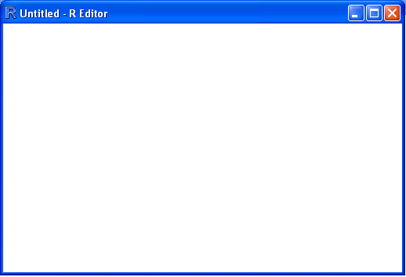
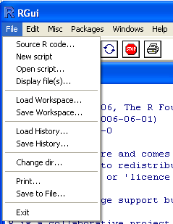
GETTING STARTED
Opening a script.
This gives you a script window.

Slide 13
Getting Started
Basic assignment and operations.
Arithmetic Operations:
+, -, *, /, ^ are the standard arithmetic operators
Assignment
To assign a value to a variable use “<-” or “=”
Matrix Arithmetic.
* is element wise multiplication
%*% is matrix multiplication
R Arithmetic operators
Operator | Description
+ | Addition
– | Subtraction
* | Multiplication
/ | Division
^ | Exponent
%% | Modulus (Remainder from division)
%/% | Integer Division
Notes:
Matrix operators - http://www.philender.com/courses/multivariate/notes/matr.html
Assign variable using <- or =
d<-5
print(d)
d=6
print(d)
Addition operator (+):
Subtraction Operator (-):
Multiplication Operator (*):
Division Operator (/):
Power Operator (^):
Modulo Operator (%%):
Element-wise Logical AND operator (&):
Element-wise Logical OR operator (|):
‹#›

Slide 14
Getting Started
How to use help in R?
R has a very good built-in help system.
If you know which function you want help with simply use ?_______ with the function in the blank.
Ex: ?hist.
If you don’t know which function to use, then use help.search(“_______”).
Ex: help.search(“histogram”)
Notes:
?print
‹#›

Slide 15
Packages
Packages are collections of
R functions,
Data sets
compiled code in a well-defined format.
documentation for the package
Test scripts
The directory where packages are stored is called the library.
To access and use the package, it has to be loaded first.
Notes:
R packages guide
https://www.datacamp.com/community/tutorials/r-packages-guide
A package is a suitable way to organize your own work and, if you want to, share it with others. Typically, a package will include code (not only R code!), documentation for the package and the functions inside, some tests to check everything works as it should, and data sets.
7. What’s The Difference Between A Package And A Library?
Speaking about the library() function, sometimes there is a confusion between a package and a library, and you can find people calling “libraries” to packages.
Please don’t get confused: library() is the command used to load a package, and it refers to the place where the package is contained, usually a folder on your computer, while a package is the collection of functions bundled conveniently.
dplyr is a grammar of data manipulation, providing a consistent set of verbs that help you solve the most common data manipulation challenges:
mutate() adds new variables that are functions of existing variables
select() picks variables based on their names.
filter() picks cases based on their values.
summarise() reduces multiple values down to a single summary.
arrange() changes the ordering of the rows.
‹#›

Slide 16
Packages
R comes with a standard set of packages. Others are available for download and installation. Once installed, they have to be loaded into the session to be used.
To install or add new R packages
install.packages(“package_name”)
To load the package
library(package_name)
To see default packages on R
library()
To see installed packages on R
installed.packages()
Remove package: remove.packages("package_name")
You can create your own package
Notes:
Download R-4.2.0 for Windows
‹#›

Slide 17
CRAN
It is A Comprehensive R Archive Network, contains many packages which can be used in many domains like
Genetics, Bioinformatics
Finance
HPC (High Performance Computing)
Machine Learning
Medical Imaging
Big data

Slide 18
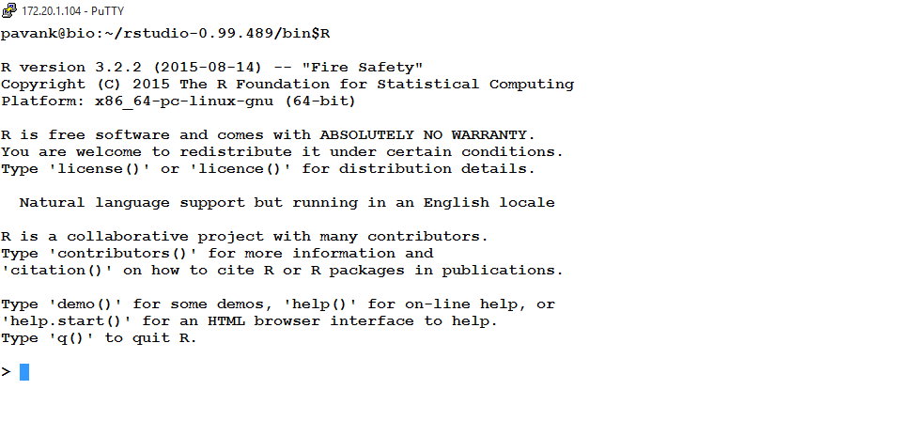
R CONSOLE
After installing R on the Linux machine. Just type R on the command line
After R console is opened, it shows some basic information about R, such as R version, date of release, licensing
Notes:
‹#›

Slide 19
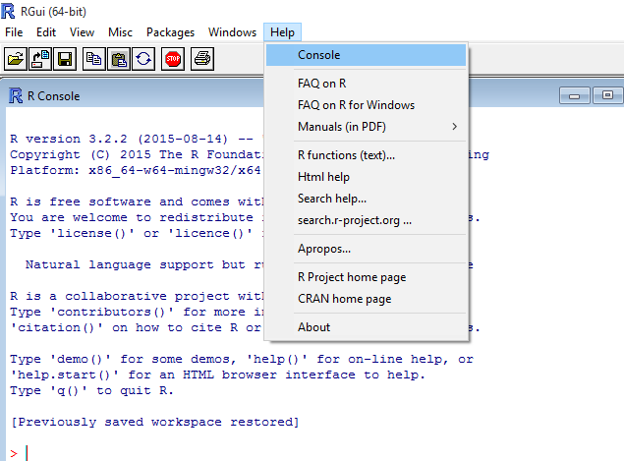
R CONSOLE
In the previous figure, notice “>” symbol.
This is called R prompt, which allows users to write commands and then press ENTER key to execute the command.
To get more information about the console, go to Help->Console.

Slide 20
DEVELOPING A SIMPLE PROGRAM
Sample program for printing
Here, we are using the print() function to display “Hello World” on the R console
>print(“Hello World”)
[1] “Hello World”
Here, we are doing simple math
>2+3
[1] 5
Code begins with ‘>’ symbol and output begins with [1]

Slide 21
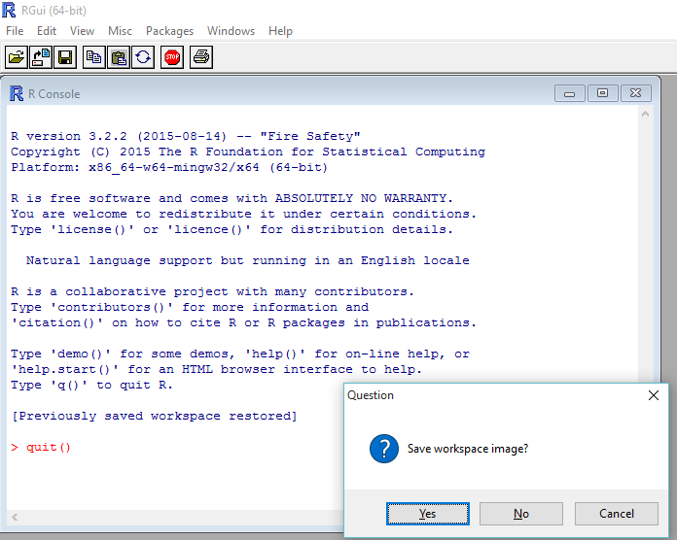
QUITTING R
You can quit an active session of R by entering q() command
After executing the q() command, the question dialogue box appears asking whether to save the work space.

Slide 22
HANDLING BASIC EXPRESSIONS
Anything that you type on R console, it executes immediately on pressing the ENTER key.
Basic Arithmetic in R
>12+45+9-7
[1] 59
R executes the expression in the following order
12+45+9=66
66-7=59

Slide 23
HANDLING BASIC EXPRESSIONS
Let’s look at complex mathematical operation
18+22/2-4/4*3.5
To calculate such complex mathematical expressions, R uses BODMAS (Brackets of Division Multiplication Addition Subtraction)
>18+(22/2)-((4/4)*3.5)
[1] 25.5
>(18+22/2-4/4)*3.5
[1] 98.875

Slide 24
HANDLING BASIC EXPRESSIONS
Mathematical Operators in R
+, -, *, () - Simple Mathematical operations
pi - Stands for Pie value
X^Y - X raised to Y
sqrt(x) - square root of x
abs(x) - Absolute value of x
factorial(x) - Factorial of x
log(x) - logarithm of x
cos(x), sin(x), tan(x) - Trigonometric functions
Notes:
8! i.e. 8 factorial
8× 7× 6× 5× 4× 3 ×2× 1 40,320
Log(1)=0
Log(10)=1
Log(100)=2
‹#›

Slide 25
DECLARING VARIABLES IN R
Variables are symbols that are used to contain and store the values.
Two ways to assign the values
Using “=” symbol
>MyVar=10
Using “<-” symbol
>MyVar<-10
Here, MyVar is a object and it is assigned with the value 10.
Any of the above mentioned can used to assign the values.

Slide 26
VARIABLE TYPES IN R
Numbers
Real numbers
R organizes numbers in 3 formats
Scalar : Represents a single number (0 dimensional)
Vector : Represents row of numbers (1 dimensional)
Matrix: Represents the table like format (2 dimensional)
Working with Vectors
It consists of ordered collection of numbers or strings
Numerical Vector
String/character vector

Slide 27
VARIABLE TYPES IN R
Numeric Vector:
Vector of numeric values.
A scalar number is the simplest numeric vector.
Example:
1.5
## [1] 1.5
To store it for future use,
X<-1.5

Slide 28
VARIABLE TYPES IN R - VECTORS
Constructing the numeric and character vectors in R
c() is used to construct the vector (Integer/Character)
> c(10,20,20,30,40) - A Numerical/Integer vector
> c('Hello2', 20, 'Hello4', 30) - A combination of Numerical and Character vector
> c('Hello1', 'Hello2', 'Hello3') - Character vector
Notes:
The numeric() is used to create a zero vector of given length
‹#›

Slide 29
INTEGER AND DOUBLE VECTORS
A number by default is considered double in R.
> batch<-c(“cdac”,”dbda”, 2022)
> typeof(batch)
> newbatch<-c(03,11,2022)
> typeof(newbatch)
> newbatch<- c(03L,11L,2022L) # To read as integer

Slide 30
VARIABLE TYPES IN R - VECTORS
We can also combine single-element vectors and multi element vectors and obtain a vector with the same elements as previously created.
Example
> c(1, 2, c(3, 4, 5))
[1] 1 2 3 4 5
> y=c(1, 2, c(3, 4, 5),c(5,6,7))
> Z = c(10:20,y, sum(10:20))
> length(Z)
Answer?
Notes:
supports a few basic data types: integer, numeric, logical, character/string, factor, and complex Logical – binary, two possible values represented by TRUE and FALSE
y=c(1, 2, c(3, 4, 5),c(5,6,7))
> Z = c(10:20,y, sum(10:20) + ) > Z [1] 10 11 12 13 14 15 16 17 18 19 20 1 2 3 4 5 5 6 7 165 >
length(Z) [1] 20 >
‹#›

Slide 31
VARIABLE TYPES IN R - VECTORS
Creating the vector using (:) operator
>1:15 (generates numbers from 1 to 15)
> c(1:15)
[1] 1 2 3 4 5 6 7 8 9 10 11 12 13 14 15
> c(1,15)
Answer?
> c(1-15)
Answer?
> sum(1:15) ## it sums the numbers from 1 to 15
[1] 120
> mean(1:15)

Slide 32
VARIABLE TYPES IN R
Strings (characters)
A string should be specified by using quotes. Both single and double quotes will work
a <- "hello" ## Assigning a string to variable a
a ## Printing variable a
"hello" ## Output of variable a
b <- c("hello","there") ## Assigning two strings to variable b
b ## Printing variable b
"hello" "there" ## Output of variable b
b[1] ## Printing first element of variable b
"hello” ## Output of variable b[1]

Slide 33
VARIABLE TYPES IN R
Logical Vectors
In contrast to numeric vectors, a logical vector stores a group of TRUE or FALSE values.
The simplest logical vectors are TRUE and FALSE themselves
A more usual way to obtain a logical vector is to ask logical questions about R objects.
For example, we can ask R whether 1 is greater than 2:
1>2
## [1] FALSE
c(1, 2) > 2
## [1] FALSE FALSE

Slide 34
VARIABLE TYPES IN R – LOGICAL VECTORS
Examples
c(1, 2) > c(2, 1)
## [1] FALSE TRUE
Execution c(1 > 2, 2 > 1)
c(2, 3) > c(1, 2, -1, 3)
## [1] TRUE TRUE TRUE FALSE
Execution c(2 > 1, 3 > 2, 2 > -1, 3 > 3)
y=c(1, 2, c(3, 4, 5),c(5,6,7))
y == "a“ # what will be the output?
Notes:
a [1] 10 10 20 30
d [1] 10 10 20 30 40 10 20 30 40 10 20 30 40 50 60
a>d [1] FALSE FALSE FALSE FALSE FALSE FALSE FALSE FALSE FALSE FALSE FALSE FALSE FALSE FALSE FALSE
Warning message: In a > d : longer object length is not a multiple of shorter object length >
‹#›

Slide 35
VARIABLE TYPES IN R
Named Vectors
It is a vector with names corresponding to the elements.
We can give names to a vector when we create it
> dbda <- c(janaki=1, nanda=2, madhavi=3, raghu=4 )
To print the vector
> dbda or > print(dbda) or > show(dbda)
##janaki nanda madhavi raghu
## 1 2 3 4
Notes:
https://rpubs.com/sowmya21jan/338762
‹#›

Slide 36
NAMED VECTOR
> names(dbda)- print only names without values
> unname(dbda) – Print values without names
> str(dbda) – see the structure of object ‘x’
> dbda[order(dbda, decreasing = TRUE)]
table(is.na(dbda)) - Number of NA’s in object “dbda”
> dbda[c(5)]<-NA – assign NA to 2nd element
> table(is.na(dbda)) – now check again for NAs
Notes:
table(is.na(dbda))
FALSE TRUE
3 1
‹#›

Slide 37
EXTRACTING AN ELEMENT
While [] creates a subset of a vector, [[]] extracts an element from a vector.
(indexing operators used by “R”)
Example:
> dbda[c(2)] – to access 2nd element of the object
or
> dbda["nanda”] – access element of object “dbda” based on names of the object.
> dbda[[“nanda"]] - to get value of 2nd element “nanda”
Notes:
Square bracket and double braket
‹#›

Slide 38
EXTRACTING AN ELEMENT BASED ON THE VALUE
Example: Extract elements which are greater than certain value
input <- c(21, 44, 69, 9, 12, 16, 19, 224, 261, 300)
input > 220
[1] FALSE FALSE FALSE FALSE FALSE FALSE FALSE TRUE TRUE TRUE
input[input > 220]
[1] 224 261 300
Notes:
‹#›

Slide 39
VARIABLE TYPES IN R - FACTORS
Another important way R can store data is in the form of factors to represent categorical data
Example of Factor data Yes/No, Male/Female, Grades - A/B/C/D/E/F, Marital status etc.
> data<-c("lion","tiger","fox","wolf","tiger","wolf","lion","tiger","fox")
> data
[1] "lion" "tiger" "fox" "wolf" "tiger" "wolf" "lion" "tiger" "fox"
> is.factor(data)
[1] FALSE
Store data in the form of factors using factor function or using data frames
> factor_data <- factor(data)
> is.factor(factor_data)
[1] TRUE
> factor_data
[1] lion tiger fox wolf tiger wolf lion tiger fox
Levels: fox lion tiger wolf
Notes:
In python, unlike R, there is no option to represent categorical data as factors.
Factors in R are stored as vectors of integer values and can be labelled. If we have our data in Series or Data Frames, we can convert these categories to numbers using pandas Series' astype method and specify 'categorical'.May 6, 2017
Or create a data frame
height <- c(132,151,162,139,166,147,122)
weight <- c(48,49,66,53,67,52,40)
gender <- c("male","male","female","female","male","female","male")
# Create the data frame.
input_data <- data.frame(height,weight,gender) print(input_data)
# Test if the gender column is a factor. print(is.factor(input_data$gender))
# Print the gender column so see the levels. print(input_data$gender)
‹#›

Slide 40
VARIABLE TYPES IN R – DATA FRAMES
Data Frames
It is the collection of many vectors of different types, stores in single variable
> a<-c(1,2,3,4)
> b<-c(2,4,6,8)
> levels <- factor(c(‘A’,’B’,’B’,’A’))
> MyDataFrame<-data.frame(a, b, levels)
> MyDataFrame
a b levels
1 1 2 A
2 2 4 B
3 3 6 A
4 4 8 B
Notes:
A data frame is a table or a two-dimensional array-like structure in which each column contains values of one variable and each row contains one set of values from each column.
Following are the characteristics of a data frame.
The column names should be non-empty.
The row names should be unique.
The data stored in a data frame can be of numeric, factor or character type.
Each column should contain same number of data items.
‹#›

Slide 41
TELLING THE CLASS OF VECTORS
Sometimes we need to tell which kind of vector we are dealing with before taking an action.
The class() function tells us the class of any R object:
class(c(1, 2, 3))
## [1] "numeric"
class(c(TRUE, TRUE, FALSE))
## [1] "logical"
class(c('Hello', 'World’))
## [1] "character“
Class(MyDataFrame)
## [1] "data.frame"

Slide 42
TELLING THE CLASS OF VECTORS
If we need to ensure that an object is indeed a vector of a specific class, we can use is.numeric, is.logical, is.character, and some other functions with similar names:
is.numeric(c(1, 2, 3))
## [1] TRUE
is.numeric(c(TRUE, TRUE, FALSE))
## [1] FALSE
is.numeric(c("Hello", "World"))
## [1] FALSE
is.character(c('a','b','c’))
## [1] TRUE
Notes:
‹#›

Slide 43
CONVERTING VECTORS
strings <-c("1", "2", "3")
class(strings)
## [1] "character”
--------------------------
strings + 10
## Error in strings + 10: non-numeric argument to binary operator
-------------------------
numbers <- as.numeric(strings)
numbers
## [1] 1 2 3
class(numbers)
## [1] "numeric”
----------------------------
numbers + 10
## [1] 11 12 13
Different classes of vectors can be coerced to a specific class of vector.
For example, some data are string representation of numbers, such as 1 and 20.
We need to convert it to numeric representation in order to apply numeric functions.
Notes:
Coercing – forcefully converting something to something else..eg: string to numeric
Numeric to logical etc
‹#›

Slide 44
CONVERTING VECTORS
as.numeric(c("1", "2", "3", "a"))
## Warning: NAs introduced by coercion
## [1] 1 2 3 NA
-------------------------
as.logical(c(-1, 0, 1, 2))
## [1] TRUE FALSE TRUE TRUE
--------------------------
as.character(c(1, 2, 3))
## [1] "1" "2" "3"
--------------------------
as.character(c(TRUE, FALSE))
## [1] "TRUE" "FALSE"
Different classes of vectors can be coerced to a specific class of vector.
For example, some data are string representation of numbers, such as 1 and 20.
We need to convert it to numeric representation in order to apply numeric functions.

Slide 45
CALLING FUNCTIONS IN R
Many predefined functions are there in R.
To invoke, user has to type the function names
For example
> sum(10,20,30)
1] 60
# Replicate lements of Vectors and Lists using rep function
> rep("Hello",3)
[1] "Hello" "Hello" "Hello“
> sqrt(100)
[1] 10
> substr("example",2,4)
[1] "xam"
Notes:
Substr - substring
‹#›

Slide 46
CREATING AND USING OBJECTS
R uses objects to store the results of a computation
> myobj<-25+12/2-16+(7*pi/2)
> myobj
[1] 25.99557
R is case sensitive – that is, it treats myobj and Myobj as completely different objects.
> Myobj
Error: object 'Myobj' not found
Assigns a mathematical expression to an object called myobj
Invokes the myobj object

Slide 47
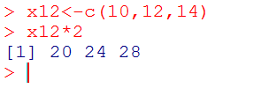
CREATING AND USING OBJECTS
An object can be assigned a set of numbers, as for example:
> x12 <- c(10,6,8)
> x12
[1] 10 6 8
Operations can then be performed on the whole set of numbers.
For example, for the object x12 created above, check the results of the following:
> x12 * 10
[1] 100 60 80

Slide 48
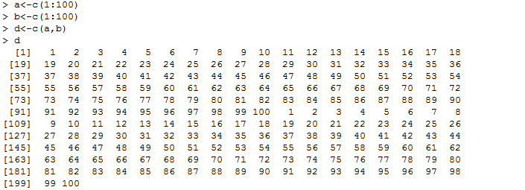
READING DATASETS
Using the c() command:
c() function is used to combine or concatenate two or more values. Here example shown is concatenating 2 numerical vectors.
Syntax for the c() command

Slide 49
HANDLING DATA IN R WORKSPACE
Handling Workspace includes following
Using the working directory
Inspecting the working environment
Modifying global options
Managing the library of packages

Slide 50
HANDLING DATA IN R WORKSPACE
Handling Workspace includes following
Using the working directory
The directory in which R is running is called the working directory of the R session.
When you access other files on your hard drive, you can use absolute paths (for example, D:\Workspaces\test-project\data\2015.csv)
In an R terminal, you can get the current working directory of the running R session using getwd()
Notes:
‹#›

Slide 51
.
INSPECTING THE ENVIRONMENT
In R, every expression is evaluated within a specific environment.
An environment is a collection of symbols and their bindings.
If you type commands in the RStudio console, your commands are evaluated in the Global Environment.
Example:
If we run x <- c(1, 2, 3), the numeric vector c(1, 2, 3) is bound to symbol x in the global environment.
Global environment has one binding that maps x to integer vector c(1,2,3)
Notes:
Global environment is the interactive workspace
The globalenv(), or global environment, is the interactive workspace. This is the environment in which you normally work. The parent of the global environment is the last package that you attached with library() or require().
The baseenv(), or base environment, is the environment of the base package. Its parent is the empty environment.
The emptyenv(), or empty environment, is the ultimate ancestor of all environments, and the only environment without a parent.
The environment() is the current environment
‹#›

Slide 52
HANDLING DATA IN R WORKSPACE
The ls() or objects() function is used to return the list of objects in the workspace
> ls()
[1] "a” "b” "bubba" "fun" "levels" "msg“
[7] "myobj" "n" "x12" "yourname“
The rm() function is used to remove the variables that are not required anymore in a session
> rm(a)
> ls()
[1] "b“ "bubba” "fun“ "levels” "msg” "myobj" "n"
[8] "x12" "yourname”

Slide 53
HANDLING DATA IN R WORKSPACE
getwd() function: Function used to display the current working directory of the user
> getwd()
[1] "C:/Users/Janaki/Documents“
save() function: Function used to save the objects created in the active session.
> save(x12, file=“Examples.rda")
It will save in the current working directory with the name “Examples.rda”
save.image() function
To save all the objects in the active session
save.image(file = "my_stuff.RData")
Notes:
save.image(file = ".RData", version = NULL, ascii = FALSE, compress = !ascii, safe = TRUE)
Rda is just a short name for RData. You can just save(), load(), attach(), etc. just like you do with RData.
Rds stores a single R object. Yet, beyond that simple explanation, there are several differences from a "standard" storage. Probably this R-manual Link to readRDS() function clarifies such distinctions sufficiently.
‹#›

Slide 54
HANDLING DATA IN R WORKSPACE
load() function : Function used to retrieve the saved data
yourname<-"mary“
> ls()
[1] "b” "fun” "levels” "msg” "myobj” "n” "x12” "yourname"
> save(yourname, file="yourname.rda")
> rm(yourname)
> ls()
[1] "b” "fun” "levels" "msg” "myobj” "n” "x12“
> load("yourname.rda") #.rda stands for R Data File.
> ls()
[1] "b” "fun” "levels” “msg” "myobj” "n” "x12” "yourname”

Slide 55
Executing R Scripts
Creating and Executing R script on Windows:
Open Notepad, and write R commands
Save it has “filename.R”
From the Rgui, file->Open script. It opens a window for browsing the Rscript
Click Open

Slide 56
EXECUTING R SCRIPTS
Creating and Executing R script on Linux:
R script is the series of commands written and saved in .R extension
To run a script “/home/bioinfo/janaki/R/use1.R”
You may either use:
From R Shell
source("/home/bioinfo/janaki/R/use1.R")
On the Linux Shell
R CMD BATCH /home/bioinfo/janaki/R/use1.R (OR)
Rscript use1.R

Slide 57
ACCESSING HELP AND DOCUMENTATION IN R
Function used to get help pages of the in-built functions are help() and example()
> help(“ls”) or ?ls()
> example(ls) – It shows the examples of ls function
find.package(“packagename”) – shows the path where package has been installed.
Sample datasets : R has many in-built datasets
> library(datasets)
> data()
> data(iris)
> summary(iris) – Summary of iris data
> summary(iris$Sepal.Length) – summary of one variable of iris data
Notes:
‹#›

Slide 58
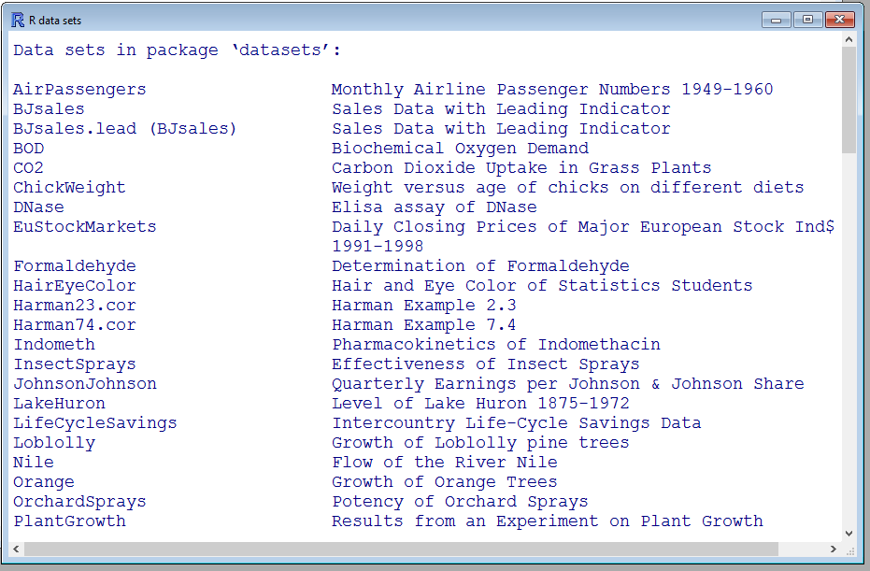
USING BUILT-IN DATASETS IN R
There many built-in data sets which can be viewed by data() command. The output is shown
>data() ##Generates the list of built-in datasets

Slide 59
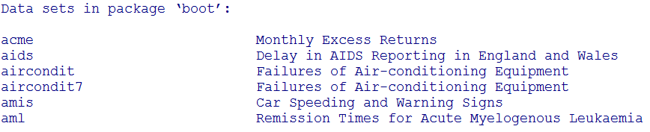
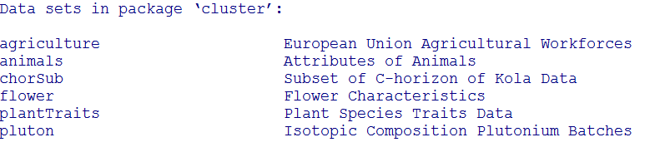
Using Built-in Datasets in R
There is a command for viewing all the data sets that are user-built or contributed packages.
data(package = .packages(all.available = TRUE))
data(package='boot')

Slide 60
DATA STRUCTURES IN R

Slide 61
DATA STRUCTURES IN R
Types of data structures in R
Vector : It is the structure that can contain one or more values of a single type or mixed (characters, integers)
It is represented as one dimensional data
Matrices : It is the 2-dimensional representation of data.
Arrays : It can be more than 2-dimensional representation of data.
Lists: A list is a generic vector that is allowed to include different types of objects.
Data Frames: It is the rectangular 2-dimensional representation of data
Notes:
So matrices are also a
stepping stone in order to get to
data frames, so let's dive straight into it.
‹#›

Slide 62
R VS PYTHON
 | R | Python
Datatypes | Character Integer Numeric Logical Complex Raw | Int float Long Complex and so on
Common datatype | Vector a<-c(4,5,1,3,4,5) print(a[3]) | List a=[4,5,1,3,4,5] # print(a[2])
Dataframes | Can be created directly Or use dplyr,reshape2 package for complex dataframes | Pandas package

Slide 63
DATA STRUCTURES IN R- INTEGER VECTORS
Following functions are used to create the integer vectors
c() : Combine (joining items end to end)
seq() : Sequence (Generating equidistant series of numbers)
rep() : Replicate (used to generate repeated values)
c() examples
> c(42,57,12,39,1,3,4)
[1] 42 57 12 39 1 3 4
You can also combine vectors of more than one element
> x <- c(1, 2, 3)
> y <- c(10, 20)
> Z <- c(x, y)
> Z
Notes:
‹#›

Slide 64
DATA STRUCTURES IN R- INTEGER VECTORS
seq(): It is used to generate the series of numbers which is of equidistant
It accepts three arguments
Start element
Stop element
Jump element
> seq(4,9)#It generates the numbers from 4 to 9, only 2 arguments are given
[1] 4 5 6 7 8 9
> seq(4,10,2) #Three arguments are given, jump by 2 elements
[1] 4 6 8 10
Notes:
> seq(4,9) [1] 4 5 6 7 8 9
‹#›

Slide 65
DATA STRUCTURES IN R- INTEGER VECTORS
seq() vector creation is used in plotting the x and y axis in the graphical analysis.
For example:
If x-axis co-ordinates are being created as
c(1.65,1.70,1.75,1.80,1.85,1.90)
Then simply using following command, can create the same
Syntax :
seq(1.65,1.90,0.05)
> 4:9 #exactly the same as seq(4,9)
[1] 4 5 6 7 8 9
seq(from, to, by)

Slide 66
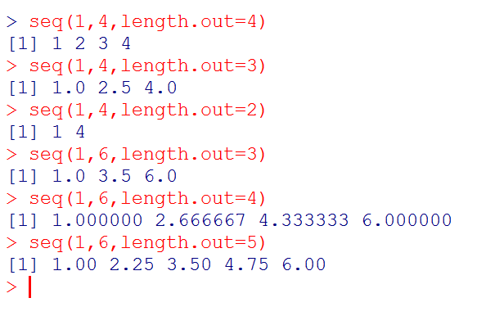
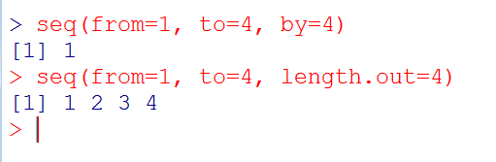
DATA STRUCTURES IN R- INTEGER VECTORS
Another Example of seq() command, Here we are adding length.out argument for the seq() command
from = “Starting Element”
to = “Ending Element”
by = ((to - from)/(length.out - 1))
From = 1, to = 4
By = 4-1/4-1= 3/3 = 1
Seq(1,4,1)
Notes:
‹#›

Slide 67
DATA STRUCTURES IN R- INTEGER VECTORS
rep(), is used to generate repeated values.
> rep(‘’Janaki", 4)
It is used in two variants, depending on whether the second argument is a vector or a single number
> oops <- c(7,9,13)
> rep(oops,3) # It repeats the entire vector oops 3 times
[1] 7 9 13 7 9 13 7 9 13
> rep(oops,1:3)
[1] 7 9 9 13 13 13
Here, oops should be repeated by vector of 1:3 values.
Indicating that 7 should be repeated once, 9 twice, and 13 three times

Slide 68
DATA STRUCTURES IN R- INTEGER VECTORS
Look at following examples
> rep(oops,1:4)
Error in rep(oops, 1:4) : invalid 'times' argument
> rep(1:2,c(10,15))
[1] 1 1 1 1 1 1 1 1 1 1 2 2 2 2 2 2 2 2 2 2 2 2 2 2 2
> rep(1:2,each=10)
[1] 1 1 1 1 1 1 1 1 1 1 2 2 2 2 2 2 2 2 2 2
> rep(1:2,c(10,10)
[1] 1 1 1 1 1 1 1 1 1 1 2 2 2 2 2 2 2 2 2 2
> rep(1:2,c(10,2)
Notes:
‹#›

Slide 69
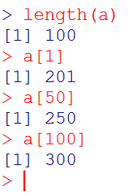
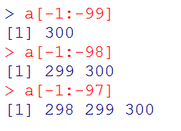
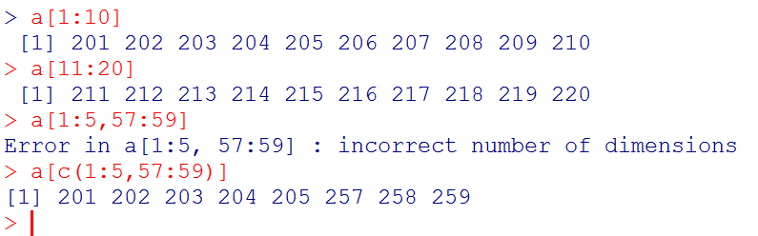
DATA STRUCTURES IN R- INTEGER VECTORS
Integer vectors : Indexing
Notes:
a[-1:-100] integer(0)
Out of index bound error in python
> a[1:-99] Error in a[1:-99] : only 0's may be mixed with negative subscripts
‹#›

Slide 70
DATA STRUCTURES IN R- CHARACTER VECTORS
Character Vector: A character vector is a vector of text strings, whose elements are specified and printed in quotes
> c("Huey","Dewey","Louie")
[1] "Huey" "Dewey" "Louie“
Single quotes or Double quotes can be used for strings
> c(’Huey’,’Dewey’,’Louie’)
[1] "Huey" "Dewey" "Louie“
"Huey", it is a string of four characters, not six.
The quotes are not actually part of the string, they are just there so that the system can tell the difference between a string and a variable name.
Notes:
‹#›

Slide 71
DATA STRUCTURES IN R- CHARACTER VECTORS
If you print a character vector, it usually comes out with quotes added to each element. There is a way to avoid this, namely to use the cat() function.
For instance,
> cat(c("Huey","Dewey","Louie"))
Huey Dewey Louie

Slide 72
ESCAPE SEQUENCES
Quoting and escape sequences
If the strings itself contains some quotations, new line characters.
This is done using escape sequences
Here, \n is an example of an escape sequence.
The backslash (\) is known as the escape character
If you want to insert quotes with in the string, the \” is used. For example
> cat("What is \"R\"?\n")
What is "R"?

Slide 73
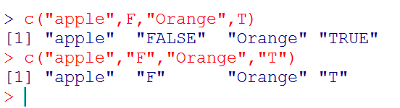
DATA STRUCTURES IN R- CHARACTER VECTORS
Logical vectors can take the value TRUE or FALSE
In input, you may use the convenient abbreviations T and F
>
[1] TRUE TRUE FALSE TRUE

Slide 74
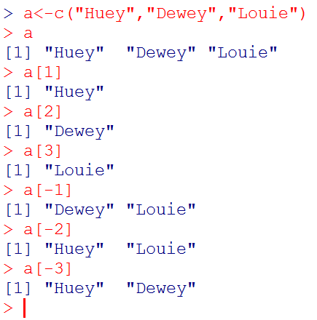
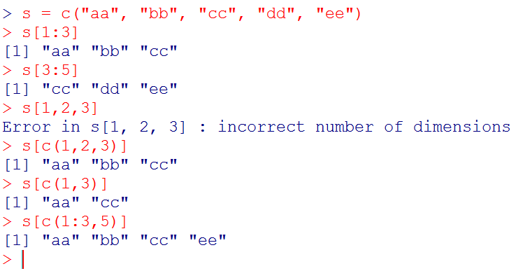
DATA STRUCTURES IN R- CHARACTER VECTORS
Example of Character Vector: Indexing

Slide 75
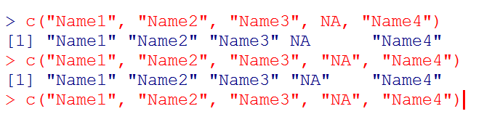
DATA STRUCTURES IN R- CHARACTER VECTORS
Missing values
In many data sets, you may find missing values.
We need to have some method to deal with the missing values
R allows vectors to contain a special NA value.
Result of computations done on NA will be NA

Slide 76
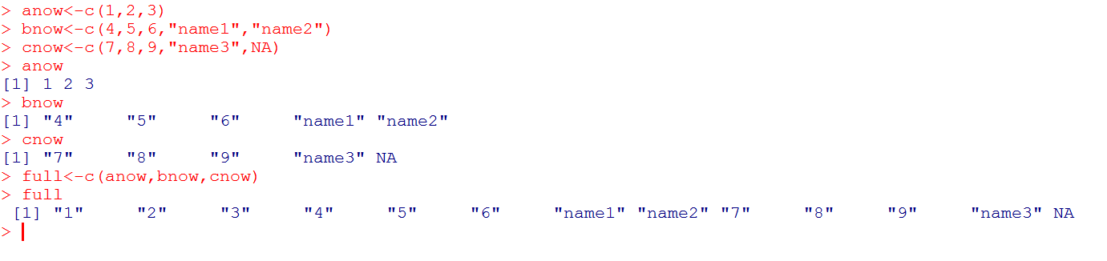
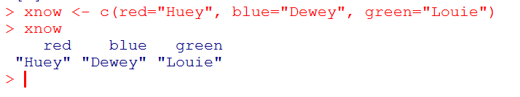
DATA STRUCTURES IN R- COMBINATION OF INT AND CHAR
Example of c()
It is also possible to assign names to the elements
Notes:
‹#›

Slide 77
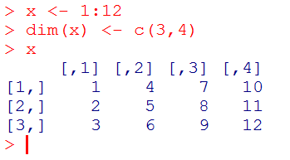
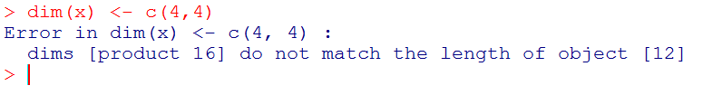
DATA STRUCTURES IN R- MATRIX
Matrix: It is two-dimensional representation of numbers.
Matrices and arrays are represented as vectors with dimensions
> x <- 1:12
> dim(x) <- c(3,4) #The dim assignment function sets or changes the dimension attribute of x, causing R to treat the vector of 12 numbers as a 3 × 4 matrix

Slide 78
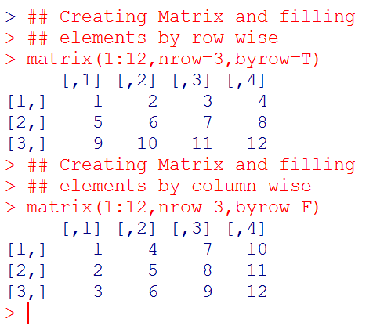
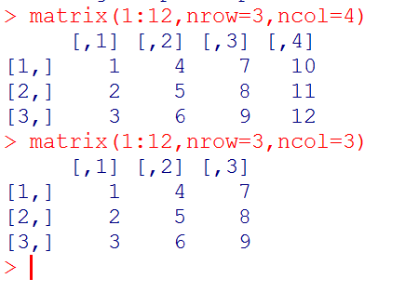
DATA STRUCTURES IN R- MATRIX
Another way to create Matrix is simply by using matrix() function
Syntax
matrix(data = NA, nrow = 1, ncol = 1, byrow = FALSE)
Notes:
‹#›

Slide 79
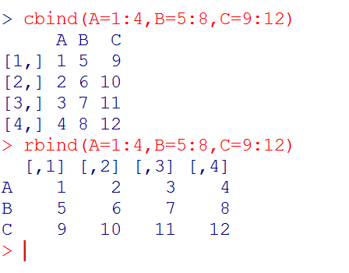
DATA STRUCTURES IN R- MATRIX
You can “glue” vectors together, columnwise or rowwise, using the cbind and rbind functions.
The cbind() : Column bind
The rbind() : Row bind
Arrays are similar to matrices but can have more than two dimensions. See help(array) for details
Notes:
‹#›

Slide 80
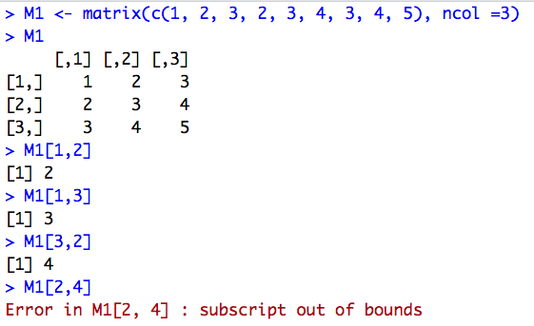
DATA STRUCTURES IN R- MATRIX
Subsetting a matrix
We can extract the elements from the matrix – Matrix Subsetting.
Since it is a two- dimensional representation of numbers, we can access it with two-dimensional accessor
[ , ]
Example
mat1<- cbind(1:12, 13:24, 25:36)
mat1
mat1[3 , 3]
mat1[8 , 3]

Slide 81
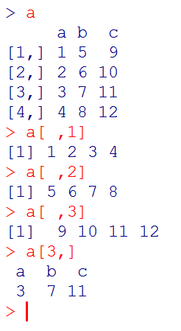
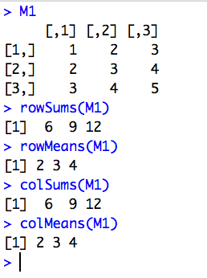
DATA STRUCTURES IN R- MATRIX
Matrix Operations
Addition
Substraction
Exp
Element-wise *
Mat Mult %*%
rowsums()
rowmeans()
colsums()
colmeans()
t()

Slide 82
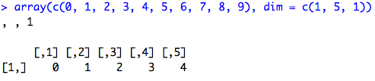
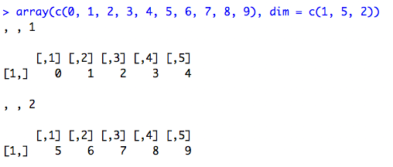
DATA STRUCTURES IN R - ARRAYS
Arrays
It is a vector that is represented and accessible in a given number of dimensions (mostly more than two dimensions).

Slide 83
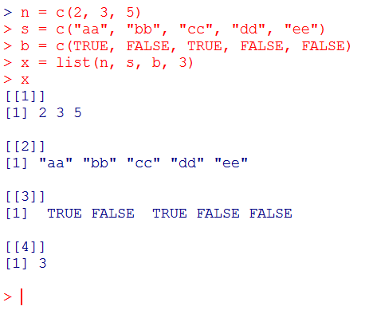
DATA STRUCTURES IN R-LISTS
Lists: It is the collection of objects that fall under similar category.
A list is not fixed in length and can contain other lists.

Slide 84
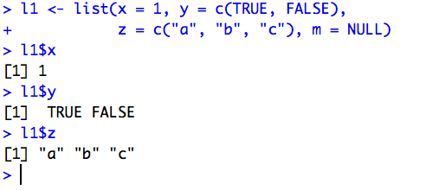
DATA STRUCTURES IN R – ACCESSING LISTS
There are various ways to access the elements of a list.
The most common way is to use a dollar-sign $ to extract the value of a list element by name

Slide 85
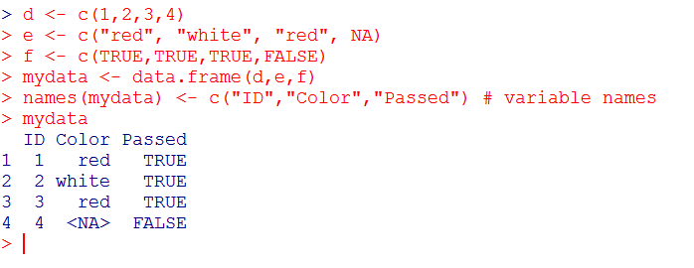
DATA STRUCTURES IN R-DATA FRAMES
Data Frame is also 2-dimensional object just like Matrix, for storing data tables.
Here, different columns can have different modes (numeric, character, factor, etc).
All data frames are rectangular and R will remove out any ‘short’ object using NA
Creating Data Frame

Slide 86
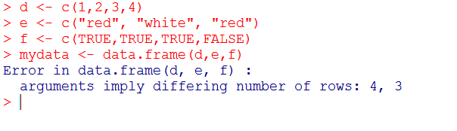
DATA STRUCTURES IN R-DATA FRAMES
Error: Here, in the second vector ‘e’ , is a 3 element vector and ‘d’ and ‘f’ are 4 element vectors.
It is a collection of vectors (Integer/Character) of equal lengths
Each column in the Data Frame can be a separate type of data. In the previous example ‘mydata’ data frame, it is the combination of numerical, character and logical data types.

Slide 87
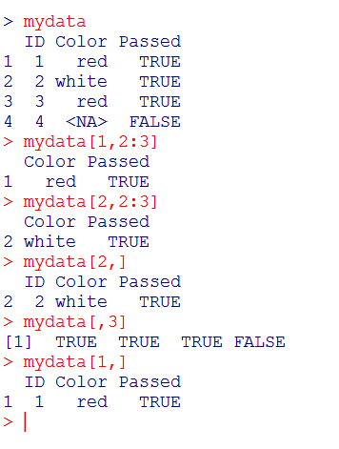
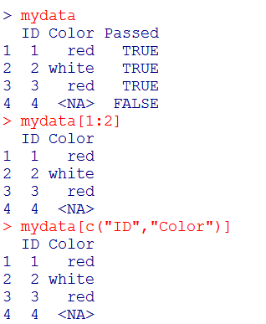
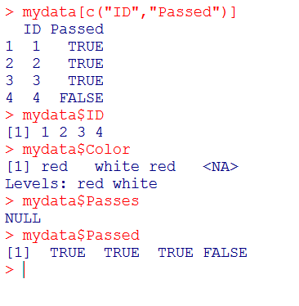
ACCESSING DATA FRAMES
There are a variety of ways to access the elements of a data frame. Here are few screenshots.

Slide 88
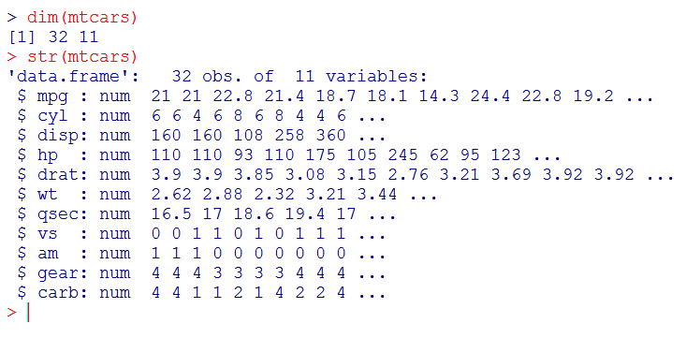
BUILD-IN DATA FRAMES IN R
R has some build-in datasets. ‘mtcars’ is one datasets

Slide 89
CREATING DATA SUBSETS
R deals with huge data, not all of which is useful.
Therefore, first step is to sort out the data containing the relevant information.
Extracted data sets are further divided into small subsets of data.
Function used for extracting the data is subset().
The following operations are used for subset the data.
$ (Dollar) : Used to select the single element of the data.
[ ] (Single Square Brackets) : Used to extract multiple elements of data.

Slide 90
CREATING DATA SUBSETS
We can extract (subset) the part of the data table based on some condition using subset() function
Syntax
Example
subset(dataset, function)
## Age.At.Death Age.As.Writer Name Surname Gender Death
## 1 22 16 Jane Doe FEMALE 2015-05-10
## 4 41 36 Jane Austen FEMALE 1817-07-18
writer_names_df <- subset(writers_df, Age.At.Death <= 40 & Age.As.Writer >= 18)
writer_names_df <- subset(writers_df, Name =="Jane")
writers_df[1,3] <- NULL #making null value

Slide 91
CREATING SUBSETS IN VECTORS
To create subsets in vectors, subset() or [] can be used
## A simple vector
v<-c(1,5,6,4,2,4,2)
#Using subset function
subset(v,v<4)
#Using square brackets
v[v<4]
#Another vector
t<-c(“one”, “one”, “two”, “three”, “four”, “two”)
# Remove “one” entries
subset(t, t!=“one”)
t[t!=“one”]
Creates the subset of numbers greater than 4 using subset() function
Creates the subset of numbers greater than 4 using [] brackets
Creates the subset of texts after removing the word, “one” using subset() function
Creates the subset of texts after removing the word, “one” using [] function

Slide 92
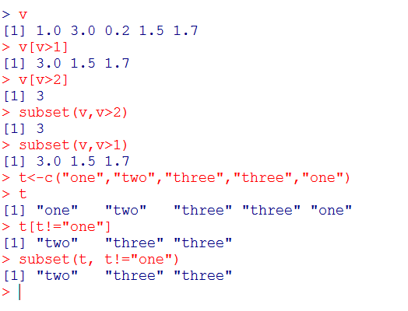
CREATING SUBSETS IN VECTORS
Execution of code on R console

Slide 93
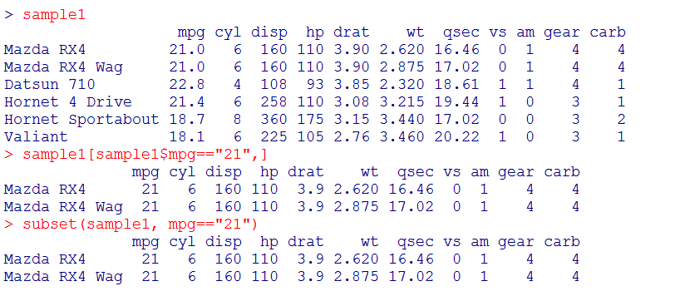
CREATING SUBSETS IN DATA FRAMES
Data Frames subsets can also be done using subset() and [] function

Slide 94
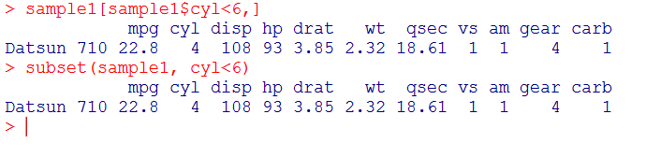
CREATING SUBSETS IN DATA FRAMES
Data Frames subsets can also be done using subset() and [] function

Slide 95
IMPORT READ AND EXPORT DATA

Slide 96
READING AND GETTING DATA INTO R
Most often, you will have to deal with large sets of data which are in the form of CSV or TSV formats.
To perform analysis on such files, you have to import/get that data into R console.
Commands to be discussed
c() : Used to combine or concatenate data
scan() : Used to read large datasets and retrieve data from CSV files.
read.csv(), read.table(), write.csv(), write.table() : Used to read and write from csv files and tables respectively

Slide 97
READING AND COMBINING NUMERICAL DATA

Slide 98
USING THE C() COMMAND
The c() command is used to concatenate or combine two or more values.
Syntax
Reading and Combining Numerical Data
### sampleitem1, sampleitem2, sampleitem3 are combined
c(sampleitem1, sampleitem2, sampleitem3)
## putting all combined values into new object
CombinedResult<-c(sampleitem1, sampleitem2, sampleitem3)
### Entering the numeric values using the c() command
Result = c(678,876,566,655,74,456,6543,56,45,675,7467,567,868)
### To print the result
Result

Slide 99
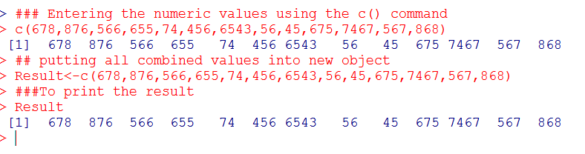
USING THE C() COMMAND
Executing on R
Here, we have passed numerical values within the parentheses of c() command with comma separation.
The values are stored in the new object called “Result” and to print the values on the R, we are entering the name of the object

Slide 100
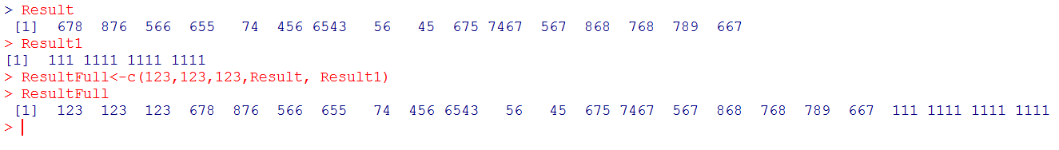
USING THE C() COMMAND
Incorporating existing data objects with the new values.
Here, we are adding some values (123,123,123) to the existing values that are stored in objects Result and Result1

Slide 101
READING AND COMBINING TEXT DATA

Slide 102
USING THE C() COMMAND
The text data is entered using quotes.
There is no difference between the single and double quotes as R converts all the quotes to double quotes.
You can use either single or double or combination of quotes as shown in the syntax.
Syntax
c(‘sampleitem1’, ‘sampleitem2’, ‘sampleitem3’)
c(“sampleitem1”, “sampleitem2”, “sampleitem3”)
c(“sampleitem1”, ‘sampleitem2’, ‘sampleitem3’)

Slide 103
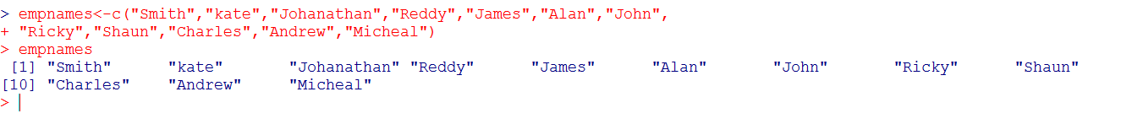
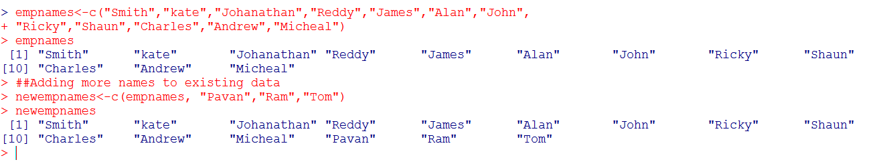
COMBINING AND READING TEXT DATA
Reading test data on R console
Adding more data to the existing data

Slide 104
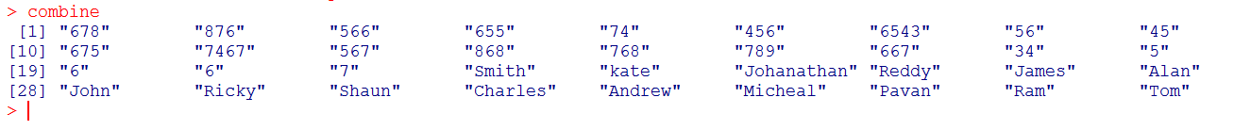
READING NUMERIC AND TEXT IN R
When text and numbers are combined, the entire data object becomes a text variable and the numbers are also converted to text.
Reading both text and numeric data in R
combine<-c(ResultFull,newempnames)
Note: Here, numeric data is shown in the double quotes like that of text data.

Slide 105
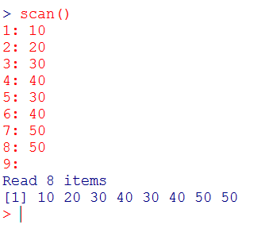
USING THE SCAN() COMMAND
The c() command is used only for reading and combining of small data. But this can be tedious when lot of typing is involved.
In c() command, all the values are separated by , (comma) to make a data object.
The same can be done with out using commas through the scan() command.
After entering the scan() command and press ENTER, console will be waiting for the desired data.
User can type the data and DOUBLE press ENTER, your data is shown on the console
Notes:
Scan takes only integer values and not variable names
‹#›

Slide 106
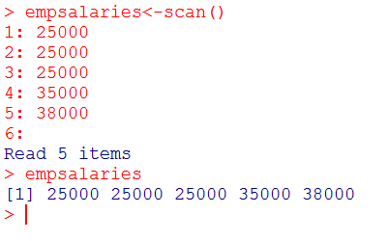
USING THE SCAN() COMMAND- READING
Reading the numeric values using the scan() command.
After entering the empsalaries<-scan() command and press ENTER, console will be waiting for the desired data.
User can type the data and DOUBLE press ENTER, your data is shown on the console
To view the stored values, object name “empsalaries” is typed

Slide 107
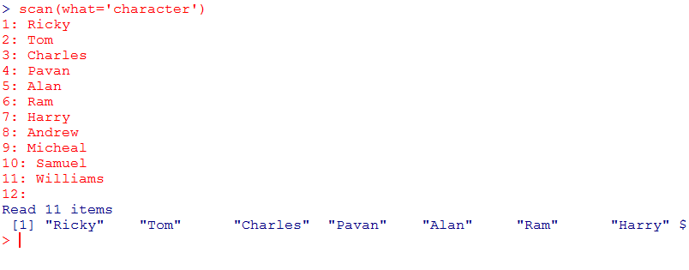
USING THE SCAN() COMMAND- READING
Reading the text data using scan() command
Syntax here depicts that user is specifying that the data that has to be entered will be characters and not numbers.

Slide 108
READING THE DATA OF A FILE FROM DISK
Using the scan() command, you can also read the data from files.
The scan() command can read data in a vector or list from the console or file.
To read a file using scan() command, add file=`filename` to the command as shown
Now, the contents of sample.txt file is stored in readdata object.
File name should be enclosed with in the quotation marks
## Reading data from the file called sample.txt
readdata<-scan(file=‘sample.txt’)
Notes:
Error in scan() scan() expected 'a real', got
Scan requires that you specify the contents of the data; by default it assumes that you are just reading in numbers (which you aren't).
‹#›

Slide 109



READING THE DATA OF A FILE FROM DISK
On execution of the command, R will look for the sample.txt file in the current working directory.
To know the current working directory and to change the directory, use following commands

Slide 110

READING THE DATA OF A FILE FROM DISK
Using scan() command for reading from file
The scan() command has an option of choosing the file by browsing the file system
scan(file.choose())
Note: scan(file.choose()) function will not work in Linux OS
Notes:
‹#›

Slide 111
USING THE READ.CSV() COMMAND
Reading from CSV files, read.csv() command is used.
The command read.csv() reads entire CSV file and display the contents on the R console.
Syntax
file: to specify the file name
sep: to provide the separator
header: to specify whether or not the first row of CSV file should be set as column names. Default is TRUE
read.csv(file, header = TRUE, sep = “,”)
Notes:
[ reached 'max' / getOption("max.print") -- omitted 5317 rows ]
‹#›

Slide 112


USING THE READ.CSV() COMMAND
Before executing the read.csv() command, file is read and saved in appropriate format CSV/XLS or TSV format
Notes:
read.csv is a fairly thin wrapper around read.table; I would be quite surprised if you couldn't exactly replicate the behaviour of read.csv by supplying the correct arguments to read.table. However, some of those arguments (such as the way that quotation marks or comment characters are handled) could well change the speed and behaviour of the function.
In particular, this is the full definition of read.csv:
function (file, header = TRUE, sep = ",", quote = "\"", dec = ".", fill = TRUE, comment.char = "", ...) { read.table(file = file, header = header, sep = sep, quote = quote, dec = dec, fill = fill, comment.char = comment.char, ...) } so as stated it's just read.table with a particular set of options.
As @Chase states in the comments below, the help page for read.table() says just as much under Details:
read.csv and read.csv2 are identical to read.table except for the defaults. They are intended for reading ‘comma separated value’ files (‘.csv’) or (read.csv2) the variant used in countries that use a comma as decimal point and a semicolon as field separator.
‹#›

Slide 113
IMPORTING DATA FROM FWF
Reading data from FWF (fixed width format) in to a dataframe.
To read data from fwf, we have read.fwf() function in R
You use this function when your data file has columns containing spaces, or columns with no spaces to separate them.
Syntax :
Example
read.fwf(file, width=“”,col.names=“”)
read.fw(“fwf.txt", widths=c(4,-13,1,-2,2),col.names=c("Subject","Gender","Marks"))
Notes:
https://www.rdocumentation.org/packages/utils/versions/3.6.2/topics/read.fwf
‹#›

Slide 114
IMPORTING EXCEL SPREADSHEETS INTO R
From the base R, you will not able to import Excel file directly.
Package to be installed is xlsx, openxlsx package.
Reading Excel Spreadsheets into R From The Clipboard
Functions used in R are read.table(file=“File_Name”)
You can convert Excel file to CSV file and import in R using read.csv()
Notes:
Xlsx did not work in 32-bit system
‹#›

Slide 115

IMPORTING JSON (IN JAVASCRIPT OBJECT NOTATION ) FILES INTO R
Package used for importing json files into R is rjson.
Library need to load is jsonlite
Function used is fromJSON
Three procedures under fromJSON() :
simplifyVector, simplifyDataFrame and simplifyMatrix
install.packages(“rjson”)
library(rjson)
Notes:
A JSON file is a file that stores simple data structures and objects in JavaScript Object Notation (JSON) format, which is a standard data interchange format. It is primarily used for transmitting data between a web application and a server.
‹#›

Slide 116


IMPORTING JSON FILES INTO R
Simple commands

Slide 117
IMPORTING DATA FROM DATABASES INTO R
Packages used for importing from various databases
MonetDB.R
Rmongodb
RMySQL,
Mongolite
Rmongo
RODBC
Roracle
RPostgreSQL
RSQLite
RJDBC

Slide 118

IMPORTING DATA FROM MYSQL INTO R
Packages and library needed
MySQL Connection
Retrieving data
install.packages("RMySQL")
library(RMySQL)
con = dbConnect(MySQL(),user="training", password="training123", dbname="trainingDB", host="localhost")
myQuery <- "select pclass, survived, avg(age) from titanic where survived=1 group by pclass;“
dbGetQuery(con, myQuery)
http://www.unomaha.edu/mahbubulmajumder/data-science/fall-2014/lectures/20-database-mysql/20-database-mysql.html#/1

Slide 119

IMPORTING LARGE DATA SETS INTO R
Package used in data.table
Function is fread()
Example :
library(data.table)
data <- fread(“textfile.txt”)

Slide 120
EXPORTING DATA FROM R
After undergoing any computations in R, the data now needs to be used in reports or various other sources.
Therefore, you need to extract data from R.
To export data from R, we use write.csv() and write.table() functions.

Slide 121


USING THE WRITE.TABLE() AND WRITE.CSV() COMMAND
The write.table() command is used to write the data stored in a vector to a file.
The data is saved using the delimiters such as spaces or tabs as shown.
Here, in the below screenshots, we are saving the ‘births’ object to the BIRTHS.csv and BIRTHS.txt in the D drive local system

Slide 122
THANK YOU!!!!!
Notes:
1. create a data frame
check the null values
1. is.na(family)
load one dataset of your choice
check the summary of the dataset
‹#›

