Slide 1
Protein Mass Spectroscopy

Slide 2
Agenda
Introduction
Protein Mass Spectrum Dataset
Exploring the Dataset (Cleaning, creating data frame)
Exploratory Data Analysis
Machine Learning Models
Results
Conclusion
Reference

Slide 3
Introduction
Protein Mass Spectroscopy
Predicting variables charge and intensity
Provide the summary table and accuracy
Provide a comparison between the two model

Slide 4
Dataset
6 excel files.
Each files contains multiple sheets named after
different proteins.
Merging all the files into a single big file.
Split the whole file into 2 Data frame
Cleaning.

Slide 5
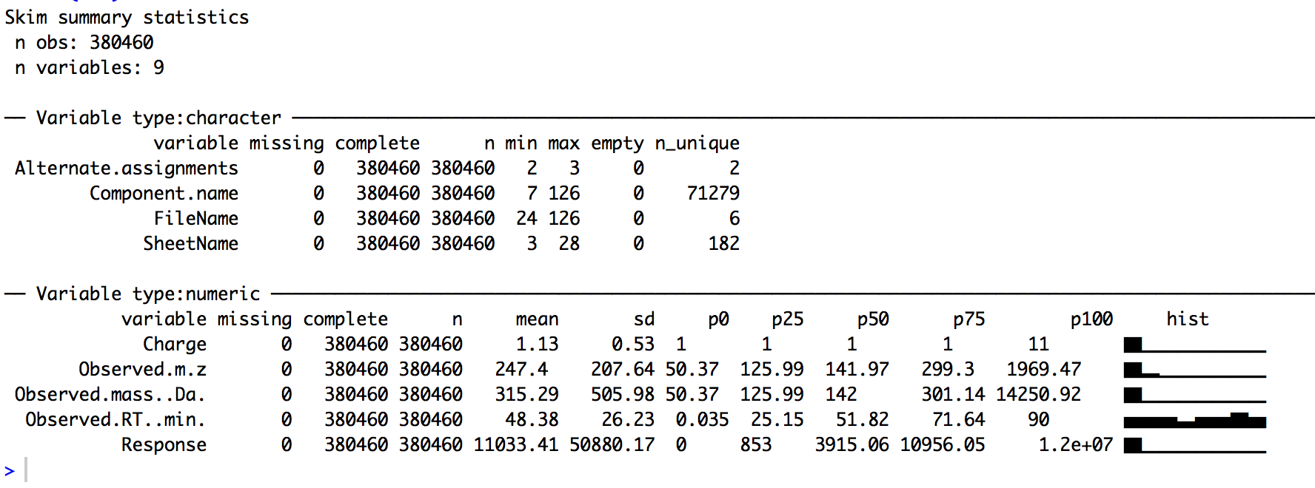
Summary for Data frame containing 0.38 million data.

Slide 6
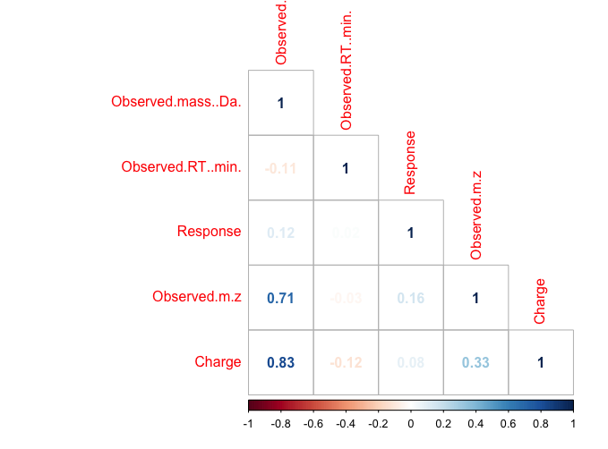
Correlation Plot for correlating variable Charge.

Slide 7
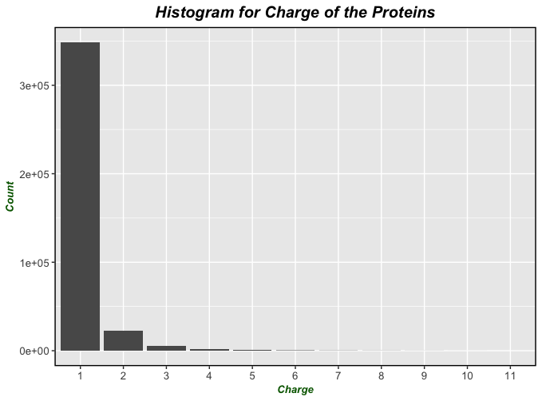
Histogram for showing distribution of charge.

Slide 8
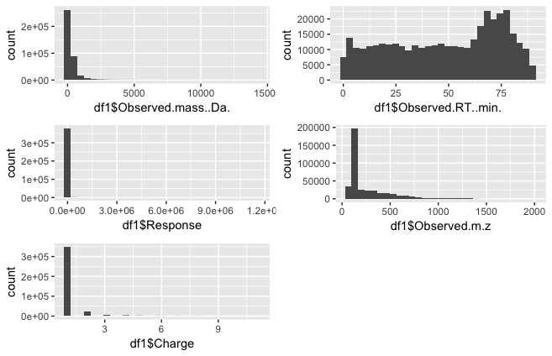
Frequency Plot

Slide 9
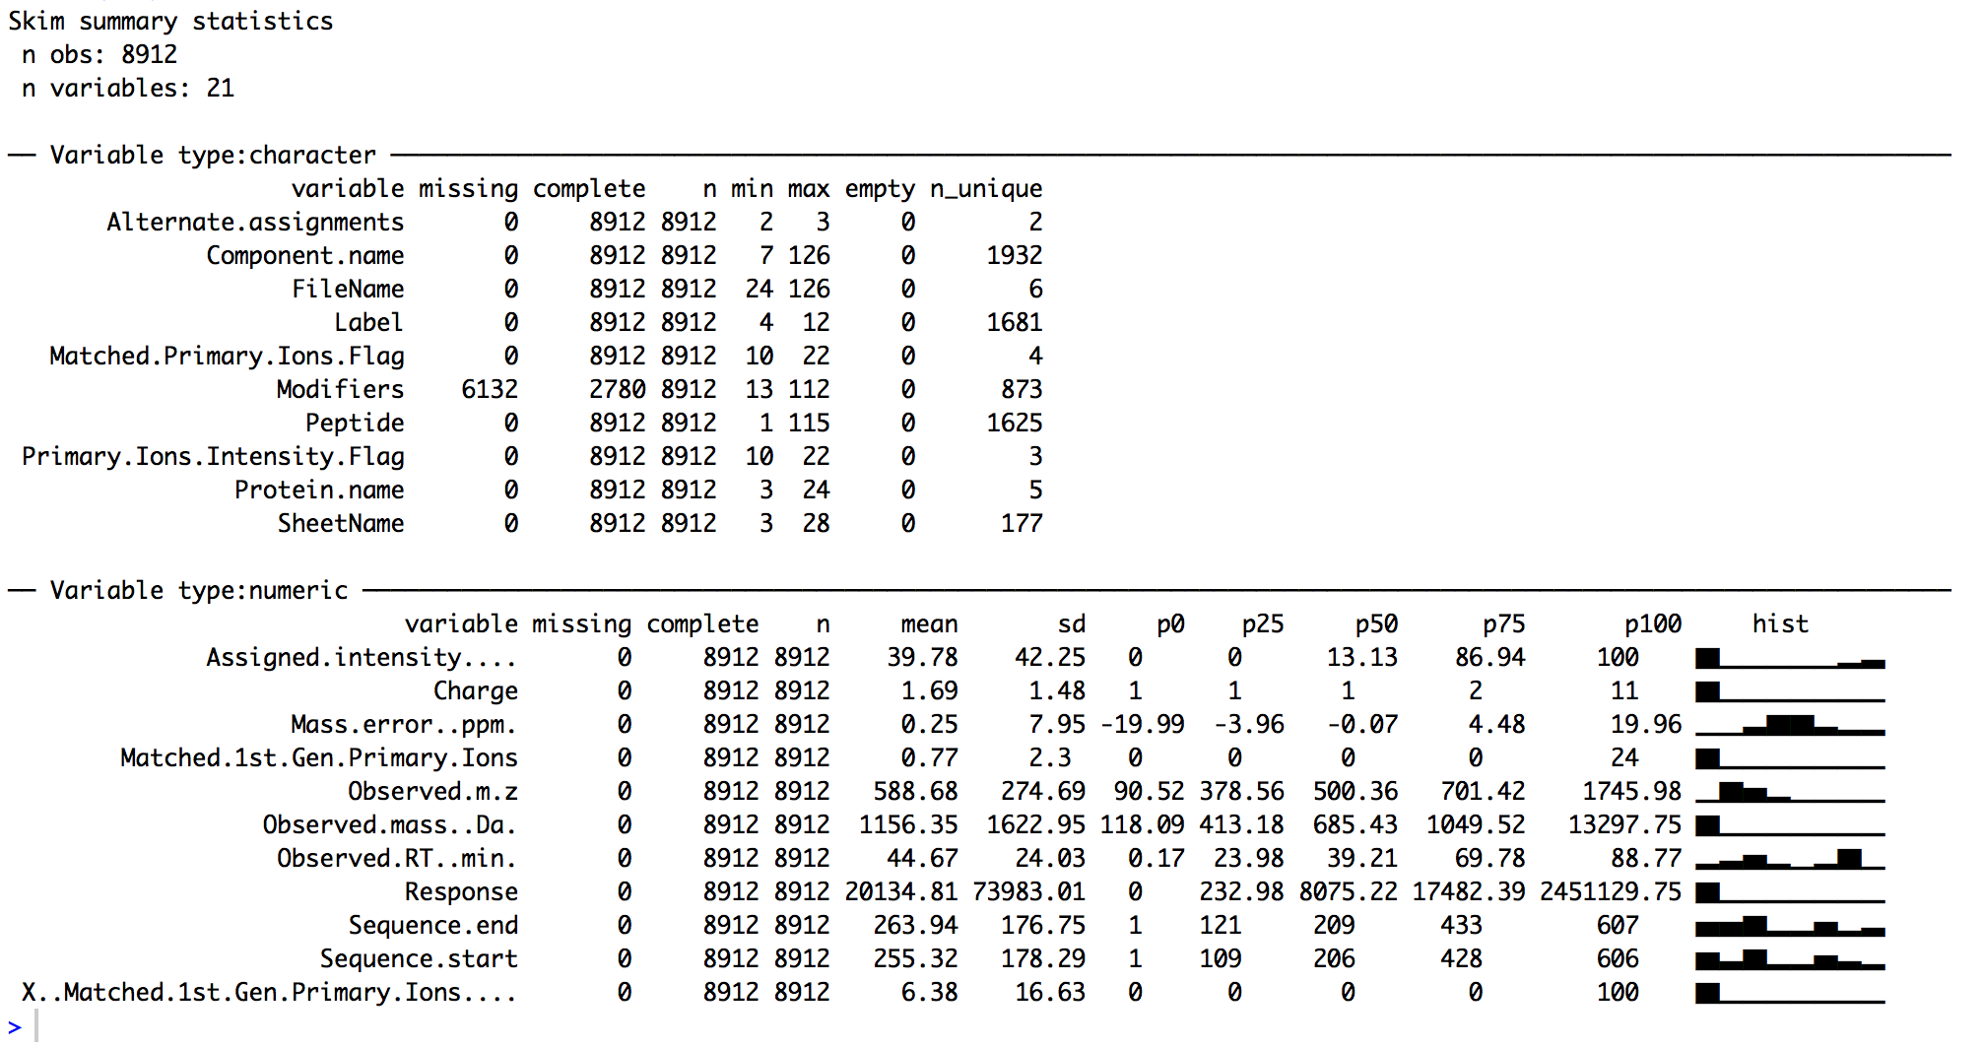
Summary for Data frame containing 8 K data.

Slide 10
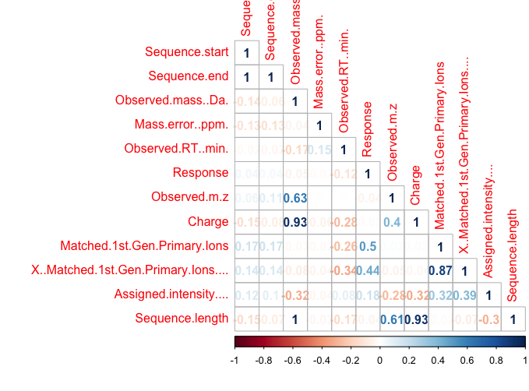
Correlation Plot for correlating variable Intensity

Slide 11
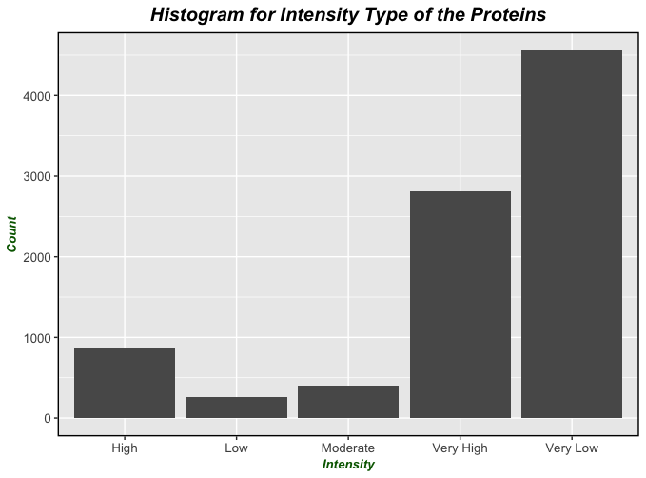
Histogram for showing distribution of Intensity

Slide 12
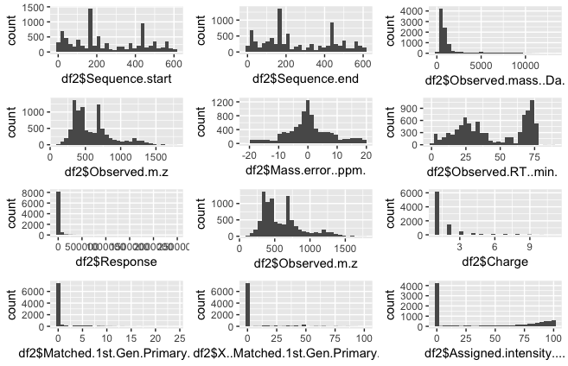
Frequency Plot

Slide 13
Machine Learning Model
Random Forest
Decision Tree

Slide 14
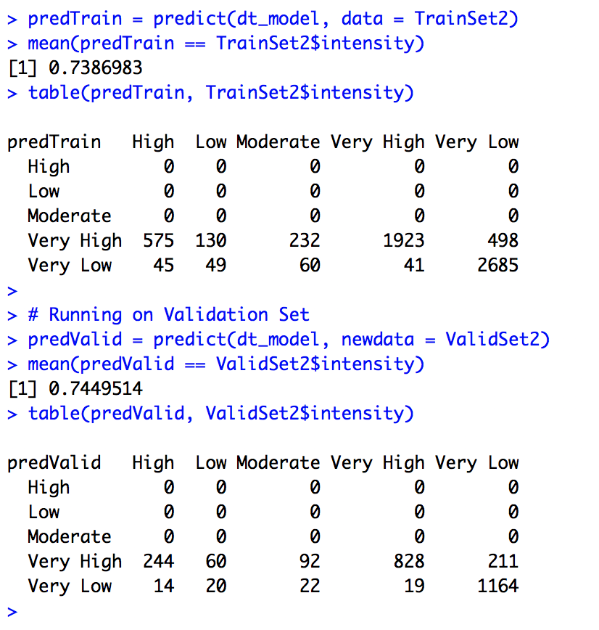
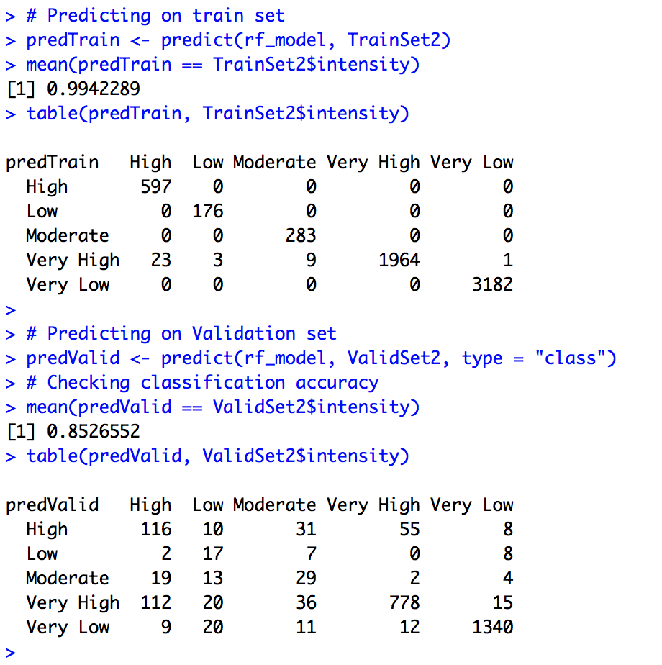
Data frame which consist of 19 columns and 8 thousand data and predicting variable “Intensity”.

Slide 15
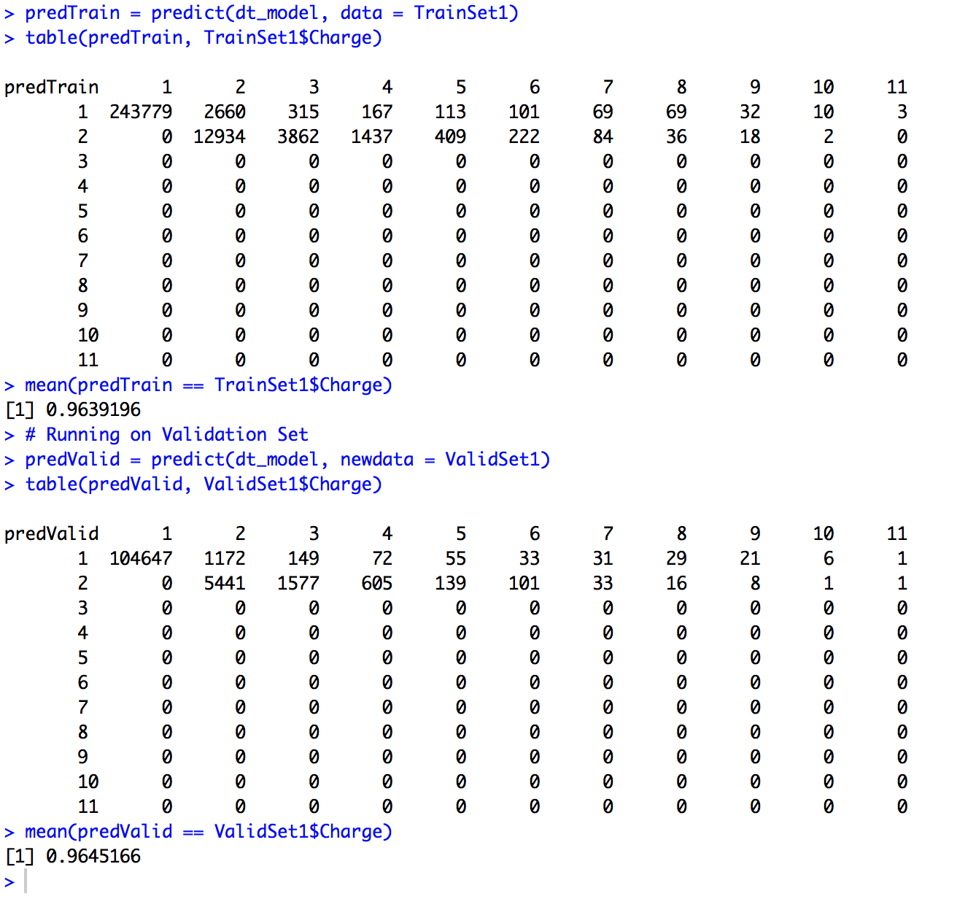
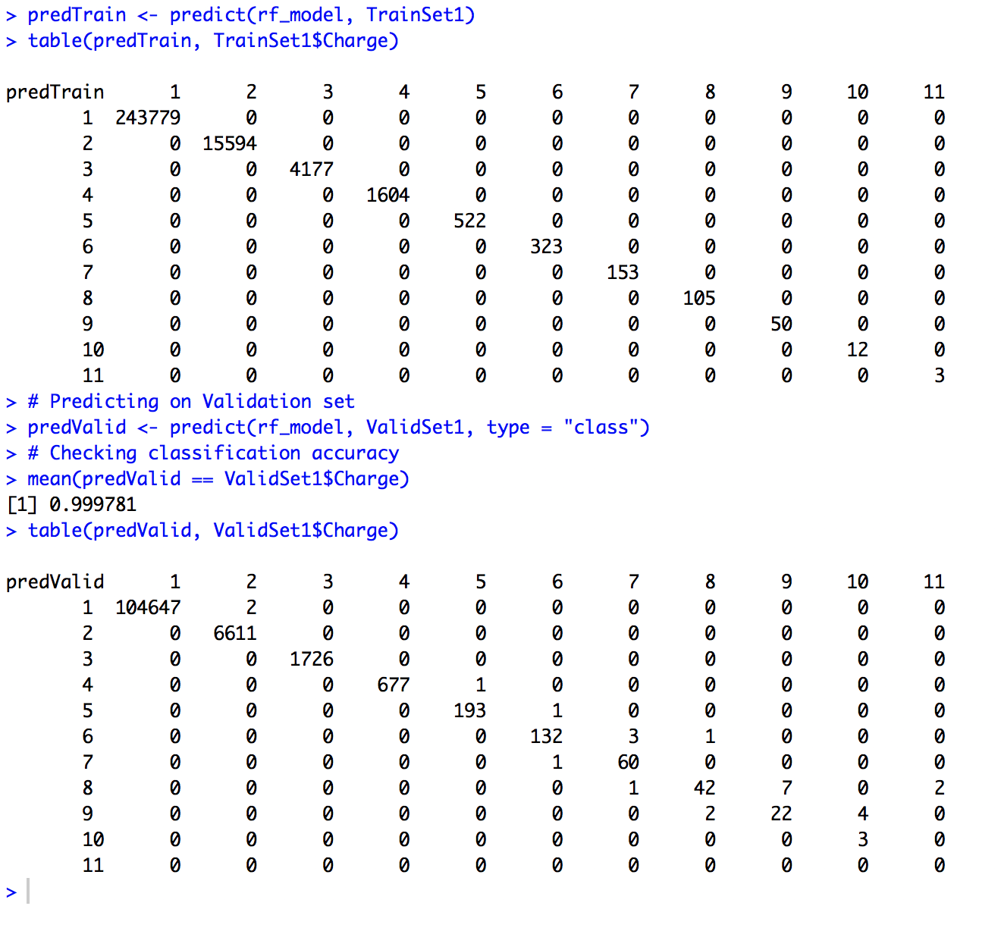
Data frame which consist of nearly 0.38 million data and 7 columns and we are predicting variable “Charge”

Slide 16
Conclusion
From the conclusion we can see that for both the data frame whether we are predicting charge or intensity we are getting better accuracy using Random Forest model.

Slide 17
Reference:
https://pubs.acs.org/doi/abs/10.1021/ac401245r
http://paolaelefante.com/2016/03/random-forest-part1/
Mass-to-charge ratio. Retrieved from https://www.sciencedirect.com/topics/biochemistry-genetics-and-molecular-biology/mass-to-charge-ratio

