Slide 1
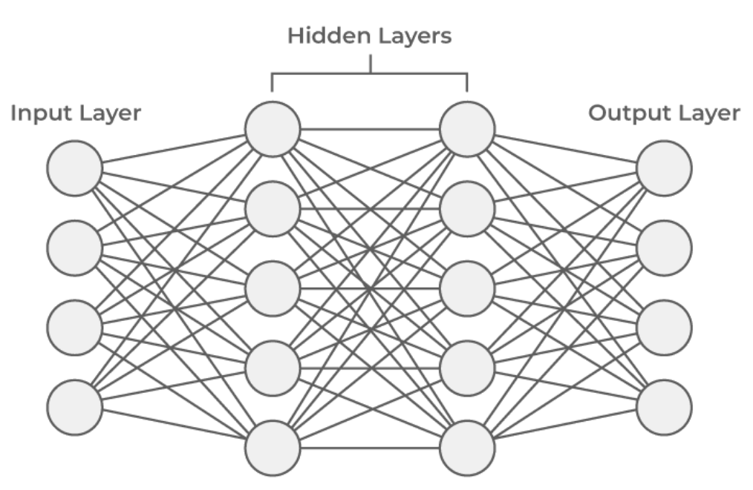









$$δ_{1}^{L+1}$$
$$W_{i, 1}^{L}$$
$$δ_{i}^{L}$$
$$δ_{2}^{L+1}$$
$$W_{i, 2}^{L}$$
$$δ_{3}^{L+1}$$
$$W_{i, 3}^{L}$$
$$δ_{4}^{L+1}$$
$$W_{i, 4}^{L}$$

