Slide 1
SSPQuadUP
τ
γ
Displacement DOF
Pore pressure DOF
Integration point

Slide 2
SSPQuad
τ
γ
Displacement DOF
Integration point

Slide 3
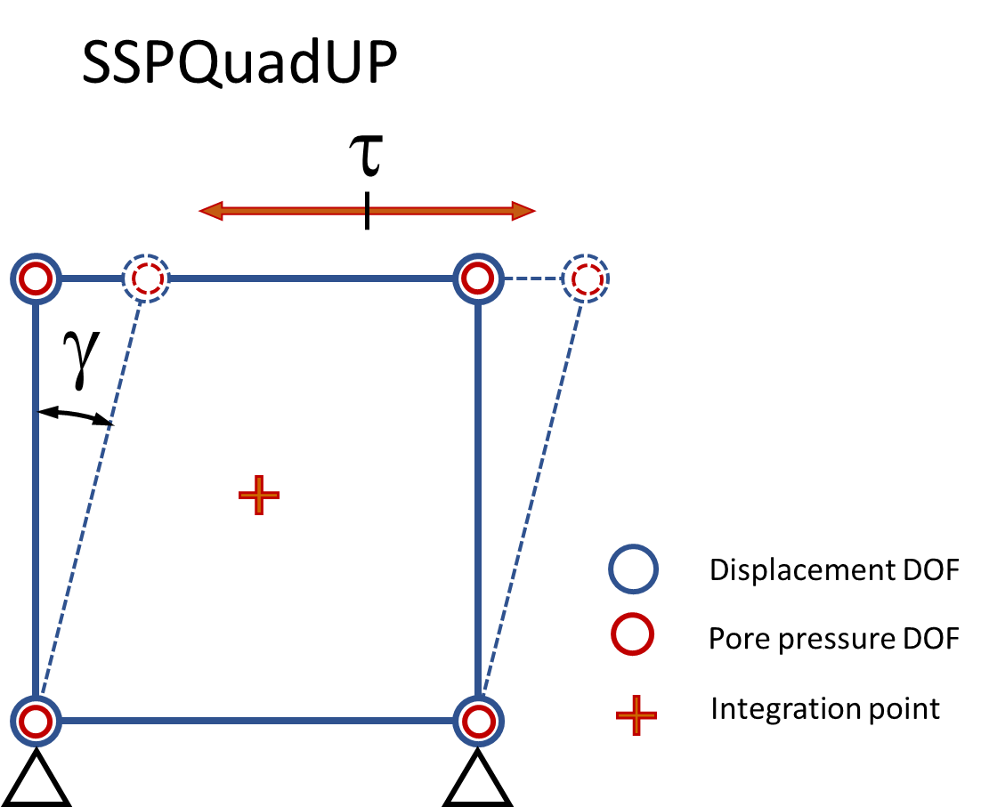
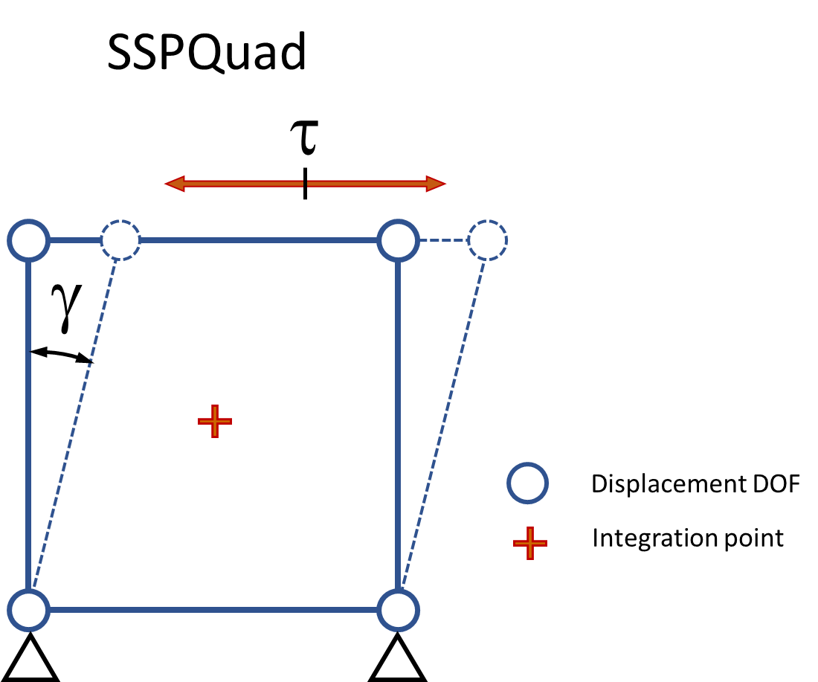
(a)
(b)
stress-control test using undrained element and imposing forces to achieve selected shear stress
stress-control test using drained element and constraining displacements to impose volume constraint and to achieve selected shear stress.

Slide 4
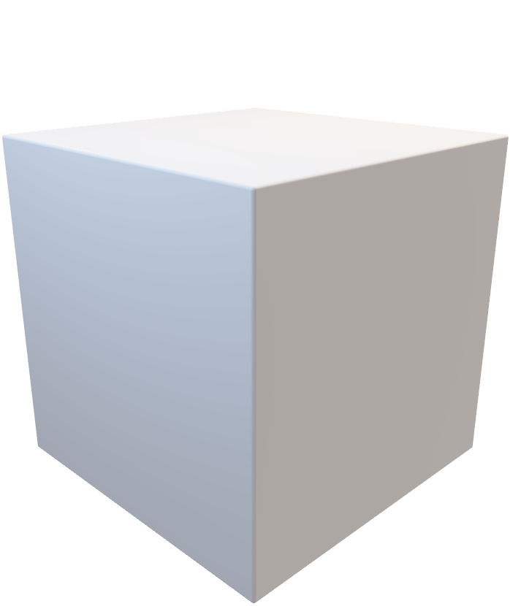
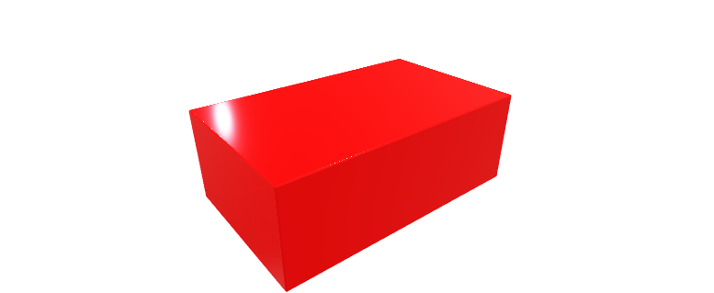

Slide 5
SSPQuad
σ_{yy}
Displacement DOF
τ_{xy}
Integration point
τ_{yx}
σ_{xx}
y
x

Slide 6
σ_{yy}
τ_{xy}
τ_{yx}
σ_{xx}
y
σ_{xx}
τ_{yx}
x
τ_{xy}
σ_{yy}
Displacement DOF
Integration point

