Slide 1
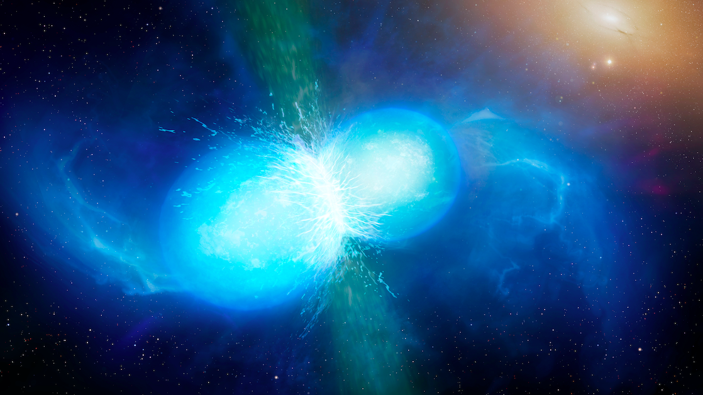
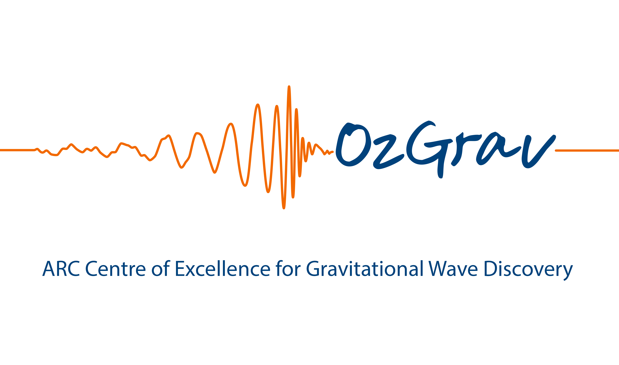

Investigating the Formation of Heavy Double Neutron Stars
Ashwathi Nair
(PhD Candidate)
Primary Supervisor : Dr. Simon Stevenson
Secondary Supervisor : Prof. Jarrod Hurley
Binary Stars in a New Era
2025

Slide 2
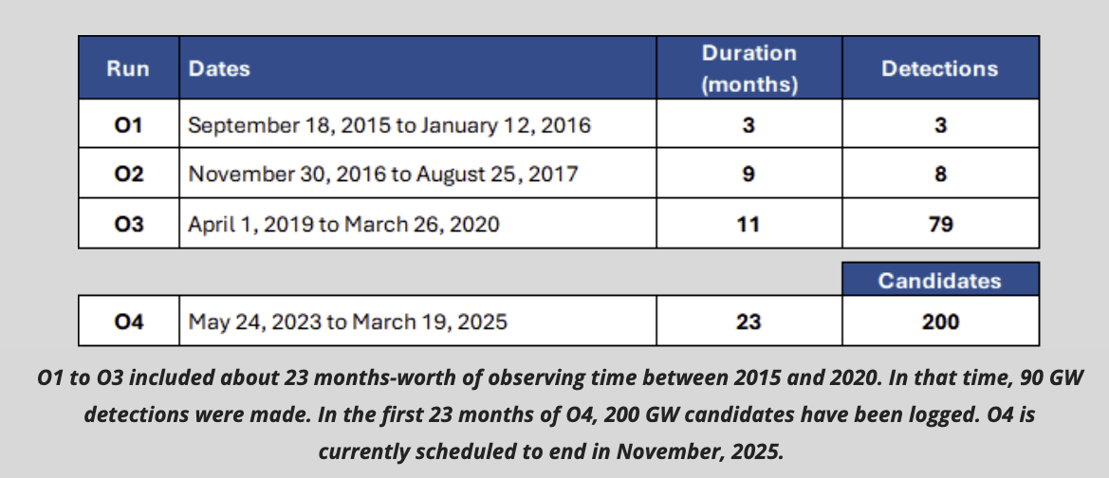
Discovering the Origins of Gravitational-Wave Sources
Notes:
Detected first source 2015 - binary black hole
Can now gain more insight about properties of compact objects
Most importantly formation & evolution of single & binary stellar systems
My work, discovering origins GW sources, studies progenitors of these events
Mainly focusing on formation of heavy DNS

Slide 3
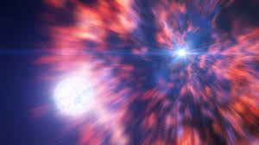
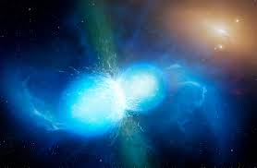
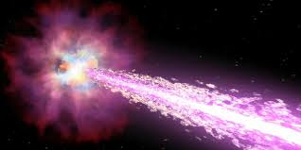
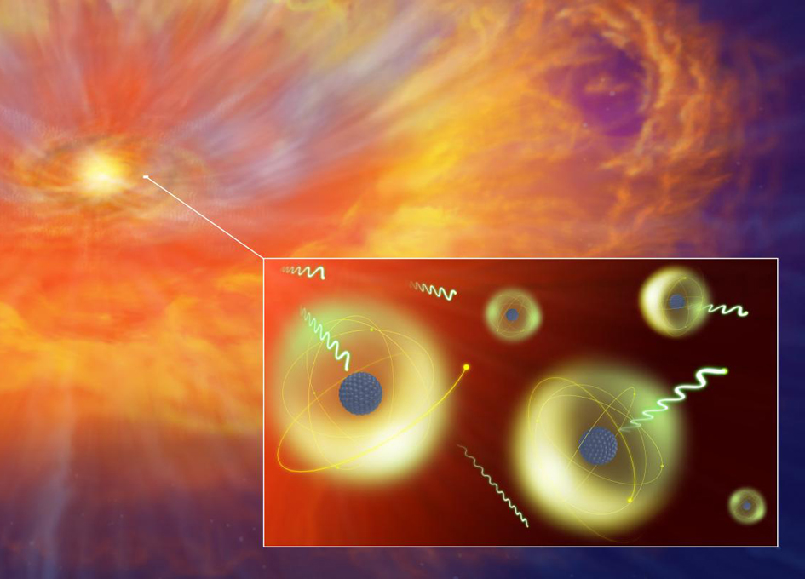
Why care about double neutron stars?
Supernova explosions (SNe)
Gamma ray bursts (GRB)
Binary stellar evolution
Kilonovae
Formation of heavy r-process elements
Notes:
Introduction
Why care about DNS –
for eg play important role in learning the origins of diff Sne,
The merging of neutron stars may give rise to a short gamma-ray burst (GRB) , emitting bright electromagnetic radiation called a kilonova
Extreme physical conditions in kilonovae produce heavy r-process elements
). Understanding GRB and kilonovae will help us learn about the formation of heavy elements in the future.
most importantly double neutron star evolve through multiple mass transfer processes and survives two supernovae explosion, which is too much to go through. Hence, DNSs can be used to back trace the evolutionary processes and enhance our understanding about massive binary evolution

Slide 4
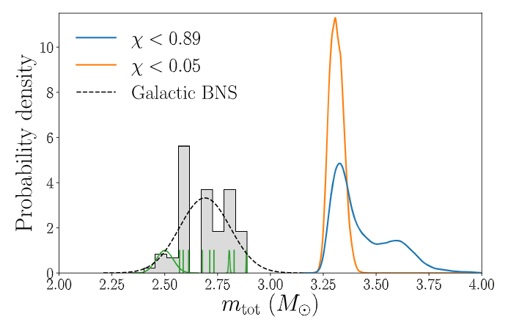

What do we know about Double Neutron Star (DNS) systems so far ?
Detected by radio telescopes and gravitational-wave detectors
Radio Timing
~ 26 Galactic DNS in the field with total masses in the range 2.50−2.89M☉
Gravitational Waves
GW170817
Total mass : ${2.87}_{−0.09}^{+0.47}$ M☉
GW190425
Total mass : ${3.4}_{−0.1}^{+0.3}$ M☉
SUS!
Abbot et al. 2020
Notes:
Detected by radio, GW
So far, observed ~25 galactic DNS 2.50-2.89 M
Only 2 with GW: GW170817 and GW190425
While GW170817 similar to previous radio detection, GW190425 much higher mass
Here have plot showing this. You can see that GW190425 is well above, in fact 5 stdv!!
This suggests GW190425 formed differently from previously observed galactic binaries

Slide 5
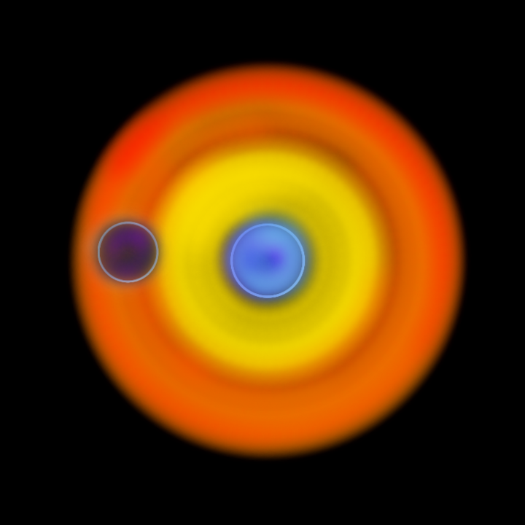
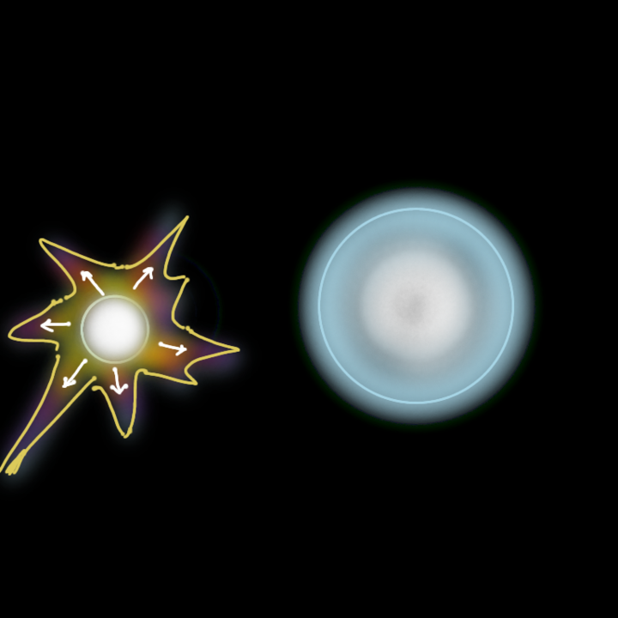
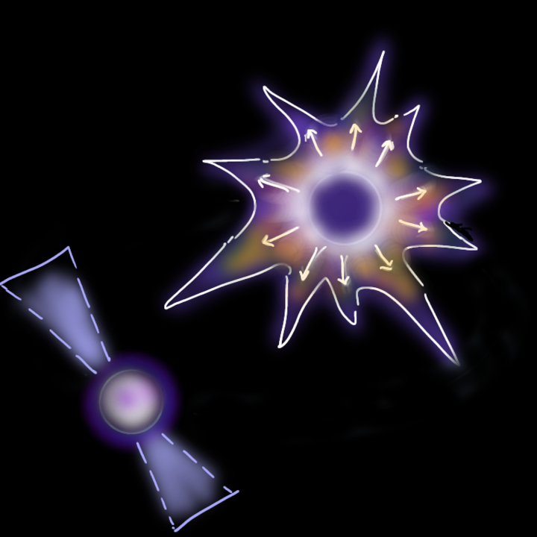
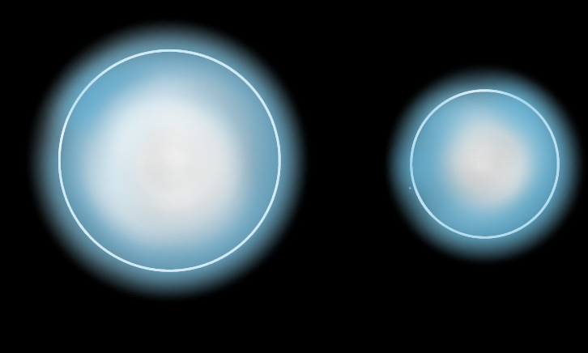

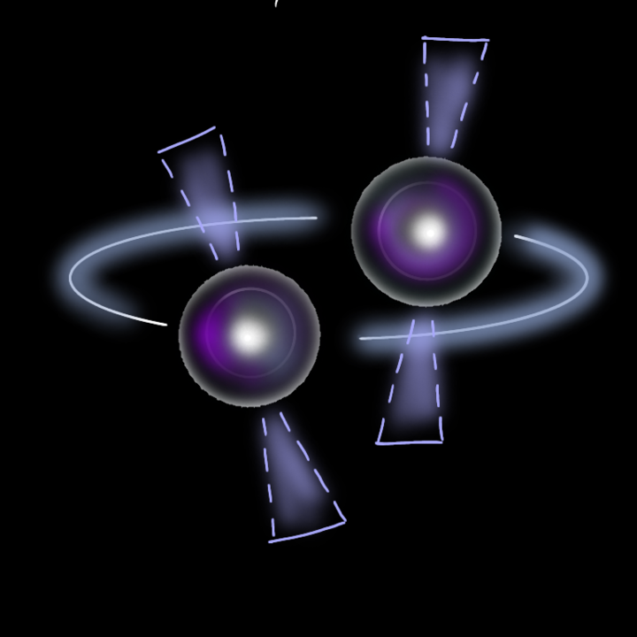
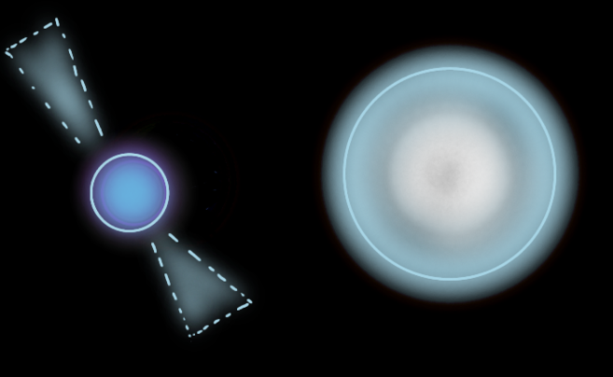
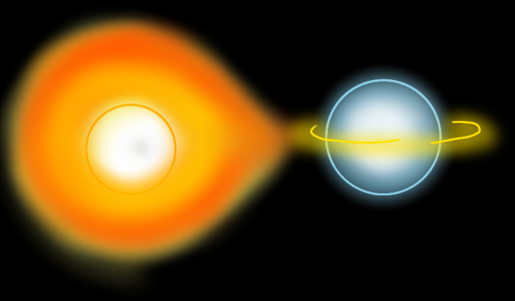

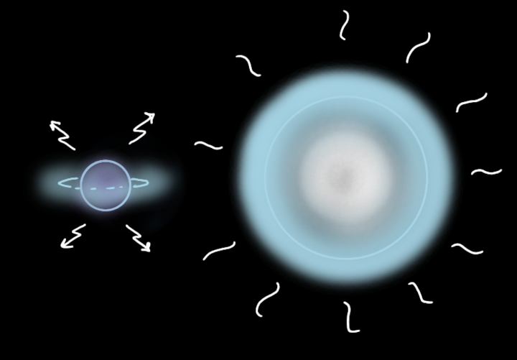
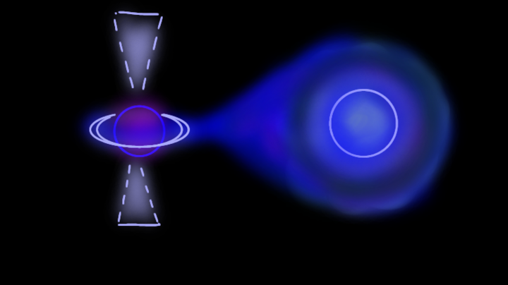
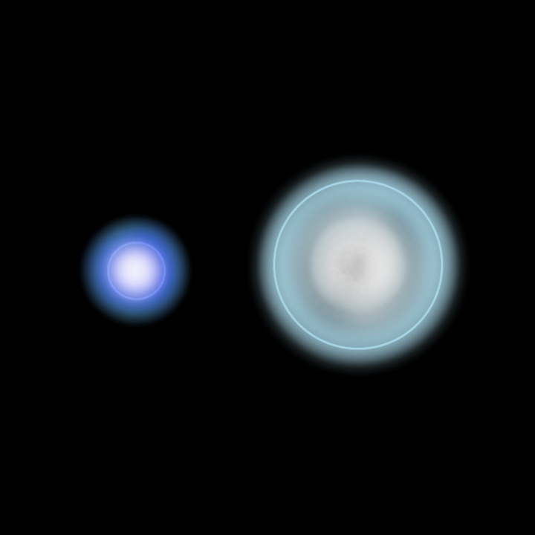
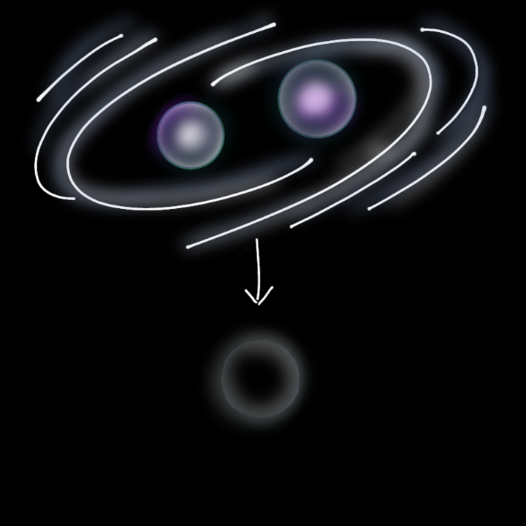
Standard Double Neutron Star Formation Pathway – T. Tauris et al. 2017
Ultra-stripped SN
OB-Type ZAMS
SN
CE
(USSN)
Recycled + young NS
NS
He
RLO
NS1
DNS merger
He-Star
HMXB
Case BB RLO
BH
Notes:
Within the isolated formation channel, there is a standard dns formation pathway
In the standard picture of DNS formation, we start with two OB-type
These are the evolutionary phases that decides the fate of the dns merger
Formation channel usually gives DNS merger we observe in the field and- GW170817 , as mentioned earlier GW19045 - formed differently.

Slide 6
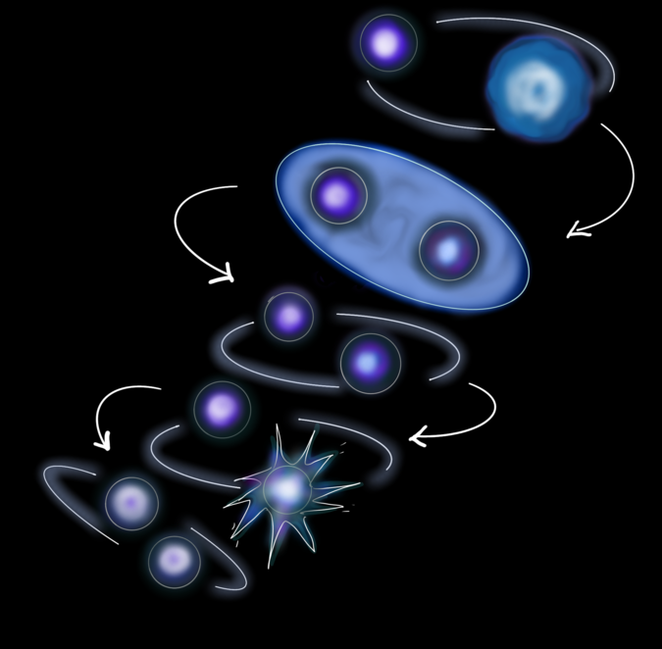
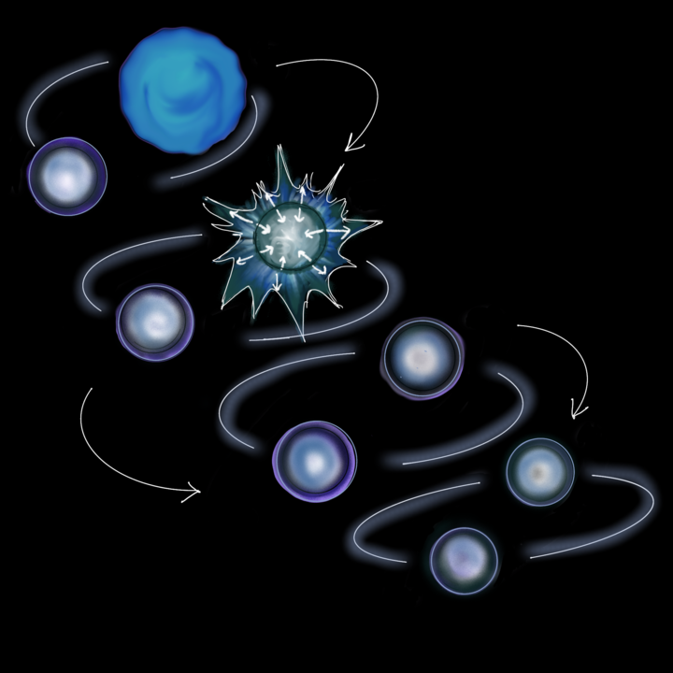


Alternate Proposed Formation Pathways for Massive Double Neutron Star
NS
Other uncertainties:
Massive helium star $>9\text{M}\text{☉}$
Unstable mass transfer
He
No mass transfer
Formation at lower metallicities - Giacobbo & Mapelli (2018)
Super-Eddington accretion - Zhang et al. (2023)
Massive first- born NS - Qin et al (2024)
NS
Tight orbit $P_{orb}<Hr$
B.P. Abbott et al. (2020)
Vigna Gómez et al. (2021)
No self-consistent unbiased formation pathway for heavy double neutron stars formation
Notes:
Recently a few studies have proposed an alternate formation patnway for the formation of massive systems
The first being
Formation via unstable mass transfer, where the binary gets into a tight orbit, amd the metal core undergoes sn explosion and leaves behind a dns binary
Vigna gomez - this dns becomes radio quiet and can only be detected in GW frequency
However there are other uncertainities associated with GW190425 formation :
Giacobbo & Mapelli find that massive DNSs tend to be formed at lower metallicities
Zhang propose super-eddington accretion as a possible scenario for GW190425
Qin et al 2024 propose the formation of massive GW190425 like DNS through stable Case BB RLO MT with a massive first born NS.
This tells us that no self-consistent unbiased formation pathway for heavy dns exists.
Pop synthesis models predict the formation of massive DNSs at solar metallicity despite no such massive DNSs have been observed in the Galactic population.

Slide 7
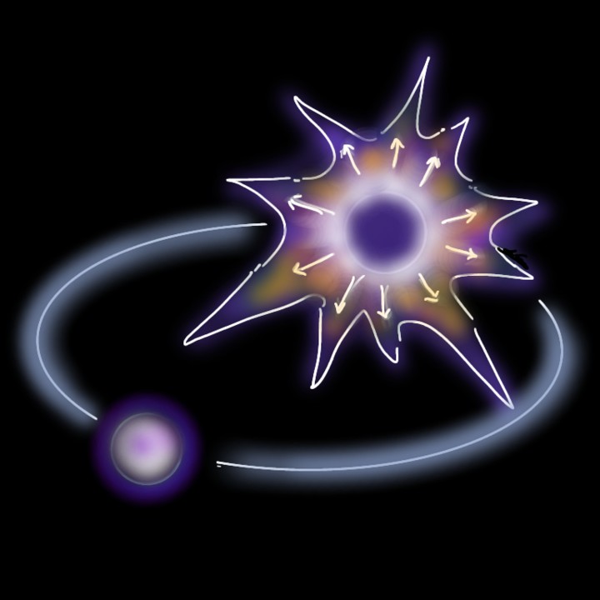

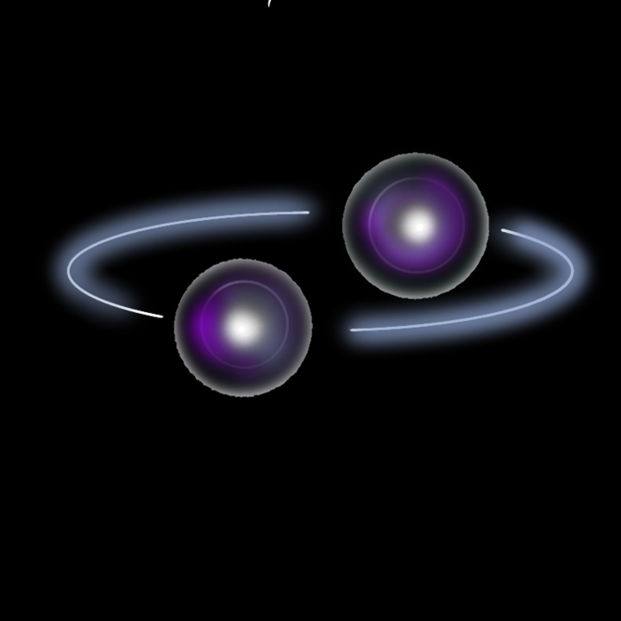

Framework Created for the Formation Pathway
Gravitational-wave merger timescale
ZAMS He ( at solar metallicity)- 1.4 M☉ NS binary evolution
Incorporating supernova and kick prescription
Post-Supernova effects on orbital dynamics
Mandel & Müller 2020,
Kapil et al. 2023
Brandt & Podsiadlowski 1995
Peters 1964b
Mandel (2021b)
Paxton et al. 2011, 2013, 2015, 2018
Notes:
Created a framework to simulate DNS formation
He-NS binary1.4 M NS using MESA which is a 1D detailed stellar evolution model.
I incorporate a prescription for predicting the supernova remnant and the kick recieved by the new born NS mass.
Later calculate Post SN effects on orbital dynamics, GW merger timescale

Slide 8
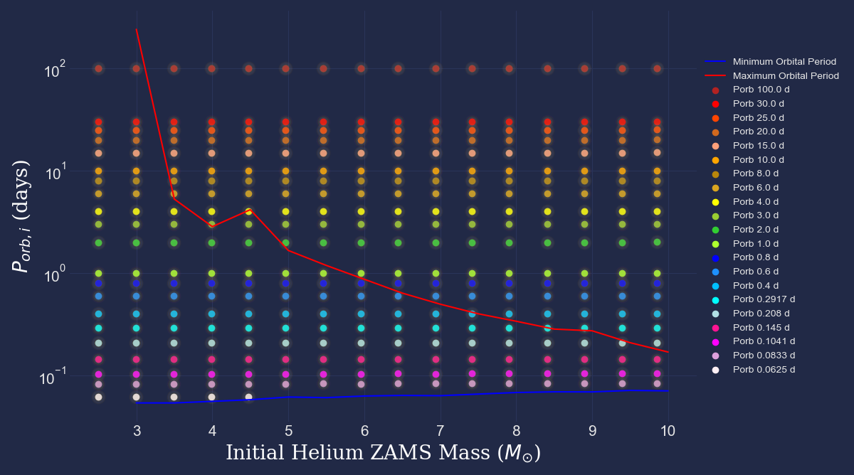
Grid of Models Based On Initial He ZAMS (solar metallicity ) Mass + 1.4 M☉NS and Initial Orbital Period
Notes:
The initial orbital period and He-star mass are two critical parameters that affect the evolution of the binary.
Using MESA
modelled a large population of He-Ns binary evolution - as shown in the plot, different color points indicates different orbital period.
The red and blue line shows the range of the orbital period that allows mass transfer by Roche lobe overflow.

Slide 9
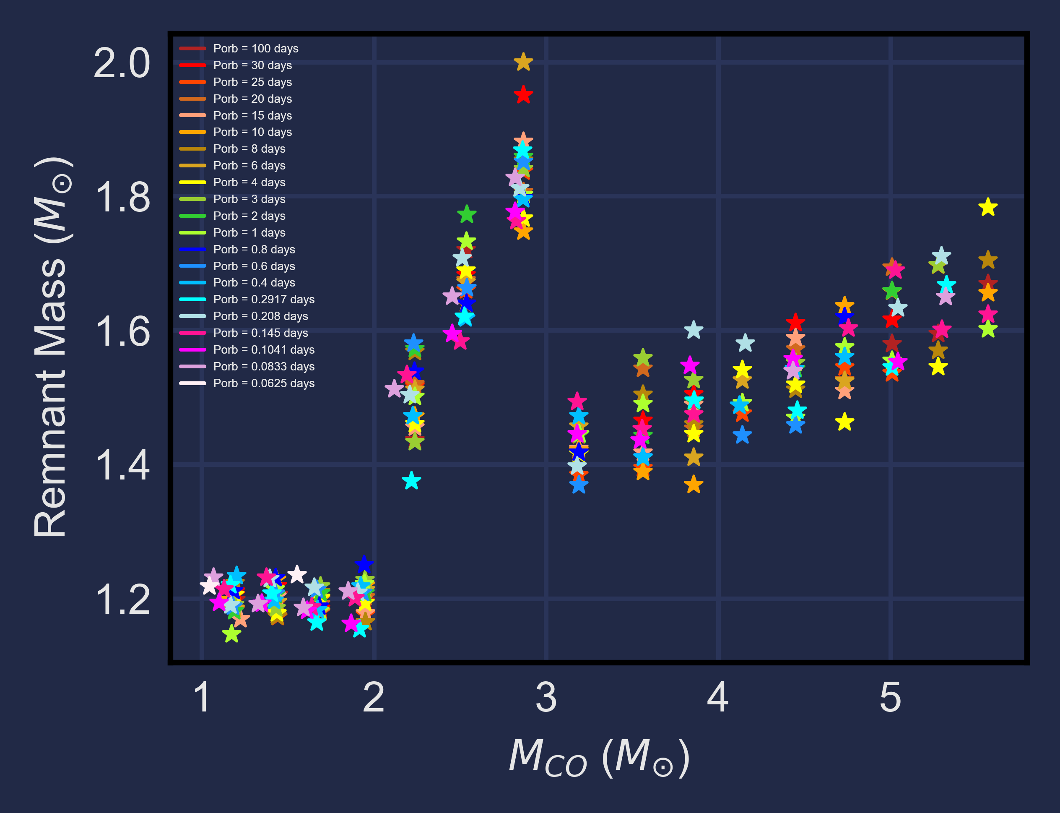
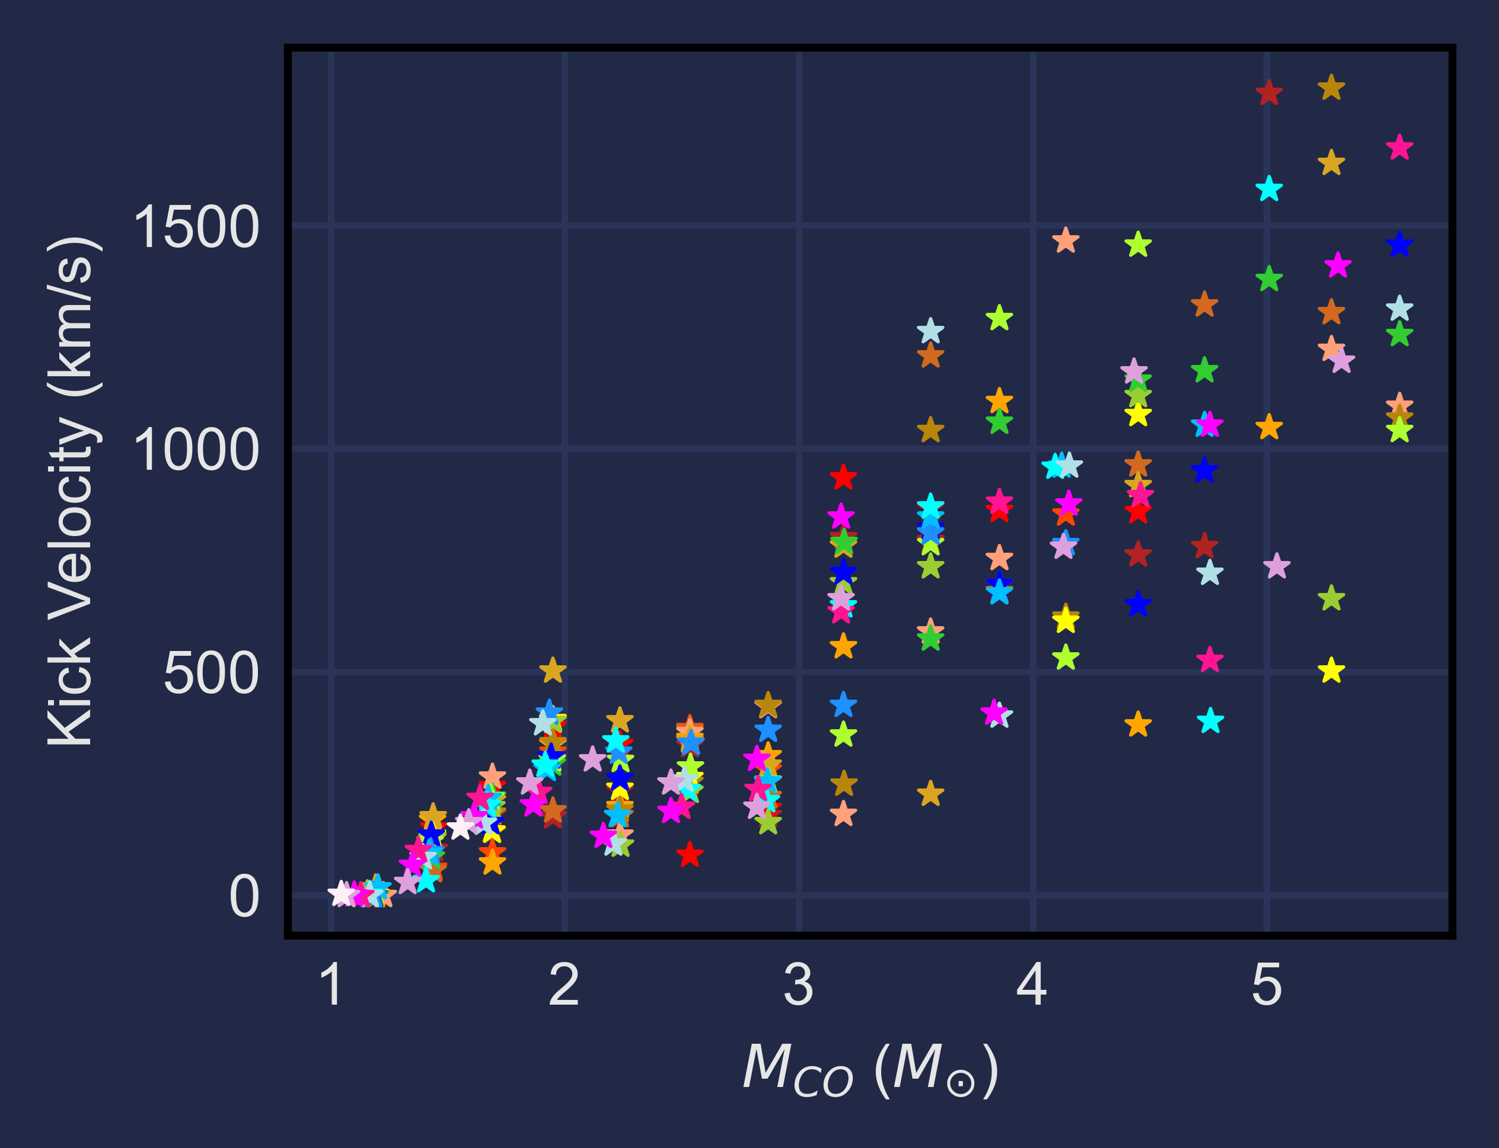
Standard Supernovae and Kick Prescription (Standard Model)
by Mandel & Müller 2020, Kapil et al. 2023
Remnant masses (NS2) as a function of CO core mass
Kick velocity for the corresponding NS2 as a function of CO core mass
Notes:
This plot shows the post-SN remnant masses and kick velocities as a function of co core mass.
plot on the left shows remnant masses - The relationship between the remnant mass and mco is not well understood, but this prescription handles it in such a way that they get a local maxima, producing neutron star remnants of 1.8-2msun. However, some studies consider more of a linear relation, indicating as the co core masses increases, remnant masses will increase.
Plot on the right, shows the kick velocities imparted onto these new born neutron stars. Depending on the final helium envelope and co core mass the star undergoes different supernova explosion,. these supernovae kicks the new born neutron star only to a few km/s, However, this prescription overestimates the explosion energies of ECSN and USSNe.

Slide 10
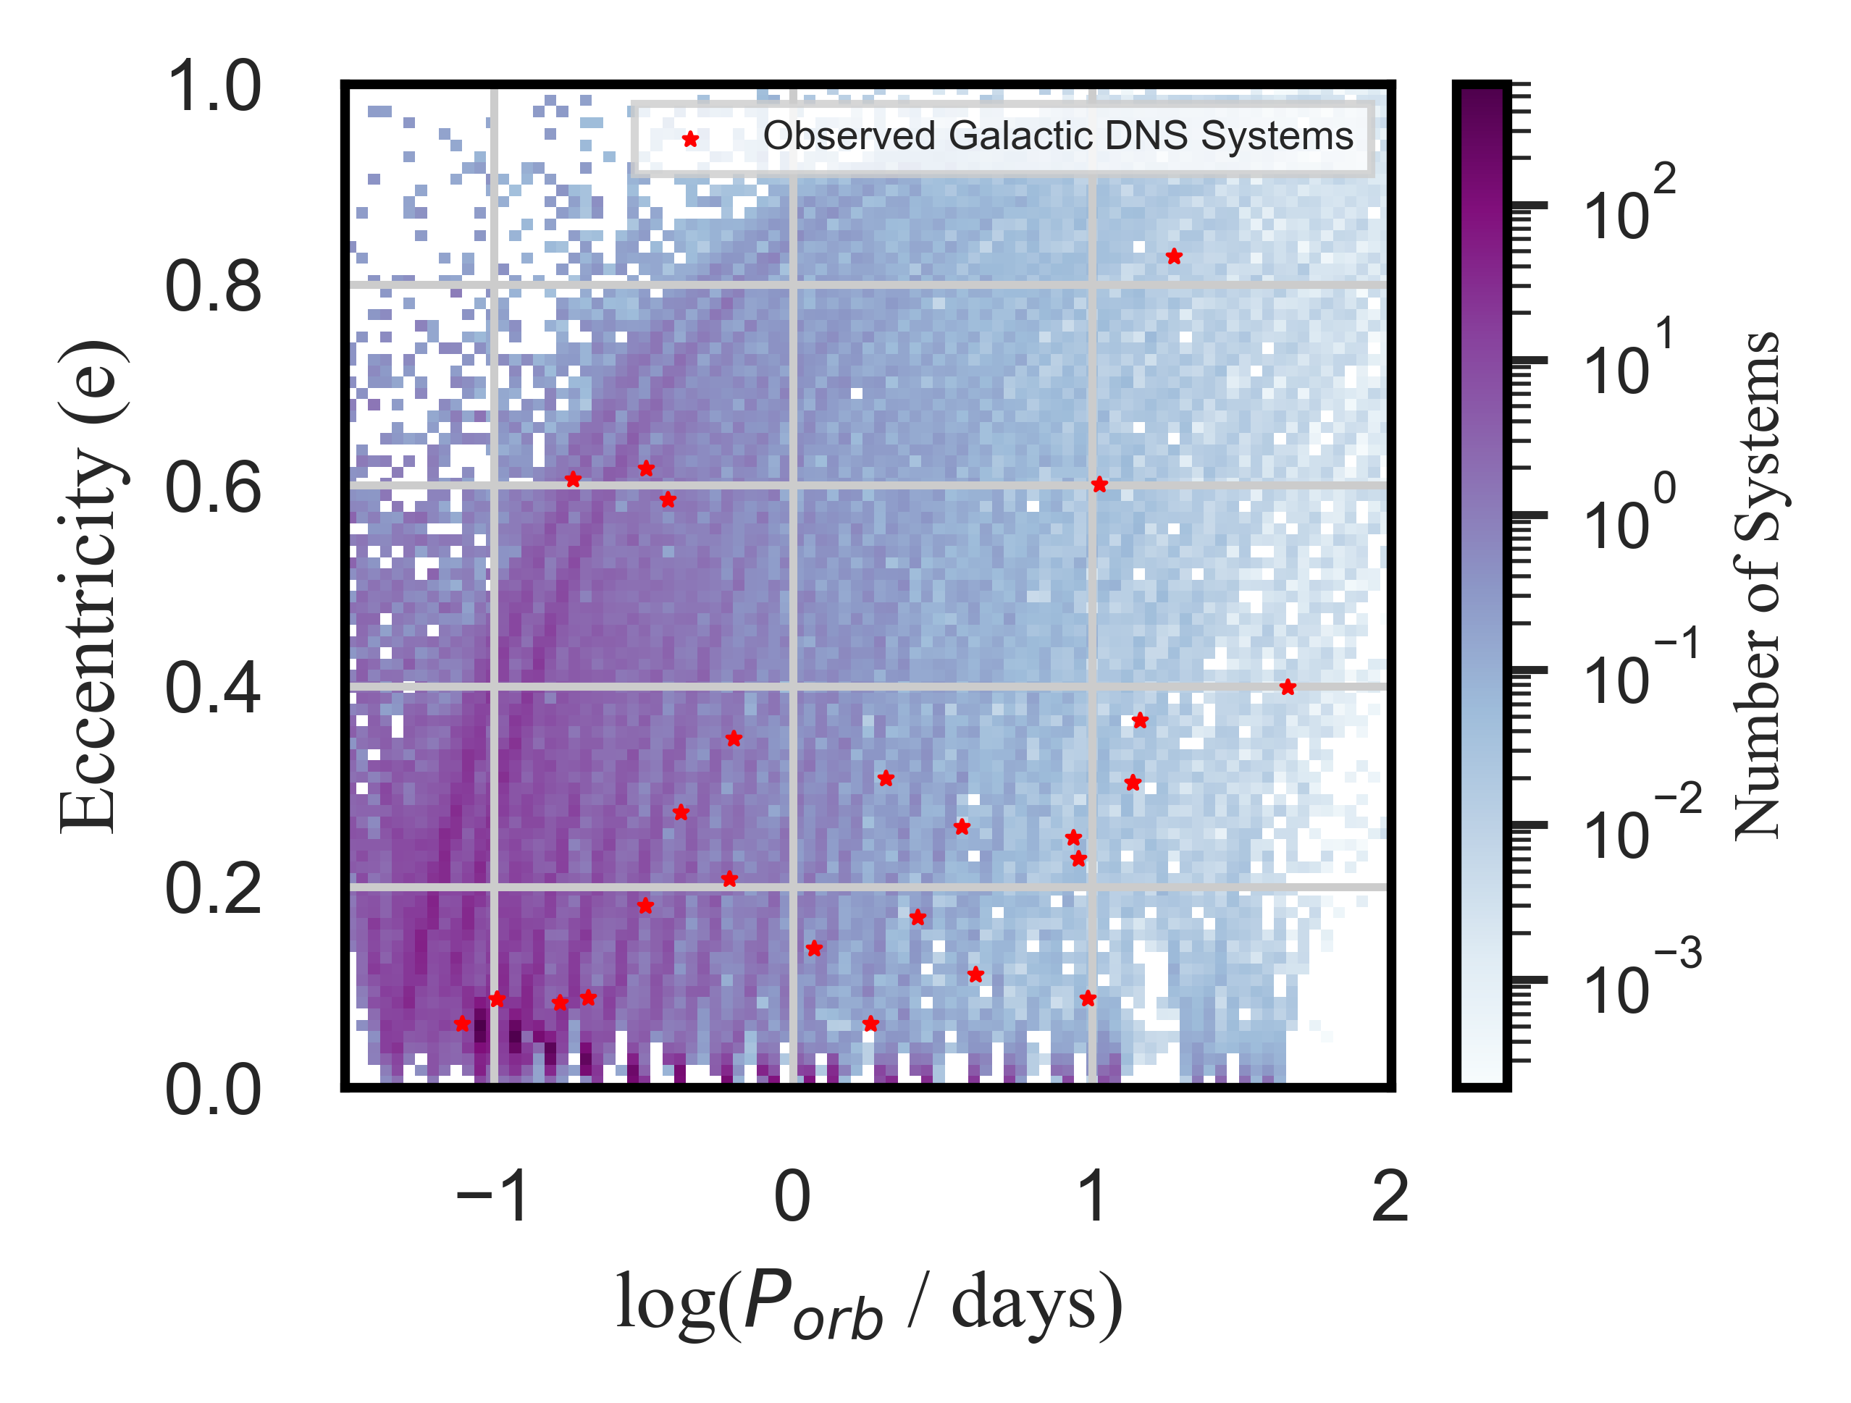

Combined $P_{orb}$-e Distribution of all models
Standard Model
Notes:
If the bianries survive the supernova explosion, it significantly changes the orbital dynamics of the binary
This plot shows the weighted Porb-e of all of my models combined. Lower orbital periods have higher weights
If you look at the red stars which is the distribution of the observed DNS s’ Porb-e there’s a gap between e=0.2-0.5, however this gap isn’t reproduced by the model.
Even the systems at low orbital period here receives higher kicks thereby producing broader range of ecccentricities. This is because the standard prescription overestimates the kick velocities for USSN and ECSN, which should be a few tens of km/s.
According to this model it could mean that either we have not observed any DNS in this parameter space until now or that the model overpredicts eccentricities.

Slide 11
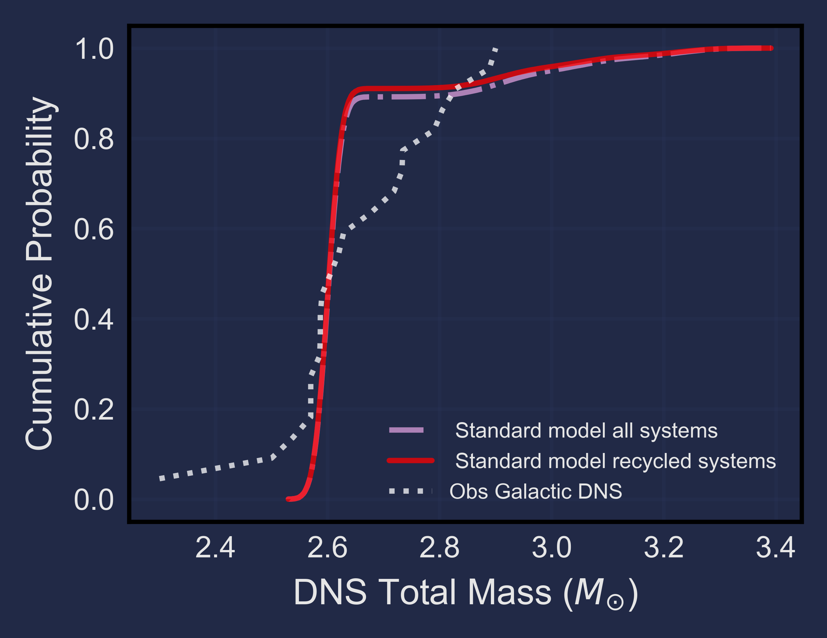
DNS Total Mass Distribution
Standard Model
Overproduce high mass systems than observed
Notes:
Another important distribution is the double neutron star total mass distribution based on the standard model prescription. The white dotted lines represent the observed galatic dns in the field. The red line represents my simulated recycled systems, which is(compared to) representative of the galactic radio sources population
The lilac dot dashed line represents all of the simulated systems, which are compared to the GW system population.
Here, we can see an extended tail above 3Msun, in both the population, but we would focus on the recycled population. This model overproduces high mass system which cant be seen in the observed population. And this comes from the previously mentioned spike that occurs due to the assumption made of remnat mass and co core mass relation.
This can mean two things – either we haven’t seen any massive systems in radio observations yet or that there’s an indiscrepency between the modeled and observed population

Slide 12
Issues with the Standard Prescription
Overpredicts orbital eccentricities of the systems
Overpredicts DNS total mass compared to what we observe at solar metallicity

Slide 13
Modifications to the Standard Model
Different remnant mass and CO core mass relation
Incorporate Ultra-stripped and Electron capture supernova conditions
Kick slow merging systems to high velocities
Notes:
To calibrate our models to ensure it can explain the observed population first, we modify the standard prescription slightly by changing thr remnant mass and co core mass relationship, incorporating USSN and ECSN condition and
But observations show fewer slow-merging systems than theory would predict.
So, adding kicks that selectively disrupt some of these slow-merging binaries helps match the theoretical population to the radio-visible population we actually observe.

Slide 14
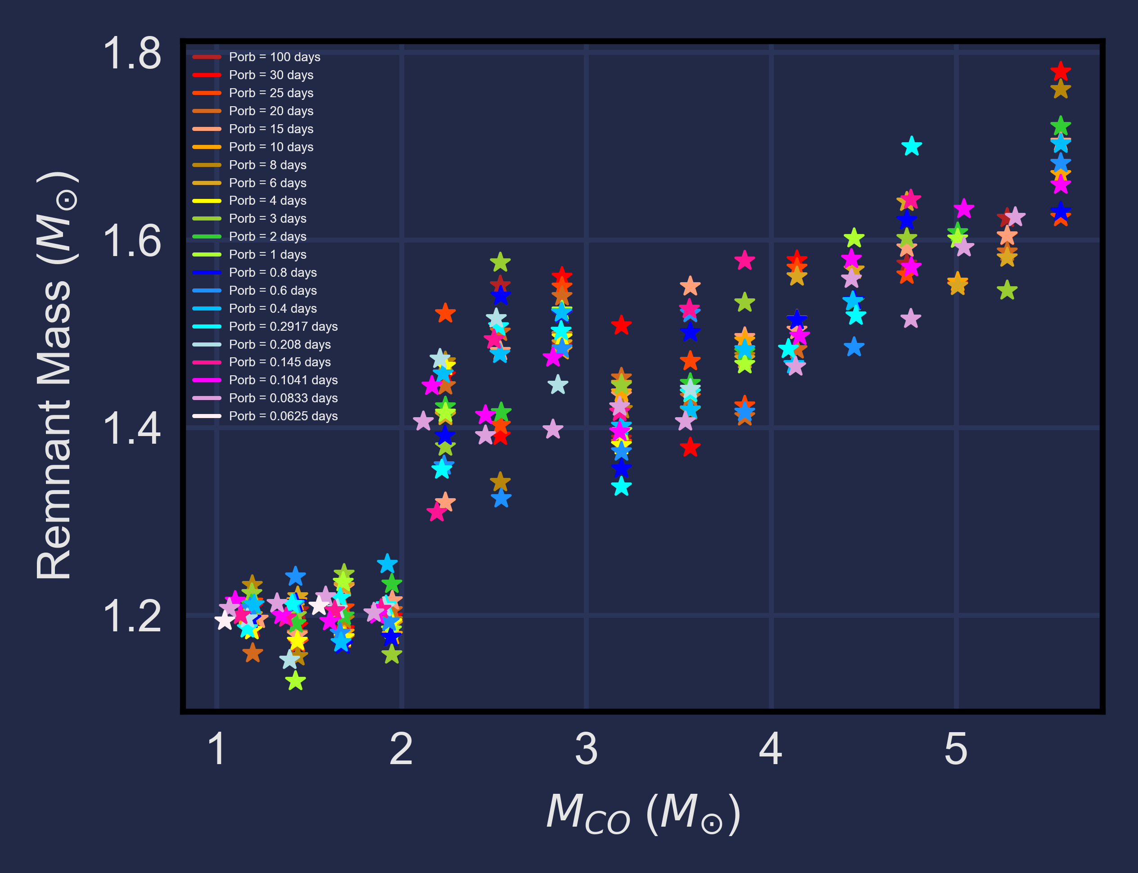
Standard Model
Modified Model
(BEFORE)
Remnant masses (NS2) as a function of CO core mass
Notes:
Now the remnant masses increases graduually as MCO increases

Slide 15
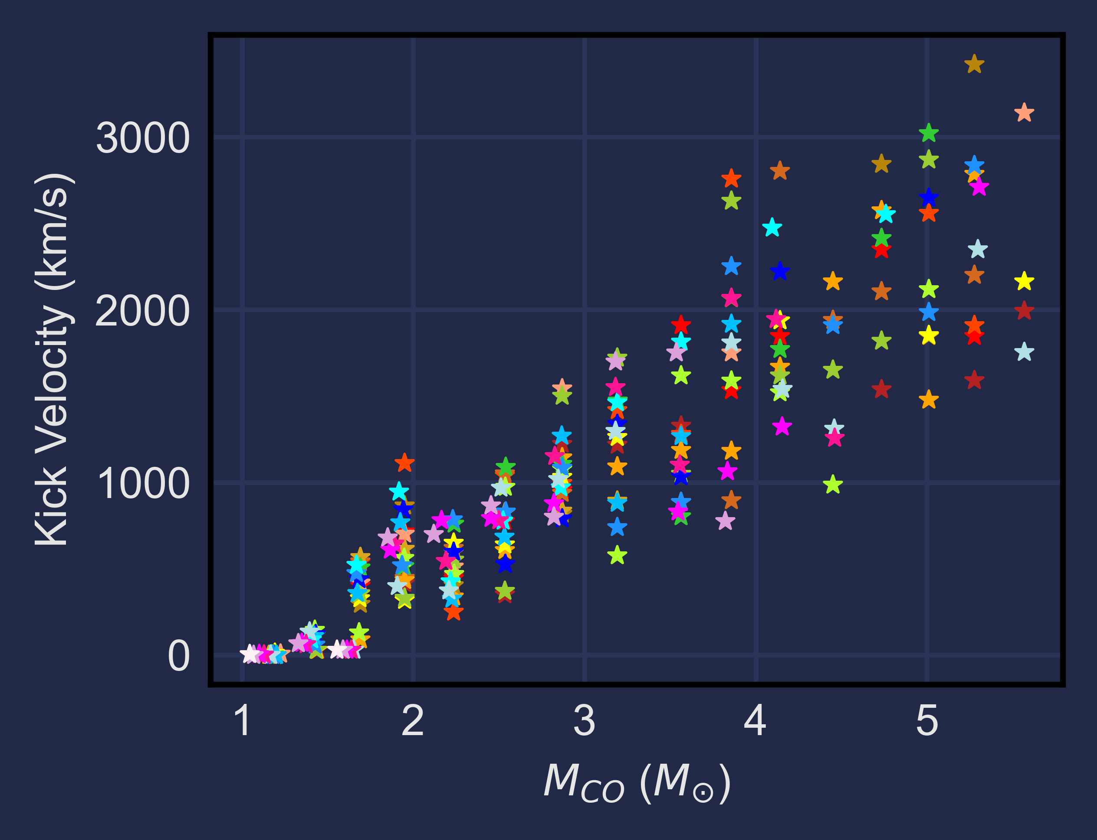
Standard Model
Modified Model
(Before)
After incorporating USSN and ECSN
Kick velocity for the corresponding NS2 as a function of CO core mass
Notes:
After implementing the USSN and kick prescription, new born NS resulting from low mass helium stars received smaller kick of tens of km/s

Slide 16
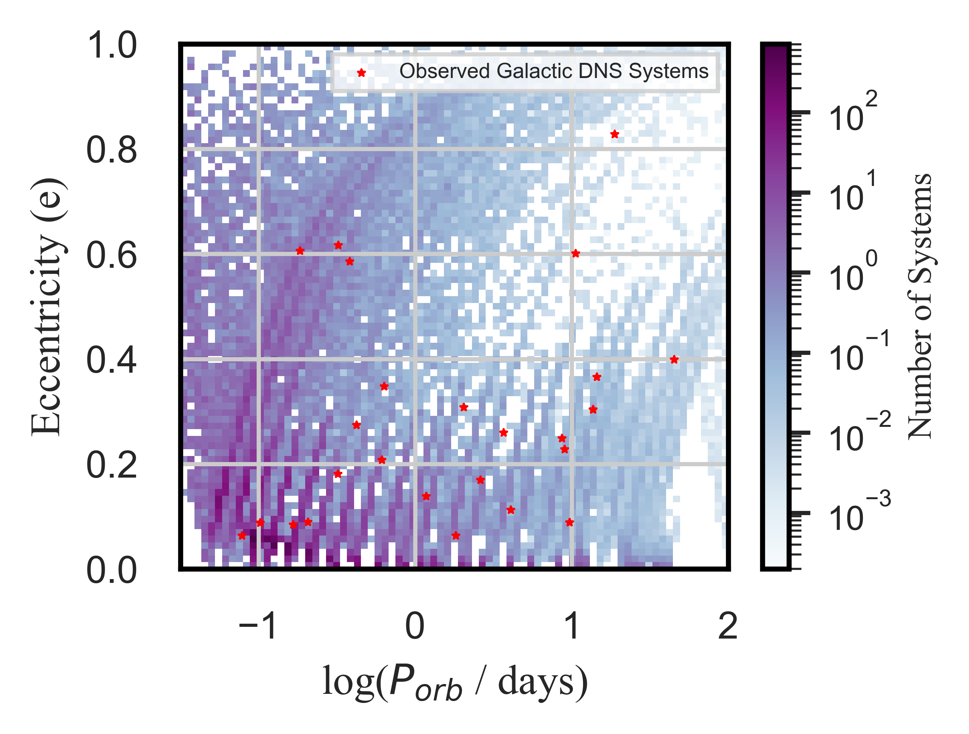
Combined Porb-e Distribution of all models
Nair et al. 2025 (Published in MNRAS)
Standard Model
(BEFORE)
Modified Model
Notes:
After implementing the modification,
This is how that porb-e plot look like
Appears to be much better!
Systems that undergo the USSN and kick prescription gets kicked to of tens of km/s which leads to llower eccentric DNS system.
However the gap I mentioned before between 0.2-0.5 e, remains slightly filled. This is largely due to intermediate mass helium stars.

Slide 17
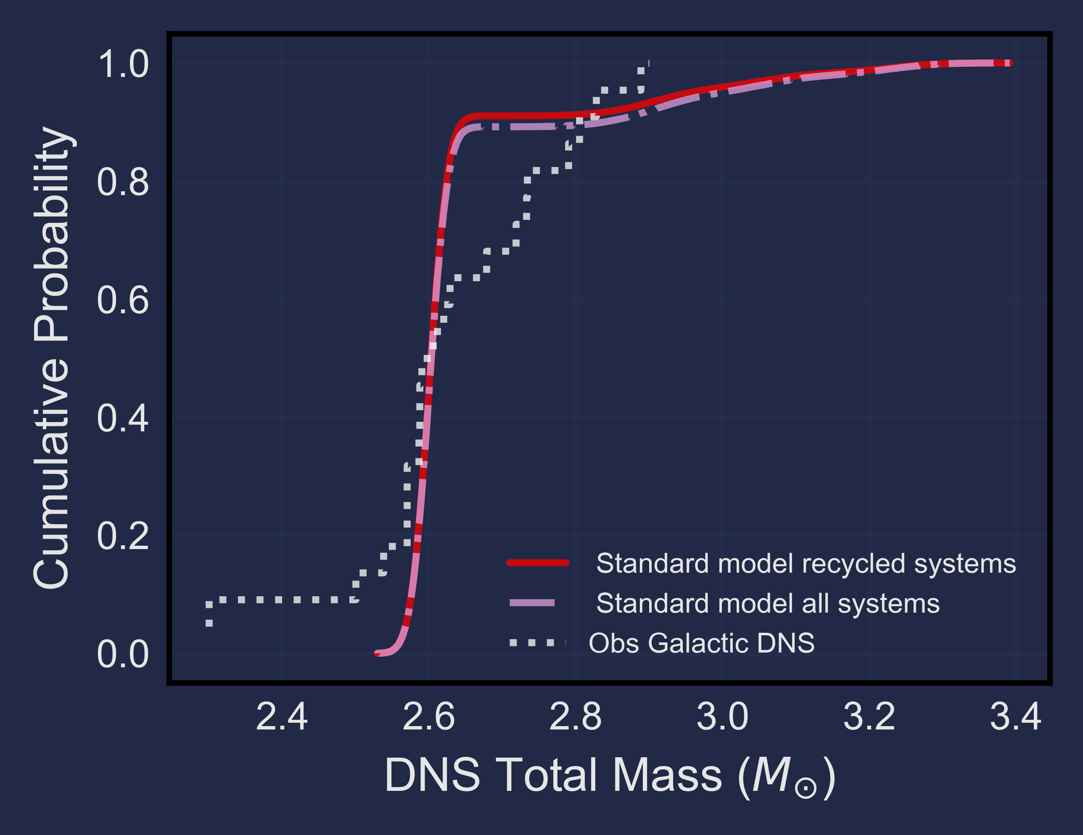
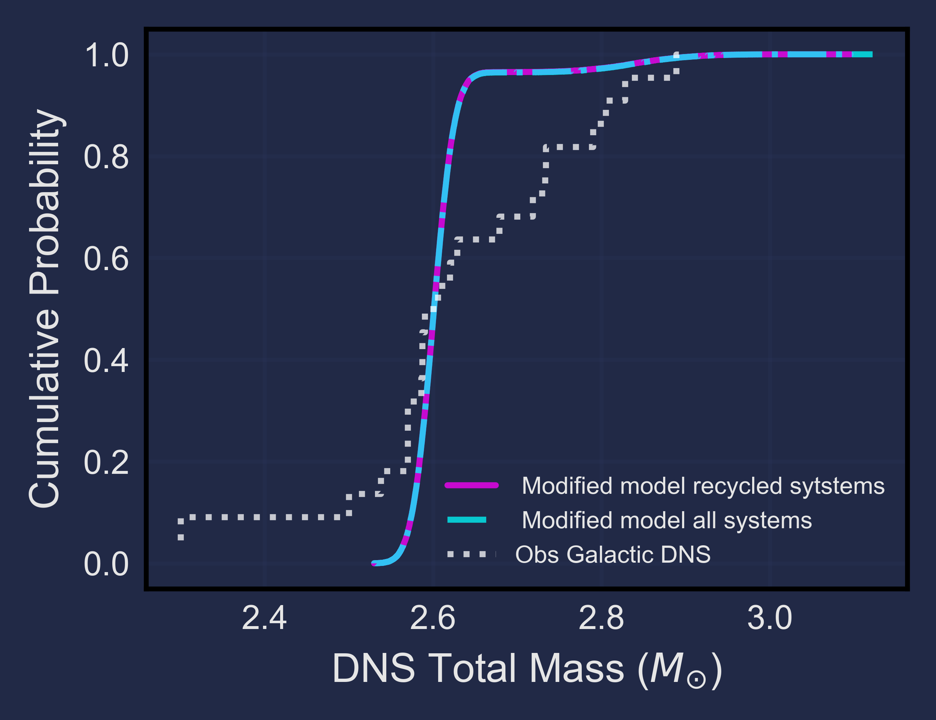

DNS Total Mass Distribution
Standard Model
Modified Model
(BEFORE)
$M_{Tot}$ ≥ 3.0 M☉ : 0.01 %
Nair et al. 2025 (Published in MNRAS)
Notes:
This is how the mtot distribution looks like
The tail has grown shorter
Better agreement with the observed dns total mass distribution
Peaks at 2.6msun because we choose constant ns1 value
After calibrating our models with the observed population, we calculate the fraction of heavy dns > 3Msun in all systems which is only 0.01%. This means our model doesn’t produce enough heavy dns systems to explain the GW population. Indicating at heavy DNS formed with helium stars with solar metallicity might be rare.

Slide 18




GW190425 Progenitors
Modified: (Out of all the systems ≥ 3 M☉ )
~80% of systems - formed via Case BB RLO MT
~20% of systems - formed via massive helium stars without recycling the first-born NS
Rules out the formation pathway via unstable mass transfer
Case BB RLO
Massive helium star $>9\text{M}\text{☉}$
No mass transfer
Unstable mass transfer
Vigna Gómez et al. (2021)
Tight orbit $P_{orb}<Hr$
B.P. Abbott et al. (2020)
Notes:
We still look at the heavy dns systems produced in our population to see which formation channel is most likely to form massive gw190425 like systems with the assumption of helium stars with solar metallicity
Since the models doesn’t form enough massive systems at solar metalicty, its difficult to say which formation pathway is a self consistent pathway for forming them as we can’t test other unceratinities here,
and so

Slide 19









Conclusions
Models calibrated to match the Galactic DNS population
Roughly reproduces the observed Galactic DNS distribution
Used models to explore GW190425 progenitors
Massive systems (like GW190425) formed at solar metallicity are rare
Unstable Case BB MT pathway does not yield GW190425-like binaries
Model limitations: Can’t explain high GW190425 rates
Next steps: Explore low-Z models, massive NS primaries & super-Eddington accretion
Hoping O4 run detects at least one DNS
Nair et al. 2025

Slide 20
EXTRA SLIDES

Slide 21
(USSN)
Ultra-stripped SN
The evolutionary phases that decides the fate of DNSs
He
NS
Preferred for modeling DNS formation pathways
Recycled + young NS
DNS merger
Case BB RLO
BH

Slide 22
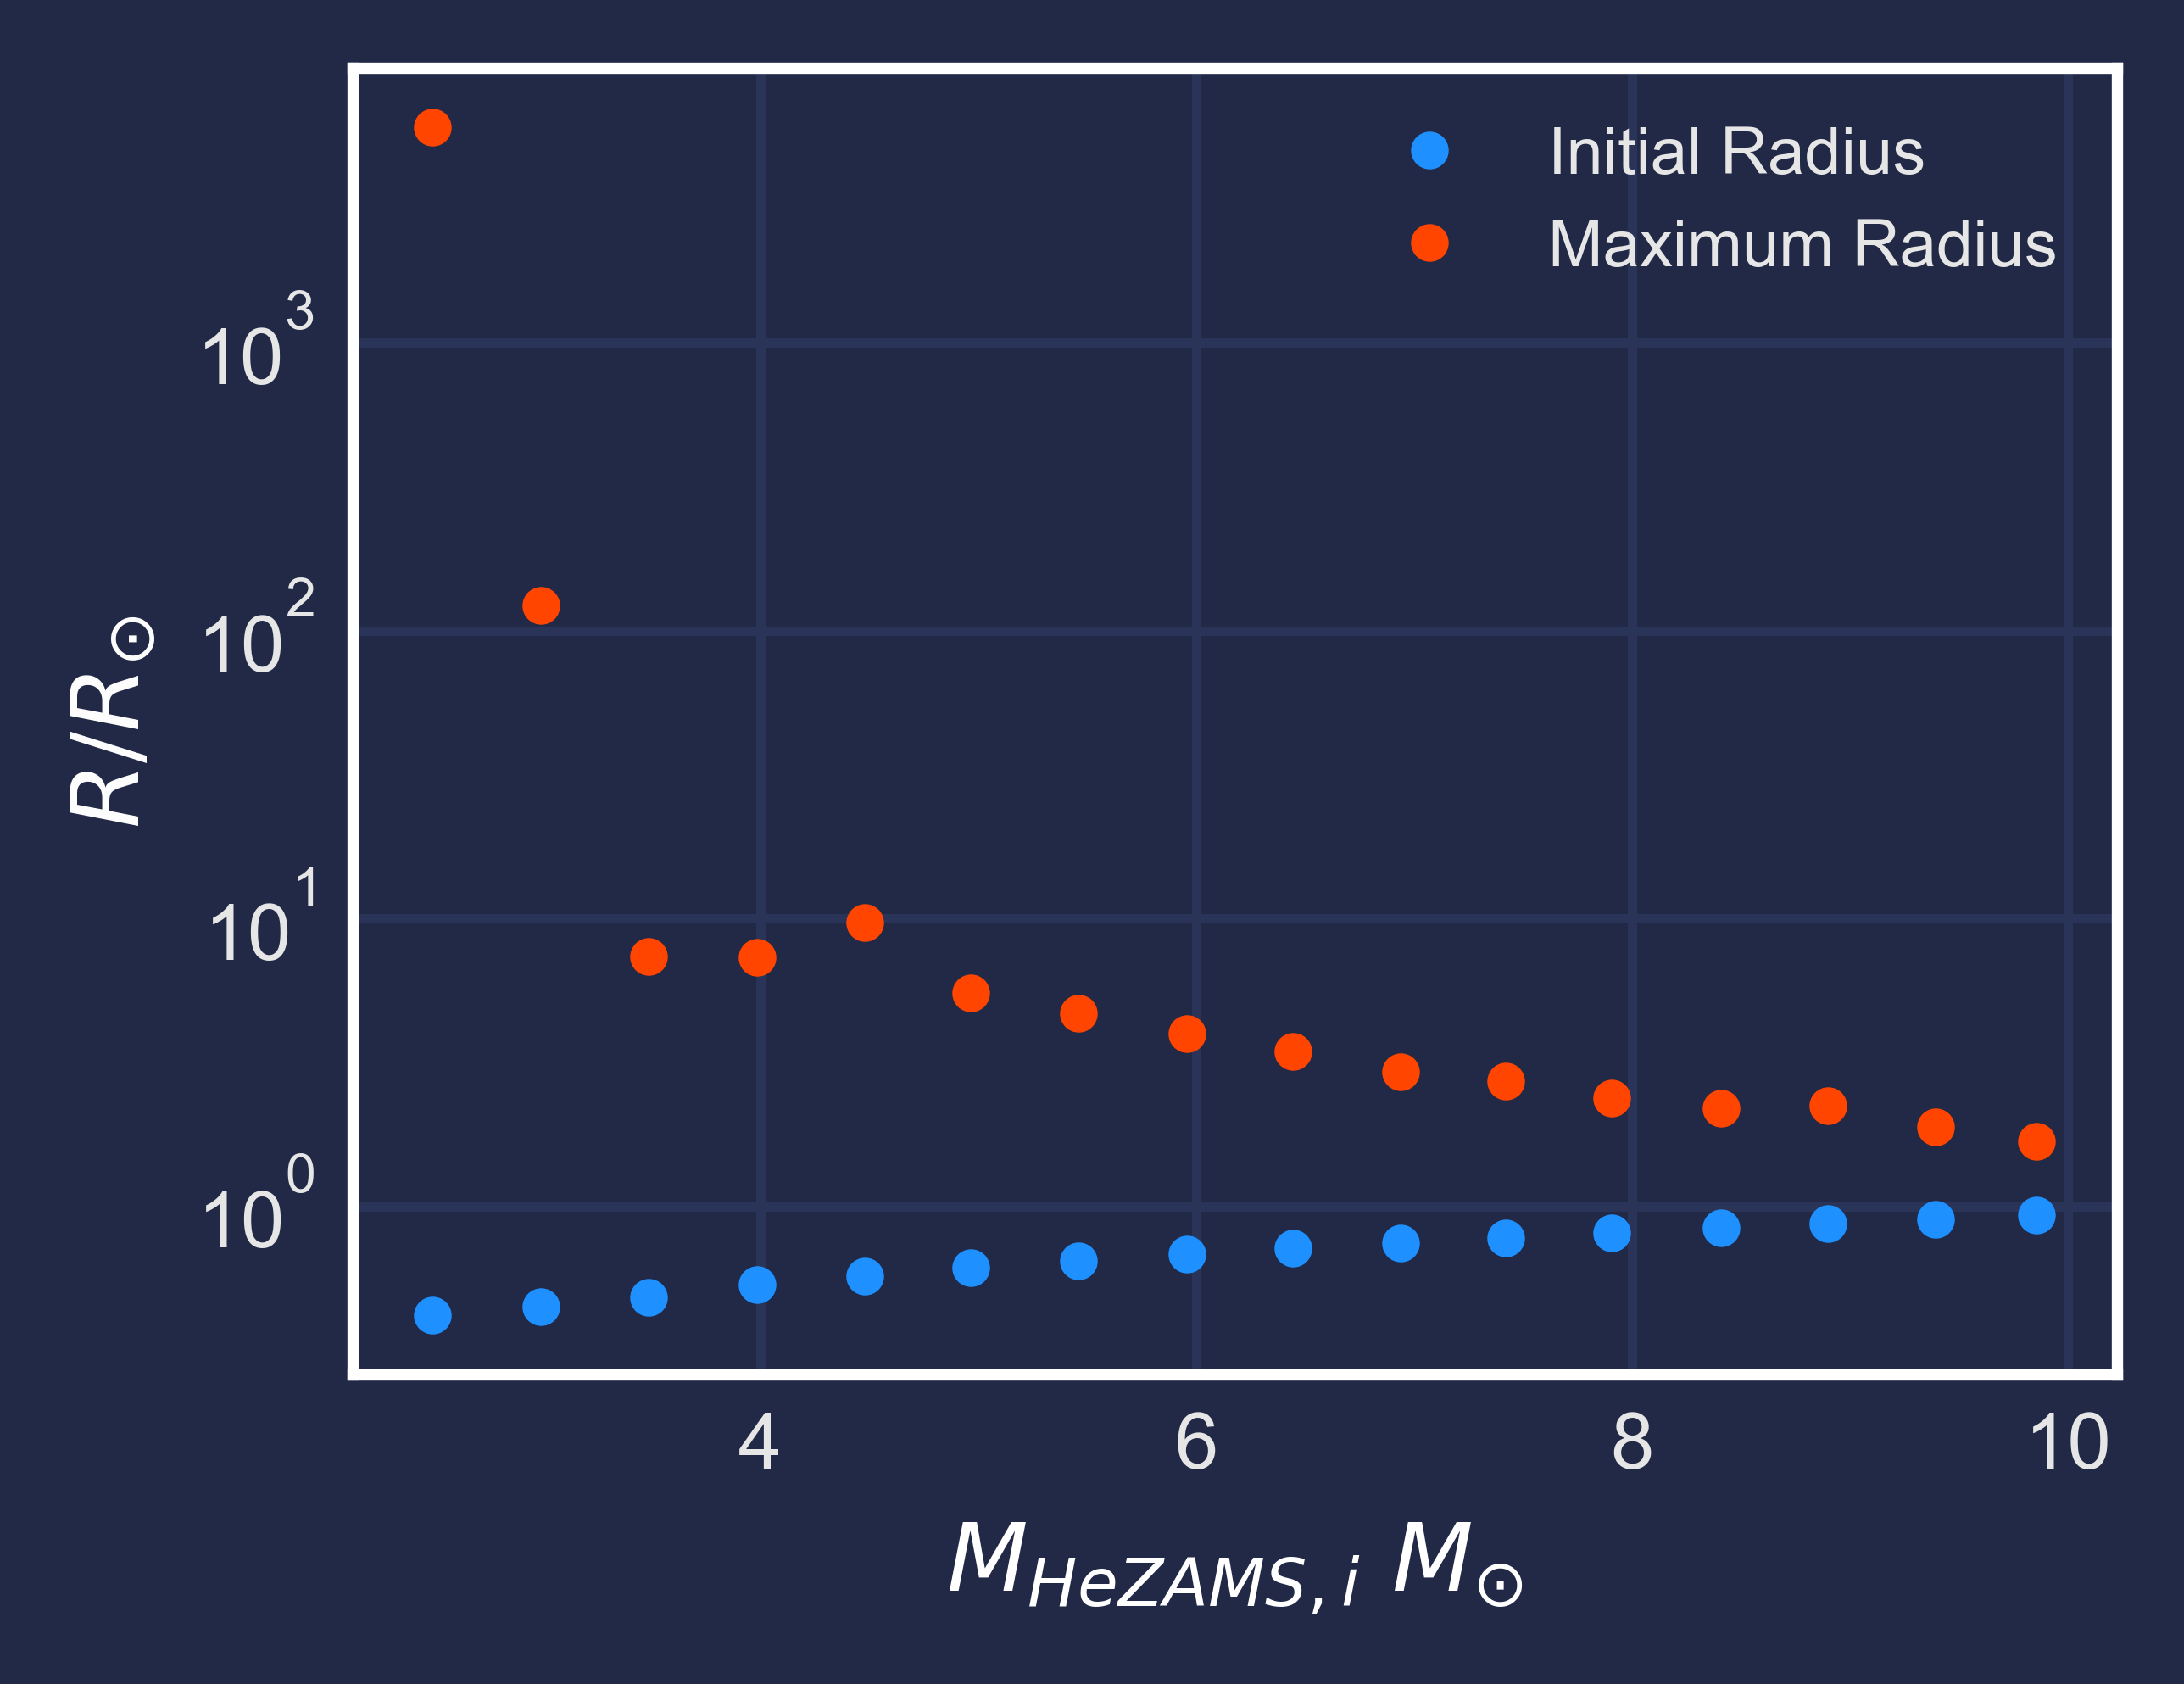
Initial and Maximum Radius as a Function of Initial He-ZAMS Mass at Solar Metallicity
(Recap)
ZAMS :
Zero Age Main Sequence
(aka newly formed stars)
Notes:
[Something to let audience know we are STILL RECAPPING]
This plot shows us the radius of the helium stars at the start of he zams and the maximum radius before igniting carbon burning
whether the star undergoes RLO MT depends on the initial mass. for 2.9 M, the radius expands to more than 100 and will undergo Roche lobe overflow. whereas >= 3.5 M doesn’t expand much and may or may not. It may if in close
.
Plot gives parameter space explore final fate of He in He-NS.

Slide 23
Standard Supernovae and Kick Prescription (Standard Model)
Remnant masses (NS2) as a function of CO core mass
Kick velocity for the corresponding NS2 as a function of CO core mass
Notes:
This plot shows the post-SN remnant masses and kick velocities as a function of co core mass.
plot on the left shows remnant masses - The relationship between the remnant mass and mco is not well understood, but this prescription handles it in such a way that they get a local maxima, producing neutron star remnants of 1.8-2msun. However, some studies consider more of a linear relation, indicating as the co core masses increases, remnant masses will increase.
Plot on the right, shows the kick velocities imparted onto these new born neutron stars. Depending on the final helium envelope and co core mass the star undergoes different supernova explosion, as I mentioned in the previous slide. these supernovae kicks the new born neutron star only to a few km/s, However, this prescription overestimates the explosion energies of ECSN and USSNe.
-------------------------------------------------------

Slide 24
Combined $P_{orb}$-e Distribution of all models
Standard Model
Notes:
If the bianries survive the supernova explosion, it significantly changes the orbital dynamics of the binary
This plot shows the weighted Porb-e of all of my models combined. Lower orbital periods have higher weights
If you look at the red stars which is the distribution of the observed DNS s’ Porb-e there’s a gap between e=0.2-0.5, however this gap isn’t reproduced by the model.
Even the systems at low orbital period here receives higher kicks thereby producing broader range of ecccentricities. This is because the standard prescription overestimates the kick velocities for USSN and ECSN, which should be a few tens of km/s.
According to this model it could mean that either we have not observed any DNS in this parameter space until now or that the model overpredicts eccentricities.

Slide 25
Project I, Part B
Explore
Low metallicities
Massive first-born NS
Super-Eddington accretion
Notes:
Now that we have the calibrated model, To test all the uncertainities, we will simulate models with
Lower metallicities
Massive first born NS
What happens to the binary if we allow super eddington accretion
Thisstudyislimitedtomodelsassumingafixedfirst-bornneutron
star mass of 1.4 M⊙ and modeling He–NS binary evolution at so-
lar metallicity. These simplifications constrain our ability to explore
additional uncertainties relevant to the formation of GW190425, as
outlined in Section 1. In Part II of this work, we will systematically
examine how the evolution of double neutron star systems is influ-
enced by lower metallicities, assess how different first-born neutron
star masses, particularly more massive neutron stars as proposed by
Qin et al. (2024), affect binary outcomes, and investigate the conse-
quences of allowing for super-Eddington accretion (cf. Zhang et al.
2023).
Havin
These assumptions will give a common ground to test all the uncertainitis associated with gw190425 formation and we will be able to find a self consistent formation pathway for massive systems.

Slide 26

DNS Total Mass Distribution
Standard Model
Overproduce high mass systems than observed
Assumed remnant mass and CO core mass relation
Notes:
Another important distribution is the double neutron star total mass distribution based on the standard model prescription. The white dotted lines represent the observed galatic dns in the field. The red line represents my simulated recycled systems, which is(compared to) representative of the galactic radio sources population
The lilac dot dashed line represents all of the simulated systems, which are compared to the GW system population.
Here, we can see an extended tail above 3Msun, in both the population, but we would focus on the recycled population. This model overproduces high mass system which cant be seen in the observed population. And this comes from the previously mentioned spike that occurs due to the assumption made of remnat mass and co core mass relation.
This can mean two things – either we haven’t seen any massive systems in radio observations yet or that there’s an indiscrepency between the modeled and observed population

Slide 27
Why care about double neutron stars?
Supernova explosions (SNe)
Gamma ray bursts (GRB) and Kilonovae
Formation of heavy r-process elements
Binary stellar evolution
Notes:
Introduction
Why care about DNS –
for eg play important role in learning the origins of diff Sne,
The merging of neutron stars may give rise to a short gamma-ray burst (GRB) , emitting bright electromagnetic radiation called a kilonova
Extreme physical conditions in kilonovae produce heavy r-process elements
). Understanding GRB and kilonovae will help us learn about the formation of heavy elements in the future.
most importantly double neutron star evolve through multiple mass transfer processes and survives two supernovae explosion, which is too much to go through. Hence, DNSs can be used to back trace the evolutionary processes and enhance our understanding about massive binary evolution

Slide 28

Supernova explosion
Ultra-stripped SN, Electron Capture SN, Core-collapse SN
Mass transfer
Recycled + young newborn NS
Incorporating supernova and kick prescription
Mandel & Müller 2020,
Kapil et al. 2023
Notes:
The binaries that undergo mass transfer, gets stripped and leave behind a co metal core – Depending on how much helium is left behind with the metal core of the star, it will undergo different types of supernova explosion such as ussn, ecsn etc
I use mandel and muller prescription to simulate this

Slide 29
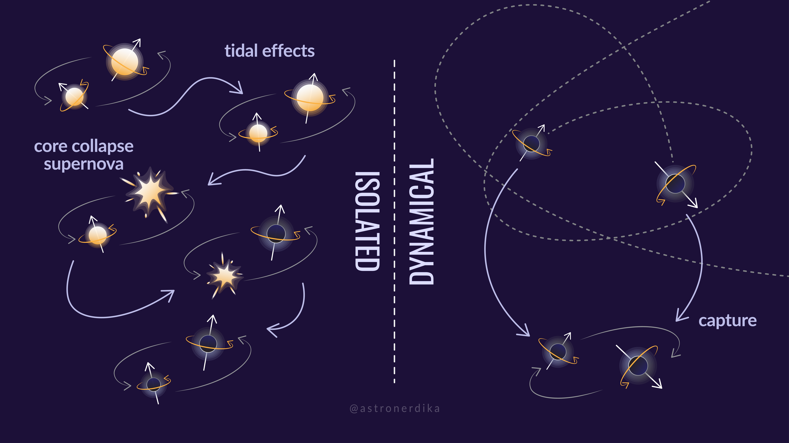
Formation Channels of Compact Binary Mergers
Notes:
So how are they formed? Well there’s two kinds. Isolated and dynamical
In isolated, pair of stars live life together, two NS formed sequentially through SN
In dynamical, system originate densely populated stellar environments - globular clusters
My research is focused on the formation of DNS via the isolated evolution channel. 🐒

