Slide 2
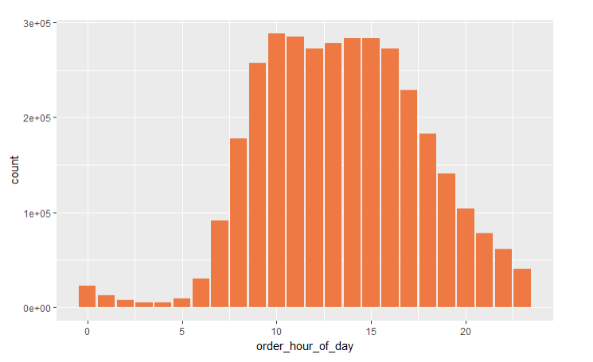
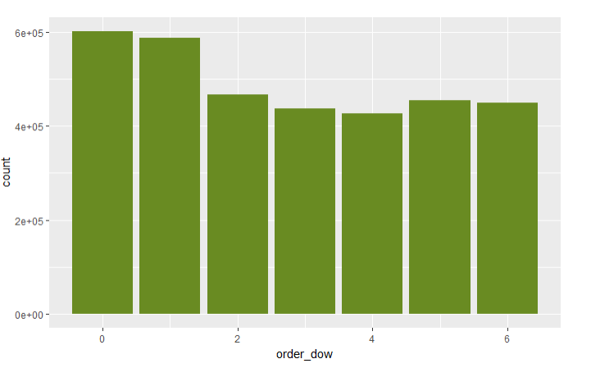
When do people order?
Hour of Day
Day of Week

Slide 3
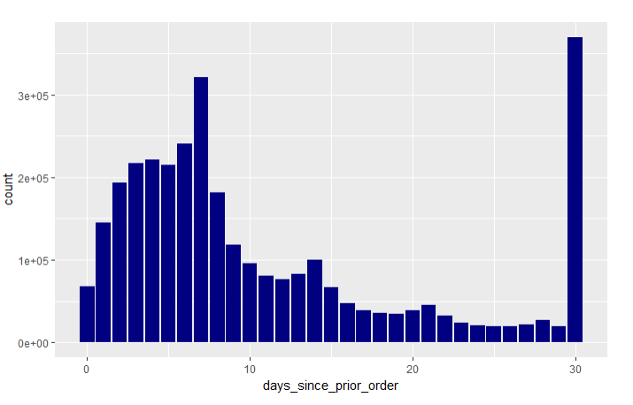
When do they order again?
People seem to order more often after exactly 7 days, 14 days and 30 days.

Slide 4
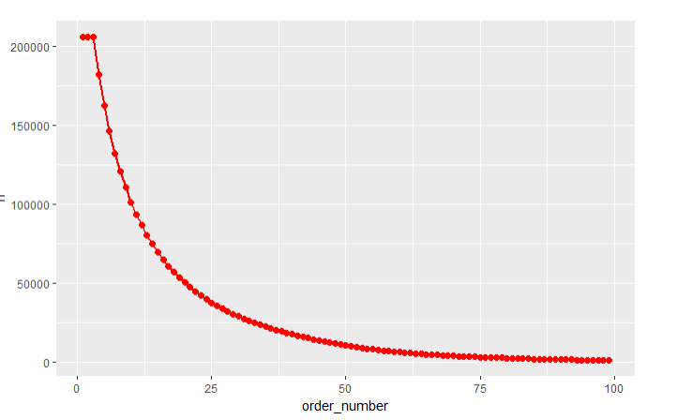
How many prior orders are there?
We can see that there are always at least 3 prior orders.

Slide 5
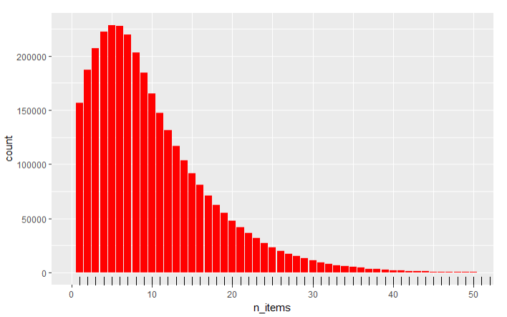
How many items do people buy?
We can see that people most often order around 5 items. The distributions are comparable between the train and prior order set.

Slide 6
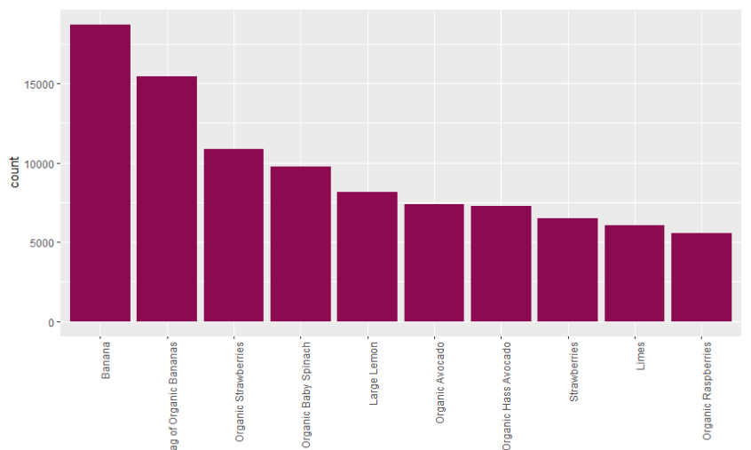
Bestsellers
Let's have a look which products are sold most often (top10). And the clear winner is Bananas

Slide 7
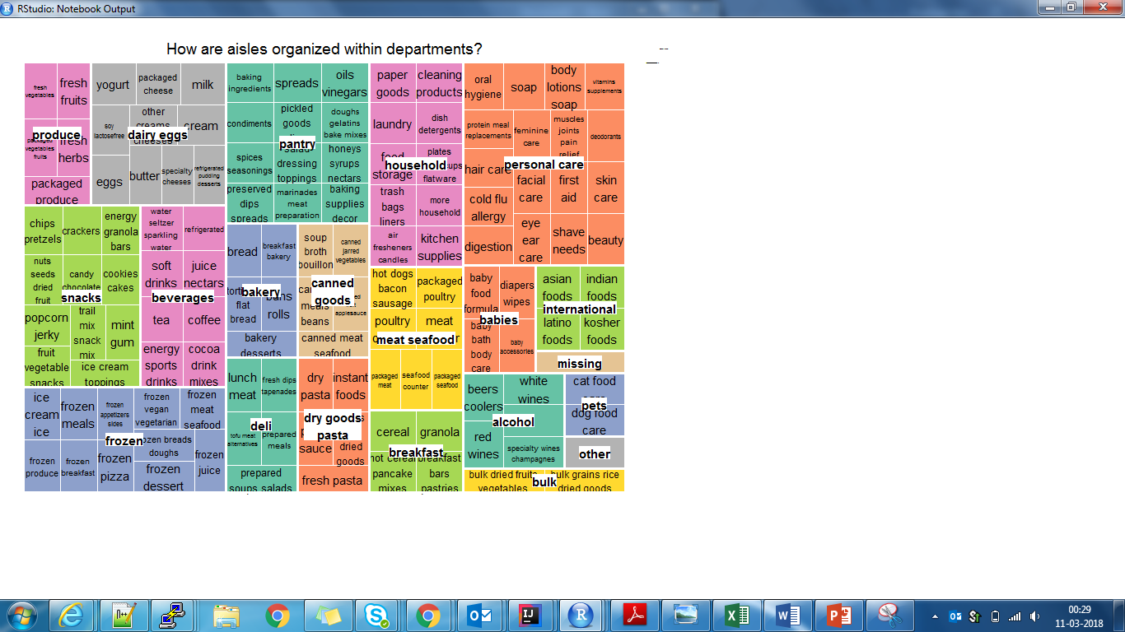
Product Portfolio

Slide 8
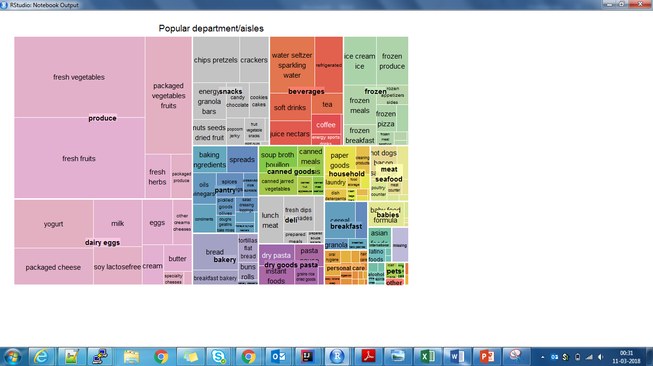
How often are products from the department/aisle sold?

Slide 9
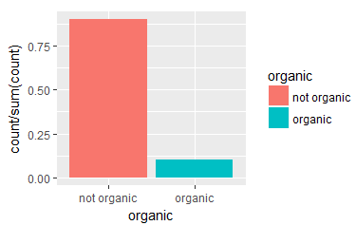
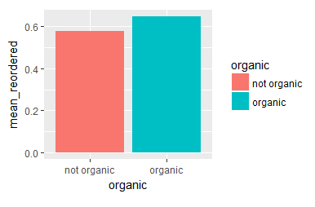
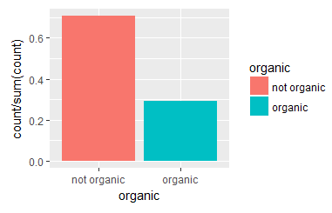
Organic vs Non-organic
Products
Reorders
Orders

Slide 10
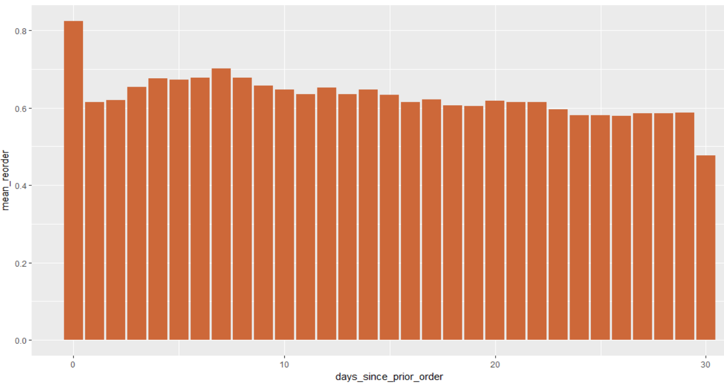
Association between time of last order and probability of reorder

Slide 11
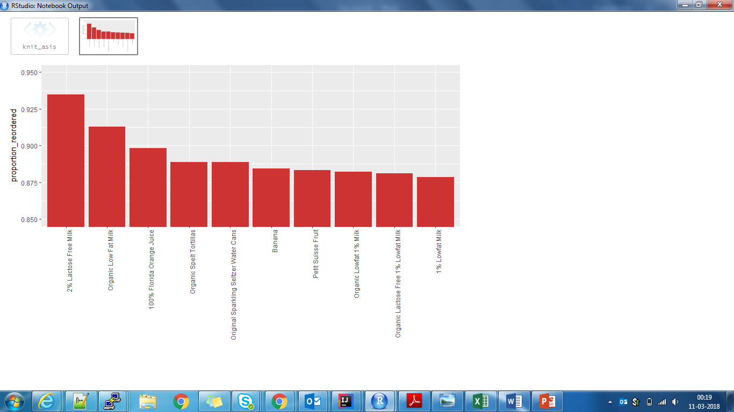
Most often reordered

Slide 12
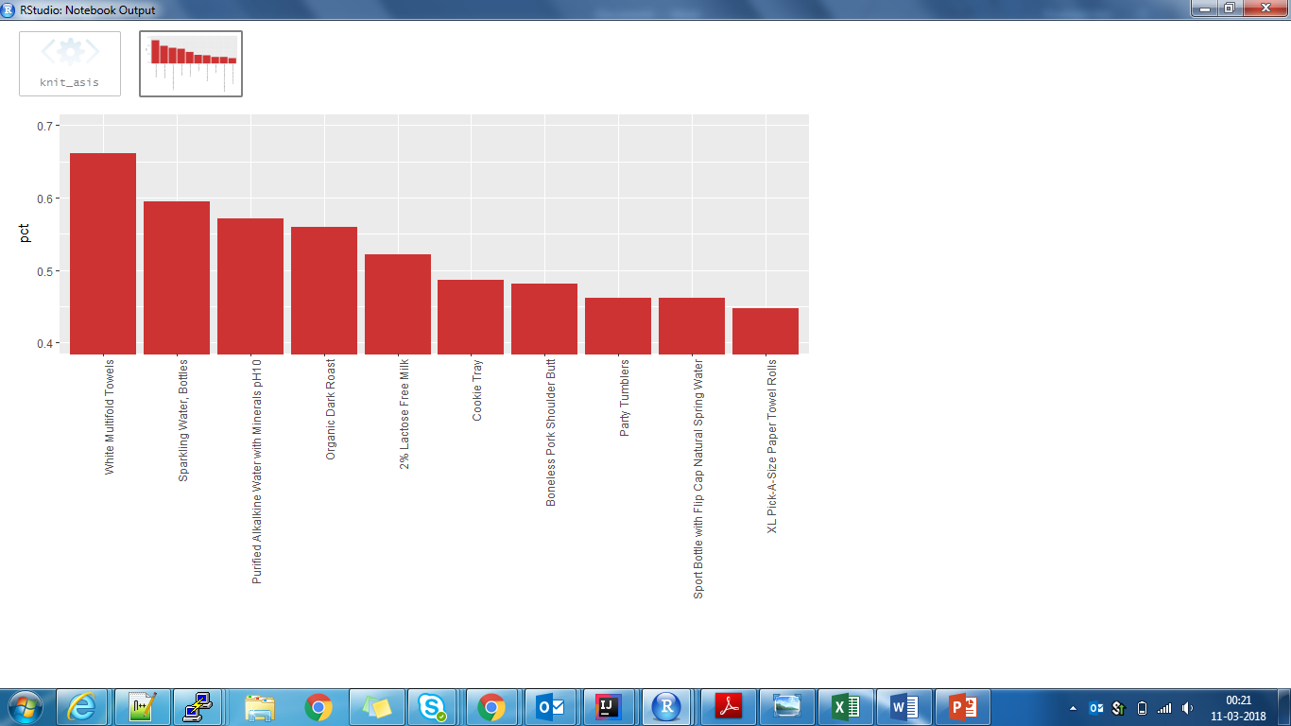
Which item do people put into the cart first?

