Slide 1

Applying Data Science to Instacart’s Public Dataset

Slide 2
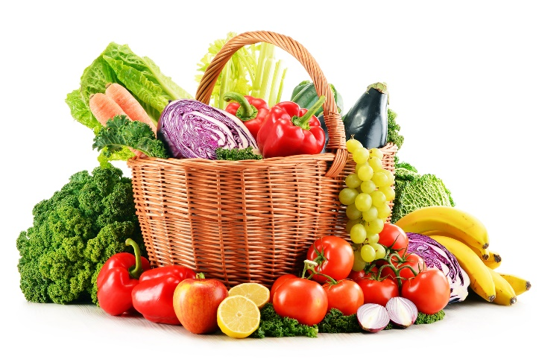

What is Instacart?
Online grocery app which ensures same-day delivery
Operating in US
Similar to Big Basket and Grofers in India
Instacart open-sourced anonymized dataset last year
Used for Kaggle competition

Slide 3
What do we have?
3.4 million grocery orders
200k users
50k products
30 million order-products information
134 aisles
21 departments

Slide 4
Initial Idea: Things we can do!
Exploratory Data Analysis
Market Basket analysis
Customer Segmentation
Predict customer’s next order

Slide 5
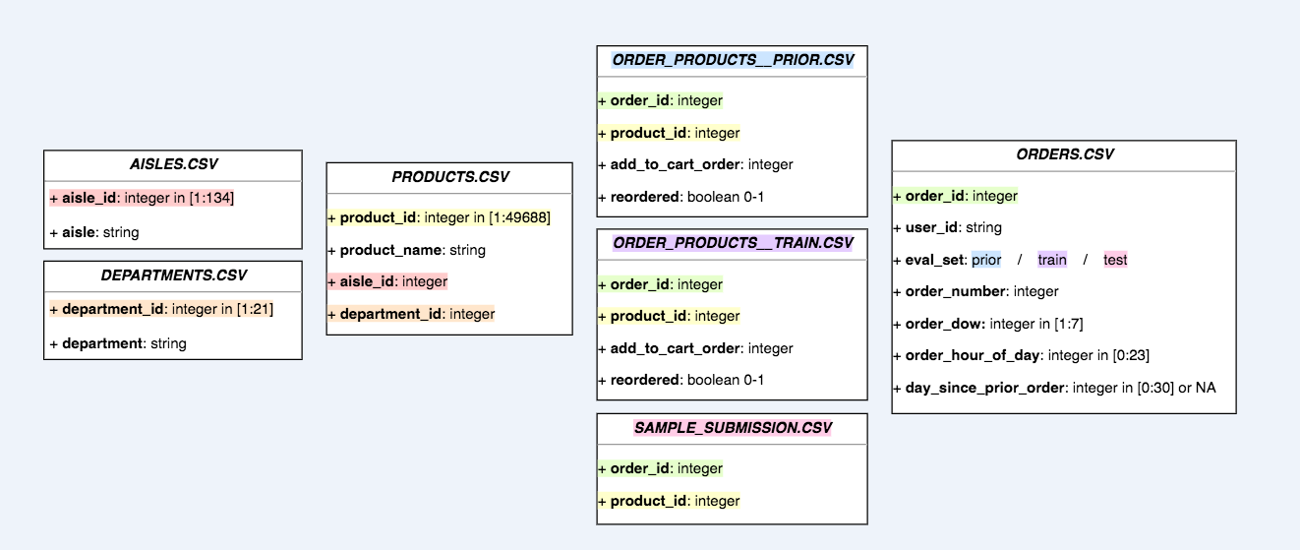
Let’s have a deeper look at the data
Six CSV Files
Orders
Products
Order_Products
Departments
Aisles
Clean data, Not many missing values. So, Data Cleaning not required

Slide 6
Exploratory Data Analysis

Slide 7
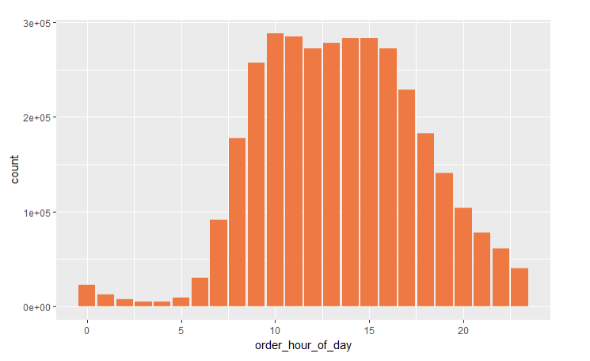
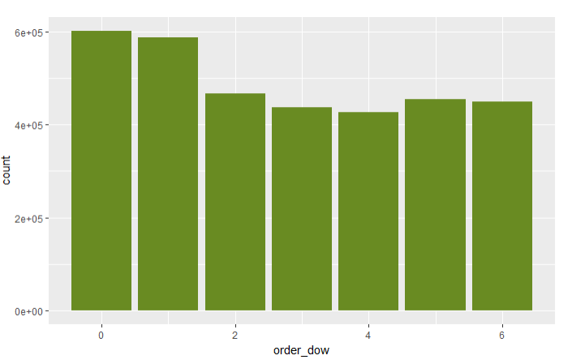
When do people order?
Hour of Day
Day of Week

Slide 8
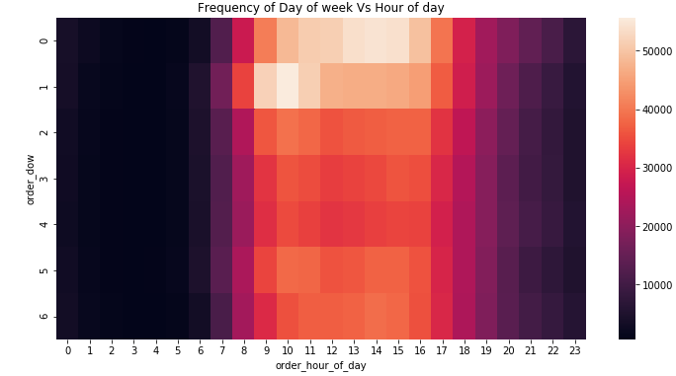
Frequency of Day of week vs Hour of day

Slide 9
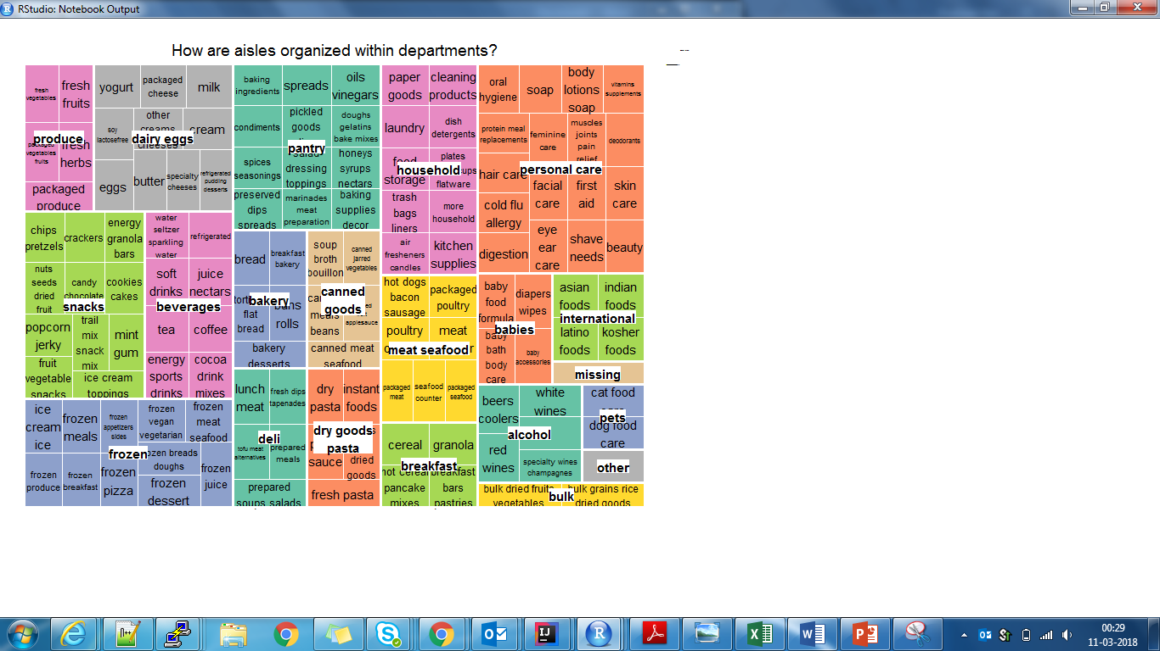
How are aisles organized within departments?

Slide 10
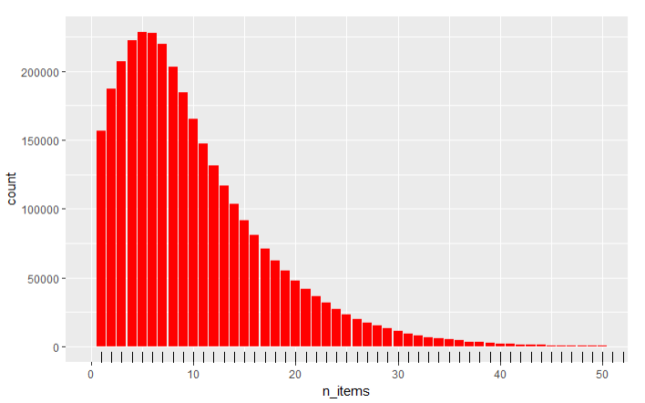
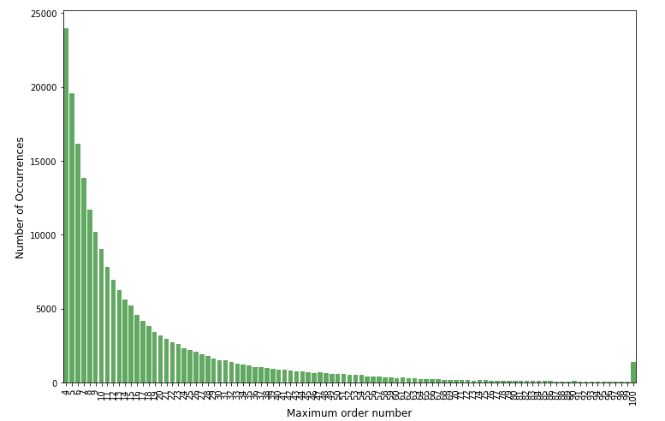
How many prior orders are there?
How many items do people buy?
We can see that there are always at least 3 prior orders.
We can see that people most often order around 5 items. The distributions are comparable between the train and prior order set.

Slide 11
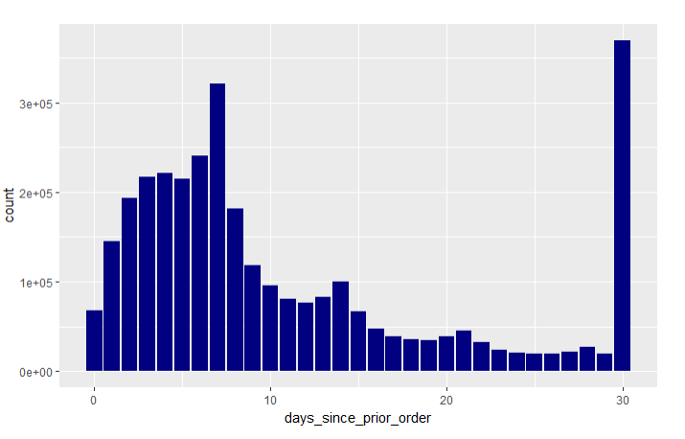
When do they order again?
People seem to order more often after exactly 7 days, 14 days and 30 days.

Slide 12
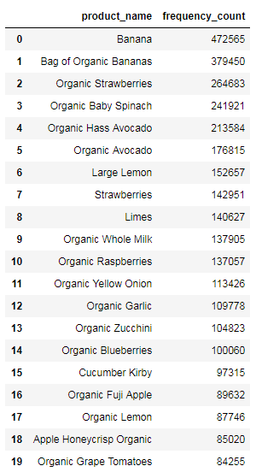
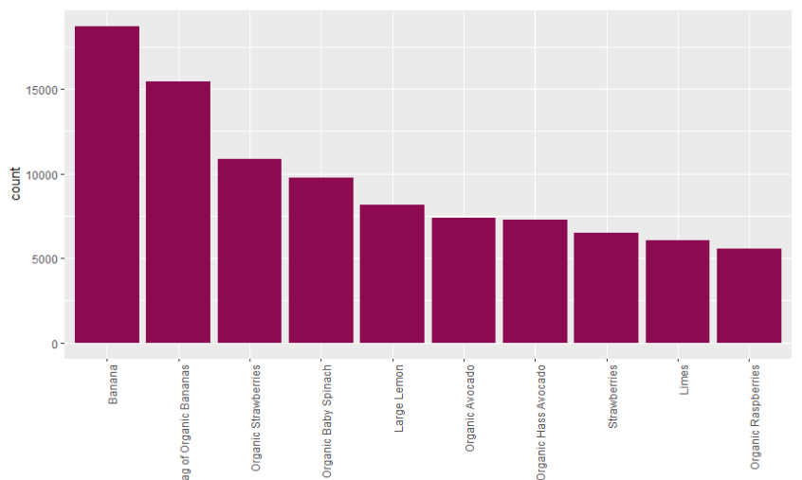
Bestsellers
Let's have a look which products are sold most often (top10). And the clear winner is Bananas

Slide 13
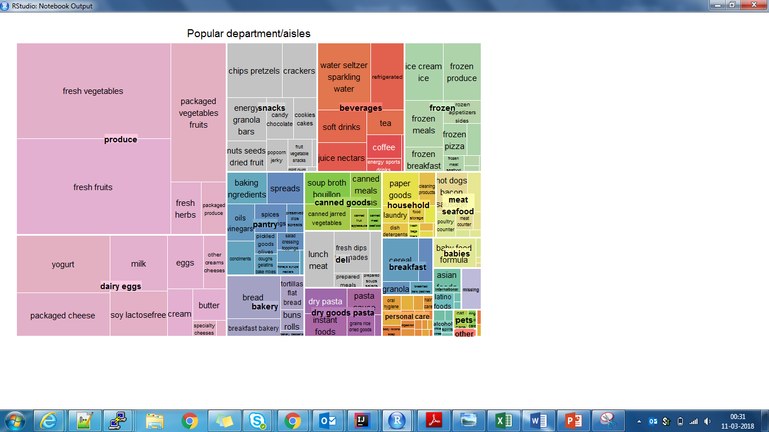
How often are products from the department/aisle sold?

Slide 14
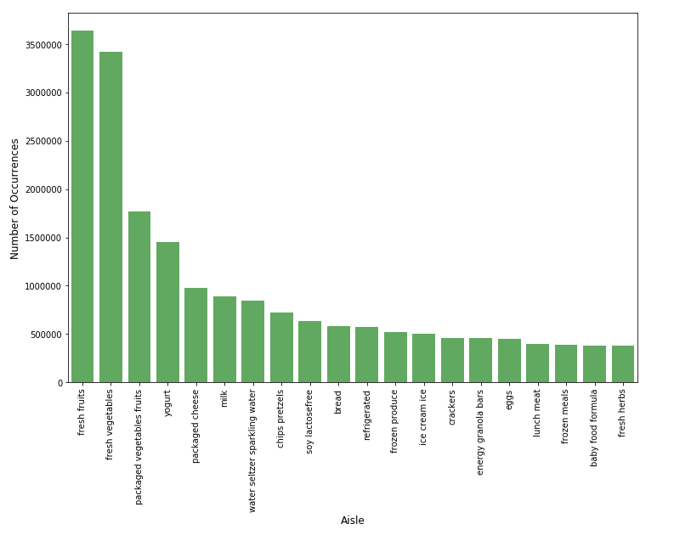
How often are products from the department/aisle sold?

Slide 15
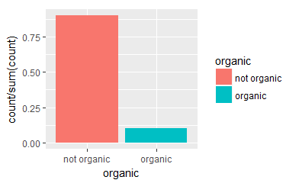
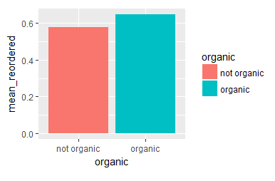
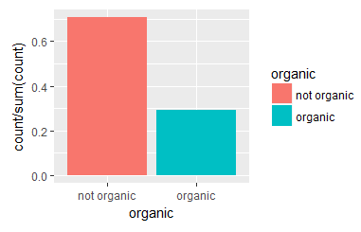
Organic vs Non-organic
Products
Reorders
Orders

Slide 16
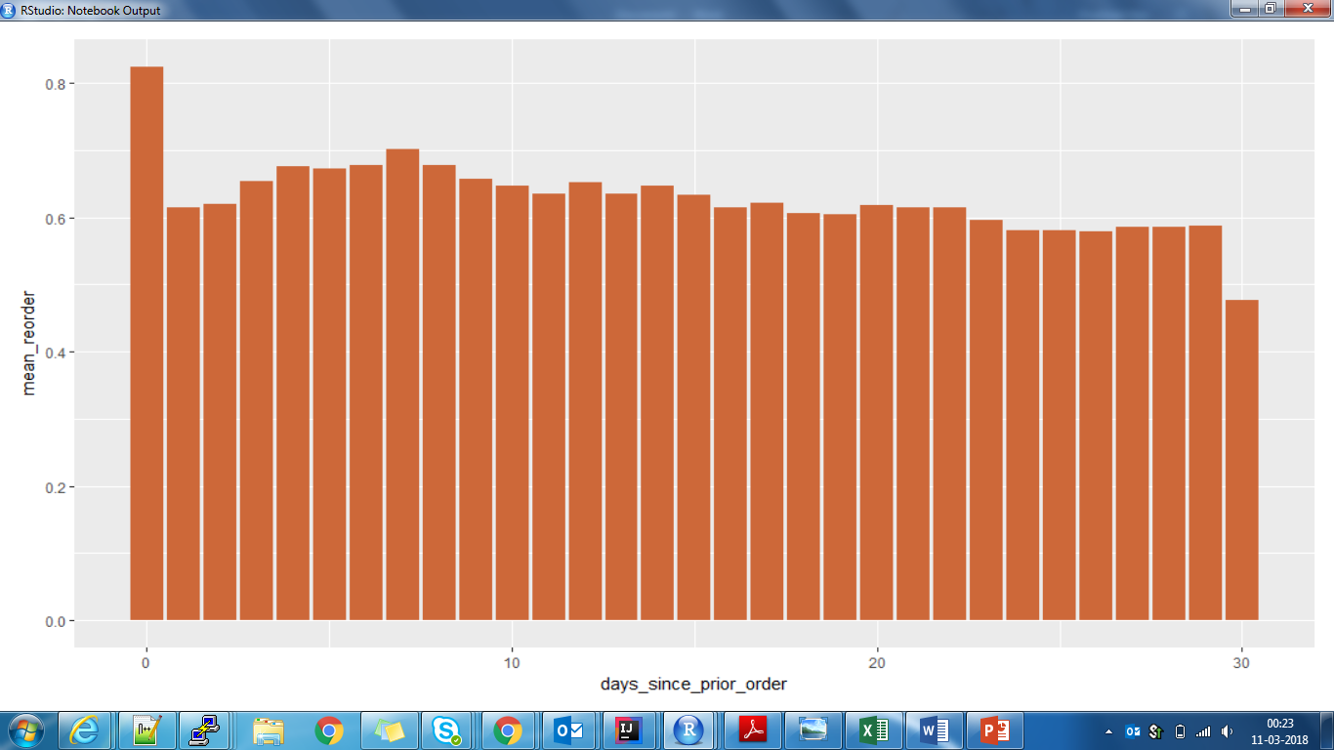
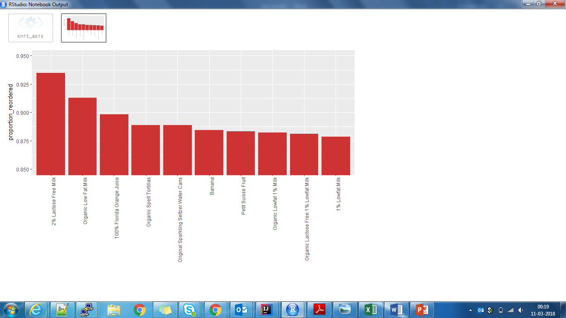
Most often reordered
Association between time of last order and probability of reorder

Slide 17
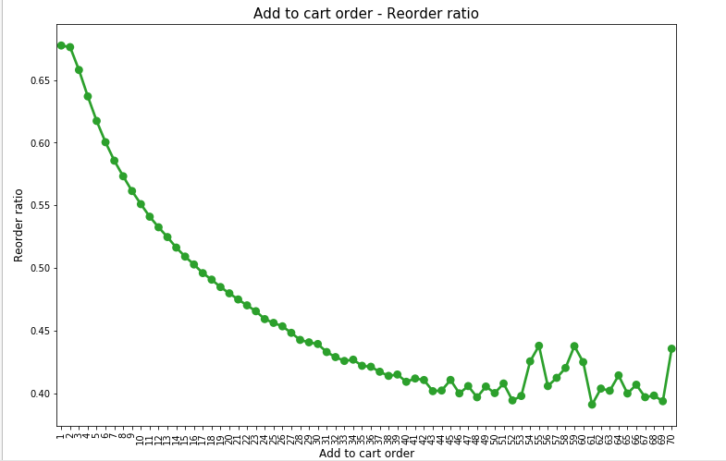
Reordered items are put to the cart first!

Slide 18
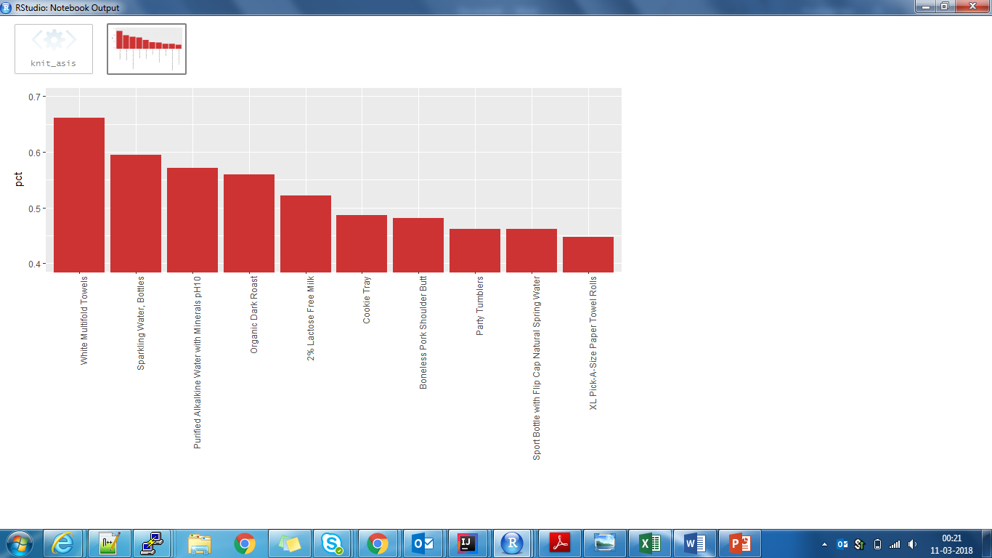
So what do people put into the cart first?

Slide 19
Some interesting findings!
Fruits are reordered more frequently than vegetables
Staples like soups and baking ingredients are least likely to be ordered
Healthier stacks purchased earlier in the day
Ice-creams are far more popular in the evening
Most reordered products are added first to the cart

Slide 20
Association analysis / Market Basket Analysis

Slide 21
Let’s revise the terminology!
Mining frequent itemsets and association rules to understand buying patterns
Support
how popular an itemset is
proportion of transactions in which an itemset appears
Confidence
how likely item Y is purchased when item X is purchased, expressed as {X -> Y}
measured by the proportion of transactions with item X, in which item Y also appears
Lift
how likely item Y is purchased when item X is purchased, while controlling for how popular item Y is
lift > 1 means that item Y is likely to be bought if item X is bought
lift < 1 means that item Y is unlikely to be bought if item X is bought

Slide 22
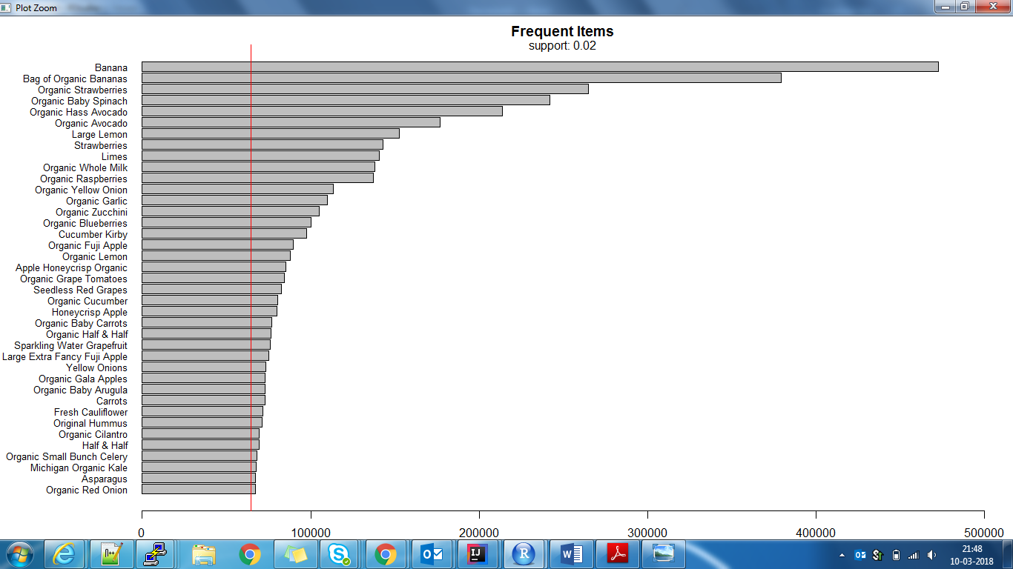
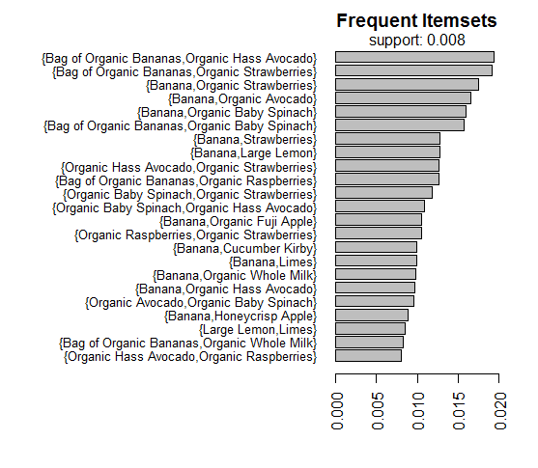
Frequent items (support=0.02)
Frequent itemsets (support=0.008)

Slide 23
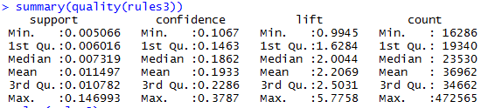
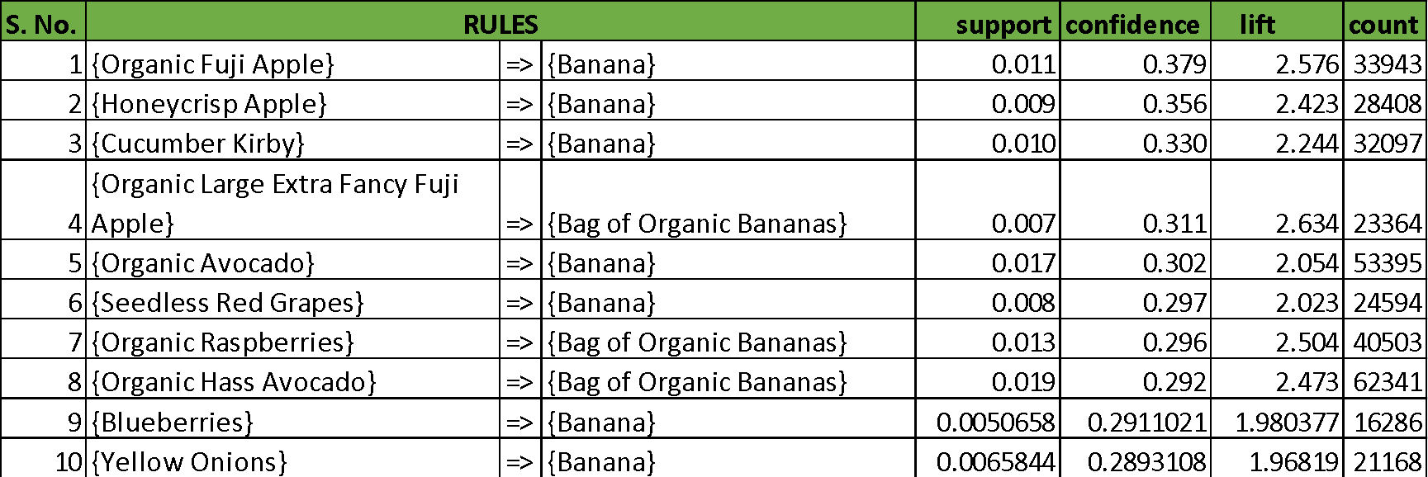
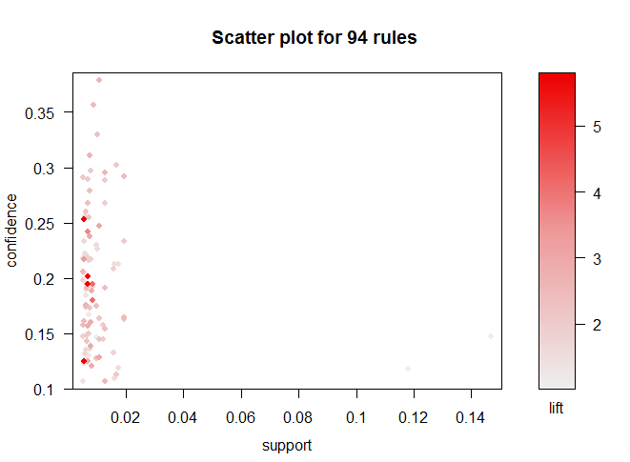
Association Mining with support=0.005, confidence=0.1
Top 10 rules by Confidence

Slide 24
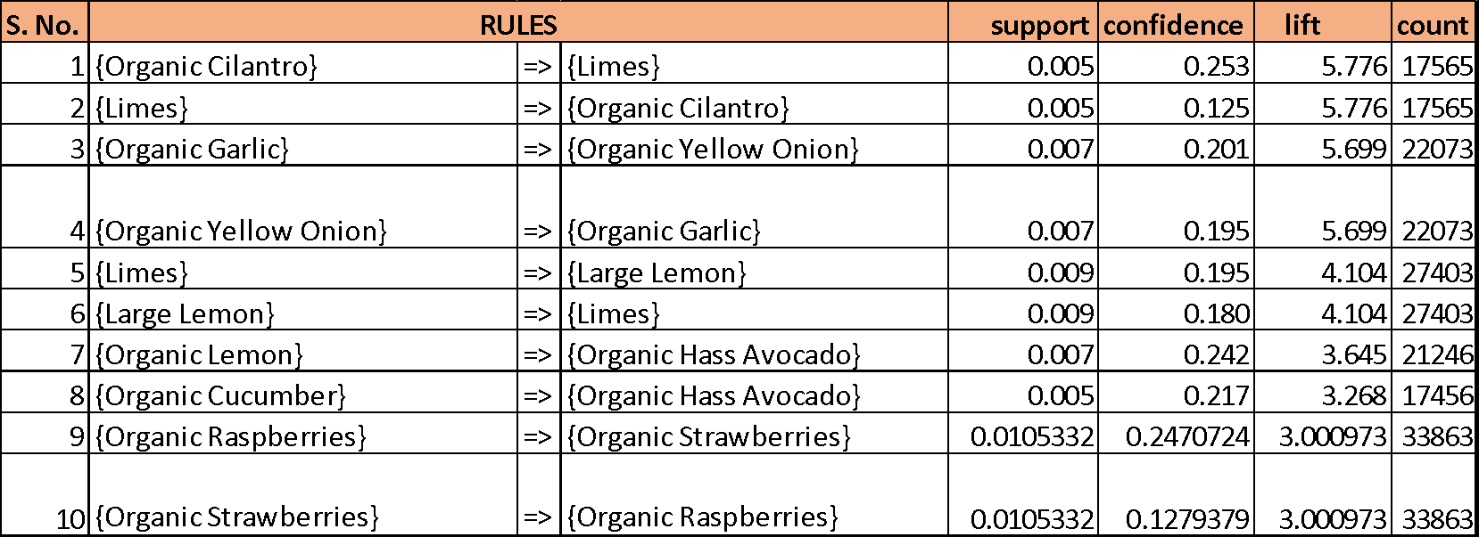
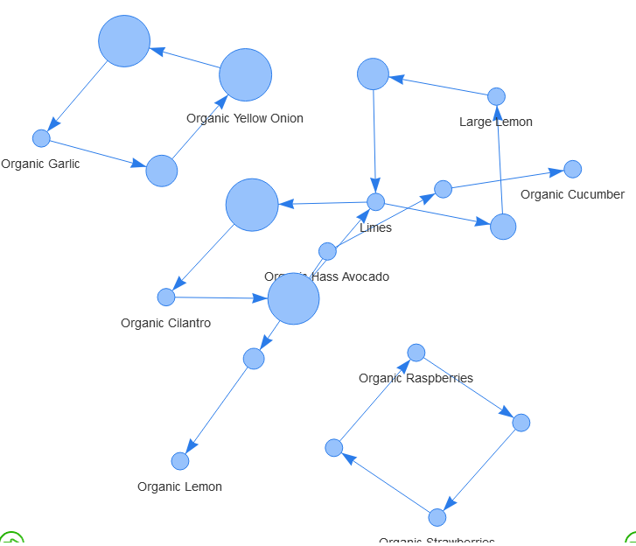
Recommendations
Top 10 rules by Lift
Bananas and Strawberries stand first in all charts. People simply love these!
Fresh Fruits and vegetables are the best sellers, as also seen by exploratory data analysis.
Some rules, though their support is quite less, have very high Lift values. Since this is such a huge dataset, even a support of 0.0002 can prove to be helpful in case of Association analysis.
The listed rules can be used for Recommendation feature in Instacart app. For eg. Someone ordering Moisturizing face wash can be recommended to also look at moisturizing non-drying face wash; as depicted by a huge Lift score.
Organic products can be bundled together!

Slide 25
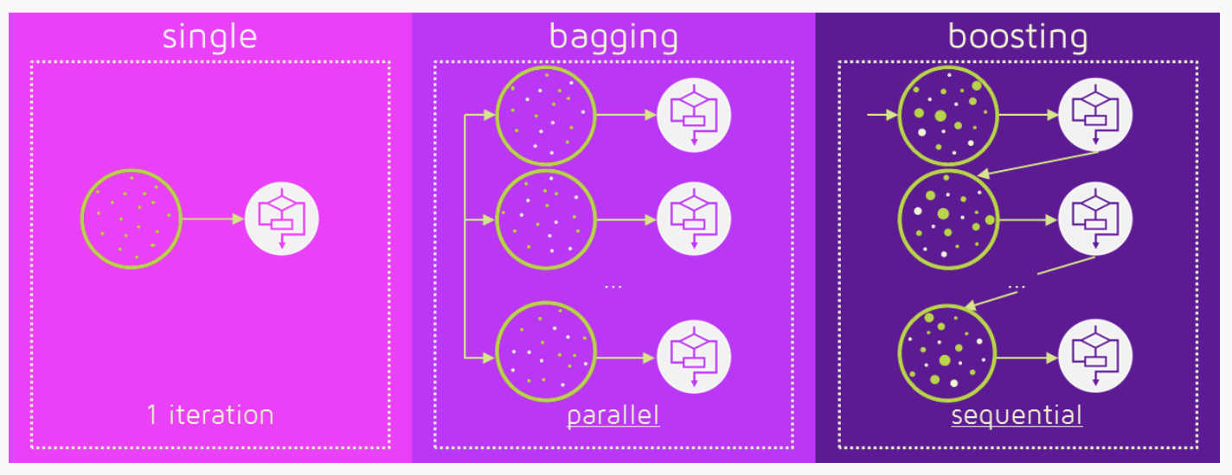
Ensemble
Collection of predictors which come together to give a final prediction
Helps to reduce noise, variance, bias
Bagging
Build many independent predictors/models/learners and combine them using averaging techniques (Eg. Weighted average, majority vote)
Boosting
Predictors are not made independently, but sequentially
Subsequent predictors learn from mistakes of previous predictors
observations have an unequal probability of appearing in subsequent models and ones with the highest error appear most
takes less time/iterations to reach close to actual predictions
Have to choose stopping criteria to avoid overfitting

Slide 26
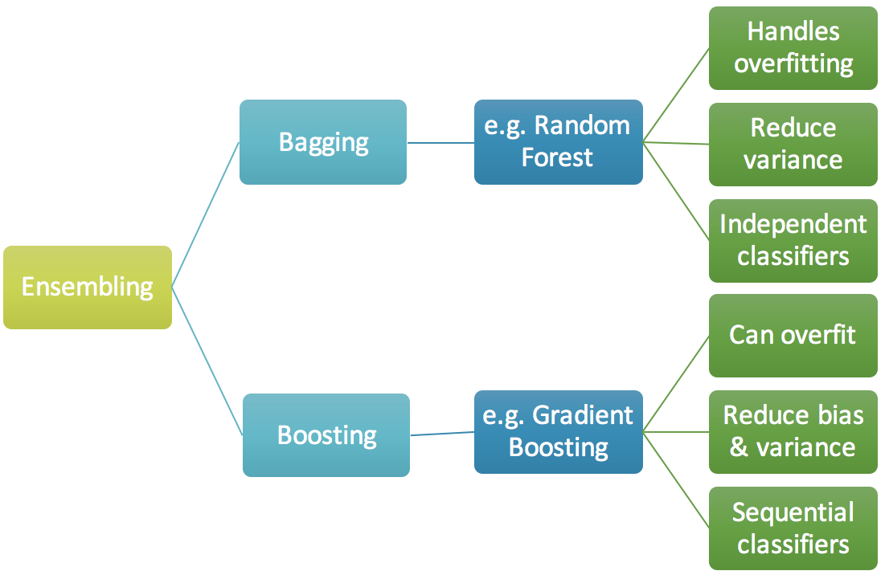
We used Boosting!
Boosting
We first model data with simple models and analyze data for errors.
These errors signify data points that are difficult to fit by a simple model.
Then for later models, we particularly focus on those hard to fit data to get them right.
In the end, we combine all the predictors by giving some weights to each predictor.

Slide 27
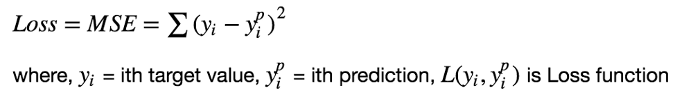
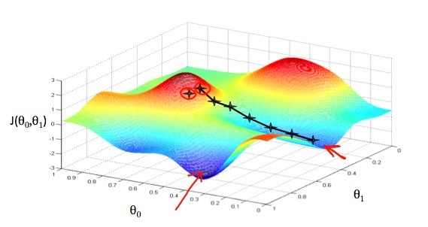
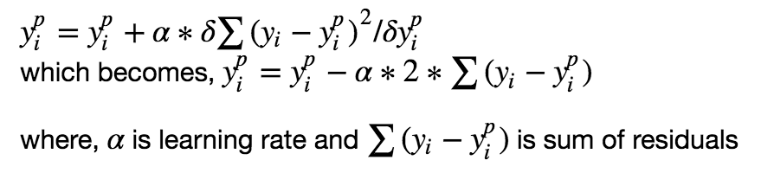
Gradient Boosting
ML technique for regression and classification problems
Produces a prediction model in the form of an ensemble of weak learning models, typically decision trees
By using gradient descent and updating our predictions based on a learning rate, we can find the values where MSE is minimum.

Slide 28
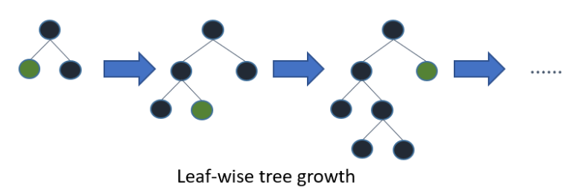
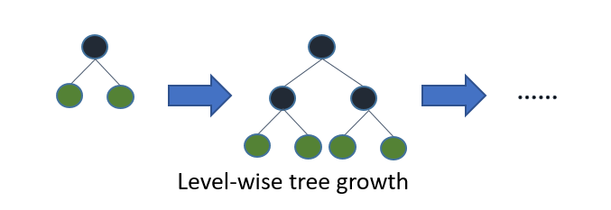
Light GBM
Light GBM is a gradient boosting framework by Microsoft
Uses tree-based learning algorithm
Leaf wise tree growth in LightGBM as compared to Level wise tree growth in XGBOOST
Leaf Wise tree growth
Level Wise tree growth

Slide 29

What is F1 SCORE?
F1 score is a statistical measure of classification test's accuracy
considers both the precision p and the recall r
Precision = (number of correct positive results)/(number of all positive results)
p= TP/(TP+FP)
Recall =(number of correct positive results)/(number of all relevant samples)\
R=TP/(TP+FN)
F1 score is the harmonic average of the precision and recall
Best score: F1 score= 1 (perfect precision and recall),
Worst: 0

Slide 30
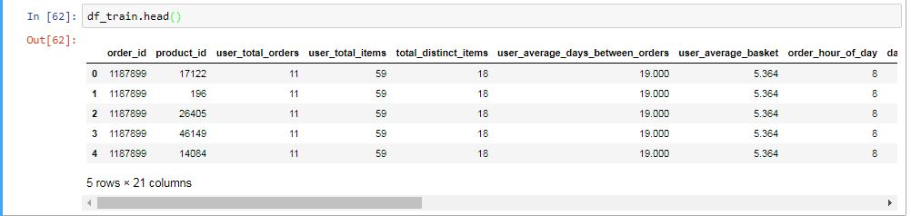
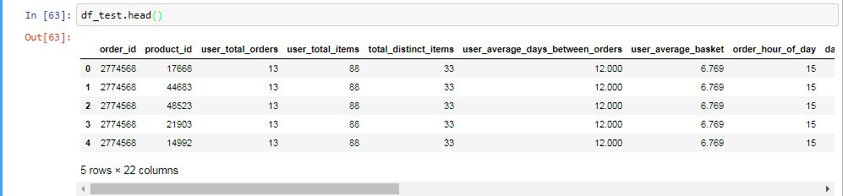
Feature extraction
started from the initial set of measured data and built derived values (features) intended to be informative and non-redundant
this facilitated the subsequent learning and generalization steps
developed a set of features by combining existing variables, to be fed into the Light GBM model

Slide 31
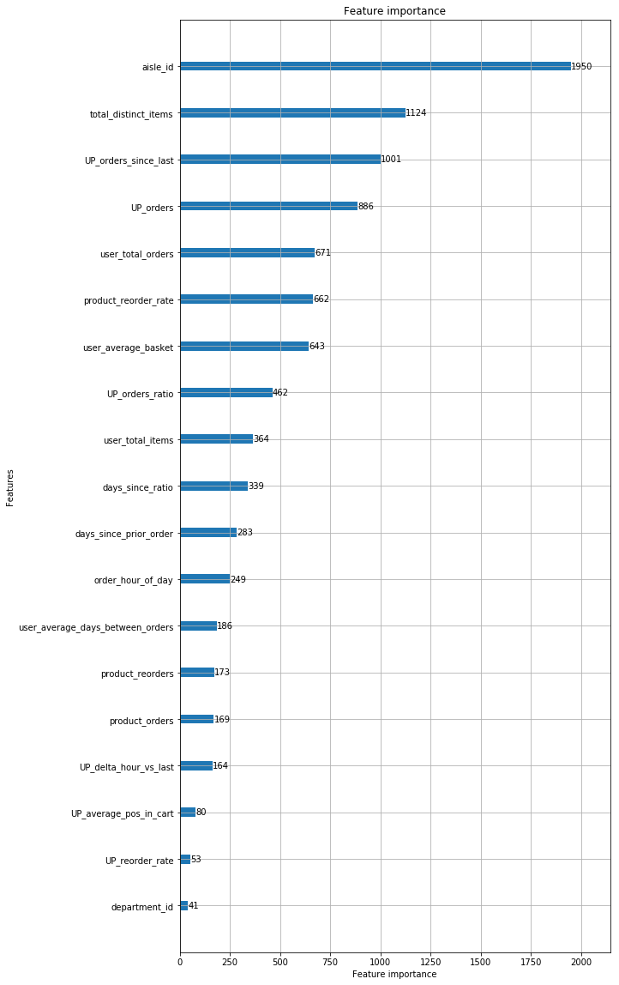
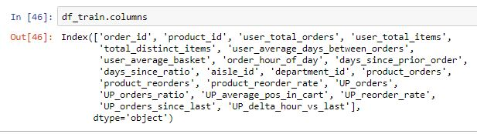
Feature selection
Features used
Features Importance

Slide 32
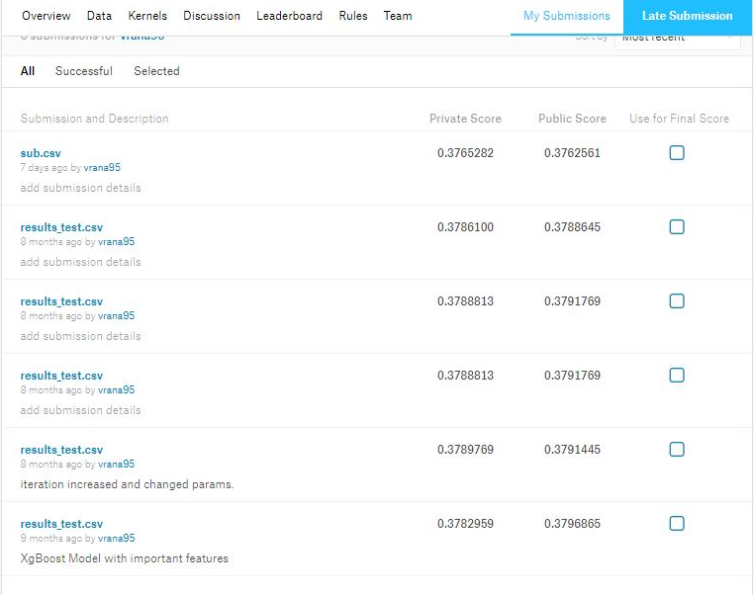
Model Validation/ Testing

Slide 33
Final Results
Result with maximum F1 score of 0.4001449
We scored 0.3762561

Slide 34
Thanks!

