Slide 1
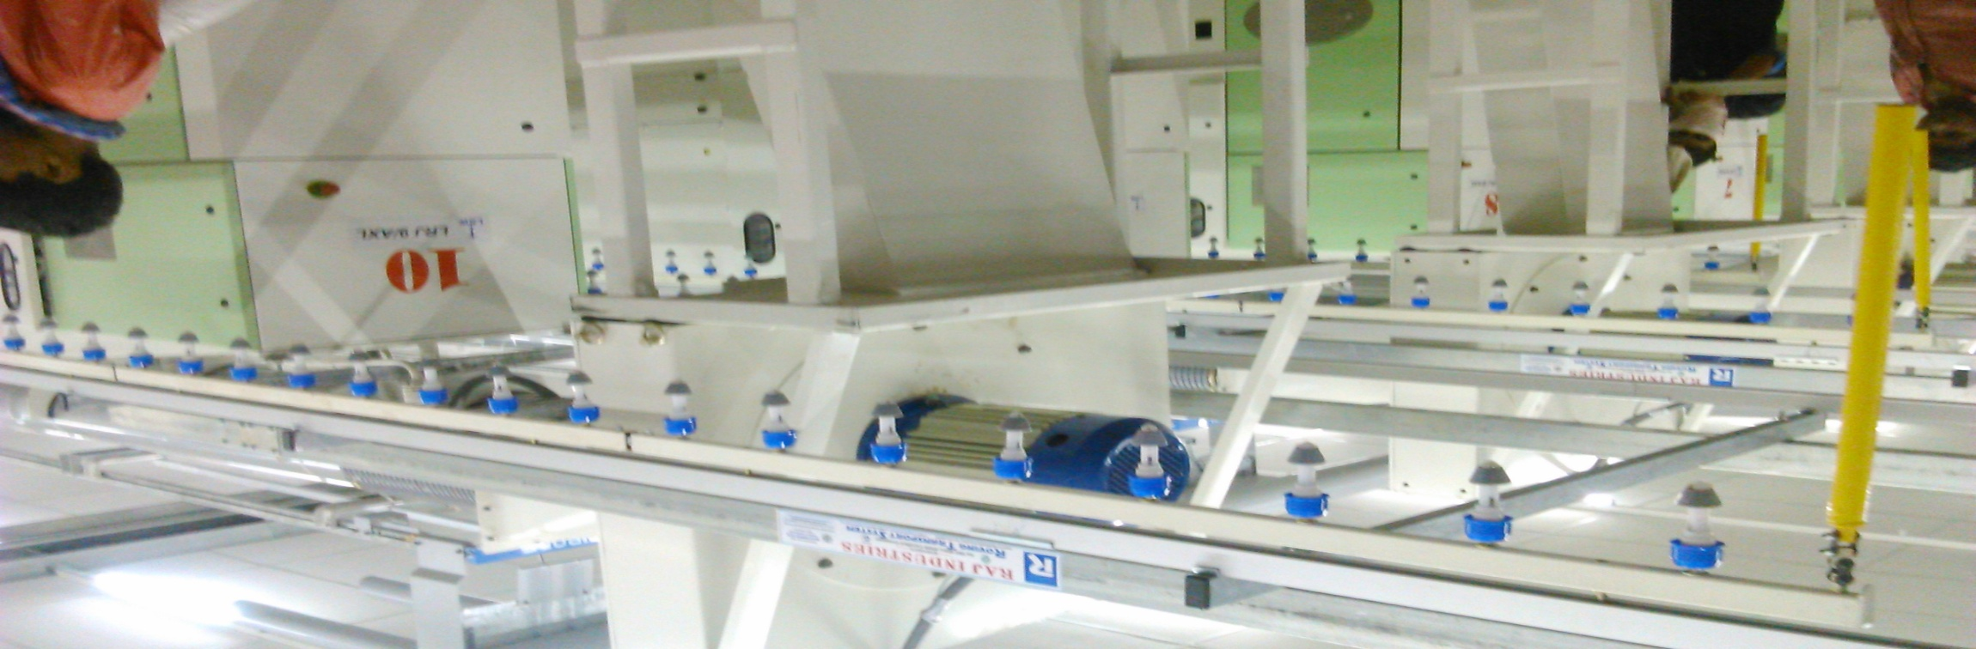


RAJ INDUSTRIES, BARAMATI
ROVING TRANSPORT SYSTEM
(RTS/BTS)
D 42, MIDC, Baramati - 413133, Pune, Maharashtra, INDIA. e - mail rajindustries@msn.com info@rajindustries.org
Mobile - +91 98230 29550, Phone : +91 2112 243210

Slide 2
ABOUT US
Established in the year 1995 in Maharashtra
Since inception, we have been involved in maintaining and servicing machines used in Textile Industry
Offered by us - Roving transport system

Slide 3
ROVING TRANSPORT SYSTEM
It Plays the roll for transfer of bobbin from Speed frame Ring frame creel

Slide 4
Types of RTS/BTS
Manual RTS/ BTS
Semi Automatic RTS/ BTS
Full Automatic RTS/ BTS

Slide 5
Semi/Full Automatic RTS/BTS
Advantages
Disadvantages
Less manpower required
High quality
3-10 times higher cost
High skilled labor required
Electricity required
Maintenance time and cost high
Low productivity

Slide 6
Manual operated RTS system
Less manpower required
High quality
Optimal cost
Unskilled labor can operate
Electricity not required
High productivity
No maintenance; saves time and cost

Slide 7

Diagrammatical presentation

Slide 8
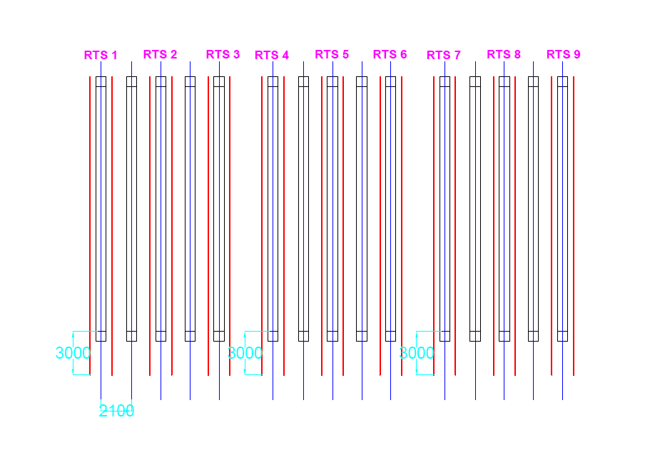
Layout

Slide 9
MILLS USING ROVING TRANSPORT SYSTEM (RTS)
Total clients in India = 72
Under execution = 10
In Bangladesh = 03

Slide 10
Marketed By………..
India
Inquiry for Bangladesh
MACHINETEX (INDIA) AGENCIES
612 Presinge Indi Estate Bawadi
Cross Lane , off Marve road Malad (W) Mumbai 400 064
e-mail: machinetexindia@rediffmail.com
Engineering Bangla Tex
Munjuri Bhaban (3rd Floor)
Room No.402.8.D.I.T. Avenue
(Ext) East Road, Motijheel C/A
Dhaka-1000,Bangladesh
Mobile:+88-01715404898,01829 641816
e-mail: banglatex80@yahoo.com / infobanglatex@gmail.com

Slide 11
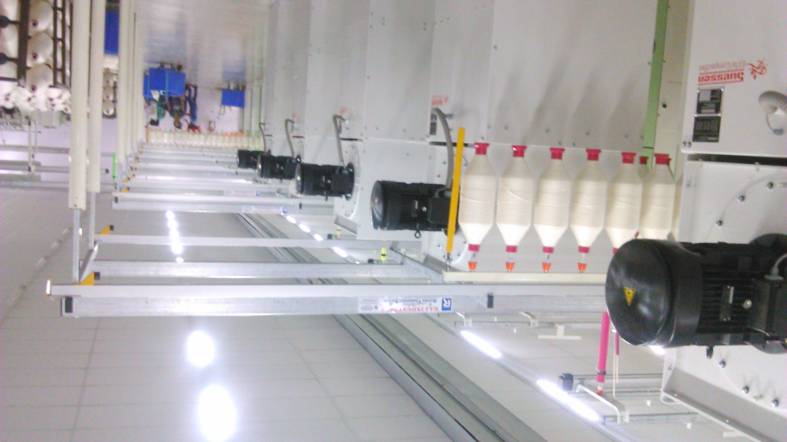
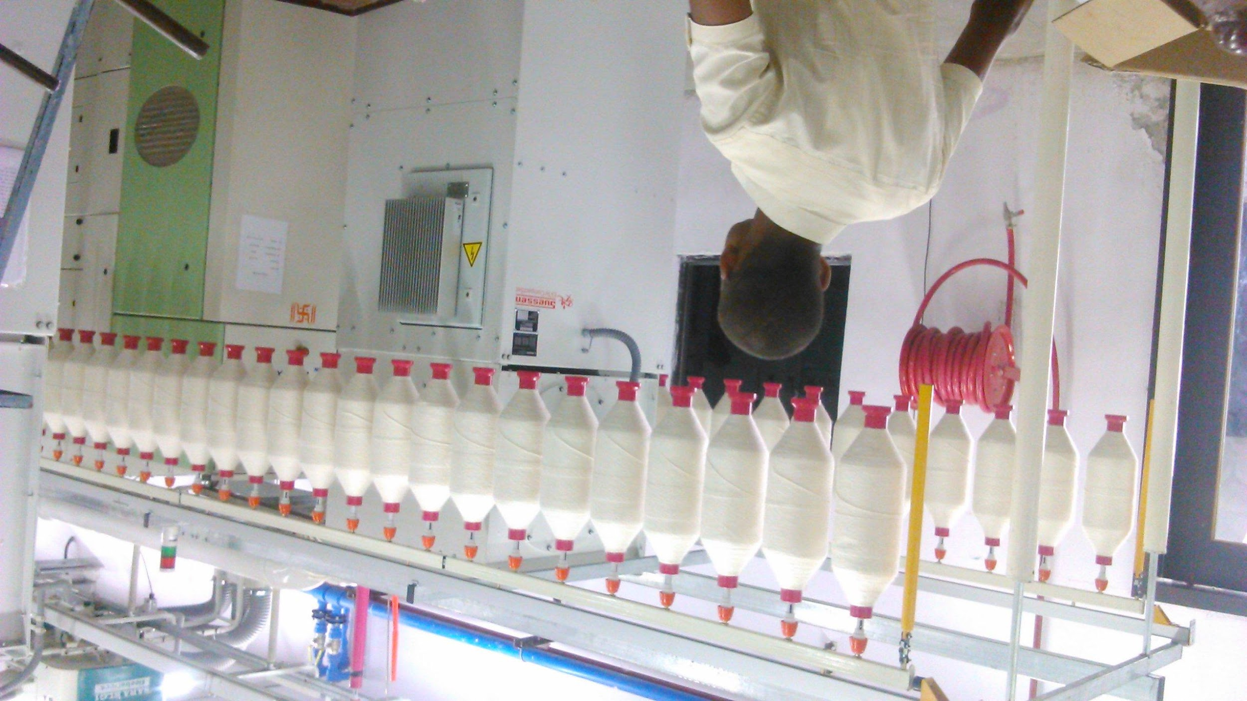
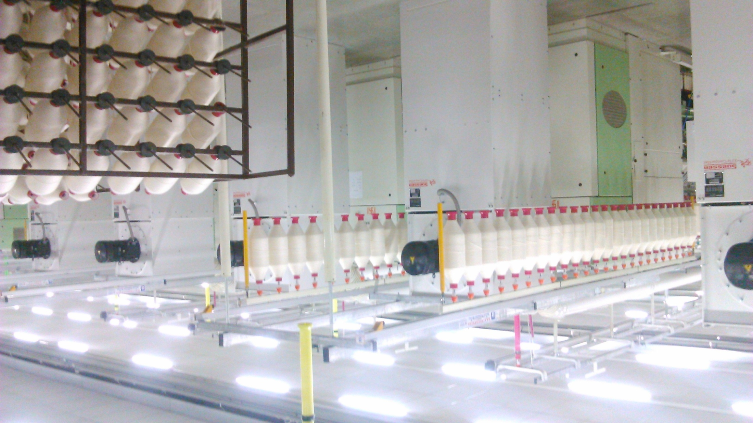
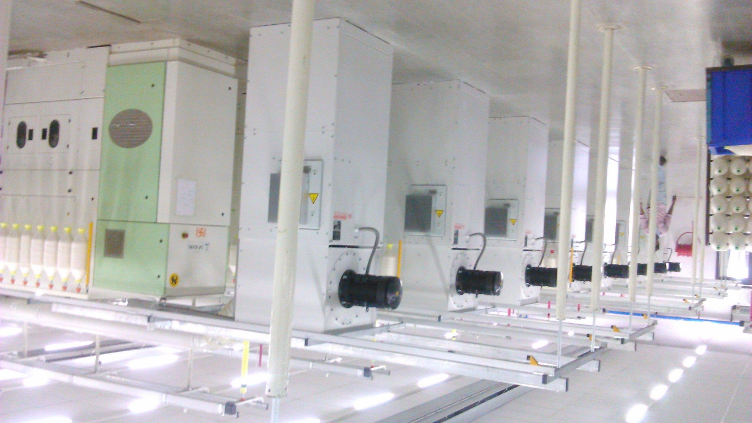

Photo Gallery

Slide 12
THANK YOU!

