Slide 1
Institute of Engineering, Thapathali Campus Department of Electronics and Computer Engineering
A Presentation on Dodge Racing Car Game
Team Members Md. Afaque Ahmad [ THA075BEI022 ] Munilal Mukhiya [ THA075BEI024 ] Shiv Ranjan Gupta [ THA075BEI039 ] Sushovan Shakya [ THA075BEI046 ]
Supervisor Er. Dipendra Rauniyar

Slide 2
Presentation Outline
Motivation
Objectives
Introduction
How the Program Works
Issues Faced During Development
Further Works
Conclusion
References

Slide 3
Motivation
Will to do something new
Desire to learn something new
Application of theory learned in classes into practice
Improvement of skills

Slide 4
Objectives
To apply the theoretical principles of Computer Graphics into practice, to get familiar with drawing pixels, image processing, etc.
To recreate a classic 2D arcade racing game

Slide 5
Introduction
“Dodge Racing” is a simple 2D arcade game, several variations of which were available as games on mobile phones prior to popularity of smartphones
While the games released before were either coded in C++ or Java, this project is coded in Python, using the Pygame library.
What is Pygame?
Pygame is a cross-platform set of Python modules designed for writing video games. It includes computer graphics and sound libraries designed to be used with the Python programming language.

Slide 6
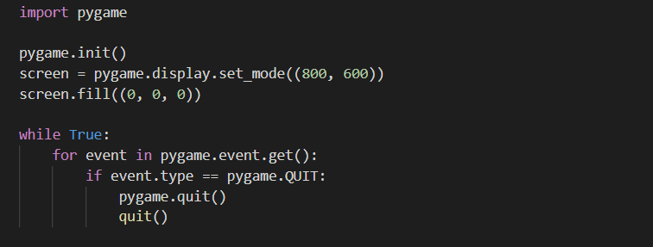
How the program works
The program starts by importing the pygame module, and initializing the program with following block of code.
Here, the resolution of the screen is set with (800, 600), and the screen background is set with the colour black, of which the RGB value is (0, 0, 0).
The main loop of the program is inside the while-loop. The event handler in for loop checks if the user has closed the application or not, if yes, then the application is closed.

Slide 7
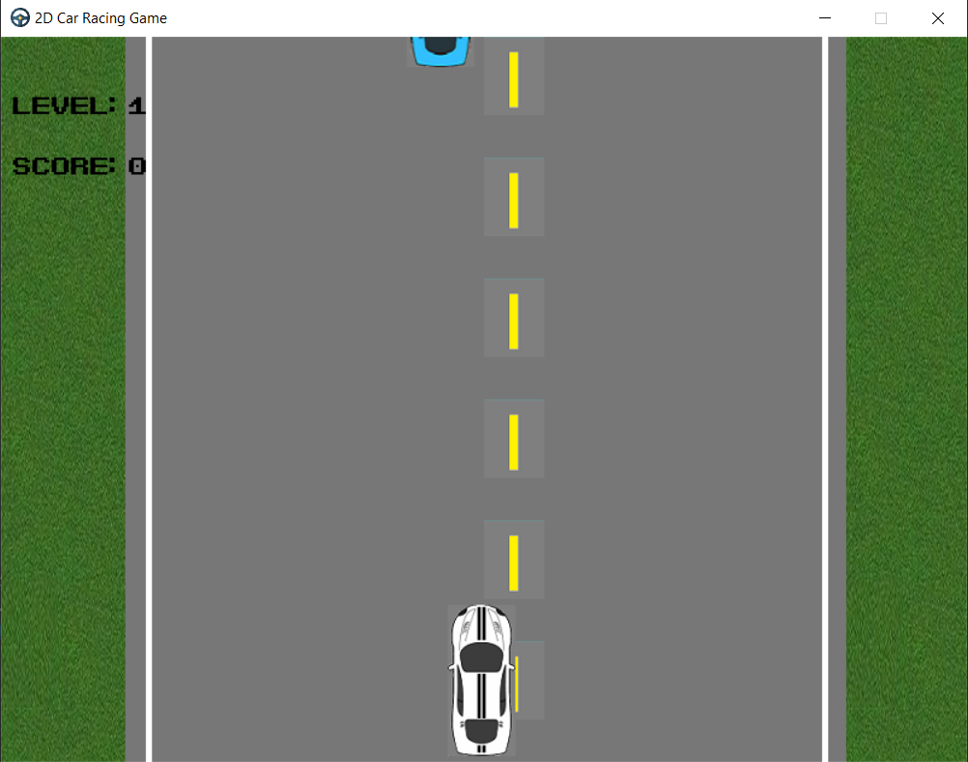
Movement Logic:
Here, the car is positioned at a particular coordinate, which is (370, 470).
When left key is pressed on the keyboard, the x-coordinates of the car is decreased, and it moves leftwards.
When right key is pressed, the x-coordinates of the car is increased, and it moves rightwards.
However, if the boundary is not set, the car will move out of the screen.

Slide 8
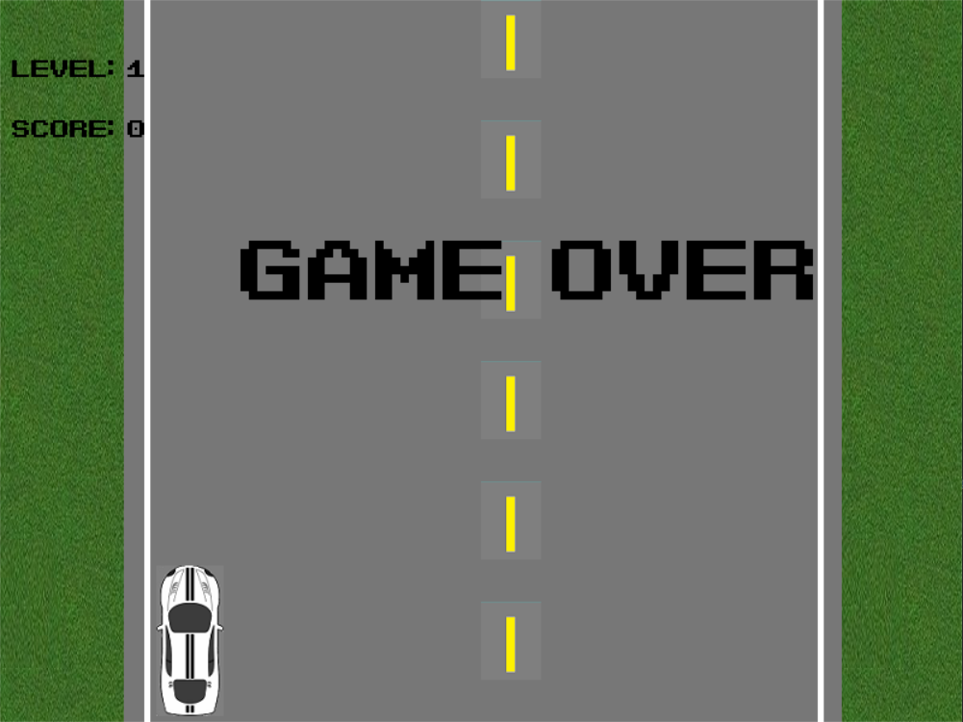
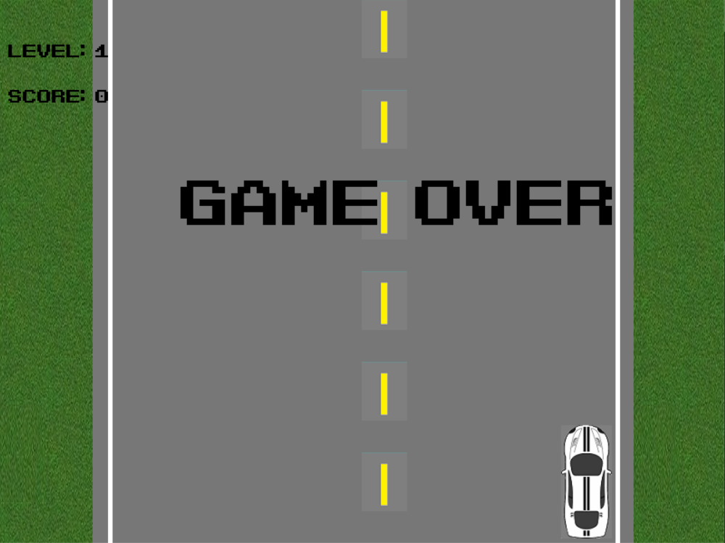
Crash logic:
Boundary-based: when the car moves off the track, it gets crashed. This is done by setting the boundary for the car.
As explained in previous slide, on moving left, the car’s x-coordinates is decreased, while on moving right, the car’s x-coordinates is increased. The boundary of the road can be set at a certain x-coordinates, and if the car’s x-coordinates matches this boundary value, then the car gets crashed.

Slide 9
Enemy-based: This is done by generating the vehicles in the road. When the car touches the oncoming vehicle, the car gets crashed. (In simple words: traffic accident)
The x-coordinates of the enemy is random value, while the y-coordinates is fixed. This is because the enemy car passes from top to bottom of the screen, but can appear anywhere within the x-coordinates of the screen.
When the coordinates of the enemy car equals the sum of coordinates of the player car and the width or the height, then the car is crashed.

Slide 10
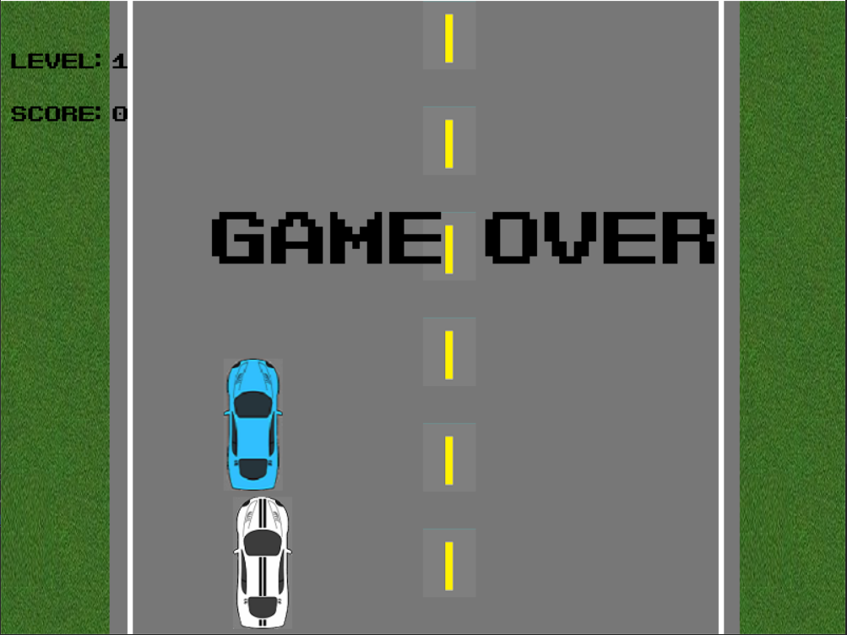
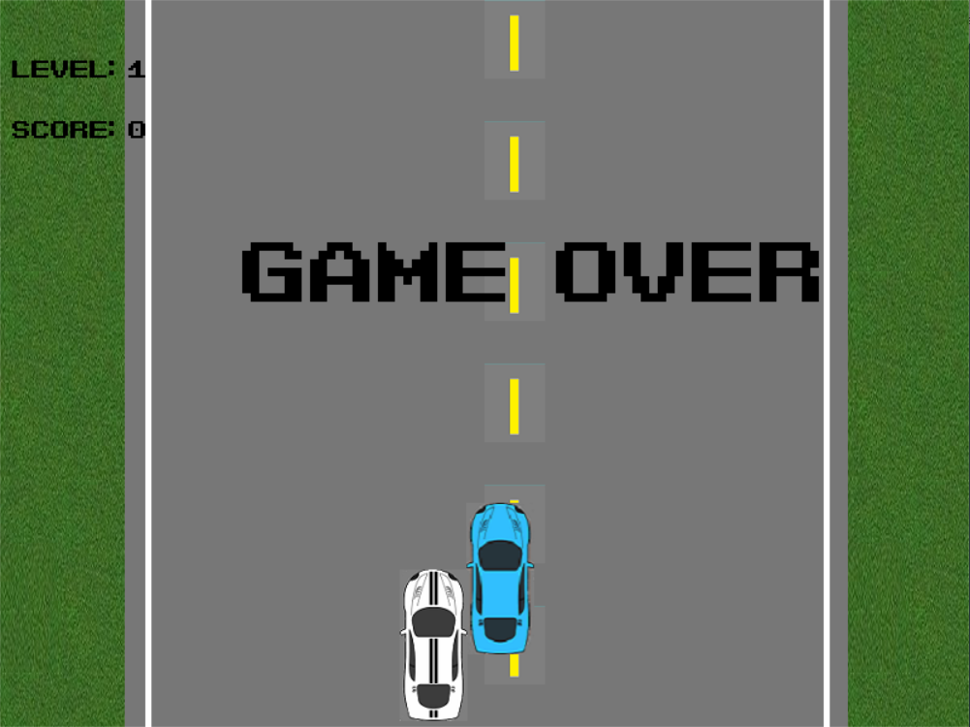

Slide 11
As long as the player car is dodging the oncoming cars, the score is increased.
When the score reaches a certain threshold value, the level of the game is increased.
Upon increasing the level, the pace of the game is increased.
The car can be accelerated by pressing s or decelerated by pressing d. However, the pace of the car cannot get slower than the pace of the level.

Slide 12
Issues faced during development
Manipulating the images, changing its coordinates based on the keys pressed, was difficult.
It was difficult to implement the logic behind the collision of cars in the game.
When the screen size was expanded, the images were distorted.
The application is heavily dependent on the Python version installed on the machine. If the Python version is less than the required version, the program will not run.

Slide 13
Further Works
Since the current version is dependent only on the keyboard, touchscreen support will be added.
We are also planning to make the game gyroscopic, that is, the movement of the car will be based on the movement of the device.
We are also planning of releasing the game on Android and Apple devices.

Slide 14
Conclusion
The Dodge Racing game can be implemented using any programming language. However, we chose Python programming language and the Pygame module due to its ease of use, easy and concise documentation.
The project is a 2D game, as Pygame is specifically made for 2D games, it was easy for us to create this game through the use of easy modules and methods.

Slide 15
References
https://www.pygame.org/docs/
https://devdocs.io/pygame/
Tech with Tim: Pygame programming tutorials https://www.youtube.com/watch?v=i6xMBig-pP4&list=PLzMcBGfZo4-lp3jAExUCewBfMx3UZFkh5

