Slide 1

SDK Moving Target
David Turner

Slide 2

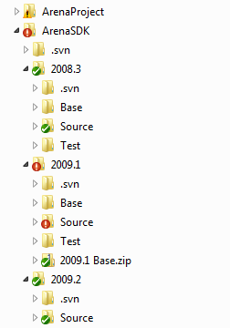

Folder Structure
ArenaSDK folder as root
Subfolder for each targeted version (i.e. 2008.3, 2009.1, 2009.2)
Create a Base, Source, and Test subfolders in each version folder

Slide 3
Base Folder
The Base folder under each version is where you will install the SDK to
After installing the SDK, you should open the project in Visual Studio and run it once to perform the RunOnce logic
After the RunOnce logic has been run, you should never open this project again
Base is used to save a “base” copy of the version’s SDK so that if you need to refer back to it, you can

Slide 4
Source Folder
After installing the SDK to the base folder and running the RunOnce logic you will copy everything in the Base folder to the Source Folder
The Source folder is where you will do all your active development for the specific version
If you have a Source folder from a previous version of the SDK, you should do a file compare between the two Source folders to copy over your custom code from the previous version to the new version

Slide 5
Test Folder
The Test Folder is for testing the install of your (or anyone else’s) custom modules
Once you have completed development in the Source folder and tested everything you will “package” up your changes and then test the package installation in the Test folder
You start testing by comparing the Base folder with the Test folder to make sure they are identical (Updating the Test folder to match the Base folder)
Open the project in the Test folder, run the application and then follow the installation steps for your module

Slide 6
Database Workflow
When you first install the SDK and run the database install, you should create a new database to match the version (i.e. Arena_2009_1)
After running the RunOnce logic in the Base folder, make a backup of your database
Create a new “development” version of your database by restoring as a new database from the backup you just made (i.e. Arena_2009_1_Dev)
Point your Source projects to the new development database and make any db changes to this database when developing
When you are ready to test your installation, you will restore the backup over the top of the first database.
Base and Test both will point to the Arena_2009_1 database and you should the backup of this database
Source will point to the Arena_2009_1_Dev database, and you should never overwrite this database from a backup

Slide 7

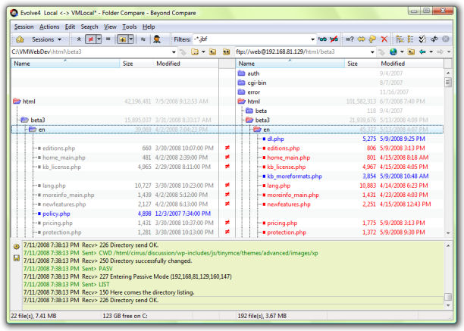
File Compare
A good file compare utility will make your job a lot easier
Comparing source files from one version’s Source directory to another version’s Source
Comparing difference between Base and Test folders
Moving your source from development folders to the packaging folders
BeyondCompare
http://www.scootersoftware.com/

Slide 8
Installing a New SDK
Run the Database Installer to create a version specific database (i.e. Arena_2009_1)
Copy the SDK files to the “Base” subfolder for the version you are installing
Open the project (in Visual Studio) from the Base folder and run the project so that the RunOnce.aspx logic runs
Back-up the Database and save the backup.
Restore Database to “Dev” version of database
Copy the files in the “Base” subfolder to the “Source” subfolder. Do not make any other changes to the Base files.

Slide 9
Installing a New SDK (Cont.)
Copy your custom source files from previous version’s “Source” directory to the new version’s “Source” directory
Open Source project, point it to the “development” database and make all changes in the Source folder
After development and testing, package your changes (will discuss Voracity’s method of packaging in next session)
Update Test folder to match the Base folder
If needed, restore the test database from backup so that it matches a new SDK installation
Run the Test project and install your new module(s)

