Slide 1
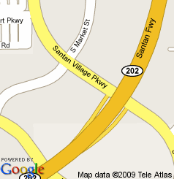

Food, Fun, & Social Time
We’re eating at Arriba’s Mexican Grill
We’ll return here for some fun
and have time to work/talk

