Slide 1

Going for Gold w/Silverlight
using Silverlight in an Arena Module
Nick Airdo
Software Engineer
Central Christian Church
Email: nick.airdo@cccev.com
Twitter: @airdo
Tweet using #RefreshCache

Slide 2
Web Services
Silverlight running on the client communicates with the server via Web Services
It is only allowed to communicate back to the host/site from which it came
Exception: if the site admin creates a cross-domain policy (crossdomain.xml or clientaccesspolicy.xml)

Slide 3
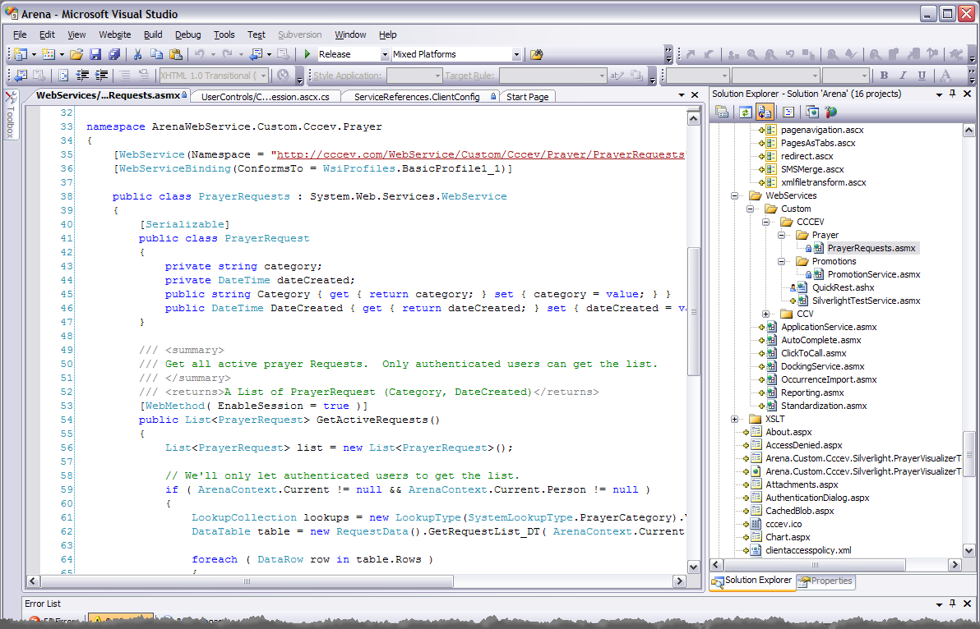
Web Service
Create a web service to consume if needed

Slide 4
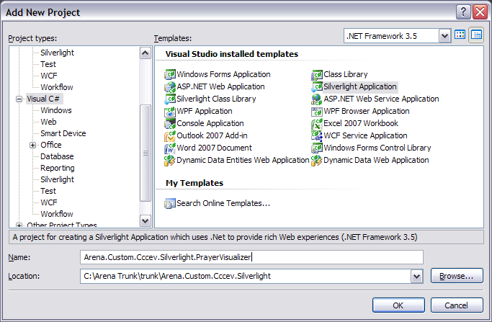
Silverlight Project
Add a new Project (“Silverlight Application”) to your Arena solution:

Slide 5
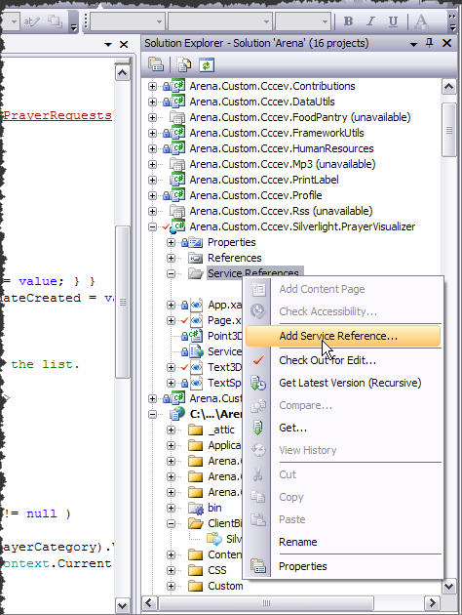
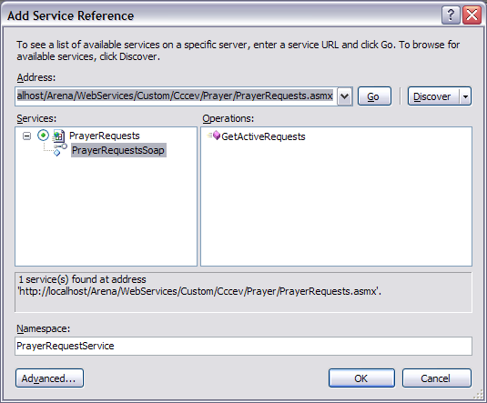
Add Service Reference
Add the service reference to the Silverlight App

Slide 6
Parts of the Silverlight App
App.xaml
Good place to add style or template resources
Page.xaml
Your main UserControl
<UserControl x:Class="Arena.Custom.Cccev.Silverlight.PrayerVisualizer.Page"
xmlns="http://schemas.microsoft.com/winfx/2006/xaml/presentation"
xmlns:x="http://schemas.microsoft.com/winfx/2006/xaml">
<UserControl.Resources>
<Storyboard x:Name="Storyboard1">
<DoubleAnimation
Storyboard.TargetName="txtTitle"
Storyboard.TargetProperty="Opacity"
From="1.0" To="0.0" Duration="0:0:1" BeginTime="0:0:4"
AutoReverse="False" />
</Storyboard>
</UserControl.Resources>
<Grid x:Name="LayoutRoot" Background="Transparent">
<TextBlock x:Name="txtTitle" Margin="5" Height="20" TextAlignment="Center" Text="Prayer Visualizer 1.0" ></TextBlock>
</Grid>
</UserControl>

Slide 7
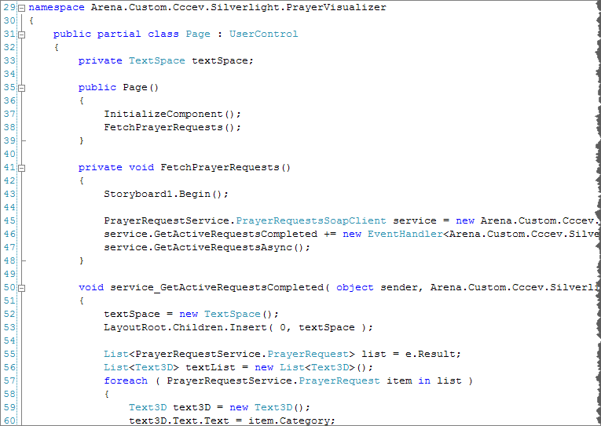
Page.xaml.cs

Slide 8

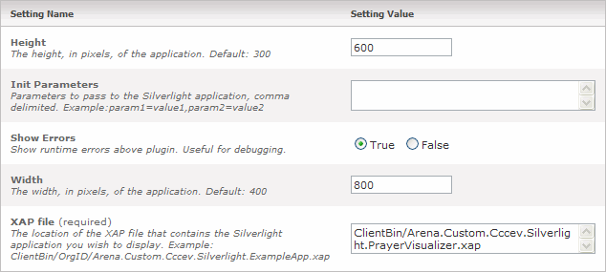
Silverlight Host Module
Download our Silverlight Host module http://community.arenachms.com/files/folders/modules/entry5941.aspx
Generates required markup to embed your Silverlight application on a page

Slide 9
Sample Markup
<script type="text/javascript">
function onSilverlightError(sender, args) {
.
.
.
}
</script>
<div id="silverlightControlHost">
<object data="data:application/x-silverlight,"
type="application/x-silverlight-2"
width='800'
height='600'>
<param name="source" value='ClientBin/Arena.Custom.Cccev.Silverlight.PrayerVisualizer.xap'/>
<param name="onerror" value="onSilverlightError" />
<param name="background" value="white" />
<param name="InitParameters" value='' />
<a href="http://go.microsoft.com/fwlink/?LinkID=108182" style="text-decoration: none;">
<img src="http://go.microsoft.com/fwlink/?LinkId=108181"
alt="Get Microsoft Silverlight"
style="border-style: none"/>
</a>
</object>
<iframe style='visibility:hidden;height:0;width:0;border:0px'></iframe>
</div>

Slide 10
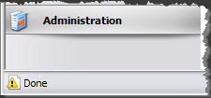
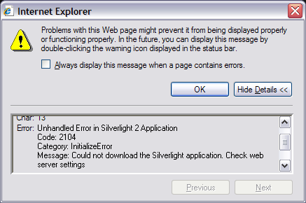
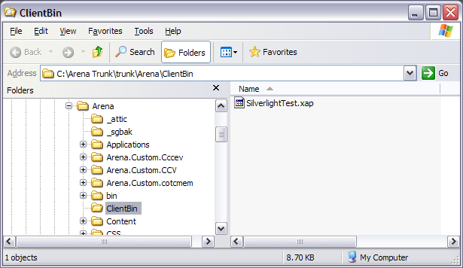
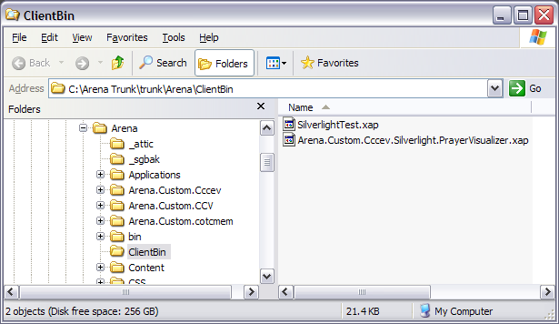
JS Errors
Be on the lookout for
Check the ClientBin folder
The xap file is Missing

Slide 11
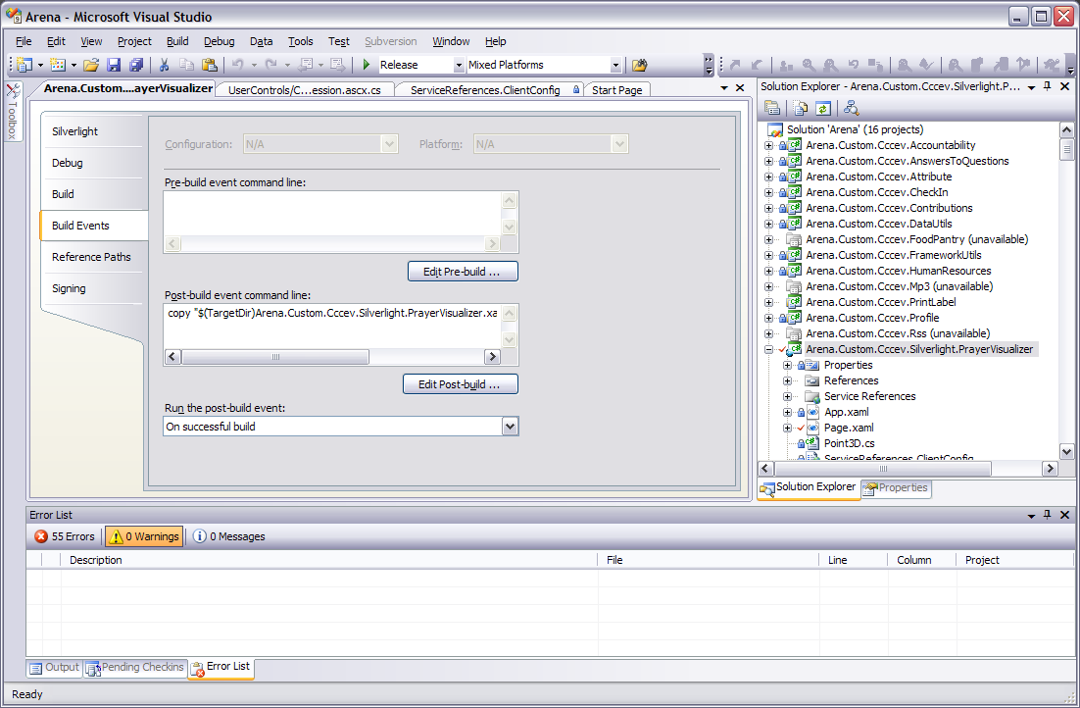
Project Properties
Add a post-build event:
copy "$(TargetDir)Arena.Custom.Cccev.Silverlight.PrayerVisualizer.xap" "C:\Arena Trunk\trunk\Arena\ClientBin"

Slide 12
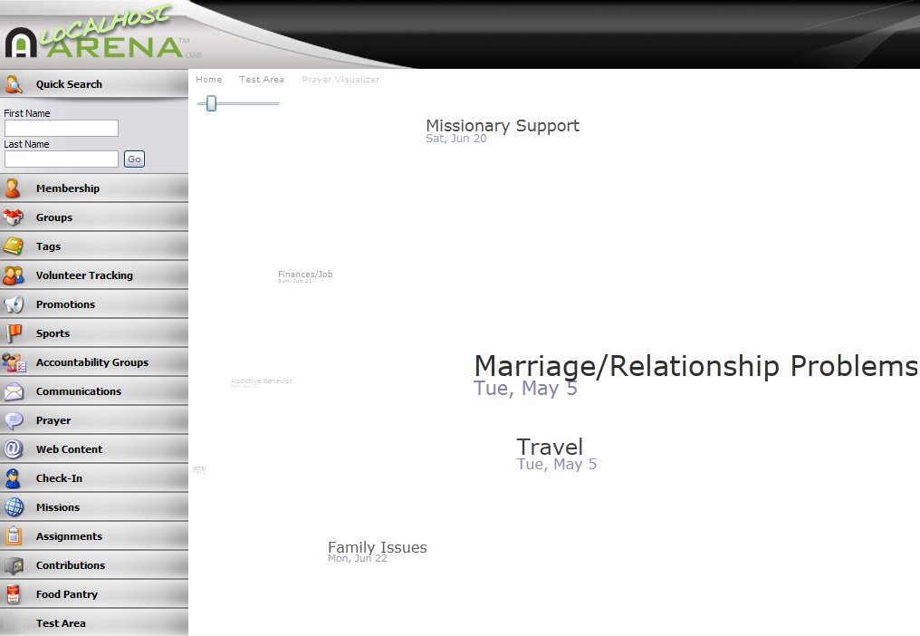
Live Demo

Slide 13

References
Dallon Feldner’s Whitepaper
http://community.arenachms.com/files/folders/documents/entry2124.aspx
Accelerated Silverlight 2

