Slide 1

Packaging for
Voracity Solutions
Control Panel
David Turner

Slide 2

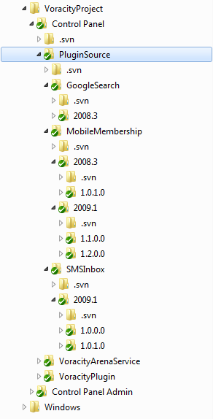

Folder Structure
Create a PluginSource folder
Create a [Plugin] Folder
Create a folder for each specific Arena version that you will be supporting
Create a folder for the version of your plugin
Notes:
“Plugin” term is what is used “behind the scenes” Synonymous with “Package” or “Module”
[Plugin] refers to plugin name

Slide 3

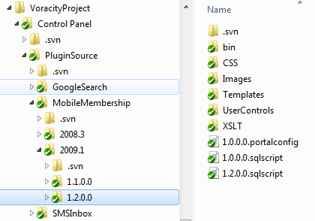
Package Files
Copy all the required Arena files to the version subfolder
Create any required [version].sqlscript and [version].portalconfig files

Slide 4
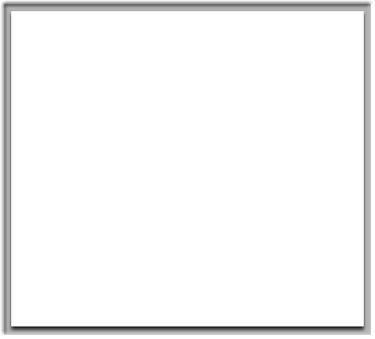
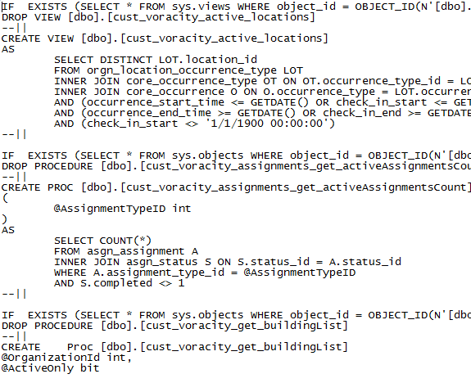
[version].sqlscript Files
Any SQL Scripts that should be run when your plugin is installed should be included in a [version].sqlscript file
The files will be run in version order
Only those files with a version number greater than the user’s current database version for the plugin will be run
Each SQL statement in the script file should be delimited by “--||” characters

Slide 5
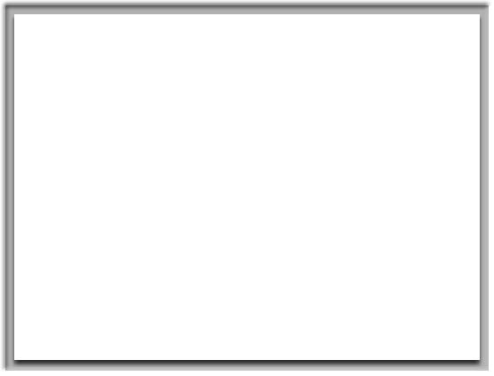
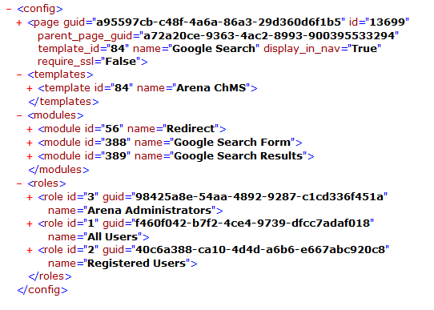
[version].portalconfig Files
Any portal configuration that is required for your plugin should be included in a [version].portalconfig file
This includes creation of portal, pages, modules, roles, etc.
The files will be run in version order
Only those files with a version number greater than the user’s current database version for the plugin will be run
Contains XML generated by custom voracity “PageXML.ascx” user control
Notes:
Should show an example portalconfig file

Slide 6

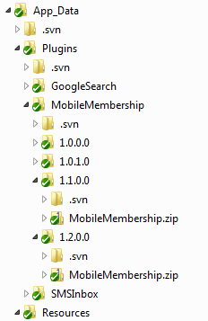
Packaging
Once you’ve created all the files, they should be zipped up as a [Plugin].zip file
This zip file will then need to be uploaded to the Voracity server as a plugin package file
The Voracity server keeps all package files in the App_Data folder grouped by Plugin and Version
Notes:
Need to add a way for community to upload and configure plugins

Slide 7
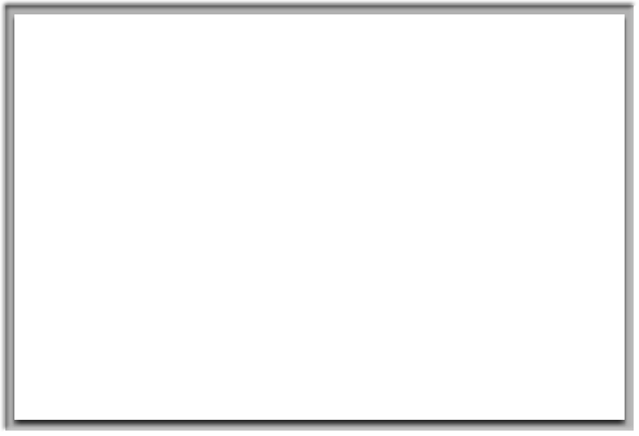
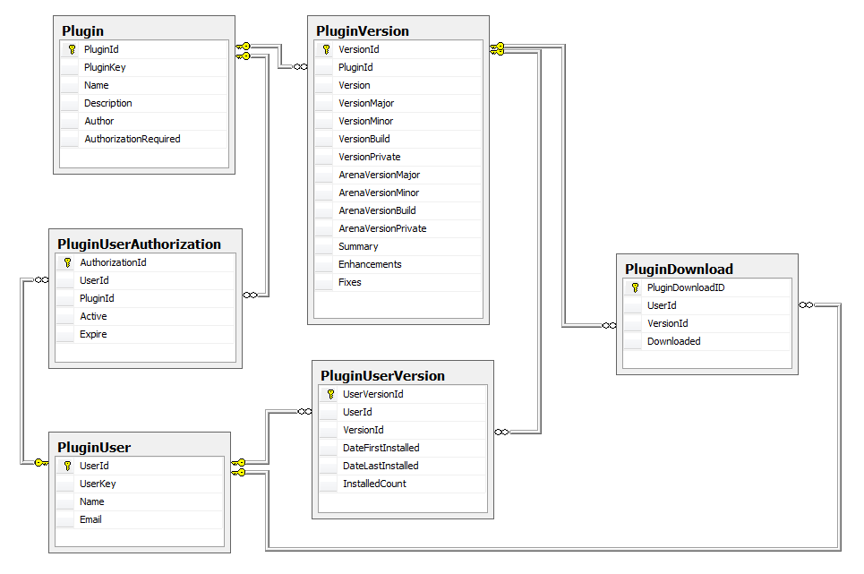
Plugin Database
Voracity Solutions keeps a database of available plugins and authorized users (partners)
When a new plugin is packaged it needs to be entered into this database
Notes:
Again... Need way for community to update configuration

Slide 8

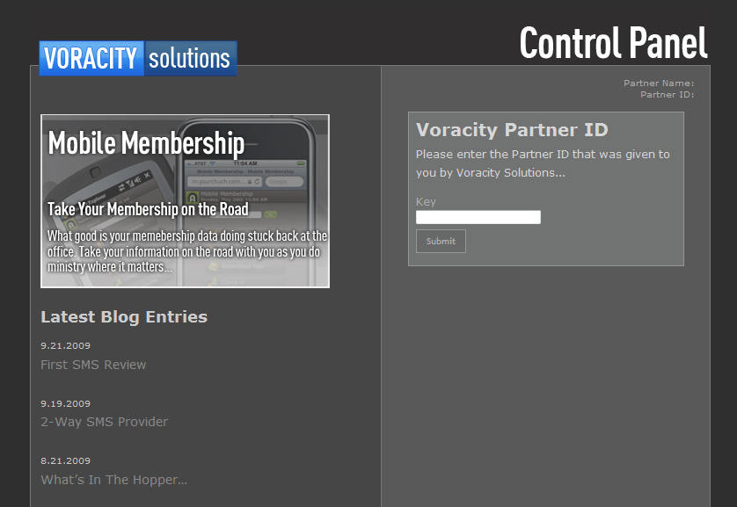
Control Panel Overview
The Voracity Solutions Control Panel allows for “one-click” installation of packaged “plugins”
To begin, Arena User installs a default.aspx file to a “Voracity” subfolder under the Arena installation
The default.aspx page downloads additional client-side files that communicate with the Voracity web service and database to display list of plugins available to user

Slide 9
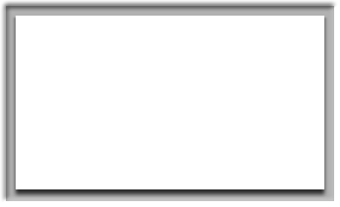

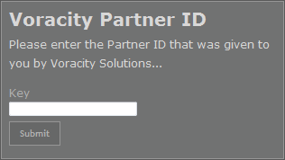
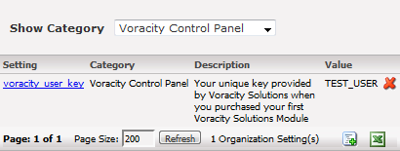
Default.aspx - Partner ID
The first thing that the Default.aspx page does is check to see if a Voracity Partner ID has been saved. If not, it will prompt user for their Partner ID
Will verify that the ID they enter is a valid Voracity Partner ID
If the ID is valid, a new organization setting (and category) will be created to save the ID
Notes:
Probably need to add an “anonymous” partner id, or way for client to choose their own so that it does not require Voracity to know of each user ahead of time

Slide 10

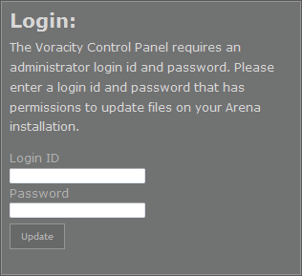
Default.aspx - Login
After verifying Partner ID, Default.aspx will then check if a valid login id and password have been entered yet during the current session
A valid network login and password are required for impersonation so that files can be installed to the Arena folders

Slide 11
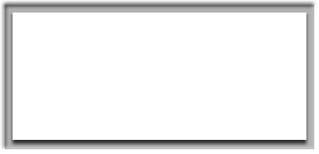
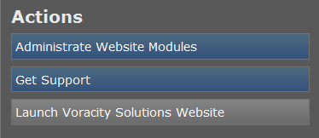
Default.aspx - File Updates
After validating the login and password, Default.aspx will then download several files from the Voracity server to the local Arena installation
Default.aspx and PluginManager.aspx will be updated in the Arena\Voracity folder (PluginManager.aspx is what the “Administrate Website Modules” option links to)
VoracityPlugin.dll, VoracityPlugin.XmlSerializers.dll, and VoracityPlugin.dll.config will be updated in the Arena\Bin folder
Files are only downloaded if a newer version exists on the Voracity server

Slide 12

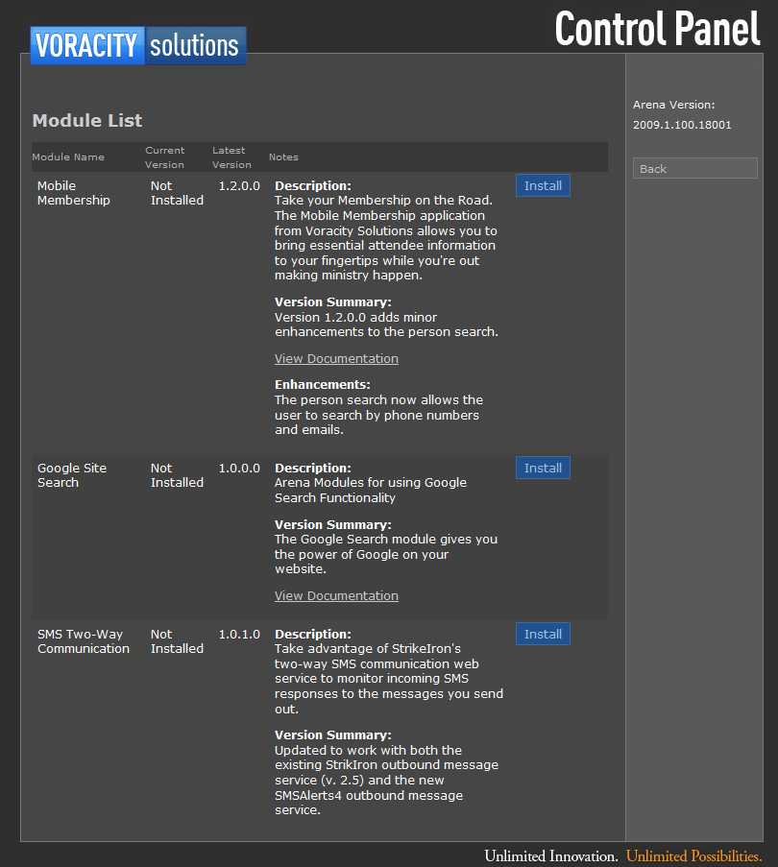
PluginManager.aspx
PluginManager.aspx is the page that is run when user clicks the “Administrate Website Modules” option on the Default.aspx page
It displays a list of the available plugins based on the Partner ID and the current Arena version

Slide 13
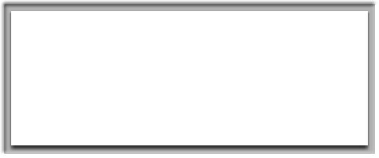

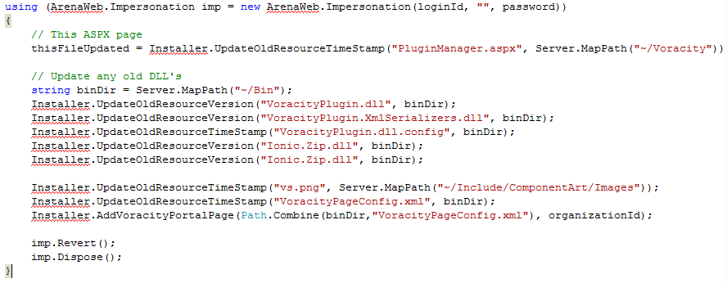

PluginManager.aspx -
File Updates
Before displaying the list of plugins, PluginManager.aspx will also check to see if any files need to be downloaded
PluginManager.aspx will be updated in the Arena\Voracity folder
VoracityPlugin.dll, VoracityPlugin.XmlSerializers.dll, VoracityPlugin.dll.config, and Ionic.Zip.dll will be updated in the Arena\Bin folder
An Image and PageConfig file will be downloaded and a “Voracity Solutions” page will be created in the administrative area of Arena
Notes:
Voracity Solutions page links to the Control Panel. Voracity uses this page as the “parent page” for various plugins (i.e. Google Search)

Slide 14

PluginManager.aspx -
Plugins
After the necessary support files have been downloaded, PluginManager.aspx displays a list of available plugins
List is based on the Partner ID and the current Arena version
On the Voracity server, each plugin version is configured with a minimum Arena version and flag indicating whether it is freely available or not
If the plugin is not freely available, specific partner ID’s are configured with access to the plugin
Notes:
Next slide discusses how “Current Version” is saved

Slide 15


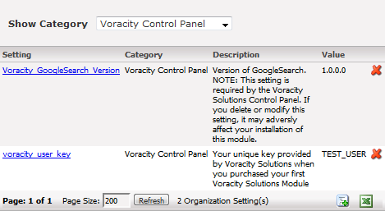
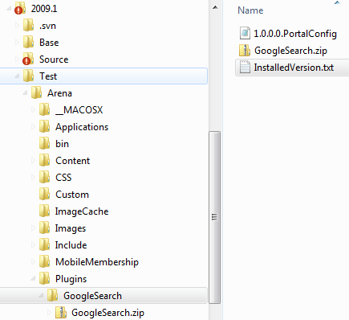
Currently Installed Version
Because a plugin is installed to both the file system and the database, these versions are stored independently and may not always be the same
A plugin’s current file system version is saved in an Arena\Plugins\[plugin_name]\InstalledVersion.txt file
A plugin’s current database version is saved as a “Voracity_[plugin_name]_Version” org setting
Notes:
Discuss why database and file version may be different

Slide 16
Plugin Installation
When user selects a plugin to install, the Control Panel will go through these steps when installing:
  Verify user is authorized for Plugin
  Create an Arena\Plugins\[Plugin] folder if it doesn’t exist
  Download plugin’s package file to Arena\Plugins\[Plugin]\[Plugin].zip
  Iterate through each file in package zip file
    If a *.portalconfig or *.sqlscript file, extract to the Arena\Plugins\[Plugin] folder
    Otherwise, if user’s current file version of plugin is less than the plugin version being installed, and file does not exist or is older than file from package then extract file

Slide 17
Plugin Installation (cont)
  Create (or update) the Arena\Plugins\[Plugin]\InstalledVersion.txt file with the current version of the plugin being installed
  Run the SQL scripts in each of the *.sqlscript files in the Arena\Plugins\[Plugin] folder if the version is greater than the user’s current database version of the plugin
  Process each of the *.portalconfig files in the Arena\Plugins\[Plugin] folder if the version is greater than the user’s current database version of the plugin
  Update the current database version of the plugin by adding/updating the Voracity_[Plugin]_Version organization setting

Slide 18
PortalConfig
For each modules/module node add a new module to Arena. Will not add module if one already exists with same url
For each roles/role node add a new role to Arena. Will not add new role if one already exists with same name or guid
For each templates/template node add a new template to Arena. Will not add new template if one already exists with same name
For the root page node (and all child pages) adds a new page to Arena. Will not add a new page if one already exists with the same guid.
Root page will be added as a child to an existing Arena page with the same guid as specified by the parent_page_guid attribute on the root page node
If a portal node exists will create a new portal in Arena. Will not add a new portal if one already exists with the same name
Notes:
Show portal config file again.
Mention that template check will be updated to check for guid as well as name

